Slide 1
Hierarchical Clustering & Topic Models
Sampath Jayarathna
Cal Poly Pomona

Slide 2
Hierarchical Clustering
Ch. 17
Build a tree-based hierarchical taxonomy (dendrogram) from a set of documents.
One approach: recursive application of a partitional clustering algorithm.
animal
vertebrate
invertebrate
fish reptile amphib. mammal worm insect crustacean

Slide 3
Hierarchical agglomerative clustering (HAC)
Start with each document in a separate cluster
Then repeatedly merge the two clusters that are most similar
Until there is only one cluster
The history of merging is a hierarchy in the form of a binary tree.
The standard way of depicting this history is a dendrogram.

Slide 4
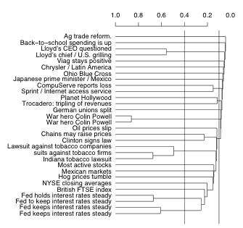
A dendogram
The history of mergers can be read off from bottom to top.
The horizontal line of each merger tells us what the similarity of the merger was.
We can cut the dendrogram at a particular point (e.g., at 0.1 or 0.4) to get a flat clustering.

Slide 5
What to do with the hierarchy?
Sec. 17.1
Use as is.
Cut at a predetermined threshold.
Cut to get a predetermined number of clusters K.
Hierarchical clustering is often used to get K flat clusters. The hierarchy is then ignored.

Slide 6
Closest pair of clusters
Sec. 17.2
Many variants to defining closest pair of clusters
Single-link
Similarity of the most cosine-similar (single-link)
Complete-link
Similarity of the “furthest” points, the least cosine-similar
Centroid
Clusters whose centroids (centers of gravity) are the most cosine-similar
Average-link
Average cosine between pairs of elements

Slide 7
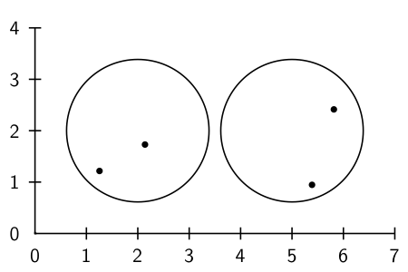
Cluster similarity: Example

Slide 8
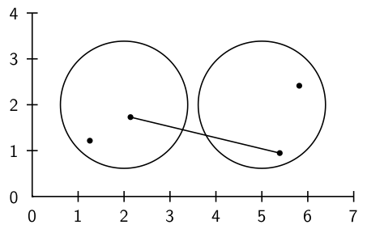
Single-link: Maximum similarity

Slide 9
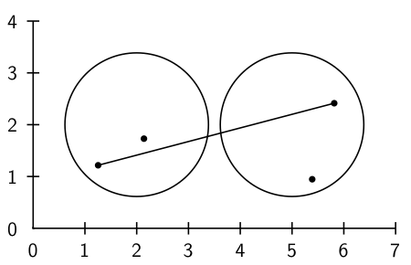
Complete-link: Minimum similarity

Slide 10
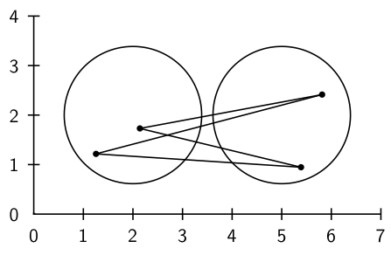
Centroid: Average intersimilarity
intersimilarity = similarity of documents in different clusters

Slide 11
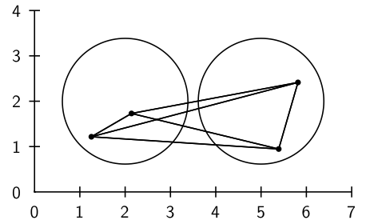
Group average: Average intrasimilarity
intrasimilarity = similarity of any pair, including cases where the
two documents are in the same cluster

Slide 12
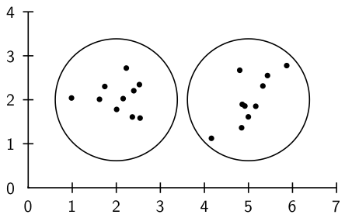
Cluster similarity: Larger Example

Slide 13
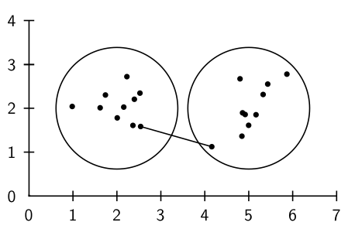
Single-link: Maximum similarity

Slide 14
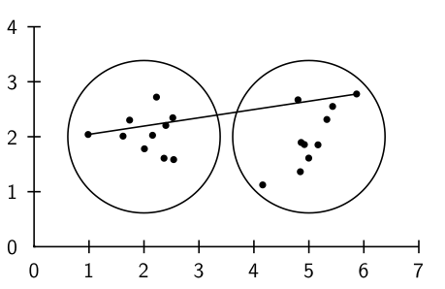
Complete-link: Minimum similarity

Slide 15
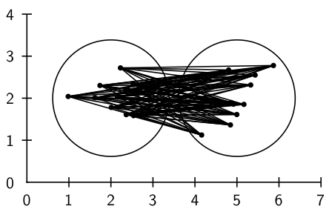
Centroid: Average intersimilarity

Slide 16
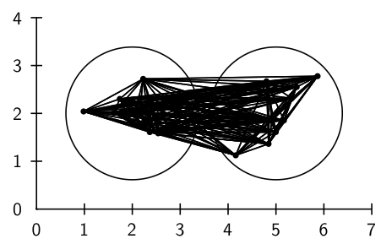
Group average: Average intrasimilarity

Slide 17
Single Link Agglomerative Clustering
Sec. 17.2
Use maximum similarity of pairs:
Can result in “straggly” (long and thin) clusters due to chaining effect.
After merging c_{i} and c_{j}, the similarity of the resulting cluster to another cluster, c_{k}, is:

Slide 18
Complete Link
Sec. 17.2
Use minimum similarity of pairs:
Makes “tighter,” spherical clusters that are typically preferable.
After merging c_{i} and c_{j}, the similarity of the resulting cluster to another cluster, c_{k}, is:
C_{i}
C_{j}
C_{k}

Slide 19
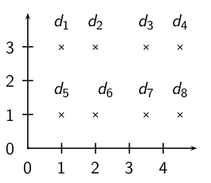
Exercise: Compute single and complete link clustering

Slide 20
Single Link Example
Sec. 17.2

Slide 21
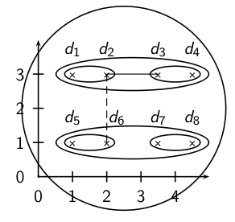
Single-link clustering

Slide 22
Complete Link Example
Sec. 17.2

Slide 23
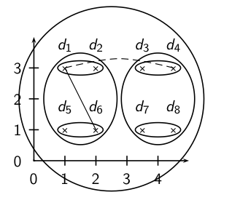
Complete link clustering

Slide 24
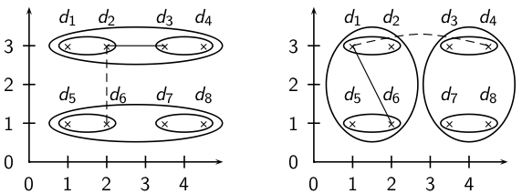
Single-link vs. Complete link clustering

Slide 25
Flat or hierarchical clustering?
For high efficiency, use flat clustering (k-means)
When a hierarchical structure is desired: hierarchical algorithm
HAC also can be applied if K cannot be predetermined (can start without knowing K)

Slide 26
Major issue in clustering – labeling
After a clustering algorithm finds a set of clusters: how can they be useful to the end user?
Need simple label for each cluster.
For example, in search result clustering for “jaguar”, The labels of the clusters could be “animal”, and “car”
Topic of this section: How can we automatically find good labels for clusters?
Often done by hand
Use metadata like Titles
Use the medoid (documents) itself
Top-terms (most frequent)
Most distinguishing terms

Slide 27
Topic Models in Text Processing

Slide 28
Overview
Motivation:
Model the topic/subtopics in text collections
Basic Assumptions:
There are k topics in the whole collection
Each topic is represented by a multinomial distribution over the vocabulary (language model)
Each document can cover multiple topics
Applications
Summarizing topics
Predict topic coverage for documents
Model the topic correlations
Classification, Clustering

Slide 29
Basic Topic Models
Unigram model
Mixture of unigrams
Probabilistic LSI
Latent Dirichlet Allocation (LDA)
Correlated Topic Models

Slide 30
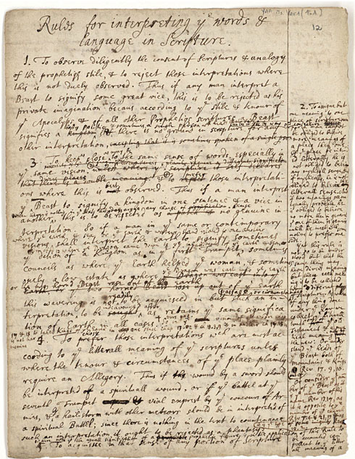
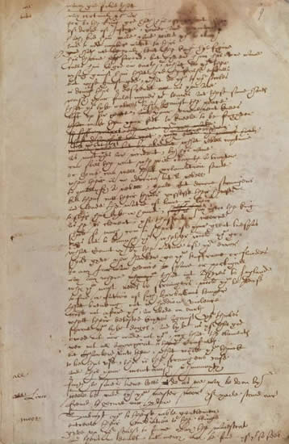
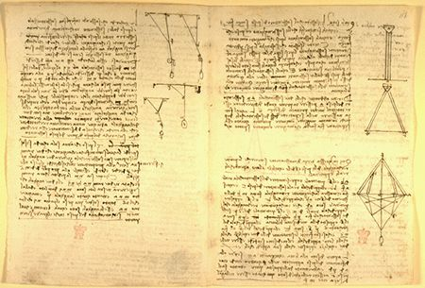
What is a “topic”?
Representation: a probabilistic distribution over words.
retrieval 0.2
information 0.15
model 0.08
query 0.07
language 0.06
feedback 0.03
……
Topic: A broad concept/theme, semantically coherent, which is hidden in documents
e.g., politics; sports; technology; entertainment; education etc.

Slide 31
Document as a mixture of topics
government 0.3 response 0.2 ...
[ Criticism of government response to the hurricane primarily consisted of criticism of its response to the approach of the storm and its aftermath, specifically in the delayed response ] to the [ flooding of New Orleans. … 80% of the 1.3 million residents of the greater New Orleans metropolitan area evacuated ] …[ Over seventy countries pledged monetary donations or other assistance]. …
Topic θ₁
city 0.2 new 0.1 orleans 0.05 ...
Topic θ₂
…
How can we discover these topic-word distributions?
Many applications would be enabled by discovering such topics
Summarize themes/aspects
Facilitate navigation/browsing
Retrieve documents
Segment documents
Many other text mining tasks
donate 0.1 relief 0.05 help 0.02 ...
Topic θ_{k}
is 0.05 the 0.04 a 0.03 ...
Background θ_{k}

Slide 32
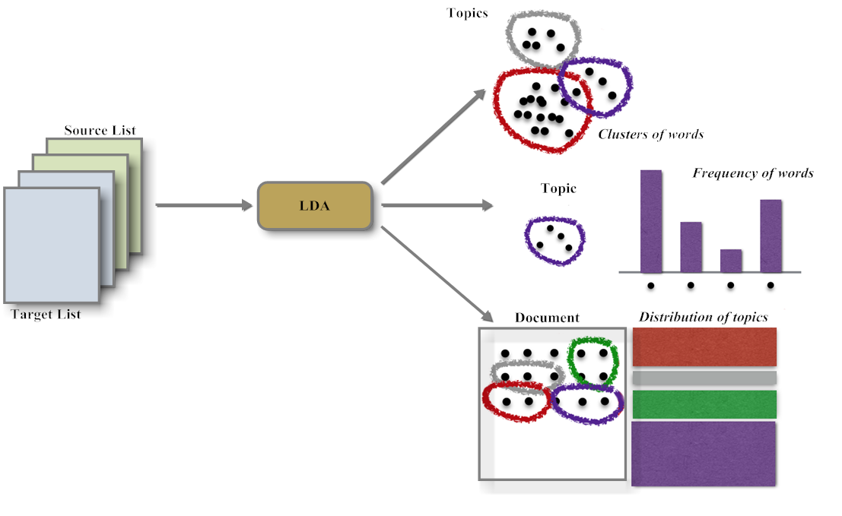
Latent Dirichlet Allocation

Slide 33
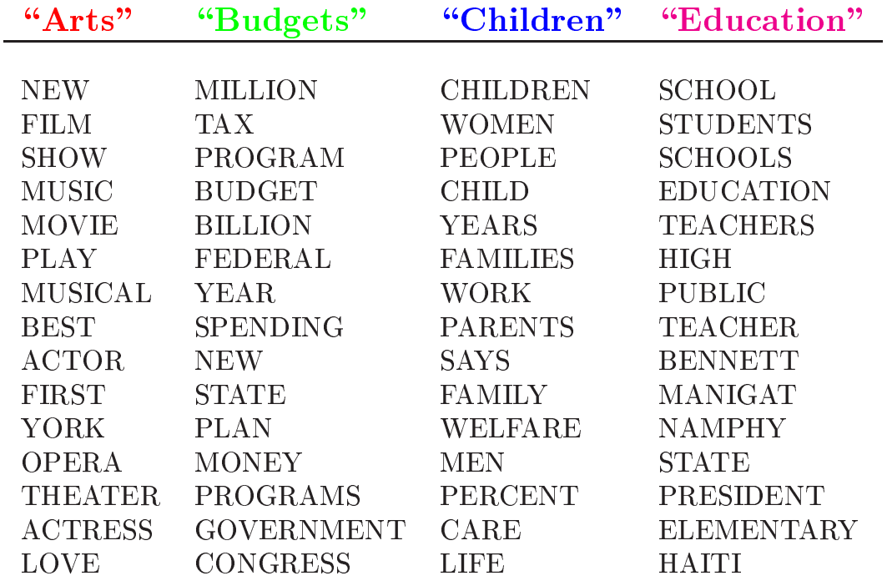
Topics learned by LDA

Slide 34
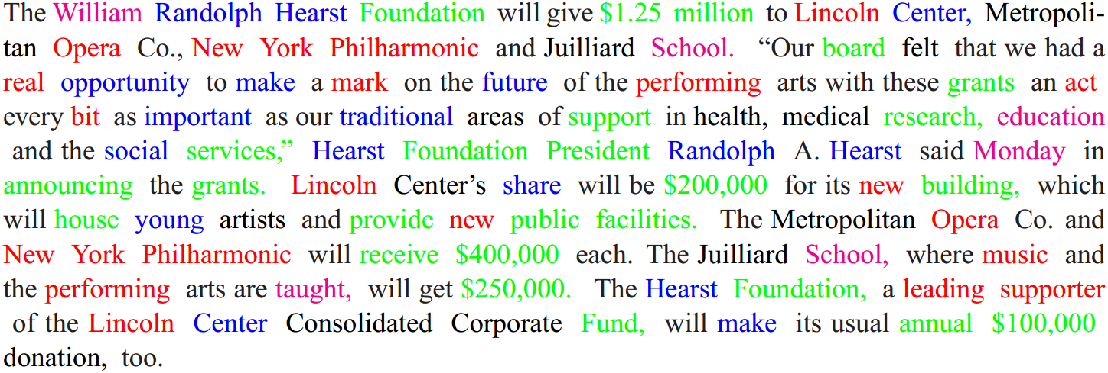
Topic assignments in document
Based on the topics shown in last slide

Slide 35
Final word
In clustering, clusters are inferred from the data without human input (unsupervised learning)
However, in practice, it’s a bit less clear: there are many ways of influencing the outcome of clustering: number of clusters, similarity measure, representation of documents.

