Slide 1
Topics in Database Systems
Sampath Jayarathna
Cal Poly Pomona

Slide 2
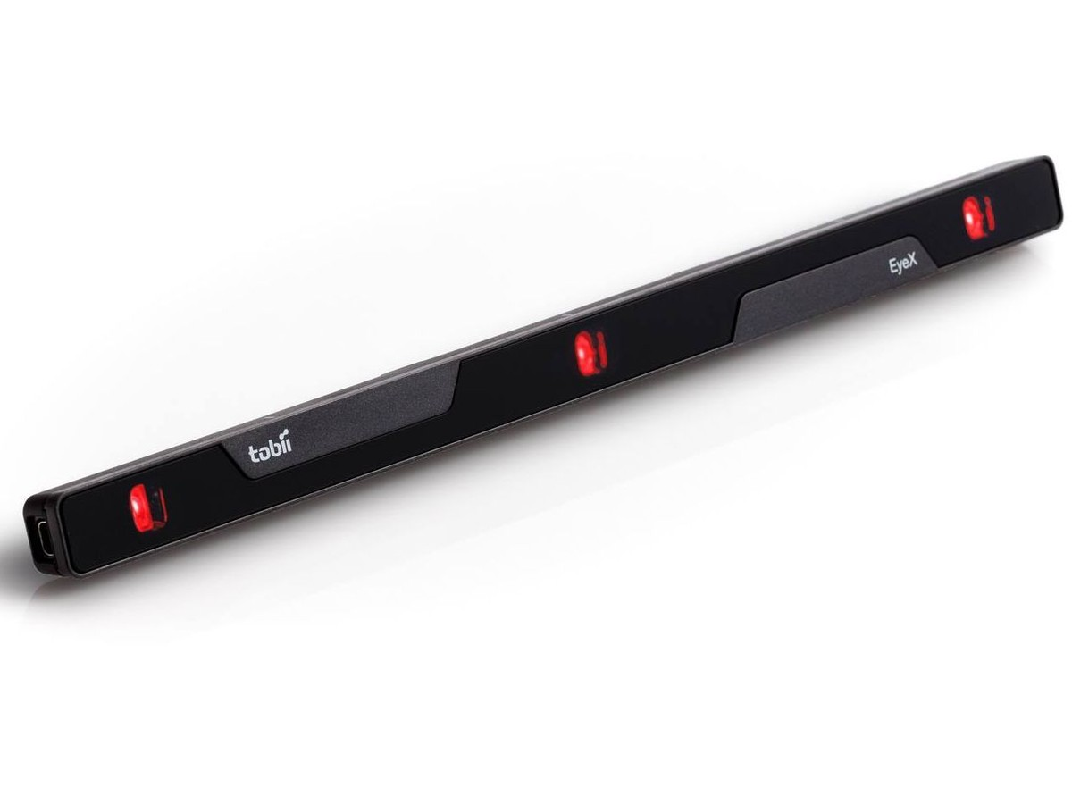
Instructor : Sampath Jayarathna Joined Cal Poly Pomona Fall 2016 from Texas A&M. Originally from Sri Lanka
Research : NeuroIR, Eye tracking, Brain EEG, User modeling
Web : http://www.cpp.edu/~ukjayarathna
Lab : http://www.cpp.edu/~ukjayarathna/nirds-lab
Contact : 8-46, ukjayarathna@cpp.edu, (909) 869-3145
Office Hours : TW 1PM – 3PM, or email me for an appointment
[Open Door Policy]

Slide 3
Course Information
Schedule : MW, 8-348, 6.00 PM – 7.50 PM http://www.cpp.edu/~ukjayarathna/courses/w18/cs575
www.piazza.com/csupomona/winter2018/cs575/home
Blackboard
Prereqs
Official: CS435 or approval of instructor
Practical: Know object-oriented programming language
Format
Before lecture: do reading
In lecture: put reading in context
After lecture: assignments, for hands-on practice

Slide 4
Required / Supplementary materials
Required textbook. No textbook is required. All the key course content will be documented in slides, which will be available in the course website after each lecture.
List of optional but recommended materials. You may find some of these optional textbooks helpful, though none are required:
Fundamentals of Database Systems, Ramez Elmasri, Shamkant Navathe, 7th Edition
Bring Your Own Device (BYOD).

Slide 5
Communication
Piazza:
All questions will be fielded through Piazza.
Many questions everyone can see the answer
You can also post private messages that can only be seen by the instructor
Blackboard:
Blackboard will be used primarily for assignments/homework, extra credit submission and grade dissemination.
Email:
Again, email should only be used in rare instances, I will probably point you back to Piazza

Slide 6
The Rules

Slide 7
Personal devices – Software Setup
Windows/Mac
MySQL
Download MySQL Community Edition
https://dev.mysql.com/downloads/mysql/
Oracle SQL Developer
Download Oracle SQL Developer Data Modeler 17.4
http://www.oracle.com/technetwork/developer-tools/datamodeler/overview/index.html

Slide 8
Course Organization
Grading
40% | Project: Proposal (5 pts), Progress reports(5), Presentation and Demo (15 pts), Final Report (15 pts)
20% | Final Exam
20% | Homework Assignments (5)
10% | Quizzes (2)
5(+1)% | Research Paper Presentation + Extra Credit for report
5% | Class Activities
101% | Your Total Score for the class

Slide 9
Course Organization
Project: More in the next couple of slides…
Final Exam: The final exam is comprehensive, closed books and will be held on Monday, March 12, 6.00pm – 8.00pm.
Homework: We will have five homework assignments, each worth 4% of your overall grade. Homework 1A – January 10, 6pm
Research Paper Presentation
More information in the syllabus
Quizzes
2 scheduled
In-class Activities

Slide 10
Team Project - Evaluation
Form teams of 4 (+ 1?) students
Independent and non-competing
Think of other teams as working for other organizations
Code and document sharing between teams is not permitted
Project grade will have a large impact on course grade (40%)
Project grade will (attempt to) recognize individual contributions
Peer evaluation, Demo evaluation
All artifacts will be considered in the evaluation
Quality matters.

Slide 11
Team Project - Milestones
Project Proposal, Jan 17
Progress reports, Feb 05, Feb 26
Final Report, March 07
In-class presentation and Demo, March 07

Slide 12
Team Project - Ideas
Industry projects
Kronosaur AeonDB Projects (2)
Possible extension of previous course projects (e.g., from IR, HCI, ML or other courses)
Some research topics

Slide 13
More on the class
Project (approximately 28+ students, about 6-7 teams)
Strict milestones (only 9 weeks)
Progress reports
Not primarily graded on whether your program "works“
Schedule is on the web page

Slide 14
To-do and Next time
Sign up for the Piazza
Team members 4(+1) and topics for presentations
HW1a is out!
Due, January 10

