Slide 1
Conceptual Modeling
Sampath Jayarathna
Cal Poly Pomona

Slide 2
Overview of Database Design Process
Two main activities:
Database design
Applications design
Focus in this chapter on conceptual database design
To design the conceptual schema for a database application
In this course we will focus on the design aspects for databases
We will NOT focus on interaction design or interface design (That is covered in other courses)
Applications design focuses on the programs and interfaces that access the database
Generally considered part of software engineering

Slide 3
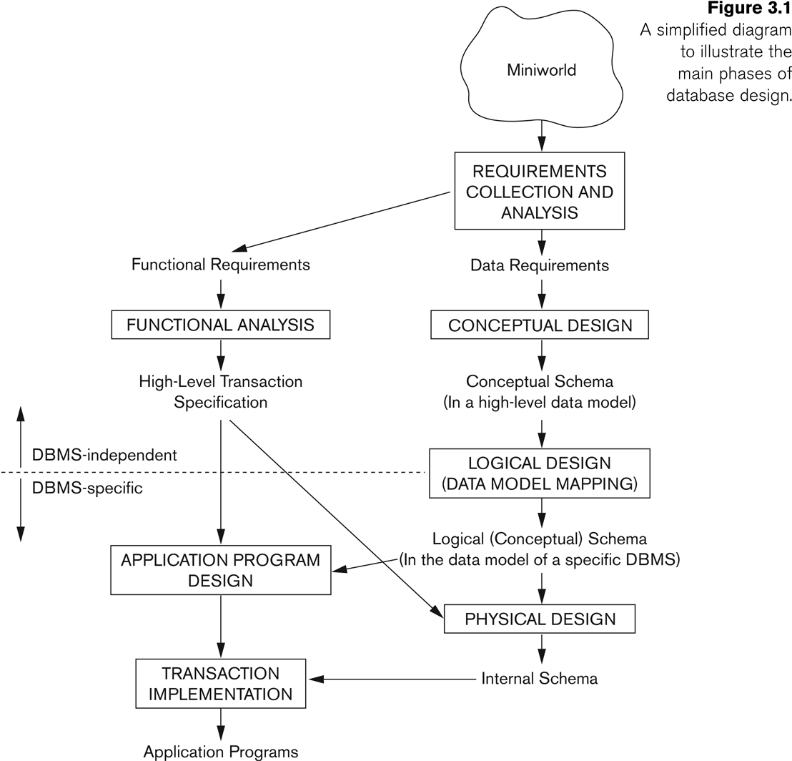
Overview of Database Design Process

Slide 4
Example COMPANY Database
We need to create a database schema design based on the following (simplified) requirements of the COMPANY Database:
The company is organized into DEPARTMENTs. Each department has a name, number and an employee who manages the department. We keep track of the start date of the department manager. A department may have several locations.
Each department controls a number of PROJECTs. Each project has a unique name, unique number and is located at a single location.

Slide 5
Example COMPANY Database (Continued)
The database will store each EMPLOYEE’s social security number, address, salary, sex, and birthdate.
Each employee works for one department but may work on several projects.
The DB will keep track of the number of hours per week that an employee currently works on each project.
It is required to keep track of the direct supervisor of each employee.
Each employee may have a number of DEPENDENTs.
For each dependent, the DB keeps a record of name, sex, birthdate, and relationship to the employee.

Slide 6
ER Model Concepts
Entities and Attributes
Entity is a basic concept for the ER model. Entities are specific things or objects in the mini-world that are represented in the database.
For example the EMPLOYEE John Smith, the Research DEPARTMENT
Attributes are properties used to describe an entity.
For example an EMPLOYEE entity may have the attributes Name, SSN, Address, Sex, BirthDate
A specific entity will have a value for each of its attributes.
For example a specific employee entity may have Name='John Smith', SSN='123456789', Address ='731, Fondren, Houston, TX', Sex='M', BirthDate='09-JAN-55‘
Each attribute has a value set (or data type) associated with it – e.g. integer, string, date, enumerated type, …

Slide 7
Types of Attributes
Key
Simple
Each entity has a single atomic value for the attribute. For example, SSN or Sex.
Composite
The attribute may be composed of several components. For example:
Address(Apt#, House#, Street, City, State, ZipCode, Country), or
Name(FirstName, MiddleName, LastName).
Composition may form a hierarchy where some components are themselves composite.
Multi-valued
An entity may have multiple values for that attribute. For example, Color of a CAR or PreviousDegrees of a STUDENT.
Denoted as {Color} or {PreviousDegrees}.
Derived

Slide 8
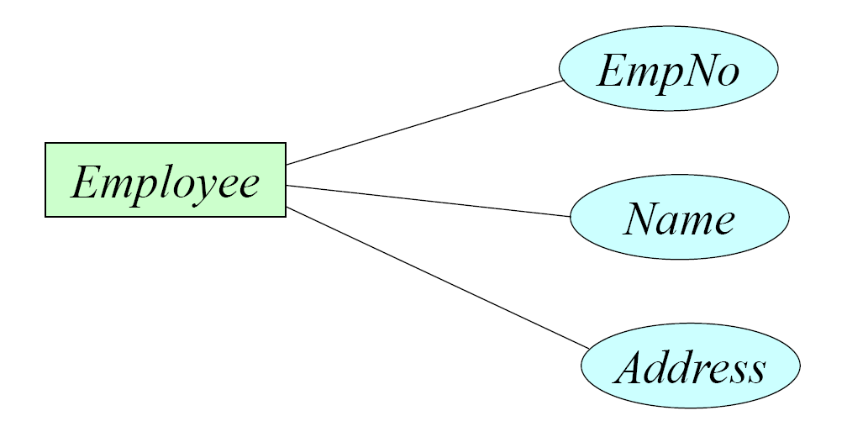
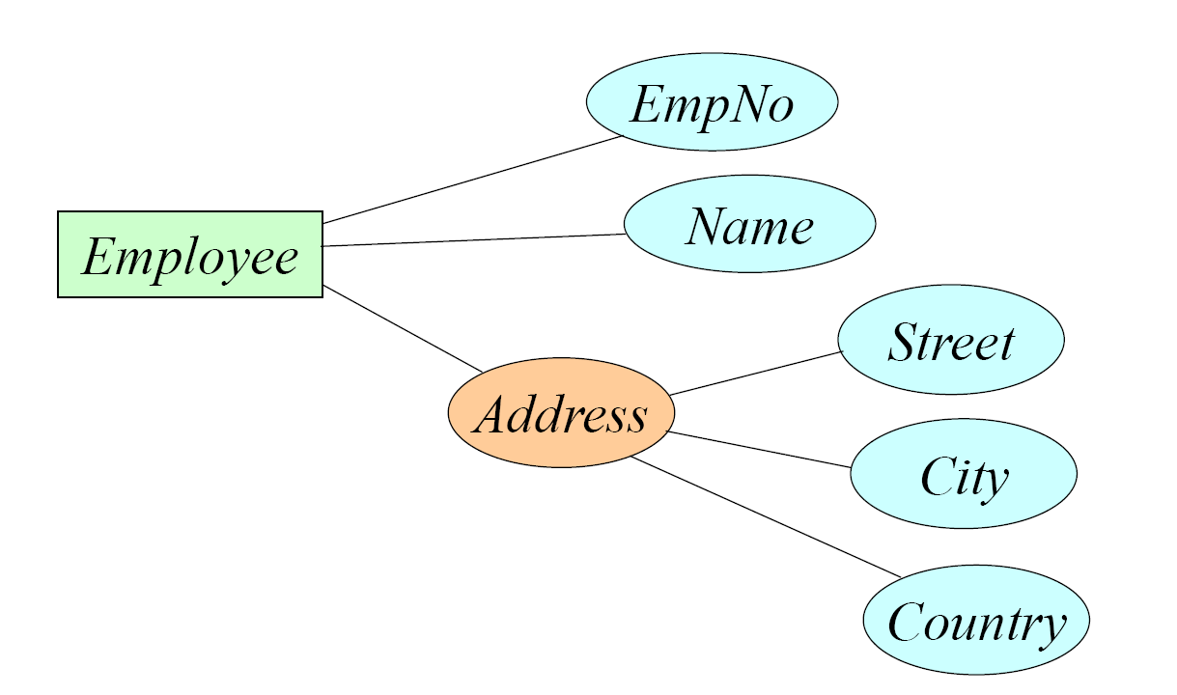
Types of Attributes
Simple attribute: contains a single value
Composite attribute: consists of several components (e.g., address)

Slide 9
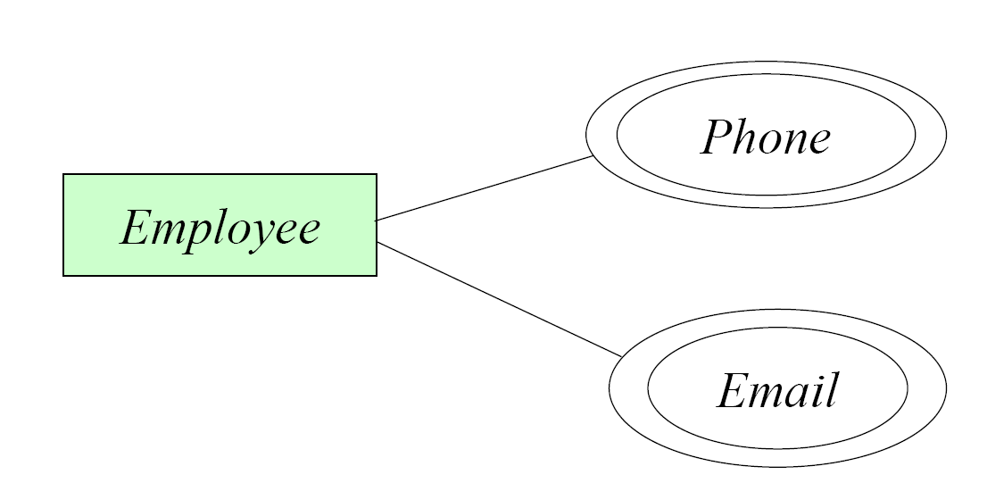
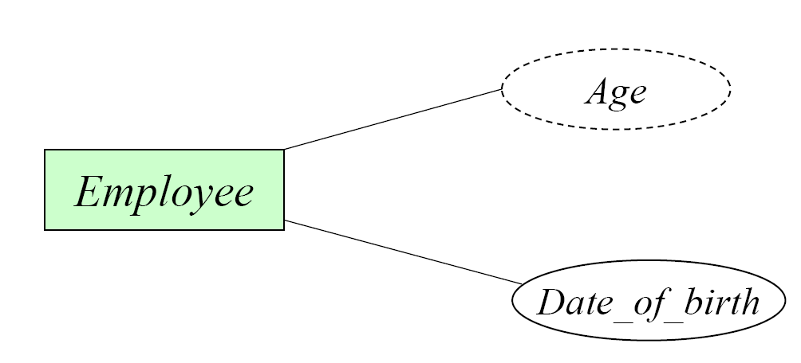
Types of Attributes
Multivalued attribute: contains more than one value
Derived attribute: computed from other attributes (e.g., age can be computed from the date of birth and the current date)

Slide 10
Entity Types and Key Attributes
Entities with the same basic attributes are grouped or typed into an entity type.
For example, the entity type EMPLOYEE and PROJECT.
An attribute of an entity type for which each entity must have a unique value is called a key attribute of the entity type.
For example, Employee number of EMPLOYEE.

Slide 11
Entity Types and Key Attributes
An entity may have more than one key.
A minimal set of attributes that uniquely identifies an entity is called a candidate key
Only one candidate key is selected to be the primary key
The CAR entity type may have two keys:
VehicleIdentificationNumber (popularly called VIN)
VehicleTagNumber (Number, State), aka license plate number.
A key attribute may be composite.
VehicleTagNumber is a key of the CAR entity type with components (Number, State).
Each key is underlined (Note: this is different from the relational schema where only one “primary key is underlined).

Slide 12
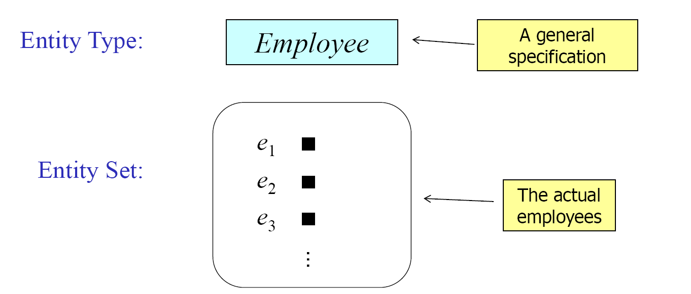
Entity Set
Each entity type will have a collection of entities stored in the database, is a set of entities of the same type.
Called the entity set or sometimes entity collection

Slide 13
Displaying an Entity type
In ER diagrams, an entity type is displayed in a rectangular box
Attributes are displayed in ovals
Each attribute is connected to its entity type
Components of a composite attribute are connected to the oval representing the composite attribute
Each key attribute is underlined
Multivalued attributes displayed in double ovals
See the full ER notation in advance on the next slide

Slide 14
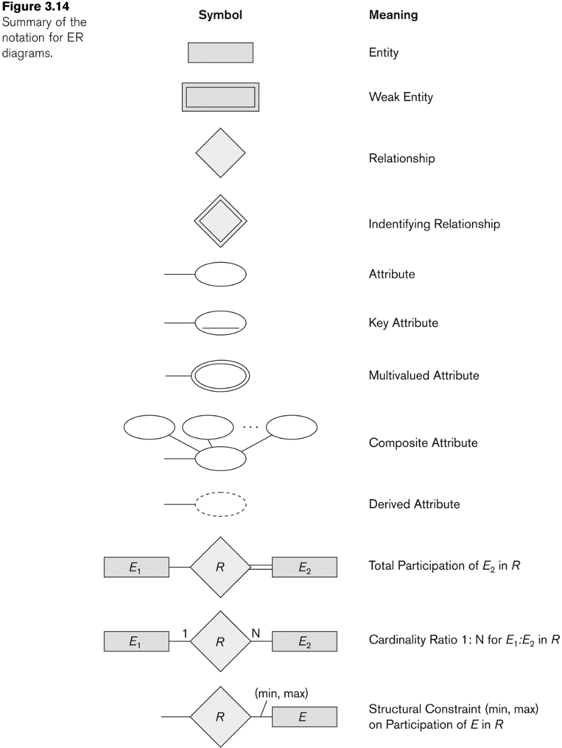
NOTATION for ER diagrams

Slide 15
Class Activity 2
Draw a complete ER diagram for an entity customer using ERDPlus tool. https://erdplus.com/
Clearly define the key, composite/derived/multivalued attributes in the diagram.
Export the image from ERDPlus and submit it to piazza thread.

Slide 16
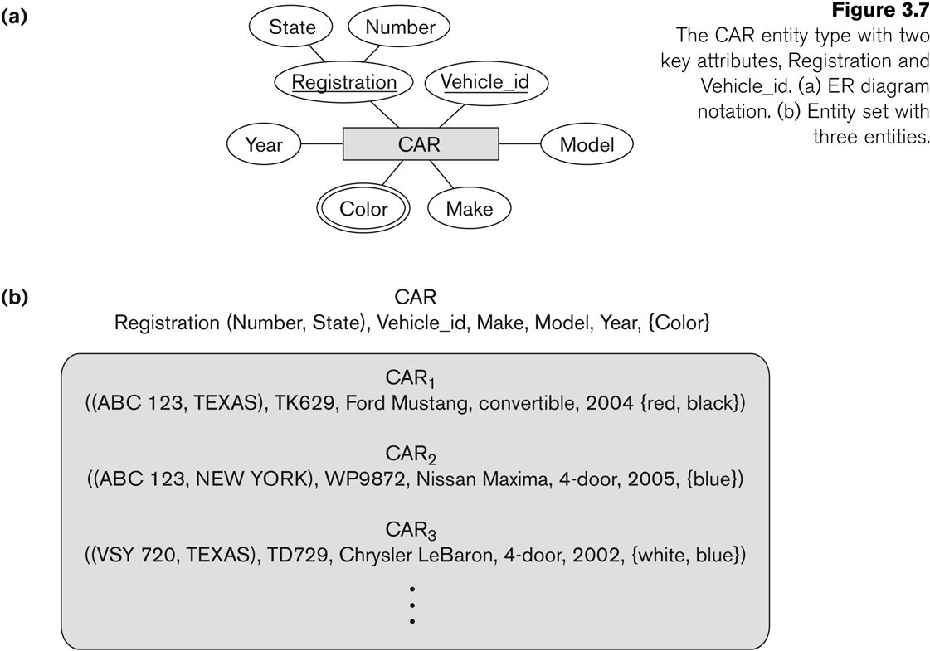
Entity Type CAR with two keys and a corresponding Entity Set

Slide 17
Initial Conceptual Design of Entity Types for the COMPANY Database Schema
Based on the requirements, we can identify four initial entity types in the COMPANY database:
DEPARTMENT
PROJECT
EMPLOYEE
DEPENDENT
Their initial conceptual design is shown on the following slide
The initial attributes shown are derived from the requirements description

Slide 18
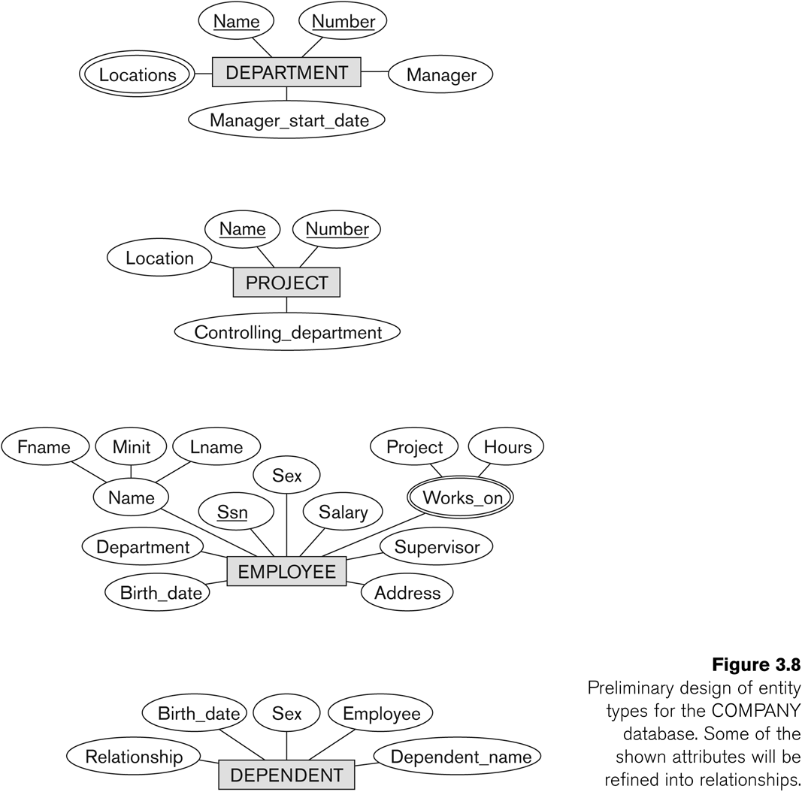
Initial Design of Entity Types: EMPLOYEE, DEPARTMENT, PROJECT, DEPENDENT

Slide 19
Refining the initial design by introducing relationships
The initial design is typically not complete
Some aspects in the requirements will be represented as relationships
ER model has three main concepts:
Entities (and their entity types and entity sets)
Attributes (simple, composite, multivalued)
Relationships (and their relationship types and relationship sets)

Slide 20
Relationships
A relationship relates two or more distinct entities with a specific meaning.
For example, EMPLOYEE John Smith works on the ProductX PROJECT, or EMPLOYEE Franklin Wong manages the Research DEPARTMENT.

Slide 21
Relationships
In ER diagrams, we represent the relationship type as follows:
Diamond-shaped box is used to display a relationship type
Connected to the participating entity types via straight lines
Note that the relationship type is not shown with an arrow. The name should be typically be readable from left to right and top to bottom.

Slide 22
Refining the COMPANY database schema by introducing relationships
By examining the requirements, six relationship types are identified
All are binary relationships( degree 2)
Listed below with their participating entity types:
WORKS_FOR (between EMPLOYEE, DEPARTMENT)
MANAGES (also between EMPLOYEE, DEPARTMENT)
CONTROLS (between DEPARTMENT, PROJECT)
WORKS_ON (between EMPLOYEE, PROJECT)
SUPERVISION (between EMPLOYEE (as subordinate), EMPLOYEE (as supervisor))
DEPENDENTS_OF (between EMPLOYEE, DEPENDENT)

Slide 23
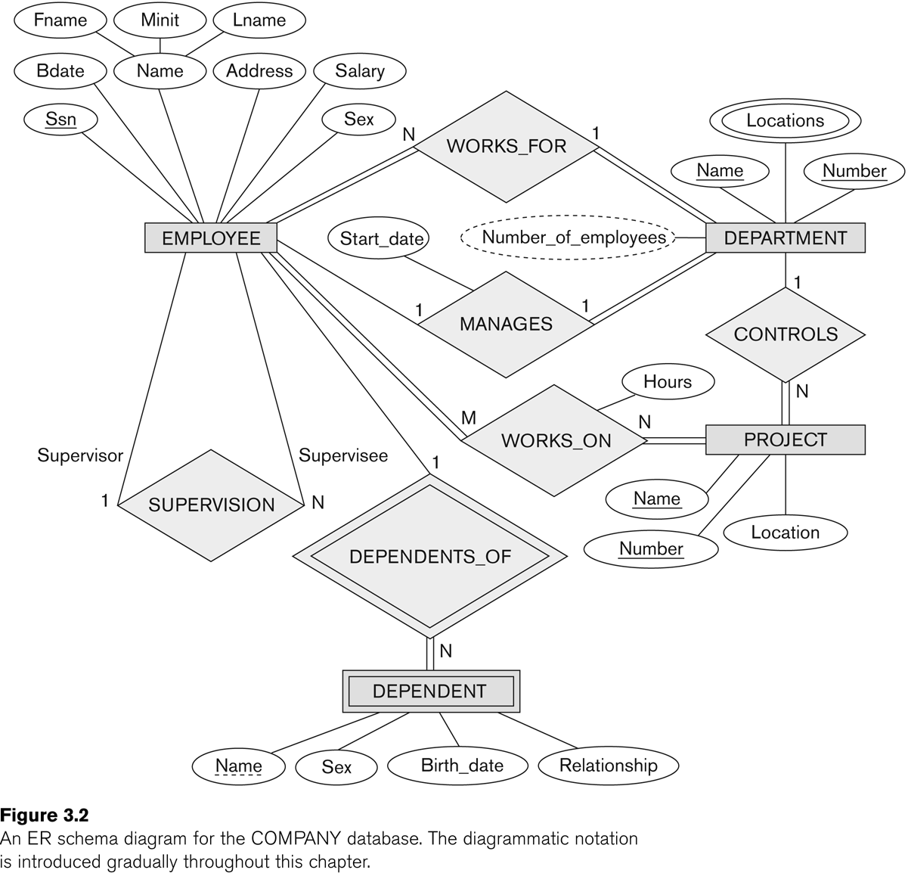
ER DIAGRAM – Relationship Types are: WORKS_FOR, MANAGES, WORKS_ON, CONTROLS, SUPERVISION, DEPENDENTS_OF

Slide 24
Discussion on Relationship Types
In the refined design, some attributes from the initial entity types are refined into relationships:
Manager of DEPARTMENT -> MANAGES
Works_on of EMPLOYEE -> WORKS_ON
Department of EMPLOYEE -> WORKS_FOR
etc
In general, more than one relationship type can exist between the same participating entity types
MANAGES and WORKS_FOR are distinct relationship types between EMPLOYEE and DEPARTMENT
Different meanings and different relationship instances.

Slide 25
Constraints on Relationships
Constraints on Relationship Types
(Also known as ratio constraints)
Cardinality Ratio (specifies maximum participation)
One-to-one (1:1)
One-to-many (1:N) or Many-to-one (N:1)
Many-to-many (M:N)
Existence Dependency Constraint (specifies minimum participation) (also called participation constraint)
zero (optional participation, not existence-dependent)
one or more (mandatory participation, existence-dependent)

Slide 26
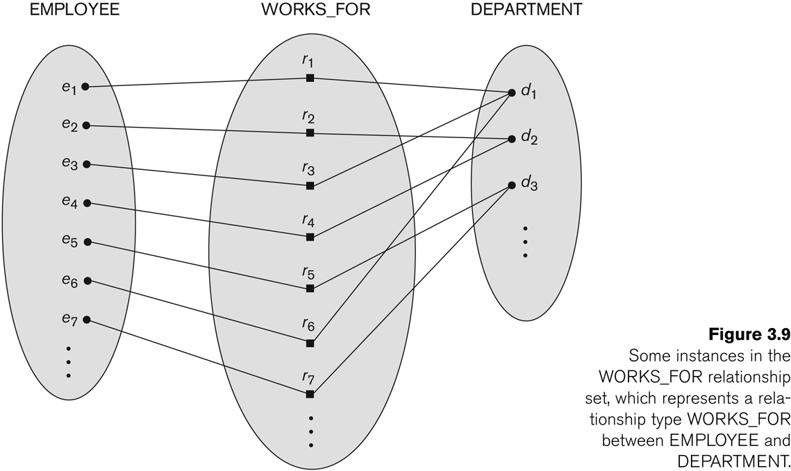
Many-to-one (N:1) Relationship

Slide 27
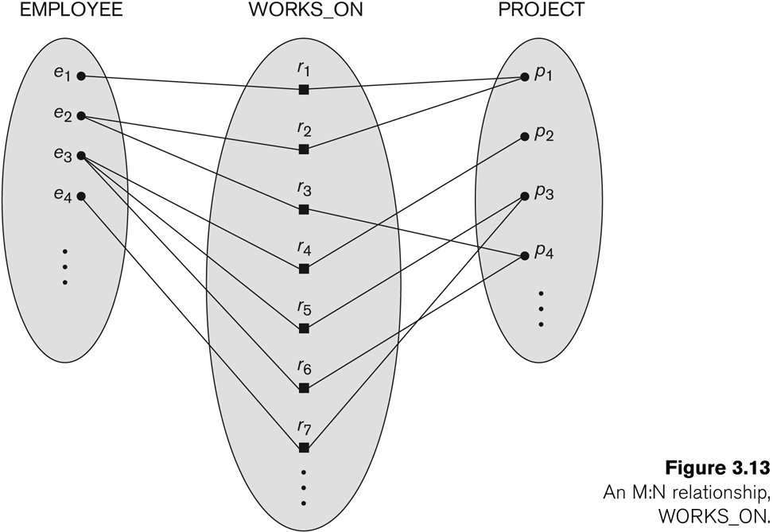
Many-to-many (M:N) Relationship

Slide 28
Recursive Relationship Type
A relationship type between the same participating entity type in distinct roles
Also called a self-referencing relationship type.
Example: the SUPERVISION relationship
EMPLOYEE participates twice in two distinct roles:
supervisor (or boss) role
supervisee (or subordinate) role
Each relationship instance relates two distinct EMPLOYEE entities:
One employee in supervisor role
One employee in supervisee role

Slide 29
Displaying a recursive relationship
In a recursive relationship type.
Both participations are same entity type in different roles.
For example, SUPERVISION relationships between EMPLOYEE (in role of supervisor or boss) and (another) EMPLOYEE (in role of subordinate or worker).
In ER diagram, need to display role names to distinguish participations.

Slide 30
Recursive Relationship Type is: SUPERVISION (participation role names are shown)

Slide 31
Weak Entity Types
An entity that does not have a key attribute and that is identification-dependent on another entity type.
A weak entity must participate in an identifying relationship type with an owner or identifying entity type
Entities are identified by the combination of:
A partial key of the weak entity type
The particular entity they are related to in the identifying relationship type
Example:
A DEPENDENT entity is identified by the dependent’s first name, and the specific EMPLOYEE with whom the dependent is related
Name of DEPENDENT is the partial key
DEPENDENT is a weak entity type
EMPLOYEE is its identifying entity type via the identifying relationship type DEPENDENT_OF

Slide 32
Attributes of Relationship types
A relationship type can have attributes:
For example, HoursPerWeek of WORKS_ON
Its value for each relationship instance describes the number of hours per week that an EMPLOYEE works on a PROJECT.
A value of HoursPerWeek depends on a particular (employee, project) combination
Most relationship attributes are used with M:N relationships
In 1:N relationships, they can be transferred to the entity type on the N-side of the relationship

Slide 33
Example Attribute of a Relationship Type: Hours of WORKS_ON

Slide 34
Notation for Constraints on Relationships
Cardinality ratio (of a binary relationship): 1:1, 1:N, N:1, or M:N
Shown by placing appropriate numbers on the relationship edges.
Participation constraint (on each participating entity type): total (called existence dependency) or partial.
Total shown by double line, partial by single line.
NOTE: These are easy to specify for Binary Relationship Types.

Slide 35
Alternative (min, max) notation for relationship structural constraints:
Specified on each participation of an entity type E in a relationship type R
Specifies that each entity e in E participates in at least min and at most max relationship instances in R
Default(no constraint): min=0, max=n (signifying no limit)
Must have min≤max, min≥0, max ≥1
Derived from the knowledge of mini-world constraints
Examples:
A department has exactly one manager and an employee can manage at most one department.
Specify (0,1) for participation of EMPLOYEE in MANAGES
Specify (1,1) for participation of DEPARTMENT in MANAGES
An employee can work for exactly one department but a department can have any number of employees.
Specify (1,1) for participation of EMPLOYEE in WORKS_FOR
Specify (0,n) for participation of DEPARTMENT in WORKS_FOR

Slide 36
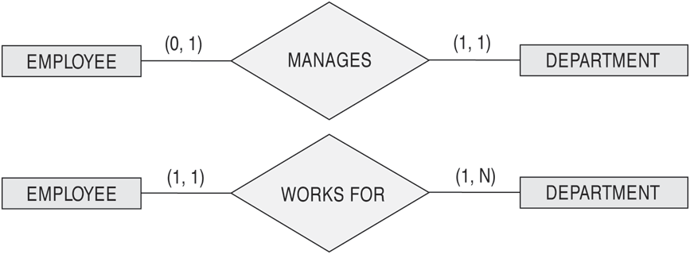
The (min,max) notation for relationship constraints
Read the min,max numbers next to the entity type and looking away from the entity type

Slide 37
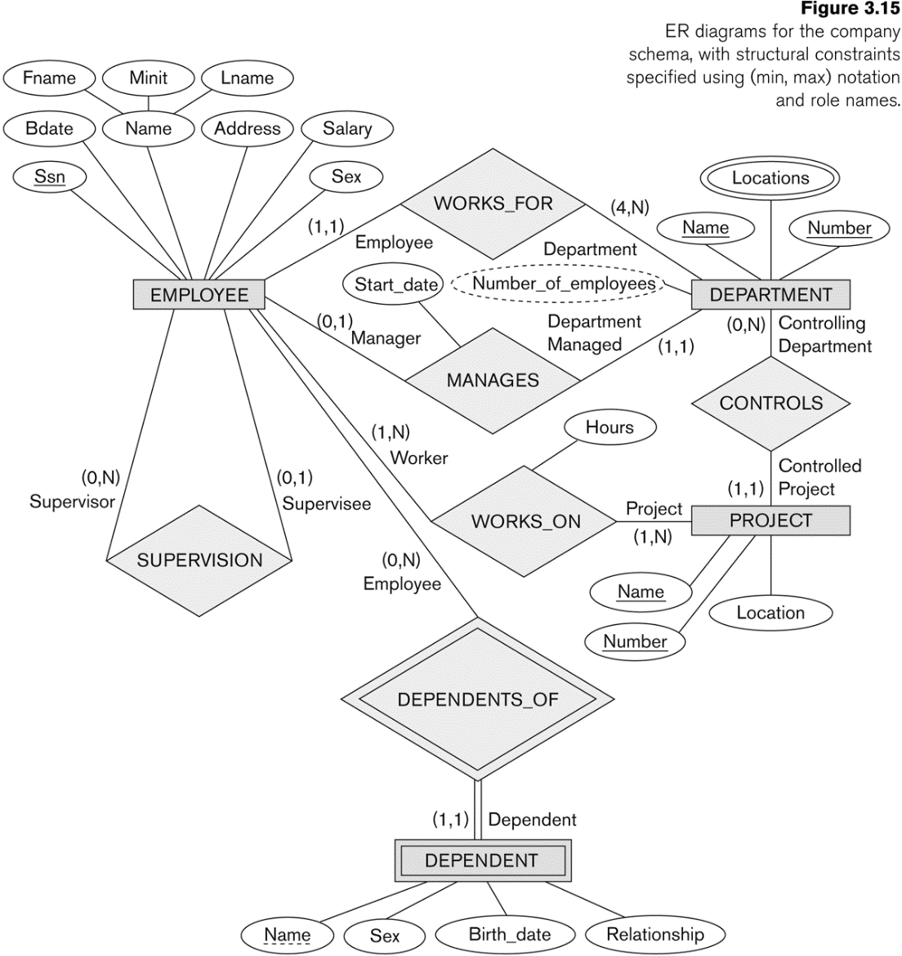
COMPANY ER Schema Diagram using (min, max) notation

Slide 38
Alternative diagrammatic notation
ER diagrams is one popular example for displaying database schemas
Many other notations exist in the literature and in various database design and modeling tools
UML class diagrams is representative of another way of displaying ER concepts that is used in several commercial design tools

Slide 39
Summary of notation for ER diagrams

Slide 40
UML class diagrams
Represent classes (similar to entity types) as large rounded boxes with three sections:
Top section includes entity type (class) name
Second section includes attributes
Third section includes class operations (operations are not in basic ER model)
Relationships (called associations) represented as lines connecting the classes
Other UML terminology also differs from ER terminology
Used in database design and object-oriented software design
UML has many other types of diagrams for software design

Slide 41
UML class diagrams
Represent classes (similar to entity types) as large rounded boxes with three sections:
Top section includes entity type (class) name
Second section includes attributes
Third section includes class operations (operations are not in basic ER model)
Relationships (called associations) represented as lines connecting the classes
Other UML terminology also differs from ER terminology
Used in database design and object-oriented software design
UML has many other types of diagrams for software design

Slide 42
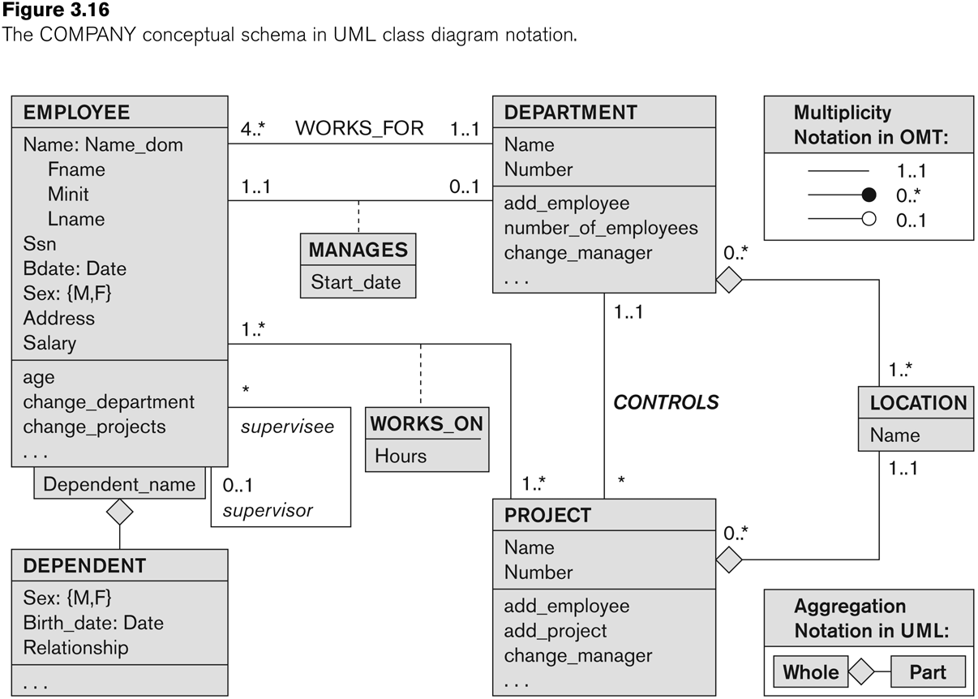
UML class diagram for COMPANY database schema

Slide 43
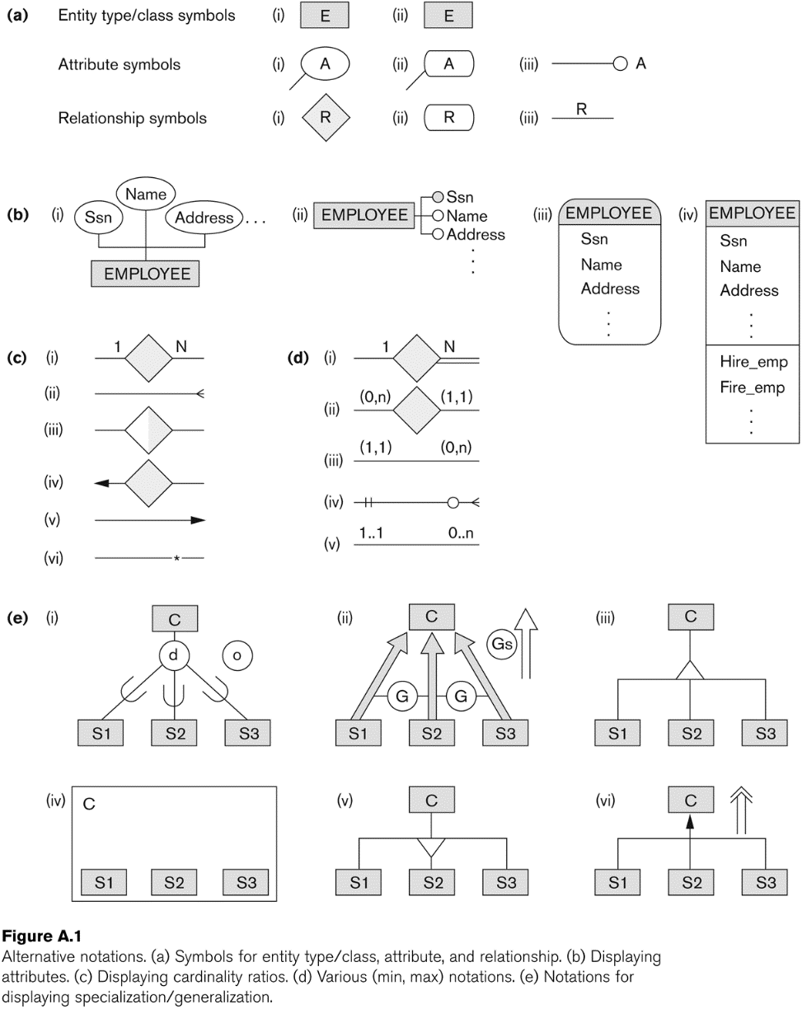
Other alternative diagrammatic notations

Slide 44
Relationships of Higher Degree
Relationship types of degree 2 are called binary
Relationship types of degree 3 are called ternary and of degree n are called n-ary
In general, an n-ary relationship is not equivalent to n binary relationships
Constraints are harder to specify for higher-degree relationships (n > 2) than for binary relationships

Slide 45
Discussion of n-ary relationships (n > 2)
In general, 3 binary relationships can represent different information than a single ternary relationship (see Figure next slide)
If needed, the binary and n-ary relationships can all be included in the schema design (see Figure 3.17a and b, where all relationships convey different meanings)
In some cases, a ternary relationship can be represented as a weak entity if the data model allows a weak entity type to have multiple identifying relationships (and hence multiple owner entity types) (see Figure 3.17c)

Slide 46
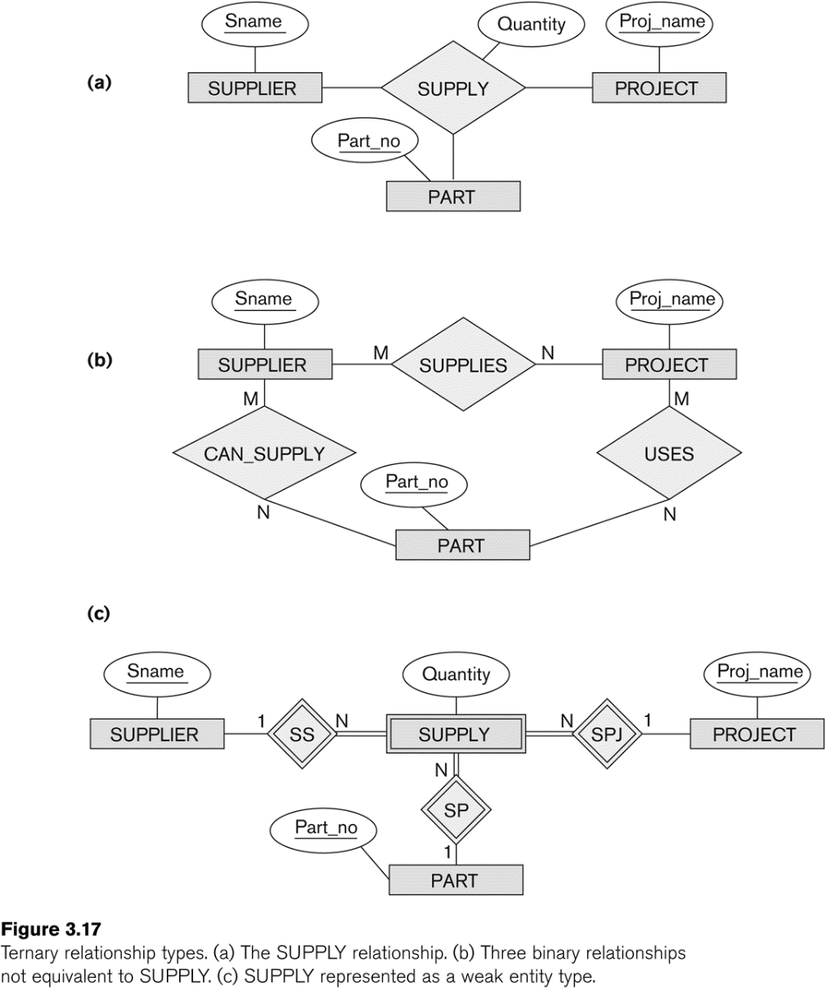
Example of a ternary relationship

Slide 47
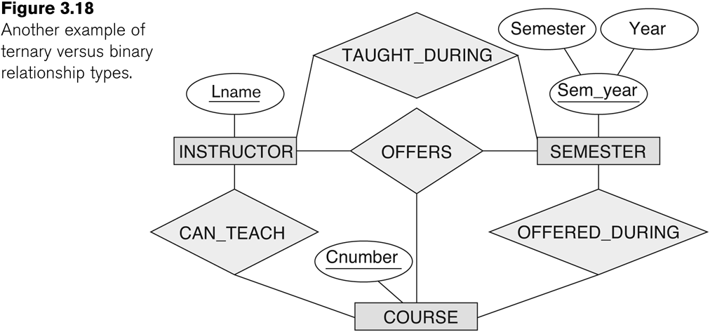
Discussion of n-ary relationships (n > 2)
If a particular binary relationship can be derived from a higher-degree relationship at all times, then it is redundant
For example, the TAUGHT_DURING binary relationship can be derived from the ternary relationship OFFERS (based on the meaning of the relationships)

Slide 48
Displaying constraints on higher-degree relationships
The (min, max) constraints can be displayed on the edges – however, they do not fully describe the constraints
Displaying a 1, M, or N indicates additional constraints
An M or N indicates no constraint
A 1 indicates that an entity can participate in at most one relationship instance that has a particular combination of the other participating entities
In general, both (min, max) and 1, M, or N are needed to describe fully the constraints
Overall, the constraint specification is difficult and possibly ambiguous when we consider relationships of a degree higher than two.

Slide 49
Some of the Automated Database Design Tools (Note: Not all may be on the market now)
COMPANY | TOOL | FUNCTIONALITY
Embarcadero Technologies | ER Studio | Database Modeling in ER and IDEF1X
 | DB Artisan | Database administration, space and security management
Oracle | Developer 2000/Designer 2000 | Database modeling, application development
Popkin Software | System Architect 2001 | Data modeling, object modeling, process modeling, structured analysis/design
Platinum (Computer Associates) | Enterprise Modeling Suite: Erwin, BPWin, Paradigm Plus | Data, process, and business component modeling
Persistence Inc. | Pwertier | Mapping from O-O to relational model
Rational (IBM) | Rational Rose | UML Modeling & application generation in C++/JAVA
Resolution Ltd. | Xcase | Conceptual modeling up to code maintenance
Sybase | Enterprise Application Suite | Data modeling, business logic modeling
Visio | Visio Enterprise | Data modeling, design/reengineering Visual Basic/C++

Slide 50
Extended Entity-Relationship (EER) Model
The entity relationship model in its original form did not support the specialization and generalization abstractions
Next lecture illustrates how the ER model can be extended with
Type-subtype and set-subset relationships
Specialization/Generalization Hierarchies
Notation to display them in EER diagrams

