Slide 1
Hashing
Sampath Jayarathna
Cal Poly Pomona

Slide 2
Contents
Static Hashing
File Organization
Properties of the Hash Function
Bucket Overflow
Indices
Dynamic Hashing
Underlying Data Structure
Querying and Updating
Comparisons
Other types of hashing
Ordered Indexing vs. Hashing

Slide 3
Static Hashing
Hashing provides a means for accessing data without the use of an index structure.
Data is addressed on disk by computing a function on a search key instead.
h
Data
Page 1
Data
Page 2
Data
Page 3
:::
Data
Page N-1
Data
Page N

Slide 4
Organization
A bucket in a hash file is unit of storage (typically a disk block) that can hold one or more records.
The hash function, h, is a function from the set of all search-keys, K, to the set of all bucket addresses, B.
Insertion, deletion, and lookup are done in constant time.
Records with different search-key values may be mapped to the same bucket; thus entire bucket has to be searched sequentially to locate a record.
Typical hash functions perform computation on the internal binary representation of the search-key.
For example, for a string search-key, the binary representations of all the characters in the string could be added and the sum modulo the number of buckets could be returned.

Slide 5
Querying and Updates
To insert a record into the structure compute the hash value h(K_{i}), and place the record in the bucket address returned.
For lookup operations, compute the hash value as above and search each record in the bucket for the specific record.
To delete simply lookup and remove.
Hash file organization of instructor file, using dept_name as key
E.g. h(Music) = 1 h(History) = 2 h(Physics) = 3 h(Elec. Eng.) = 3

Slide 6
Properties of the Hash Function
Worst hash function maps all search-key values to the same bucket
this makes access time proportional to the number of search-key values in the file.
The distribution should be uniform.
An ideal hash function should assign the same number of records in each bucket.
The distribution should be random.
Regardless of the actual search-keys, the each bucket has the same number of records on average
Hash values should not depend on any ordering or the search-keys

Slide 7
Bucket Overflow
How does bucket overflow occur?
Not enough buckets to handle data
A few buckets have considerably more records then others. This is referred to as skew in distribution of records.
Multiple records have the same hash value
Chosen hash function produces non-uniform distribution of key values.
Although the probability of bucket overflow can be reduced, it cannot be eliminated; it is handled by using overflow buckets.

Slide 8
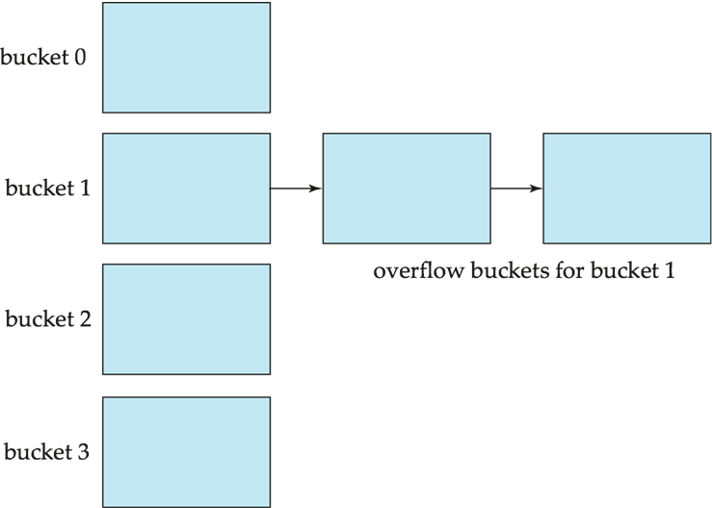
Solutions: Closed Hashing
Provide more buckets than are needed.
Overflow chaining
If a bucket is full, link another bucket to it. Repeat as necessary.
The system must then check overflow buckets for querying and updates. This is known as closed hashing.

Slide 9
Solutions: Open Hashing
Open hashing
The number of buckets is fixed
Overflow is handled by using the next bucket in cyclic order that has space.
This is known as linear probing.
Compute more hash functions.

Slide 10
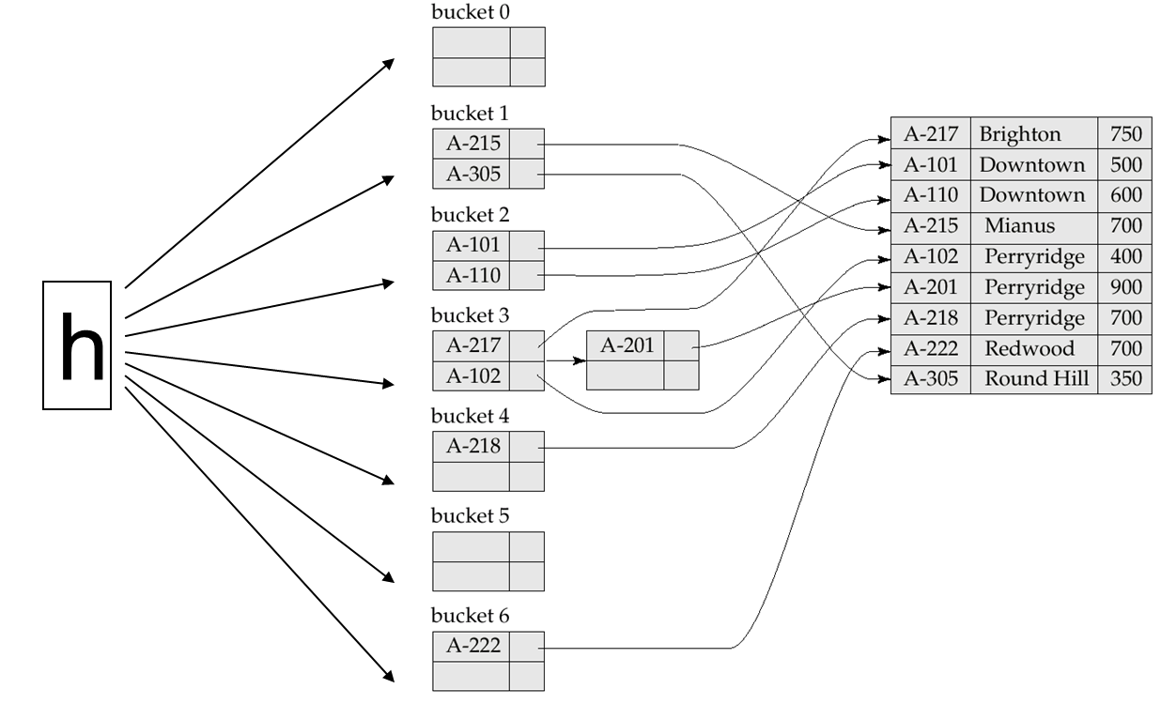
Hash Indices
A hash index organizes the search keys, with their pointers, into a hash file.

Slide 11
Static Hashing
A hash structure (or table or file) is a generalization of the simpler notion of an ordinary array
A hash function h is used to map keys into a range of bucket numbers
0
h(key) mod N
2
key
With Static Hashing,
allocated (as needed)
when corresponding buckets become full
h
With Static Hashing,
allocated sequentially
and never de-allocated
N-1
Primary bucket pages
Overflow pages

Slide 12
Deficiencies of Static Hashing
In static hashing, function h maps search-key values to a fixed set of B of bucket addresses.
Databases grow or shrink with time. If initial number of buckets is too small, and file grows, performance will degrade due to too much overflows.
If space is allocated for anticipated growth, a significant amount of space will be wasted initially (and buckets will be underfull).
If database shrinks, again space will be wasted.
One solution: periodic re-organization of the file with a new hash function
Expensive, disrupts normal operations
Better solution: allow the number of buckets to be modified dynamically.
Dynamic Hashing (Extendible Hashing, Linear Hashing)

Slide 13
Directory of Pointers
How else (as opposed to overflow pages) can we add a data record to a full bucket in a static hash file?
Reorganize the table (e.g., by doubling the number of buckets and redistributing the entries across the new set of buckets)
But, reading and writing all pages is expensive!
In contrast, we can use a directory of pointers to buckets
Buckets number can be doubled by doubling just the directory and splitting “only” the bucket that overflowed
The trick lies on how the hash function can be adjusted!

Slide 14
Extendible Hashing
Extendible Hashing uses a directory of pointers to buckets
The result of applying a hash function h is treated as a binary number and the last d bits are interpreted as an offset into the directory
d is referred to as the global depth of the hash file and is kept as part of the header of the file
GLOBAL DEPTH
4*
12*
32*
16*
Bucket A
2
00
1*
5*
21*
Bucket B
01
10
10*
Bucket C
11
DIRECTORY
15*
7*
19*
Bucket D
DATA PAGES

Slide 15
Extendible Hashing: Searching for Entries
To search for a data entry, apply a hash function h to the key and take the last d bits of its binary representation to get the bucket number
Example: search for 5*
2
00
4*
12*
32*
16*
Bucket A
01
Bucket B
5 = 101
1*
5*
21*
10
Bucket C
11
10*
15*
7*
19*
Bucket D
DIRECTORY
DATA PAGES

Slide 16
Extendible Hashing: Inserting Entries
An entry can be inserted as follows:
Find the appropriate bucket (as in search)
Split the bucket if full and redistribute contents (including the new entry to be inserted) across the old bucket and its “split image”
Double the directory if necessary
Insert the given entry

Slide 17
Extendible Hashing: Inserting Entries
Find the appropriate bucket (as in search), split the bucket if full, double the directory if necessary and insert the given entry
Example: insert 13*
2
00
4*
12*
32*
16*
Bucket A
01
Bucket B
13 = 1101
1*
5*
21*
13*
10
Bucket C
11
10*
15*
7*
19*
Bucket D
DIRECTORY

Slide 18
Extendible Hashing: Inserting Entries
Find the appropriate bucket (as in search), split the bucket if full, double the directory if necessary and insert the given entry
Example: insert 20*
FULL, hence, split and redistribute!
2
00
4*
12*
32*
16*
Bucket A
01
Bucket B
20 = 10100
1*
5*
21*
13*
10
Bucket C
11
10*
15*
7*
19*
Bucket D
DIRECTORY

Slide 19
Extendible Hashing: Inserting Entries
Find the appropriate bucket (as in search), split the bucket if full, double the directory if necessary and insert the given entry
Example: insert 20*
32*
16*
Bucket A
2
00
Bucket B
1*
5*
21*
13*
01
20 = 10100
10
11
10*
Bucket C
DIRECTORY
Bucket D
15*
7*
19*
Is this enough?
4*
12*
20*
Bucket A2
(`split image'
of Bucket A)

Slide 20
Extendible Hashing: Inserting Entries
Find the appropriate bucket (as in search), split the bucket if full, double the directory if necessary and insert the given entry
Example: insert 20*
32*
16*
Bucket A
2
00
Bucket B
1*
5*
21*
13*
01
20 = 10100
10
11
10*
Bucket C
DIRECTORY
Bucket D
15*
7*
19*
Double the directory and increase the global depth
4*
12*
20*
Bucket A2
(`split image'
of Bucket A)

Slide 21
Extendible Hashing: Inserting Entries
Find the appropriate bucket (as in search), split the bucket if full, double the directory if necessary and insert the given entry
Example: insert 20*
GLOBAL DEPTH
32*
16*
Bucket A
3
0 00
1*
5*
21*
13*
Bucket B
These two bits indicate a data entry that belongs to one of these two buckets
001
010
011
10*
Bucket C
1 00
The third bit distinguishes between these two buckets!
101
110
15*
7*
19*
Bucket D
111
But, is it necessary always to double the directory?
DIRECTORY
4*
12*
20*
Bucket A2
(`split image'
of Bucket A)

Slide 22
Extendible Hashing: Inserting Entries
Find the appropriate bucket (as in search), split the bucket if full, double the directory if necessary and insert the given entry
Example: insert 9*
GLOBAL DEPTH
32*
16*
Bucket A
3
FULL, hence, split!
000
1*
5*
21*
13*
Bucket B
001
010
9 = 1001
011
10*
Bucket C
100
101
110
15*
7*
19*
Bucket D
111
DIRECTORY
4*
12*
20*
Bucket A2
(`split image'
of Bucket A)

Slide 23
Extendible Hashing: Inserting Entries
Find the appropriate bucket (as in search), split the bucket if full, double the directory if necessary and insert the given entry
Example: insert 9*
GLOBAL DEPTH
32*
16*
Bucket A
3
000
1*
9*
Bucket B
001
010
10*
Bucket C
9 = 1001
011
100
101
15*
7*
19*
Bucket D
Almost there…
110
111
4*
12*
20*
Bucket A2
(`split image‘ of A)
DIRECTORY
5*
21*
13*
Bucket B2
(`split image‘ of B)

Slide 24
Extendible Hashing: Inserting Entries
Find the appropriate bucket (as in search), split the bucket if full, double the directory if necessary and insert the given entry
Example: insert 9*
GLOBAL DEPTH
32*
16*
Bucket A
3
000
1*
9*
Bucket B
001
010
10*
Bucket C
9 = 1001
011
There was no need to double the directory!
100
101
15*
7*
19*
Bucket D
110
111
4*
12*
20*
Bucket A2
When NOT to double the directory?
(`split image‘ of A)
DIRECTORY
5*
21*
13*
Bucket B2
(`split image‘ of B)

Slide 25
Extendible Hashing: Inserting Entries
Find the appropriate bucket (as in search), split the bucket if full, double the directory if necessary and insert the given entry
Example: insert 9*
LOCAL DEPTH
3
GLOBAL DEPTH
32*
16*
Bucket A
3
3
000
1*
9*
Bucket B
001
2
010
10*
Bucket C
9 = 1001
011
100
2
If a bucket whose local depth equals to the global depth is split, the directory must be doubled
101
15*
7*
19*
Bucket D
110
3
111
4*
12*
20*
Bucket A2
(`split image‘ of A)
DIRECTORY
3
5*
21*
13*
Bucket B2
(`split image‘ of B)

Slide 26
Extendible Hashing: Inserting Entries
Example: insert 9*
Repeat…
LOCAL DEPTH
3
GLOBAL DEPTH
32*
16*
Bucket A
FULL, hence, split!
3
2
000
1*
5*
21*
13*
Bucket B
001
010
2
9 = 1001
011
10*
Bucket C
100
101
2
Because the local depth (i.e., 2) is less than the global depth (i.e., 3), NO need to double the directory
110
15*
7*
19*
Bucket D
111
3
DIRECTORY
4*
12*
20*
Bucket A2
(`split image'
of Bucket A)

Slide 27
Extendible Hashing: Inserting Entries
Example: insert 9*
Repeat…
LOCAL DEPTH
3
GLOBAL DEPTH
32*
16*
Bucket A
3
3
000
1*
9*
Bucket B
001
2
010
10*
Bucket C
9 = 1001
011
100
2
101
15*
7*
19*
Bucket D
110
3
111
4*
12*
20*
Bucket A2
(`split image‘ of A)
DIRECTORY
3
5*
21*
13*
Bucket B2
(`split image‘ of B)

Slide 28
Extendible Hashing: Inserting Entries
Example: insert 9*
Repeat…
LOCAL DEPTH
3
GLOBAL DEPTH
32*
16*
Bucket A
3
3
000
1*
9*
Bucket B
001
2
010
10*
Bucket C
9 = 1001
011
100
2
101
15*
7*
19*
Bucket D
FINAL STATE!
110
3
111
4*
12*
20*
Bucket A2
(`split image‘ of A)
DIRECTORY
3
5*
21*
13*
Bucket B2
(`split image‘ of B)

Slide 29
Extendible Hashing: Inserting Entries
Example: insert 20*
Repeat…
FULL, hence, split!
LOCAL DEPTH
2
4*
12*
32*
16*
Bucket A
GLOBAL DEPTH
2
2
00
1*
5*
21*
13*
Bucket B
20 = 10100
01
10
2
10*
Bucket C
11
Because the local depth and the global depth are both 2, we should double the directory!
DIRECTORY
2
15*
7*
19*
Bucket D
DATA PAGES

Slide 30
Extendible Hashing: Inserting Entries
Example: insert 20*
Repeat…
LOCAL DEPTH
2
32*
16*
Bucket A
GLOBAL DEPTH
2
2
00
1*
5*
21*
13*
Bucket B
01
10
2
20 = 10100
11
10*
Bucket C
2
Is this enough?
DIRECTORY
Bucket D
15*
7*
19*
2
4*
12*
20*
Bucket A2
(`split image'
of Bucket A)

Slide 31
Extendible Hashing: Inserting Entries
Example: insert 20*
Repeat…
LOCAL DEPTH
2
GLOBAL DEPTH
32*
16*
Bucket A
3
2
000
1*
5*
21*
13*
Bucket B
001
010
2
011
10*
Bucket C
100
101
2
Is this enough?
15*
7*
19*
110
Bucket D
111
2
DIRECTORY
4*
12*
20*
Bucket A2
(`split image'
of Bucket A)

Slide 32
Extendible Hashing: Inserting Entries
Example: insert 20*
Repeat…
LOCAL DEPTH
3
GLOBAL DEPTH
32*
16*
Bucket A
3
2
000
1*
5*
21*
13*
Bucket B
001
FINAL STATE!
010
2
011
10*
Bucket C
100
101
2
110
15*
7*
19*
Bucket D
111
3
DIRECTORY
4*
12*
20*
Bucket A2
(`split image'
of Bucket A)

Slide 33
Class Activity 10
Consider following state of the extendible hashing structure. Add 25, 60, 28 and show the final state.

Slide 34
Deletion in Extendable Hash Structure
To delete a key value,
locate it in its bucket and remove it.
The bucket itself can be removed if it becomes empty (with appropriate updates to the bucket address table).
Merging of buckets can be done (can merge only with a “split image” bucket)
Decreasing bucket address table size is also possible
Note: decreasing bucket address table size is an expensive operation and should be done only if number of buckets becomes much smaller than the size of the table

Slide 35
Comparison to Other Hashing Methods
Advantage: performance does not decrease as the database size increases
Space is conserved by adding and removing as necessary
Disadvantage: additional level of indirection for operations
Complex implementation
Bucket address table may itself become very big (larger than memory)
Need a tree structure to locate desired record in the structure!
Changing size of bucket address table is an expensive operation
Linear hashing is an alternative mechanism which avoids these disadvantages at the possible cost of more bucket overflows

Slide 36
Ordered Indexing vs. Hashing
Hashing is less efficient if queries to the database include ranges as opposed to specific values.
What indexing technique can we use to support range searches (e.g., “Find s_name where gpa >= 3.0)?
Tree-Based Indexing
In cases where ranges are infrequent hashing provides faster insertion, deletion, and lookup then ordered indexing.
What about equality selections (e.g., “Find s_name where sid = 102”?
Tree-Based Indexing
Hash-Based Indexing
Hash-based indexing, however, proves to be very useful in implementing relational operators

