Slide 1
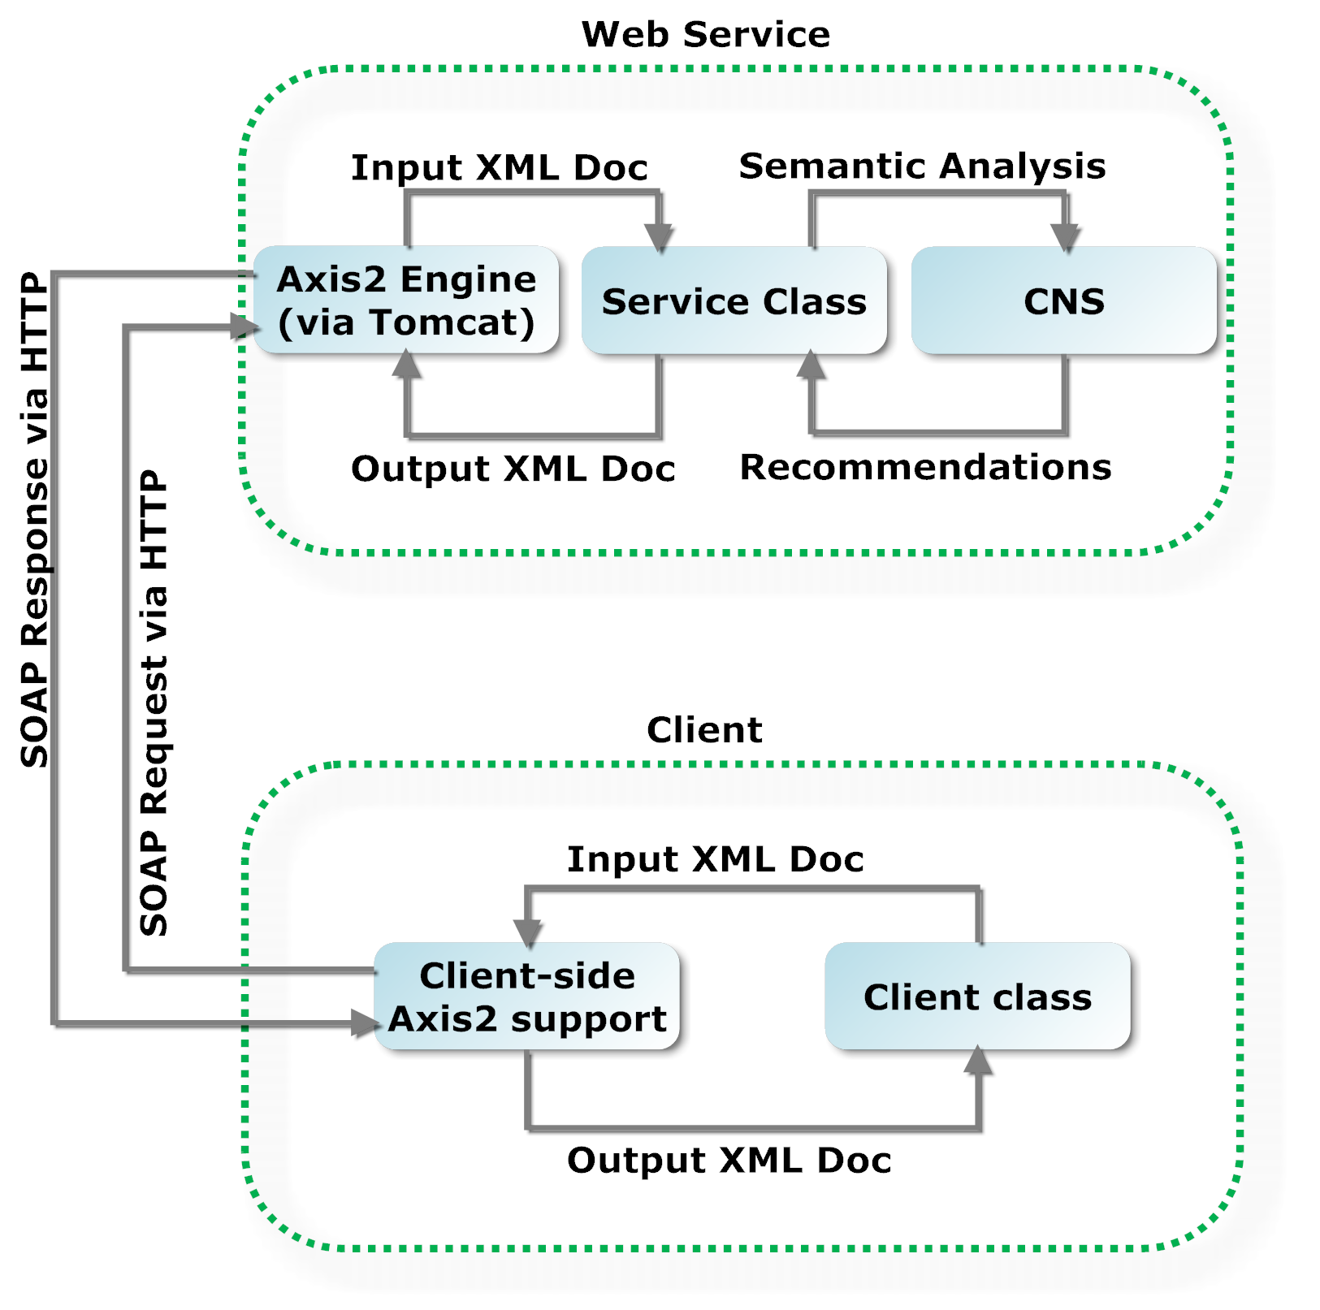
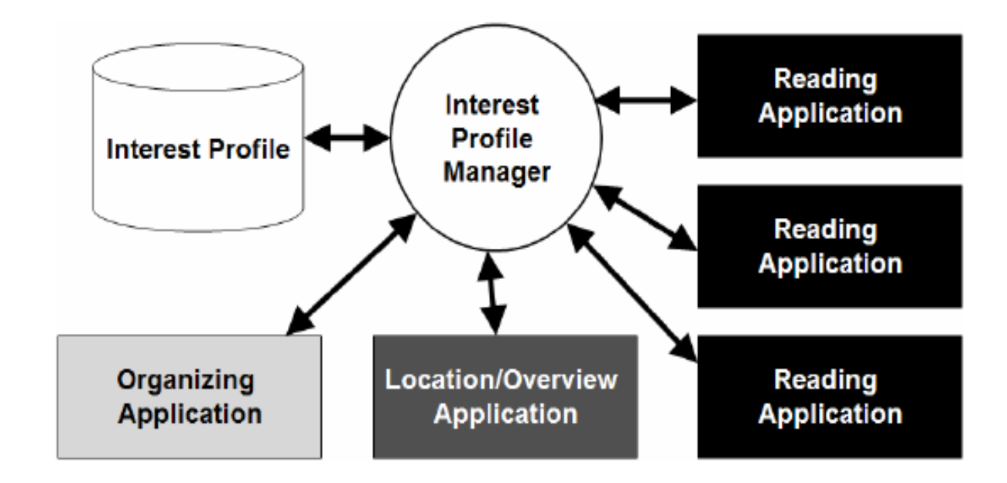
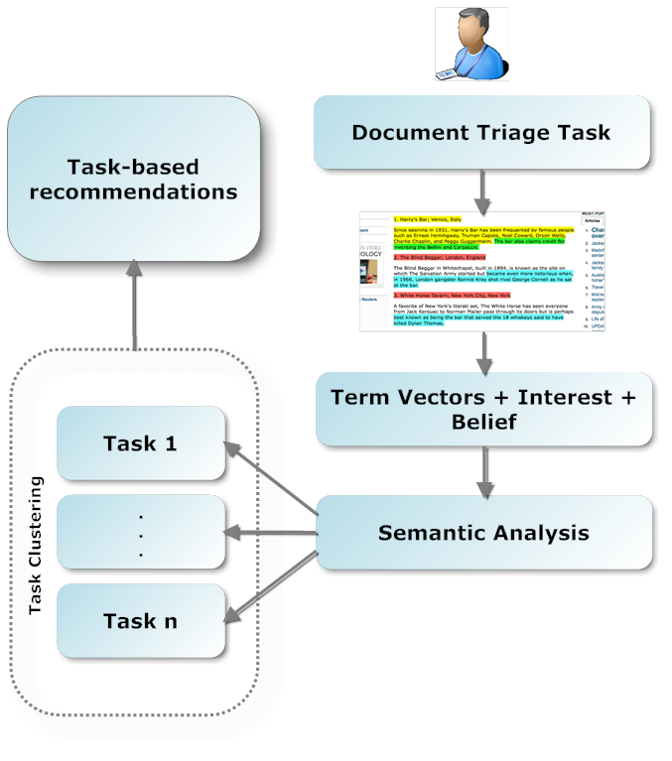
CNS: NSDL Service to Support Personalized & Community-Oriented Navigation
Sampath Jayarathna, Frank Shipman
Department of Computer Science, Texas A&M University – College Station
Introduction
Community Navigation Service
Semantic Analysis
To be useful, a Digital Library must provide its patrons with easy access to materials that are relevant to their needs.
To accomplish this end, this research study is developing a Community Navigation Service (CNS) based on data collected by an Interest Profile Manager (IPM) while continuing to personalize resource presentation by way of the IPM to preserve privacy.
Tools are being developed under this research study to help users to retrieve data that is pertinent to interest of the specific user.
Latent Semantic Analysis (LSA) is a theoretical approach for extracting and representing the contextual-usage meaning of words by statistical computations applied to a large corpus of text.
In addition, each interest profile consists of interest (1-100) and belief (1-100) value per document of interest to a specific user.
So, we can define the semantic similarity between task A and task B,
$$S_{t_{A},t_{B}}=\sum_{D∈B}{\sum_{D∈A}{LSA\left(D_{A},D_{B}\right).}}BWI\left(D_{A},D_{B}\right)$$
In order to decide which task clusters should be combined, an agglomerative hierarchical clustering is used with a measure of Euclidian distance between pairwise distances of task clusters in the sets.
Figure 2. Web Service Architecture
Figure 1. Interest Profile Manager and Document Triage task
Task-based Recommendations
Discussion
Motivation
We address the issue of recommender systems by making use of user provided belief weighted interests ratings and document term vectors to come up with task-based recommendation based on semantic analysis.
CNS is a web service based recommender system that works upon local interests profiles populated over community of recommenders.
Each of the local interests profiles can be easily transported to the CNS via XML file transfer service.
The innovative feature of the research is that it uses an IPM combined with the collaborative filtering and semantic analysis provided by a CNS to infer the value of a resource to the user
References
Landauer, T.K., P.W. Foltz, and D. Laham, An introduction to latent semantic analysis. Discourse Processes, 1998. 25(2): p. 259 – 284
Badi, R., et al., Recognizing user interest and document value from reading and organizing activities in document triage, in Proceedings of the 11th international conference on Intelligent user interfaces. 2006, ACM: Sydney, Australia. p. 218-225
Netflix. Netflix Prize. 2009; Available from: http://www.netflixprize.com/
Figure 3. Task-based Recommender System - Overview
Acknowledgement: This research is supported by NSF grant 0938074 to Frank Shipman

