Slide 1
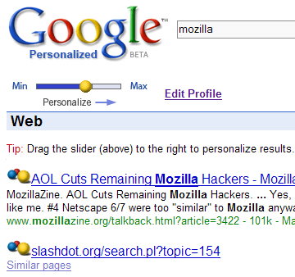
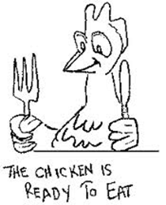
“You might also like…” from Everyday Applications to Recommendations
Customize search results based on the inferred interest of the user
User Interest Model
Query input (short, ambiguous)
how can we build more valuable models of a user’s interests based on their prior activities?

