Slide 1
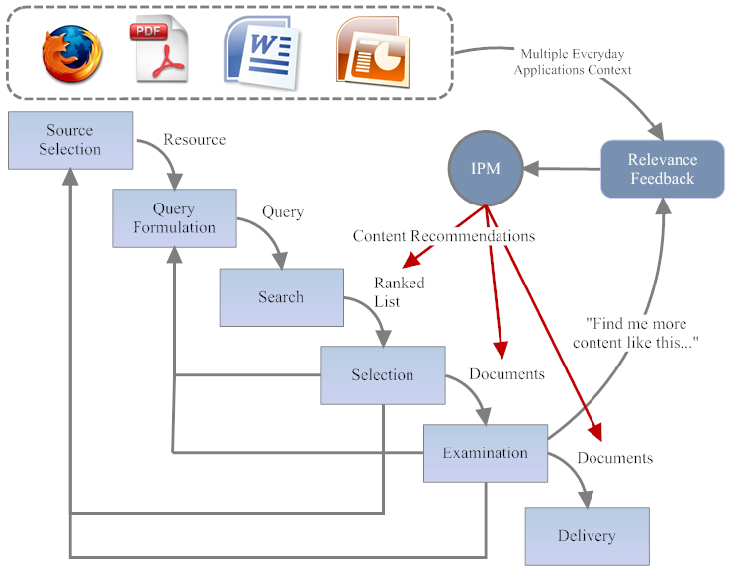
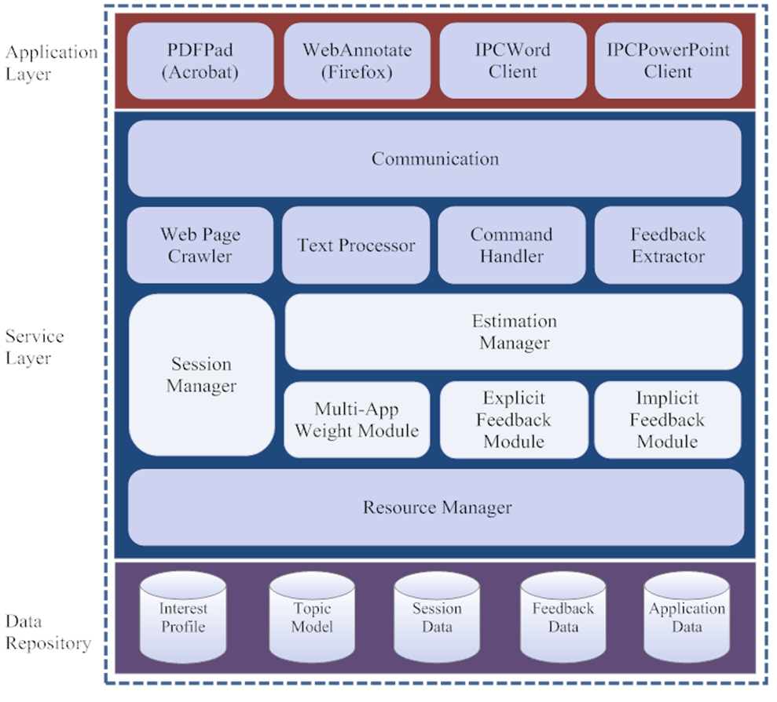
Unified Feedback for Multi-Application User Interest Modeling
Sampath Jayarathna, Atish Patra and Frank Shipman
Computer Science & Engineering, Texas A&M University – College Station
ABSTRACT
BACKGROUND
DATASET AND RESULTS
How can we build more valuable models of a user’s interests based on their prior activities?
What are the tradeoffs between alternative approaches to recommending documents and document components based on a combination of implicit and explicit feedback across multiple applications?
we explore novel user interest modeling techniques in order to generate document recommendations to support users during open-ended information gathering tasks. Our work is unique by making use of a combination of implicit, semi-explicit, and explicit feedback in the context of users’ interactions with multiple applications, coupled with an analysis of the characteristics and content of the documents they are interacting with.
Figure 1. Basic IR Cycle and IPM Recommendations
Unified feedback across multiple applications will result in more accurate and more rapid assessment of documents than available through either implicit or explicit feedback alone.
Unified feedback across multiple applications can be used to more accurately and rapidly determine when a user's interest has changed.
Explicit feedback: users explicitly mark relevant and irrelevant documents
Implicit feedback: system attempts to infer user intentions based on observable behavior
Unified feedback: implicit ratings can be combined with existing explicit ratings to form a hybrid system to predict user satisfaction
Figure 2. IPM System Architecture
All participants were placed in the role of a researcher who had to read 32 web pages (4 tasks, 8 web pages per task) and prepare a short report in MS Word and a presentation in MS PPT on a specific task. During the reading of the selected web pages, they had to annotate paragraphs they seems interesting from the given webpage and assign ratings to them using the WebAnnotate tool. Once they completed reading each page, they had to provide a readability score and relevance score for the completed web pages.
Ground-truth dataset
Simulated search tasks environment
Multiple everyday applications (MS Word, MS PowerPoint, Mozilla Browser)
Implicit feedback, semi-explicit feedback (annotations), explicit feedback (paragraph relevance score, page relevance score, page readability score)
31 Students (24 male, 7 female)
CONTRIBUTIONS
Our major contributions in this work can be summarized as:
A unified user interest model
Classification of documents into different user interests based on combined (implicit + semi-explicit) user expressions
Multiple everyday-applications model
Examine how inferred models of user interest from different applications may be used in building multi-application environments
Rating Prediction
Model the unified feedback data so that they are interchangeable as sources of relevance information for the explicit ratings
Session Segmentation
A task-based session segmentation approach to identify multiple interests expressed in a single task session
Emphasize the exploitation of users' immediate and session-based context in multiple everyday applications
REFERENCES
Jayarathna, S, A. Patra, and F. Shipman (2013). "Mining user interest from search tasks and annotations." Proceedings of the 22nd ACM international conference on Conference on information & knowledge management. ACM.
Bae, S. I. and F. Shipman (2008). Balancing human and system visualization during document triage, Texas A & M University.
Budzik, J. and K. J. Hammond (2000). User interactions with everyday applications as context for just-in-time information access. Proceedings of the 5th international conference on Intelligent user interfaces, ACM.
Liu, N. N., E. W. Xiang, M. Zhao and Q. Yang (2010). Unifying explicit and implicit feedback for collaborative filtering. Proceedings of the 19th ACM international conference on Information and knowledge management, ACM
HYPOTHESIS
USER STUDY
Acknowledgements : This research is supported by NSF grant 0938074

