Slide 1
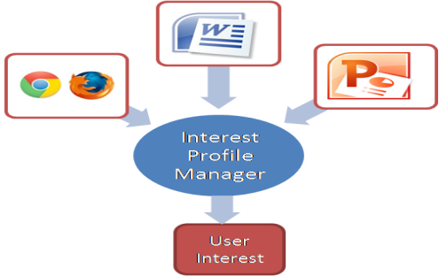
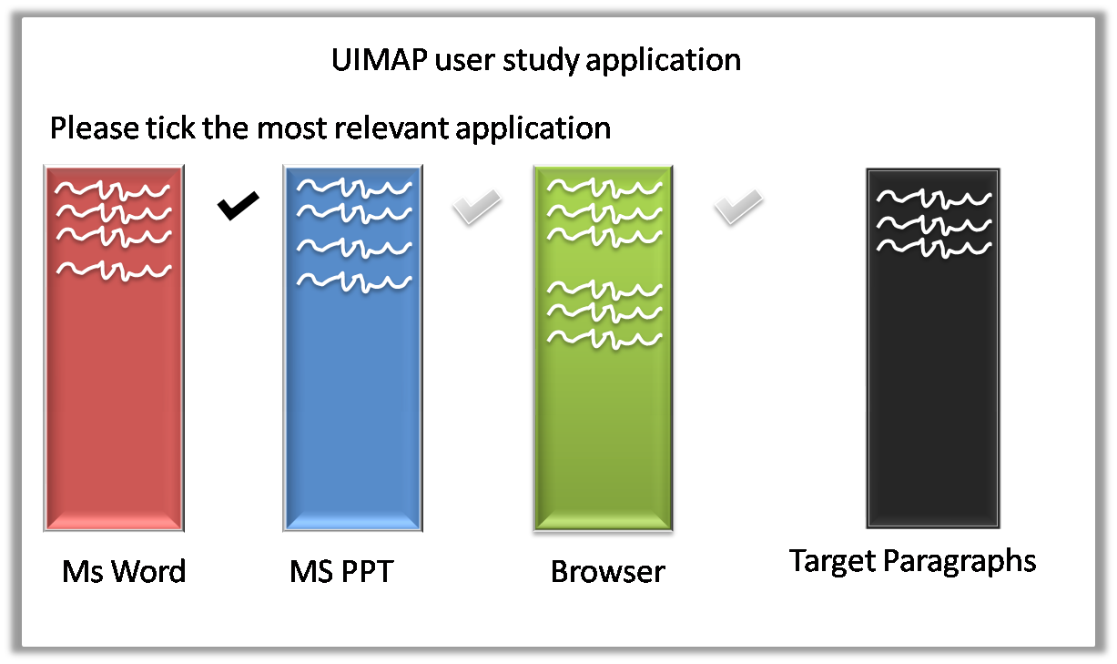
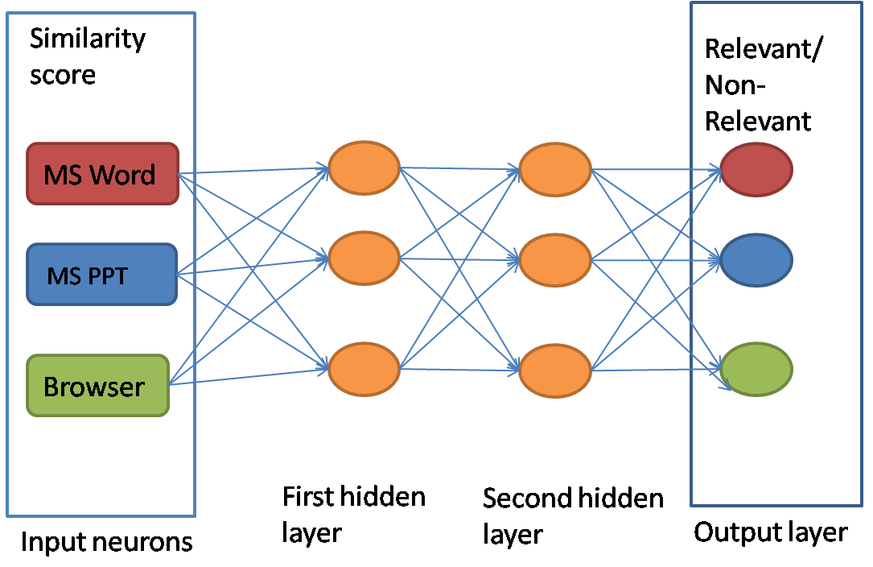
Learning weights using multi-layer perceptron in User Interest Modeling
Atish Patra, Sampath Jayarathna, and Frank Shipman
Computer Science & Engineering, Texas A&M University
INTRODUCTION
MULTI LAYER PERCEPTRONS (MLP)
DATA SET FOR TRAINING
The goal of this research to learn the importance of each application in a multi-application based user interest modeling. It explores the nuances behind the distributed user interest across different applications while researching on a task.
Non-linear separable nature of problem prompted us to use MLP as our learning model.
Supervised learning nature of this model require us to collect the user data first.
Back propagation algorithm is used to compute the errors at each node.
Gradient descent principle will be applied to reduce the error afterwards.
The output of this application will be stored in following format : <pid : R_{v}>
where pid: Paragraph id
R_{v} : {R_{w},R_{p},R_{b}}
(a three dimensional Relevance vector consisting binary relevance judgment)
Fig-1: User Interest Modeling
Fig.3 : Sample UI For Survey Application
MOTIVATION
DISCUSSION
An interest model is already created by computing similarity using probabilistic topic modeling (LDA[1]) from extracted text across applications.
But sometimes an application does not infer much interest although it has much more content. On the other hand some other application can indicate a higher interest although it has less but concise content.
PROBLEM STATEMENT
Each application should be given a weight indicating the actual interest of user in that application in stead only content similarity.
An AI approach to learn the weight of each application in user interest modeling
Include implicit as well as explicit feedbacks
More level of relevance instead of binary relevance
Online learning of neural network
Fig-2 : Paragraph wise Similarity For Each Application in MLP
EVALUATION METHEDOLOGY
A stand alone user study application which simulates exact behavior of each application will collect the data.
This separate application is required to collect ground truth data regarding user relevance judgment and reduce the user study time and .
Precision/Recall and Micro average will be computed to evaluate the accurateness of the MLP.
REFERENCES
Jayarathna, S.,Patra, A., Shipman, F., "Mining User Interest from Search Tasks and Annotations", 22nd ACM Conference on Information and Knowledge Management (CIKM), Burlingame, CA, October 27- November 1, 2013
Manevitz, L., Yousef, M, “One-class document classification via Neural Networks” in 14th European Symposium on Artificial Neural Networks
Bae, S., Hsieh, H., Kim, D., Marshall, C.C., Meintanis, K., Moore, J.M., Zacchi, A. and Shipman, F.M. Supporting document triage via annotation-based visualizations. American Society for Information Science and Technology, 45 (1). 1-16.
Tolomei, G., Orlando, S. and Silvestri, F., Towards a task-based search and recommender systems. In Proceedings of ICDE Workshops, (2010), 333-336.
Acknowledgements : This research is supported by NSF grant 0938074

