Slide 1
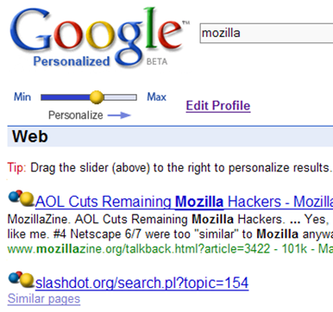
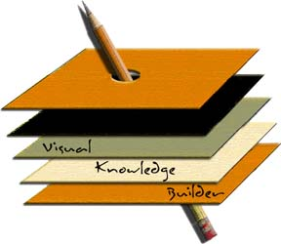
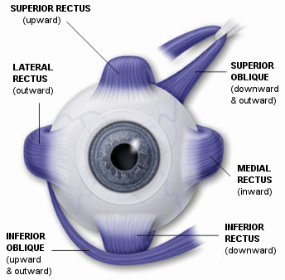
Improving Web Search by Incorporating User Behavior in Everyday Applications
Sampath Jayarathna and Frank Shipman
Computer Science & Engineering, Texas A&M University – College Station
ABSTRACT AND MOTIVATION
BACKGROUND
DATASET AND RESULTS
We explore novel user interest modeling techniques in order to generate document recommendations to support users during open-ended information gathering tasks.
Personalized Information Delivery
“Google Personalized Beta”
User Query input / Search History
Most direct evidence of user need
Privacy issues
Short, imprecise, and ambiguous
We interact with different applications, and have extra information about the content we are interacting with.
How can we build more valuable models of a user’s interests based on these prior interactions?
Can we find tradeoffs between alternative approaches to recommending documents and document components based on a relevance feedback across multiple applications?
Explicit feedback: users explicitly mark relevant and irrelevant documents
Implicit feedback: system attempts to infer user intentions based on observable behavior
Unified feedback: implicit ratings can be combined with existing explicit ratings to form a hybrid system to predict user satisfaction
Unified feedback across multiple applications will result in more accurate and more rapid assessment of documents than available through either implicit or explicit feedback alone.
Unified feedback across multiple applications can be used to more accurately and rapidly determine when a user's interest has changed.
Figure 1. IPM System Architecture
4 information summarization tasks
8 web documents per task
Use multiple everyday applications (Word, PowerPoint, Firefox web browser)
Asked to:
Write short summary/answer to task question in Word
Generate 2-3 slides on topic/answer in PowerPoint
About 30 minutes per task but no limit enforced
Ground-truth dataset, simulated search tasks environment
Implicit feedback, semi-explicit feedback (annotations), explicit feedback (paragraph relevance score, page relevance score, page readability score)
31 Students (24 male, 7 female)
Consumption
Applications
Model | Page-Level RMSE
 | Task-1 | Task-2 | Task-3 | Task-4
baseline-LDA | 1.1799 | 1.3145 | 1.2387 | 1.5147
Semi-Explicit | 1.1259 | 1.3258 | 1.2583 | 1.4628
Unified | 1.0966 | 1.1979 | 1.1617 | 1.3881
Production Applications
PROBLEM STATEMENT
CONCLUSIONS & CONTRIBUTIONS
A unified user interest model
Classification of documents into different user interests based on combined (implicit + semi-explicit) user expressions
Multiple everyday-applications model
Examine how inferred models of user interest from different applications may be used in building multi-application environments
FUTURE WORK
USER STUDY
HYPOTHESIS
REFERENCES
Jayarathna, S., A. Patra, and F. Shipman (2015), Unified Relevance Feedback for Multi-Application User Interest Modeling. ACM IEEE JCDL. Nominated for Best Student paper award.
Jayarathna, S, A. Patra, and F. Shipman (2013). "Mining user interest from search tasks and annotations." ACM CIKM.
Acknowledgements : This research is supported by NSF grant 0938074

