Slide 1
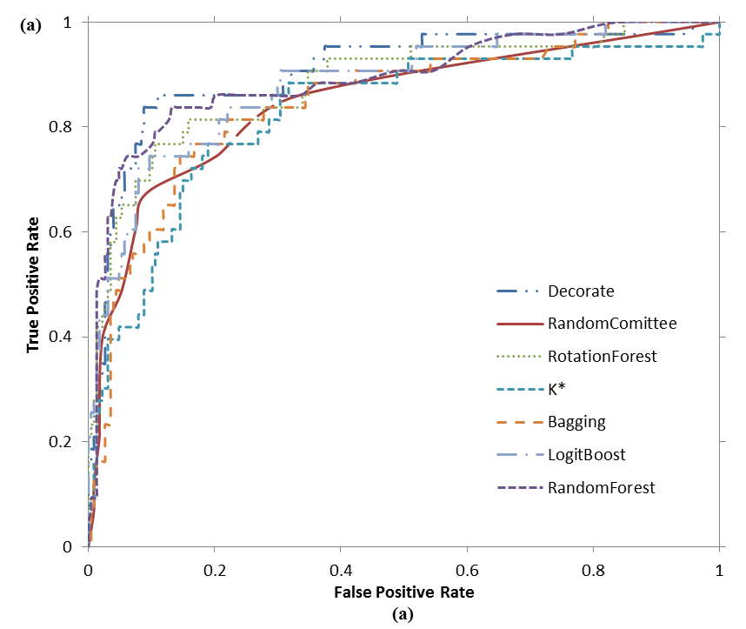
Bringing Order to the Web: Categorizing Changes in a Digital Repository
Sampath Jayarathna, Luis Meneses, Richard Furuta, and Frank Shipman Center for the Study of Digital Libraries (CSDL), Computer Science & Engineering
Abstract
ACM Digital Repository
Classification Results
It is not unusual for digital collections to degrade and suffer from problems associated with unexpected change.
Categorizing this degree of change is not a binary problem.
We examine and categorize the various degrees of change that digital documents endure within the boundaries of digital repository.
How can we categorize the various degrees of change that documents endure?
What strategies can be implemented to effectively detect and alleviate the consequences of various types of change?
Figure 1: Screenshot of http://www.jcdl2011.org
Web documents are not static resources and certain degree of change is expected from them.
However, these documents are expected to either change little over time or mutate harmoniously with other documents to preserve semantic meaning and ordering of a collection.
By examining a distributed collection of an institutional digital library, we intend to describe the types of issues found in the collection and the potential to automatically identify these issues when they arise.
The ACM maintains a list of conference proceedings in its digital repository, http://dl.acm.org/proceedings.cfm
6086 URLs out of which 2001 unique. Approximately 75% of page requests (1492 pages) resulted in a response code indicating success (200), which means no problems were found when trying to fulfill the request.
Figure 2: Distribution of Pages with 200 HTTP Response Code.
Figure 3: Distribution of the Incorrect pages.
Out degree, Reciprocal link degree, Edge reciprocity, Host links, External links, Broken links, Multimedia links, Import links, Non-multimedia links, Text-similarity (6 features) using LDA, Images, No anchor text links.
We performed category classification with 71 algorithms that are implemented in the Weka toolkit.
Table 1: Classification of “Incorrect” categories.
Table 2: Classification of “Incorrect” categories without “Different languages” and “Unsure” categories
Figure 4: ROC Curves for “Deceiving pages”
Our research is on investigating methods to detect unexpected changes in web documents within a collection.
We limited our work to features that could be computed quickly with a minimal number of http requests per resource.
 | Accuracy | MAE | Precision | Recall | F
Decorate | 66.38% | 0.1904 | 0.633 | 0.664 | 0.6320
RandomCommittee | 62.03% | 0.1825 | 0.576 | 0.62 | 0.590
RotationForest | 67.25% | 0.1851 | 0.641 | 0.672 | 0.637
RandomForest | 67.25% | 0.1916 | 0.662 | 0.672 | 0.624
K* | 61.45% | 0.1555 | 0.583 | 0.614 | 0.589
Bagging | 62.61% | 0.2093 | 0.575 | 0.626 | 0.562
LogitBoost | 63.19% | 0.2008 | 0.58 | 0.632 | 0.589
Problem Statement
 | Accuracy | MAE | Precision | Recall | F
Decorate | 83.33% | 0.1832 | 0.824 | 0.833 | 0.824
RandomCommittee | 78.15% | 0.1849 | 0.759 | 0.781 | 0.765
RotationForest | 82.59% | 0.1850 | 0.82 | 0.826 | 0.813
RandomForest | 80.74% | 0.1916 | 0.798 | 0.807 | 0.793
K* | 78.52% | 0.1497 | 0.767 | 0.785 | 0.767
Bagging | 78.15% | 0.2153 | 0.778 | 0.781 | 0.758
LogitBoost | 80.00% | 0.1872 | 0.79 | 0.8 | 0.784
Background
Goal
Features
Conclusion

