Slide 1
Monte Carlo for Linear Operator Equations
Fall 2012
By Hao Ji

Slide 2
Review
Last Class
  Quasi-Monte Carlo
This Class
  Monte Carlo Linear Solver
    von Neumann and Ulam method
    Randomize Stationary iterative methods
    Variations of Monte Carlo solver
  Fredholm integral equations of the second kind
  The Dirichlet Problem
  Eigenvalue Problems
Next Class
  Monte Carlo method for Partial Differential Equations

Slide 3
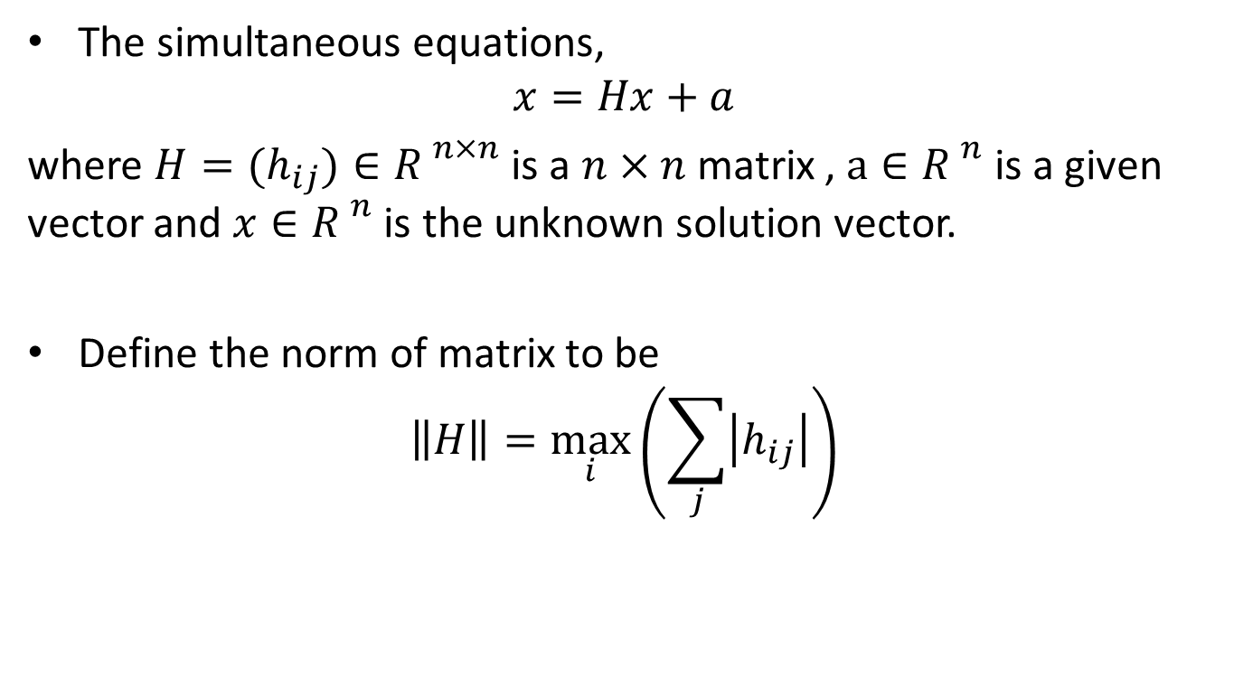
Solving Linear System
The simultaneous equations,
$$x=Hx+a$$
where $H=(h_{ij})∈{R }^{n×n}$ is a $n×n$ matrix , $a∈{R }^{n}$is a given vector and $x∈{R }^{n}$ is the unknown solution vector.
Define the norm of matrix to be
$$\left\|H\right\|=\max_{i}\left(\sum_{j}{\left|h_{ij}\right|}\right)$$

Slide 4
Solving Linear System
Direct methods
  Gaussian elimination
  LU decomposition
  …
Iterative methods
  Stationary iterative methods (Jacobi method, Gauss Seidel method, …)
  Krylov subspace methods(CG, Bicg, GMRES,…)
  …
Stochastic linear solvers
  Monte Carlo methods
  …

Slide 5
Monte Carlo Linear Solver
The Monte Carlo method proposed by von Neumann and Ulam:
  Define the transition probabilities and the terminating probabilities.
  Build an unbiased estimator of the solution.
  Produce Random Walks and calculate the average value.

Slide 6

Monte Carlo Linear Solver
Let $P$ be a $n×n$ matrix based on the matrix $H$, such that
$$p_{ij}≥0, \sum_{j}{p_{ij}}≤1$$
and
$$h_{ij}≠0→p_{ij}≠0$$
$$p_{i}=1−\sum_{j}{p_{ij}}≤1$$
A special case:
$$p_{ij}=\left|h_{ij}\right|$$

Slide 7
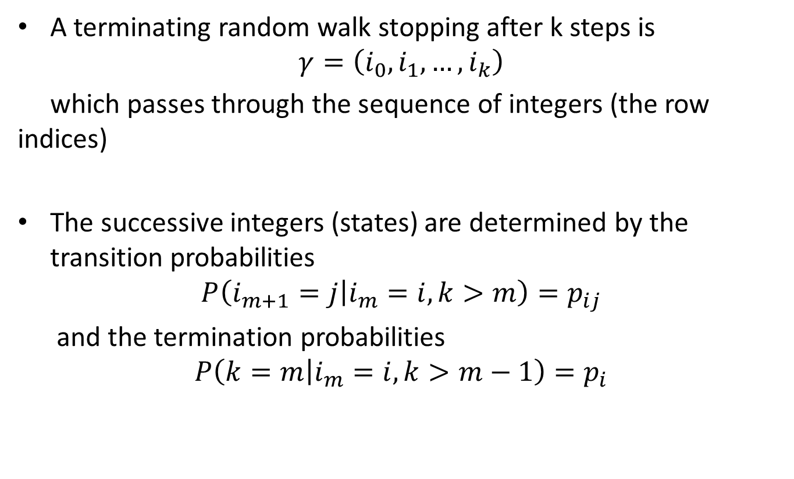
Monte Carlo Linear Solver
A terminating random walk stopping after k steps is
$$γ=\left(i_{0},i_{1},…,i_{k}\right)$$
which passes through the sequence of integers (the row indices)
The successive integers (states) are determined by the transition probabilities
$$P\left(i_{m+1}=j\left|i_{m}=i\right., k>m\right)=p_{ij}$$
and the termination probabilities
$$P\left(k=m\left|i_{m}=i\right., k>m−1\right)=p_{i}$$

Slide 8
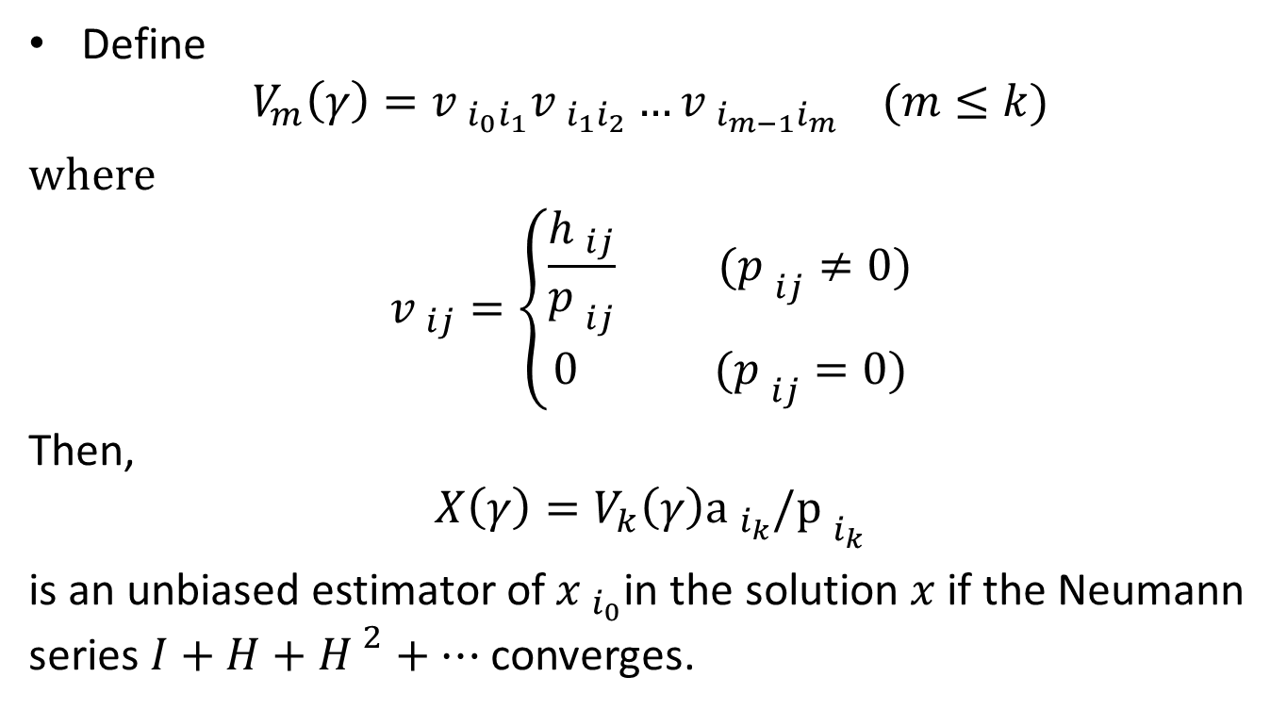
Monte Carlo Linear Solver
Define
$$V_{m}\left(γ\right)={v }_{i_{0}i_{1}}{v }_{i_{1}i_{2}}…{v }_{i_{m−1}i_{m}} (m≤k)$$
where
$${v }_{ij}=\left\{\begin{matrix}\frac{{h }_{ij}}{{p }_{ij}} ({p }_{ij}≠0) \\ 0 ({p }_{ij}=0)\end{matrix}\right.$$
Then,
$$X\left(γ\right)=V_{k}\left(γ\right){\text{a} }_{i_{k}}/{\text{p} }_{i_{k}}$$
is an unbiased estimator of ${x }_{i_{0}}$in the solution $x$ if the Neumann series $I+H+{H }^{2}+…$ converges.

Slide 9
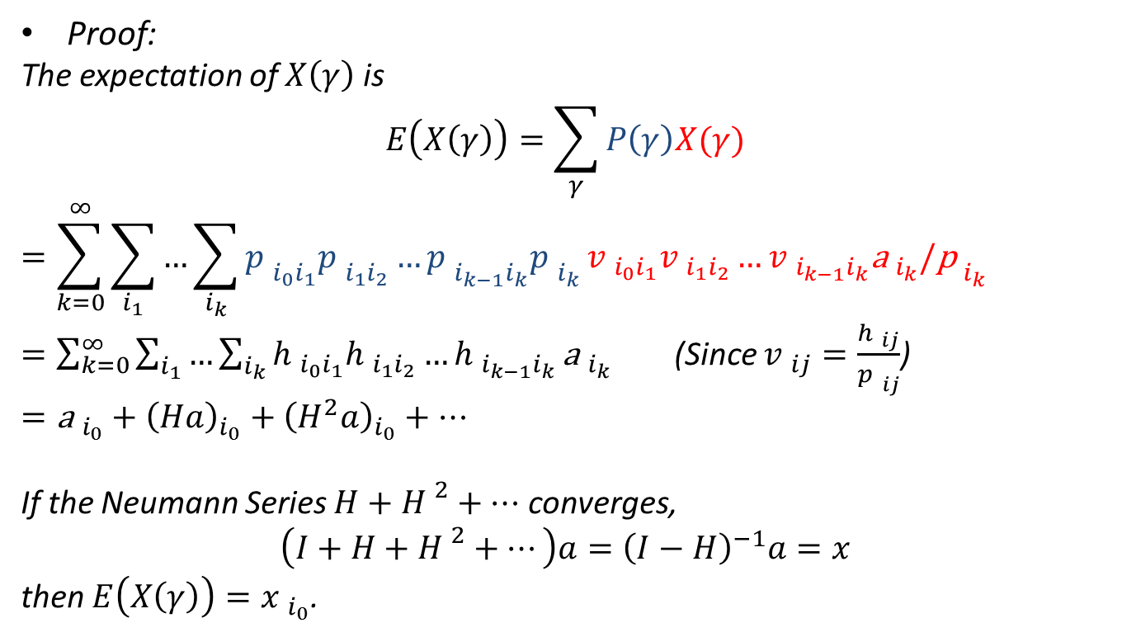
Monte Carlo Linear Solver
Proof:
The expectation of $X\left(γ\right)$ is
$$E\left(X\left(γ\right)\right)=\sum_{γ}{P\left(γ\right)X(γ)}$$
$$=\sum_{k=0}^{∞}{\sum_{i_{1}}{…\sum_{i_{k}}{{p }_{i_{0}i_{1}}{p }_{i_{1}i_{2}}…{p }_{i_{k−1}i_{k}}{p }_{i_{k}}}}}{v }_{i_{0}i_{1}}{v }_{i_{1}i_{2}}…{v }_{i_{k−1}i_{k}}{\text{a} }_{i_{k}}/{\text{p} }_{i_{k}}$$
$=\sum_{k=0}^{∞}{\sum_{i_{1}}{…\sum_{i_{k}}{{h }_{i_{0}i_{1}}{h }_{i_{1}i_{2}}…{h }_{i_{k−1}i_{k}}}}}{\text{a} }_{i_{k}}$ (Since ${v }_{ij}=\frac{{h }_{ij}}{{p }_{ij}}$)
$={\text{a} }_{i_{0}}+{\left(Ha\right)}_{i_{0}}+{\left(H^{2}a\right)}_{i_{0}}+…$
If the Neumann Series $H+{H }^{2}+…$ converges,
$$\left(I+H+{H }^{2}+…\right)a={\left(I−H\right)}^{−1}a=x$$
then $E\left(X\left(γ\right)\right)={x }_{i_{0}}$.

Slide 10
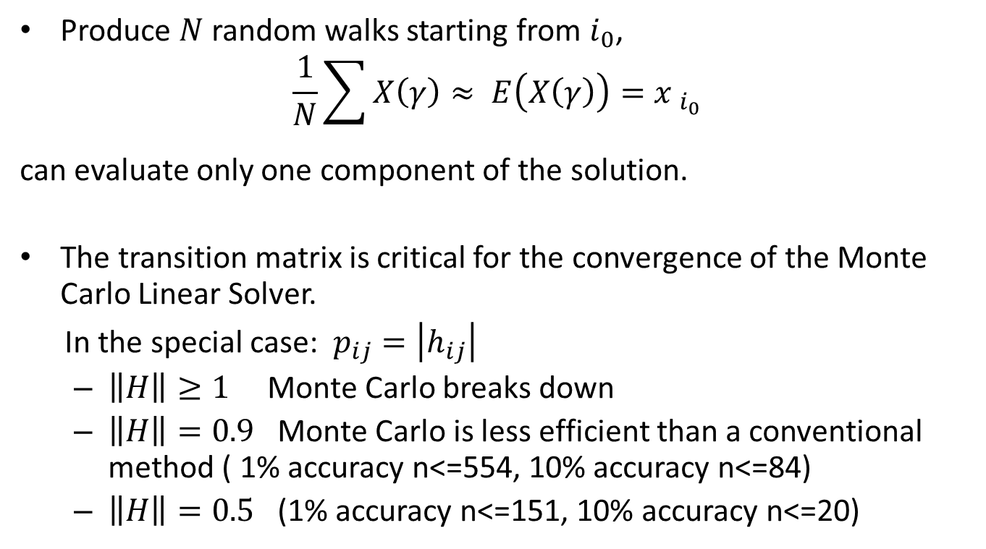
Monte Carlo Linear Solver
Produce $N$ random walks starting from $i_{0}$,
$$\frac{1}{N}\sum{X\left(γ\right)}≈ E\left(X\left(γ\right)\right)={x }_{i_{0}}$$
can evaluate only one component of the solution.
The transition matrix is critical for the convergence of the Monte Carlo Linear Solver.
In the special case: $p_{ij}=\left|h_{ij}\right|$
  $\left\|H\right\|≥1$ Monte Carlo breaks down
  $\left\|H\right\|=0.9$ Monte Carlo is less efficient than a conventional method ( 1% accuracy n<=554, 10% accuracy n<=84)
  $\left\|H\right\|=0.5$ (1% accuracy n<=151, 10% accuracy n<=20)

Slide 11
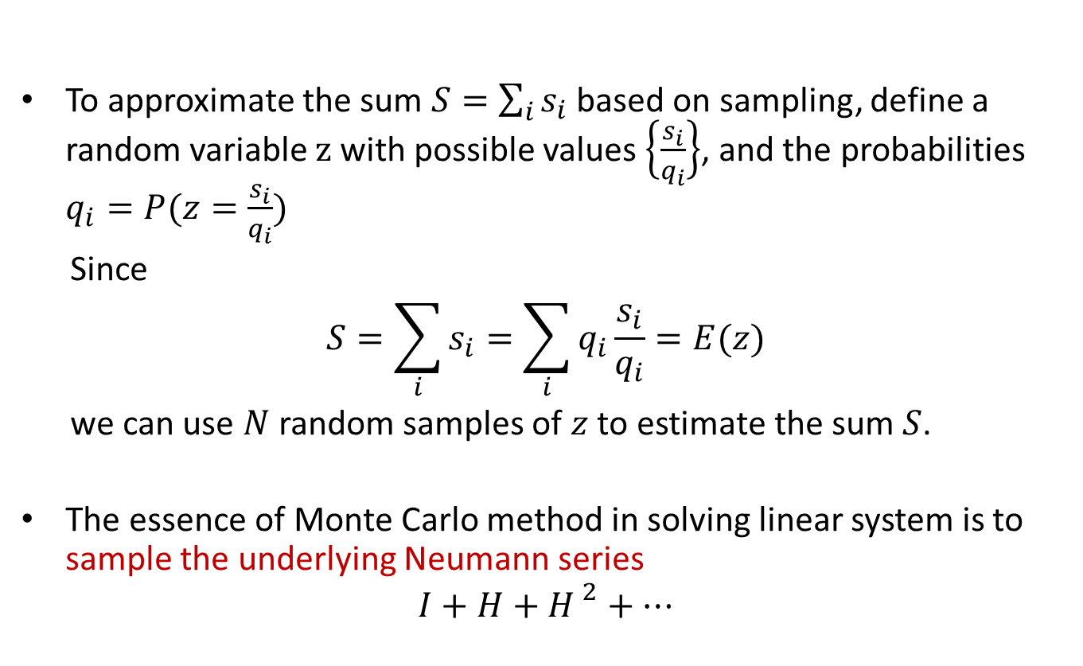
Monte Carlo Linear Solver
To approximate the sum $S=\sum_{i}{s_{i}}$ based on sampling, define a random variable $z$ with possible values $\left\{\frac{s_{i}}{q_{i}}\right\}$, and the probabilities $q_{i}=P(z=\frac{s_{i}}{q_{i}})$
Since
$$S=\sum_{i}{s_{i}}=\sum_{i}{q_{i}\frac{s_{i}}{q_{i}}}=E(z)$$
we can use $N$ random samples of $z$ to estimate the sum $S$.
The essence of Monte Carlo method in solving linear system is to sample the underlying Neumann series
$$I+H+{H }^{2}+…$$

Slide 12
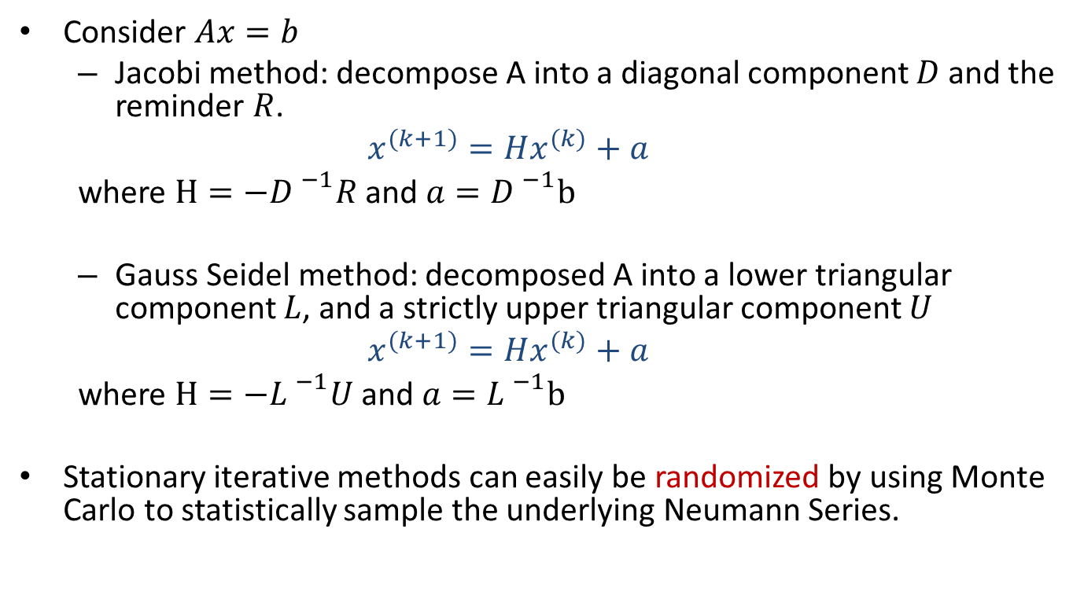
Randomize Stationary iterative methods
Consider $Ax=b$
  Jacobi method: decompose A into a diagonal component $D$ and the reminder $R$.
  $$x^{(k+1)}=Hx^{(k)}+a$$
  where $H=−{D }^{−1}R$ and $a={D }^{−1}b$
  Gauss Seidel method: decomposed A into a lower triangular component $L$, and a strictly upper triangular component $U$
  $$x^{(k+1)}=Hx^{(k)}+a$$
  where $H=−{L }^{−1}U$ and $a={L }^{−1}b$
Stationary iterative methods can easily be randomized by using Monte Carlo to statistically sample the underlying Neumann Series.

Slide 13
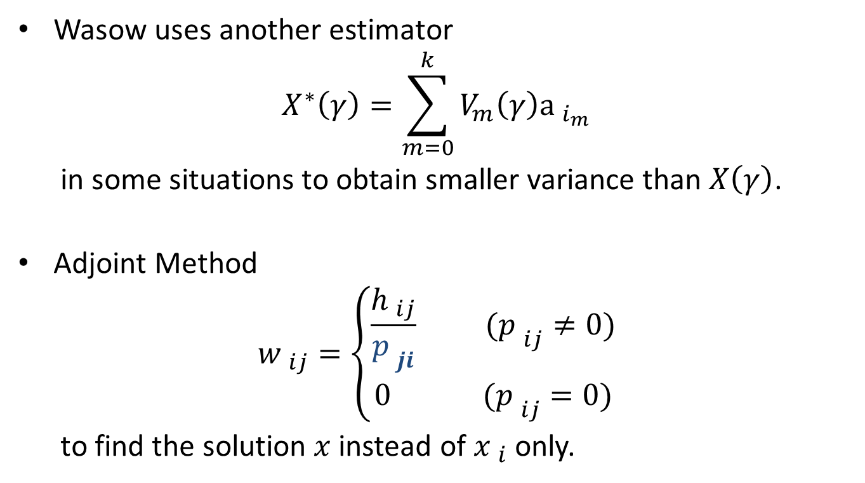
Variations of Monte Carlo Linear Solver
Wasow uses another estimator
$$X^{∗}\left(γ\right)=\sum_{m=0}^{k}{V_{m}\left(γ\right){\text{a} }_{i_{m}}}$$
in some situations to obtain smaller variance than $X\left(γ\right)$.
Adjoint Method
$${w }_{ij}=\left\{\begin{matrix}\frac{{h }_{ij}}{{p }_{ji}} ({p }_{ij}≠0) \\ 0 ({p }_{ij}=0)\end{matrix}\right.$$
to find the solution $x$ instead of ${x }_{i}$ only.

Slide 14
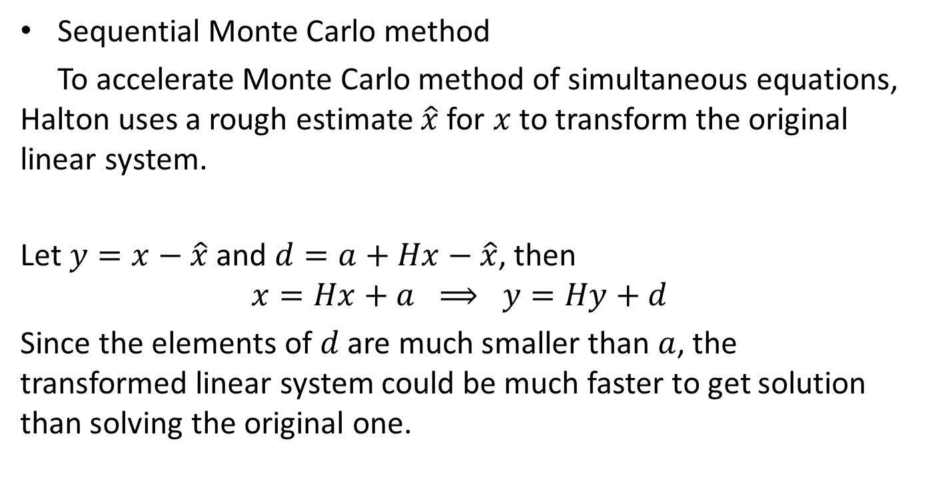
  Variations of Monte Carlo Linear Solver
Sequential Monte Carlo method
To accelerate Monte Carlo method of simultaneous equations, Halton uses a rough estimate $\hat{x}$ for $x$ to transform the original linear system.
Let $y=x−\hat{x}$ and $d=a+Hx−\hat{x}$, then
$$x=Hx+a ⟹ y=Hy+d$$
Since the elements of $d$ are much smaller than $a$, the transformed linear system could be much faster to get solution than solving the original one.

Slide 15
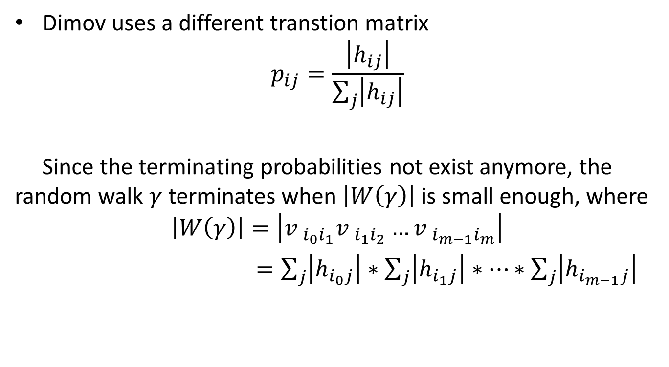
  Variations of Monte Carlo Linear Solver
Dimov uses a different transtion matrix
$$p_{ij}=\frac{\left|h_{ij}\right|}{\sum_{j}{\left|h_{ij}\right|}}$$
Since the terminating probabilities not exist anymore, the random walk $γ$ terminates when $\left|W\left(γ\right)\right|$ is small enough, where
$$\left|W\left(γ\right)\right|=\left|{v }_{i_{0}i_{1}}{v }_{i_{1}i_{2}}…{v }_{i_{m−1}i_{m}}\right|$$
$=\sum_{j}{\left|h_{i_{0}j}\right|}∗\sum_{j}{\left|h_{i_{1}j}\right|}∗…∗\sum_{j}{\left|h_{i_{m−1}j}\right|}$

Slide 16
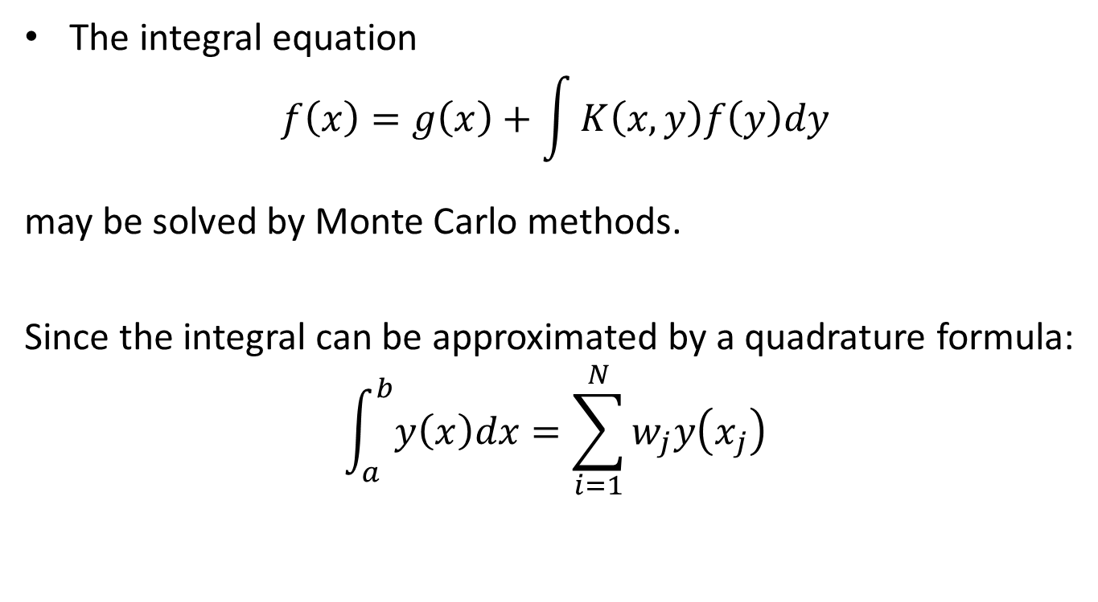
  Fredholm integral equations of the second kind
The integral equation
$$f\left(x\right)=g\left(x\right)+\int{K\left(x,y\right)f\left(y\right)dy}$$
may be solved by Monte Carlo methods.
Since the integral can be approximated by a quadrature formula:
$$\int_{a}^{b}{y\left(x\right)dx}=\sum_{i=1}^{N}{w_{j}y\left(x_{j}\right)}$$

Slide 17
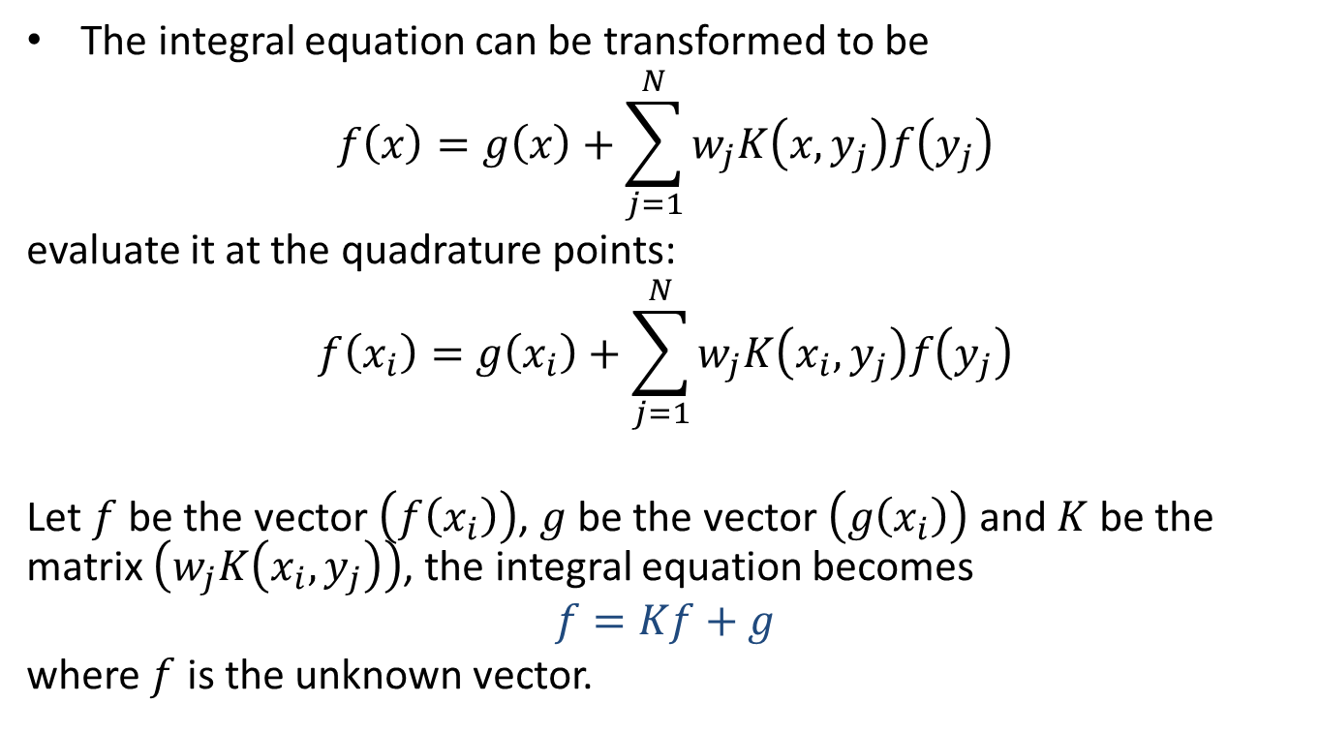
  Fredholm integral equations of the second kind
The integral equation can be transformed to be
$$f\left(x\right)=g\left(x\right)+\sum_{j=1}^{N}{w_{j}K\left(x,y_{j}\right)f\left(y_{j}\right)}$$
evaluate it at the quadrature points:
$$f\left(x_{i}\right)=g\left(x_{i}\right)+\sum_{j=1}^{N}{w_{j}K\left(x_{i},y_{j}\right)f\left(y_{j}\right)}$$
Let $f$ be the vector $\left(f\left(x_{i}\right)\right)$, $g$ be the vector $\left(g\left(x_{i}\right)\right)$ and $K$ be the matrix $\left(w_{j}K\left(x_{i},y_{j}\right)\right)$, the integral equation becomes
$$f=Kf+g$$
where $f$ is the unknown vector.

Slide 18
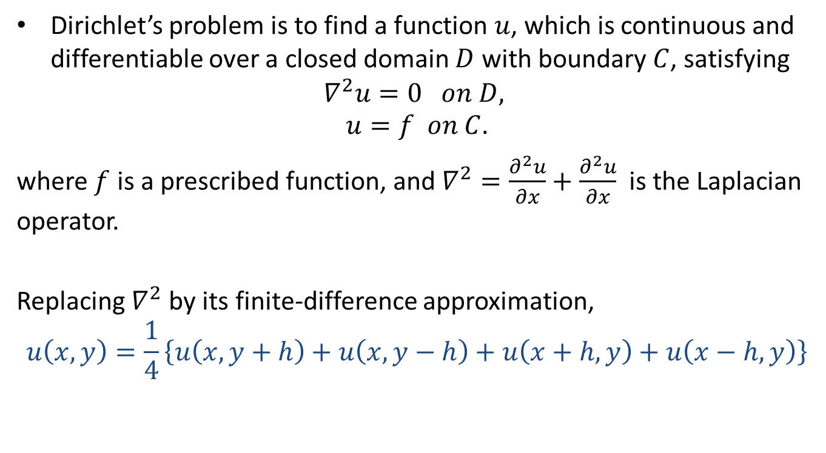
  The Dirichlet Problem
Dirichlet’s problem is to find a function $u$, which is continuous and differentiable over a closed domain $D$ with boundary $C$, satisfying
$$∇^{2}u=0 on D,$$
$$u=f on C.$$
where $f$ is a prescribed function, and $∇^{2}=\frac{∂^{2}u}{∂x}+\frac{∂^{2}u}{∂x}$ is the Laplacian operator.
Replacing $∇^{2}$ by its finite-difference approximation,
$$u\left(x,y\right)=\frac{1}{4}\left\{u\left(x,y+h\right)+u\left(x,y−h\right)+u\left(x+h,y\right)+u\left(x−h,y\right)\right\}$$

Slide 19
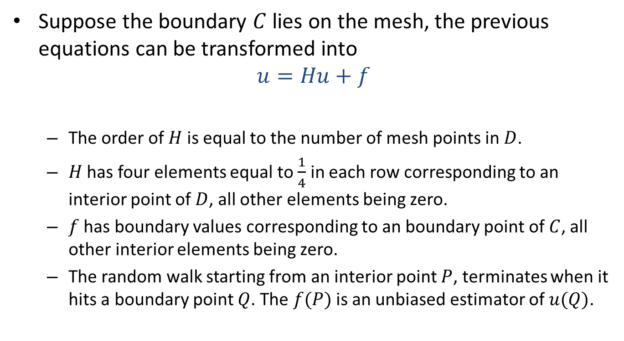
The Dirichlet Problem
Suppose the boundary $C$ lies on the mesh, the previous equations can be transformed into
$$u=Hu+f$$
  The order of $H$ is equal to the number of mesh points in $D$.
  $H$ has four elements equal to $\frac{1}{4}$ in each row corresponding to an interior point of $D$, all other elements being zero.
  $f$ has boundary values corresponding to an boundary point of $C$, all other interior elements being zero.
  The random walk starting from an interior point $P$, terminates when it hits a boundary point $Q$. The $f(P)$is an unbiased estimator of $u(Q)$.

Slide 20
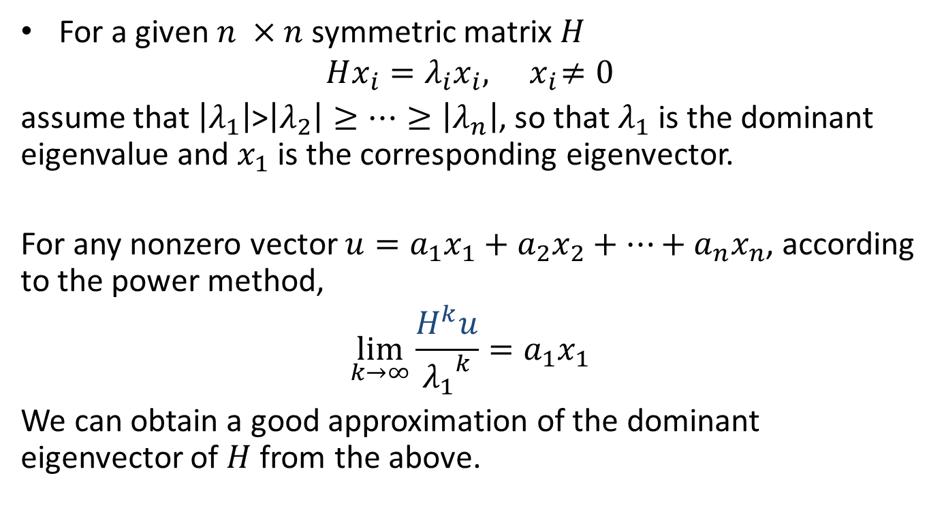
Eigenvalue Problems
For a given $n ×n$symmetric matrix $H$
$$Hx_{i}=λ_{i}x_{i},{ x}_{i}≠0$$
assume that $\left|λ_{1}\right|$>$\left|λ_{2}\right|≥…≥\left|λ_{n}\right|$, so that $λ_{1}$ is the dominant eigenvalue and $x_{1}$ is the corresponding eigenvector.
For any nonzero vector $u=a_{1}x_{1}+a_{2}x_{2}+…+a_{n}x_{n}$, according to the power method,
$$\lim_{k→∞}{\frac{H^{k}u}{{λ_{1}}^{k}}}=a_{1}x_{1}$$
We can obtain a good approximation of the dominant eigenvector of $H$ from the above.

Slide 21
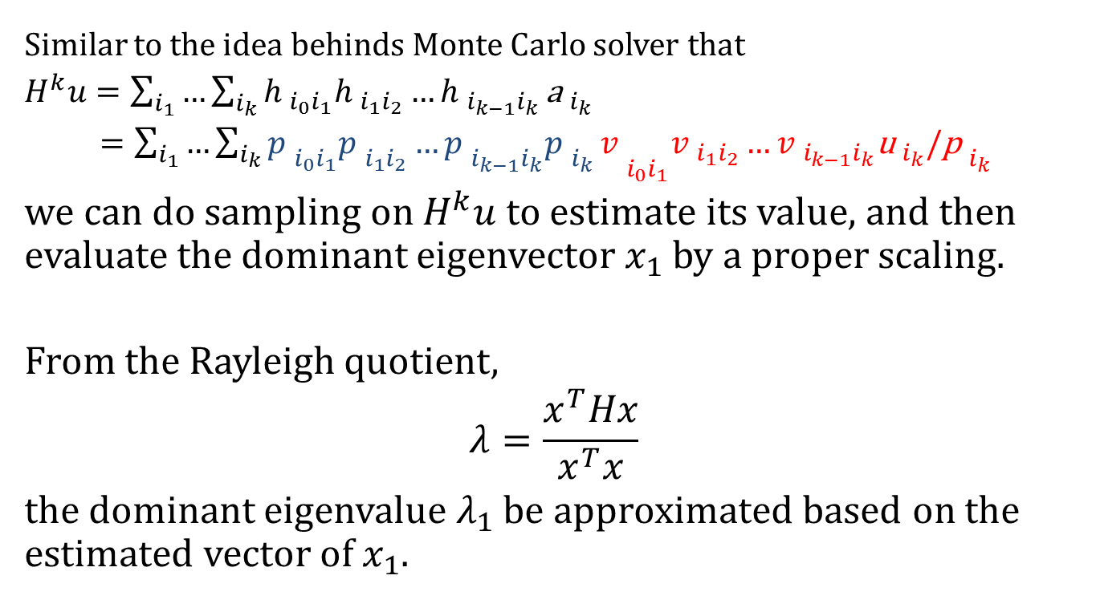
Eigenvalue Problems
Similar to the idea behinds Monte Carlo solver that
$H^{k}u=\sum_{i_{1}}{…\sum_{i_{k}}{{h }_{i_{0}i_{1}}{h }_{i_{1}i_{2}}…{h }_{i_{k−1}i_{k}}}}{\text{a} }_{i_{k}}$
$={\sum_{i_{1}}{…\sum_{i_{k}}{{p }_{i_{0}i_{1}}{p }_{i_{1}i_{2}}…{p }_{i_{k−1}i_{k}}{p }_{i_{k}}}}v }_{i_{0}i_{1}}{v }_{i_{1}i_{2}}…{v }_{i_{k−1}i_{k}}{\text{u} }_{i_{k}}/{\text{p} }_{i_{k}}$
we can do sampling on $H^{k}u$to estimate its value, and then evaluate the dominant eigenvector $x_{1}$ by a proper scaling.
From the Rayleigh quotient,
$$λ=\frac{x^{T}Hx}{x^{T}x}$$
the dominant eigenvalue $λ_{1}$ be approximated based on the estimated vector of $x_{1}$.

Slide 22
Summary
This Class
  Monte Carlo Linear Solver
    von Neumann and Ulam method
    Randomize Stationary iterative methods
    Variations of Monte Carlo solver
  Fredholm integral equations of the second kind
  The Dirichlet Problem
  Eigenvalue Problems

Slide 23
What I want you to do?
Review Slides
Work on Assignment 4

