Slide 1
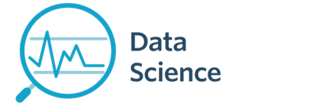
Lecture 4- Data Wrangling
CS 620 / DASC 600
Introduction to Data Science & Analytics
Dr. Sampath Jayarathna
Old Dominion University

Slide 2
Exploring Your Data
Working with data is both an art and a science. We’ve mostly been talking about the science part, getting your feet wet with Python tools for Data Science. Lets look at some of the art now.
After you’ve identified the questions you’re trying to answer and have gotten your hands on some data, you might be tempted to dive in and immediately start building models and getting answers. But you should resist this urge. Your first step should be to explore your data.

Slide 3
Exploring Your Data

Slide 4
Data Wrangling
The process of transforming “raw” data into data that can be analyzed to generate valid actionable insights
Data Wrangling : aka
  Data preprocessing
  Data preparation
  Data Cleansing
  Data Scrubbing
  Data Munging
  Data Transformation
  Data Fold, Spindle, Mutilate……

Slide 5
Data Wrangling Steps
Iterative process of
  Obtain
  Understand
  Explore
  Transform
  Augment
  Visualize

Slide 6
Data Wrangling Steps

Slide 7
Data Wrangling Steps

Slide 8
Exploring Your Data
The simplest case is when you have a one-dimensional data set, which is just a collection of numbers. For example,
  daily average number of minutes each user spends on your site,
  the number of times each of a collection of data science tutorial videos was watched,
  the number of pages of each of the data science books in your data science library.
An obvious first step is to compute a few summary statistics.
  You’d like to know how many data points you have, the smallest, the largest, the mean, and the standard deviation.
  But even these don’t necessarily give you a great understanding.

Slide 9
Summary statistics of a single data set
Information (numbers) that give a quick and simple description of the data
  Maximum value
  Minimum value
  Range (dispersion): max – min
  Mean
  Median
  Mode
  Quantile
  Standard deviation
  Etc.
0 quartile = 0 quantile = 0 percentile
1 quartile = 0.25 quantile = 25 percentile
2 quartile = .5 quantile = 50 percentile (median)
3 quartile = .75 quantile = 75 percentile
4 quartile = 1 quantile = 100 percentile

Slide 10

Mean vs average vs median vs mode
(Arithmetic) Mean: the “average” value of the data
Average: can be ambiguous
  The average household income in this community is $60,000
    The average (mean) income for households in this community is $60,000
    The income for an average household in this community is $60,000
    What if most households are earning below $30,000 but one household is earning $1M
Median: the “middlest” value, or mean of the two middle values
  Can be obtained by sorting the data first
  Does not depend on all values in the data.
  More robust to outliers
Mode: the most-common value in the data
def mean(a): return sum(a) / float(len(a))
def mean(a): return reduce(lambda x, y: x+y, a) / float(len(a))
  Quantile: a generalization of median.
  E.g. 75 percentile is the value which 75% of values are less than or equal to

Slide 11

Variance and standard deviation
Describes the spread of the data from the mean
  Is the mean squared of the deviation
Standard deviation (square root of the variance): σ
  Easier to understand than variance
  Has the same unit as the measurement
  Say the data measures height of people in inch, the unit of σ is also inch. The unit for σ² is square inch …

Slide 12
CDC BRFSS Dataset
The Behavioral Risk Factor Surveillance System (BRFSS) is the nation's premier system of health-related telephone surveys that collect state data about U.S. residents regarding their health-related risk behaviors, chronic health conditions, and use of preventive services.
  https://www.cs.odu.edu/~sampath/courses/f19/cs620/files/data/brfss.csv

Slide 13
Activity 8
Download the brfss.csv file and load it to your python module.
  https://www.cs.odu.edu/~sampath/courses/f19/cs620/files/data/brfss.csv
Display the content and observe the data
Create a function cleanBRFSSFrame() to clean the dataset
  Drop the sex from the dataframe
  Drop the rows of NaN values (every single NaN)
Use describe() method to display the count, mean, std, min, and quantile data for column weight2.
Find the median (median()) and mode (mode()) of the age
Notes:
Obj = pd.read_csv(‘values.csv’)

Slide 14
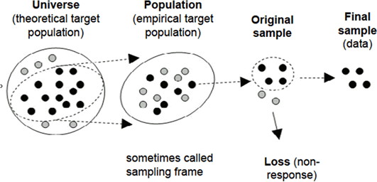
Population vs sample
Sampling is a process used in statistical analysis in which a predetermined number of observations are taken from a larger population
Notes:
Random, stratified, systematic, cluster (natural)

Slide 15
Population vs sample
Population: all members of a group in a study
  The average height of men
  The average height of living male ≥ 18yr in USA between 2001 and 2010
  The average height of all male students ≥ 18yr registered in Fall’17
Sample: a subset of the members in the population
  Most studies choose to sample the population due to cost/time or other factors
  Each sample is only one of many possible subsets of the population
  May or may not be representative of the whole population
  Sample size and sampling procedure is important
df = pd.read_csv('brfss.csv')
print(df.sample(100)) # random sample of 100 values
Notes:
Random, stratified, systematic, cluster (natural)

Slide 16
Why do we sample?
Enables research/ surveys to be done more quickly/ timely
Less expensive and often more accurate than large CENSUS ( survey of the entire population)
Given limited research budgets and large population sizes, there is no alternative to sampling.
Sampling also allows for minimal damage or lost
Sample data can also be used to validate census data
  A survey of the entire universe (gives real estimate not sample estimate)
Notes:
Obj = pd.read_csv(‘values.csv’)

Slide 17
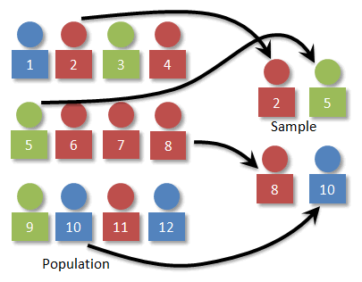
Simple Random Sampling
In Simple Random Sampling, each element of the larger population is assigned a unique ID number, and a table of random numbers or a lottery technique is used to select elements, one at a time, until the desired sample size is reached.
Simple random sampling is usually reserved for use with relatively small populations with an easy-to-use sampling frame ( very tedious when drawing large samples).
Bias is avoided because the person drawing the sample does not manipulate the lottery or random number table to select certain individuals.
Notes:
Obj = pd.read_csv(‘values.csv’)

Slide 18
Random Selection
Selects at random
With replacement
From any array
A specified number of times
np.random.choice
np.random.choice(some_array, sample size)
Example:
import numpy as np
d = np.arange(6) + 1
s = np.random.choice(d, 1000)
print(s)
Notes:
Random, stratified, systematic, cluster (natural)

Slide 19
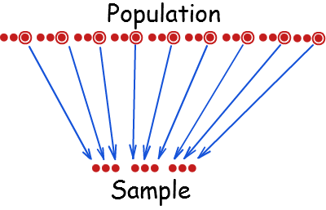
Systematic Sampling
Systematic sampling is a type of probability sampling method in which sample members from a larger population are selected according to a random starting point and a fixed periodic interval.
In this approach, the estimated number of elements in the larger population is divided by the desired sample size to yield a SAMPLNG INTERVAL. The sample is then drawn by listing the population in an arbitrary order and selecting every nth case, starting with a randomly selected.
This is less time consuming and easier to implement.
Systematic sampling is useful when the units in your sampling frame are not numbered or when the sampling frame consists of very long list.
Notes:
Obj = pd.read_csv(‘values.csv’)

Slide 20
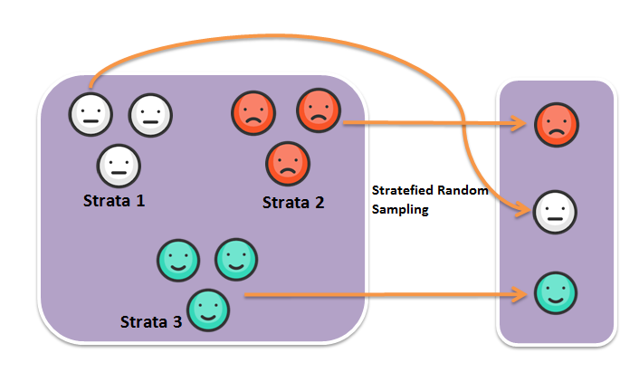
Stratified Sampling
Populations often consist of strata or groups that are different from each other and that consist of very different sizes.
Stratified Sampling ensures that all relevant strata of the population are represented in the sample.
Stratification treats each stratum as a separate population- arranging the sampling frame first in strata before either a simple random technique or a systematic approach is used to draw the sample.
Notes:
Obj = pd.read_csv(‘values.csv’)

Slide 21
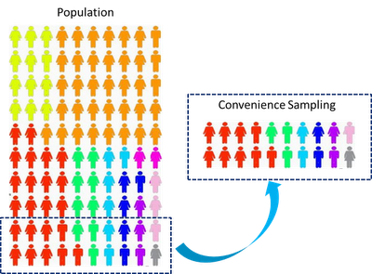
Convenience Sampling
Convenience sampling is where subjects are selected because of their convenient accessibility and proximity to the researcher.
Convenience Sampling involves the selection of samples from whatever cases/subjects or respondents that happens to be available at a given place or time.
Also known as Incidental/Accidental, Opportunity or Grab Sampling. Snow- ball Sampling is a special type of convenience sampling where individuals or persons that have agreed or showed up to be interviewed in the study serially recommend their acquaintances.
Notes:
Obj = pd.read_csv(‘values.csv’)

Slide 22
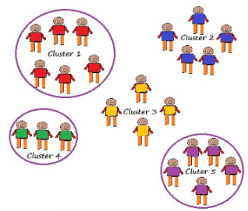
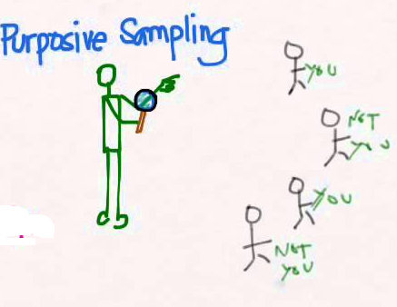
Other Sampling
In Cluster Sampling, samples are selected in two or more stages
Non-probability sampling involves a technique where samples are gathered in a process that does not give all the individuals in the population equal chances of being selected.
  Nonprobability sampling procedures are not valid for obtaining a sample that is truly representative of a larger population
Notes:
Obj = pd.read_csv(‘values.csv’)

Slide 23
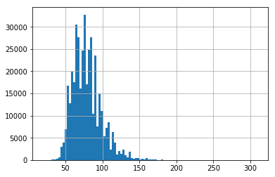
Exploring Your Data
Good next step is to create a histogram, in which you group your data into discrete buckets and count how many points fall into each bucket:
df = pd.read_csv('brfss.csv', index_col=0)
df['weight2'].hist(bins=100)
  A histogram is a plot that lets you discover, and show, the underlying frequency distribution (shape) of a set of continuous data. This allows the inspection of the data for its underlying distribution (e.g., normal distribution), outliers, skewness, etc.
Notes:
The major difference is that a histogram is only used to plot the frequency of score occurrences in a continuous data set that has been divided into classes, called bins. Bar charts, on the other hand, can be used for a great deal of other types of variables including ordinal and nominal data sets.

Slide 24
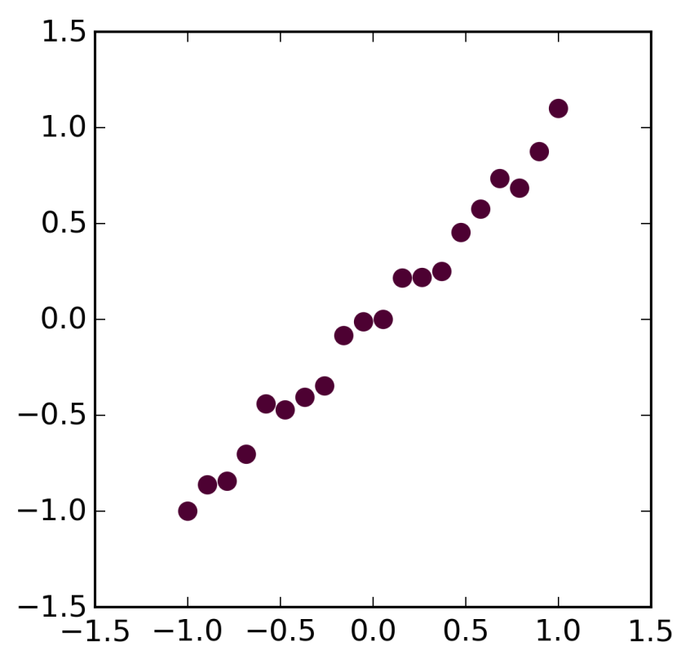
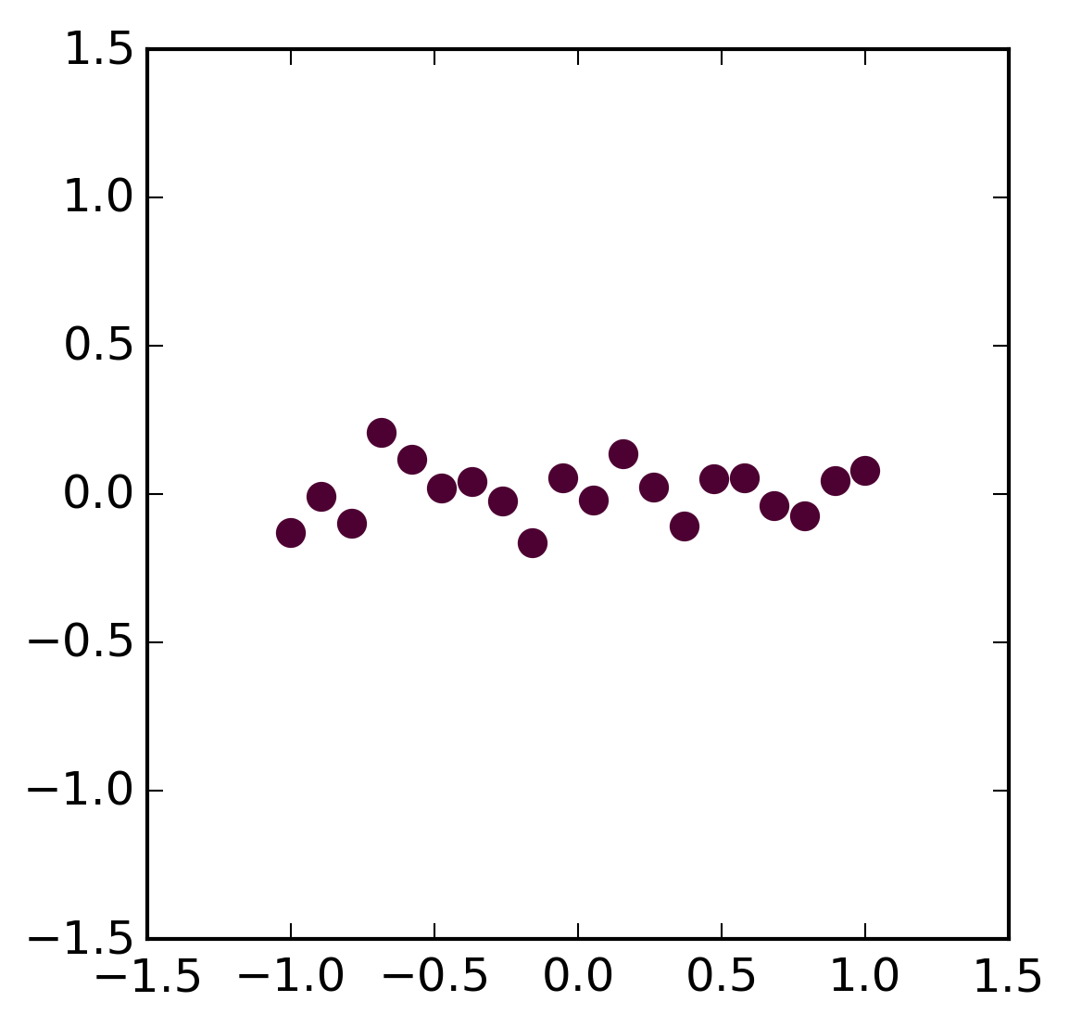
Regression vs Correlation
Regression – estimation of the relationship between variables
Linear regression
Assessing the assumptions
Non-linear regression
Correlation
Correlation coefficient quantifies the association strength
Sensitivity to the distribution
Relationship
No Relationship

Slide 25
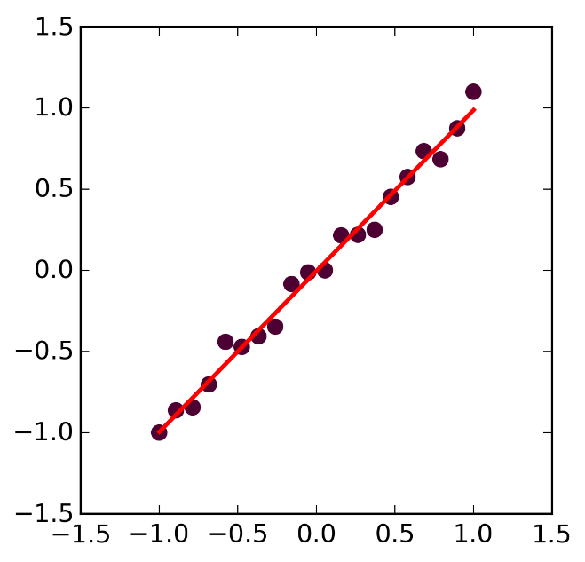
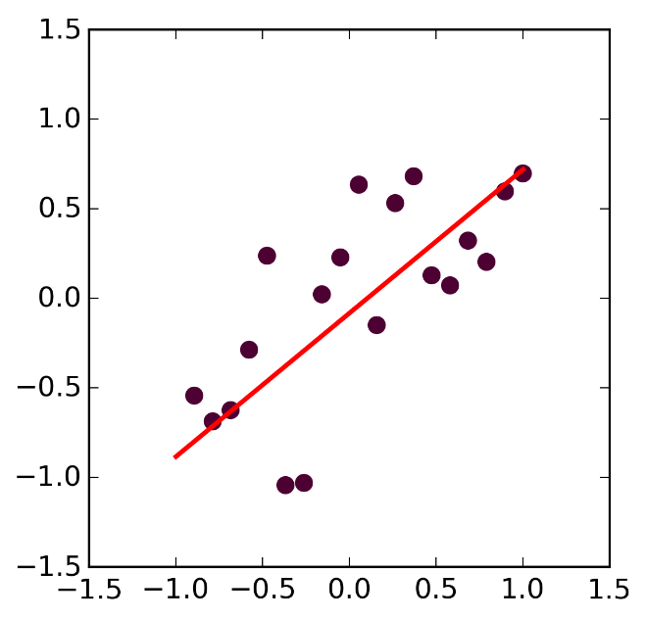
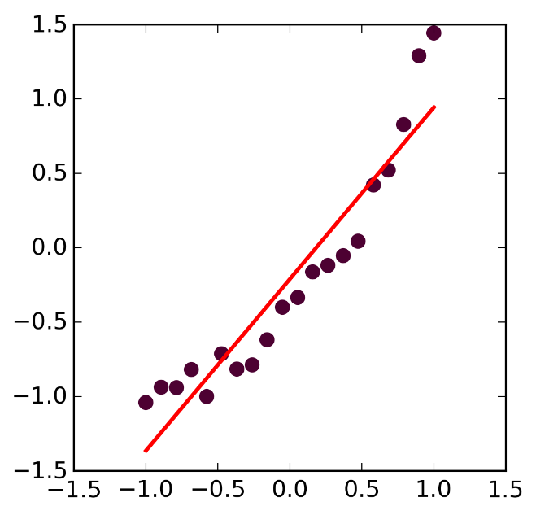
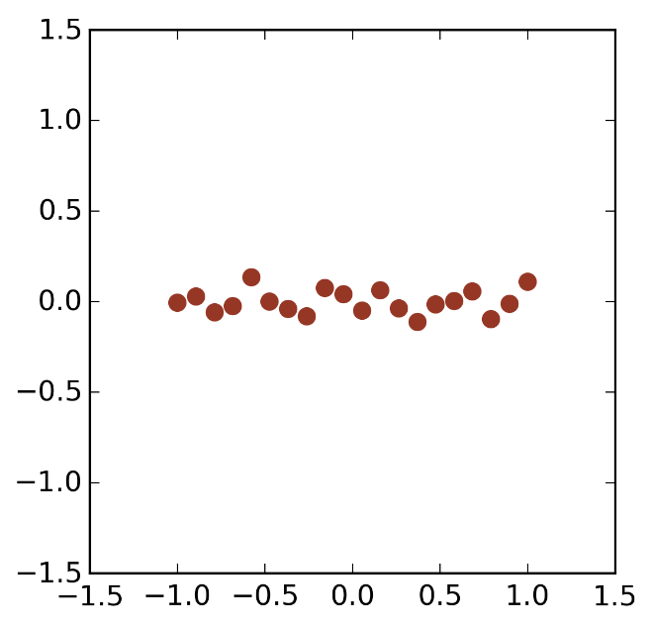
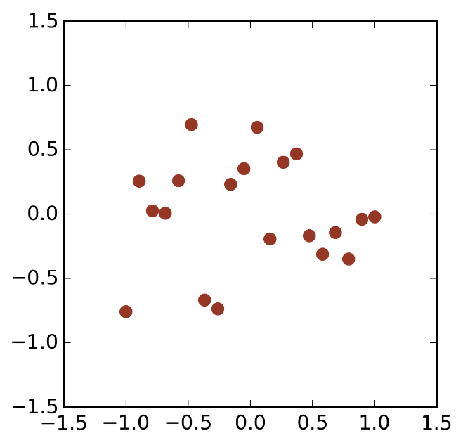
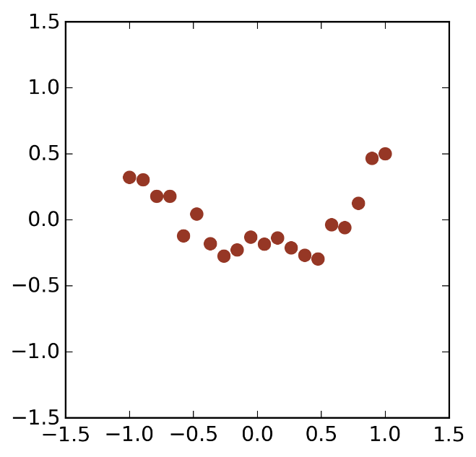
Relationship
Linear, Strong
Linear, Weak
Non-Linear
Residuals
Residuals
Residuals

Slide 26
Regression vs Correlation
Correlation quantifies the degree to which two variables are related.
  Correlation does not fit a line through the data points. You simply are computing a correlation coefficient (r) that tells you how much one variable tends to change when the other one does.
  When r is 0.0, there is no relationship. When r is positive, there is a trend that one variable goes up as the other one goes up. When r is negative, there is a trend that one variable goes up as the other one goes down.
Linear regression finds the best line that predicts Y from X.
  Correlation is almost always used when you measure both variables. It rarely is appropriate when one variable is something you experimentally manipulate.
  Linear regression is usually used when X is a variable you manipulate

Slide 27
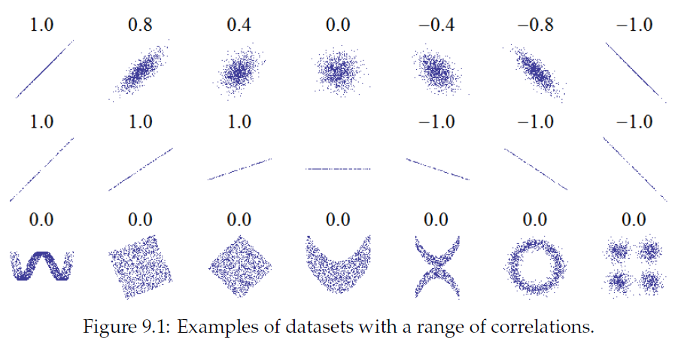
Correlation only measures linear relationship

Slide 28
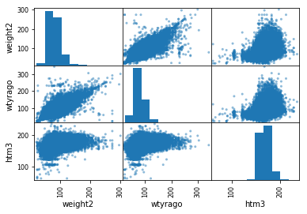
Feature Matrix
We can review the relationships between attributes by looking at the distribution of the interactions of each pair of attributes.
from pandas.tools.plotting import scatter_matrix
scatter_matrix(df[['weight2', 'wtyrago', 'htm3' ]])
  This is a powerful plot from which a lot of inspiration about the data can be drawn. For example, we can see a possible correlation between weight and weight year ago

Slide 29
Types of data
There are two basic types of data: numerical and categorical data.
Numerical data: data to which a number is assigned as a quantitative value.
age, weight, shoe size….
Categorical data: data defined by the classes or categories into which an individual member falls.
eye color, gender, blood type, ethnicity

Slide 30
Continuous or Non-continuous data
A continuous variable is one in which it can theoretically assume any value between the lowest and highest point on the scale on which it is being measured
  (e.g. weight, speed, price, time, height)
Non-continuous variables, also known as discrete variables, that can only take on a finite number of values
  Discrete data can be numeric -- like numbers of apples -- but it can also be categorical -- like red or blue, or male or female, or good or bad.

Slide 31
Qualitative vs. Quantitative Data
A qualitative data is one in which the “true” or naturally occurring levels or categories taken by that variable are not described as numbers but rather by verbal groupings
  Open ended answers
Quantitative data on the other hand are those in which the natural levels take on certain quantities (e.g. price, travel time)
That is, quantitative variables are measurable in some numerical unit (e.g. pesos, minutes, inches, etc.)
  Likert scales, semantic scales, yes/no, check box

Slide 32
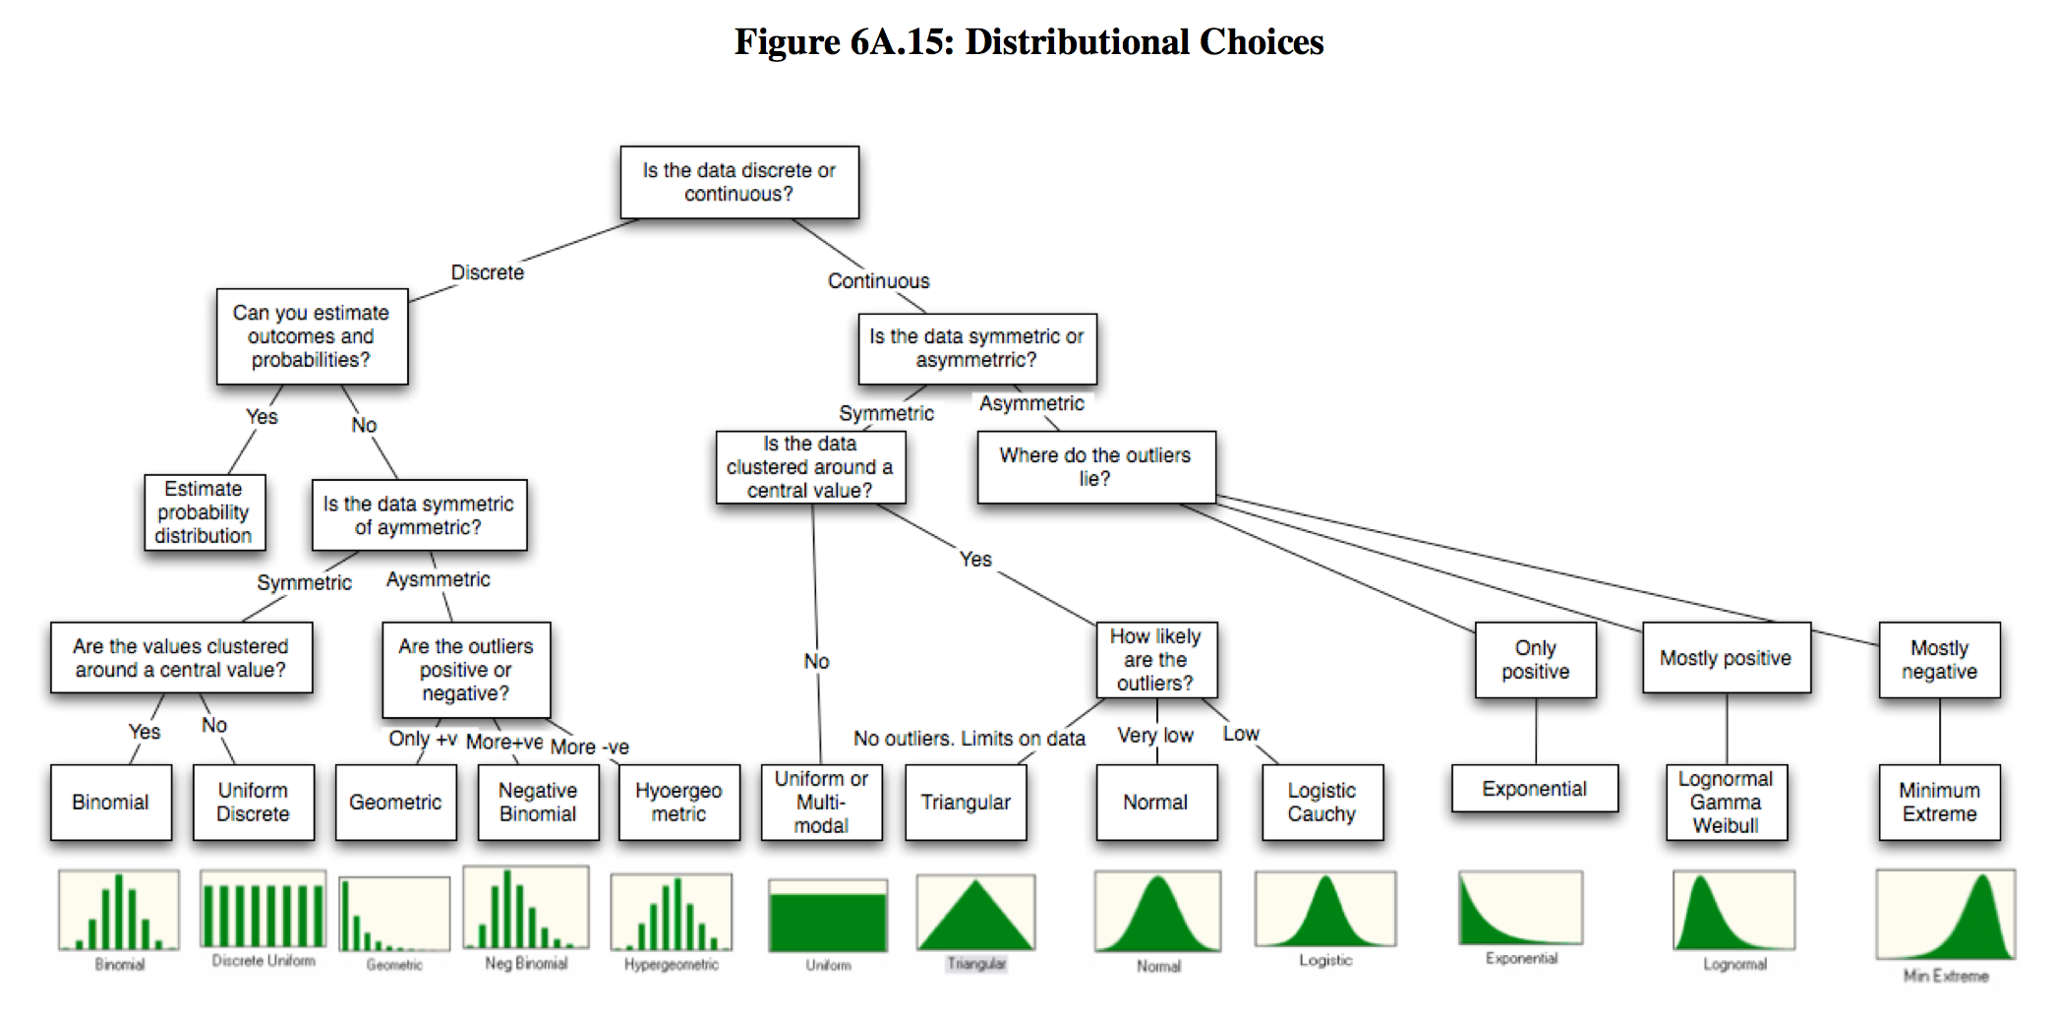
Data transformation
Transform data to obtain a certain distribution
  transform data so different columns became comparable / compatible
Typical transformation approach:
  Z-score transformation
  Scale to between 0 and 1
  mean normalization

Slide 33
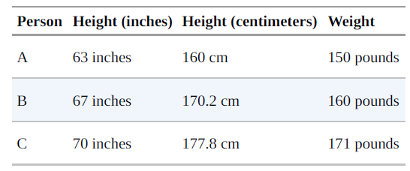
Rescaling
Many techniques are sensitive to the scale of your data. For example, imagine that you have a data set consisting of the heights and weights of hundreds of data scientists, and that you are trying to identify clusters of body sizes.
data = {"height_inch":{'A':63, 'B':67, 'C':70},
"height_cm":{'A':160, 'B':170.2, 'C':177.8},
"weight":{'A':150, 'B':160, 'C':171}}
df2 = DataFrame(data)
print(df2)

Slide 34
Why normalization (re-scaling)
height_inch height_cm weight
A 63 160.0 150
B 67 170.2 160
C 70 177.8 171
from scipy.spatial import distance
a = df2.iloc[0, [0,2]]
b = df2.iloc[1, [0,2]]
c = df2.iloc[2, [0,2]]
print("%.2f" % distance.euclidean(a,b)) #10.77
print("%.2f" % distance.euclidean(a,c)) # 22.14
print("%.2f" % distance.euclidean(b,c)) #11.40

Slide 35
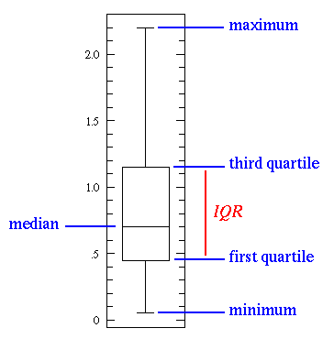
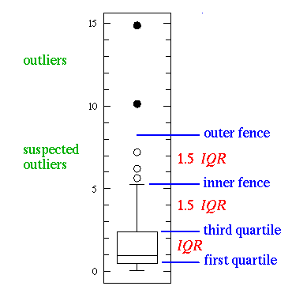
Boxplot
The box plot (a.k.a. box and whisker diagram) is a standardized way of displaying the distribution of data based on the five number summary: minimum, first quartile, median, third quartile, and maximum. In the simplest box plot the central rectangle spans the first quartile to the third quartile (the interquartile range or IQR). A segment inside the rectangle shows the median and "whiskers" above and below the box show the locations of the minimum and maximum.
Notes:
1st quartile − 1.5 IQR and 3rd quartile + 1.5IQR

Slide 36
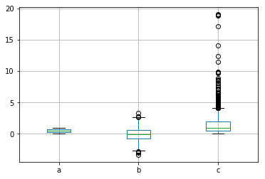
Boxplot example
df=DataFrame({'a': np.random.rand(1000),
'b': np.random.randn(1000),'c': np.random.lognormal(size=(1000))})
print(df.head())
df.boxplot()
a b c
0 0.316825 -1.418293 2.090594
1 0.451174 0.901202 0.735789
2 0.208511 -0.710432 1.409085
3 0.254617 -0.637264 2.398320
4 0.256281 -0.564593 1.821763
Notes:
numpy.random.randn generates samples from the normal distribution, while numpy.random.rand from unifrom (in range [0,1])

Slide 37
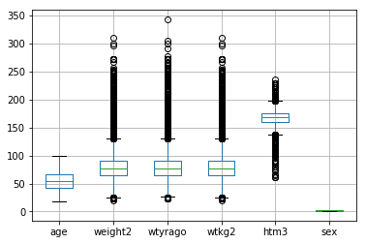
Boxplot example 2
df2 = pd.read_csv('brfss.csv', index_col=0)
df2.boxplot()

Slide 38
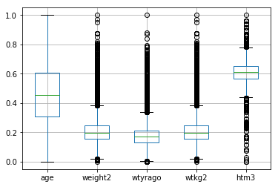
Activity 9
Use the brfss.csv file and load it to your python module.
  https://www.cs.odu.edu/~sampath/courses/f19/cs620/files/data/brfss.csv
Use the min-max algorithm to re-scale the data. Remember to drop the column ‘sex’ from the dataframe before the rescaling. (Activity 8)
  (series – series.min())/(series.max() – series.min())
Create a boxplot (DataFrame.boxplot()) of the dataset.
Notes:
Obj = pd.read_csv(‘values.csv’)

Slide 39
Z-score transformation
Z scores, or standard scores, indicate how many standard deviations an observation is above or below the mean. These scores are a useful way of putting data from different sources onto the same scale.
The z-score linearly transforms the data in such a way, that the mean value of the transformed data equals 0 while their standard deviation equals 1. The transformed values themselves do not lie in a particular interval like [0,1] or so.
Z score: Z = (x - sample mean)/sample standard deviation.

Slide 40
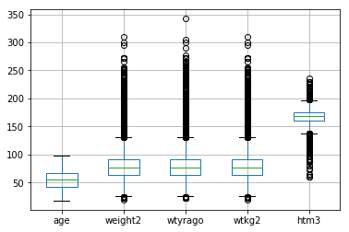
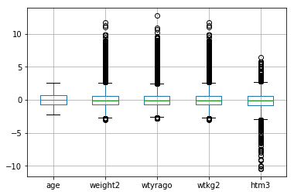
Z-score transformation
def zscore(series):
return (series - series.mean(skipna=True)) / series.std(skipna=True);
df3 = df2.apply(zscore)
df3.boxplot()
df4.boxplot()
Notes:
Suppose you weigh an apple and it weighs 110 grams. There’s no way to tell from the weight alone how this apple compares to other apples. However, as you’ll see, after you calculate its Z-score, you know where it falls relative to other apples. Standardization are a great way to understand where a specific observation falls relative to the entire distribution. They also allow you to take observations drawn from normally distributed populations that have different means and standard deviations and place them on a standard scale. This standard scale enables you to compare observations that would otherwise be difficult.

Slide 41
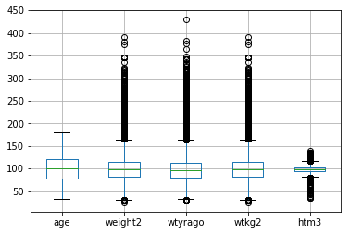
Mean-based scaling
def meanScaling(series):
return series / series.mean()
df8 = df4.apply(meanScaling) * 100
df8.boxplot()

