Slide 1
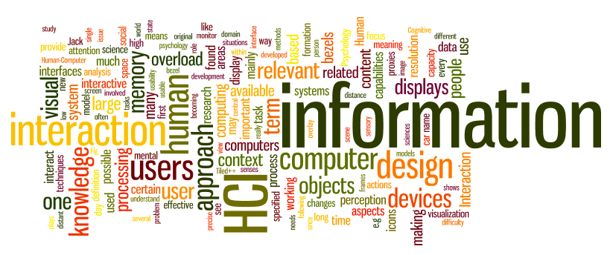
CS 795/895
Human Computer Interaction (HCI)
Dr. Sampath Jayarathna
Old Dominion University
Credit for some of the slides in this lecture goes to https://hcibook.com/

Slide 2
What is human-computer interaction (HCI)?
HCI is the study and the practice of usability.
It is about understanding and creating software and other technology that people will want to use, will be able to use, and will find effective when used.
HCI is the study of how people use computer systems to perform certain tasks
HCI tries to provide us with all understanding of the computer and the person using it, so as to make the interaction between them more effective and more enjoyable.

Slide 3
Humans, Computer and Interaction
The H | Humans good at: Sensing low level stimuli, pattern recognition,inductive reasoning, multiple strategies, adapting “Hard and fuzzy things”.
The C | Computers good at: Counting and measuring, accurate storage and recall, rapid and consistent responses, data processing/calculation, repetitive actions, performance over time, “Simple and sharply defined things”.
The I | The list of skills is somewhat complementary. Let humans do what humans do best and computers do what computers do best.

Slide 4
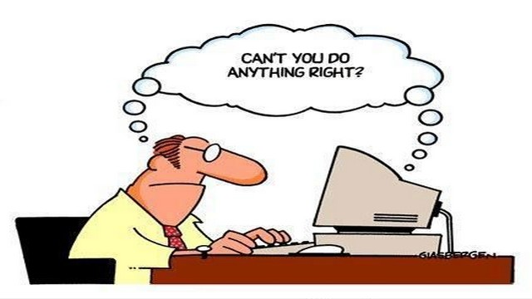
Interacting with computers
to understand human–computer interaction … need to understand computers!
what goes in and out devices, paper, sensors, etc.
what can it do? memory, processing, networks

Slide 5
Motivation: Why Care About People?
Human - computer interaction (HCI)
The study of the ways that people use computers
Practice of making computers easier for people to use
Is that possible?
Yes
It happens when people who design computers and software keep in mind that they are designing for other people

Slide 6
Different design Needs
Three broad categories of computer user:
Expert users with detailed knowledge of that particular system.
Occasional users who know well how to perform the tasks they need to perform frequently.
Novices who have never used the system before.
Users may well be novices at one computer application but experts at another one, so users will belong to different categories for particular computer systems.

Slide 7
Activity 1
Conduct a small experiment on human reaction time using https://www.humanbenchmark.com/tests/reactiontime
Write down each persons reaction time. You can try several times.
Submit to Piazza thread with the teams member names and their reaction time.

Slide 8
How many …
computers in your house?
hands up, … … none, 1, 2 , 3, more!!
computers in your pockets?
are you thinking …
… PC, laptop, PDA ??

Slide 9
How many computers …
in your house?
PC
TV, VCR, DVD, HiFi, cable/satellite TV
microwave, cooker, washing machine
central heating
security system
can you think of more?
in your pockets?
PDA
phone, camera
smart card, card with magnetic strip?
electronic car key
USB memory
try your pockets and bags

Slide 10
Interactivity?
Long ago in a galaxy far away … batch processing
punched card stacks or large data files prepared
long wait ….
line printer output
… and if it is not right …
Now most computing is interactive
rapid feedback
the user in control (most of the time)
doing rather than thinking …
Is faster always better?

Slide 11
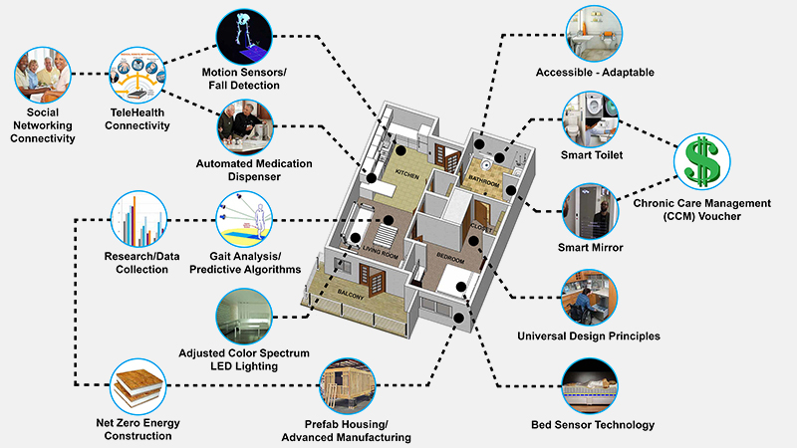
Richer interaction

Slide 12
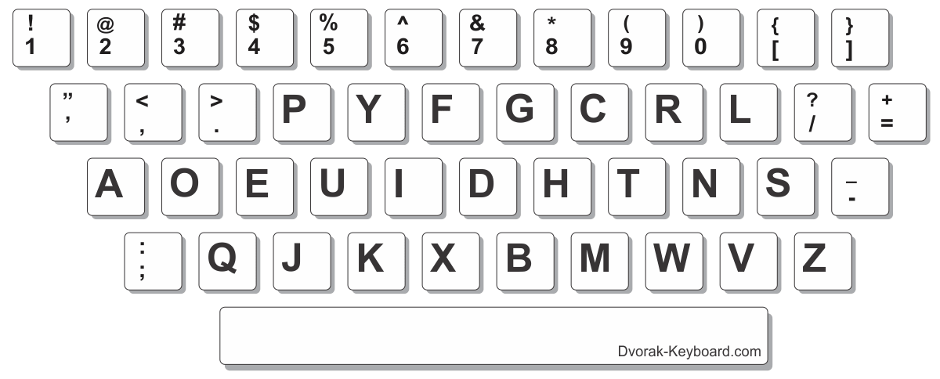
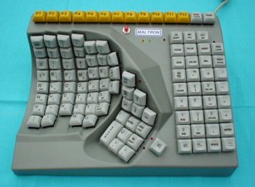
alternative keyboard layouts
Alphabetic
keys arranged in alphabetic order
not faster for trained typists
not faster for beginners either!
Dvorak
common letters under dominant fingers
biased towards right hand
common combinations of letters alternate between hands
10-15% improvement in speed and reduction in fatigue
But - large social base of QWERTY typists produce market pressures not to change
Special keyboards
designs to reduce fatigue for RSI
for one handed use
e.g. the Maltron left-handed keyboard

Slide 13
Handwriting recognition
Text can be input into the computer, using a pen and a digesting tablet
natural interaction
Technical problems:
capturing all useful information - stroke path, pressure, etc. in a natural manner
segmenting joined up writing into individual letters
interpreting individual letters
coping with different styles of handwriting
Used in PDAs, and tablet computers … … leave the keyboard on the desk!

Slide 14
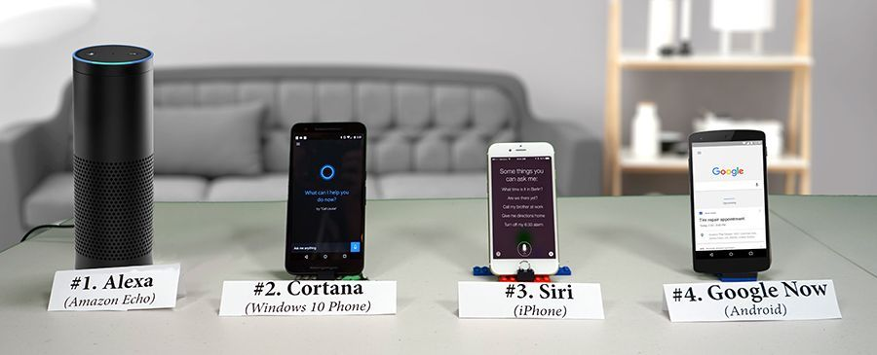
Speech recognition
Improving rapidly, Alexa, Google Asst., Siri
Most successful when:
single user – initial training and learns peculiarities
limited vocabulary systems
Problems with
external noise interfering
imprecision of pronunciation
large vocabularies
different speakers

Slide 15
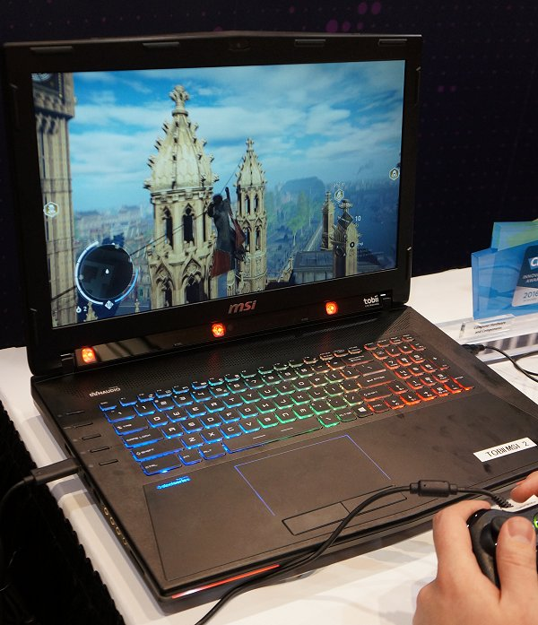
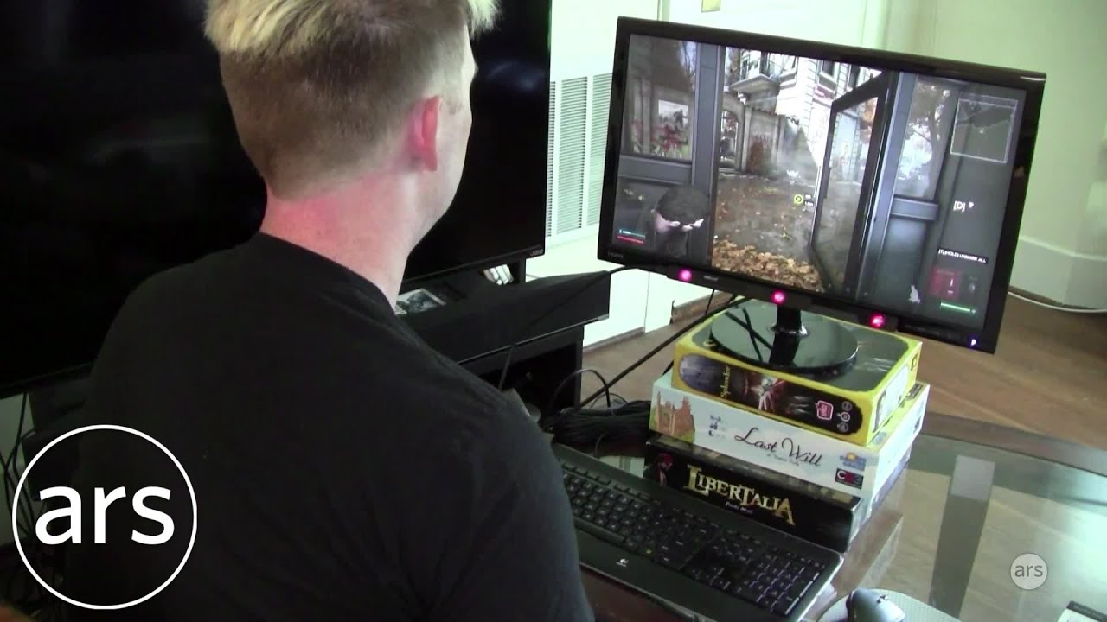
Eye Tracking
control interface by eye gaze direction
e.g. look at a menu item to select it
uses IR beam reflected off retina
mainly used for evaluation
potential for hands-free control
cheaper and lower accuracy devices available sit under the screen like a small webcam

Slide 16
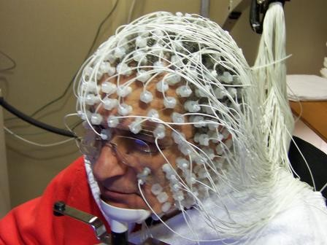
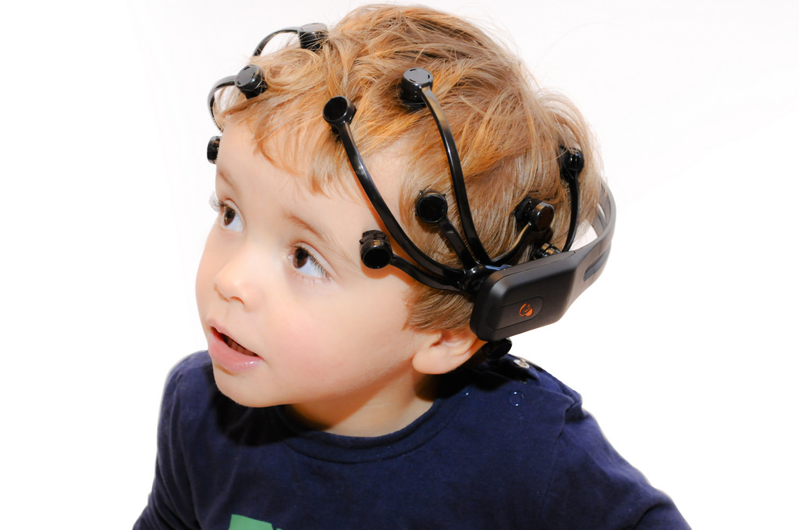
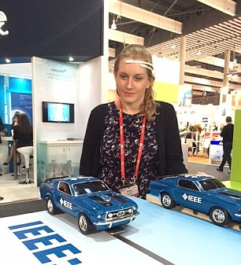
Brain Tracking
Emotive Epoc 14 Channel EEG
Designed for gaming,
consumer biofeedback
Wireless, portable
Affordable
$300 basic headset, Emotiv Insight
$750 research, Emotiv epoc+
$2000 research, Emotiv Flex
Notes:
EEG measures voltage fluctuations resulting from ionic current within the neurons of the brain. An event-related potential (ERP) is the measured brain response that is the direct result of a specific sensory, cognitive, or motor event.
Diagnostic applications generally focus either on event-related potentials or on the spectral content of EEG. The former investigates potential fluctuations time locked to an event like stimulus onset or button press. The latter analyses the type of neural oscillations (popularly called "brain waves") that can be observed in EEG signals in the frequency domain.
The traditional theory of EDA holds that skin resistance varies with the state of sweat glands in the skin. Sweating is controlled by the sympathetic nervous system,^{[4]}and skin conductance is an indication of psychological or physiological arousal. If the sympathetic branch of the autonomic nervous system is highly aroused, then sweat gland activity also increases, which in turn increases skin conductance. In this way, skin conductance can be a measure of emotional and sympathetic responses

Slide 17
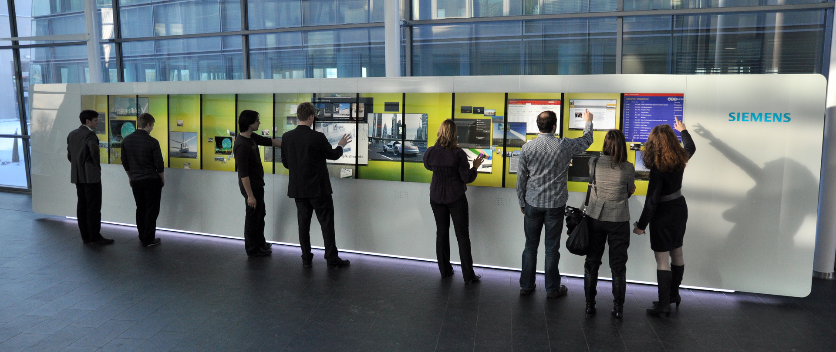
Situated Displays
displays in ‘public’ places
large or small
very public or for small group
display only
for information relevant to location
or interactive
use stylus, touch sensitive screen
in all cases … the location matters
meaning of information or interaction is related to the location

Slide 18
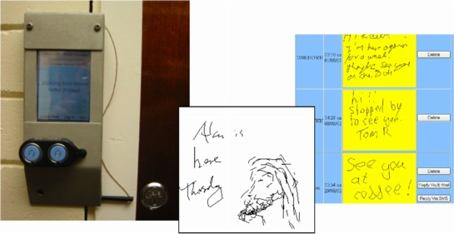
Hermes a situated display
small displays beside office doors
handwritten notes left using stylus
office owner reads notes using web interface
small displays beside office doors
handwritten
notes left using stylus
office owner reads notes using web interface

Slide 19
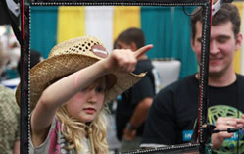
Positioning in 3D Space
cockpit and virtual controls
steering wheels, knobs and dials … just like real!
the 3D mouse
six-degrees of movement: x, y, z + roll, pitch, yaw
data glove
fibre optics used to detect finger position
VR helmets
detect head motion and possibly eye gaze
whole body tracking
accelerometers strapped to limbs or reflective dots and video processing

Slide 20
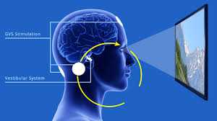
VR Motion Sickness
Refresh rate disagreement (brain vs display)
time delay
move head … lag … display moves
conflict: head movement vs. eyes
depth perception
headset gives different stereo distance
but all focused in same plane
conflict: eye angle vs. focus
Eye vs ear, when sitting still
conflicting cues => sickness
helps motivate improvements in technology

Slide 21
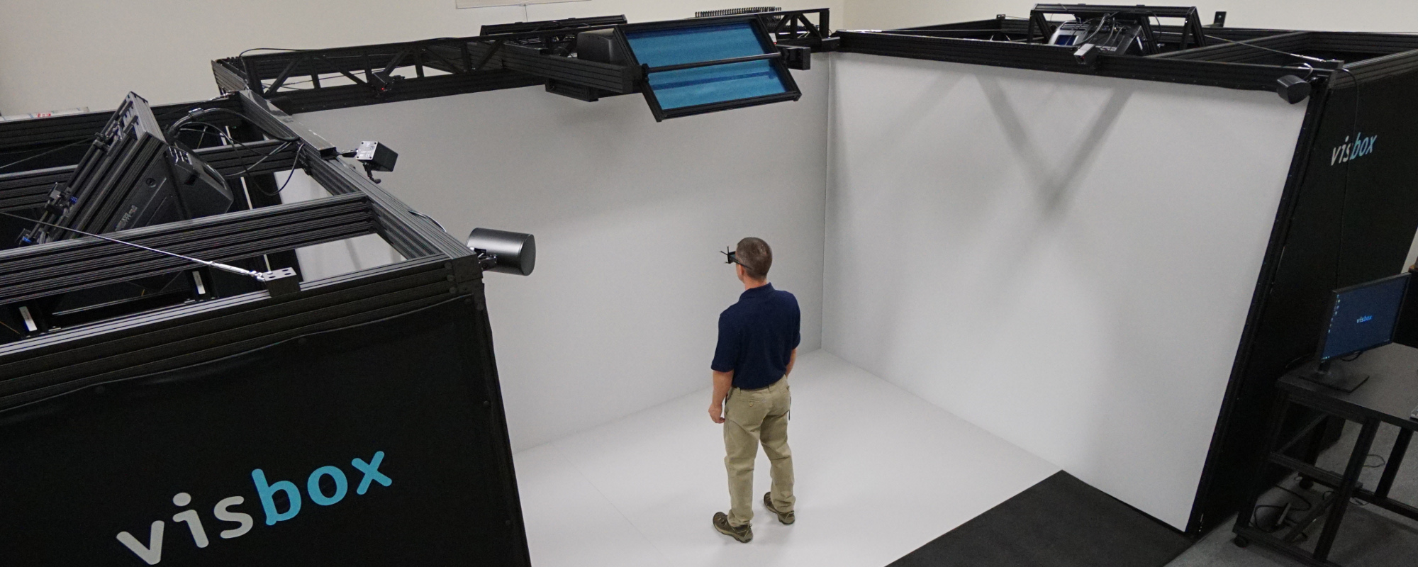
Simulators and VR caves
scenes projected on walls
realistic environment
hydraulic rams!
real controls
other people
http://viewpure.com/hQLF06rwzVE?start=0&end=0

Slide 22
Sounds
beeps, bongs, clonks, whistles and whirrs
used for error indications
confirmation of actions e.g. keyclick

Slide 23
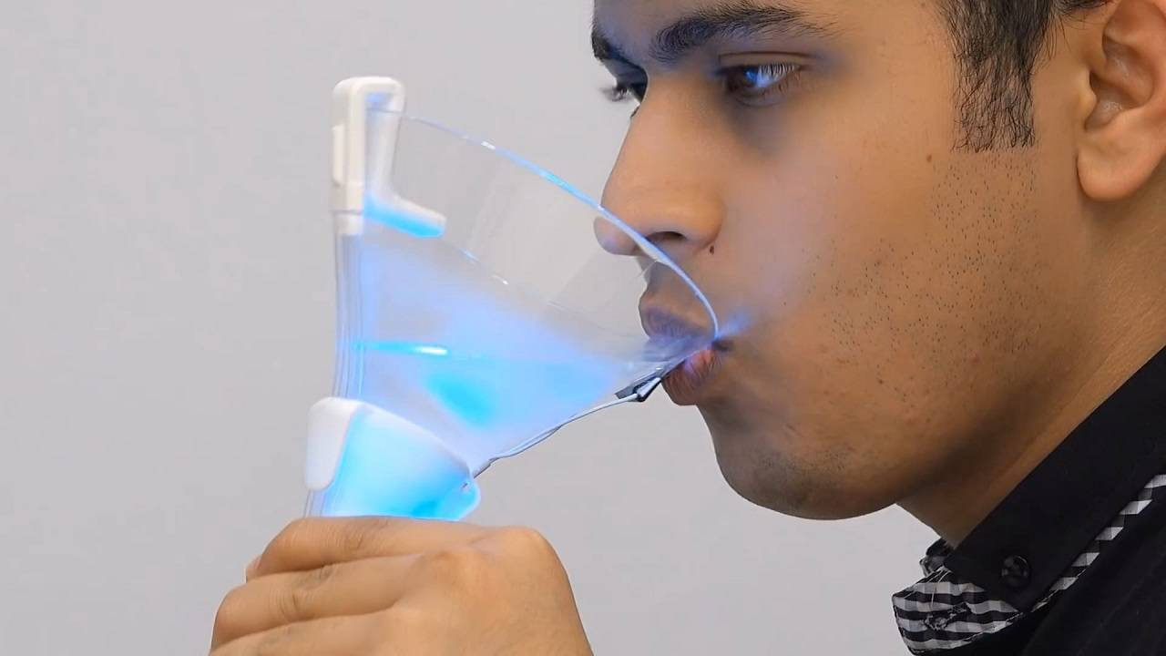
Touch, feel, smell
touch and feeling important
in games … vibration, force feedback
in simulation … feel of surgical instruments
called haptic devices
texture, smell, taste
current technology very limited
Virtual Cocktail

Slide 24
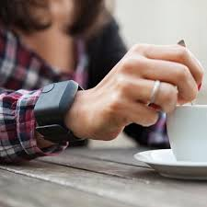
Environment and bio-sensing
sensors all around us
car courtesy light – small switch on door
ultrasound detectors – security, washbasins
RFID security tags in shops
temperature, weight, location
… and even our own bodies …
iris scanners, body temperature, heart rate, galvanic skin response, blink rate

Slide 25
Finite processing speed
Designers tend to assume fast processors, and make interfaces more and more complicated
But problems occur, because processing cannot keep up with all the tasks it needs to do
cursor overshooting because system has buffered keypresses
icon wars - user clicks on icon, nothing happens, clicks on another, then system responds and windows fly everywhere
Also problems if system is too fast - e.g. help screens may scroll through text much too rapidly to be read

Slide 26
Moore’s law
computers get faster and faster!
1965 …
Gordon Moore, co-founder of Intel, noticed a pattern
processor speed doubles every 18 months
PC … 1987: 1.5 Mhz, 2002: 1.5 GHz
similar pattern for memory
but doubles every 12 months!!
hard disk … 1991: 20Mbyte : 2002: 30 Gbyte
Beyond Moore's Law?
TLOP Project (Towards Low Power ICT), single-electron and single-atom transistors, which designs are not that different from those used in today's microprocessors.

Slide 27
The myth of the infinitely fast machine
implicit assumption … no delays an infinitely fast machine
what is good design for real machines?
good example … the telephone :
type keys too fast
hear tones as numbers sent down the line
emulate in design

Slide 28
Limitations on interactive performance
Computation bound
Computation takes ages, causing frustration for the user
Storage channel bound
Bottleneck in transference of data from disk to memory
Graphics bound
Common bottleneck: updating displays requires a lot of effort - sometimes helped by adding a graphics co-processor optimised to take on the burden
Network capacity
Many computers networked - shared resources and files, access to printers etc. - but interactive performance can be reduced by slow network speed

