Slide 1
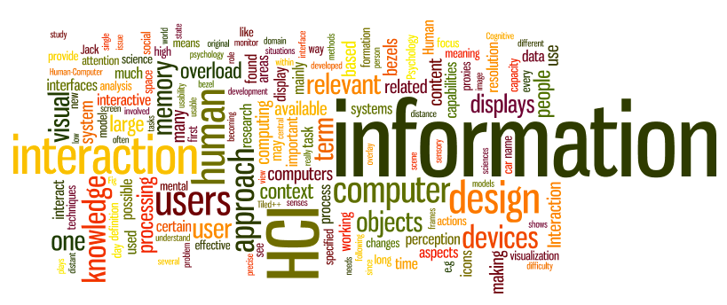
Lecture 1- Introduction
CS 795/895
Human Computer Interaction (HCI)
Dr. Sampath Jayarathna
Old Dominion University

Slide 2
Today
Who I am
CS 795/895 educational objectives (and why)
Overview of the course, and logistics

Slide 3
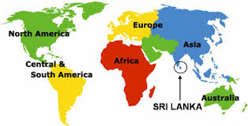
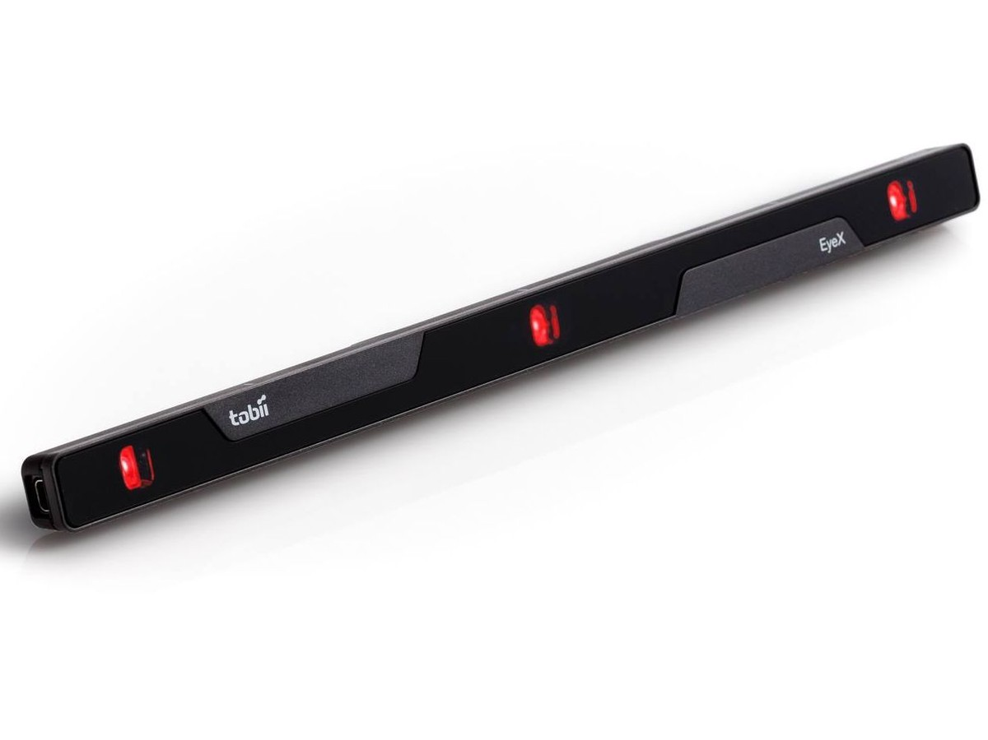
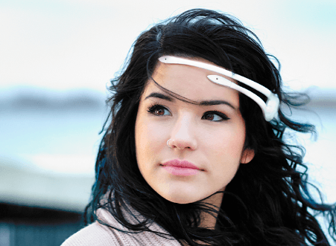
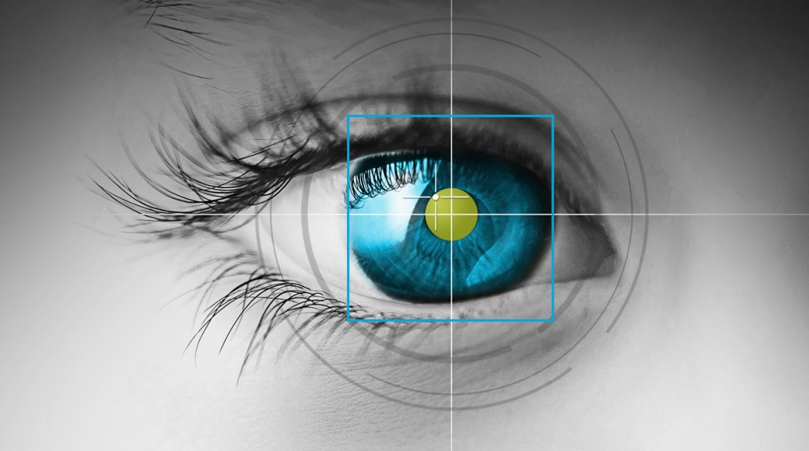
Who am I?
Instructor : Sampath Jayarathna
Joined ODU Fall 2018 (Assistant Professor Cal Poly 2016-2018)
Originally from Sri Lanka
Research : Eye tracking, Brain EEG, neuro-IR, Machine Learning
Web : http://www.cs.odu.edu/~sampath/
Contact : E&CS 3109, sampath@cs.odu.edu, (757) 683-7787
Office Hours : T(online)/Th 3pm – 4pm, or email me for an appointment
[Open Door Policy]

Slide 4
Course Information
Schedule : Tuesday and Thursday, Time: 4.20 PM – 7.00 PM http://www.cs.odu.edu/~sampath/courses/s19/cs795/
https://piazza.com/odu/spring2019/cs795/home
https://www.blackboard.odu.edu/
Prereqs
  There are no specific course prerequisites for this course. But, I expect you to be comfortable learning new programming languages/tools/APIs.
Format
  Before lecture: do reading slides
  In lecture: put reading in context
  After lecture: assignments, projects for hands-on practice

Slide 5
Student Learning Outcomes
After successfully completing this course, students should be able to:
Explain characteristics of good and bad interaction design and use them to evaluate human computer interactions
Explain characteristics of users that influence human computer interaction and use them inform interface development
Explain, analyze and develop interaction evaluations including qualitative and quantitative methods.
Explain and develop requirements for interaction design
Constructs interactions using evaluation-based iterative process for directing the design of user interfaces

Slide 6

Communication
Piazza:
  All questions will be fielded through Piazza.
  Many questions everyone can see the answer
  You can also post private messages that can only be seen by the instructor
Blackboard:
  Blackboard will be used primarily for assignments/homework submission, and grade dissemination.
Email:
  Again, email should only be used in rare instances, I will probably point you back to Piazza

Slide 7

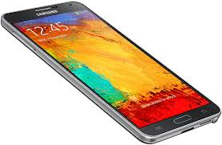
The Rules

Slide 8
Cooperate on Learning
Except for the work you hand in as individual contributions, I strongly encourage you to collaborate and help each other
If in doubt if a collaboration is legitimate: ask!
    Don’t claim to have written code that you copied from others or online
    Don’t give anyone else your code (to hand in for a grade)
    When you rely on the work of others, explicitly list all of your sources – i.e. give credit to those who did the work
Don’t study alone when you don’t have to
    Form study groups
    Do help each other (without plagiarizing)

Slide 9
Course Organization
Grading
Required Materials
  No textbook is required. All the key course content will be documented in slides, which will be available in the course website after each lecture.
  List of optional but recommended materials. You may find some of these optional textbooks helpful, though none are required:
    Interaction Design: Beyond Human-Computer Interaction, 4th Edition, Jenny Preece, Helen Sharp, Yvonne Rogers, Wiley, 2015
    The Design of Everyday Things, Revised and Expanded Edition, Donald Norman, Perseus, 2013.
  Bring Your Own Device (BYOD).

Slide 10
Course Organization
Project: More in the next couple of slides…
Final Exam: The final exam is comprehensive, closed books and will be held on Tuesday, April 23 from 5.00 pm to 7.00 PM
Homework: We will have 6 homework assignments, each worth 5% of your overall grade. Homework 1 – Jan 22, 11.55pm
In-class Activities/Participation
  ungraded in-class activities
Extra credit Research paper report

Slide 11
Startup Project
Form teams of students (starting next week) to play diferent roles
  Non-competing
  Think of other teams as working in the same startup
  Code (Gitlab), Communication (Slack) and document (Overleaf) sharing is required. Sign up ASAP
Project grade will have a large impact on course grade (40%)
Project grade will (attempt to) recognize individual contributions
  Peer evaluation

Slide 12
To-do and Next time
Sign up for the Piazza
Sign up for Overleaf
Sing up for Slack channel
Sign up for Gitlab
HW1 is out!
  Due, Jan 22.

