Slide 1
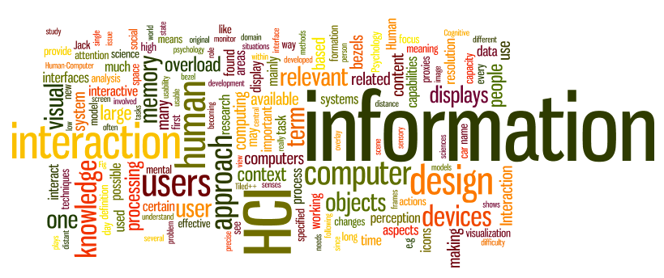
Lecture 1- Interaction Design
Dr. Sampath Jayarathna
Old Dominion University
Credit for some of the slides in this lecture goes to www.id-book.com

Slide 2
What is interaction design?
“Designing interactive products to support the way people communicate and interact in their everyday and working lives.”
      Preece, Sharp and Rogers (2015), (Interaction Design Book)
“The design of spaces for human communication and interaction.”
      Winograd (1997), (Stanford HCI Group)

Slide 3
Goals of interaction design
Develop usable products
  Usability means easy to learn, effective to use and provide an enjoyable experience
Involve users in the design process
Number of other terms used emphasizing what is being designed, e.g.
  user interface design, software design, user-centered design, product design, web design, experience design (UX)

Slide 4
HCI and interaction design
Interaction design is the umbrella term covering all of these aspects
  fundamental to all disciplines, fields, and approaches concerned with researching and designing computer-based systems for people

Slide 5
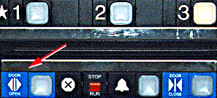
Bad designs
  Elevator controls and labels on the bottom row all look the same, so it is easy to push a label by mistake instead of a control button
  People do not make same mistake for the labels and buttons on the top row. Why not?

Slide 6
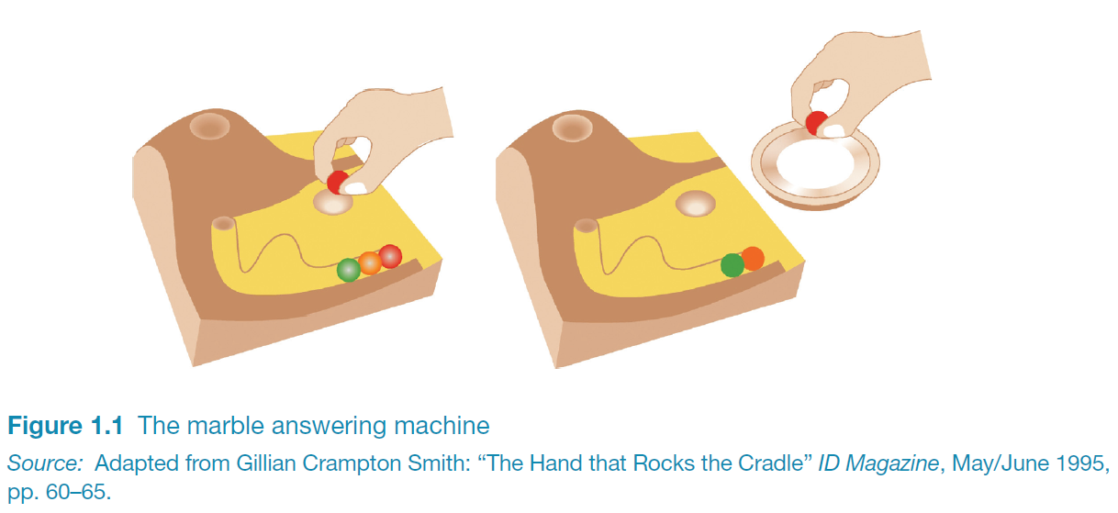
Good design
Marble answering machine (Bishop, 1995)
Based on how everyday objects behave
Easy, intuitive and a pleasure to use
Only requires one-step actions to perform core tasks
http://viewpure.com/RgVbXV1krgU?start=0&end=0
6

Slide 7
Activity 2
The Marble Answering Machine (by Durell Bishop, student at the Royal College of Art) is a prototype telephone answering machine. The Marble Answering Machine demonstrates the great potential of making digital information graspable.
Find a partner.
Discuss and write down what is good and bad about the way this design works compared to regular voice mail systems (say your mobile service).
Submit your answers to Piazza thread. Don't forget to write both your names on your post!

Slide 8
What to design
Need to take into account:
  Who the users are
  What activities are being carried out
  Where the interaction is taking place
Need to optimize the interactions users have with a product:
  So that they match the users’ activities and needs
  Product success depends on designing systems/tools that can be used
Notes:
Efficiency: Doing things right.
Effectiveness: Doing the right things.

Slide 9
Understanding users’ needs
  Need to take into account what people are good and bad at
  Consider what might help people in the way they currently do things
  Think through what might provide quality user experiences
  Listen to what people want and get them involved
  Use tried and tested user-centered methods

Slide 10
Bad design results in
  Anger and frustration
  Decreased productivity in the workplace
  Higher error rates
  Physical and emotional injury
  Equipment damage
  Loss of customer loyalty
  Costs money

Slide 11
Working in multidisciplinary teams
Many people from different backgrounds involved
Different perspectives and ways of seeing
and talking about things
Benefits
  more ideas and designs generated
Disadvantages
  difficult to communicate and progress forward the designs being create

Slide 12
What do professionals do in the ID business?
interaction designers - people involved in the design of all the interactive aspects of a product
usability engineers - people who focus on evaluating products, using usability methods and principles
web designers - people who develop and create the visual design of websites, such as layouts
information architects - people who come up with ideas of how to plan and structure interactive products
user experience designers (UX)
- people who do all the above but who may also carry out field studies to inform the design of products

Slide 13
The User Experience
How a product behaves and is used by people in the real world
  the way people feel about it and their pleasure and satisfaction when using it, looking at it, holding it, and opening or closing it
  “every product that is used by someone has a user experience: newspapers, ketchup bottles, reclining armchairs.”
Cannot design a user experience, only design for a user experience

Slide 14
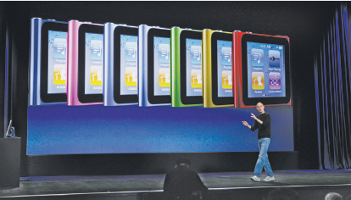
Why was the iPod user experience was such a success?
Quality user experience from the start
Simple, elegant, distinct brand, pleasurable, must have fashion item, catchy names, cool, etc.

Slide 15
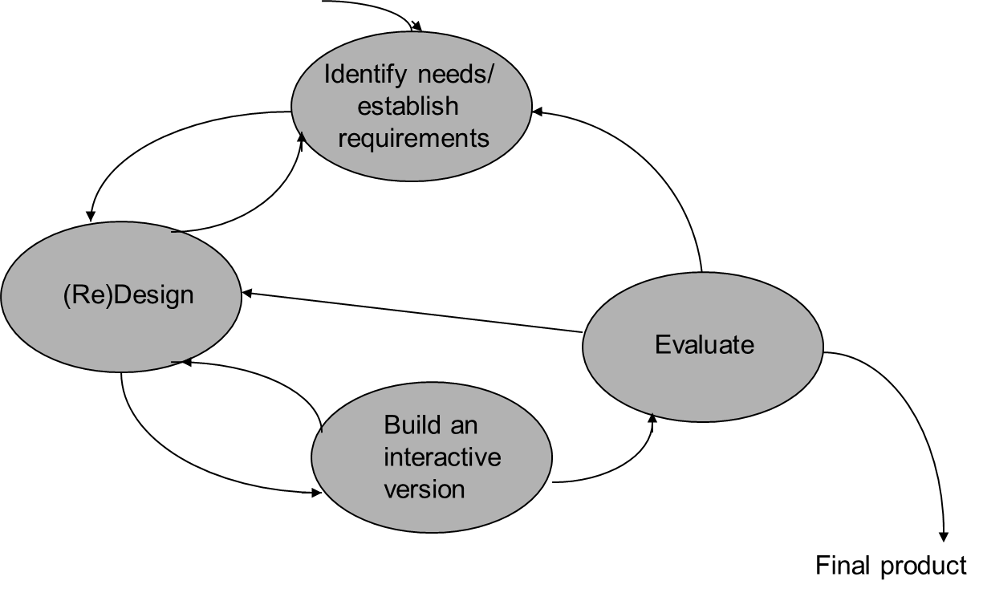
Simple Interaction Design Lifecycle Model
Establishing requirements
Developing alternatives
Prototyping
Evaluating

Slide 16
Core characteristics of interaction design
Users should be involved through the development of the project
Specific usability and user experience goals need to be identified, clearly documented and agreed at the beginning of the project
Iteration is needed through the core activities

Slide 17
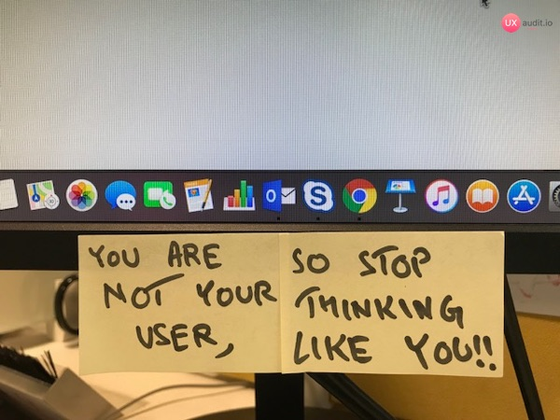
You are not your user!!!
Seems obvious but…
  You have different experiences
  You have different terminology
  You have different ways of looking at the world
Fatal mistakes
  Assume all users are alike
  Assume all users are like the designer,…..especially YOU!

Slide 18
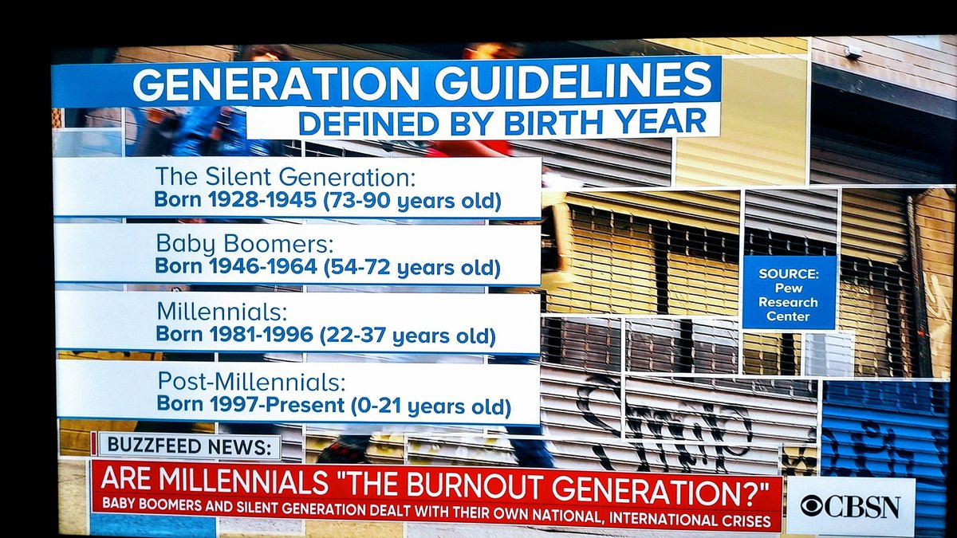
Why go to this length?
Help designers:
  understand how to design interactive products that fit with what people want, need and may desire
  appreciate that one size does not fit all
    e.g., teenagers are very different to grown-ups
  identify any incorrect assumptions they may have about particular user groups
    e.g., not all old people want or need big fonts
  be aware of both people’s sensitivities and their capabilities

Slide 19
Cultural differences and accessibility
5/21/2015 versus 21/5/2015?
  Which should be used for international services and online forms?
Accessibility: Degree to which a product is usable and accessible by as many people as possible
  Focus on disability
  Have a mental or physical impairment
  This has an adverse affect on their everyday lives
  It is long term
  https://www.washington.edu/doit/sites/default/files/atoms/files/Designing-Software-Accessible-Individuals-Disabilites.pdf

Slide 20
Usability goals
Effective to use (doing the right thing)
  How good a product is at doing what it is supposed to do
Efficient to use (doing things right)
  Product supports users carrying out their tasks efficiently. , Amazon One-Click
Safety
  Safe to use
Have good utility
  Product provides a right kind of a functionality so users can do what they need or want to do
Learnability
  Easy to learn
Memorability
  Easy to remember how to use

Slide 21
User experience goals
Desirable aspects
satisfying helpful fun
enjoyable motivating provocative
engaging challenging surprising
pleasurable enhancing sociability rewarding
exciting supporting creativity emotionally fulfilling
entertaining cognitively stimulating
Undesirable aspects
boring unpleasant
frustrating patronizing
making one feel guilty making one feel stupid
annoying cutesy
childish gimmicky

Slide 22
Activity 3
Selecting terms to convey a person’s feelings, emotions, etc., can help designers understand the multifaceted nature of the user experience
Find a partner.
Discuss and find the answers to the following. Submit to piazza.
How do usability goals differ from user experience goals?

Slide 23
Design principles
Generalizable abstractions for thinking about different aspects of design
The do’s and don'ts of interaction design
What to provide and what not to provide at the interface
Derived from a mix of theory-based knowledge, experience and common-sense

Slide 24
Design principles
Visibility – Can I see it?
Feedback – What is it doing now?
Constraint – Why can't I do that?
Consistency – I think I have seen this before?
Affordance – how do I use it?
Mapping – Where am I and where can I go?

Slide 25
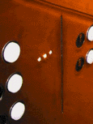
Visibility
• This is a control panel for an elevator
• How does it work?
• Push a button for the floor you want?
• Nothing happens. Push any other button? Still nothing. What do you need to do?
It is not visible as to what to do!

Slide 26
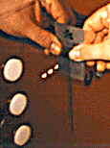
Visibility
      …you need to insert your room card in the slot by the buttons to get the elevator to work!
      How would you make this action more visible?
      • make the card reader more obvious
      • provide an auditory message, that says what to do (which language?)
      • provide a big label next to the card reader that flashes when someone enters
      • make relevant parts visible
      • make what has to be done obvious

Slide 27
The case of the mistaken urinal

Slide 28
The case of the mistaken urinal

Slide 29
Visibility
Car Controls are positioned in a way that they can be easily found and used

Slide 30
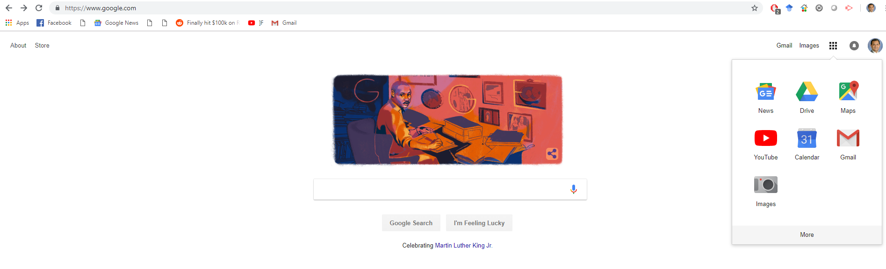
Visibility
Hiding certain functions can be advantageous in interface design
Certain functions are kept invisible until needed; also contained within group of similar types
Google Search makes it clear where to enter text

Slide 31

Feedback
Sending information back to the user about what has been done
Includes sound, highlighting, animation and combinations of these
Needs to be immediate and synchronized with user action
  e.g. when screen button clicked on provides sound or red highlight feedback:

Slide 32
Constraints
Restricting the possible actions that can be performed
Helps prevent user from selecting incorrect options or reduce chance of an error
Can also work to focus user's attention to needed task
Physical objects can be designed to constrain things
  e.g. only one way you can insert a key into a lock

Slide 33
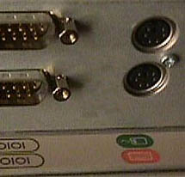
Logical or ambiguous design?
Where do you plug the mouse?
Where do you plug the keyboard?
top or bottom connector?
Do the color coded icons help?
33

Slide 34


How to design them more logically
(i) A provides direct adjacent mapping between icon and connector
(ii) B provides color coding to associate the connectors with the labels
34

Slide 35
Consistency
Design interfaces to have similar operations and use similar elements for similar tasks
  For example: always use ctrl key plus first initial of the command for an operation – ctrl+C, ctrl+S, ctrl+O
Main benefit is consistent interfaces are easier to learn and use
  Enable people to quickly transfer prior knowledge to new context and focus on relevant tasks

Slide 36
Aesthetic and Functional consistency
Aesthetic
  Style and appearance is repeated to enhance recognition, communicates membership and sets emotional tone
  Benz: instantly recognizable because consistently features its logo
Functional
  Meaning and action are consistent to improve learnability and
  understanding
  Traffic always turns yellow before red.
            Cassette recorder control symbols used

Slide 37
Internal and external consistency
Internal consistency refers to designing operations to behave the same within an application
  Consistency with other elements in the system
External consistency refers to designing operations, interfaces, etc., to be the same across applications and devices
  More difficult to achieve because different systems rarely observe the same design standards.
  Extends the benefit of internal consistencies across multiple, independent systems

Slide 38
When consistency breaks down
What happens if there is more than one command starting with the same letter?
  e.g. save, spelling, select, style
Have to find other initials or combinations of keys, thereby breaking the consistency rule
  e.g. ctrl+S, ctrl+Sp, ctrl+shift+L
Increases learning burden on user, making them more prone to errors

Slide 39
Affordances: to give a clue
Perceived and actual properties of an object that give clues to its operation
  e.g. a mouse button invites pushing, a door handle affords pulling
Since has been much popularised in interaction design to discuss how to design interface objects
  e.g. scrollbars to afford moving up and down, icons to afford clicking on

Slide 40
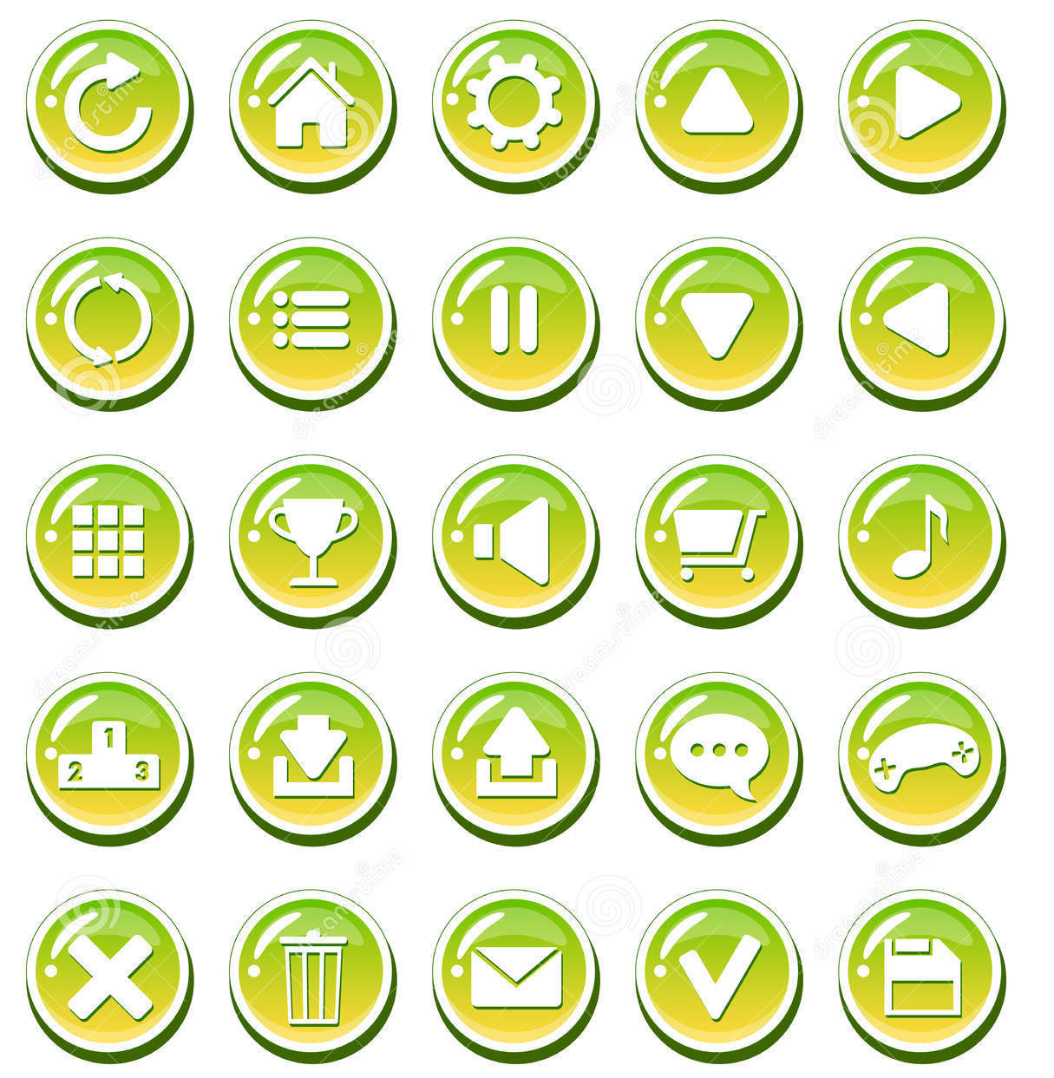
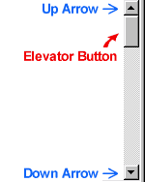
What does ‘affordance’ have to offer interaction design?
Interfaces are virtual and do not have affordances like physical objects
Instead interfaces are better conceptualized as 'perceived' or 'virtual' affordances

Slide 41
Mapping
  Controls and displays should exploit natural mapping
  Natural mapping takes advantage of physical analogies and cultural standards
    Physical : Steering wheel
    Cultural: red means stop, green means go

Slide 42
What about Software?
  Visibility: Visibility of tasks the UI supports and communication of system state/mode
  Affordance: If it looks like a button it can be pressed, if it is underlined, it can be clicked
  Mapping: Clicking on particular UI element produces expected effect
  Constraints: Constraining search criterial, greying out menu items that don't display in a particular context
  Feedback: Provide clear and immediate feedback for each action, animated icons for any waiting
  Many more examples of these that we will see during the semester………….

Slide 43
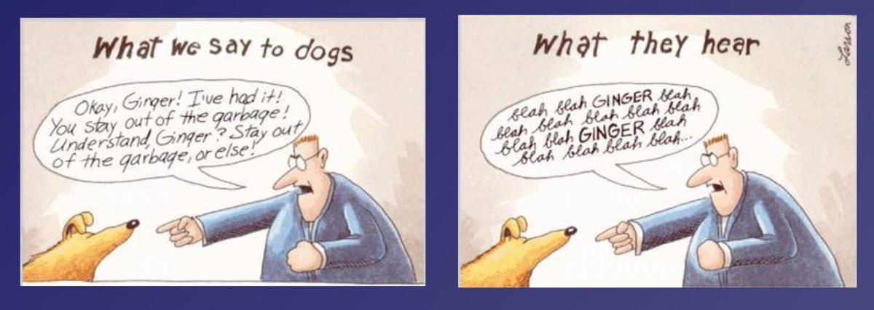
Larson's dog effect

Slide 44
How do we learn about users?
People skim ruthlessly – particularly in online environments.
  If possible, they avoid reading entirely.
If there are usability problems in everyday 'simple' things, this makes it a much greater challenge for complex software
Problems can overcome through HCI methods that collect and analyze data to better understand your users.
There are many methods, we will learn and practice few
  Surveys
  Contextual inquiry
  Interviews
  Usage Analysis

Slide 45
Activity 4
This assignment is intended for you to put into practice what you have read about todays lecture. Specifically, the objective is to enable you to define usability and user experience goals and to transform these and other design principles into specific questions to help evaluate an interactive product.
Think about our Startup project idea, and examine how we should design this, paying particular attention to how the user is meant to interact with it.
From your first impressions, write down what first comes to mind as to what is good and bad about the way the interaction works.
Compile a set of usability and user experience goals that you think will be most relevant in evaluating this project. Decide which are the most important ones and explain why.
Finally, discuss possible design principles applicable to this project interface.

