Slide 1
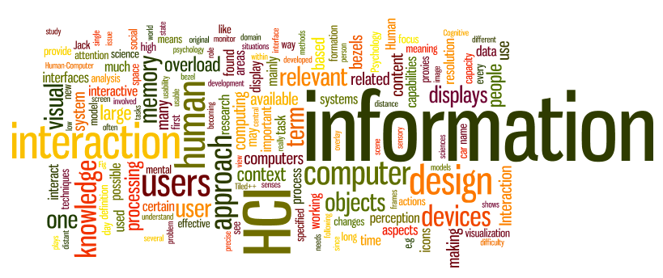
Data Analysis
Dr. Sampath Jayarathna
Old Dominion University
Credit for some of the slides in this lecture goes to www.id-book.com

Slide 2
Data Analysis
Discuss the difference between qualitative and quantitative data and analysis.
Enable you to analyze data gathered from:
  Questionnaires.
  Interviews.
  Observation studies.
  Contextual Inquiries

Slide 3
Data interpretation and analysis
Start soon after data gathering session
Initial interpretation before deeper analysis
Different approaches emphasize different elements
  Use-cases
  Scenarios ('user stories') and Personas
  HTA

Slide 4
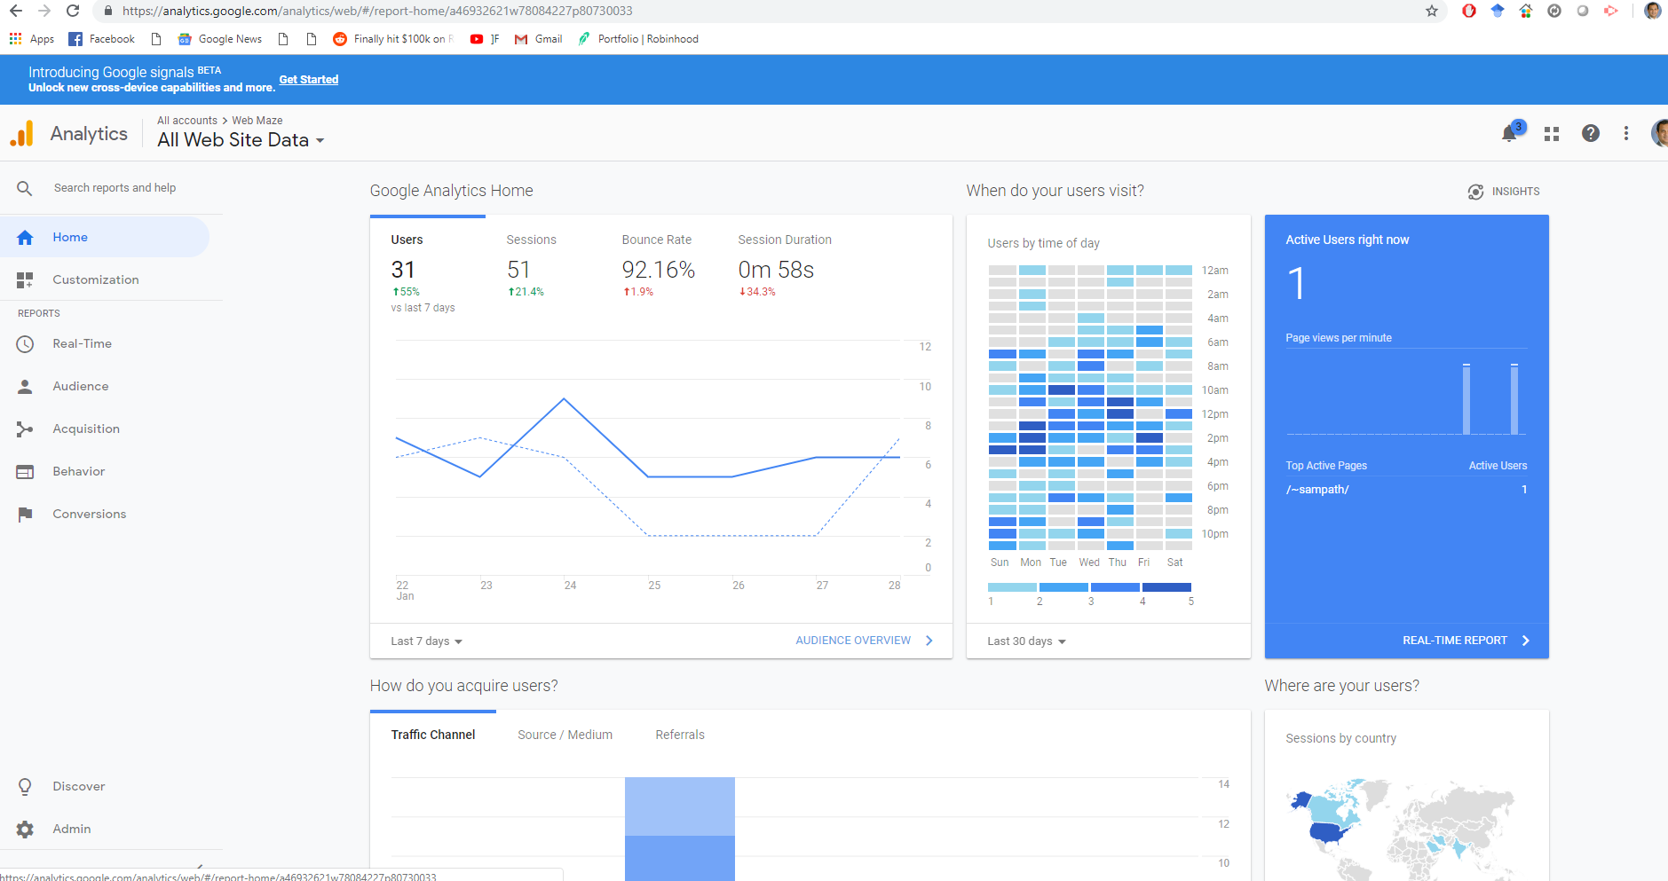
A section of Google analytics dashboard

Slide 5
Quantitative and qualitative
Quantitative data
  expressed as numbers
  numerical methods to ascertain size, magnitude, amount
Qualitative data
  difficult to measure sensibly as numbers, e.g. count number of words to measure dissatisfaction
  expresses the nature of elements and is represented as themes, patterns, stories
Be careful how you manipulate data and numbers!

Slide 6
Simple quantitative analysis
Averages, Percentages
  Mean: add up values and divide by number of data points
  Median: middle value of data when ranked
  Mode: figure that appears most often in the data
Be careful not to mislead with numbers!
Graphical representations give overview of data
  Google Forms

Slide 7
Qualitative Analysis
So you have collected data from all the qualitative research you are doing
Contextual Inquiries, Interviews, Observations etc…
Now What?
Data analysis
An attempt by the researcher to summarize the data.
Data Interpretation
An attempt to derive meaning from the data

Slide 8
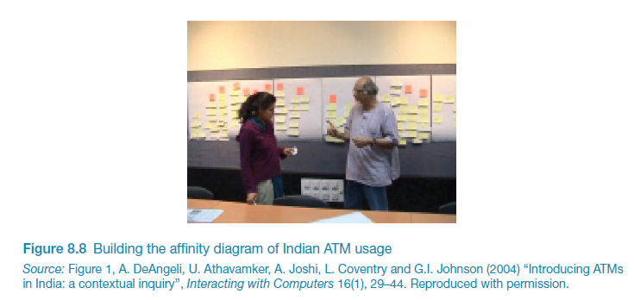
Simple qualitative analysis
Recurring patterns or themes
  Emergent from data, dependent on observation framework if used
Categorizing data
  Categorization scheme may be emergent or pre-specified
Looking for critical incidents
  Helps to focus in on key events

Slide 9
Grounded Theory (Thematic Analysis)
Aims to derive theory from systematic analysis of data
Based on categorization approach (called here ‘coding’)
Three levels of ‘coding’
  Open: identify categories
  Axial: flesh out and link to subcategories (process of relating categories)
  Selective: form theoretical scheme (choose one category to be core category)
      Researchers are encouraged to draw on own theoretical backgrounds to inform analysis

Slide 10
Sources of Codes
A priori codes
- previous research
- previous theory
- research questions
- your intuition of the data or setting
Grounded codes
- “in vivo” – Lets codes emerge from the data

Slide 11
Code Names
Codes are given meaningful names that are applied to all instances of similar content
  Strings of text may contain more than one code
  When new content is discovered, a new code is created to apply to it and other similar content.
As you do your analysis
  Code may evolve
  The number of codes may grow as more topics or themes become apparent

Slide 12
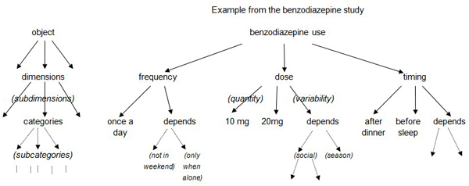
Identifying Themes
Generate broader themes by linking instances of codes with other instances/codes
Begin with big picture and list themes that emerge
First round of coding: 30-40 categories
Second round of coding: 15-20 categories
  Remove redundancy
  Reduce overlap
Eventual target: 3-8 main themes
  Can have sub-categories

Slide 13
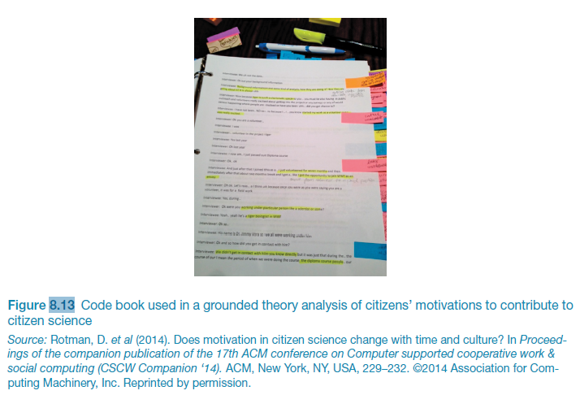
Code book used in grounded theory analysis

Slide 14
Create a narrative
Once you have your 3~8 main themes, the themes are formed into a narrative about the data
Create a story that best represents your data
“our participants expressed mixed feelings about deleting their accounts. For example….”
For product design, create “user stories” that describe the key concerns/actions/feelings fro each main category of users (persona)

Slide 15
Activity 7: Lets do Coding
Work in pairs
Create a coding for each
of the description (single code)
Submit your 5 codes to Piazza

Slide 16
How to describe the tasks?
Scenarios
  an informal narrative story, simple, ‘natural’, personal, not generalizable
Use cases
  assume interaction with a system
  assume detailed understanding of the interaction
HTA

Slide 17
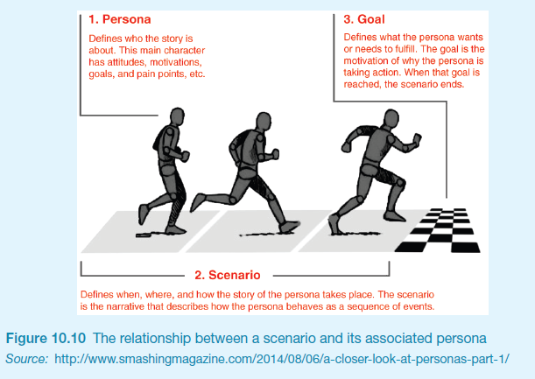
Scenarios and Personas

Slide 18
Scenario for travel organizer
The Thomson family enjoy outdoor activities and want to try their hand at sailing this year. There are four family members: Sky (10 years old), Eamonn (15 years old), Claire (35), and Will (40). One evening after dinner they decide to start exploring the possibilities. They all gather around the travel organizer and enter their initial set of requirements – a sailing trip for four novices in the Mediterranean. The console is designed so that all members of the family can interact easily and comfortably with it. The system’s initial suggestion is a flotilla, where several crews (with various levels of experience) sail together on separate boats. Sky and Eamonn aren’t very happy at the idea of going on vacation with a group of other people, even though the Thomsons would have their own boat. The travel organizer shows them descriptions of flotillas from other children their ages and they are all very positive, so eventually, everyone agrees to explore flotilla opportunities. Will confirms this recommendation and asks for detailed options. As it’s getting late, he asks for the details to be printed so everyone can consider them tomorrow. The travel organizer prints out a summary of the different options available.”

Slide 19
Use case for travel organizer
1. The system displays options for investigating visa and vaccination requirements.
2. The user chooses the option to find out about visa requirements.
3. The system prompts user for the name of the destination country.
4. The user enters the country’s name.
5. The system checks that the country is valid.
6. The system prompts the user for her nationality.
7. The user enters her nationality.
8. The system checks the visa requirements of the entered country for a passport holder of her nationality.
9. The system displays the visa requirements.
10. The system displays the option to print out the visa requirements.
11. The user chooses to print the requirements.

Slide 20
Alternative courses for travel organizer
Some alternative courses:
6. If the country name is invalid:
  6.1 The system displays an error message.
  6.2 The system returns to step 3.
8. If the nationality is invalid:
  8.1 The system displays an error message.
  8.2 The system returns to step 6.
9. If no information about visa requirements is found:
  9.1 The system displays a suitable message.
  9.2 The system returns to step 1.

Slide 21
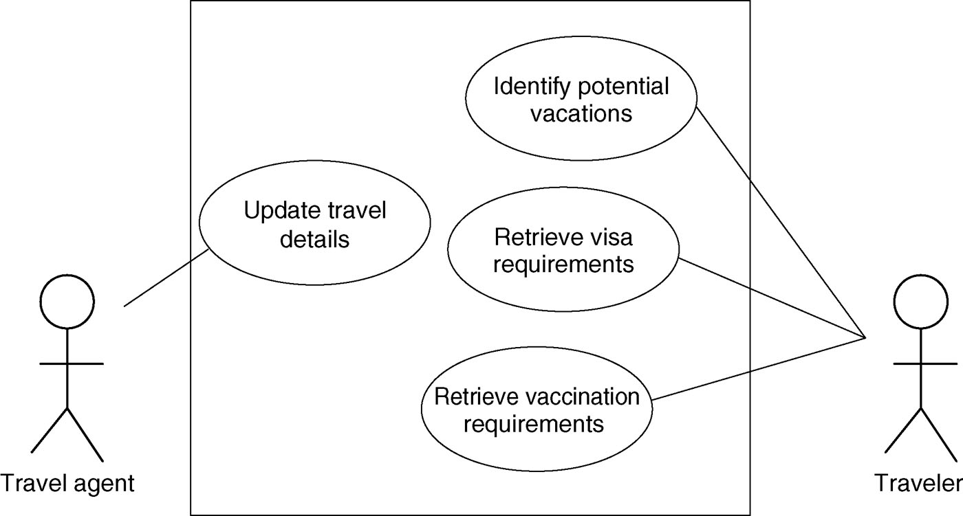
Example use case diagram for travel organizer

Slide 22
Task analysis
Task descriptions are often used to envision new systems or devices
Task analysis is used mainly to investigate an existing situation
It is important not to focus on superficial activities
  What are people trying to achieve?
  Why are they trying to achieve it?
  How are they going about it?
Many techniques, the most popular is Hierarchical Task Analysis (HTA)

Slide 23
Hierarchical Task Analysis
Involves breaking a task down into subtasks, then sub-sub-tasks and so on. These are grouped as plans which specify how the tasks might be performed in practice
HTA focuses on physical and observable actions, and includes looking at actions not related to software or an interaction device
Start with a user goal which is examined and the main tasks for achieving it are identified
Tasks are sub-divided into sub-tasks

Slide 24
Example Hierarchical Task Analysis
0. In order to buy a DVD
1. locate DVD
2. add DVD to shopping basket
3. enter payment details
4. complete address
5. confirm order
plan 0: If regular user do 1-2-5.
If new user do 1-2-3-4-5.

Slide 25
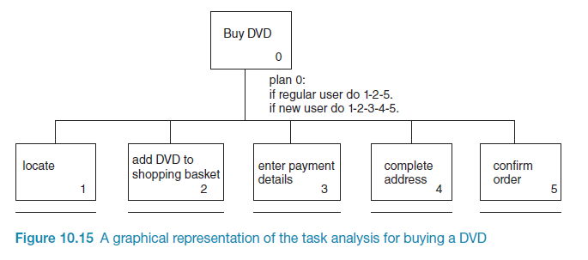
Example Hierarchical Task Analysis

Slide 26
Activity 8: HTA
Work in pairs
Create a Graphical HTA for borrowing a book from a library
You need to have at least 2 plans in your hierarchy
Submit your diagram to Piazza

Slide 27
Tools to support data analysis
Spreadsheet – simple to use, basic graphs
Statistical packages, e.g. SPSS
Qualitative data analysis tools
  Nvivo http://www.qsrinternational.com/ ($$$$)
  Dedoose https://www.dedoose.com/home/features ($)
  Atlas.ti http://atlasti.com/ ($$)
  QDA Miner https://provalisresearch.com/ ($$$)
  Transana ($$)
  AQUAD (Free)

Slide 28
Presenting the findings
Only make claims that your data can support
The best way to present your findings depends on the audience, the purpose, and the data gathering and analysis undertaken
Graphical representations (as discussed above) may be appropriate for presentation
Other techniques are:
  Rigorous notations, e.g. UML
  Using stories, e.g. to create scenarios
  Summarizing the findings

Slide 29
Supplement slides: Use Case Modeling

Slide 30
Use case modeling
Use cases were developed originally to support requirements elicitation and now incorporated into the UML.
Each use case represents a discrete task that involves external interaction with a system.
Actors in a use case may be people or other systems.
Represented diagrammatically to provide an overview of the use case and in a more detailed textual form.

Slide 31
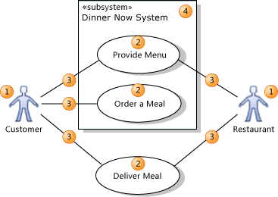
Use case modeling basics
An actor (1) is
  a class of person, organization, device, or external software component that interacts with your system. Example actors are Customer, Restaurant, Temperature Sensor, Credit Card Authorizer.
A use case (2)
  represents the actions that are performed by one or more actors in the pursuit of a particular goal. Example use cases are Order Meal, Update Menu, Process Payment.
On a use case diagram, use cases are associated (3) with the actors that perform them.
Your system (4) is
  whatever you are developing. It might be a small software component, whose actors are just other software components; or it might be a complete application; or it might be a large distributed suite of applications deployed over many computers and devices. Example subsystems are Meal Ordering Website, Meal Delivery Business, Website Version 2.
A use case diagram can show which use cases are supported by your system or its subsystems.

Slide 32
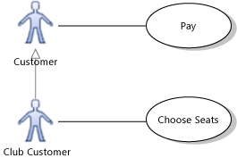
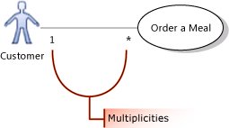
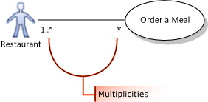
Use case modeling basics
You can draw a Generalization link between Actors.
  The specialized actor, such as Club Customer in the example, inherits the use cases of the generalized actor, such as Customer.
The association between an actor and a use case can show a multiplicity at each end.
  1 to state that exactly one instance of this role participates in each link.
  1..* to state that one or more instance of this role participate in each link.
  0..1 to state that participation is optional.
  * to state that zero or more instances of this role participate in the link.
  In the illustration, one or more restaurants can take part in fulfilling the same meal order.

Slide 33
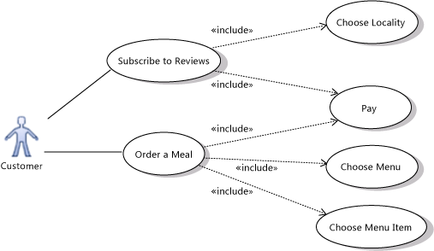
Use case modeling basics
Use an Include relation to show that one use case describes some of the detail of another. In the illustration, Order a Meal includes Pay, Choose Menu, and Choose Menu Item. Each of the included, more detailed use cases is a step that the actor or actors might have to perform to achieve the overall goal of the including use case. The arrow should point at the more detailed, included use case.

Slide 34

Use case modeling basics
Use an Extend link to show that one use case may add functionality to another use case under certain circumstances. The arrow should point at the main, extended use case.
For example, the Login use case of a typical Web site can include Register New User - but only when the user does not already have an account.

Slide 35
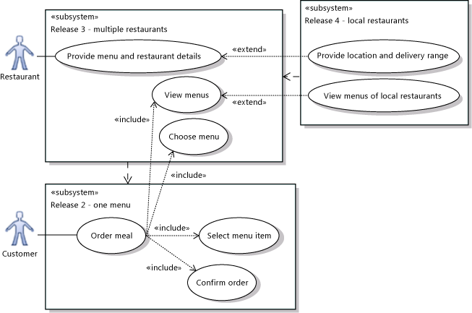
Use case modeling basics
You can use different subsystem boundaries to illustrate different versions of the system.
Use Dependency relations to link subsystems representing different versions or variants.

