Slide 1
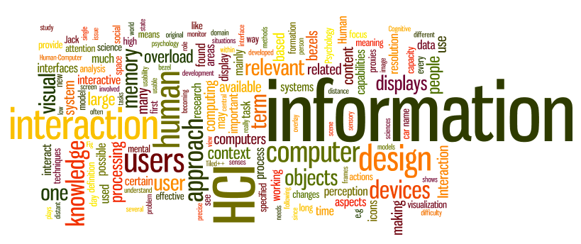
Prototyping
Dr. Sampath Jayarathna
Old Dominion University
Credit for some of the slides in this lecture goes to www.id-book.com

Slide 2
Prototyping
“It is easier to tell what you don’t like about an existing system than to describe what you would like in an imaginary one”

Slide 3
Prototyping
Problem:
We can’t evaluate a design until it’s built
but….
After building, changes to the design are difficult
What to do?
Solution
Prototype!

Slide 4
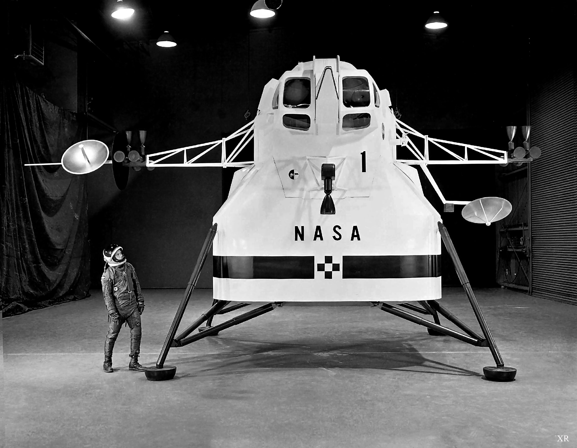
Prototyping
The engineers at Apollo missions built a full-size cardboard prototype of the lunar landing module to test the position and size of the windows in relation to the field of view of the astronauts. This experimentation led to the design decision that the astronauts would stand not sit inside the lander. This allowed the windows to be smaller, saving crucial weight.

Slide 5
Prototyping
What is a prototype?
Different kinds of prototyping
  - Low fidelity
  - High fidelity
Compromises in prototyping
  - Vertical
  - Horizontal
Final product needs to be engineered

Slide 6
What is prototyping?
  Simulate the design in low-cost manner
  Make it fast. Make it cheap
  Facilitate iterative design and evaluation
    Your first idea is rarely your best!
  Promote feedback
  Allow lots of flexibility for radically different designs
    Don’t kill crazy ideas!

Slide 7
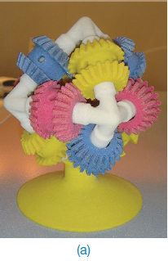
What is a prototype?
In other design fields a prototype is a small-scale model:
  a miniature car
  a miniature building or town
  the examples here come
  from a 3D printer

Slide 8
What is a prototype?
In interaction design it can be (among other things):
  a series of screen sketches
  a storyboard, i.e. a cartoon-like series of scenes
  a PowerPoint slide show
  a video simulating the use of a system
  a lump of wood
  a cardboard mock-up
  a piece of software with limited functionality written in the target language or in another language

Slide 9
Reminder: What is a prototype?
A prototype is an incomplete, early version of a product
There are many approaches to building prototypes for software user interfaces
UI prototypes can be as simple as drawing on a piece of paper or as complex as web application
  Or anywhere in between those extremes!

Slide 10
Dimensions of Fidelity
Fidelity can be thought of as how close of an approximation of the final product is being attempted
Fidelity can be broken down into four basic dimensions
  Breadth
  Depth
  Look
  Interaction

Slide 11
How to prototype?
Vertical – “Depth” Prototyping
Show only portion of interface, but large amount of those portions
Horizontal – “Breadth” Prototyping
Show much of the interface, but in a shallow manner.

Slide 12
Breadth
The breadth of a prototype refers to how much of the product’s functionality is represented in the prototype
  A very narrow prototype only represents a single feature
  A broad prototype represents all intended functionality
Prototypes should generally be as broad as needed to cover basic or most important tasks, but not much more

Slide 13
Depth
The depth of a prototype refers to how much of the prototype is functional, and how robust it is
  A very shallow prototype has no backend at all and is hard-coded to respond as though the user had provided ideal input
  A deep prototype has some logic and error-handling capabilities
  At first glance, depth may seem unimportant, but it affects the amount of exploration a user can do
Thus depth can actually have a profound influence on user testing!

Slide 14
Look
“Look” is probably what most people think of when they think of prototype fidelity
It refers to how accurately a prototype represents the product’s intended appearance, including fonts, colors, and graphics
It’s generally a good idea to hold off on something which has a high fidelity look until later in the design process
  People are less likely to point out flaws and mistakes
  People can easily fixate on the “little” things
  You are less likely to throw it out and start again

Slide 15
Interaction
“Interaction” refers to how the prototype handles input and output
Interaction can often be simulated,
  You might create a digital prototype for an ipad application which runs on your desktop and responds to traditional mouse and keyboard
  You might use hyperlinks or animation to simulate clicking interaction (e.g., in PowerPoint)

Slide 16
How to prototype?
Low Fidelity Vs. High Fidelity
Amount of polish should reflect maturity of the prototype.

Slide 17
Lo-Fi vs. Hi-Fi
Traditionally, prototypes are categorized as either lo-fi (low fidelity) or hi-fi (high fidelity)
In this class, we will often use lo-fi synonym for paper prototyping and hi-fi as synonym for digital prototyping
Your design process should use multiple levels of fidelity as you move from an idea to a fully designed product
But as you are about to see, its actually more complicated than that!

Slide 18
How to prototype?
Easy access to cameras makes it easy to blur the lines between lo-fi and hi-fi prototypes
Photos of hand-drawn prototypes can easily be captures and displayed on real screens
Sequences of photos can also be animated to simulate interactions

Slide 19
Low-fidelity Prototyping
Uses a medium which is unlike the final medium, e.g. paper, cardboard
Is quick, cheap and easily changed
Examples:
  sketches of screens, task sequences, etc
  ‘post-it’ notes
  storyboards
  ‘Wizard-of-Oz’

Slide 20
Storyboards
Often used with scenarios, bringing more detail, and a chance to role play
It is a series of sketches showing how a user might progress through a task using the device
Used early in design

Slide 21
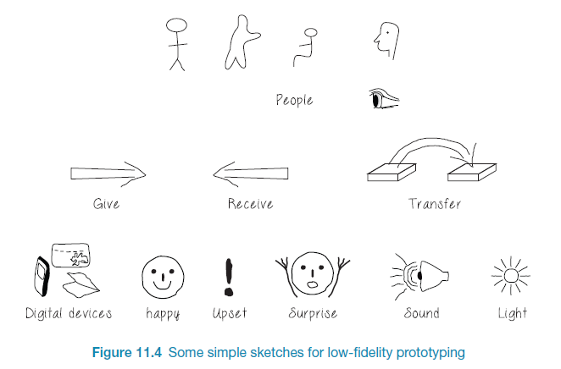
Generate storyboard from scenario

Slide 22
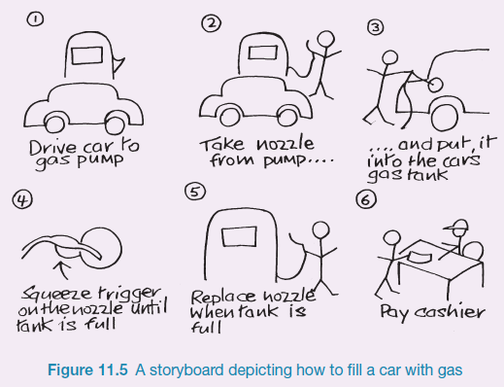
Sketching
Sketching is important to low-fidelity prototyping

Slide 23
Sketching: But I can’t draw!
Drawing is hard…But it doesn't have to be
Spending too much time drawing details is unnecessary!
Also you don’t have to draw- take photos, etc.

Slide 24
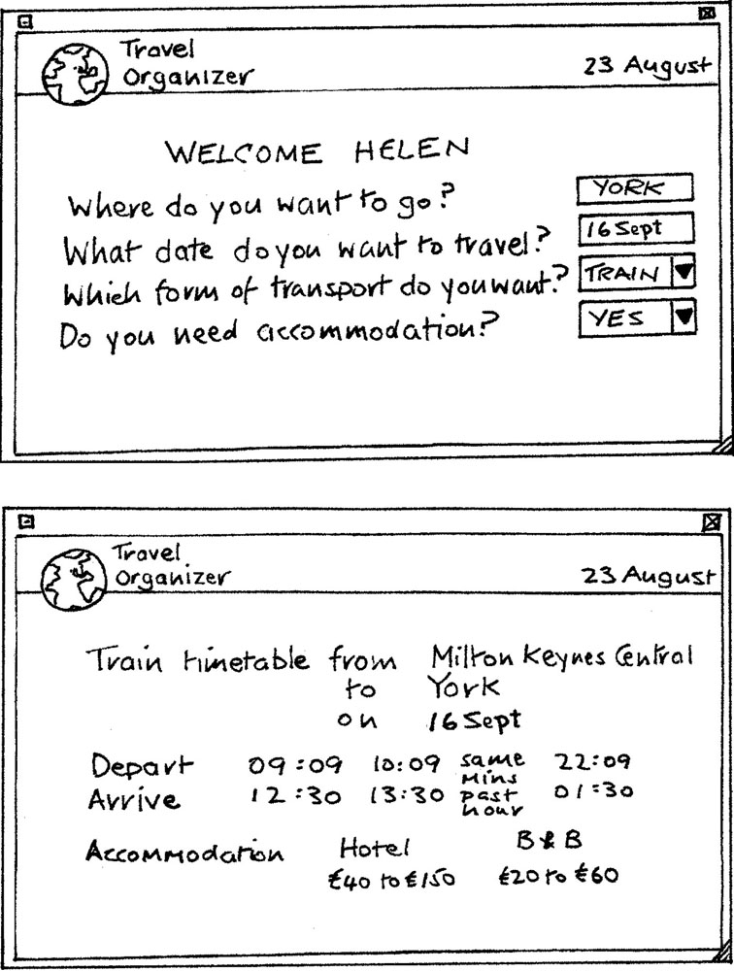
Card-based prototypes
  Index cards (3 X 5 inches)
  Each card represents
  one screen or part of screen
  Often used in website
  development

Slide 25
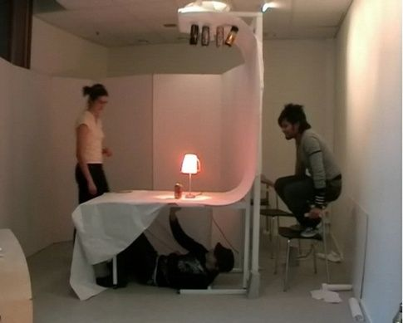
‘Wizard-of-Oz’ prototyping
The user thinks they are interacting with a computer, but a developer is responding to output rather than the system. http://viewpure.com/-RQxD4Ff7dY?ref=search
Usually done early in design to understand users’ expectations
Ex: Aardvark startup (human search engine)

Slide 26
Why do it?
Low cost
Fast to implement
  Typical hi-fi prototype takes a few weeks as opposed to a few hours
Allows you to merge the design and prototyping phase together
It gets everyone involved!
  Build teamwork in groups with diverse skill sets
  So simple, no one gets left out

Slide 27
Why do it?
Feedback on the BIG things
Lo-fi nature forces users to consider usability issues related to layout, control mechanisms
Nit picking over choice of colors, button sizes, font choice ignored
Focus on Content as opposed to Appearance

Slide 28
Why not to do it?
Does not produce anything concrete
May seem unprofessional to some users
  May not the right prototype for the VCs ☺
Can’t represent some effects with paper
  Typically you start with several rounds of paper prototyping, and move towards high-fidelity prototyping as the design becomes more finalized.

Slide 29
Building a lo-fi prototype
Gather essential materials
White unlined paper
5x8 inch cards
Adhesives
Markers
Sticky pads
Scissors
Anything else you think off!!!

Slide 30
Building a lo-fi prototype
Don’t get carried away with design!
Goal is to get as much user feedback as possible
Set a deadline – forget minor details
Draw generic frames
Make everything needed to simulate effects
Photocopier/camera is your friend!

Slide 31
Activity 9
Prototype Your Alarm Clock
Think about the alarm clock you use to wake up every day. It may be a digital clock radio, it may be an analog clock, it may even be a cellphone or a desktop application. Make a low-fidelity prototype of your alarm clock. Include enough of the interface so that your low-fi prototype can display and change the current time, display and change the alarm time, and turn the alarm on and off.
Work in a group of 5-6 people.
Submit a picture of your lo-fi prototype with all the team names.

Slide 32
Preparing for a test
Select users
  Perform user and task analysis
  Find out educational background, knowledge of computers, typical tasks required
  Get testers who fit the final user profile
Ready test scenarios
  Practice
    Sort out bugs/hitches before real testing.
    Get everyone comfortable with their role

Slide 33
Conducting a test
Facilitator
  Encourage user to express thoughts
  Don’t influence decisions!!!
  Giving instructions
  Make sure timing is met
“Computer” person
  Arranges the prototype according to
  user input
  Needs to be organized
  Knows the prototype well
  Makes changes quickly
Observers
  Take notes
  Write possible solutions to problems faced
  Cannot react to user’s actions

Slide 34
Evaluating Results
Summarize problems (e.g., make a list)
  Usability issues
  Missing (or mis-specified) functional requirements
  Preferences for different alternatives
  User priorities
  Issues outside the user interfaces (e.g., high-level understanding)
Prioritize problems
Construct revised prototypes
Iterate, Iterate, Iterate!

Slide 35
Conclusion: lo-fi
An important prototyping tool (but not the only tool!)
Quick to build/refine, thus enable rapid design interactions. Useful tool for speeding up the process of iterative design
Requires minimal resources and material (cheap!)
Detects usability problems at a very early stage before implementation
  Focus on the “right” things early on
Promotes communication between stakeholders. Team members gain understanding of user needs and priorities
I recommend you always do few rounds of lo-fi prototyping for every new design/app/system/solution that you create!

Slide 36
High-fidelity prototyping
Once you have developed a lo-fi prototype and solicited feedback on it through peer critique and user testing:
You may wish to create another lo-fi prototype (isn’t iterative design fun?)
Or you may be ready to move on to a hi-fi prototype
Which choice you make will be a function of how much your original design you feel needs to change
Remember, a high fidelity prototype is a non-trivial time investment
It is good for evaluating a working design that has been derived from a few rounds of less costly lo-fi prototyping

Slide 37
High-fidelity prototyping
Uses materials that you would expect to be in the final product
Prototype looks more like the final system than a low-fidelity version
High-fidelity prototypes can be developed by integrating existing hardware and software components

Slide 38
Hi-fi Prototypes
Useful for getting client approval before developing all the functionality. "The site will look like this. Would you like changes before I go on?"
Usually appears well into the project.
Beware: it looks so realistic that the client will regard it as real. Any typos will be treated seriously and will distract from the main purpose.
  See compromises

Slide 39
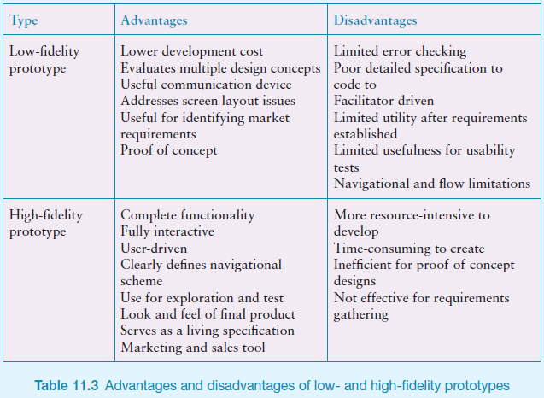
Low Vs High Fidelity prototypes

Slide 40
Compromises in prototyping
All prototypes involve compromises
For software-based prototyping maybe there is a slow response? sketchy icons? limited functionality?
Two common types of compromise
  horizontal: provide a wide range of functions, but with little detail
  vertical: provide a lot of detail for only a few functions
Compromises in prototypes mustn't be ignored. Product needs engineering

Slide 41
GUI Prototyping Tools
Pencil Project :
  http://pencil.evolus.vn/
  supports Linux, Mac OS X and Windows.
  A Firefox add-on is also available
  Free
Smartdraw
  https://www.smartdraw.com/
  $200

Slide 42
Activity 10
Work in pairs.
You are presenting your ideas for a diary tool to a PDA software designer.
What type of prototype would you use?

Slide 43
Explore the user’s experience (UX)
Use personas, card-based prototypes or stickie's to model the user experience
Visual representation called:
  design map
  customer/user journey map
  experience map
Two common representations
  wheel
  timeline

Slide 44
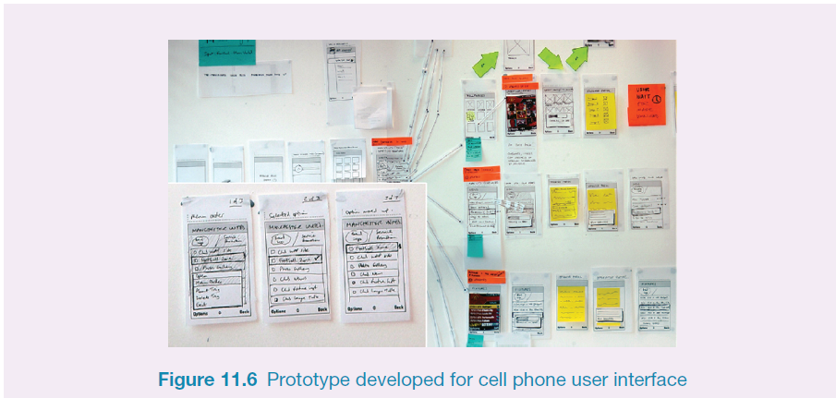
Generate card-based prototype from use case

Slide 45
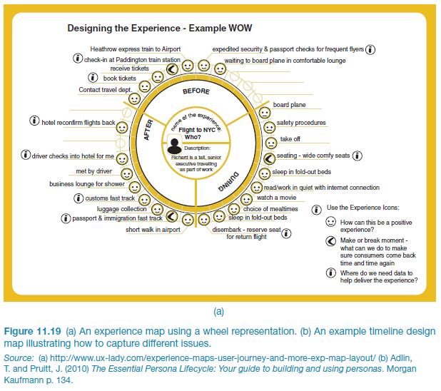
An experience map drawn as a wheel

Slide 46
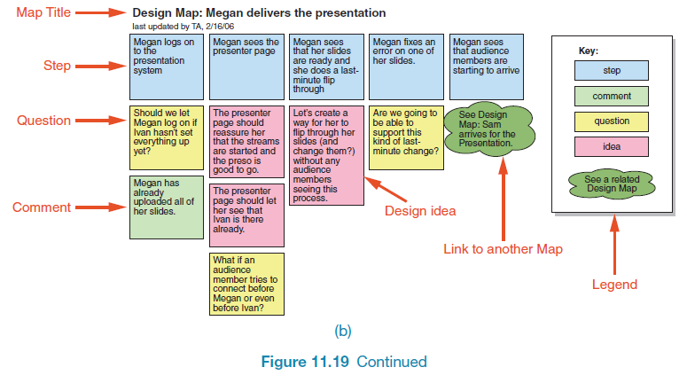
An experience map drawn as a timeline

Slide 47
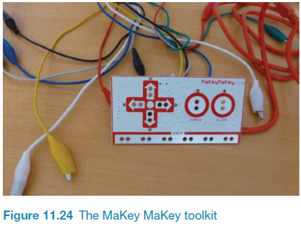
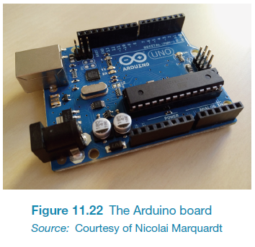
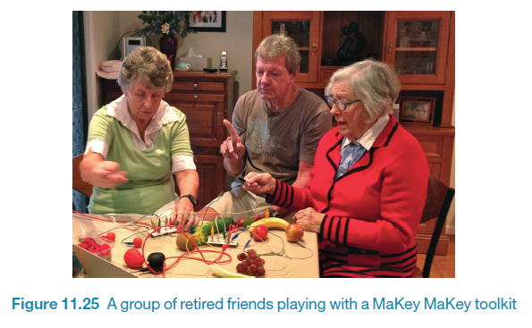
Construction: physical computing
Build and code prototypes using electronics
Toolkits available include
  Arduino
  Senseboard
  MaKey MaKey http://viewpure.com/rfQqh7iCcOU?ref=search
Software Development Kits
  programming tools and components to develop for a
  specific platform, e.g. iOS
  Includes: IDE, documentation, drivers, sample code, application programming interfaces (APIs)
  Makes development much easier
  Microsoft’s Kinect SDK has been used in research
Designed for use by wide range of people

