Slide 1
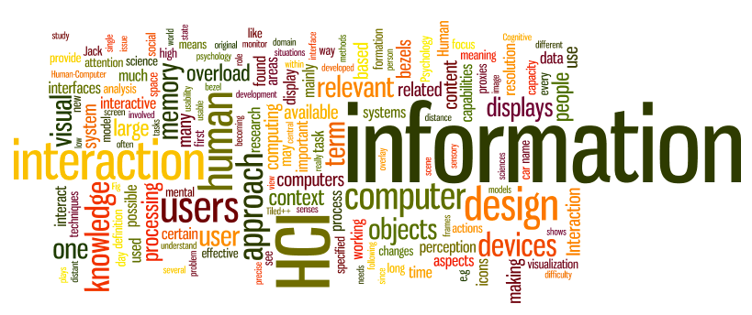
Cognitive Aspects of Design
Dr. Sampath Jayarathna
Old Dominion University
Credit for some of the slides in this lecture goes to www.id-book.com

Slide 2
Motivation
Well-designed user interfaces and user interactions require an understanding of the way users think and feel with respect to the product
Cognitive science provides some models and other hints that can be used for interaction design.
Different types of cognitive approaches may be appropriate for different users, situations, or tasks.

Slide 3
Why do we need to understand users?
Interacting with technology is cognitive
Need to take into account cognitive processes involved and cognitive limitations of users
Provides knowledge about what users can and cannot be expected to do
Identifies and explains the nature and causes of problems users encounter
Supply theories, modelling tools, guidance and methods that can lead to the design of better interactive products
Notes:
3

Slide 4
1. Bringing cognitive psychology knowledge to HCI

Slide 5
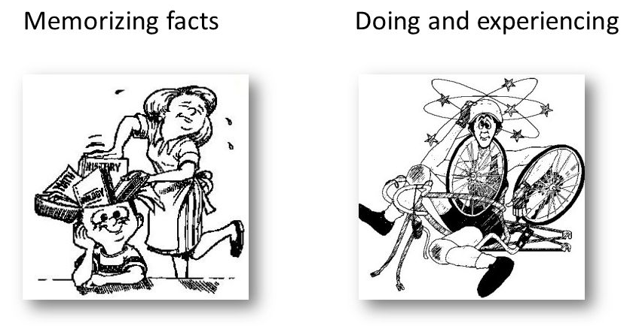
What is cognition?
Experiential cognition is a state of mind in which we perceive, act and react to events around us effectively and effortlessly
  Examples include driving a car, reading a book
Reflective cognition involves thinking, comparing, and decision making
  Examples include learning, writing
Notes:
5

Slide 6
Cognitive processes
Cognition can also be described in terms of cognitive processes
Attention
Perception
Memory
Learning
Reading, speaking and listening
Problem-solving, planning, reasoning and decision-making
Notes:
6

Slide 7
Attention
Selecting things to concentrate on at a point in time from the mass of stimuli around us
  Allows us to focus on information that is relevant to what we are doing
  Involves audio and/or visual senses
  Focussed and divided attention enables us to be selective in terms of the mass of competing stimuli but limits our ability to keep track of all events
Information at the interface should be structured to capture users’ attention,
  e.g. use perceptual boundaries (windows), colour, video, sound and flashing lights
Notes:
7

Slide 8
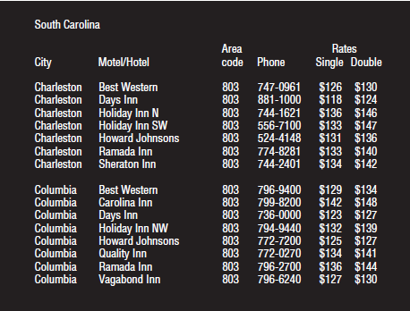
Find the price of a double room at the Holiday Inn in Columbia
Notes:
8

Slide 9

Find the price for a double room at the Quality Inn in Pennsylvania
Notes:
9

Slide 10
Results
Tullis (1987) found that the two screens produced quite different results
  1st screen - took an average of 5.5 seconds to search
  2nd screen - took 3.2 seconds to search
Why, since both displays have the same density of information (31%)?
Spacing
  In the 1st screen the information is bunched up together, making it hard to search
  In the 2nd screen the characters are grouped into vertical categories of information making it easier
Notes:
10

Slide 11

Multitasking and attention
Is it possible to perform multiple tasks without one or more of them being detrimentally affected?
Ophir et.al. (2009) compared heavy vs light multi-taskers
  Heavy were more prone to being distracted than those who infrequently multitask
  Heavy multi-taskers are easily distracted and find it difficult to filter irrelevant information
Notes:
11

Slide 12
Design implications for attention
Make information salient when it needs attending to
Use techniques that make things stand out like color, ordering, spacing, underlining, sequencing and animation
Avoid cluttering the interface with too much information because software allows it
Search engines and form fill-ins that have simple and clean interfaces are easier to use
Notes:
12

Slide 13
Perception
How information is acquired from the world and transformed into experiences
Vision is the most dominant sense for sighted individuals
  Obvious implication is to design representations that are readily perceivable, e.g.
    Text should be legible
    Icons should be easy to distinguish and read
Notes:
13

Slide 14
Is color contrast good? Find Italian
Notes:
14

Slide 15
Are borders and white space better? Find french
Notes:
15

Slide 16
Results
Weller (2004) found people took less time to locate items for information that was grouped
  using a border (2nd screen) compared with using color contrast (1st screen)
Some argue that too much white space on web pages is detrimental to search
  Makes it hard to find information
Notes:
16

Slide 17

Which is easiest to read and why?
What is the time?
What is the time?
What is the time?
What is the time?
What is the time?
Notes:
17

Slide 18
Design implications
  Icons should enable users to readily distinguish their meaning
  Bordering and spacing are effective visual ways of grouping information
  Sounds should be audible and distinguishable
  Speech output should enable users to distinguish between the set of spoken words
  Text should be legible and distinguishable from the background
  Tactile feedback should allow users to recognize and distinguish different meanings
Notes:
18

Slide 19
Memory
Involves first encoding and then retrieving knowledge.
We don’t remember everything - involves filtering and processing what is attended to
We recognize things much better than being able to recall things
we remember less about objects we have photographed than when we observe them with the naked eye (Henkel, 2014)
Notes:
19

Slide 20
Context is important
Context affects the extent to which information can be subsequently retrieved
Sometimes it can be difficult for people to recall information that was encoded in a different context:
  “You are on a train and someone comes up to you and says hello. You don’t recognize him for a few moments but then realize it is one of your neighbours. You are only used to seeing your neighbour in the hallway of your apartment block and seeing him out of context makes him difficult to recognize initially”
Notes:
20

Slide 21
Processing in memory
Encoding is first stage of memory
  Determines which information is attended to in the environment and how it is interpreted.
The more attention paid to something ….
  The more it processed in terms of thinking about it and comparing it with other knowledge….
  The more likely it is to be remembered
Notes:
21

Slide 22
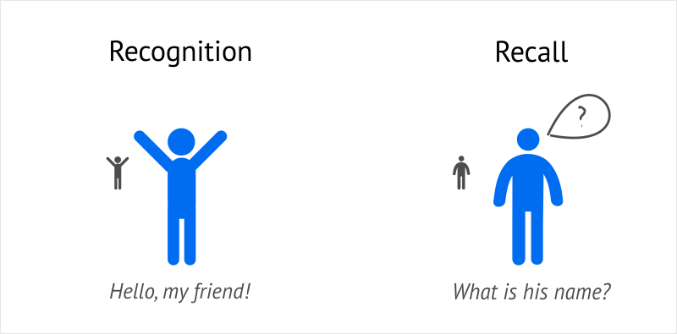
Recognition versus recall
Command-based interfaces require users to recall from memory a name from a possible set of 100s
GUIs provide MP3 players visually-based options that users need only browse through until they recognize one
Web browsers, etc., provide lists of visited URLs, song titles etc., that support recognition memory
Notes:
22

Slide 23
The problem with the classic ‘7±2’
George Miller’s (1956) theory of how much information people can remember
People’s immediate memory capacity is very limited
Many designers think this is useful finding for interaction design
Exercise
  Cat, house, paper, laugh, people, red, yes, number, shadow, broom, rain, plant, lamp, chocolate, radio, one, coin, jet
Notes:
23

Slide 24
What some designers get up to…
Present only 7 options on a menu
Display only 7 icons on a tool bar
Have no more than 7 bullets in a list
Place only 7 items on a pull down menu
Place only 7 tabs on the top of a website page
      But this is wrong? Why?
Notes:
24

Slide 25
Why?
Inappropriate application of the theory
People can scan lists of bullets, tabs, menu items for the one they want
They don’t have to recall them from memory having only briefly heard or seen them
Sometimes a small number of items is good
But depends on task and available screen estate
Notes:
25

Slide 26
Digital content management
Is a growing problem for many users
  vast numbers of documents, images, music files, video clips, emails, attachments, bookmarks, etc.,
  where and how to save them all, then remembering what they were called and where to find them again
Memory involves 2 processes
  recall-directed and recognition-based scanning
File management systems should be designed to optimize both kinds of memory processes
  e.g. Search box and history list
Help users encode files in richer ways
  Provide them with ways of saving files using colour, flagging, image, flexible text, time stamping, etc.
Notes:
26

Slide 27
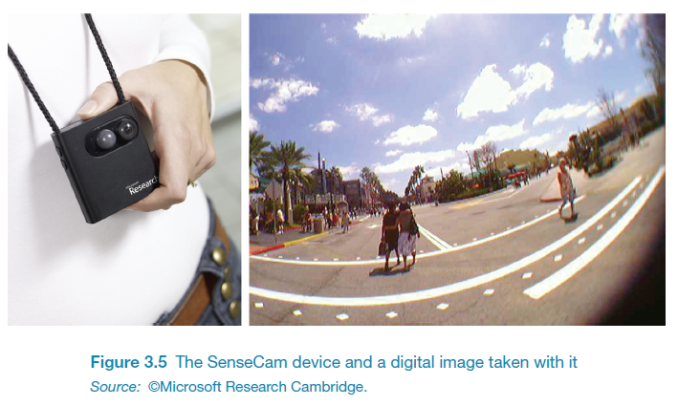
Memory aids
SenseCam developed by Microsoft Research Labs (now Autographer)
a wearable device that intermittently takes photos without any user intervention while worn
digital images taken are stored and revisited using special software
Has been found to improve people’s memory, suffering from Alzheimers

Slide 28
Design implications
Don’t overload users’ memories with complicated procedures for carrying out tasks
Design interfaces that promote recognition rather than recall
Provide users with various ways of encoding information to help them remember
  e.g. categories, color, flagging, time stamping
Notes:
28

Slide 29
Reading, speaking, and listening
The ease with which people can read, listen, or speak differs
  Many prefer listening to reading
  Reading can be quicker than speaking or listening
  Listening requires less cognitive effort than reading or speaking
  Dyslexics have difficulties understanding and recognizing written words

Slide 30
Applications
Speech-recognition systems allow users to interact with them by asking questions
  e.g. Google Voice, Siri, Alexa
Speech-output systems use artificially generated speech
  e.g. written-text-to-speech systems for the blind
Natural-language systems enable users to type in questions and give text-based responses
  e.g. Ask search engine

Slide 31
Learning
How to learn to use a computer-based application
Using a computer-based application or YouTube video to understand a given topic
People find it hard to learn by following instructions in a manual
    prefer to learn by doing

Slide 32
Design implications
Speech-based menus and instructions should be short
Accentuate the intonation of artificially generated speech voices
  they are harder to understand than human voices
Provide opportunities for making text large on a screen

Slide 33
Cognitive prosthetic devices
We rely more and more on the internet and smartphones to look things up
Expecting to have internet access reduces the need and extent to which we remember
Also enhances our memory for knowing where to find it online (Sparrow et al,2011)
What are implications for designing technologies to support how people will learn, and what they learn?

Slide 34
Dilemma
The app mentality developing in the psyche of the younger generation is making it worse for them to make their own decisions because they are becoming risk averse (Gardner and Davis, 2013)
Relying on a multitude of apps means that they are becoming increasingly more anxious about making decisions by themselves
Do you agree? Can you think of an example?

Slide 35
Mental models
Users develop an understanding of a system through learning about and using it
Knowledge is sometimes described as a mental model:
  How to use the system (what to do next)
  What to do with unfamiliar systems or unexpected situations (how the system works)
People make inferences using mental models of how to carry out tasks
Notes:
35

Slide 36
Everyday reasoning and mental models
You arrive home on a cold winter’s night to a cold house. How do you get the house to warm up as quickly as possible?
Set the thermostat to be at its highest or to the desired temperature?
Notes:
36

Slide 37
Heating up a room or oven that is thermostat-controlled
Many people have erroneous mental models (Kempton, 1996)
Why?
  General valve theory, where ‘more is more’ principle is generalised to different settings (e.g. gas pedal, gas cooker, tap, radio volume)
  Thermostats based on model of on-off switch model
Notes:
37

Slide 38
Heating up a room or oven that is thermostat-controlled
Same is often true for understanding how interactive devices and computers work:
  poor, often incomplete, easily confusable, based on inappropriate analogies and superstition (Norman, 1983)
  e.g. elevators and pedestrian crossings - lot of people hit the button at least twice
  Why? Think it will make the lights change faster or ensure the elevator arrives!
Notes:
38

Slide 39
Activity 11
Write down how an ATM works
  How much money are you allowed to take out?
  What denominations?
  If you went to another machine and tried the same what would happen?
  What information is on the strip on your card? How is this used?
  What happens if you enter the wrong number?
  Why does the card stay inside the machine?
  Do you count the money? Why?

Slide 40
Gulfs of execution and evaluation
The ‘gulfs’ explicate the gaps that exist between the user and the interface
The gulf of execution
  the distance from the user to the physical system
The gulf of evaluation
  the distance from the physical system to the user
Notes:
40

Slide 41
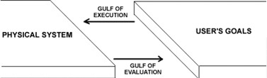
Bridging the gulfs
Bridging the gulfs can reduce cognitive effort required to perform tasks

Slide 42
Model Human processor (Card et al, 1983)
Models the information processes of a user interacting with a computer
Predicts which cognitive processes are involved when a user interacts with a computer
Enables calculations to be made of how long a user will take to carry out a task
Notes:
42

Slide 43
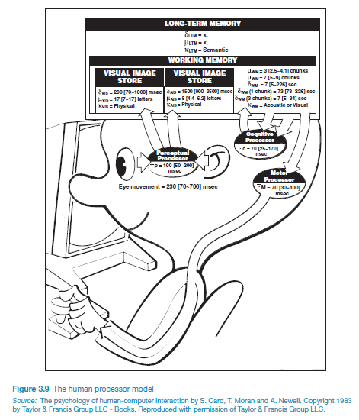
The human processor model
Notes:
43

Slide 44
Limitations
Based on modelling mental activities that happen exclusively inside the head
Do not adequately account for how people interact with computers and other devices in real world

Slide 45
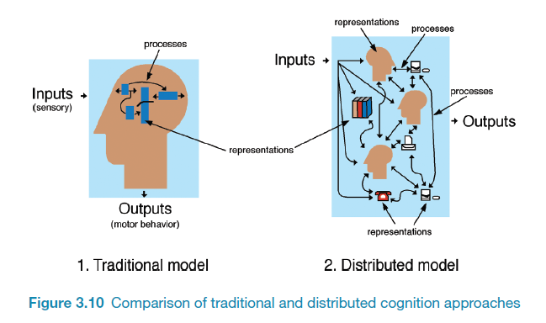
How it differs from information processing
Notes:
45

Slide 46
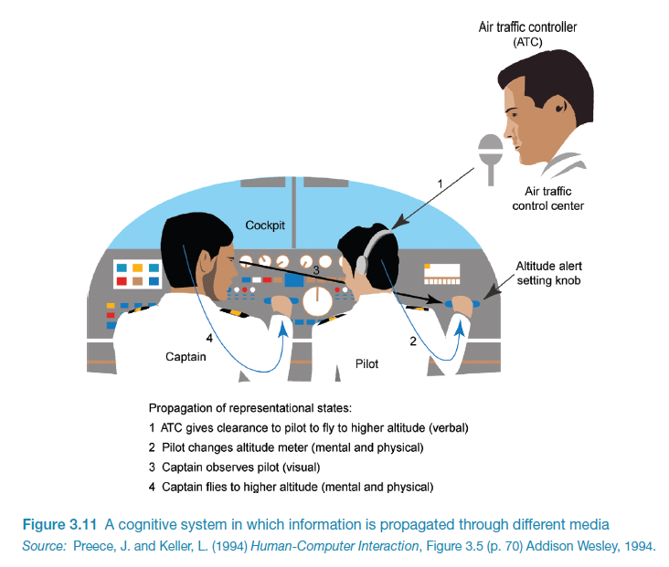

Slide 47
What’s involved
The distributed problem-solving that takes place
The role of verbal and non-verbal behaviour
The various coordinating mechanisms that are used (e.g. rules, procedures)
The communication that takes place as the collaborative activity progresses
How knowledge is shared and accessed
Notes:
47

Slide 48
Distributed cognition
Concerned with the nature of cognitive phenomena across individuals, artefacts, and internal and external representations (Hutchins, 1995)
Describes these in terms of propagation across representational state
Information is transformed through different media (computers, displays, paper, heads)
Notes:
48

Slide 49
External cognition
Concerned with explaining how we interact with external representations (e.g., maps, notes, diagrams)
What are the cognitive benefits and what processes involved
How they extend our cognition
What computer-based representations can we develop to help even more?
  Externalizing
  Computational offloading
  Annotating and cognitive tracing
Notes:
49

Slide 50
Externalizing to reduce memory load
Diaries, reminders, calendars, notes, shopping lists, to-do lists
  written to remind us of what to do
Post-its, piles, marked emails
  where placed indicates priority of what to do
External representations:
  Remind us that we need to do something (e.g. to buy something for mother’s day)
  Remind us of what to do (e.g. buy a card)
  Remind us when to do something (e.g. send a card by a certain date)
Notes:
50

Slide 51
Computational offloading
When a tool is used in conjunction with an external representation to carry out a computation (e.g. pen and paper)
Try doing the two sums below (a) in your head, (b) on a piece of paper and c) with a calculator.
  234 x 456 =??
  CCXXXIIII x CCCCXXXXXVI = ???
Which is easiest and why? Both are identical sums
Notes:
51

Slide 52
Annotation and cognitive tracing
Annotation involves modifying existing representations through making marks
  e.g. crossing off, ticking, underlining
Cognitive tracing involves externally manipulating items into different orders or structures
  e.g. playing Scrabble, playing cards
Notes:
52

Slide 53
Design implication
Provide external representations at the interface that reduce memory load and facilitate computational offloading
  e.g. Information visualizations have been designed to allow people to make sense and rapid decisions about masses of data
Notes:
53

Slide 54
Summary
Cognition involves several processes including attention, memory, perception and learning
The way an interface is designed can greatly affect how well users can perceive, attend, learn and remember how to do their tasks
Theoretical frameworks, such as mental models and external cognition, provide ways of understanding how and why people interact with products
This can lead to thinking about how to design better products
Notes:
54

