Slide 1
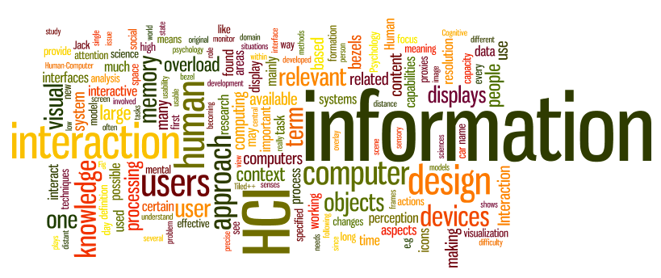
User Interfaces
Dr. Sampath Jayarathna
Old Dominion University
Credit for some of the slides in this lecture goes to www.id-book.com

Slide 2
Why study user interfaces?
Good UIs are critical to success
UI programming is
  easy (sophisticated algorithms not required)
  straightforward (can immediately correct mistakes)
  fun (results are immediately visible)
  rational (apply simple rules)
UI design is not graphic design

Slide 3
Good GUI Rules
Understand People
Be Careful of Different Perspectives
Design for Clarity
Design for Consistency
Provide Visual Feedback
Be Careful With Audible Feedback
Keep Text Clear
Provide Traceable Paths
Provide Keyboard Support
Use Controls Correctly
Design Principles: Visibility, Feedback, Constraints, Consistency, Affordances
Also, Usability and User Experience Goals

Slide 4
Cardinal axiom
“A user interface is well-designed when the program behaves exactly how the user thought it would.” – Joel Spolsky (Stack Overflow, Trello)
  Assume User:
    Have not read the manual
    Have not attend training
    Do not have external help readily at hand
All the other rules are just corollaries:
  Golden rules: place user in control, reduce user’s memory load, make interface consistent

Slide 5
User and program models
User model: User’s idea of what’s happening
Program model: Program’s idea of what’s happening (i.e., what’s actually happening)
Successful UI when program model corresponds to user model
  Speak user’s language: Follow real-world conventions, make information appear in natural and logical order
  Use metaphors from real world

Slide 6
How do you get the user model?
Ask the users!
The 50-cent usability test
  Usually 5-6 people is enough, will start to see consensus
  Don’t need formal usability lab, or “people off the street”
  Just sketch or prototype and ask your neighbor

Slide 7
From problem space to design space
Having a good understanding of the problem space can help inform the design space
  e.g. what kind of interface, behaviour, functionality to provide
But before deciding upon these it is important to develop a conceptual model (mental model)
Notes:
7

Slide 8
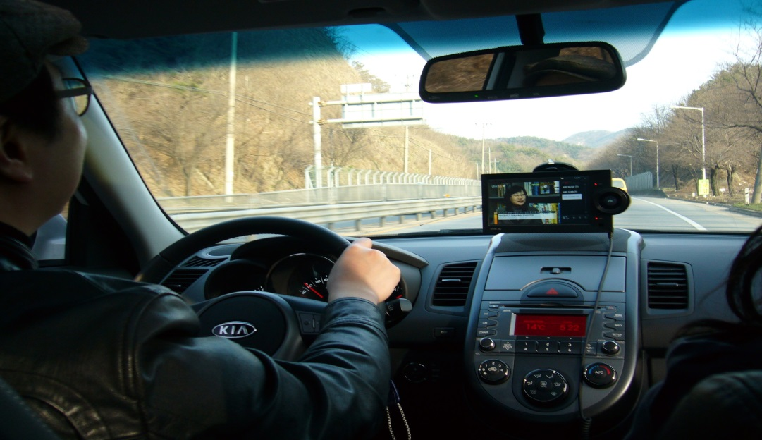
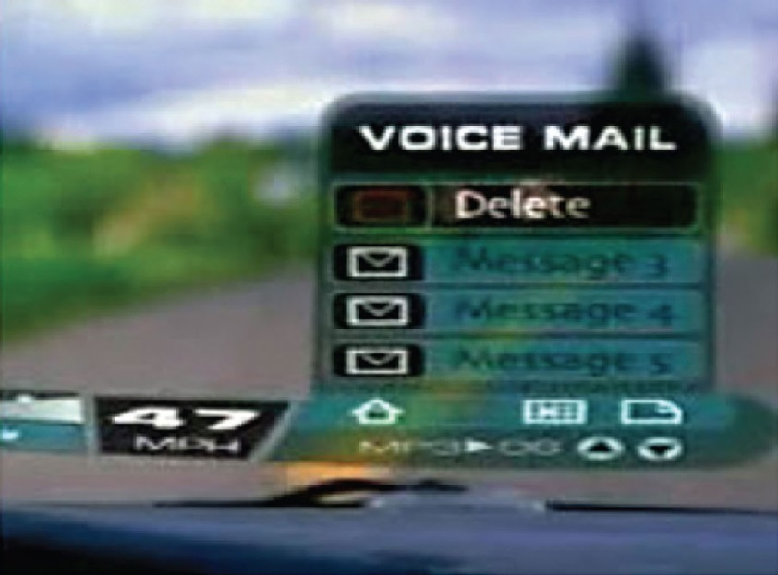
What is an assumption?
taking something for granted when it needs further investigation
  e.g. people will want to watch TV while driving

Slide 9
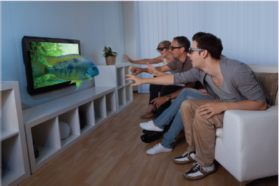
Activity 13
What are the assumptions made about 3D TV?
Write 2-4 assumptions made by 3D TV Industry
Notes:
9

Slide 10
Assumptions
People would not mind wearing the glasses that are needed to see in 3D in their living rooms – reasonable
People would not mind paying a lot more for a new 3D-enabled TV screen – not reasonable
People would really enjoy the enhanced clarity and color detail provided by 3D – reasonable
People will be happy carrying around their own special glasses – reasonable only for a very select bunch of users
Notes:
10

Slide 11
First steps in formulating a conceptual model
What will the users be doing when carrying out their tasks?
How will the system support these?
What kind of interface metaphor, if any, will be appropriate?
What kinds of interaction modes and styles to use?
  - always keep in mind when making design decisions how the user will understand the underlying conceptual model

Slide 12
Interface metaphors
Interface designed to be similar to a physical entity but also has own properties
  e.g. desktop metaphor, web portals
Can be based on activity, object or a combination of both
  e.g. surfing the web
Exploit user’s familiar knowledge, helping them to understand ‘the unfamiliar’
Conjures up the essence of the unfamiliar activity, enabling users to leverage of this to understand more aspects of the unfamiliar functionality

Slide 13
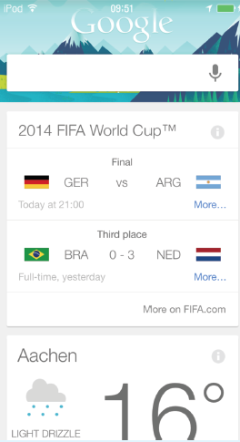
Card UI
The card is a very popular UI
Why?: Has familiar form factor
Material properties are added, giving appearance and physical behavior, e.g. surface of paper
Notes:
Add new image for figure 2.5

Slide 14
Benefits of interface metaphors
Makes learning new systems easier
Helps users understand the underlying conceptual model
Can be very innovative and enable the realm of computers and their applications to be made more accessible to a greater diversity of users

Slide 15
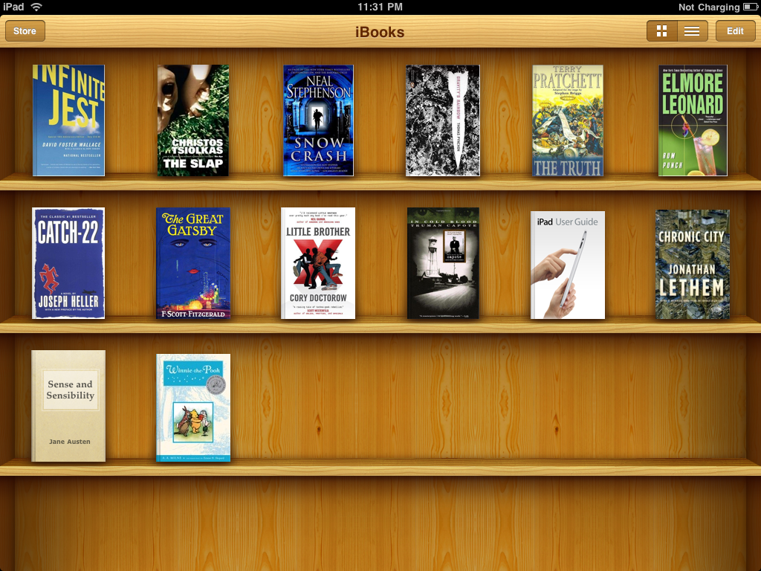
Problems with interface metaphors
Break conventional and cultural rules
  e.g. recycle bin placed on desktop
Can constrain designers in the way they conceptualize a problem space
Conflict with design principles
Forces users to only understand the system in terms of the metaphor
Designers can inadvertently use bad existing designs and transfer the bad parts over
Limits designers’ imagination in coming up with new conceptual models

Slide 16
Interaction types
Instructing
  issuing commands and selecting options
Conversing
  interacting with a system as if having a conversation
Manipulating
  interacting with objects in a virtual or physical space by manipulating them
Exploring
  moving through a virtual environment or a physical space
Notes:
16

Slide 17
1. Instructing
Where users instruct a system and tell it what to do
  e.g. tell the time, print a file, save a file
Very common conceptual model, underlying a diversity of devices and systems
  e.g. word processors, VCRs, vending machines
Main benefit is that instructing supports quick and efficient interaction
  good for repetitive kinds of actions performed on multiple objects

Slide 18
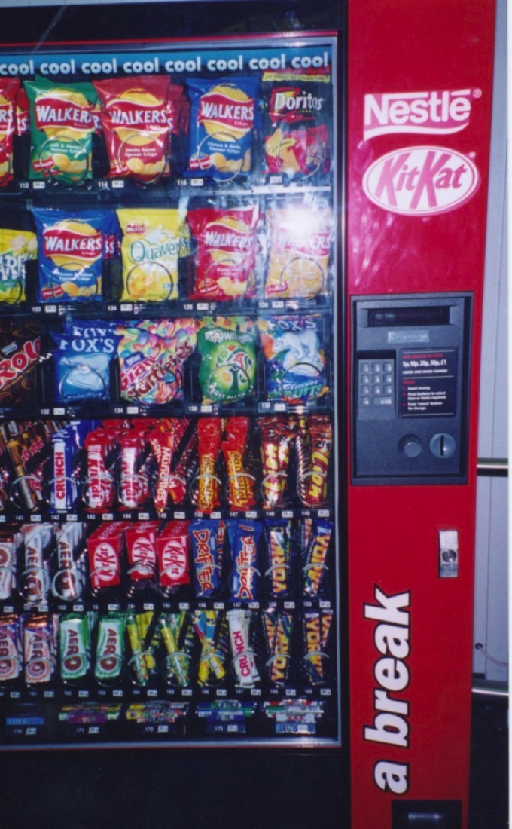
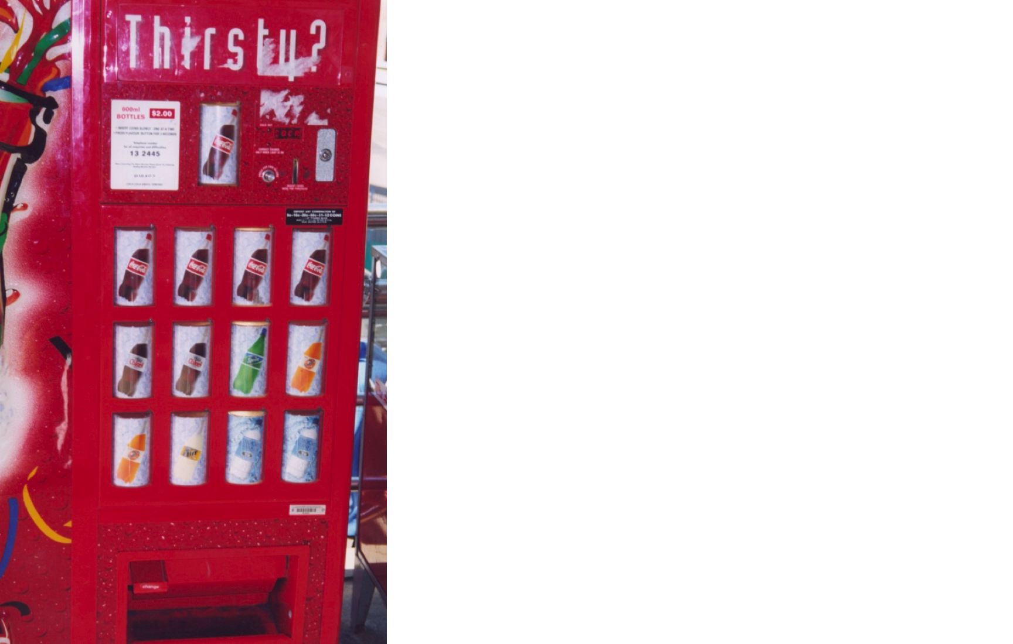
Which is easiest and why?
Notes:
The first vending machine has been designed using simple instructions. There is a small number of drinks to choose from and each is represented by a large button displaying the label of each drink. The user simply has to press one button and this should have the effect of returning the selected drink. The second machine is more complex, offering a wider range of snacks. The trade-off for providing more choices, however, is that the user can no longer instruct the machine by using a simple one-press action but is required to use a more complex process, involving: (i) reading off the code (e.g., C12) under the item chosen, then (ii) keying this into the number pad adjacent to the displayed items, and (iii) checking the price of the selected option and ensuring that the amount of money inserted is the same or greater (depending on whether or not the machine provides change). Problems that can arise from this type of interaction are the customer misreading the code and or miskeying in the code, resulting in the machine not issuing the snack or providing the wrong item.
A better way of designing an interface for a large number of choices of variable cost might be to continue to use direct mapping, but use buttons that show miniature versions of the snacks placed in a large matrix (rather than showing actual versions). This would use the available space at the front of the vending machine more economically. The customer would need only to press the button of the object chosen and put in the correct amount of money. There is less chance of error resulting from pressing the wrong code or keys. The trade-off for the vending company, however, is that the machine is less flexible in terms of which snacks it can sell. If a new product line comes out they will also need to replace part of the physical interface to the machine – which would be costly.
18

Slide 19
2. Conversing
Underlying model of having a conversation with another human
Range from simple voice recognition menu-driven systems to more complex ‘natural language’ dialogs
Examples include virtual assistants, timetables, search engines, advice-giving systems, help systems
Also toys and pet robots designed to converse with you
Notes:
19

Slide 20
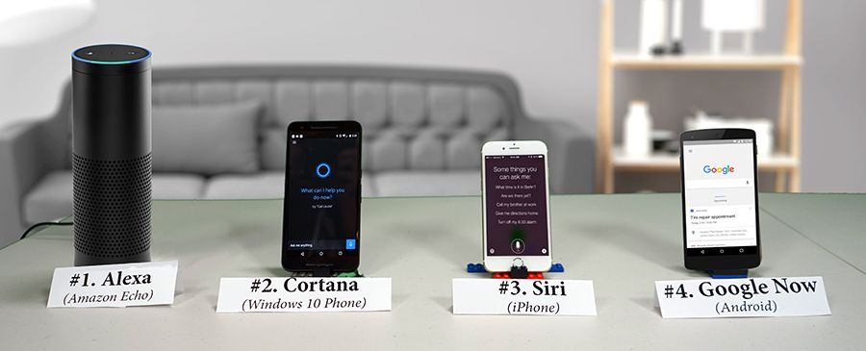
Pros and cons of conversational model
Allows users, especially novices and technophobes, to interact with the system in a way that is familiar
  makes them feel comfortable, at ease and less scared
Misunderstandings can arise when the system does not know how to parse what the user says

Slide 21
3. Manipulating
Involves dragging, selecting, opening, closing and zooming actions on virtual objects
Exploit’s users’ knowledge of how they move and manipulate in the physical world
Can involve actions using physical controllers (e.g. Wii) or air gestures (e.g. Kinect) to control the movements of an on screen avatar
Tagged physical objects (e.g. balls) that are manipulated in a physical world result in physical/digital events (e.g. animation)
Notes:
21

Slide 22
Direct Manipulation
Shneiderman (1983) coined the term DM, came from his fascination with computer games at the time
  Continuous representation of objects and actions of interest
  Physical actions and button pressing instead of issuing commands with complex syntax
  Rapid reversible actions with immediate feedback on object of interest
Notes:
22

Slide 23
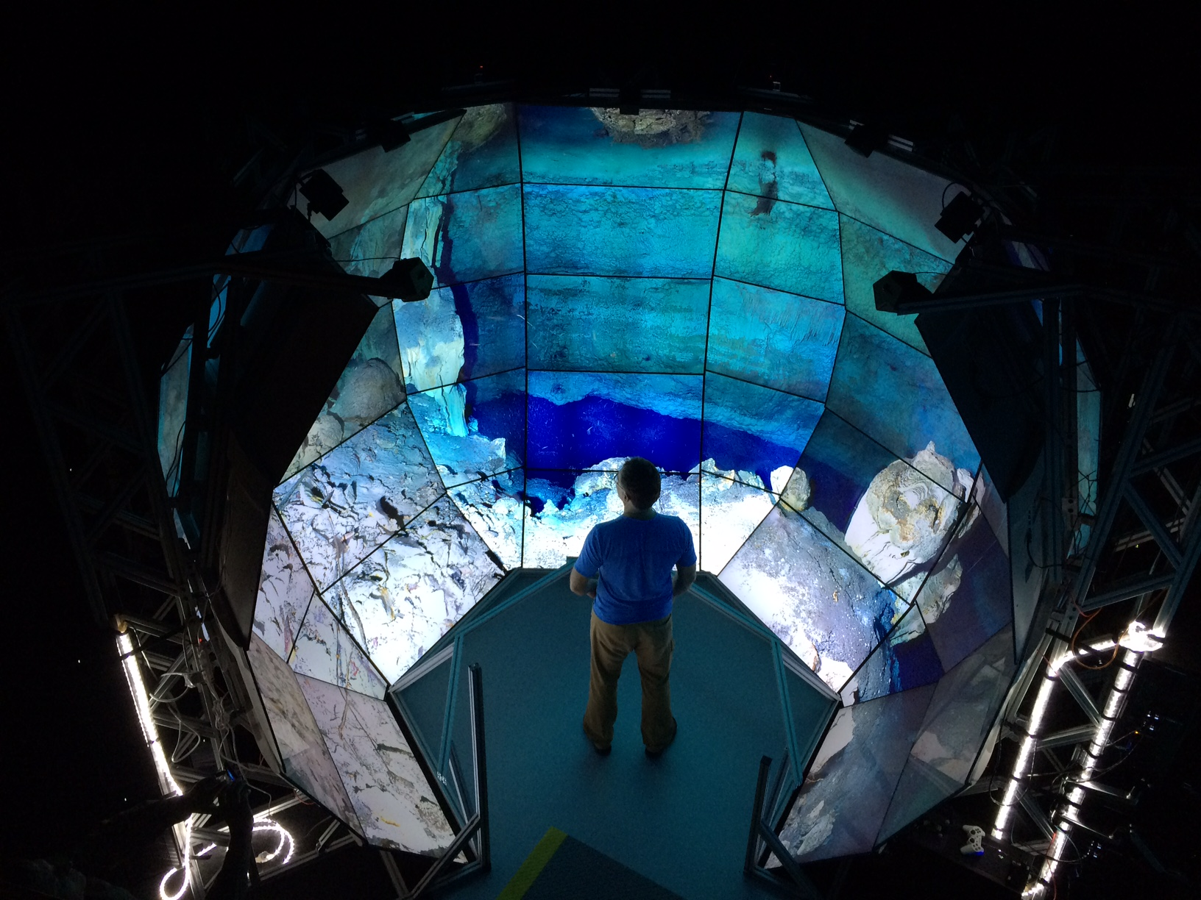
4. Exploring
Involves users moving through virtual or physical environments
Physical environments with embedded sensor technologies

Slide 24
Which conceptual model is best?
Direct manipulation is good for ‘doing’ types of tasks, e.g. designing, drawing, flying, driving, sizing windows
Issuing instructions is good for repetitive tasks, e.g. spell-checking, file management
Having a conversation is good for children, computer-phobic, disabled users and specialised applications (e.g. phone services)
Hybrid conceptual models are often employed, where different ways of carrying out the same actions is supported at the interface - but can take longer to learn
Notes:
24

Slide 25
WIMP and GUI
Xerox Star first WIMP -> rise to GUIs
Windows
  could be scrolled, stretched, overlapped, opened, closed, and moved around the screen using the mouse
Icons
  represented applications, objects, commands, and tools that were opened when clicked on
Menus
  offering lists of options that could be scrolled through and selected
Pointing device
  a mouse controlling the cursor as a point of entry to the windows, menus, and icons on the screen
Notes:
25

Slide 26
GUIs
Same basic building blocks as WIMPs but more varied
  Color, 3D, sound, animation,
  Many types of menus, icons, windows
New graphical elements, e.g.
  toolbars, tabs, ribbons
Challenge now is to design GUIs that are best suited for tablet, smartphone/smartwatch, and wearables
Notes:
26

Slide 27
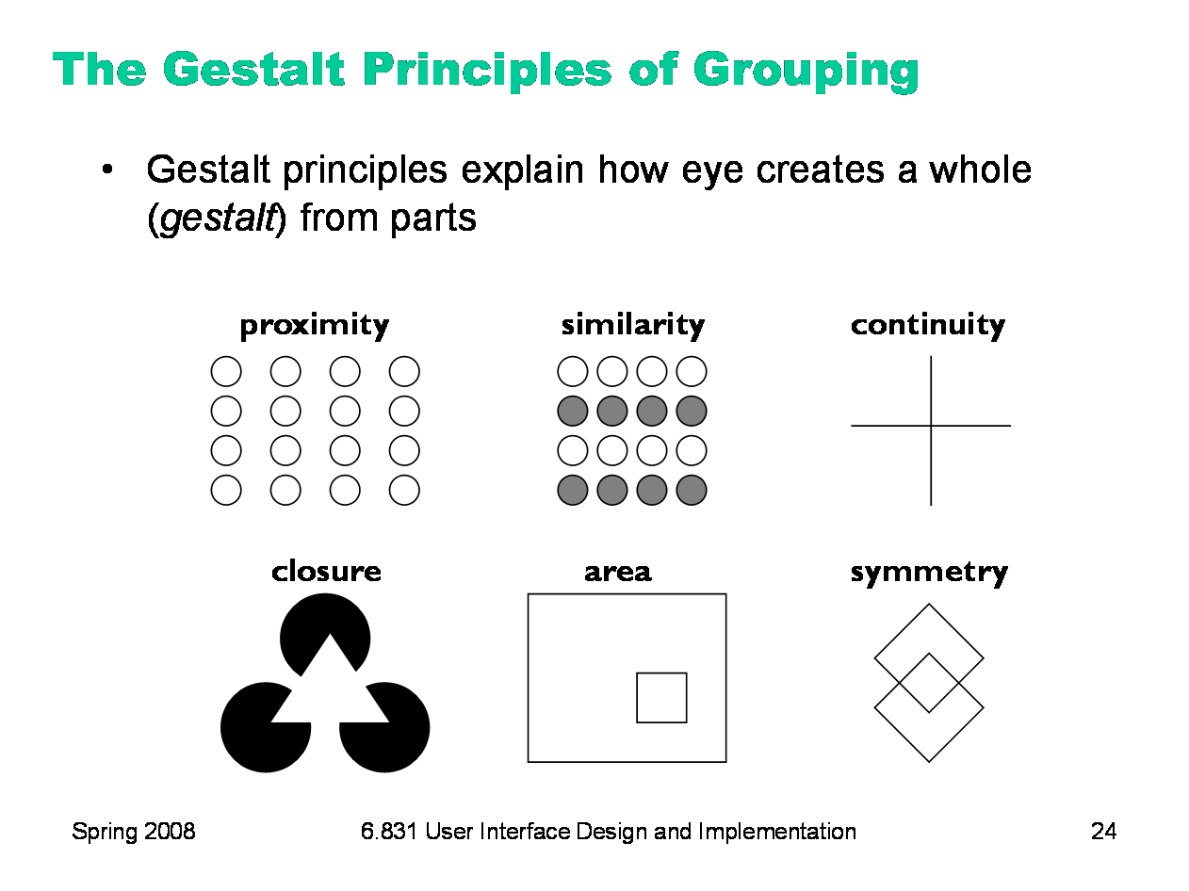
Four Gestalt Principles of Perception
Gestalt laws, are rules of the organization of perceptual scenes.
When we look at the world, we usually perceive complex scenes composed of many groups of objects on some background, with the objects themselves consisting of parts, which may be composed of smaller parts

Slide 28
Principle 1: Proximity
Our eyes/brain logically group together visual elements that are “proximate” (close) to one another.
Given the following image, do you see
  Six squares?
  Three groups of two squares?
More will answer “Three groups of two squares”

Slide 29
Proximity Example
Items close together appear to have a relationship
Distance implies no relationship
Time:
Time:

Slide 30
Visual Structure (Proximity) Reinforces Logical Structure
Proximity creates groups to reinforce alphabetization
ATE GET
BAT GOT
BIT HAT
CAT HIT
DOG HOT
EAT LAP
FAR MAP
FAT PAT
ATE BAT BIT CAT DOG EAT
FAR FAT GET GOT HAT HIT
HOT LAP MAP PAT

Slide 31
Principle 2: Similarity
Our eyes/brain logically group together visual elements that are similar to one another.
Given the following image, do you see
  Six circles
  Three groups of two circles
More will answer “Three groups of two circles”

Slide 32
Similarity Example
Given the following image, do you see
  Six letter ‘A’s?
  Three groups of two ‘A’s?
More will answer “Three groups of two ‘A’s”
AAAAAA

Slide 33
Similarity Creates a Typographical Hierarchy
This is a level 1 heading
This is a level 2 heading
This is another level 2 heading
This is a level 3 heading
Yet another level 3 heading
Back up to level 2
Down to level 3
Still at level 3
Back to level 1

Slide 34
Principle 3: Area (Common Fate)
We group elements that move in the same direction.
Our eyes/brain associate elements that are similar to one another (not same as similarity for grouping).
What associations do you see here?
Lines are not vertically aligned
=> do not have common fate
=> do not seem grouped together
Lines are vertically aligned
=> do have common fate
=> do seem grouped together

Slide 35
Grids Provide Structure Using Common Fate
Grids are (hidden) horizontal and vertical lines
  They help place graphic elements
Alignment to same grid line creates logical grouping
  Common fate
Grids avoid disconcerting irregularities
  That attract the eye

Slide 36
Grids Provide Structure Using Common Fate
Grids are (hidden) horizontal and vertical lines
  They help place graphic elements
Alignment to same grid line creates logical grouping
  Common fate
Grids avoid disconcerting irregularities
  That attract the eye

Slide 37
Principle 4: Closure
Our eyes/brain logically group together visual elements that approximate a closed shape, to form that closed shape
Given the following image, do you see
  Twelve dots?
  A circle?
More will answer “A circle”

Slide 38
Closure Example
Given the following image, do you see
  Eleven dots?
  A circle?
More will answer “A circle” - despite the missing dot

Slide 39
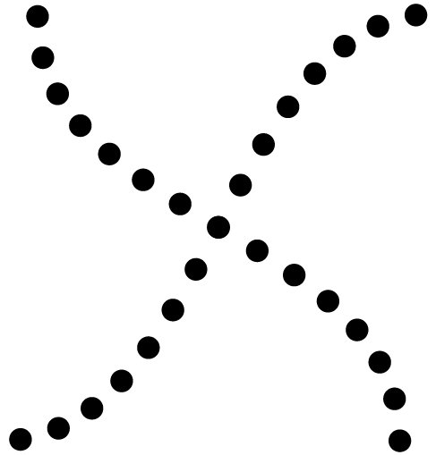
Principle 5: Continuity
The law of continuity suggests that we are more likely to perceive continuous, smooth flowing lines rather than jagged, broken lines
Given the following image, do you see
  Line of dots?
  An X?
More will answer “An X”

Slide 40
Principles can be Combined
Proximity and similarity => grouping
Proximity and closure => grouping

Slide 41
Combining Principles - Menu Example
No visual structure to reinforce logical structure
Grouping created by
Proximity within clusters
Visual separation between clusters
Hierarchy created by
Indentation (common fate)
Rotate X
Rotate Y
Rotate Z
Zoom In
Zoom Out
Rotate X
Rotate Y
Rotate Z
Zoom In
Zoom Out
Rotate
X
Y
Z
Zoom
In
Out

Slide 42
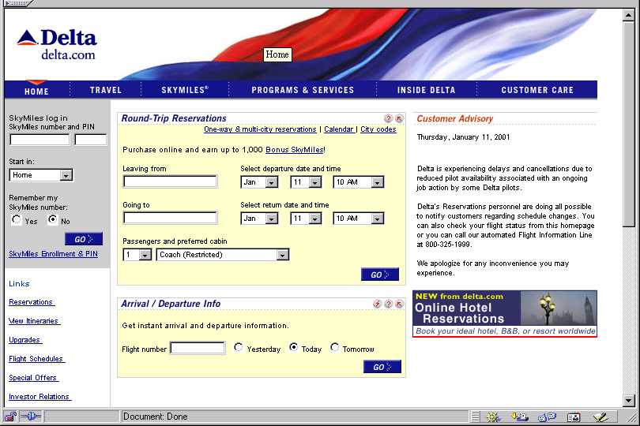
Combining Principles – Web Example
Grouping defined
by background
(common fate)
and by box (closure)
Grouping defined by
background
(common fate)
Grid
(common fate)
www.delta.com

Slide 43
Grouping: Poor Dialogue Box Design
Logical structure hard to understand – proximity problem

Slide 44
Which is the Logical Structure?

Slide 45
Grouping: Two solutions; Which is Better?
More vertical space
creates
less vertical proximity
Horizontal rule creates
two areas (closure) to
overcome proximity

Slide 46
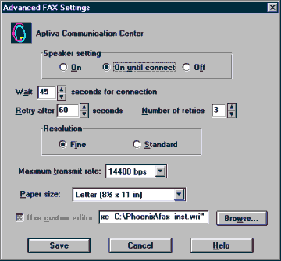
Bad Example
No gridding
Inconsistent use of visual cues for grouping
Inconsistent space between label and data

Slide 47
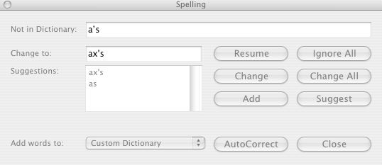
A Well-Designed Dialogue Box
Strong grid structure
(common fate)

Slide 48
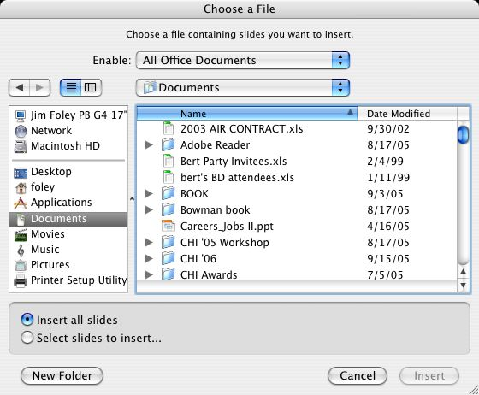
Another Well-Designed Dialogue Box
Strong grid structure
(common fate)
Horizontal line uses closure
to create two groups and
counter proximity
Box surrounding related
Items (closure)
Different background color
(common fate)

Slide 49




Activity 14
(A)
(B)
(C)
(D)

Slide 50
Menus
A number of menu interface styles
  flat lists, drop-down, pop-up, contextual, and expanding ones, e.g., scrolling and cascading
Choice of menu to use determined by application and type of system
  flat menus are best for displaying a small number of options at one time
  expanding menus are good for showing a large number of options
Notes:
50

Slide 51
Icons: Research and design issues
There is a wealth of resources now so do not have to draw or invent new icons from scratch
  guidelines, style guides, icon builders, libraries
Text labels can be used alongside icons to help identification for small icon sets
Notes:
51

Slide 52
Information visualization and dashboards
Computer-generated interactive graphics of complex data
Amplify human cognition, enabling users to see patterns, trends, and anomalies in the visualization (Card et al, 1999)
Aim is to enhance discovery, decision-making, and explanation of phenomena
Techniques include:
  3D interactive maps that can be zoomed in and out of and which present data via webs, trees, clusters, scatterplot diagrams, and interconnected nodes

Slide 53
In your face ads
Web advertising is often intrusive and pervasive
Flashing, aggressive, persistent, annoying
Often need to be ‘actioned’ to get rid of
What is the alternative?
Notes:
Web advertising has become pervasive and invasive. Advertisers realized how effective flashing and animated ads were for promoting their products, taking inspiration from the animated neon light adverts used in city centers, such as London’s Piccadilly Circus. But since the banner ads (the 728 x 90 pixel ads that were placed at the top of web pages) emerged in the 90s, they have become even more cunning and aggressive in their tactics. In addition to designing even flashier banner ads, more intrusive kinds of web ads have begun to appear on our screens. Short movies and garish cartoon animations – often with sound – now pop up in floating windows that zoom into view or tagged on at the front end of a online newspaper or magazine news videoclip. Moreover, this new breed of in-your-face web ads often requires the user to either sit and wait till it ends or find a checkbox to close the window down. This can be really annoying to have to do especially when multiple ad windows open up. Sites that provide free services, such as Facebook, YouTube and Gmail, have also become populated with web ads. Many people choose to ignore them or simply put up with them. However, as advertisers get even more aggressive in their tactics there will be a point where that will become harder to do. The problem is advertisers pay significant revenues to online companies to have their adverts placed on their websites entitling them to say where, what and how they should appear
53

Slide 54
Air-based gestures
Uses camera recognition, sensor and computer vision techniques
  can recognize people’s body, arm and hand gestures in a room
  systems include Kinect
Movements are mapped onto a variety of gaming motions, such as swinging, bowling, hitting and punching
Does holding a control device feel more intuitive than controller free gestures?
  For gaming, exercising, dancing

Slide 55
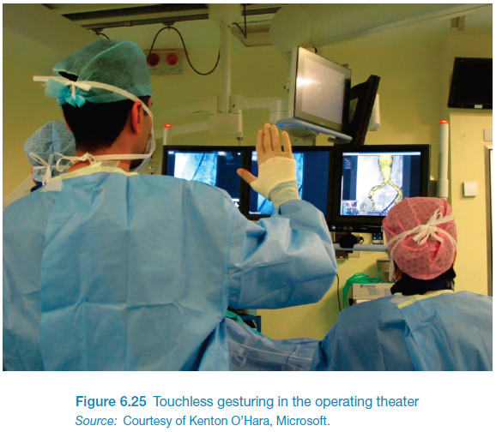
Gestures in the operating theatre
A touchless system that recognizes gestures
surgeons can interact with and manipulate MRI or CT images
  e.g. two-handed gestures for zooming and panning

Slide 56
Haptic
Tactile feedback
  applying vibration and forces to a person’s body, using actuators that are embedded in their clothing or a device they are carrying, such as a smartphone
Can enrich user experience or nudge them to correct error
Can also be used to simulate the sense of touch between remote people who want to communicate

Slide 57
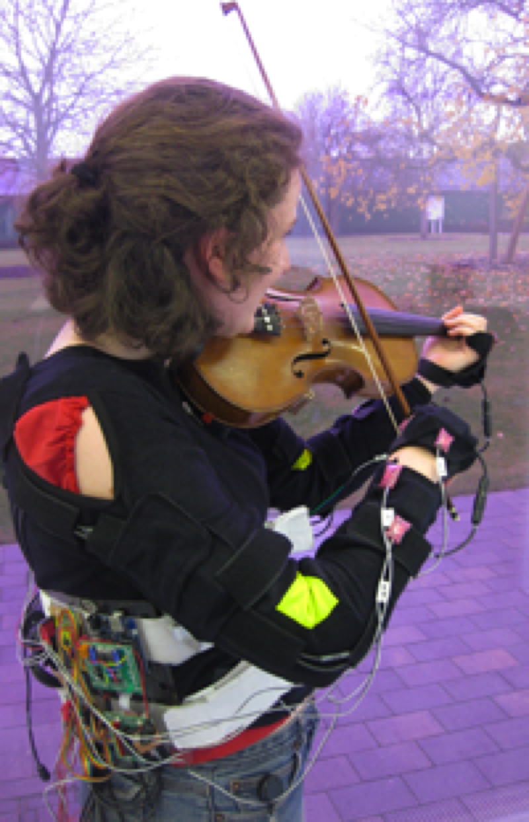
Realtime vibrotactile feedback
Provides nudges when
playing incorrectly
Uses motion capture
Nudges are vibrations
on arms and hands

Slide 58
Research and design issues
Where best to place actuators on body
Whether to use single or sequence of ‘touches’
When to buzz and how intense
How does the wearer feel it in different contexts?
What kind of new smartphones/smart-watches apps can use vibrotactile creatively?
  e.g. slow tapping to feel like water dropping that is meant to indicate it is about to rain and heavy tapping to indicate a thunderstorm is looming
Notes:
Haptics are now commonly used in gaming consoles and controllers to heighten the experience. Haptic feedback is also being developed in clothing and other wearables as a way of simulating being touched, stroked, prodded or buzzed. A promising application area is sensory-motor skills, such as in sports training and learning to play a musical instrument. For example, patterns of vibrations have been played across snowboarders bodies to indicate which moves to take whilst snowboarding. A study reported faster reaction times than when the same instructions were given verbally (Spelmezan et al, 2009). A key design question is where best to place the actuators on the body, whether to use a single or a sequence of touches, when to activate, what intensity and how often to use them to make the feeling of being touched convincing (e.g. Jones and Sarter, 2008). Providing continuous haptic feedback would be simply too annoying. People would also habituate too quickly to the feedback. Intermittent buzzes can be effective at key moments when a person needs to attend to something but not necessarily tell them what to do. For example, a study by Johnson et al (2010) of a commercially available haptic device, intended to improve posture through giving people a vibrotactile buzz whenever they slouched, found that while the buzzing did not show them how to improve their posture it did improve their body awareness.
58

Slide 59
Multi-modal
Meant to provide enriched and complex user experiences
  multiplying how information is experienced and detected using different modalities, i.e. touch, sight, sound, speech
  support more flexible, efficient, and expressive means of human–computer interaction
  Most common is speech and vision

Slide 60
Wearables
First developments were head- and eyewear-mounted cameras that enabled user to record what was seen and to access digital information
Since, jewellery, head-mounted caps, smart fabrics, glasses, shoes, and jackets have all been used
  provide the user with a means of interacting with digital information while on the move
Applications include automatic diaries, tour guides, cycle indicators and fashion clothing
Notes:
60
Imagine being at a party and being able to access the Facebook of a person whom you have just met, while or after talking to her to find out more about her. The possibility of having instant information before one’s very own eyes that is contextually relevant to an ongoing activity and that can be viewed surreptitiously (i.e. without having to physically pull out a smartphone) is very appealing.

Slide 61
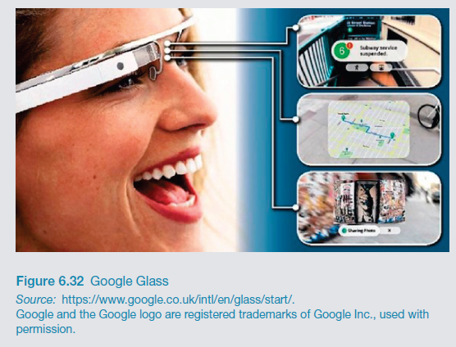
Google Glass: short-lived
What were the pros and cons?
Notes:
Google glass was designed to look like a pair of glasses, but with one lens of the glass being an interactive display with an embedded camera, that can be controlled with speech input. It allows the wearer to take photos and video on the move and look at digital content, such as emails, texts, and maps. The wearer can also search the web using voice commands and the results come back on the screen. A number of applications have been developed besides everyday use, including WatchMeTalk that provides live captions that helps the hearing-impaired in their day-to-day conversations and Preview for Glass that enables a wearer to watch a movie trailer the moment they look at a movie poster.
It stopped being sold at the end of 2014. It was considered slightly unnerving when in the company of someone wearing Google Glass as they look up and to the right to view what is on the glass screen rather than at you and into your eyes. As a result you might see more of the whites of their eyes than the usual interested dilated pupils. Could this be the end of eye contact as we know it? One of the criticisms of early wearers of Google Glass was that it made them appear to be staring into the distance.
Others are worried that those wearing Google Glass are recording everything that is happening in front of them. As a reaction a number of bars and restaurants in San Francisco and other cities have implemented a “no Glass” policy to prevent customers from recording other patrons. There has also been much debate in the press about the latest developments in facial recognition. There are apps developed for Google Glass that take a picture of the person you are talking with and then check their online profile, providing a cloud of personal information about them, presumably mined from Facebook and other social media apps. So, you can find out more about someone on the go while talking to them – for example, what music they like, what films they have just seen, where they have just been on vacation, and so on – all in a digestible précis surrounded by a halo of photos. One could imagine that if this way of meeting up with others actually takes off, we might find ourselves in the situation where we won’t need to talk to each other anymore. Just as text messaging has largely taken over from making phone calls for many people, ‘cloud talk’ could start taking over our initial encounters with people when we meet them at parties, at conferences, on trains etc. We might nod and smile in acknowledgement of each other but we won’t ever have to have those awkward conversations anymore, such as about where you come from or what you do for work. A panacea for the shy? But how will we know what each other is looking at? You might think I am reading your blog or tweets when in your presence but really I might just be watching the latest updates of the football results and pretending to ‘meet you’.

Slide 62
Research and design issues
Comfort
  needs to be light, small, not get in the way, fashionable, and preferably hidden in the clothing
Hygiene
  is it possible to wash or clean the clothing once worn?
Ease of wear
  how easy is it to remove the electronic gadgetry and replace it?
Usability
  how does the user control the devices that are embedded in the clothing?
Notes:
62

Slide 63
Summary
Many innovative interfaces have emerged post the WIMP/GUI era, including speech, wearable, mobile, brain and tangible
Raises many design and research questions to decide which to use
  e.g. how best to represent information to the user so they can carry out ongoing activity or task
New interfaces that are context-aware or monitor raise ethical issues concerned with what data is being collected and what it is used for
Notes:
63

