Slide 1
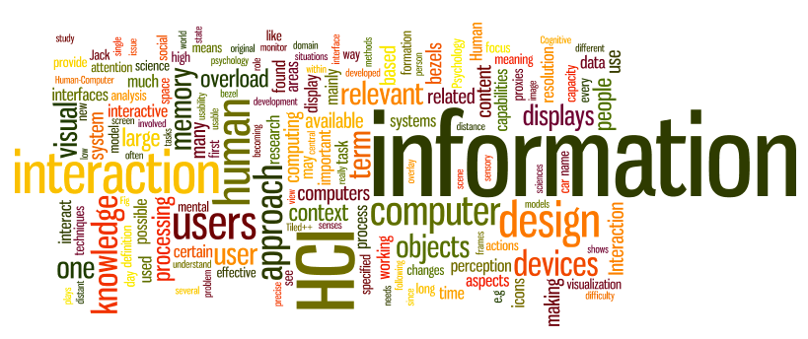
Evaluations
Dr. Sampath Jayarathna
Old Dominion University
Credit for some of the slides in this lecture goes to www.id-book.com

Slide 2
System Development Cycle
Designers need to check whether the their ideas are really what users need/want; or whether the final product works as expected.
To do that, we need some form of methods, or more specifically, empirical methods for HCI.

Slide 3
Evaluation Methods
Inspection methods (no users needed)
  Heuristic Evaluations
  Cognitive Walkthroughs
User Tests (users needed!)
  Observations/ Ethnography
  Usability tests/ Controlled experiments,
    On-line, remote usability tests

Slide 4
Inspection Methods
Experts use their knowledge of users & technology to review system usability.
Expert critiques can be formal or informal reports.
Benefits:
  Generate results quickly with low cost.
  Can be used early in the design phases
Heuristic evaluation is a review guided by a set of heuristics.

Slide 5
“Discount” Usability Engineering
Cheap
  no special labs or equipment needed
  the more careful you are, the better it gets
Fast
  on order of 1 day to apply
  standard usability testing may take a week
Easy to use
  can be taught in 2-4 hours

Slide 6
Heuristic Evaluation
Developed by Jakob Nielsen
Helps find usability problems in a UI design
Small set (3-5) of evaluators examine UI
  independently check for compliance with usability principles (“heuristics”)
  different evaluators will find different problems
  evaluators only communicate afterwards
    findings are then aggregated
Can perform on working UI or on sketches
These heuristics have been revised for current technology by Nielsen and others for:
  mobile devices,
  wearables,
  virtual worlds, etc.

Slide 7
Revised version (2014) of Nielsen’s original heuristics
H-1: Visibility of system status.
H-2: Match between system and real world.
H-3: User control and freedom.
H-4: Consistency and standards.
H-5: Error prevention.
H-6: Recognition rather than recall.
H-7: Flexibility and efficiency of use.
H-8: Aesthetic and minimalist design.
H-9: Help users recognize, diagnose, recover from errors.
H-10: Help and documentation.
Notes:
7

Slide 8
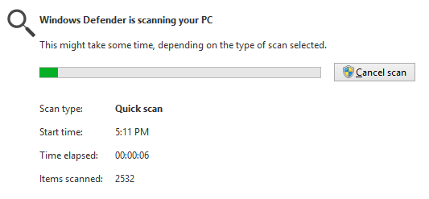
Heuristics
H-1: Visibility of system status
  The system should always keep users
  informed about what is going on, through
  appropriate feedback within reasonable time
0.1 second is about the limit for having the user feel that the system is reacting instantaneously, meaning that no special feedback is necessary except to display the result.
1.0 second is about the limit for the user's flow of thought to stay uninterrupted, even though the user will notice the delay. Normally, no special feedback is necessary during delays of more than 0.1 but less than 1.0 second, but the user does lose the feeling of operating directly on the data.
10 seconds is about the limit for keeping the user's attention focused on the dialogue. For longer delays, users will want to perform other tasks while waiting for the computer to finish, so they should be given feedback indicating when the computer expects to be done. Feedback during the delay is especially important if the response time is likely to be highly variable, since users will then not know what to expect.
Notes:
E.g. WWW forms should be able to immediately inform the user of misfilled fields
Error messages should vanish from screen after error has been corrected
If a task takes a long time, a task progress indicator should be used to inform the user
0.1 sec: no special indicators needed, why?
1.0 sec: user tends to lose track of data
10 sec: max. duration if user to stay focused on action
for longer delays, use percent-done progress bars

Slide 9
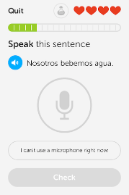
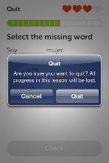
Heuristics
H-2: Match between system & real world
  speak the users’ language
  follow real world conventions, e.g., Metaphors
H-3: User control & freedom
  “emergency exits” for mistaken choices,
  undo, redo
  don’t force down fixed paths
  If an operation takes more than 10 seconds
  user should be able to cancel it.
Notes:
E.g. WWW forms should be able to immediately inform the user of misfilled fields
Error messages should vanish from screen after error has been corrected
If a task takes a long time, a task progress indicator should be used to inform the user
0.1 sec: no special indicators needed, why?
1.0 sec: user tends to lose track of data
10 sec: max. duration if user to stay focused on action
for longer delays, use percent-done progress bars

Slide 10
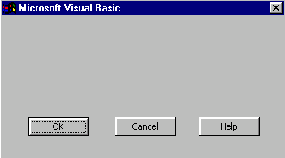
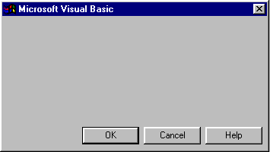
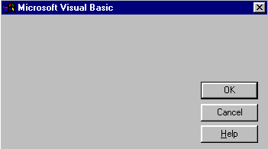
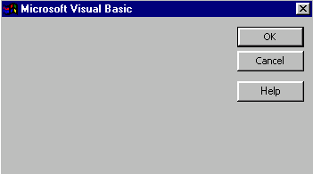
Heuristics (cont.)
H-4: Consistency & standards
  Users should not have to wonder whether different words, situations, or actions mean the same thing. Follow platform conventions
UI should be consistent troughout application
E.g. layout of UI components should not change
Especially shortcuts, like keyboard combinations, should remain the same
Style guides should be produced and used

Slide 11
Heuristics (cont.)
H-5: Error prevention
  Even better than good error messages is a careful design which prevents a problem from occurring in the first place. Either eliminate error-prone conditions or check for them and present users with a confirmation option before they commit to the action
H-6: Recognition rather than recall
  Minimize the user's memory load by making objects, actions, and options visible.
  Instructions for use of the system should be visible or easily retrievable whenever appropriate

Slide 12
Heuristics (cont.)
Edit
Cut
Copy
Paste
H-7: Flexibility and efficiency of use
  accelerators for experts (e.g., gestures, kb shortcuts)
  allow users to tailor frequent actions (e.g., macros)
  UIs can be of an adaptive kind
    User’s actions are observed
    UI automatically adjusts itself to the most suitable form
  UIs could, for example, automatically progress from novice level to expert level

Slide 13
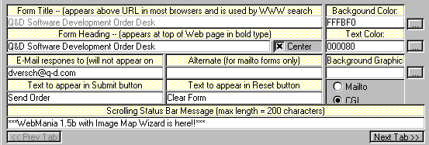
Heuristics (cont.)
H-8: Aesthetic and minimalist design
  Dialogues should not contain information which is irrelevant or rarely needed. Every extra unit of information in a dialogue competes with the relevant units of information and diminishes their relative visibility.

Slide 14
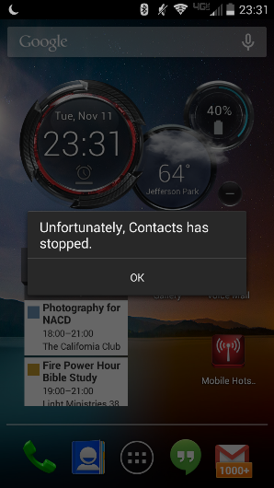
Heuristics (cont.)
H-9: Help users recognize, diagnose, and recover from errors
  error messages in plain language (no codes)
  precisely indicate the problem
  constructively suggest a solution
Error messages can be used as explanations of application’s conceptual model
Expressions should be polite/neutral

Slide 15
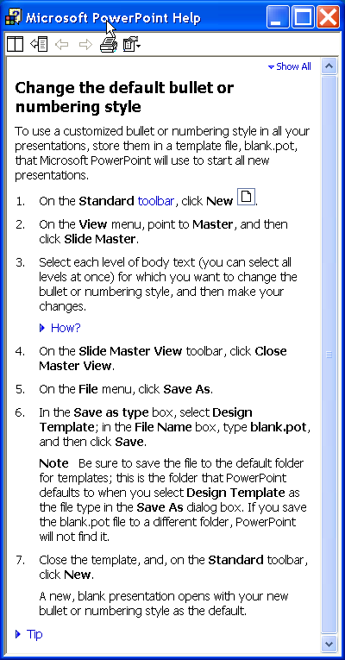
Heuristics (cont.)
H-10: Help and documentation
  easy to search
  focused on the user’s task
  list concrete steps to carry out
  not too large
Documentations are used by users as a last resort
Online docs may be better than printed ones
  fast search functions
  do not require a shift in eyesights focus
Writing a good set of instructions is a demanding task

Slide 16
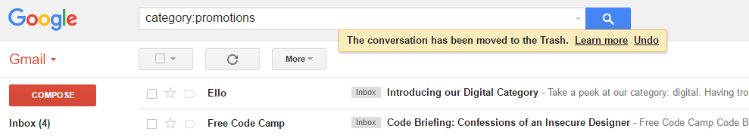
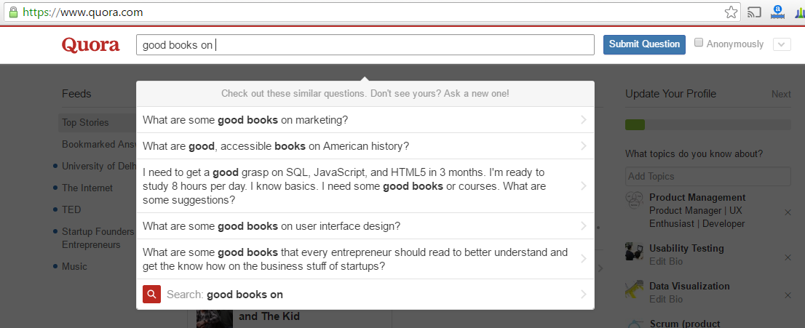

Activity 15: Identify each Heuristic used here!
Gmail’s flash message with undo action when we accidentally delete an email
Quora suggesting possible questions based on what I am trying to type
Neil Patel could very well say “Sign Up” on his landing page. Instead, he chose to say ambitiously — “Yes, I want Neil to teach me how to grow my Business!”.

Slide 17
Phases of Heuristic Evaluation
1) Pre-evaluation training
  give evaluators needed domain knowledge and information on the scenario
2) Evaluation
  individuals evaluate and then aggregate results
3) Severity rating
  determine how severe each problem is (priority)
    can do this first individually & then as a group
4) Debriefing
  discuss the outcome with design team

Slide 18
4 stages for doing heuristic evaluation
Briefing session to tell experts what to do.
  If system is walk-up-and-use or evaluators are domain experts, no assistance needed.
  otherwise might supply evaluators with scenarios
Evaluation period of 1-2 hours in which:
  Each expert works separately;
  Take one pass to get a feel for the product;
  Take a second pass to focus on specific features.
Each evaluator produces list of problems
  explain why with reference to heuristic or other information
  be specific and list each problem separately
Debriefing session in which experts work together to prioritize problems.
Notes:
18

Slide 19
Heuristic evaluation
Can’t copy info from one window to another
  violates “User Control and freedom” (H-3)
  fix: allow copying
Typography uses mix of upper/lower case formats and fonts
  violates “Consistency and standards” (H-4)
  slows users down
  probably wouldn’t be found by user testing
  fix: pick a single format for entire interface

Slide 20
Severity Rating
Used to allocate resources to fix problems
Estimates of need for more usability efforts
Combination of
  frequency
  impact
  persistence (one time or repeating)
Should be calculated after all evaluations are in
Should be done independently by all judges

Slide 21
Severity Ratings (cont.)
0 - don’t agree that this is a usability problem
1 - cosmetic problem
2 - minor usability problem
3 - major usability problem; important to fix
4 - usability catastrophe; imperative to fix

Slide 22
Severity Ratings Example
1. [H-4 Consistency] [Severity 3]
The interface used the string "Save" on the first screen for saving the user's file, but used the string "Write file" on the second screen. Users may be confused by this different terminology for the same function.

Slide 23
Debriefing
Conduct with evaluators, observers, and development team members
Discuss general characteristics of UI
Suggest potential improvements to address major usability problems
Dev. team rates how hard things are to fix
Make it a brainstorming session
  little criticism until end of session

Slide 24
Advantages and problems
Few ethical & practical issues to consider because users not involved.
Can be difficult & expensive to find experts.
Best experts have knowledge of application domain & users.
Biggest problems:
  Important problems may get missed;
  Many trivial problems are often identified;
  Experts have biases.
Notes:
24

Slide 25
Number of evaluators
Nielsen suggests that on average 5 evaluators identify 75-80% of usability problems.
Single evaluator achieves poor results
  only finds 35% of usability problems
  5 evaluators find ~ 75% of usability problems
  why not more evaluators???? 10? 20?
    adding evaluators costs more
    many evaluators won’t find many more problems
Notes:
25

Slide 26
Individual vs. Teams
Nielsen
  Recommends individual evaluations inspect the interface alone
Why?
  Evaluation is not influenced by others
  Independent and unbiased
  Greater variability in the kinds of errors found
  No overhead required to organize group meetings
Notes:
26

Slide 27
Self Guided vs. Scenario Exploration
Self- guided
  Open ended exploration
  Not necessarily task-directed
  Good for exploring diverse aspects of the interface, and to follow potential pitfalls
Scenarios
  Step through the interface using representative end user tasks
  Ensures problems identified in relevant portions of the interface
  Ensures that specific features of interest are evaluated
  But limits the scope of the evaluation – problems can be missed
Notes:
27

Slide 28
Heuristic Evaluation vs. User Testing
HE is much faster
  1-2 hours each evaluator vs. days-weeks
HE doesn’t require interpreting user’s actions
User testing is far more accurate (by definition)
  takes into account actual users and tasks
  HE may miss problems & find “false positives”
Good to alternate between HE & user testing
  find different problems
  don’t waste participants

Slide 29
Heuristic Evaluation Advantages and Problems
Few ethical & practical issues to consider because users not involved.
Can also be difficult & expensive to find experts.
Best experts have knowledge of application domain & users.
Biggest problems:
  Important problems may get missed;
  Many trivial problems are often identified;
  Experts have biases; they are not real users.

Slide 30
Summary
Heuristic evaluation is a discount method
Have evaluators go through the UI twice
Ask them to see if it complies with heuristics
  note where it doesn’t and say why
Combine the findings from 3 to 5 evaluators
Have evaluators independently rate severity
Discuss problems with design team
Alternate with user testing

Slide 31
Cognitive Walkthroughs
Focus on ease of learning.
Designer presents an aspect of the design & usage scenarios.
Expert is told the assumptions about user population, context of use, task details.
One of more experts walk through the design prototype with the scenario, involve stepping through a pre-planned scenario and noting potential problems.
Experts are guided by 3 questions. As the experts work through the scenario they note problems.
    Will the user try to achieve the effect that the subtask has?
    Will the user notice that the correct action is available?
    Will the user associate and interpret the response from the action correctly?

Slide 32
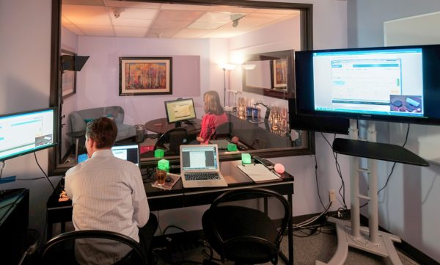
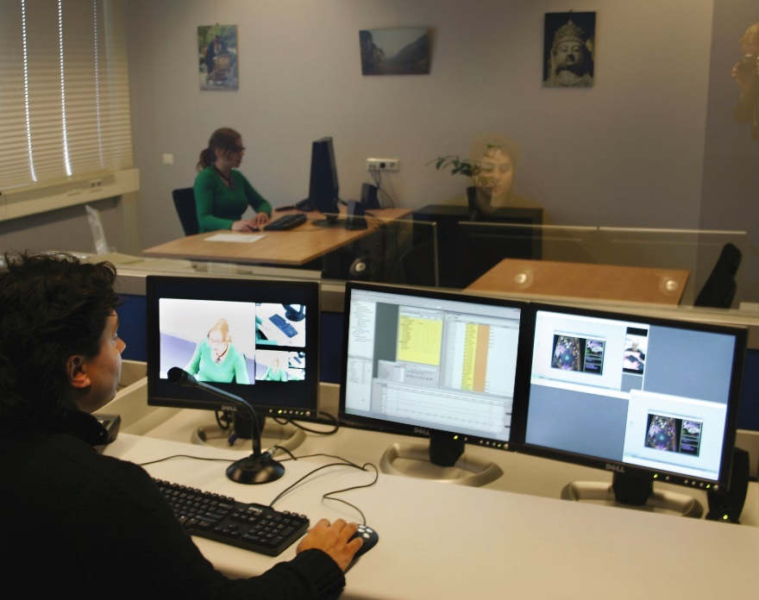
Usability Testing and Laboratories
The usability lab consists of two areas: the testing room and the observation room
  The testing room is typically smaller and accommodates a small number of people
  The observation room, can see into the testing room typically via a one-way mirror. The observation room is larger and can hold the usability testing facilitators with ample room to bring in others, such as the developers of the product being tested

Slide 33

Usability Testing and Laboratories(continued)
This shows a picture of glasses worn for eye-tracking
  This particular device tracks the participant’s eye movements when using a mobile device
  Tobii is one of several manufacturers

Slide 34

Usability Testing and Laboratories (continued)
Eye-tracking software is attached to the airline check-in kiosk
  It allows the designer to collect data observing how the user “looks” at the screen
  This helps determine if various interface elements (e.g. buttons) are difficult (or easy) to find

Slide 35
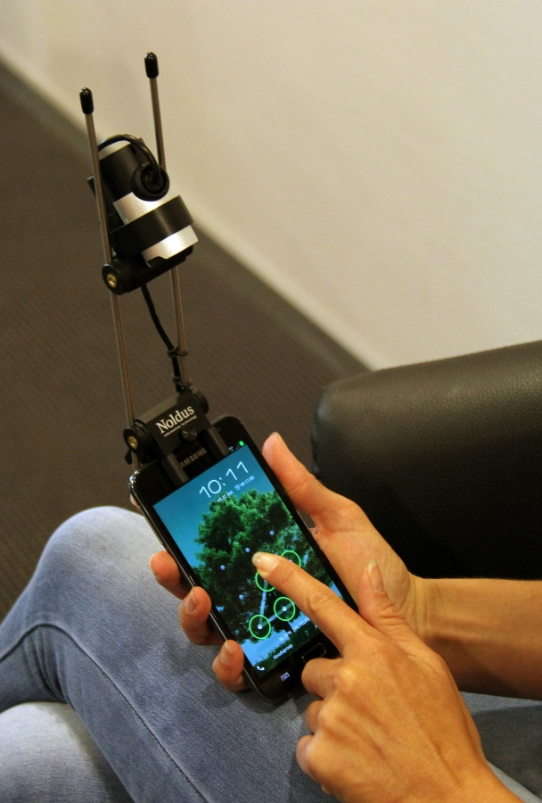
Usability Testing and Laboratories (continued)
The special mobile camera to track and record activities on a mobile device
  Note the camera is up and out of the way still allowing the user to use their normal finger gestures to operate the device

Slide 36
Experiments & usability testing
Experiments test hypotheses to discover new knowledge by investigating the relationship between two or more variables.
Usability testing is applied experimentation.
Developers check that the system is usable by the intended user population for their tasks.
Notes:
36

Slide 37
Testing conditions
Usability lab or other controlled space.
Emphasis on:
  selecting representative users;
  developing representative tasks.
5-10 users typically selected.
Tasks usually around 30 minutes
Test conditions are the same for every participant.
Informed consent form explains procedures and deals with ethical issues.
Notes:
37

Slide 38
Example: Usability testing the iPad
7 participants with 3+ months experience with iPhones
Signed an informed consent form explaining:
  what the participant would be asked to do;
  the length of time needed for the study;
  the compensation that would be offered for participating;
  participants’ right to withdraw from the study at any time;
  a promise that the person’s identity would not be disclosed; and
  an agreement that the data collected would be confidential and would be available to only the evaluators
Then they were asked to explore the iPad
Next they were asked to perform randomly assigned specified tasks

Slide 39
Experimental designs
Different participants - single group of participants is allocated randomly to the experimental conditions.
Same participants - all participants appear in both conditions.
Matched participants - participants are matched in pairs, e.g., based on expertise, gender, etc.
Notes:
39

Slide 40
Controlled Experiments
It is a test of the effect of a single variable by changing it while keeping all other variables the same.
A controlled experiment generally compares the results obtained from an experimental sample against a control sample.
General terms
  Participant (subject)
  Independent variables (test conditions), dependent variable,
  Control variable, random variable
  Confounding variable
  Within subjects vs. between subjects
  Counterbalancing, Latin square
Notes:
40

Slide 41
Independent Variable
Independent Variable (IV, what you very)
  Independent of participant behavior
  Examples: interface, visual layout, gender, age
Test conditions: levels, or value of an IV
Provide a name for both IV and its levels (test conditions)
Notes:
41

Slide 42
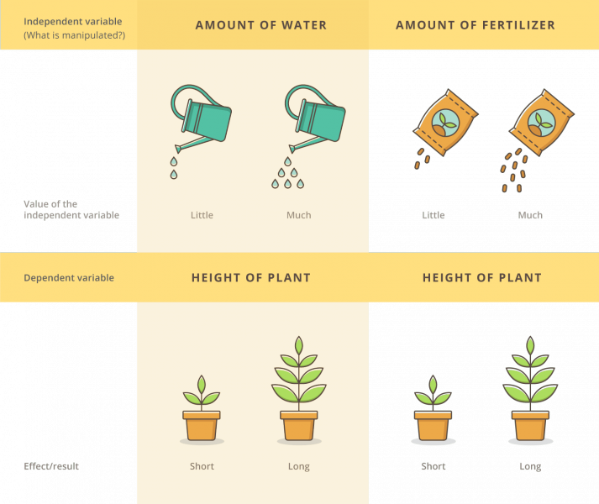
Dependent Variable
Dependent Variable (DV, what you measure)
  User performance time
  Accuracy, errors
  Subjective satisfaction
Notes:
42

Slide 43
Confounding variable
A confounding variable is one that provides an alternative explanation for the thing we are trying to explain with our IVs.
  Example:
  we want to compare two systems (windows 7 vs. windows 8)
  All participants have prior experience with windows 7, but no experience with windows 8
  “Prior experience” is a confounding variable
A major issue in observation studies is that we often don't always know what the potential confounding factors may be.
Notes:
43

Slide 44
General Process
Determine research questions
Start with a testable hypothesis
  Interface X is faster than interface Y
Manipulate independent variables
  different interfaces, tasks
4. Measure dependent variables
  times, errors, satisfaction
Use statistical tests to accept or reject the hypothesis
Notes:
44

Slide 45
Experimental Design
Main types:
  Between-subjects (B-S)
  Within-subjects (W-S)
Between-subjects
  One subject is exposed to only one condition,
  and contributes
  one entry to the whole data.
  Subjects are randomly allocated to one of the conditions
Within-subjects
  Each subject is exposed to each of the conditions
  Each subject contributes one entry for each of the conditions
  Usually, WS design is used in HCI evaluations, and requires 10-30 subjects
Notes:
45

Slide 46
Within Subject
Advantages
  fewer subjects
  Less time
  Less expensive
  Increased control of subjects variability: comparisons between
  conditions happen within each subject.
  More power to detect significant difference
Disadvantages
  Learning effect
  Carryover effect
  Fatigue, boredom
Solutions:
  More practice before testing; randomization; counterbalancing (Latin square)
  Have rest between tasks
  Limit the testing time
Notes:
46

Slide 47
Field studies
Field studies are done in natural settings.
“In the wild” is a term for prototypes being used freely in natural settings.
Aim to understand what users do naturally and how technology impacts them.
Field studies are used in product design to:
  identify opportunities for new technology;
  determine design requirements;
  decide how best to introduce new technology;
  evaluate technology in use.
Notes:
47

Slide 48
IRB
Should apply for IRB approval from research office of ODU before starting your experiment.
  Information sheet
  Voluntary
  Withdraw at any time without penalty
  Contact details: complaints, questions
Participant consent form: Named and signed
You must not cause your subjects distress: Invading privacy, physical abuse, unpleasant emotions, etc.
Original material produced by subjects must be kept confidential.
In reports, subjects should not be identifiable in any way.
Notes:
48

Slide 49
Points to Note
Pilot study is essential and critical for success.
Make sure each experimental run is as similar as possible to all of the subjects.
Put subjects at their ease.
Test experimental variables, not subjects.
Subjects may need to be motivated in some way.
No experiments are perfect! Results obtained should be interpreted within the limitations.
Notes:
49

