Slide 1
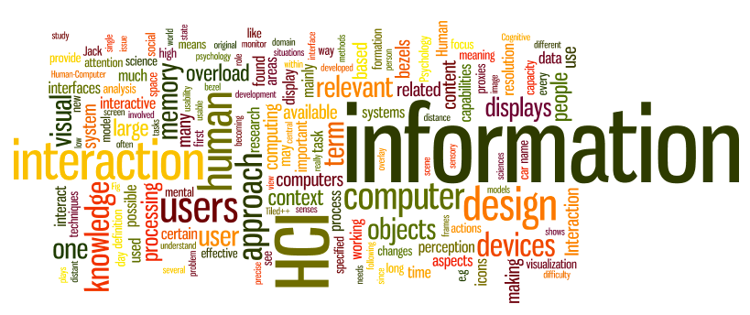
Accessibility & Ethics
Dr. Sampath Jayarathna
Old Dominion University

Slide 2
Who is affected?
People with disabilities
Visual, hearing, motor, cognitive, reading
About 1 in 5 adults (webaim.org/intro)
Older adults
up to 50% of computer users may benefit from accessibility features
(http://www.microsoft.com/enable/research/)
“Situational impairments”
mobile device users, temporarily injured people
Sometimes it’s just convenient
reading transcripts vs. watching a video

Slide 3
Why make things accessible?
Good for business
Reach a large audience
Support social inclusion
Participation from a diverse group is good
Follow the law
Access to information is a basic human right

Slide 4
Legal support for accessibility
1990: Americans with Disabilities Act (ADA) 1998: Rehabilitation Act (section 508)
2006: Individuals with Disabilities Education Act (IDEA)
http://webaim.org/articles/laws/usa/

Slide 5
Legal Cases
1996 ADA complaint vs. City of San Jose, CA
Use of PDF inaccessible to city commissioner
Web sites are a “service” and thus subject to the ADA
Led to S. J. Web Page Disability Access Standard
1999 National Federation of the Blind vs. AOL
Based on the interpretation of the Web as a place of public accommodation (ADA)
Settled out of court
2000: AOL agreed to make its browser accessible
2006 National Federation of the Blind vs. Target
ADA as applied to Target’s web site
Settled for US $6 million

Slide 6
Assistive tech improves quality of life
Enables a person to function at his or her own pace.
Fosters independent living.
Maintains or improves daily function
Reduces stress-­‐related injuries
Eases integration into society (levels the “playing field”)
Modifies the environment instead of the person

Slide 7

Assistive Tech can be simple
A magnifying glass
Anti-­‐glare screen for the monitor Door handles instead of door knobs
Calculators/clocks with extra large digits

Slide 8
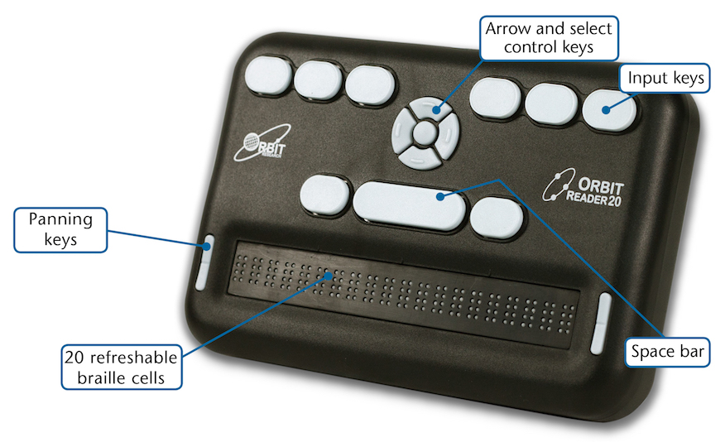
Assistive Tech can be complex
Alternative keyboards or switches Braille and refreshable braille Scanning software
Screen magnifiers
Screen readers Speech recognition
Speech synthesis
Text browsers
Visual notification
Voice browsers

Slide 9
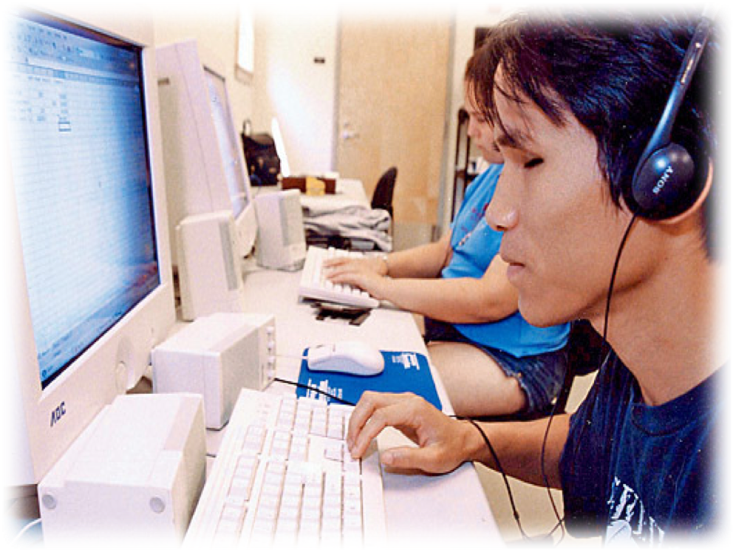

Screen Reader for Blind Users
Allows non-­‐visual access to screens
Speech
Refreshable Braille Display
10

Slide 10
Screen Reader Timeline
1973 – Section 508 of Rehabilitation Act set bar for accessible
technology
1980 – First screen readers for computers.
1986 – IBM Screen Reader, first screen reader for Windows
1990 -­‐ World Wide Web Consortium (W3C) released Web Content Accessibility Guidelines (WCAG).
1995 – JAWS (Job Access With Speech), first successful wide-­‐ spread commercial screen reader
2006 – NVDA (NonVisual Desktop Access), first successful open
source screen reader
2008 – VoiceOver, first built-­‐in screen reader for iOS devices.
11

Slide 11
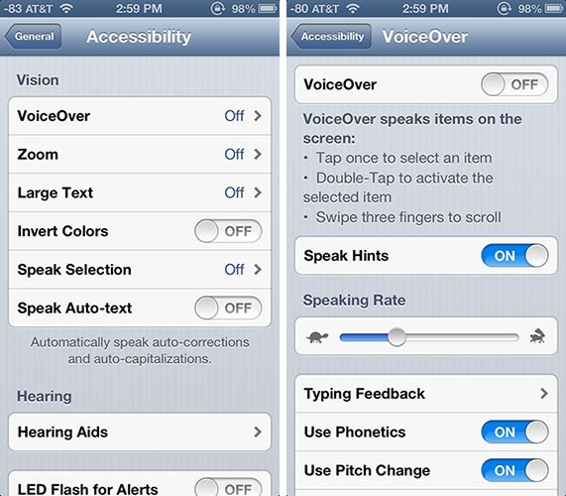
iOS Text-To-Speech
12

Slide 12
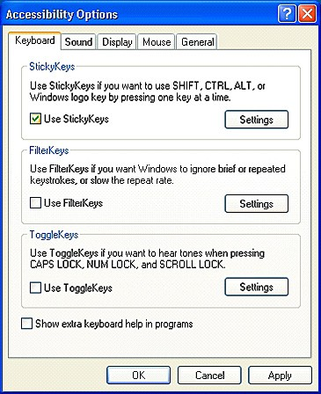
Accessibility features in OS
Sticky keys / filter keys
Screen magnifiers
Mouse & cursor control
Keyboard navigation
Visual alert
On-­‐screen keyboard
Speech recognition for specific commands

Slide 13
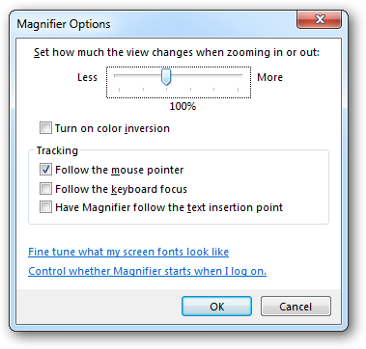
Magnification
CRTL+ or Command+ on browsers Spread gesture on touchscreens
14

Slide 14
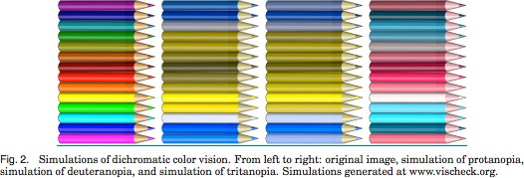
Color blindness
Affects 10% of males Multiple variations
http://vischeck.com

Slide 15
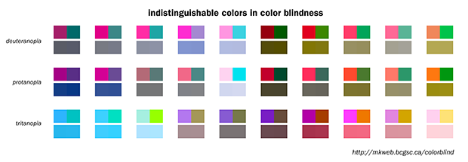
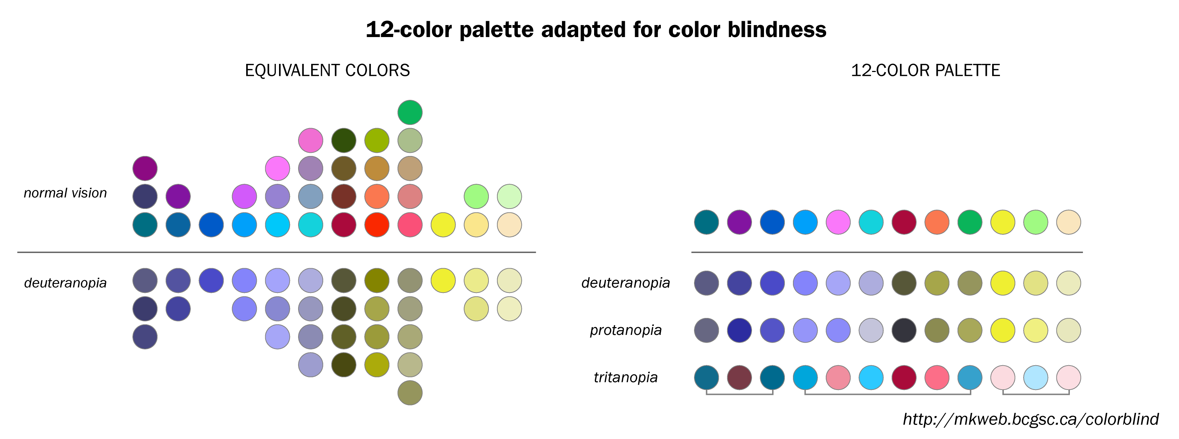
Color Guidelines
Choosing a set of colors which work well together is a challenging task for anyone who does not have an intuitive gift for color
7-10% of males are red-green color blind. Avoid following combinations
  Green & Red.
  Green & Brown.
  Blue & Purple.
  Green & Blue.
  Light Green & Yellow.
  Blue & Grey.
  Green & Grey.
  Green & Black.

Slide 16
Web Accessibility
Web accessibility refers to the practice of removing barriers that prevent interaction with, or access to, websites by people with disabilities so that all users have equal access to information and functionality.
Web content is extremely visual, so people with vision impairments are particularly affected
Web developers need to accommodate needs of visually impaired more than for any other group e.g., blind, low-­‐vision, color blind, etc.

Slide 17
Web Content Accessibility Guidelines
Perceivable Operable Understandable Robust

Slide 18
Web Content Accessibility Guidelines
Perceivable
Provide text alternatives for non-­‐text content and provide captions and alternatives for audio and video content.
Make content adaptable; and make it available to assistive technologies.
Use sufficient contrast to make things easy to see and hear.
Operable
Help users find content and make everything keyboard accessible.
Give users enough time to read and use content.
Do not use content that causes seizures.

Slide 19
Web Content Accessibility Guidelines
Understandable
Make text and content understandable, and readable
Make content operate in predictable ways and help users avoid and correct mistakes.
Robust
Maximize compatibility with current and future technologies.
Doesn’t break every time there is an OS update
Works across a variety of services and platforms

Slide 20
10 Quick Tips
Images & animations: Use the alt attribute to describe the function of each visual.
Image maps. Use the client-­‐side map and text for hotspots.
Multimedia. Provide captioning and transcripts of audio, and descriptions of video.
Hypertext links. Use text that makes sense when read out of context. For example, avoid "click here."
Page organization. Use headings, lists, and consistent structure. Use CSS for layout and style where possible.
Graphs & charts. Summarize

Slide 21
10 Quick Tips (cont)
Scripts, applets, & plug-­‐ins. Provide alternative content in case active features are inaccessible or unsupported.
Use meaningful titles.
Tables. Make line-­‐by-­‐line reading sensible. Summarize.
10. Check your work. Validate. Use tools, checklist, and guidelines at http://www.w3.org/TR/WCAG

Slide 22
Verifying accessibility
Testing with real users is the best way
Online materials can help
http://webaim.org/intro/#principles
http://webaim.org/standards/wcag/checklist
Simulating disability
http://vischeck.com/
http://firevox.clcworld.net/
http://www.chromevox.com/

Slide 23
Summary
Web accessibility refers to the practice of removing barriers that prevent interaction with, or access to, websites by people with disabilities so that all users have equal access to information and functionality.
There are established guidelines and checklists for how to make your designs and systems accessible.
Please use them!

Slide 24
Ethics
What is it, why is it relevant to HCI, why is it important?

Slide 25
What is ethics?
Right and wrong
Behaviour
‘absolute’ not conditional
Professional issues

Slide 26
Why us?
Technology changes society
  Need to understand that change, put it to effective use, understand the consequences of our actions
We are often asked to do things that create ethical dilemmas
We have powerful tools at our command that we can do significant things with

Slide 27
Why HCI people?
At the intersection of technology, individuals and society
Understand the capabilities of technologies, the needs of individuals, the needs of societies
Sometimes in conflict

Slide 28
Examples
Boss asks us to monitor employees’ email
  Legal or illegal
  Ethical or unethical
Specialist knowledge puts you into major role in consultancy company
  Company asked to develop missile offence system for government
  Many employees are pacifists
  Take the contract, or not?

Slide 29
Philosophical approaches to ethics
Utilitarianism
  “greatest happiness of the greatest number”
  Happiness = sum of pleasure – sum of pain
  Simple, democratic, forward looking and consequential
Problems with utilitarianism
  Copying software could be argued as good as it spreads more happiness to more people
  Yet most would regard it as unethical
  Hard to measure happiness and compare different happy events
  No notion of duty or friendship

Slide 30
Kantian ethics
Deontic (to do with acts) by German philosopher Immanuel Kant.
Do your duty
The right motive is “to do the right thing”, “to do one’s duty”, “to respect the moral law.”
A rational being who consistently has the right motive has Good Will.
Nothing is more important for morality than having a good will. According to Kant, a rational being with a Good Will automatically does its duty.
E.g. Do not lie
  Woman comes into your house seeking shelter from a violent partner. Partner comes in and asks if woman is there.

Slide 31
Ethical issues to consider
Data protection/freedom of information
(Ethical) hacking
Consequences of software errors – who is responsible?

Slide 32
British Psychology Society Code of Human Research Ethics
Respect for the autonomy, privacy and dignity of individuals and communities
Scientific integrity
Social responsibility
Maximizing benefit and minimizing harm
5

Slide 33
The Belmont Report (1974)
Respect for persons
    Protecting the autonomy of all people and treating them with courtesy and respect and allowing for informed consent. Researchers must be truthful and conduct no deception
Beneficence
    The philosophy of "Do no harm" while maximizing benefits for the research project and minimizing risks to the research subjects
Justice
    Ensuring reasonable, non-exploitative, and well- considered procedures are administered fairly — the fair distribution of costs and benefits to potential research participants — and equally.
http://www.hhs.gov/ohrp/regulations-and-policy/belmont-report/index.html
6

Slide 34
Respect for persons
Treat individuals as autonomous agents
Persons with diminished autonomy are entitled to protection
Applications
  Participation should be voluntary
  Participants should be fully informed of the costs and benefits of participation
7

Slide 35
Beneficence
Do not harm
Maximize the possible benefits and minimize the possible harms
Applications
  Systematic analysis of the risks and benefits of the research to both the individual and to society at large
8

Slide 36
Justice
Who should bear the burdens of research and who should receive the benefits?
    To each person an equal share
    To each person according to individual need
    To each person according to individual effort
    To each person according to societal contribution
    To each person according to merit
Application
    Selection of research participants
9

Slide 37
Case studies in Ethics and Computer Science
Facebook emotion contagion study
  We show, via a massive (N = 689,003) experiment on Facebook, that emotional states can be transferred to others via emotional contagion, leading people to experience the same emotions without their awareness. We provide experimental evidence that emotional contagion occurs without direct interaction between people (exposure to a friend expressing an emotion is sufficient), and in the complete absence of nonverbal cues.”
Experimental evidence of massive-scale emotional contagion through social networks by Adam D. I. Kramer, Jamie E. Guillory, and Jeffrey T. Hancock

Slide 38
The study
All Facebook users who spoke English qualified
Two groups: positive and negative emotions
Positive/negative posts where then suppressed from the news feed
689,003 participants randomly selected by user id
Saw an impact
    When positive posts withheld the participant’s posts got more negative
    When negative posts withheld the participants posts got more positive
    Withdrawal effect: people who saw less emotion posts less likely to express themselves for several days
15

Slide 39
Activity 16
Does the Facebook Emotion Contagion study fit the requirements of the Belmont Report?

Slide 40
Will bank customers enter their passwords even if their browsers’ [security UI element] is missing?
An evaluation of website authentication and the effect of role playing on usability studies ndy Ozment, and Ian Fischer http://www.usablesecurity.org//emperor/emperor.pdf
Bank Security Study
28

Slide 41
Study design
Participants recruited using on-campus flyers
Flyers said the participant could “earn $25 and make online baking better”
No mention of security or privacy in any advertising materials or consent form (deception study)
Participants came to the lab and used a lab computer
Computer was pre-setup to attack the connection between the bank and the user

Slide 42
To handle ethics the researchers:
Notified participants that their actions would be recorded
System did not record passcodes or other private data
Care was taken with the technical design to make sure the participant’s bank credentials remained safe
Participant was debriefed after the study
Participant was told how to protect themselves in the future
30

Slide 43
The Dark (Patterns) Side OF UX DESIGN
“A user interface that has been carefully crafted to trick users into doing things…they are not mistakes, they are carefully crafted with a solid understanding of human psychology, and they do not have the user’s interests in mind”
Brignull, Harry. “Dark Patterns: Inside the Interfaces Designed to Trick You.” The Verge, August 29, 2013. https://www.theverge.com/2013/8/29/4640308/dark-patterns-inside-the-interfaces-designed-to-trick-you.
Gray, Colin M., Yubo Kou, Bryan Battles, Joseph Hoggatt, and Austin L. Toombs. “The Dark (Patterns) Side of UX Design.” In Proceedings of the 2018 CHI Conference on Human Factors in Computing Systems – CHI ’18, 1–14. Montreal QC, Canada: ACM Press, 2018. https://doi.org/10.1145/3173574.3174108.

Slide 44
Brignull's Typology

Slide 45
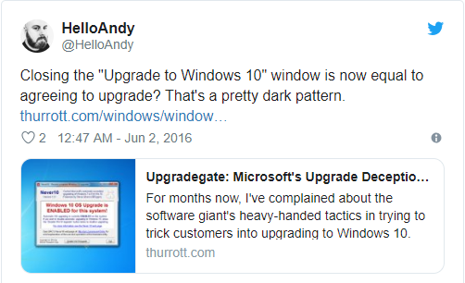
BAIT AND SWITCH
The user sets out to do one thing, but a different, undesirable thing happens instead. The most famous example of digital bait and switch was Microsoft’s misguided approach to getting people to upgrade their computers to Windows 10.

Slide 46
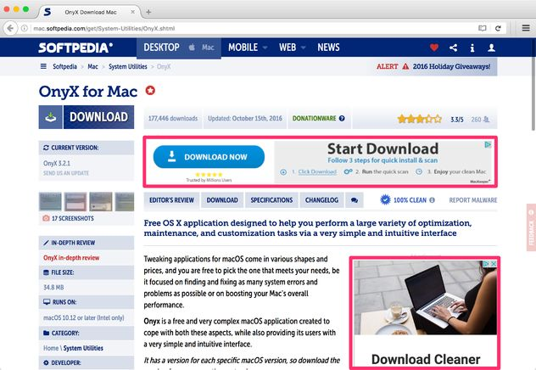
DISGUISED ADS
Adverts that are disguised as other kinds of content or navigation, in order to get you to click on them.
Softpedia is a popular software download site. One of their sources of revenue is display advertising. They often run advertisements that look like a download button, tricking users into clicking on the ads rather than getting the thing they wanted.

Slide 47

FORCED CONTINUITY
When your free trial with a service comes to an end and your credit card silently starts getting charged without any warning. You are then not given an easy way to cancel the automatic renewal.

Slide 48
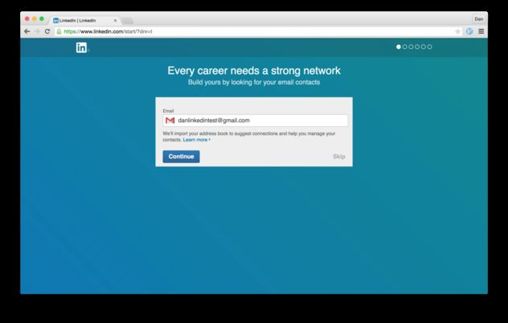
FRIEND SPAM
The product asks for your email or social media permissions under the pretense it will be used for a desirable outcome (e.g. finding friends), but then spams all your contacts in a message that claims to be from you.
The most famous example of this dark pattern was used by Linkedin, which resulted in them being fined $13 million dollars as part of a class action lawsuit in 2015.

Slide 49
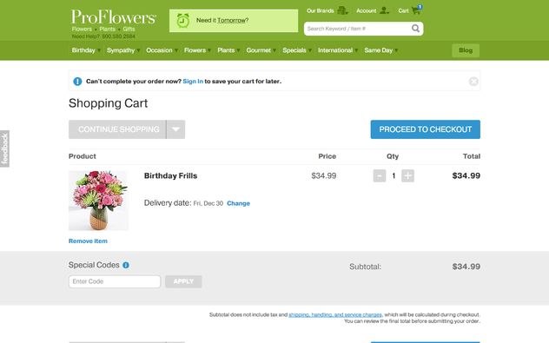
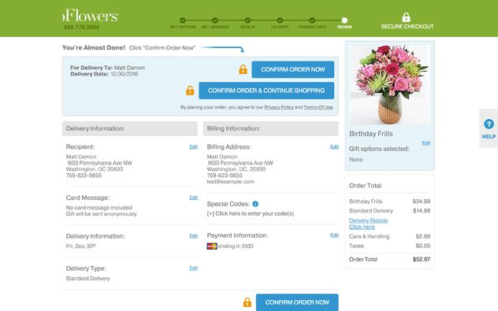
HIDDEN COSTS
You get to the last step of the checkout process, only to discover some unexpected charges have appeared, e.g. delivery charges, tax, etc.
Proflowers is a flower retailer in the United States. They provide a perfect example of the hidden costs dark pattern. This is their home page:

Slide 50
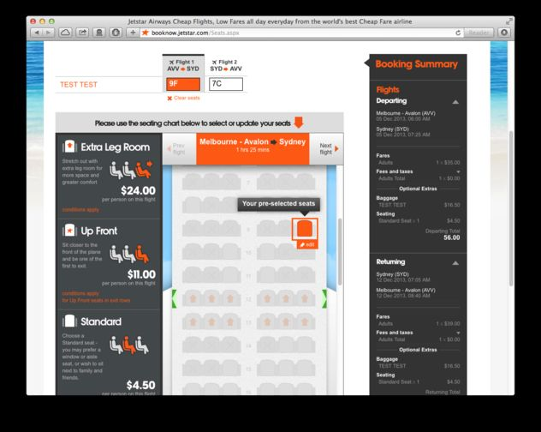
MISDIRECTION
The design purposefully focuses your attention on one thing in order to distract you attention from another. Most Dark Patterns use this trick in some way.
A good example is Australian low-cost airline jetstar.com:
  When this page loads, they have already preselected a random seat for you. They use word-play trickery, as a "preselected" random seat here costs $5, but if you opt out via the tiny "skip seat selection" link at the bottom of the page, you're assigned a random seat without the $5 charge.

Slide 51
PRIVACY ZUCKERING
You are tricked into publicly sharing more information about yourself than you really intended to. Named after Facebook CEO Mark Zuckerberg.
In its early days, Facebook had a reputation for making it difficult for users to control their privacy settings, and generally making it very easy to "overshare" by mistake. In response to feedback from consumers and privacy groups, Facebook has created a clearer, easier to use privacy settings area.
Today, privacy zuckering seems to take place mainly behind the scenes, thanks to the data brokerage industry. Here's how it works: when you use a service (e.g. a store card), the small print hidden in the Terms and Conditions gives them permission to sell your personal data to anyone. Data brokers buy it and combine it with everything else they find about you online into a profile, which they then resell.

Slide 52
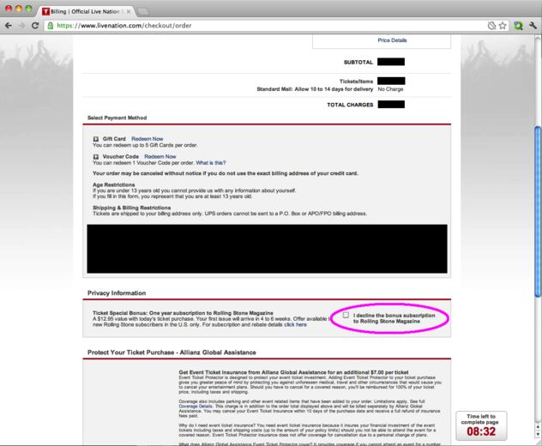
ROACH MOTEL
The design makes it very easy for you to get into a certain situation, but then makes it hard for you to get out of it (e.g. a subscription).
  Ticket sales sites Livenation and Ticketmaster have engaged in a roach motel practices for a number of years. When purchasing some types of tickets, they try to sneak a subscription to a magazine into your basket via a trick question on the checkout page

Slide 53
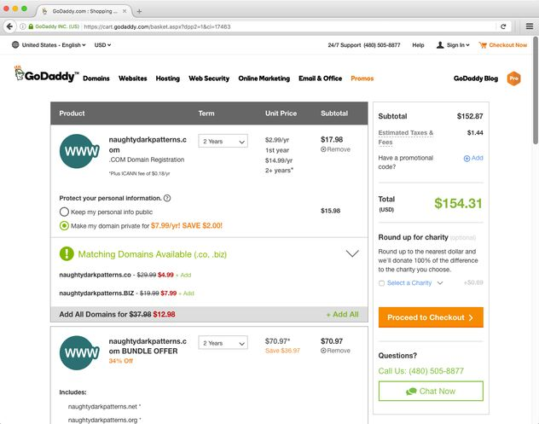
SNEAK INTO BASKET
You attempt to purchase something, but somewhere in the purchasing journey the site sneaks an additional item into your basket, often through the use of an opt-out radio button or checkbox on a prior page.
  godaddy.com provides a perfect example of this dark pattern and any other telecom providers like Cox.

Slide 54
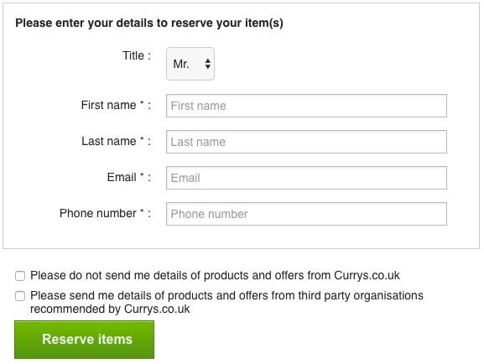
TRICK QUESTIONS
You respond to a question, which, when glanced upon quickly appears to ask one thing, but if read carefully, asks another thing entirely.
This is very common when registering with a service. Typically a series of checkboxes is shown, and the meaning checkboxes is alternated so that ticking the first one means "opt out" and the second means "opt in".

Slide 55
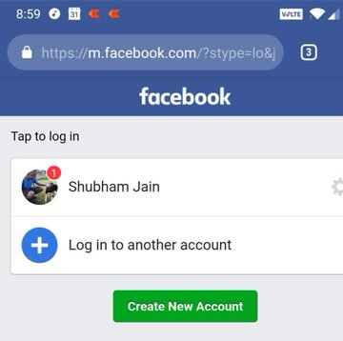
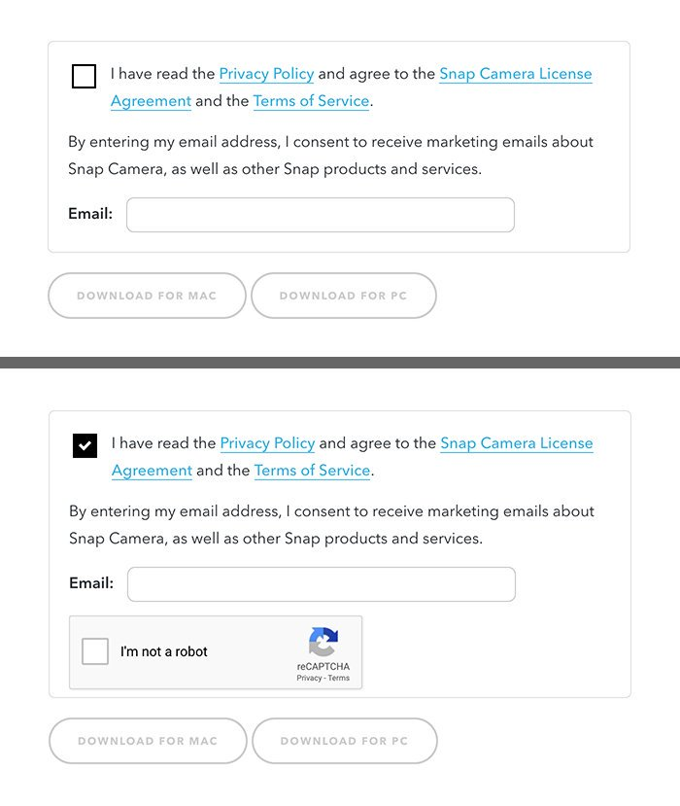
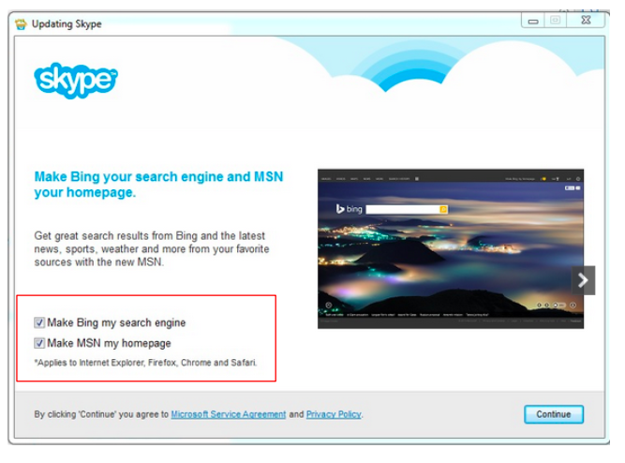
Activity 17: Find the related Dark Pattern
A. Icon shows notification,
but login reveals no new notifications
C. Check box for additional services
B. Email required to continue with
the form

