Slide 1
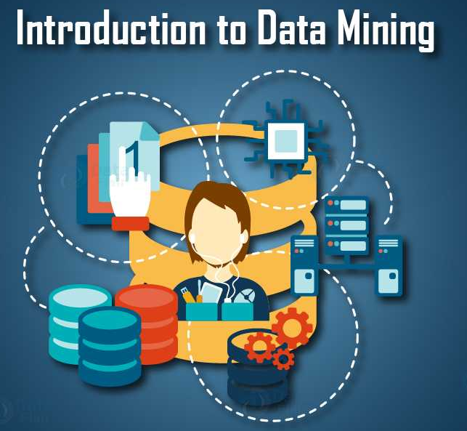
Lecture 1a- Syllabus
CS 495/595
Introduction to Data Mining
Dr. Sampath Jayarathna
Old Dominion University

Slide 2
Today
Who I am
CS 495/595 educational objectives (and why)
Overview of the course, and logistics

Slide 3
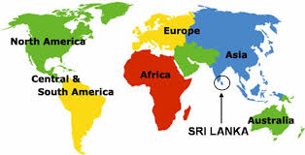
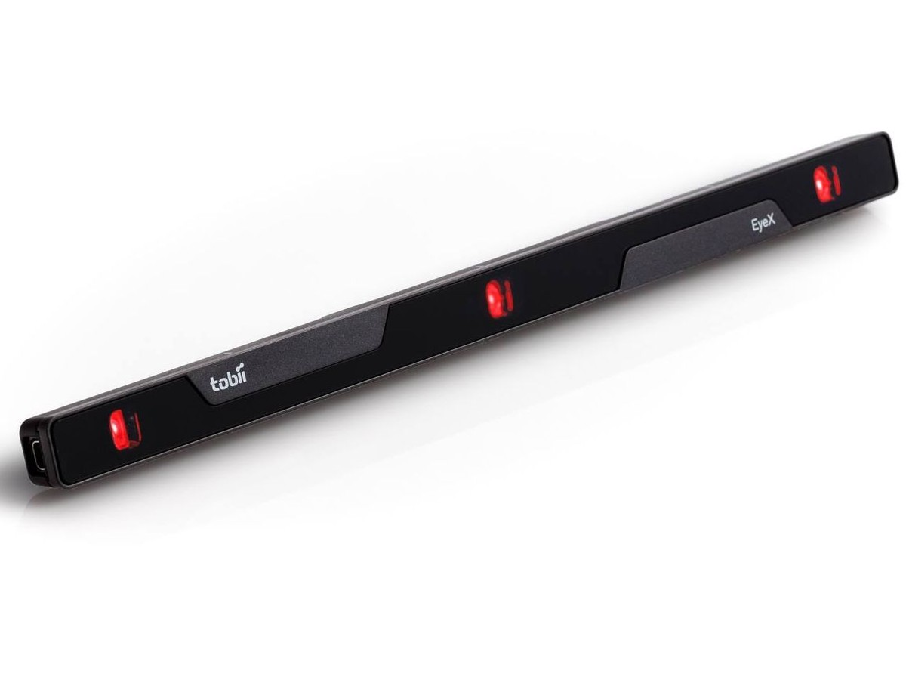
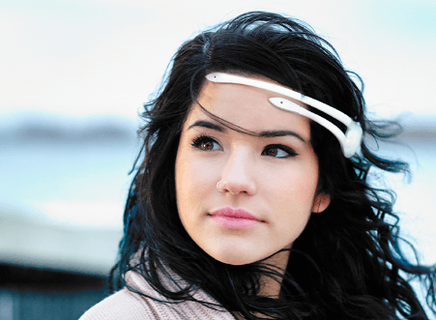
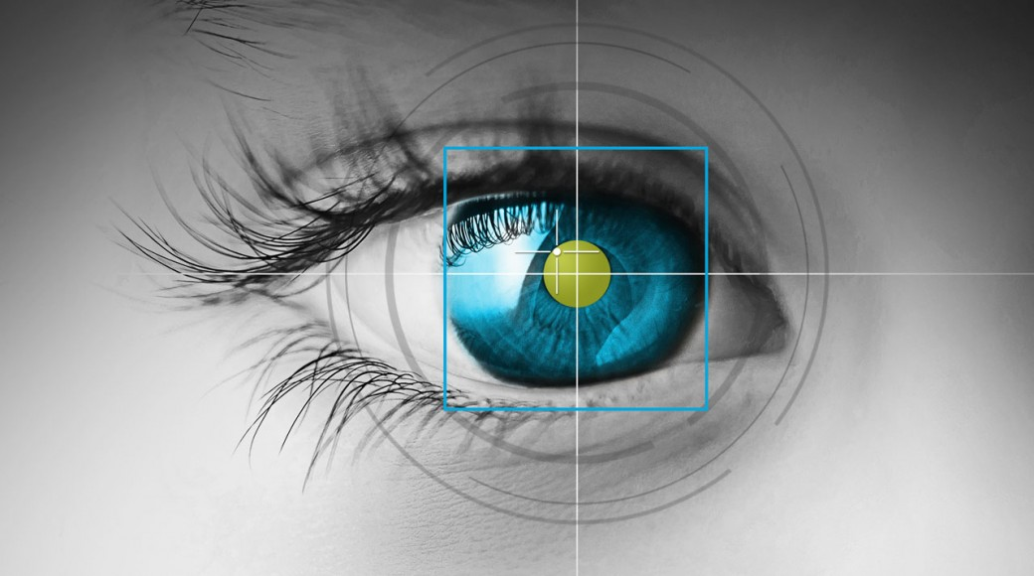
Who am I?
Instructor : Sampath Jayarathna Joined ODU Fall 2018 (Assistant Professor Cal Poly 2016-2018) Originally from Sri Lanka
Research : Multi-modeal Sensing, Eye tracking, neuro-IR, ML
Web : http://www.cs.odu.edu/~sampath/
Contact : ECS 3109, sampath@cs.odu.edu, (757) 683-7787
Office Hours : T 2pm – 3pm, or email me for an appointment
[Open Door Policy]

Slide 4
Course Information
Schedule : Tuesday and Thursday, Time: 5.45 PM – 7.00 PM http://www.cs.odu.edu/~sampath/courses/s20/cs495
https://piazza.com/odu/spring2020/cs495/home https://www.blackboard.odu.edu/
Prereqs
There are no specific course prerequisites for this course. But, I expect you to be comfortable learning new programming languages/tools/APIs, and knowledge in linear algebra and statistics.
Format
Before lecture: do reading slides
In lecture: put reading in context
After lecture: assignments, projects for hands-on practice

Slide 5
Student Learning Outcomes
After successfully completing this course, students should be able to:
Understand basic data mining algorithms and their applications.
Develop an appreciation of the many techniques for data modeling
Be comfortable using commercial and open source tool and technologies available for analyzing various types of data.

Slide 6
Communication
Piazza:
All questions will be fielded through Piazza.
Many questions everyone can see the answer
You can also post private messages that can only be seen by the instructor
Blackboard:
Blackboard will be used primarily for assignments/homework submission, and grade dissemination.
Email:
Again, email should only be used in rare instances, I will probably point you back to Piazza

Slide 7
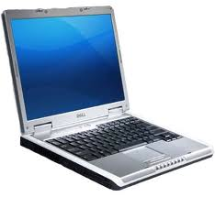
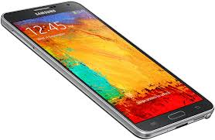
The Rules

Slide 8
Cooperate on Learning
Except for the work you hand in as individual contributions, I strongly encourage you to collaborate and help each other
If in doubt if a collaboration is legitimate: ask!
Don’t claim to have written code that you copied from others or online
Don’t give anyone else your code (to hand in for a grade)
When you rely on the work of others, explicitly list all of your sources – i.e. give credit to those who did the work
Don’t study alone when you don’t have to
Form study groups
Do help each other (without plagiarizing)

Slide 9
Course Organization
Grading
Required Materials
Required textbook. Data Mining, the Text Book, by Charu Aggarwal. Springer, 2015. The book (pdf) is freely available to download in campus network. http://www.charuaggarwal.net/Data-Mining.htm
All the key course content will be documented in slides, which will be available in the course website after each lecture.
Bring Your Own Device (BYOD).

Slide 10
Course Organization
Team Project: More in the next couple of slides…
Midterm Exams: The midterm exams (I and II) will be held on Thursday (March 05, April 23) during class time. You may bring one standard 8.5" by 11" piece of paper with any notes you deem appropriate or significant (front and back).
Homework: We will have 4 homework assignments, each worth 5% of your overall grade.
In-class activities + attendance
ungraded in-class activities

Slide 11
Team Project - Evaluation
Form teams of 1 (or 2) students
Independent and non-competing
Think of other teams as working for other organizations
Code and document sharing between teams is not permitted
Project grade will have a large impact on course grade (20%)
Project grade will (attempt to) recognize individual contributions
Peer evaluation, Demo evaluation
All artifacts will be considered in the evaluation
Quality matters.

Slide 12
Team Project - Milestones
Project Proposal (Google Colab), Jan. 30
Progress reports (Google Colab), Feb. 20, March 26
Final Report (Google Colab), April 16
Presentation/Demo, April 14 & April 16

Slide 13
Team Project - Ideas
Industry projects
Research projects (potential publications in upcoming conferences such as CHIIR, JCDL, CIKM etc.)
Work with some equipment such as IoT, wearables, eye trackers, brain trackers, GSR, VR/AR or other sensory data
Talk to me about using some of these equipment available at the lab (can extend this work towards your undergraduate projects, MS Thesis)

Slide 14
Personal devices – Software Setup
Windows/Mac/Linux
Weka 3.8
https://www.cs.waikato.ac.nz/ml/weka/downloading.html
mongoDB community server
https://www.mongodb.com/download-center?jmp=nav#community

Slide 15
To-do and Next time
Sign up for the Piazza
Team members 1(+1)
HW1 is out!
Due, Jan 31

