Slide 1
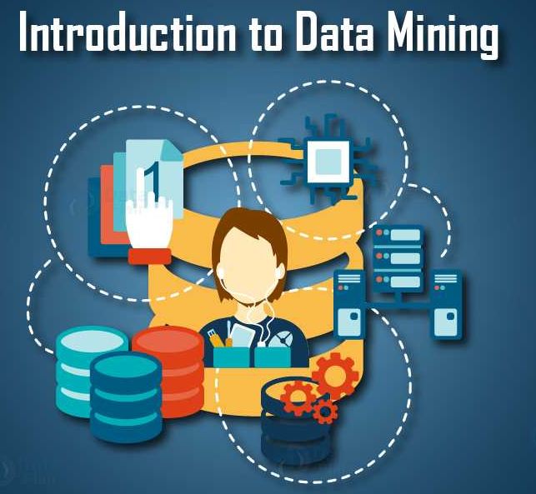
Lecture 1b- Introduction
CS 495/595
Introduction to Data Mining
Dr. Sampath Jayarathna
Old Dominion University
Credit for some of the slides in this lecture goes to http://hanj.cs.illinois.edu/book & www.users.cs.umn.edu/~kumar001/dmbook/

Slide 2


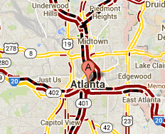
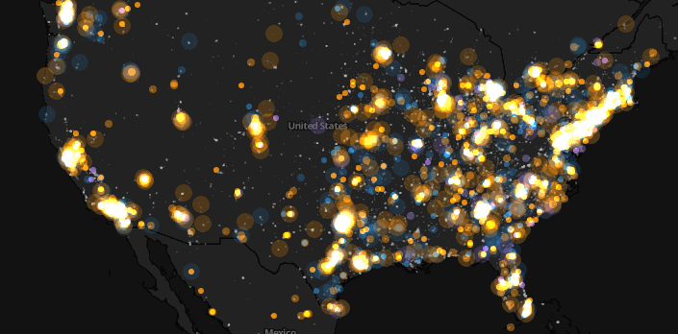
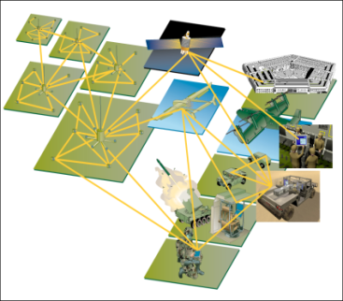
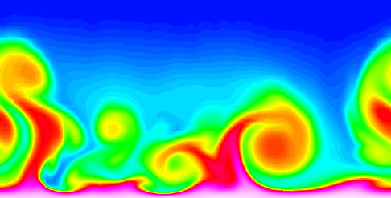
Large-scale Data is Everywhere!
There has been enormous data growth in both commercial and scientific databases due to advances in data generation and collection technologies
New mantra
  Gather whatever data you can whenever and wherever possible.
Expectations
  Gathered data will have value either for the purpose collected or for a purpose not envisioned.
E-Commerce
Cyber Security
Traffic Patterns
Social Networking: Twitter
Sensor Networks
Computational Simulations
Notes:
2

Slide 3



Why Data Mining? Commercial Viewpoint
Lots of data is being collected
and warehoused
  Web data
    Google handle about 20 Peta Bytes of web data (2008)
    Facebook has billions of active users
  purchases at department/
  grocery stores, e-commerce
    Amazon handles billions of visits/monthly
  Bank/Credit Card transactions
Computers have become cheaper and more powerful
Competitive Pressure is Strong
  Provide better, customized services for an edge (e.g. in Customer Relationship Management)
Notes:
3

Slide 4
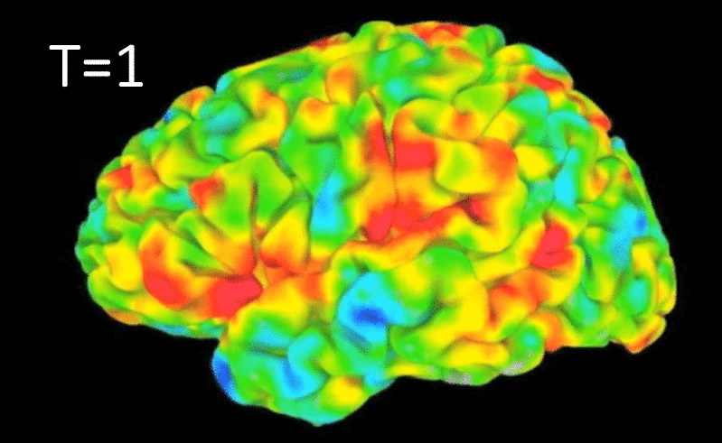
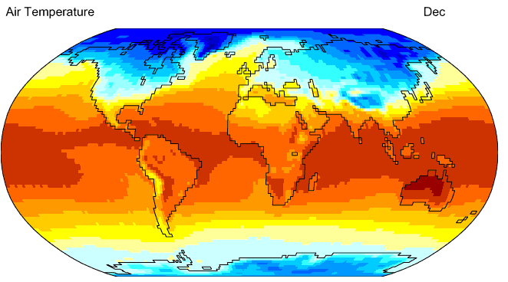
Why Data Mining? Scientific Viewpoint
Data collected and stored at
enormous speeds
  remote sensors on a satellite
    NASA EOSDIS archives over
    petabytes of earth science data / year
    https://www.planethunters.org
  telescopes scanning the skies
    Sky survey data
  High-throughput biological data
  scientific simulations
    terabytes of data generated in a few hours
Data mining helps scientists
  in automated analysis of massive datasets
  In hypothesis formation
fMRI Data from Brain
Sky Survey Data
Gene Expression Data
Surface Temperature of Earth
Notes:
4

Slide 5
Recap: Why Data Mining?
The Explosive Growth of Data: from terabytes to petabytes
  Data collection and data availability
    Automated data collection tools, database systems, Web, computerized society
  Major sources of abundant data
    Business: Web, e-commerce, transactions, stocks, …
    Science: Remote sensing, bioinformatics, scientific simulation, …
    Society and everyone: IoT, news, digital cameras, social media
We are drowning in data, but starving for knowledge!
“Necessity is the mother of invention”—Data mining—Automated analysis of massive data sets

Slide 6
What Is Data Mining?
Data mining (knowledge discovery from data)
  Extraction of interesting (non-trivial, implicit, previously unknown and potentially useful) patterns or knowledge from huge amount of data
  Data mining: a misnomer?
Alternative names
  Knowledge discovery (mining) in databases (KDD), knowledge extraction, data/pattern analysis, data archeology, data dredging, information harvesting, business intelligence, etc.

Slide 7
What is (not) Data Mining?
What is not Data Mining?
  Look up phone number in phone directory
  Query a Web search engine for information about “Amazon”
What is Data Mining?
  Certain names are more prevalent in certain US locations (O’Brien, O’Rourke, O’Reilly… in Boston area)
  Group together similar documents returned by search engine according to their context (e.g., Amazon rainforest, Amazon.com)

Slide 8
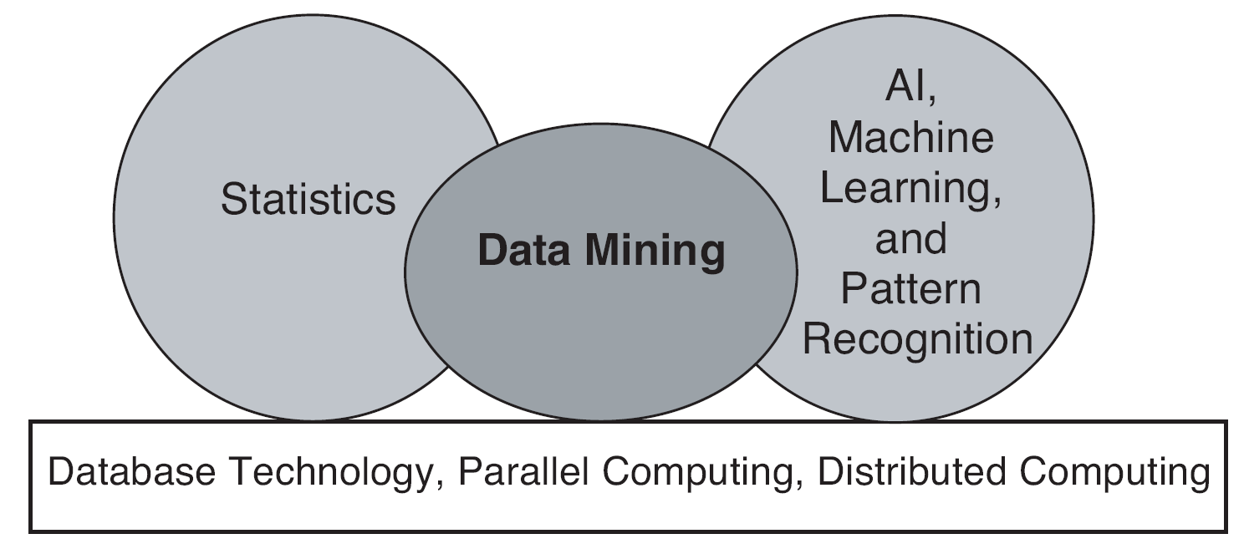
Origins of Data Mining
Draws ideas from machine learning/AI, pattern recognition, statistics, and database systems
Traditional techniques may be unsuitable due to data that is
  Large-scale
  High dimensional
  Heterogeneous
  Complex
  Distributed
A key component of the emerging field of data science and data-driven discovery

Slide 9
Knowledge Discovery (KDD) Process
Knowledge
This is a view from typical database systems and data warehousing communities
Data mining plays an essential role in the knowledge discovery process
Pattern Evaluation
Data Mining
Task-relevant Data
Data Warehouse
Selection
Data Cleaning
Data Integration
Databases

Slide 10
Example: A Web Mining Framework
Web mining usually involves
  Data cleaning
  Data integration from multiple sources
  Warehousing the data
  Data selection for data mining
  Data mining
  Presentation of the mining results
  Patterns and knowledge to be used or stored into knowledge-base

Slide 11
Data Mining in Business Intelligence
Increasing potential
to support
business decisions
Decision Making
End User
Data Presentation
Business
Analyst
Visualization Techniques
Data Mining
Data
Analyst
Information Discovery
Data Exploration
Statistical Summary, Querying, and Reporting
Data Preprocessing/Integration, Data Warehouses
Data Sources
DBA
Paper, Files, Web documents, Scientific experiments, Database Systems

Slide 12
A View from ML and Statistics
Pattern
Information
Knowledge
Input Data
Data Pre-Processing
Data Mining
Post-Processing
Data integration
Normalization
Feature selection
Dimension reduction
Pattern discovery
Classification
Clustering
Outlier analysis
… … … …
Pattern evaluation
Pattern selection
Pattern interpretation
Pattern visualization
This is a view from typical machine learning and statistics communities

Slide 13
Data Mining vs. Data Analytics
Which view do you prefer?
  KDD vs. ML/Stat. vs. Business Intelligence
  Depending on the data, applications, and your focus
Data Mining vs. Data Analytics vs. Data Science
  Data mining is a systematic and sequential process of identifying and discovering hidden patterns and information in a large dataset
  Data Analysis, on the other hand, is a superset of Data Mining that involves extracting, cleaning, transforming, modeling and visualization of data with an intention to uncover meaningful and useful information that can help in deriving conclusion and take decisions.
  Data Science is a broader field using various algorithms and processes to extract meaningful insights out of the unstructured and semi-structured data.

Slide 14
Multi-Dimensional View of Data Mining
Data to be mined
  Database data (extended-relational, object-oriented, heterogeneous), data warehouse, transactional data, stream, spatiotemporal, time-series, sequence, text and web, multi-media, graphs & social and information networks
Knowledge to be mined (or: Data mining functions)
  Characterization, discrimination, association, classification, clustering, trend/deviation, outlier analysis, …
  Descriptive vs. predictive data mining
  Multiple/integrated functions and mining at multiple levels
Techniques utilized
  Data-intensive, data warehouse, machine learning, statistics, pattern recognition, visualization, high-performance, etc.
Applications adapted
  Retail, telecommunication, banking, fraud analysis, bio-data mining, stock market analysis, text mining, Web mining, etc.

Slide 15
Data Mining: On What Kinds of Data?
Database-oriented data sets and applications
  Relational database, data warehouse, transactional database
  Object-relational databases, Heterogeneous databases and legacy databases
Advanced data sets and advanced applications
  Data streams and sensor data
  Time-series data, temporal data, sequence data (incl. bio-sequences)
  Structure data, graphs, social networks and information networks
  Spatial data and spatiotemporal data
  Multimedia database
  Text databases
  The World-Wide Web

Slide 16
Data Mining Process
Data Collection: Application Specific, e.g., collecting data from sensors
Data Pre-processing: Data Wrangling, Munching….
Analytical Processing: 4 major building blocks (or functions) of data mining
  Associate Pattern Mining
  Classification
  Clustering
  Outlier Analysis

Slide 17
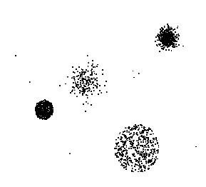

Data Mining Tasks …
Data
Clustering
Predictive Modeling
Association
Rules
Anomaly
Detection
Milk

Slide 18
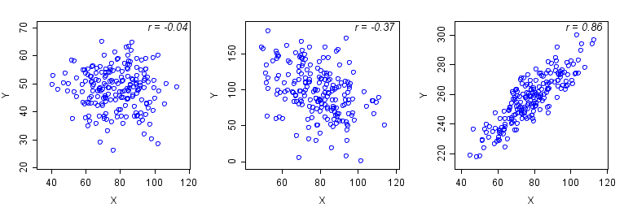
Data Mining Functions: Pattern Discovery
Frequent patterns (or frequent itemset)
  What items are frequently purchased together in your Walmart?
Association and Correlation Analysis
A typical association rule
    Diaper → Beer
    Are strongly associated items also strongly correlated?
How to mine such patterns and rules efficiently in large datasets?
How to use such patterns for classification, clustering, and other applications?

Slide 19
Association Analysis: Applications
Market-basket analysis
  Rules are used for sales promotion, shelf management, and inventory management
Telecommunication alarm diagnosis
  Rules are used to find combination of alarms that occur together frequently in the same time period
Medical Informatics
  Rules are used to find combination of patient symptoms and test results associated with certain diseases

Slide 20
Activity 1
Given above sales records, what patterns can you identify?
Submit your answer to Piazza!

Slide 21
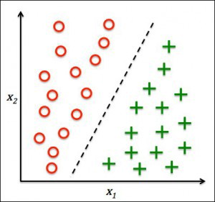
Data Mining Functions: Classification
Classification and label prediction
  Construct models (functions) based on some training examples
  Describe and distinguish classes or concepts for future prediction
    Ex. 1. Classify countries based on (climate)
    Ex. 2. Classify cars based on (gas mileage)
  Predict some unknown class labels
Typical methods
  Decision trees, naïve Bayesian classification, support vector machines, neural networks, rule-based classification, pattern-based classification, logistic regression, …

Slide 22
Classification Example
categorical
categorical
continuous
class
Test
Set
Learn
Classifier
Training
Set
Model

Slide 23

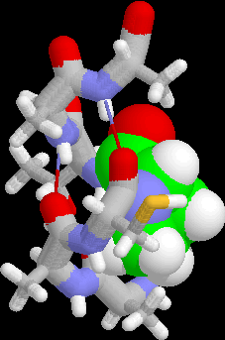
Examples of Classification Task
Classifying credit card transactions
as legitimate or fraudulent
Classifying land covers (water bodies, urban areas, forests, etc.) using satellite data
Categorizing news stories as finance,
weather, entertainment, sports, etc
Identifying intruders in the cyberspace
Predicting tumor cells as benign or malignant
Classifying secondary structures of protein
as alpha-helix, beta-sheet, or random coil
Notes:
Denial-of-service (DoS) and distributed denial-of-service (DDoS) attacks.
Man-in-the-middle (MitM) attack.
Phishing and spear phishing attacks.
Drive-by attack.
Password attack.
SQL injection attack.
Cross-site scripting (XSS) attack.
Eavesdropping attack.

Slide 24
Data Mining Functions: Cluster Analysis
Unsupervised learning (i.e., Class label is unknown)
Group data to form new categories (i.e., clusters), e.g., cluster houses to find distribution patterns
Principle: Maximizing intra-class similarity & minimizing interclass similarity
Many methods and applications

Slide 25
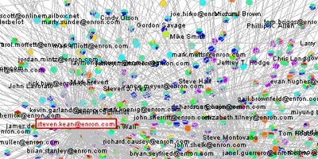
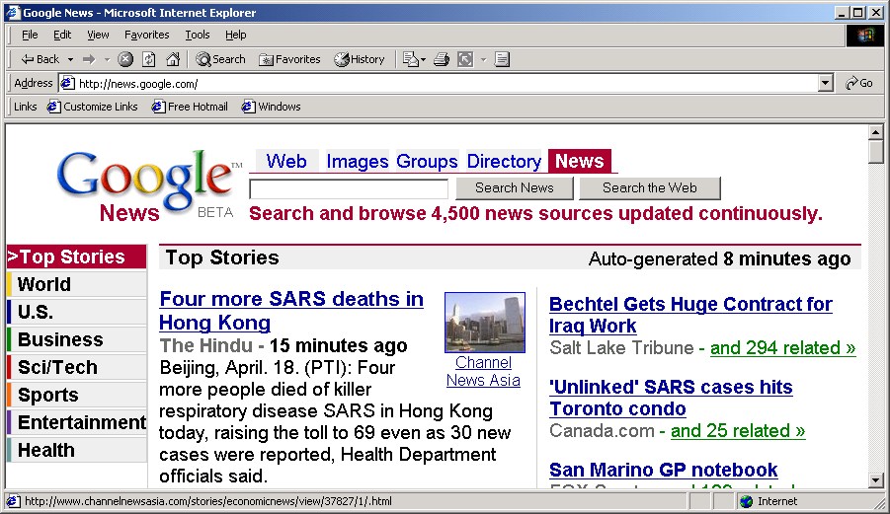
Applications of Cluster Analysis
Understanding
  Custom profiling for targeted marketing
  Group related documents for browsing
  Group genes and proteins that have similar functionality
  Group stocks with similar price fluctuations
  Yippy (formally Clusty):
Summarization
  Reduce the size of large data sets

Slide 26
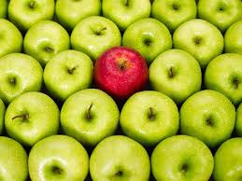
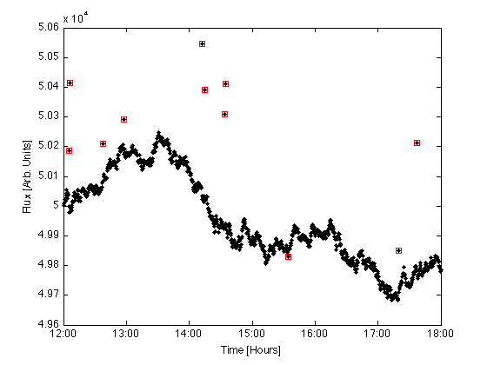
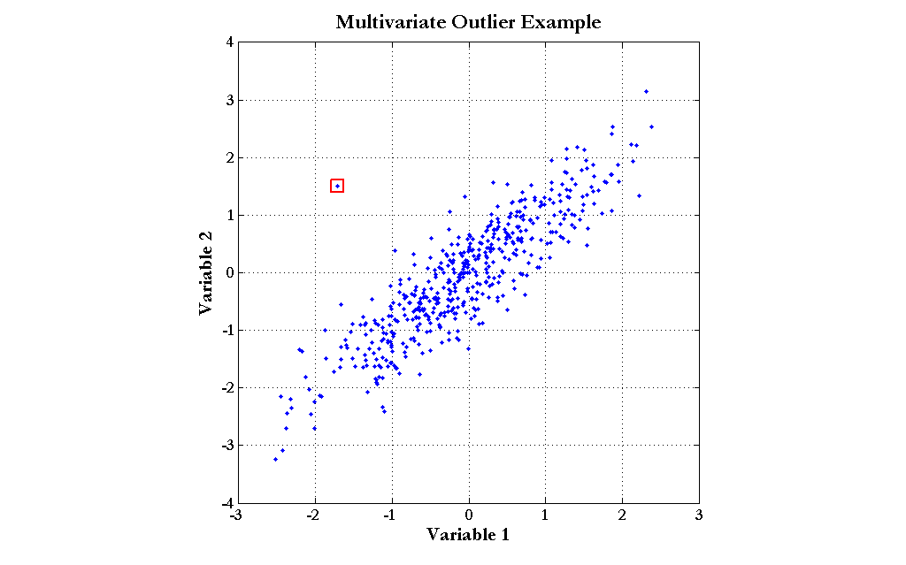
Data Mining Functions: Outlier Analysis
Outlier analysis
  Outlier: A data object that does not comply with the general behavior of the data
  Noise or exception?―One person’s garbage could be another person’s treasure
  Methods: by product of clustering or regression analysis, …
  Useful in fraud detection, rare events analysis

Slide 27

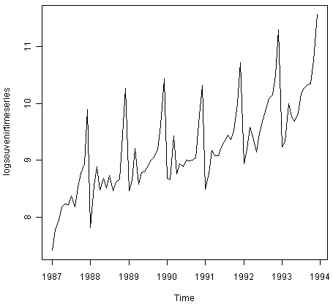
Other Functions: Time and Ordering
Sequence, trend and evolution analysis
  Trend, time-series, and deviation analysis
    e.g., regression and value prediction
  Sequential pattern mining
    e.g., buy digital camera, then buy large memory cards
  Periodicity analysis
  Motifs (repeated patterns) and biological sequence analysis
    Approximate and consecutive motifs
  Similarity-based analysis
Mining data streams
  Ordered, time-varying, potentially infinite, data streams

Slide 28
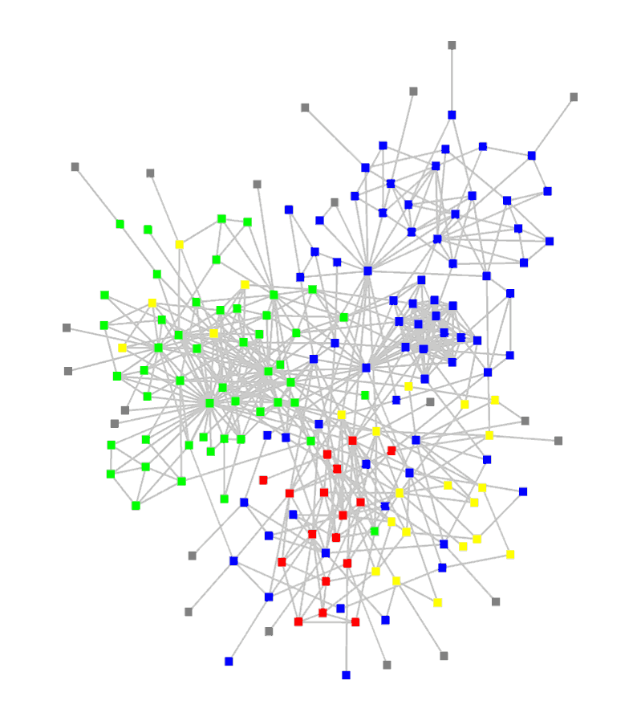
Data Mining Functions: Structure and Network Analysis
Graph mining
  Finding frequent subgraphs (e.g., chemical compounds), trees (XML), substructures (web fragments)
Information network analysis
  Social networks: actors (objects, nodes) and relationships (edges)
    e.g., author networks in CS, terrorist networks
  Multiple heterogeneous networks
    A person could be multiple information networks: friends, family, classmates, …
  Links carry a lot of semantic information: Link mining
Web mining
  Web is a big information network: from PageRank to Google
  Analysis of Web information networks
    Web community discovery, opinion mining, usage mining

Slide 29

Evaluation of Knowledge
Are all mined knowledge interesting?
  One can mine tremendous amount of “patterns”
  Some may fit only certain dimension space (time, location, …)
  Some may not be representative, may be transient, …
Evaluation of mined knowledge → directly mine only interesting knowledge?
  Descriptive vs. predictive
  Coverage
  Typicality vs. novelty
  Accuracy
  Timeliness
Notes:
The predictive analytics goes a step ahead of descriptive analytics. While descriptive analytics is limited to past data, predictive analytics predicts future trends. ... It can also include predicting the values of missing fields in a data set and probable impact of data changes on future trends

Slide 30
Data Mining: Confluence of Multiple Disciplines
Machine
Learning
Pattern
Recognition
Statistics
Applications
Data Mining
Visualization
Algorithm
Database
Technology
High-Performance
Computing

Slide 31
Why Confluence of Multiple Disciplines?
Tremendous amount of data
  Algorithms must be scalable to handle big data
High-dimensionality of data
  Micro-array may have tens of thousands of dimensions
High complexity of data
  Data streams and sensor data
  Time-series data, temporal data, sequence data
  Structure data, graphs, social and information networks
  Spatial, spatiotemporal, multimedia, text and Web data
  Software programs, scientific simulations
New and sophisticated applications

Slide 32
Major Issues in Data Mining (1)
Mining Methodology
  Mining various and new kinds of knowledge
  Mining knowledge in multi-dimensional space
  Data mining: An interdisciplinary effort
  Boosting the power of discovery in a networked environment
  Handling noise, uncertainty, and incompleteness of data
  Pattern evaluation and pattern- or constraint-guided mining
User Interaction
  Interactive mining
  Incorporation of background knowledge
  Presentation and visualization of data mining results

Slide 33
Major Issues in Data Mining (2)
Efficiency and Scalability
  Efficiency and scalability of data mining algorithms
  Parallel, distributed, stream, and incremental mining methods
Diversity of data types
  Handling complex types of data
  Mining dynamic, networked, and global data repositories
Data mining and society
  Social impacts of data mining
  Privacy-preserving data mining
  Invisible data mining

Slide 34
Conferences and Journals on Data Mining
KDD Conferences
  ACM SIGKDD Int. Conf. on Knowledge Discovery in Databases and Data Mining (KDD)
  SIAM Data Mining Conf. (SDM)
  (IEEE) Int. Conf. on Data Mining (ICDM)
  European Conf. on Machine Learning and Principles and practices of Knowledge Discovery and Data Mining (ECML-PKDD)
  Pacific-Asia Conf. on Knowledge Discovery and Data Mining (PAKDD)
  Int. Conf. on Web Search and Data Mining (WSDM)
Other related conferences
  DB conferences: ACM SIGMOD, VLDB, ICDE, EDBT, ICDT, …
  Web and IR conferences: WWW, SIGIR, WSDM
  ML conferences: ICML, NIPS
  PR conferences: CVPR,
Journals
  Data Mining and Knowledge Discovery (DAMI or DMKD)
  IEEE Trans. On Knowledge and Data Eng. (TKDE)
  KDD Explorations
  ACM Trans. on KDD

