Slide 1

Lecture 2 - Data
CS 495/595
Introduction to Data Mining
Dr. Sampath Jayarathna
Old Dominion University
Credit for some of the slides in this lecture goes to http://hanj.cs.illinois.edu/book & www.users.cs.umn.edu/~kumar001/dmbook/

Slide 2
What is Data?
Collection of data objects and their attributes
An attribute is a property or characteristic of an object
  Examples: eye color of a person, temperature, etc.
  Attribute is also known as variable, field, characteristic, dimension, or feature
A collection of attributes describe an object
  Object is also known as record, point, case, sample, entity, or instance
Attributes
Objects

Slide 3
A More Complete View of Data
Data may have parts
The different parts of the data may have relationships
More generally, data may have structure
Data can be incomplete
We will discuss this in more detail later

Slide 4
Attribute Values
Attribute values are numbers or symbols assigned to an attribute for a particular object
Distinction between attributes and attribute values
  Same attribute can be mapped to different attribute values
    Example: height can be measured in feet or meters
  Different attributes can be mapped to the same set of values
    Example: Attribute values for ID and age are integers

Slide 5
Types of Attributes
There are different types of attributes
  Nominal
    Examples: ID numbers, eye color, zip codes
  Ordinal
    Examples: rankings (e.g., taste of potato chips on a scale from 1-10), grades, height {tall, medium, short}
  Interval
    Examples: calendar dates, temperatures in Celsius or Fahrenheit.
  Ratio
    Examples: temperature in Kelvin, length, time, counts

Slide 6
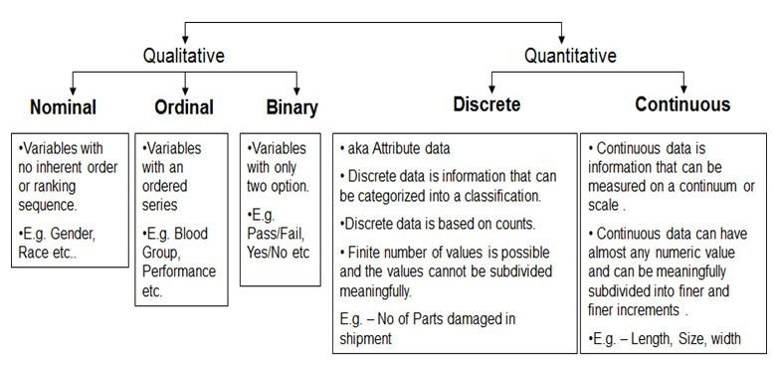
Types of Attributes
Continuous
  Interval: Ordered, meaningful/equal differences between units, no natural zero (temperature in F/C, IQ, age)
  Ratio (includes everything from interval and one additional attribute "zero" point): Ordered, meaningful/equal differences between units, natural zero (temperature in Kelvin, height, weight)

Slide 7
Key Messages for Attribute Types
The types of operations you choose should be “meaningful” for the type of data you have
  Distinctness, order, meaningful intervals, and meaningful ratios are only four properties of data
  The data type you see – often numbers or strings – may not capture all the properties or may suggest properties that are not there
  Analysis may depend on these other properties of the data
    Many statistical analyses depend only on the distribution
  Many times what is meaningful is measured by statistical significance
  But in the end, what is meaningful is measured by the domain

Slide 8
Important Characteristics of Data
  Dimensionality (number of attributes)
    High dimensional data brings a number of challenges
  Sparsity
    Only presence counts
  Resolution
    Patterns depend on the scale
      The patterns in the data depend on the level of resolution. If the resolution is too fine, a pattern may not be visible or may be buried in noise; if the resolution is too coarse, the pattern may disappear.
  Size
    Type of analysis may depend on size of data

Slide 9
Types of data sets
Record
  Data Matrix
  Document Data
  Transaction Data
Graph
  World Wide Web
  Molecular Structures
Ordered
  Spatial Data
  Temporal Data
  Sequential Data
  Genetic Sequence Data

Slide 10
Record Data
Data that consists of a collection of records, each of which consists of a fixed set of attributes

Slide 11
Document Data
Each document becomes a ‘term’ vector
  Each term is a component (attribute) of the vector
  The value of each component is the number of times the corresponding term occurs in the document.

Slide 12
Transaction Data
A special type of record data, where
  Each record (transaction) involves a set of items.
  For example, consider a grocery store. The set of products purchased by a customer during one shopping trip constitute a transaction, while the individual products that were purchased are the items.

Slide 13
Graph Data
Examples: Generic graph, a molecule, and webpages
Benzene Molecule: C6H6

Slide 14
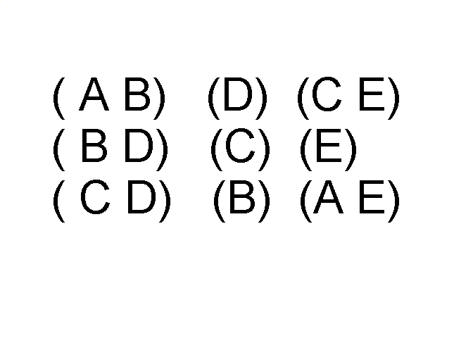
Ordered Data
Sequences of transactions
Items/Events
An element of the sequence

Slide 15
Ordered Data
Genomic sequence data

Slide 16
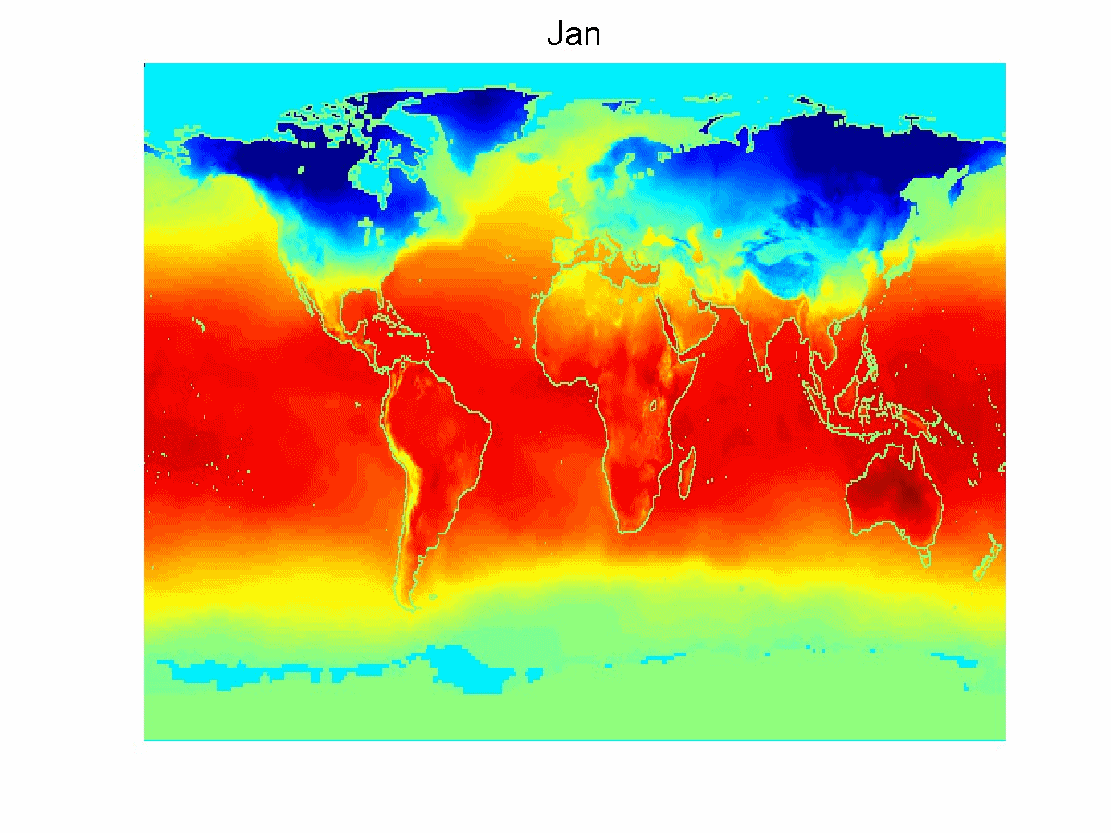
Ordered Data
Spatio-Temporal Data
Average Monthly Temperature of land and ocean

Slide 17
Data Quality
Poor data quality negatively affects many data processing efforts
“The most important point is that poor data quality is an unfolding disaster.
  Poor data quality costs the typical company at least ten percent (10%) of revenue; twenty percent (20%) is probably a better estimate.”
Data mining example: a classification model for detecting people who are loan risks is built using poor data
  Some credit-worthy candidates are denied loans
  More loans are given to individuals that default

Slide 18
Data Quality …
What kinds of data quality problems?
How can we detect problems with the data?
What can we do about these problems?
Examples of data quality problems:
  Noise and outliers
  Missing values
  Duplicate data
  Wrong data

Slide 19
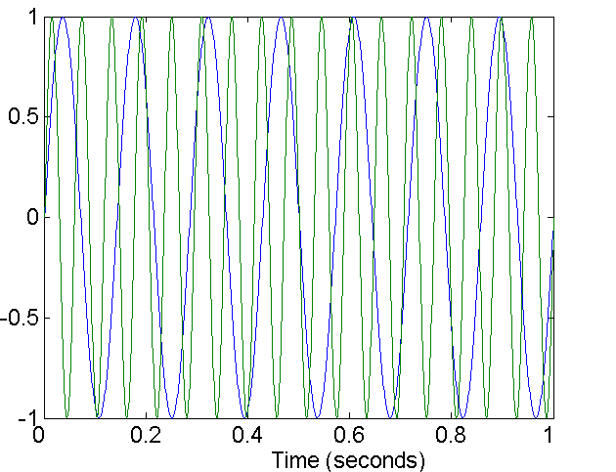
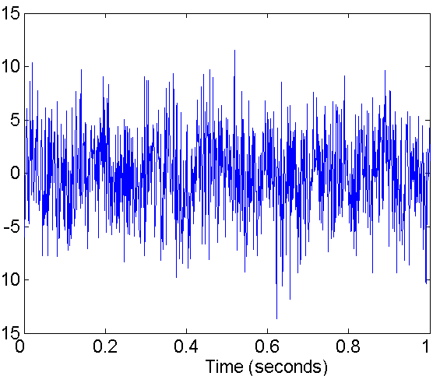
Noise
For objects, noise is an extraneous object
For attributes, noise refers to modification of original values
  Examples: distortion of a person’s voice when talking on a poor phone and “snow” on television screen
Two Sine Waves
Two Sine Waves + Noise

Slide 20
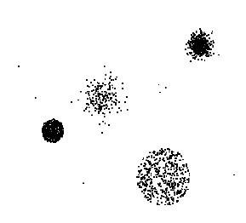
Outliers
Outliers are data objects with characteristics that are considerably different than most of the other data objects in the data set
  Case 1: Outliers are
  noise that interferes
  with data analysis
  Case 2: Outliers are
  the goal of our analysis
    Credit card fraud
    Intrusion detection

Slide 21
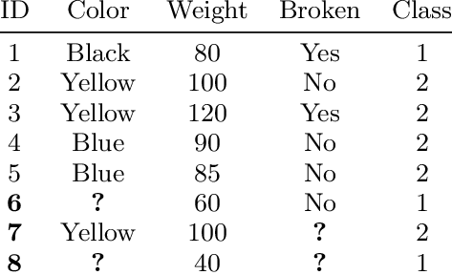
Missing Values
Reasons for missing values
  Information is not collected
  (e.g., people decline to give their age and weight)
  Attributes may not be applicable to all cases
  (e.g., annual income is not applicable to children)
Handling missing values
  Eliminate data objects or variables
  Estimate missing values
    Example: time series of temperature
    Example: census results
  Ignore the missing value during analysis

Slide 22
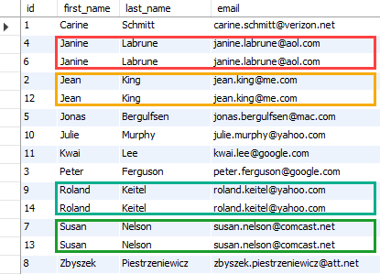
Duplicate Data
Data set may include data objects that are duplicates, or almost duplicates of one another
  Major issue when merging data from heterogeneous sources
Examples:
  Same person with multiple email addresses
Data cleaning
  Process of dealing with duplicate data issues

Slide 23
Similarity and Distance
For many different problems we need to quantify how close two objects are.
Examples:
  For an item bought by a customer, find other similar items
  Group together the customers of a site so that similar customers are shown the same ad.
  Group together web documents so that you can separate the ones that talk about politics and the ones that talk about sports.
  Find all the near-duplicate mirrored web documents.
  Find credit card transactions that are very different from previous transactions.
To solve these problems we need a definition of similarity, or distance.
  The definition depends on the type of data that we have

Slide 24
Similarity and Dissimilarity Measures
Similarity measure
  Numerical measure of how alike two data objects are.
  Is higher when objects are more alike.
  Often falls in the range [0,1]
Dissimilarity measure
  Numerical measure of how different two data objects are
  Lower when objects are more alike
  Minimum dissimilarity is often 0
  Upper limit varies
Proximity refers to a similarity or dissimilarity

Slide 25
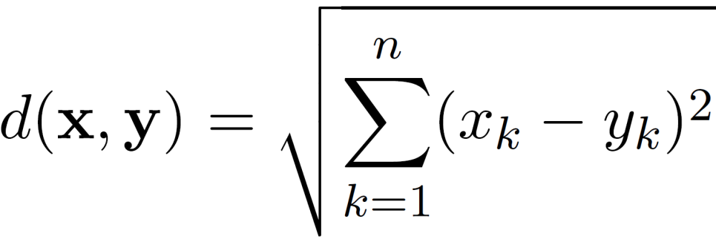
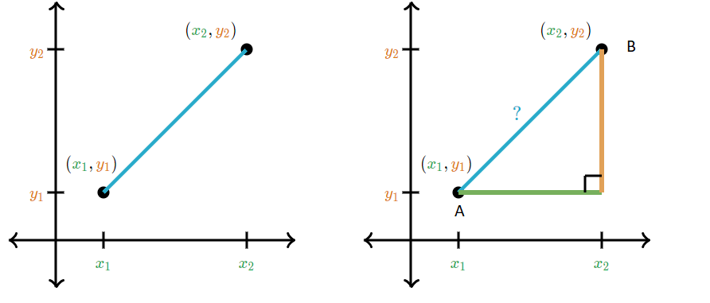

Euclidean Distance
Euclidean Distance
  where n is the number of dimensions (attributes) and x_{k} and y_{k} are, respectively, the k^{th} attributes (components) or data objects x and y.
Standardization is necessary, if scales differ.

Slide 26
Euclidean Distance
Distance Matrix

Slide 27
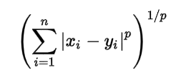
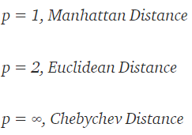
Minkowski Distance
Minkowski Distance is a generalization of Euclidean Distance.
  Here generalized means that we can manipulate the formula to calculate the distance between two data points in different ways, example: Euclidean, Manhattan, Chebyshev.

Slide 28
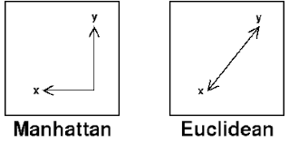
Manhattan Distance
We use Manhattan Distance if we need to calculate the distance between two data points in a grid like path. As mentioned earlier, we use Minkowski distance formula to find Manhattan distance by setting p’s value as 1.
  Also known as Taxicab Geometry, City Block Distance etc.

Slide 29
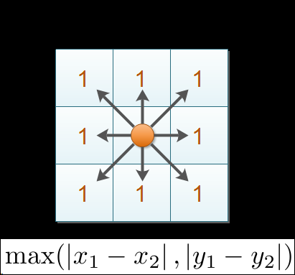
Chebyshev Distance (chessboard distance)
In Chebyshev distance, all 8 adjacent cells from the given point can be reached by one unit.
The Chebyshev distance is sometimes used in warehouse logistics, as it effectively measures the time an overhead crane takes to move an object (as the crane can move on the x and y axes at the same time but at the same speed along each axis).

Slide 30
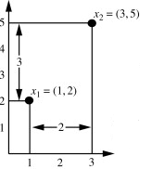
Activity 2
Let x₁ = (1, 2) and x₂ = (3, 5) represent two objects as shown in Figure.
Calculate the Euclidian, Chebyshev and Manhattan distance

Slide 31
Python code sample
import scipy.spatial.distance as dist
A = [1,2]
B = [3,5]
print('Euclidean distance is', dist.euclidean(A, B))
print('Manhattan distance is', dist.cityblock(A, B))
print('Chebyshev distance is', dist.chebyshev(A, B))

Slide 32
Similarity Between Binary Vectors
Common situation is that objects, p and q, have only binary attributes
Compute similarities using the following quantities
f₀₁ = the number of attributes where p was 0 and q was 1
f₁₀ = the number of attributes where p was 1 and q was 0
f₀₀ = the number of attributes where p was 0 and q was 0
f₁₁ = the number of attributes where p was 1 and q was 1
Simple Matching Coefficient
SMC = number of matches / number of attributes
= (f₁₁ + f₀₀) / (f₀₁ + f₁₀ + f₁₁ + f₀₀)

Slide 33
SMC : Example
x = 1 0 0 0 0 0 0 0 0 0
y = 0 0 0 0 0 0 1 0 0 1
f₀₁ = 2 (the number of attributes where p was 0 and q was 1)
f₁₀ = 1 (the number of attributes where p was 1 and q was 0)
f₀₀ = 7 (the number of attributes where p was 0 and q was 0)
f₁₁ = 0 (the number of attributes where p was 1 and q was 1)
SMC = (f₁₁ + f₀₀) / (f₀₁ + f₁₀ + f₁₁ + f₀₀)
= (0+7) / (2+1+0+7) = 0.7

Slide 34
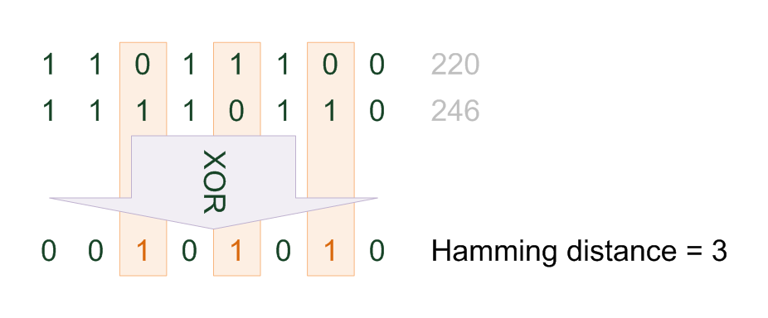
Hamming Distance
Hamming distance is a metric for comparing two binary data strings. While comparing two binary strings of equal length, Hamming distance is the number of bit positions in which the two bits are different.
x = 1 0 0 0 0 0 0 0 0 0
y = 0 0 0 0 0 0 1 0 0 1
d(x,y) = 3

Slide 35
Jaccard Similarity
The Jaccard similarity (Jaccard coefficient) of two sets S₁, S₂ is the size of their intersection divided by the size of their union.
  JSim (C₁, C₂) = |C₁∩C₂| / |C₁∪C₂|.
  Extreme behavior:
    Jsim(X,Y) = 1, iff X = Y
    Jsim(X,Y) = 0 iff X,Y have no elements in common
3 in intersection.
8 in union.
Jaccard similarity
= 3/8

Slide 36
SMC versus Jaccard: Example
x = 1 0 0 0 0 0 0 0 0 0
y = 0 0 0 0 0 0 1 0 0 1
f₀₁ = 2 (the number of attributes where p was 0 and q was 1)
f₁₀ = 1 (the number of attributes where p was 1 and q was 0)
f₀₀ = 7 (the number of attributes where p was 0 and q was 0)
f₁₁ = 0 (the number of attributes where p was 1 and q was 1)
SMC = (f₁₁ + f₀₀) / (f₀₁ + f₁₀ + f₁₁ + f₀₀)
= (0+7) / (2+1+0+7) = 0.7
J = (f₁₁) / (f₀₁ + f₁₀ + f₁₁) = 0 / (2 + 1 + 0) = 0
Jaccard coefficient is a measure of asymmetric binary attributes, i.e., a scenario where the presence of an item is more important than its absence.

Slide 37
Similarity between vectors
Documents (and sets in general) can also be represented as vectors
document | Apple | Microsoft | Obama | Election
D1 | 10 | 20 | 0 | 0
D2 | 30 | 60 | 0 | 0
D3 | 60 | 30 | 0 | 0
D4 | 0 | 0 | 10 | 20
How do we measure the similarity of two vectors?
  We could view them as sets of words. Jaccard Similarity will show that D4 is different form the rest
  But all pairs of the other three documents are equally similar
We want to capture how well the two vectors are aligned

Slide 38
Example
document | Apple | Microsoft | Obama | Election
D1 | 10 | 20 | 0 | 0
D2 | 30 | 60 | 0 | 0
D3 | 60 | 30 | 0 | 0
D4 | 0 | 0 | 10 | 20
apple
Documents D1, D2 are in the “same direction”
Document D3 is on the same plane as D1, D2
Document D3 is orthogonal to the rest
microsoft
{Obama, election}

Slide 39
Cosine Similarity
Sim(X,Y) = cos(X,Y)
  The cosine of the angle between X and Y
If the vectors are aligned (correlated) angle is zero degrees and cos(X,Y)=1
If the vectors are orthogonal (no common coordinates) angle is 90 degrees and cos(X,Y) = 0
Cosine is commonly used for comparing documents, where we assume that the vectors are normalized by the document length.

Slide 40
Cosine Similarity Measure
t₃
Cosine similarity measures the cosine of the angle between two vectors.
Inner product normalized by the vector lengths.
θ₁
D₁
D₃
CosSim(d_{j}, q) =
θ₂
t₁
t₂
D₂
D₁ = 2T₁ , 3T₂ , 5T₃ CosSim(D₁ , D₃) = (0+0+10) / √(4+9+25)(0+0+4) = 0.81
D₂ = 3T₁ , 7T₂ , 1T₃ CosSim(D₂ , D₃) = (0+0+2) / √(9+49+1)(0+0+4) = 0.13
D₃ = 0T₁ , 0T₂ , 2T₃

Slide 41
Comparison of Proximity Measures
Domain of application
  Similarity measures tend to be specific to the type of attribute and data
  Record data, images, graphs, sequences, 3D-protein structure, etc. tend to have different measures
However, one can talk about various properties that you would like a proximity measure to have
  Symmetry is a common one
  Tolerance to noise and outliers is another
  Ability to find more types of patterns?
  Many others possible
The measure must be applicable to the data and produce results that agree with domain knowledge

Slide 42
Activity 3
If d₁ and d₂ are two document vectors, then
cos( d₁, d₂ ) = <d₁,d₂> / ||d₁|| ||d₂|| ,
where <d₁,d₂> indicates inner product or vector dot product of vectors, d₁ and d_{2,} and || d || is the length of vector d.
Calculate the cosine similarity cos(d₁, d₂ )
d₁ = 3 2 0 5
d₂ = 1 0 0 0

