Slide 1
Lecture 5c – Intro. to Weka
CS 495/595
Introduction to Data Mining
Dr. Sampath Jayarathna
Old Dominion University

Slide 2
Todays Workshop!
What is WEKA?
The Explorer:
Preprocess data
Classification
Clustering
Attribute Selection
Data Visualization
KnowledgeFlow
Visual Modeler

Slide 3
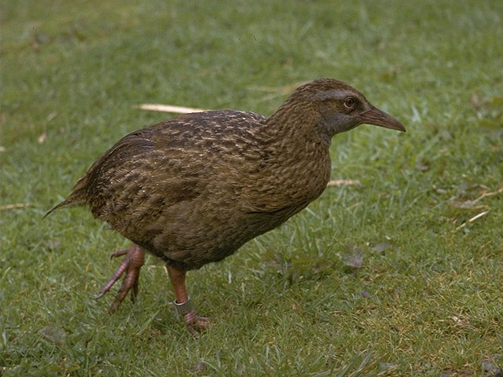
What is WEKA?
Waikato Environment for Knowledge Analysis
It’s a data mining/machine learning tool developed by Department of Computer Science, University of Waikato, New Zealand.
Weka is also a bird found only on the islands of New Zealand.
Website: http://www.cs.waikato.ac.nz/ml/weka/
Support multiple platforms (written in java):
Windows, Mac OS X and Linux

Slide 4
Main Features
49 data preprocessing tools
76 classification/regression algorithms
8 clustering algorithms
3 algorithms for finding association rules
15 attribute/subset evaluators + 10 search algorithms for feature selection

Slide 5
WEKA GUI
Main components
“The Explorer” (exploratory data analysis)
“The Experimenter” (experimental environment)
“The KnowledgeFlow” (process model inspired interface)
“Simple CLI” (Command Line interface)

Slide 6
Todays Workshop!
What is WEKA?
The Explorer:
Preprocess data
Classification
Attribute Selection
KnowledgeFlow

Slide 7
Explorer: pre-processing the data
Data can be imported from a file in various formats: ARFF, CSV, C4.5, binary
Data can also be read from a URL or from an SQL database (using JDBC)
Pre-processing tools in WEKA are called “filters”
WEKA contains filters for:
Discretization, normalization, resampling, attribute selection, transforming and combining attributes, …

Slide 8
WEKA “arff” format
@relation heart-disease-simplified
@attribute age numeric
@attribute sex { female, male}
@attribute chest_pain_type { typ_angina, asympt, non_anginal, atyp_angina}
@attribute cholesterol real
@attribute exercise_induced_angina { yes, no}
@attribute class { present, not_present}
@data
63,male,typ_angina,233,no,not_present
67,male,asympt,286,yes,present
67,male,asympt,229,yes,present
38,female,non_anginal,?,no,not_present
...
Numeric attribute
Nominal attribute
Missing value represented by ?
Notes:
Nominal – variables with no inherent order or ranking sequence such as Gender, Race etc.
Ordinal – Variables with an ordered series, such as blood group, performance etc.
Binary – variables with only 2 options, pass/fail, yes/no
All above are Qualitative.
Quantitative: Discrete and Continues

Slide 9
Explorer: building “classifiers”
Classifiers in WEKA are models for predicting nominal or numeric quantities or classes
Implemented classifiers include:
Decision trees and lists, instance-based classifiers, support vector machines, multi-layer perceptrons, logistic regression, Bayes’ nets, …
Bagging, boosting, stacking, error-correcting output codes, locally weighted learning, …

Slide 10
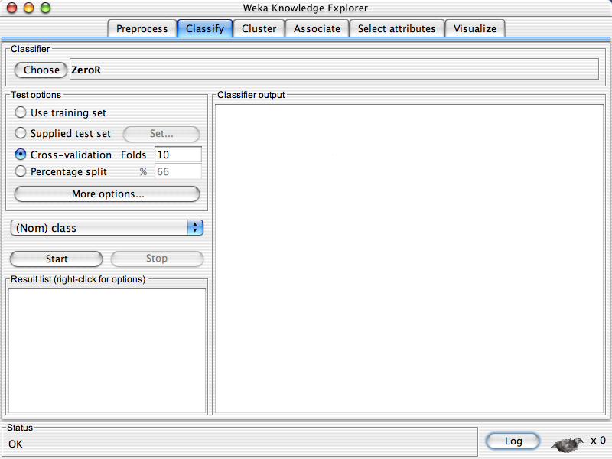

Slide 12
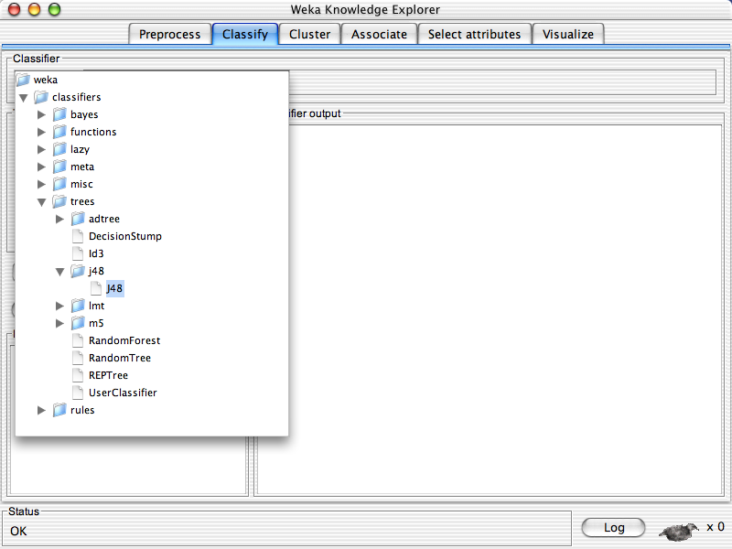

Slide 13
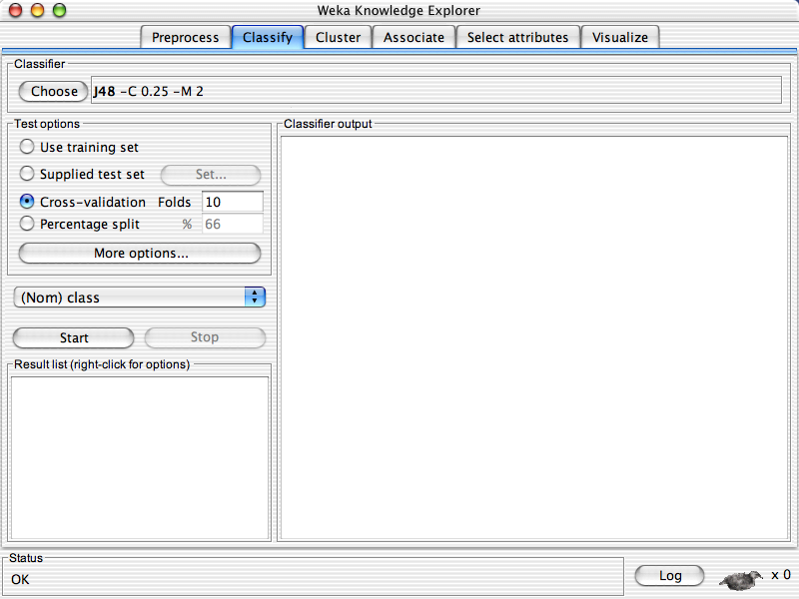

Slide 15
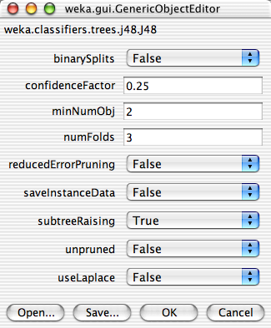

Slide 19
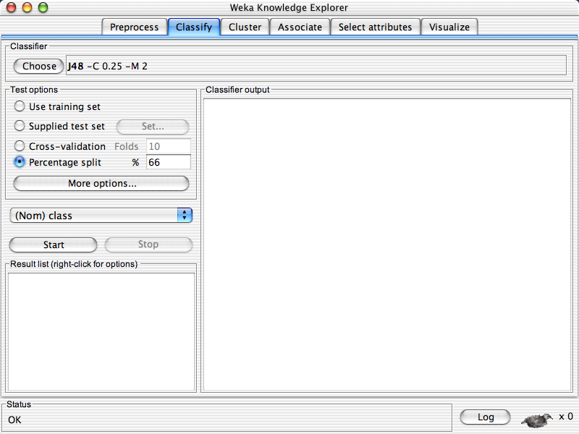

Slide 21
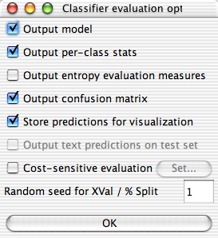

Slide 24
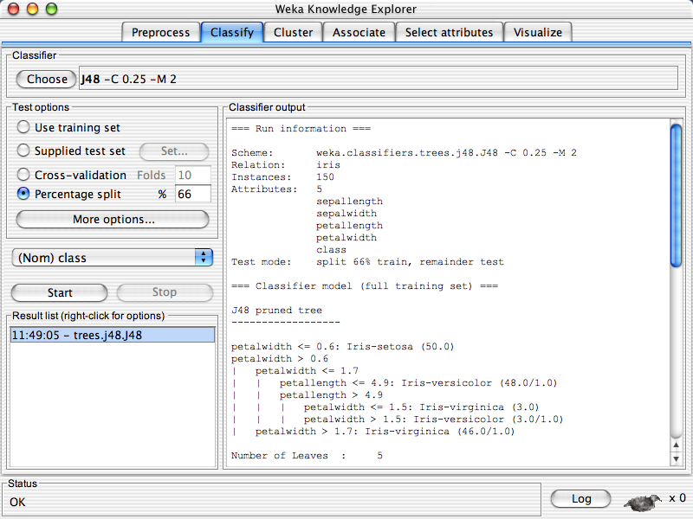

Slide 25
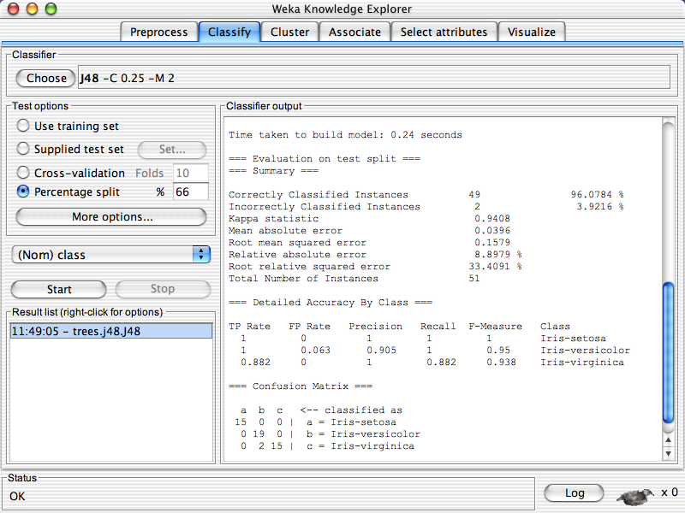
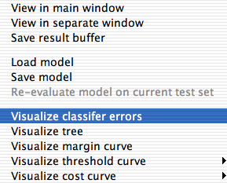

Slide 26
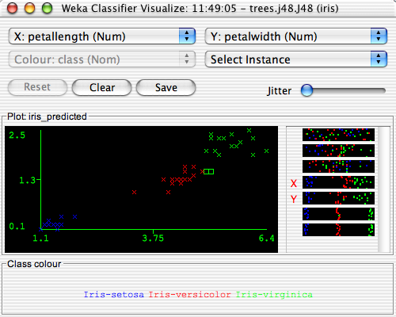

Slide 27
Exercise
Load iris.arff dataset from Weka 3.8.1\data
Use KNN classifier and modify the value of K=1, K=3, K=5 and report the accuracy

Slide 28
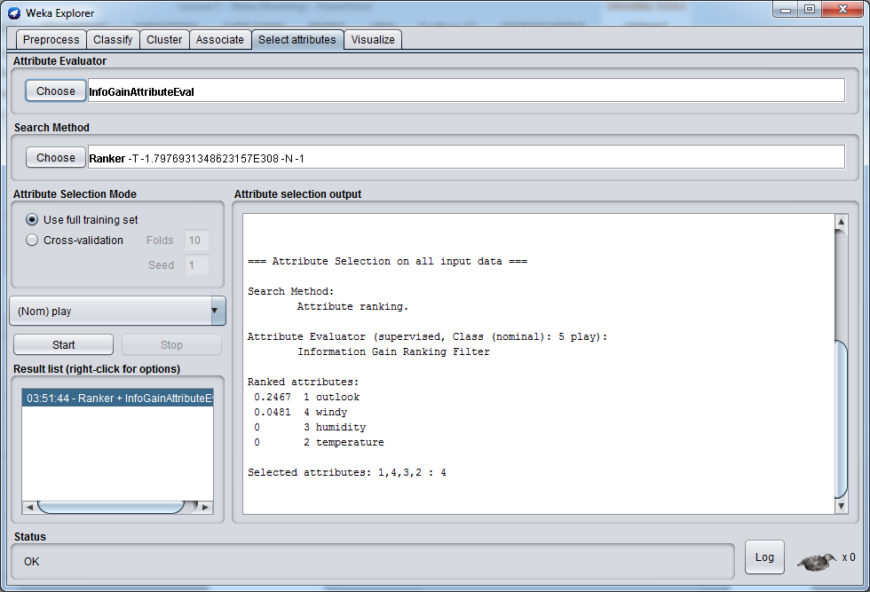
Feature Selection (filter method)

Slide 29
Todays Workshop!
What is WEKA?
The Explorer:
Preprocess data
Classification
Attribute Selection
KnowledgeFlow

Slide 30
Knowledge Flow Interface
“Visual: drag-and-drop” user interface for WEKA - intuitive
Java-Beans-based
Can do everything that Explorer does (plus a bit more), but not as comprehensively as Experimenter
Data sources, classifiers, etc. are beans and can be connected graphically
Data “flows” through modules: e.g.,
“data source” ->“filter” ->“classifier”-> “evaluator”
KF layouts can be saved and re-used later

Slide 31
Knowledge Flow: An Example
What we want to do:
Take a dataset
Do some attribute selection
Perform some classification on the reduced data using 10 fold CV
Examine the subsets selected for each CV fold
Visualize the results in text format and curves

Slide 32
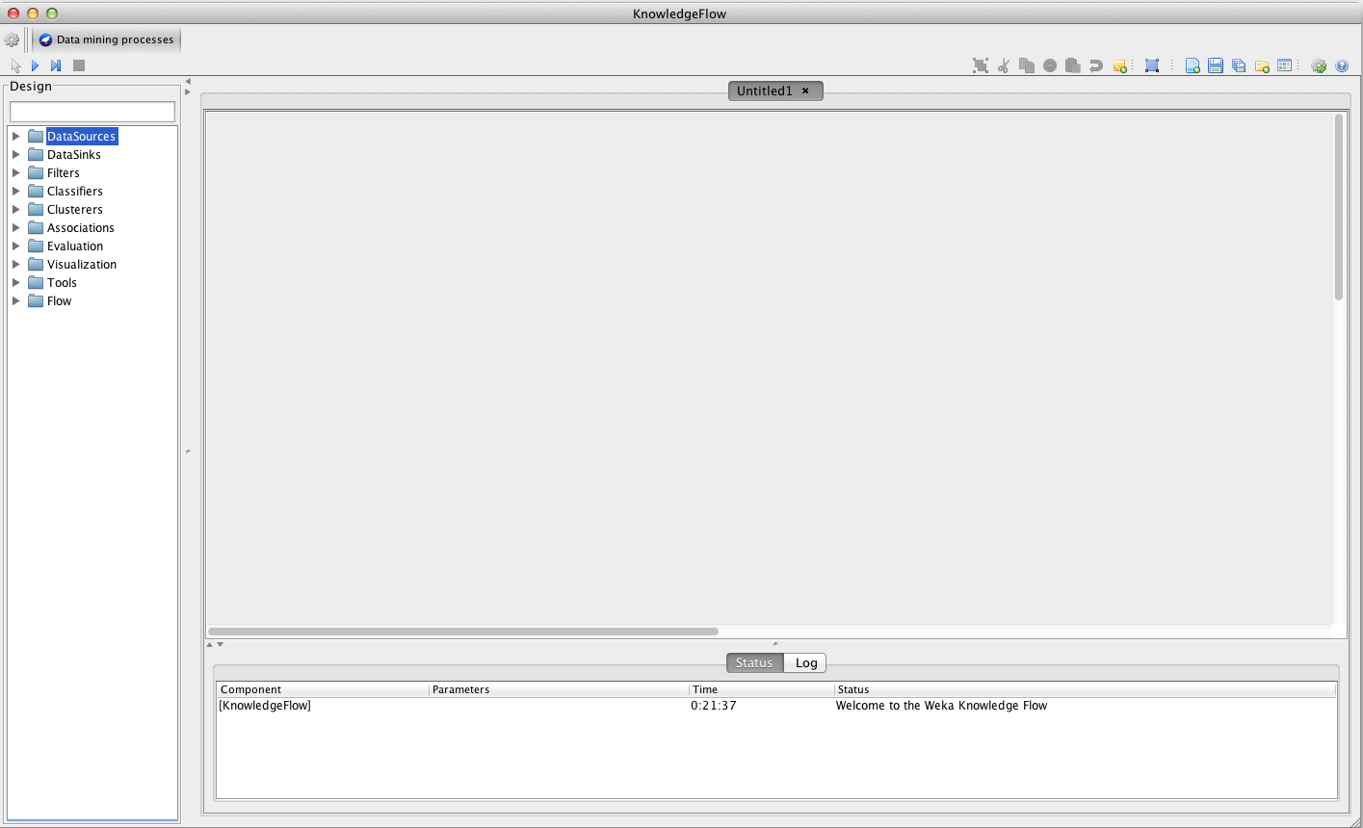
Getting Started

Slide 33
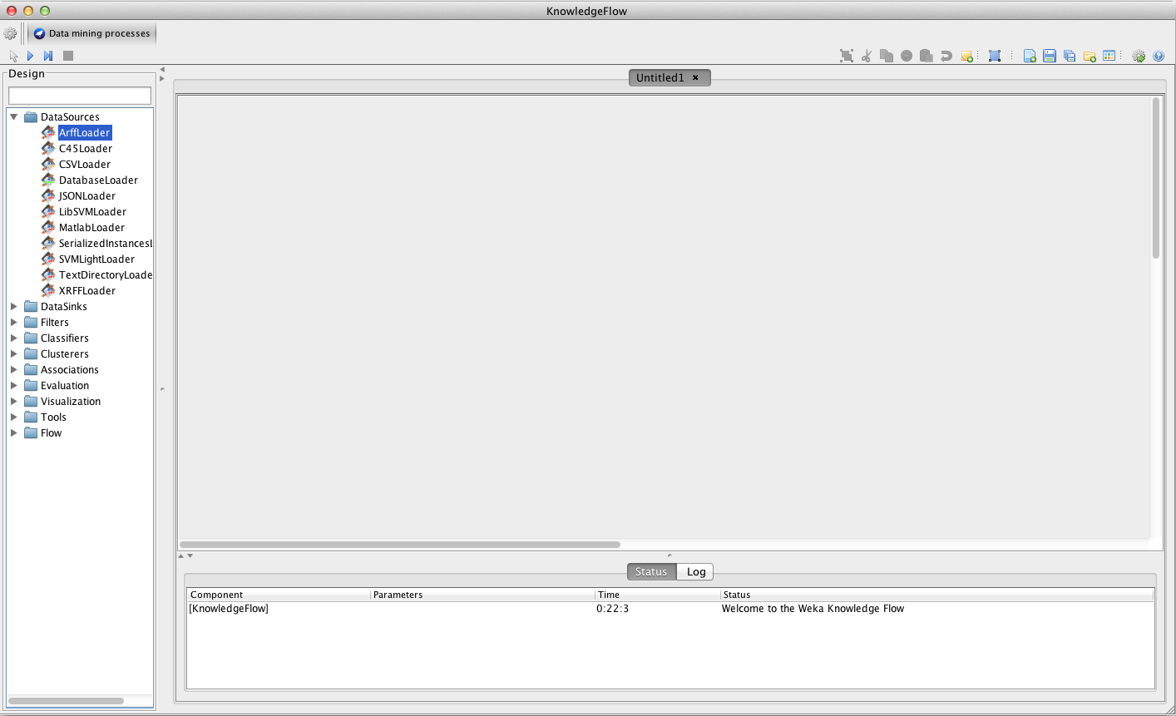

Slide 34
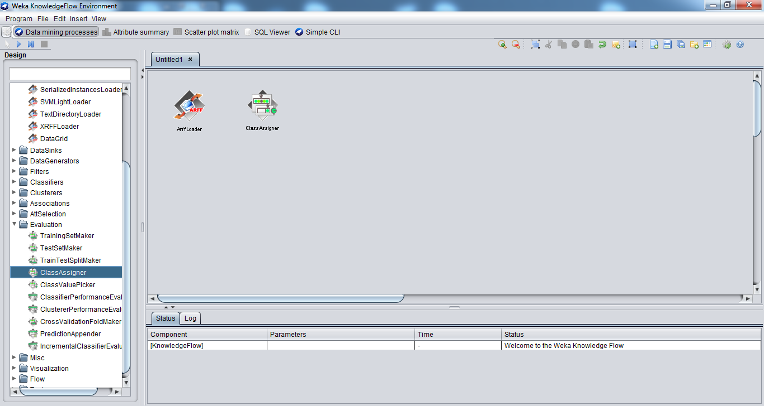
Class Assigner

Slide 35
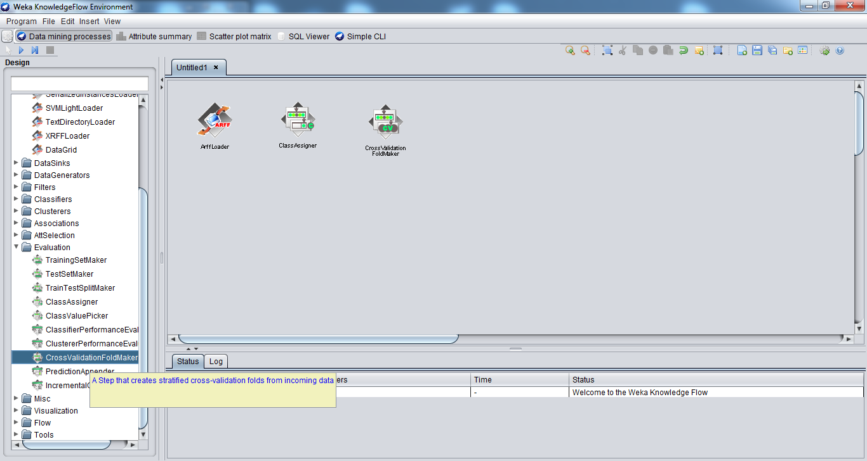
Cross Validation Fold Maker

Slide 36
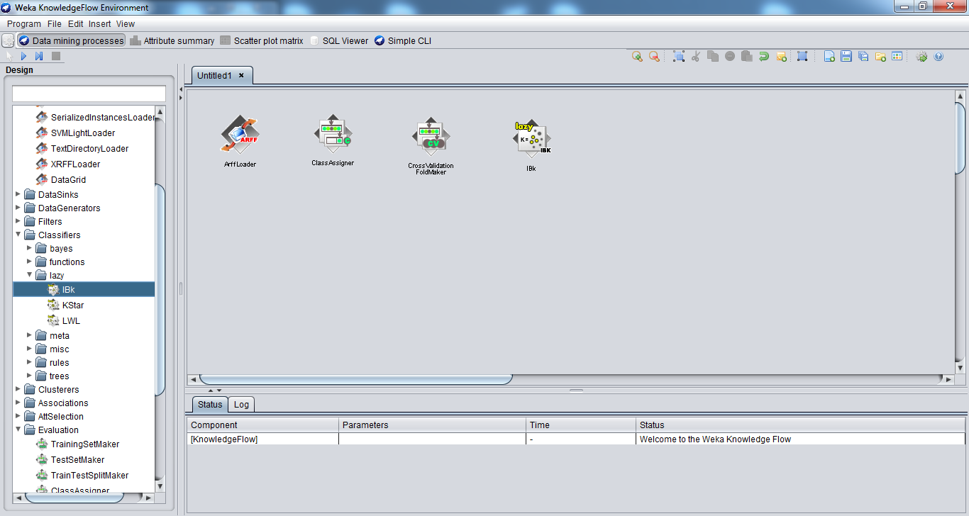
Classifier

Slide 37
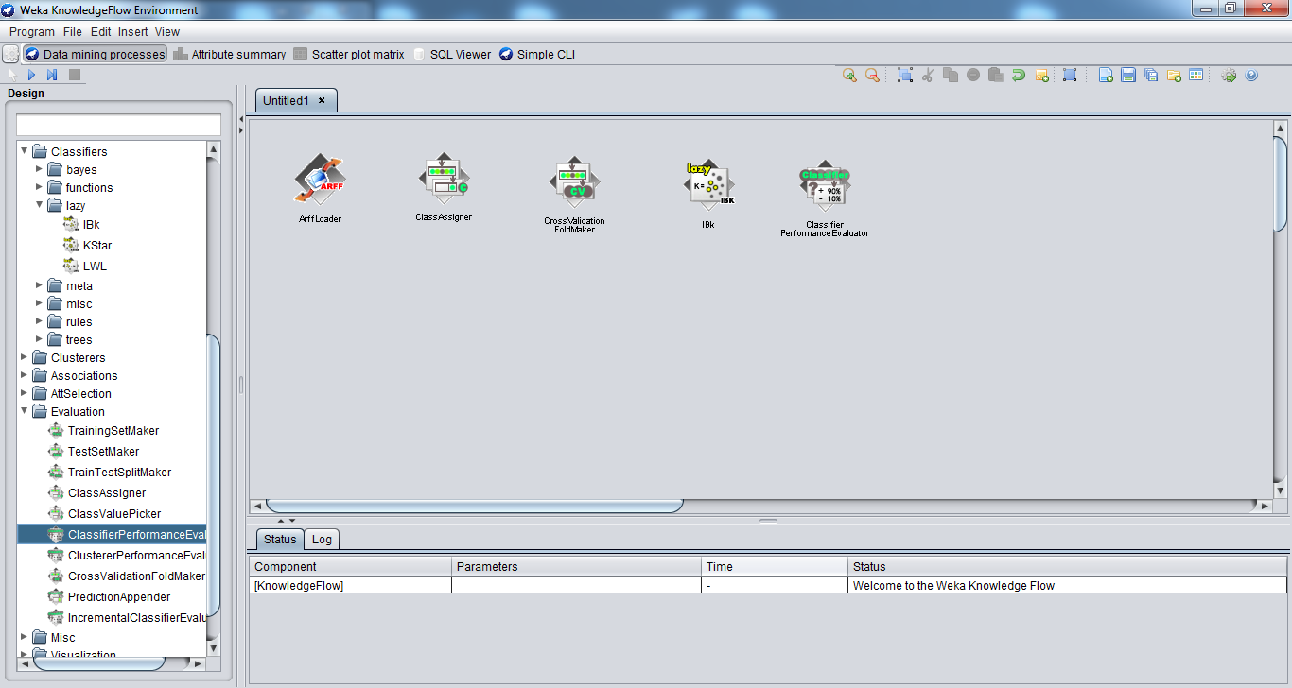
Classifier Performance Evaluator

Slide 38
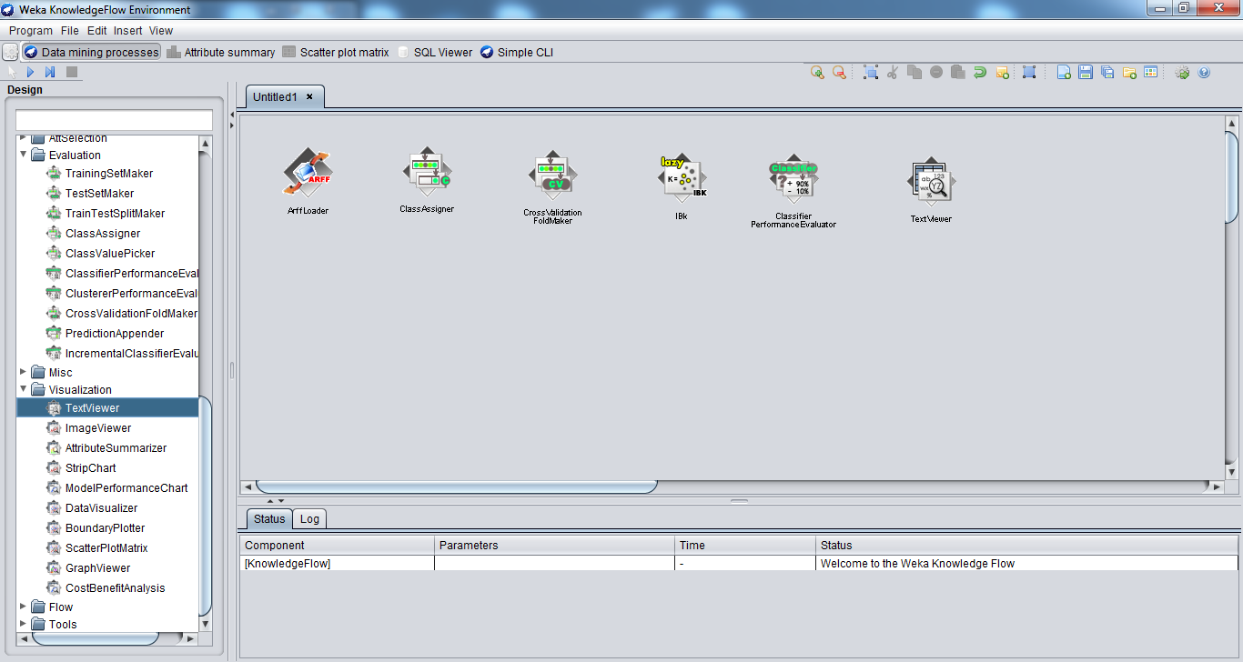
TextViewers can be used for visualization of results as well as examining the processes

Slide 39
TextViewers can be used for visualization of results as well as examining the processes

Slide 40
Run Classifier
Load data from ArffLoader (right click>configure)
Remember to add following into your KnowledgeFlow
CrossValidationFoldMaker
Add ModelPerformanceChart from Visualization
Assign class from ClassAssigner
Connect dataset from all to Cross Validation
Get Training and Testing set to classifier
Send batch classifier to performance evaluator

Slide 41
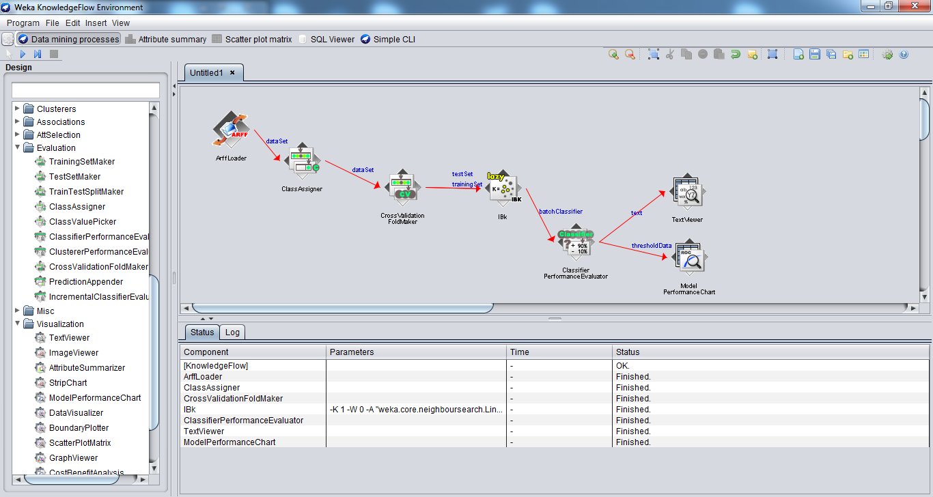

Slide 42
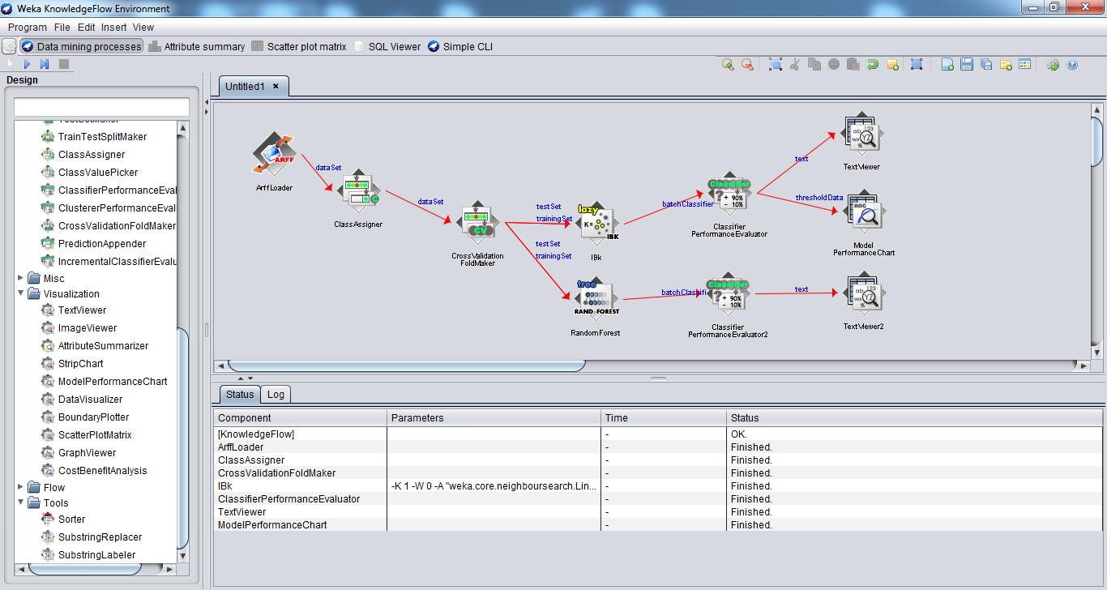
Run multiple classifiers

Slide 43
Conclusion
Explorer and Knowledge Flow:
Offer useful and flexible ways to perform a range of batches of experiments
Beware of the way in which results are generated!
KF is particularly useful for visualization
Just a snapshot of capabilities of WEKA!

