Slide 1

Lecture 8 – Mining Time Series Data
CS 495/595
Introduction to Data Mining
Dr. Sampath Jayarathna
Old Dominion University
Credit for some of the slides in this lecture goes to Carlo Zaniolo UCLA and Abdullah Mueen UNM

Slide 2
What are Time Series?
25.1750
25.2250
25.2500
25.2500
25.2750
25.3250
25.3500
25.3500
25.4000
25.4000
25.3250
25.2250
25.2000
25.1750
..
..
24.6250
24.6750
24.6750
24.6250
24.6250
24.6250
24.6750
24.7500
A time series is a collection of observations made sequentially in time.
29
28
27
26
25
24
23
0
50
100
150
200
250
300
350
400
450
500

Slide 3
Time Series are Ubiquitous!
People measure things...
  The presidents approval rating.
  The blood pressure.
  Crypto value
  The number of web hits per second.
… and things change over time.
Thus time series occur in virtually every medical, scientific and businesses domain.

Slide 4
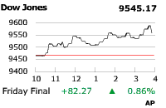
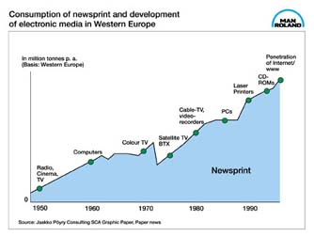
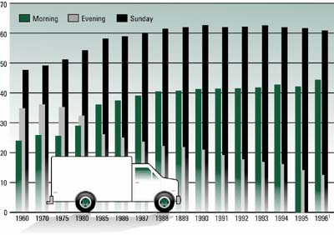
Time Series are Ubiquitous!
A random sample of 4,000 graphics from 15 of the world’s newspapers published from 1974 to 1989 found that more than 75% of all graphics were time series (Tufte, 1983).

Slide 5
Time Series Forecasting
To forecast future events based on known past data
E.g., to predict the opening price of a stock based on its
past performance
Popular models
Autoregressive moving average (ARMA)
Autoregressive integrated moving average (ARIMA)

Slide 6
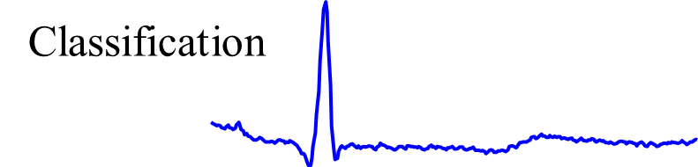
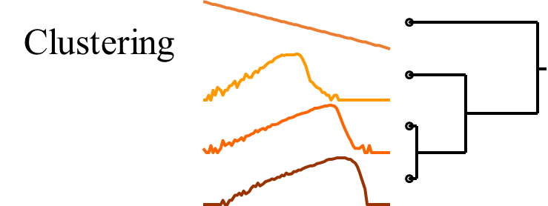
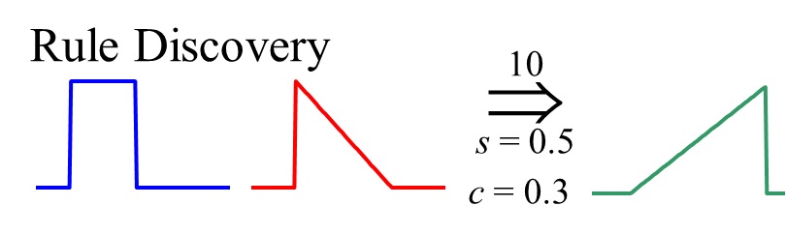
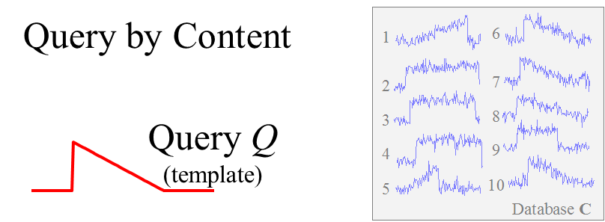
Time Series Similarity
Defining the similarity between two time series is at the heart of most time series data mining applications/tasks

Slide 7
Why is Working With Time Series Difficult?
Answer: We are dealing with subjective notions of similarity.
The definition of similarity depends on the user, the domain and the task at hand. We need to be able to handle this subjectivity.

Slide 8
Why is Working With Time Series Difficult?
Answer: Miscellaneous data handling problems.
Differing data formats.
Differing sampling rates.
Noise, missing values, etc.

Slide 9
Similarity Matching Problem: Flavors 1
Query Q
(template)
1: Whole Matching
1
6
2
7
3
8
4
9
C₆ is the best match.
5
10
Database C
Given a Query Q, a reference database C and a distance measure, find the C_{i} that best matches Q.

Slide 10
Similarity matching problem: flavor 2
Query Q
(template)
2: Subsequence Matching
Database C
The best matching subsection.
Given a Query Q, a reference database C and a distance measure, find the location that best matches Q.

Slide 11
Why Similarity Important?
After all that background we might have forgotten what we are doing and why we care!
So here is a simple motivator and review..
You go to the doctor because of chest pains. Your ECG looks strange…
You doctor wants to search a database to find similar ECGS, in the hope that they will offer clues about your condition...
Two questions:
How do we define similar?
How do we search quickly?

Slide 12
Similarity Measures
A similarity measure compares two time series and produces a number representing their similarity
A distance measure is an inverted similarity measure
Lockstep Measures
Euclidean Distance
Correlation Coefficient
Cross-correlation
Elastic Measures
Dynamic Time Warping
Edit Distance
Longest Common Subsequence

Slide 13
Preprocessing the data before similarity
If we naively try to measure the distance between two “raw” time series, we may get very unintuitive results.
This is because Euclidean distance is very sensitive to some distortions in the data. For most problems these distortions are not meaningful, and thus we can and should remove them.
In the next four slides, we discuss the 4 most common forms of distortion, and how to remove them.
        Offset Translation
        Amplitude Scaling
        Linear Trend
        Noise

Slide 14
Transformation I: Offset Translation
3
3
D(Q,C)
2.5
2.5
2
2
1.5
1.5
1
1
0.5
0.5
0
0
50
100
150
200
250
300
0
0
50
100
150
200
250
300
Operations Performed:
Q = Q - mean(Q)
C = C - mean(C)
D(Q,C)
0
50
100
150
200
250
300
0
50
100
150
200
250
300

Slide 15
Transformation II: Amplitude Scaling
0
100
200
300
400
500
600
700
800
900
1000
0
100
200
300
400
500
600
700
800
900
1000
Operations Performed:
Q = (Q - mean(Q)) / std(Q)
C = (C - mean(C)) / std(C)
D(Q,C)
This is same as z-score transformation

Slide 16
Transformation III: Linear Trend
5
Operation performed:
1. offset translation
4
3
2
2. amplitude scaling
12
1
10
0
8
-1
6
-2
4
-3
2
0
20
40
60
80
100
120
140
160
180
200
0
-2
5
-4
4
Operation Performed
1. Removed linear trend
0
20
40
60
80
100
120
140
160
180
200
3
Removing linear trend :
Fit the best fitting straight line to the time series, then subtract that line from the time series.
2
1
2. offset translation
0
3. amplitude scaling
-1
-2
-3
0
20
40
60
80
100
120
140
160
180
200

Slide 17
Transformation IV: Noise
8
8
6
6
4
4
2
2
0
0
-2
-2
-4
0
20
40
60
80
100
120
140
-4
0
20
40
60
80
100
120
140
Q = smooth(Q)
The intuition behind removing noise is this.
Average each datapoints value with its neighbors.
C = smooth(C)
D(Q,C)

Slide 18
A Quick Experiment to Demonstrate the Utility of Preprocessing the Data
3
Clustered using Euclidean distance on the raw data
2
9
6
8
5
7
4
1
Clustered using Euclidean distance on the raw data, after removing noise, linear trend, offset translation and amplitude scaling.
9
8
7
5
6
4
3
2
1

Slide 19
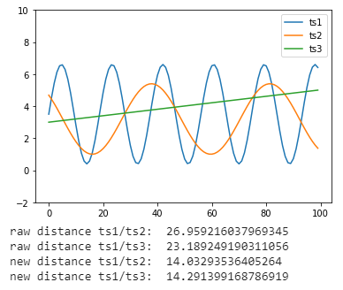
Python Code Sample
import pandas as pd
import numpy as np
import matplotlib.pylab as plt
import math
x=np.linspace(0,50,100)
ts1=pd.Series(3.1*np.sin(x/1.5)+3.5)
ts2=pd.Series(2.2*np.sin(x/3.5+2.4)+3.2)
ts3=pd.Series(0.04*x+3.0)
ts1.plot()
ts2.plot()
ts3.plot()
plt.ylim(-2,10)
plt.legend(['ts1','ts2','ts3'])
plt.show()
def euclid_dist(t1,t2):
return math.sqrt(sum((t1-t2)**2))
print(euclid_dist(ts1,ts2))
print(euclid_dist(ts1,ts3))
def amplitude_scaling(series):
return (series - series.mean())/series.std()
def offset_translation(series):
return (series - series.mean())
ts1 = offset_translation(ts1)
ts2 = offset_translation(ts2)
ts3 = offset_translation(ts3)
ts1 = amplitude_scaling(ts1)
ts2 = amplitude_scaling(ts2)
ts3 = amplitude_scaling(ts3)
print("new distance: ", euclid_dist(ts1,ts2))
print("new distance: ", euclid_dist(ts1,ts3))

Slide 20
Summary of Preprocessing
The “raw” time series may have distortions which we should remove before clustering, classification etc.
Of course, sometimes the distortions are the most interesting thing about the data, the above is only a general rule.

Slide 21
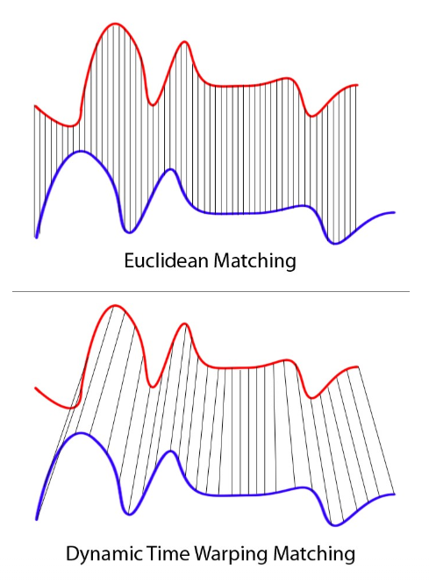
Elastic Similarity Measures
Dynamic Time Warping (DTW) is one of the algorithms for measuring the similarity between two temporal time series sequences, which may vary in speed.

Slide 22
Dynamic Time Warping (DTW)
Fixed Time Axis
Sequences are aligned “one to one”.
“Warped” Time Axis
Nonlinear alignments are possible.

Slide 23
Computing the Dynamic Time Warp Distance
Q
|n|
|p|
C
Every possible mapping from Q to C can be represented as a warping path in the search matrix.
We simply want to find the cheapest one…
Although there are exponentially many such paths, we can find one in only quadratic time using dynamic programming.
Q
p
wk
j
C
1
w1
1
i
n
γ(i,j) = d(q_{i},c_{j}) + min{ γ(i-1,j-1) , γ(i-1,j ) , γ(i,j-1) }

Slide 24
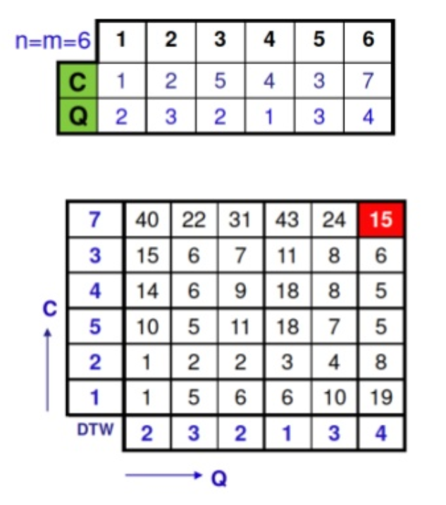
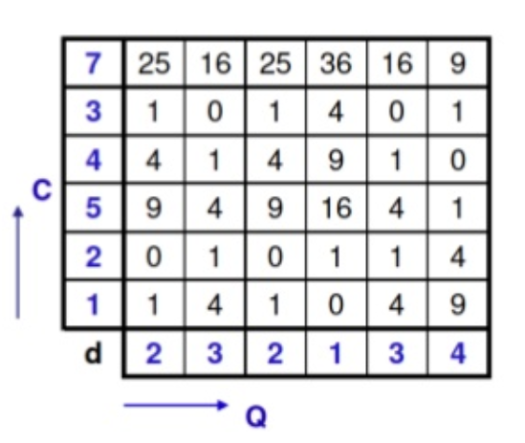
Computing the DTW Matrix
Consider the following 2 time series, C and Q.
Below we have the distance matrix d. Use that to fill the DTW matrix.

Slide 25
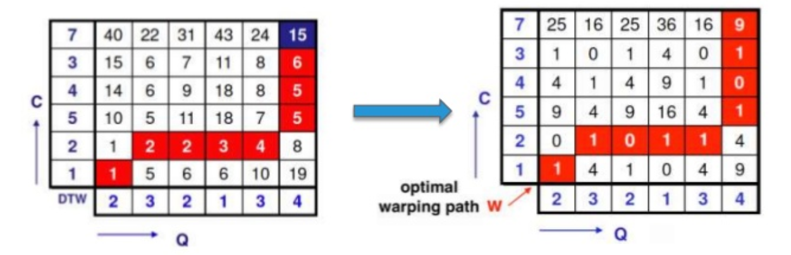

Computing the DTW Optimal Wrapping Path
Considering the d distance matrix, in order to align two time series we must find a wrapping path which is the minimum cost path between each points.
Start from end point (15) and find the minimum of three neighbors (24, 8, 6) which is 6…etc.
The DTW distance is the cost of the optimal wrapping path $\sqrt{15}.$
The “Euclidean path” moves along the main diagonal, and cost $\sqrt{29}$ in this example.

Slide 26
Activity 13
For the following two time series q and c and calculate the optimal DTW path and the DTW distance between these time series.
Q = (1,3,4,5,6,7)
C = (2,3,1,5,3,4)
4
3
5
1
3
2
 | 1 | 3 | 4 | 5 | 6 | 7

