Slide 1
Roadnet
Vehicular Ad-Hoc Network System

Slide 2
Outline
Traffic Problems
Data Crash-Course
Vehicle Safety Solutions
Target Market
Existing Project Solutions
Roadnet Solution
Prospects and Feasibility
The Future of Traffic

Slide 3
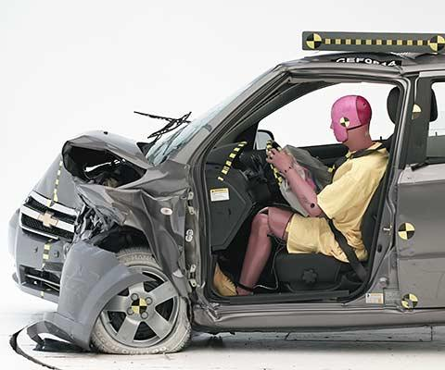
Traffic Problems
Millions of drivers
Communication extremely limited
Many contributing factors to vehicle crash potential
Personal injury, fatalities, property damage
Crashes avoidable or inevitable?

Slide 4
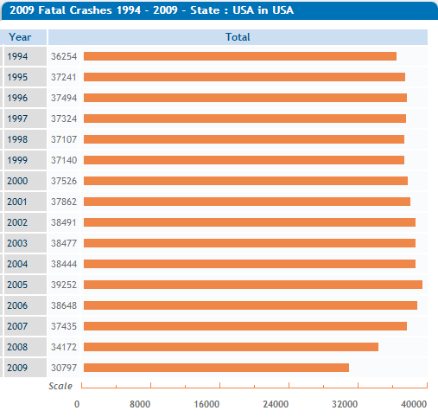
Data Crash-Course
*Data chart source: National Highway Traffic Safety Administration,
Fatality Analysis Reporting System (FARS) – [available data only up to 2009]
http://www-fars.nhtsa.dot.gov

Slide 5
Vehicle Safety Solution
Better intercommunication between drivers
Earlier warnings for traffic discrepancies
Traffic jams
Construction / Closed roads
Accidents
More accurate vehicle status monitoring
Flagging system for emergency situations

Slide 6
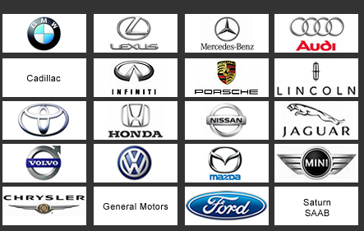
Target Market
Manufacturers to implement technology into products
Ideal outcome: majority integration in cars (still millions)
Safety and convenience as a common focus
Unification without increased competition
*Picture source: www.pagautoimport.com

Slide 7
Existing Project Solutions
SeVeCom: vehicle communication security
NoW (Network on Wheels): new protocols, IEEE 802.11
WILLWARN: hazard detection (environment sensors, GPS)
CarTalk2000: inter-vehicle communication (self-configuring)
Safespot: vehicle to road infrastructure (roadside transmission equipment)
CVIS (Cooperative Vehicle-Infrastructure Systems): improving reliability (2.5G/3G wireless technology)
Others with similar contributions (vanet.info)

Slide 8
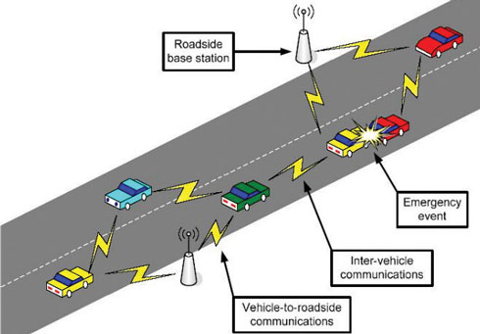
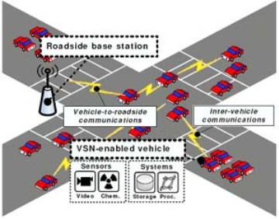
Roadnet Solution
Combination of existing technologies
Vehicle-to-vehicle
Vehicle-to-road
Roadside services (emergencies, reports, traffic lights)
Wi-Fi, Bluetooth, and GPS technologies
Goal: universal compatibility
*Picture sources: www.pcquest.ciol.com , www.wired.com

Slide 9
Prospects and Feasibility
Overall very large project
Usefulness dependent on majority integration
Experimentation and testing
Existing solution improvements took years
Manufactured into vehicles
Separate hub for installation (support older vehicles)

Slide 10
The Future of Traffic
Positive Impacts
Negative Impacts
Universal communication
Earlier warnings for emergencies
Automatic driver notifications
General less road frustration
Expense
Technology failures (drivers reliant)
Driver vigilance
Complexity

Slide 11
References
Pictures:
pagautoimport.com
pcquest.ciol.com
wired.com
Data:
www-fars.nhtsa.dot.gov
sevecom.org
network-on-wheels.de
prevent-ip.org
cartalk2000.net
safespot-eu-org
cvisproject.org

