Slide 1
Siren Detection Application By Sujani Godavarthi

Slide 2
Outline
Problem
Emergency Siren Detector
Solution
Software Component
Hardware Component
GPS
Market Survey
Conclusion
References
Sujani Godavarthi
CS 410
September 19, 2011

Slide 3
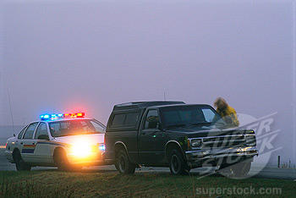
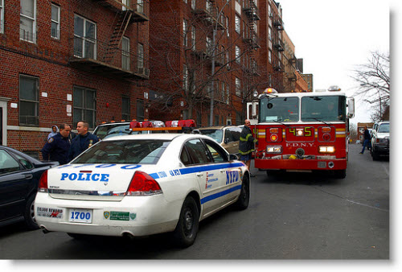
PROBLEM
Detection of police car
and ambulance sirens
while driving.
Noise Disturbances like loud music & other sounds,
while talking on phone, we cannot hear the police cars.
Sujani Godavarthi
CS 410
September 19, 2011

Slide 4
Emergency Siren Detector
A small visual device like blinking red light will be located at the dashboard which alerts the driver of the emergency sound is detected.
A small microphone shall be placed in the engine or truck compartment where specifically pitched sounds and pitch rate of change could be easily detected .
Sujani Godavarthi
CS 410
September 19, 2011

Slide 5
SOLUTION
The application will provide us information from which direction the siren sound is coming from and an alternative route can be chosen to reach the destination point.
An alternative solution is that this application can also be implemented in GPS(Global Positioning System) which will be convenient and helpful.
Sujani Godavarthi
CS 410
September 19, 2011

Slide 6
SOLUTION
For the Disability and Hearing Aid people:
The app device can provide many features like high volume and give pop up notifications.
The hearing aid people can fully or partially hear the frequencies of sound and can be on a safer side.
Senior citizens can also be benefited by using this app.
Sujani Godavarthi
CS 410
September 19, 2011

Slide 7
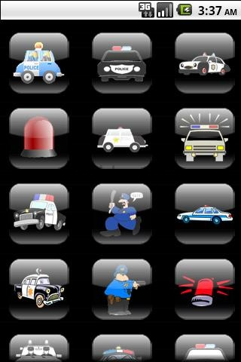
SOFTWARE COMPONENT
An application App where
in all the ambulance, fire engines,
police car, Tornado / Hurricane
warnings can be detected.
Sujani Godavarthi
CS 410

Slide 8
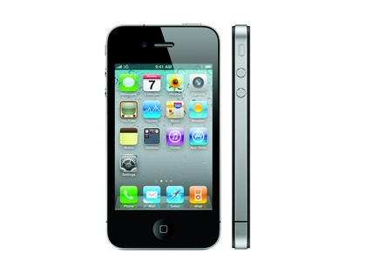
HARDWARE COMPONENT
IPHONE
(IOS)
Sujani Godavarthi
CS 410
September 19, 2011

Slide 9
Global Positioning System(GPS)
Satellite based navigation system made up of a network of 24 satellites placed into orbit by the U.S. Department of Defense.
It was developed and mostly used in military purposes, aircraft and ships. Now widely, can be used in weather conditions, anywhere in the world.
Sujani Godavarthi
CS 410
September 19, 2011

Slide 10
MARKET SURVEY
The number of subscribers of GPS is anticipated to grow in near future with market revenue touching US$ 10 billion by 2013 .
Emerging Countries like India and China will continue to witness rapid growth in the adoption of GPS technology.
India’s navigation system market is projected to grow around 16% during the years of 2010-2012 and reach around US$ 48 Million by 2013.
Rapidly, GPS is popularly growing all around the world.
Sujani Godavarthi
CS 410
September 19, 2011

Slide 11
CONCLUSION
This application can be used by everyone and also provide help with people having difficulties.
Features include high volume, pop up notifications, buzz sounds.
Sujani Godavarthi
CS 410
September 19, 2011

Slide 12
REFERENCES
Application : http://cdn1.staztic.com/screenshots/police-sound-ringtone-143-2.jpg
Ambulance : http://www.frugal-cafe.com/public_html/frugal-blog/frugal-cafe-blogzone/wp-content/uploads/2011/02/nypd-police-car.jpg
Police Car : http://wwwdelivery.superstock.com/WI/223/1566/X1000/PreviewComp/SuperStock_1566-017518.jpg
http://www.boxoid.org/?p=50
Sujani Godavarthi
CS 410
September 19, 2011

