Slide 1
Variable Speed Limits
Binh Dong

Slide 2
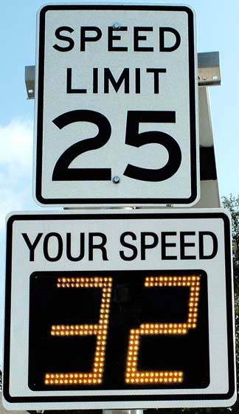

Slide 3
Problem
Many speed limits are underrated
Time and traffic has influences on flow
Variances in speed causes accidents

Slide 4
Majority of accidents happen at low speeds
Speed variation leading cause of accidents

Slide 5
Solution
Dynamic Speed min and max signs
Time of day
Congestion
Accidents

Slide 6
Benefits
Optimal speed regulations
Less accidents
Better traffic flow

Slide 7
Cons
Some competition

Slide 8
Customer
Department of transportation
Citizens of the state

Slide 9
Conclusion
Dynamic speed system reduces traffic congestion and accidents

Slide 10
Reference
Virginiadot.org
Smartmotorist.org
iihs.org

