Slide 1
RoadNet
CS 410 – Blue Team

Slide 2
Outline
Team Blue Staff Chart
Societal Problem
Problem Details
Traffic Data
Customer Identification
Market Analysis
Competition
RoadNet Solution
Without RoadNet
With RoadNet
Major Functional Components
Risk Assessment
Conclusion

Slide 3
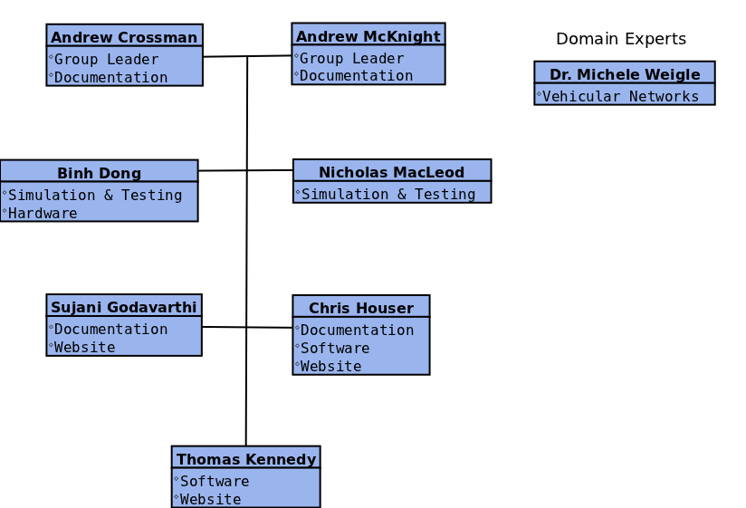
Team Blue Staff Chart

Slide 4
Societal Problem
Drivers’ limited awareness of adverse road conditions increases the potential for traffic congestion and collisions.

Slide 7
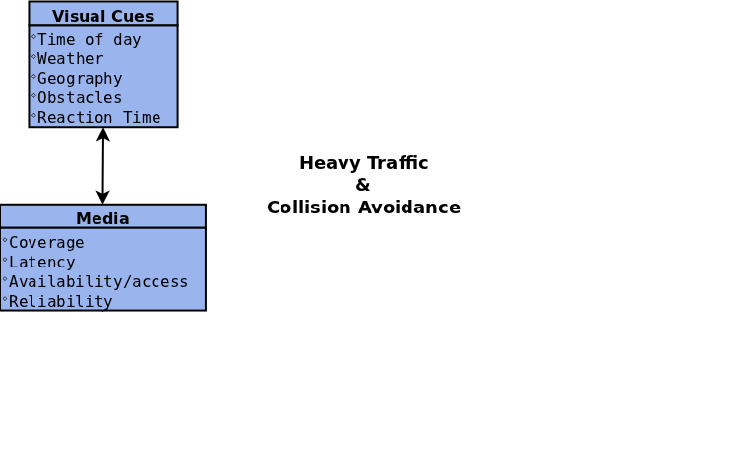

Slide 8
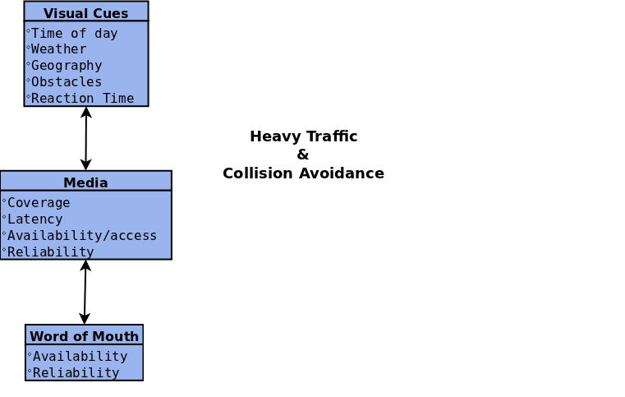

Slide 9
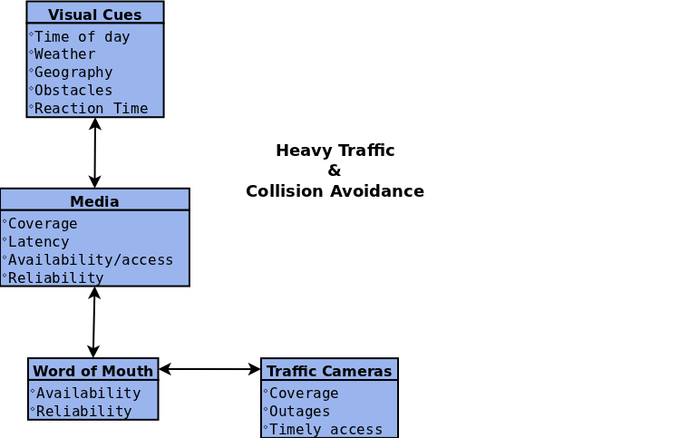

Slide 10
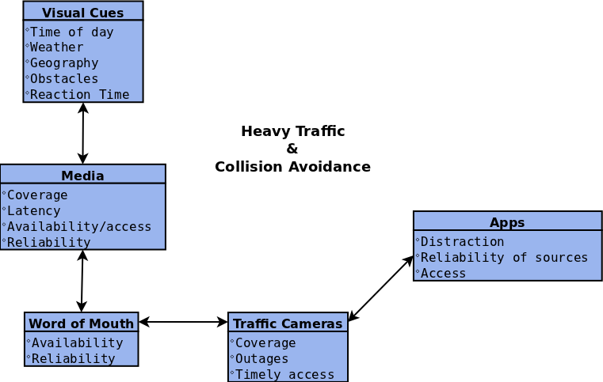

Slide 11
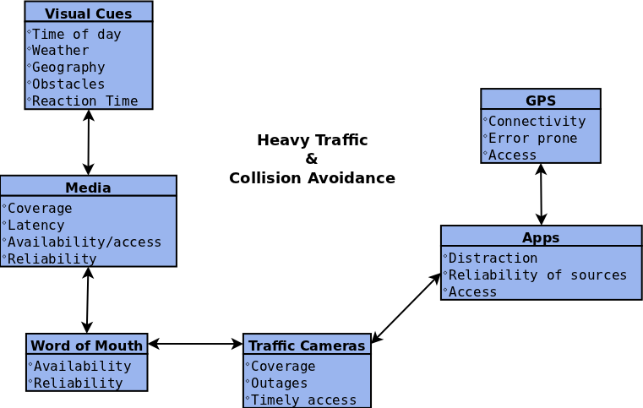

Slide 12
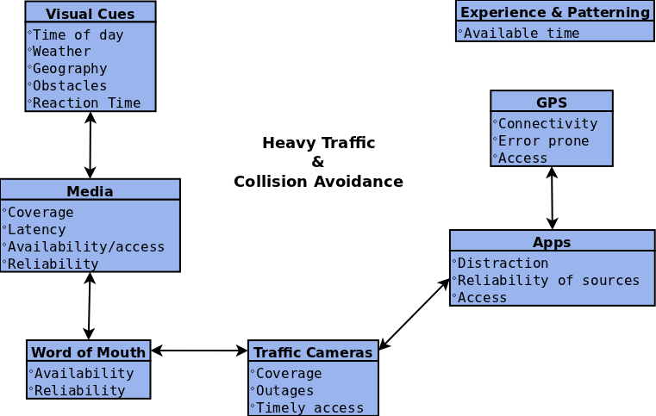

Slide 13
Problem Details
Drivers unaware of traffic congestion on their intended route are likely to get stuck in that traffic.
“Surprise” road conditions (construction, accidents) can sometimes lead to an accident if a driver does not know of it soon enough.
In 2009, 33,808 people were killed in traffic crashes and over 2.2 million were injured.⁶
Drivers need to be informed of dangerous conditions before it is too late.
“Security is a hard issue … and nobody has really solved it yet.” – Dr. Weigle on existing vehicle-to-vehicle communication. ²
²Source: Interview with Dr. Weigle
⁶Source: U.S. Census Bureau

Slide 14
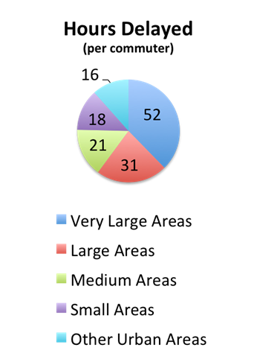
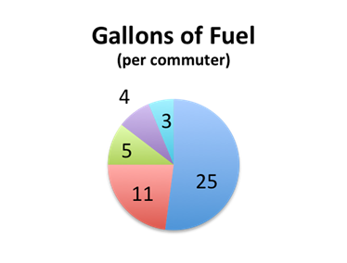
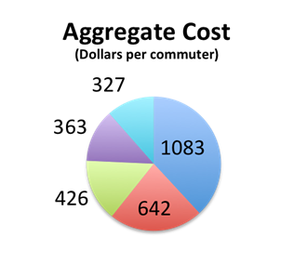
Traffic Data
Total Cost:
$100.9 billion
Total Delay:
4.8 billion hours
Total Fuel Consumption:
1.9 billion gallons
⁴Source: Texas Transportation Institute

Slide 15
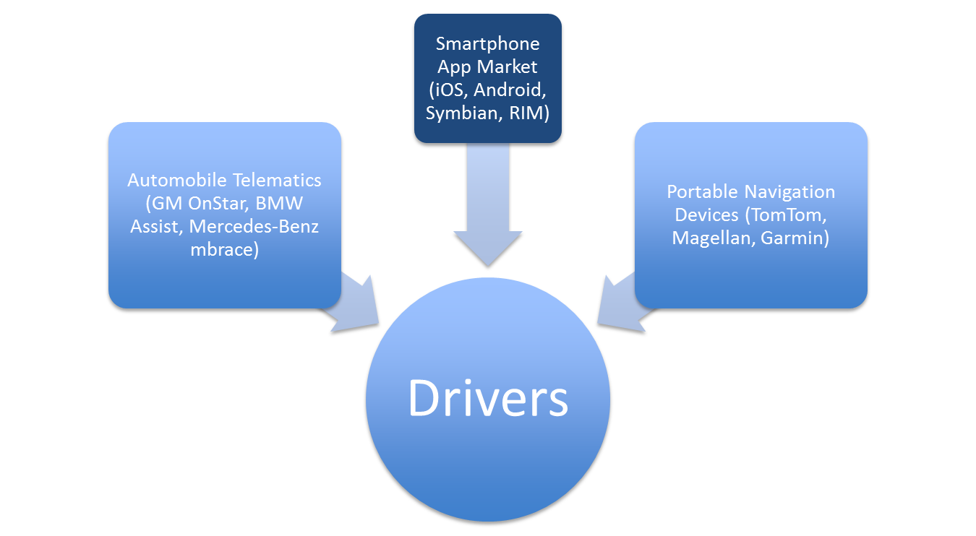
Customer Identification

Slide 16
Market Analysis
³Source: CENS

Slide 17
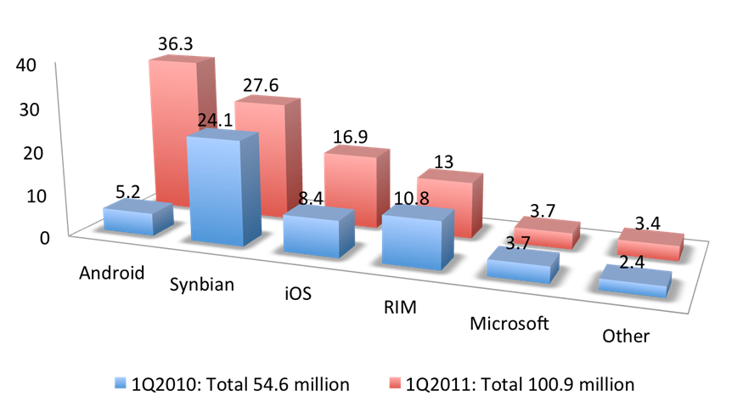
⁵Source: Mashable Tech

Slide 18
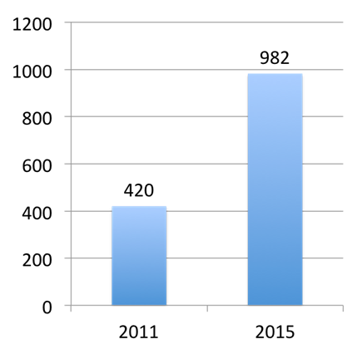
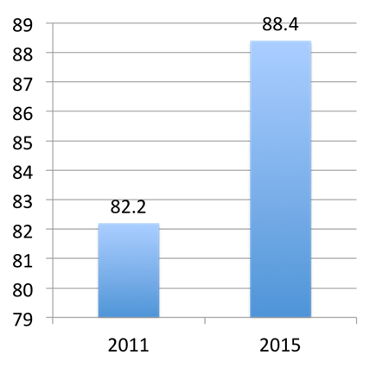
Trends in Smartphone Sales
Projected Worldwide Smartphone Sales
(Millions of units)
Projected US Smartphone Sales
(Millions of units)
¹Source: Email Marketing Reports

Slide 19
Competition

Slide 20
RoadNet Solution
Goals
RoadNet will improve driver awareness of adverse road conditions.
Traffic congestion information/analysis
Real-time traffic update distribution
Accident/construction site notification
Virtual checkpoint system to transmit information with minimal data usage

Slide 21
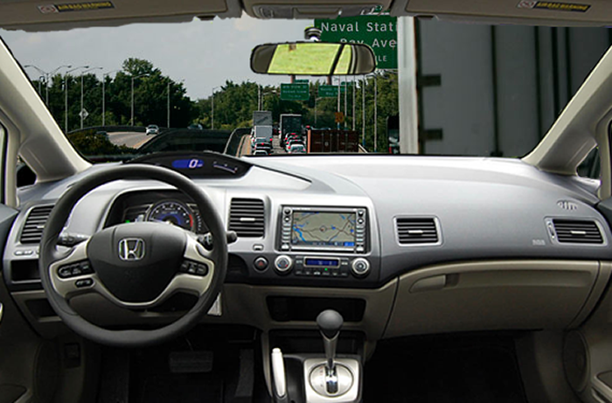
Without RoadNet
Drivers travel, some even with navigation devices, yet get stuck in unpredicted congestion.

Slide 22
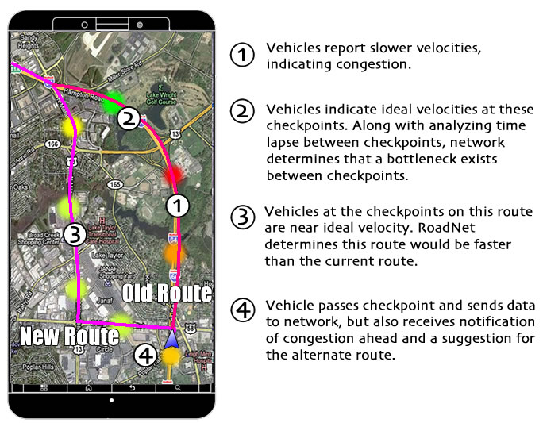
With RoadNet

Slide 23
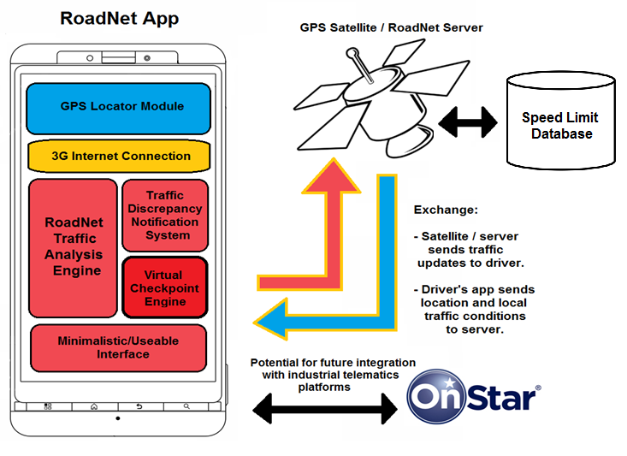
Major Functional Components

Slide 24
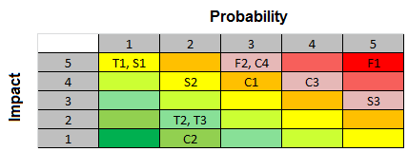
Risk Assessment
Financial Risks
F1. Customer Investment – Vital to initial growth and sales
F2. Hardware/Software Network Maintenance - Fixing broken equipment, maintaining network
Technical Risks
T1. Hardware Selection – Feature limitations
T2. Communication Protocols – Usefulness and latency of technology
T3. Server Infrastructure – Configuration for distribution (scalability)
Customer Risks
C1. Product Interest – Market competition
C2. Ease-of-use to Customer – Simple and easy to use interface / installation
C3. Driver Distraction – Interaction becomes a potential distraction
C4. Product Accessibility – Requires smartphone / data plan to provide updates
Schedule Risks
S1. Hardware Selection – Platform switching
S2. Product Design – Oversights in implementation, setting up virtual checkpoints
S3. Prototype / Test Phase – Dependent on quality, resolving issues

Slide 25
Financial Risks:
F1. Customer Investment
Probability 5 Impact 5
The RoadNet app cannot succeed if customers do not buy into it. This is highly dependent on marketing and can be counter-acted with effective advertising and marketing.
F2. Hardware/Software Network Maintenance
Probability 3 Impact 5
Server infrastructure is subject to needing repairs and the network connecting drivers must be maintained. Since the foundation of the app lies in drivers’ smartphones (as opposed to additional hardware), the probability of this decreases.

Slide 26
Customer Risks:
C1. Product Interest
Probability 3 Impact 4
With so many products and competition in the market, customers will need to prefer this solution over others. This can be mitigated with effective marketing.
C2. Ease-of-use to Customer
Probability 2 Impact 1
Low cost, efficient, and easy installation of the product onto drivers’ smartphones.
C3. Driver Distraction
Probability 4 Impact 4
Interaction with an app while driving is a high distraction risk. This will be counteracted with a minimalistic interface that assists the driver with little to no physical interaction with the device.
C4. Product Accessibility
Probability 3 Impact 5
Not every driver has a smartphone to access and download the app. The smartphone market has been well analyzed and is expected to grow immensely.

Slide 27
Technical Risks:
T1. Hardware Selection
Probability 1 Impact 5
The selected hardware will heavily influence the product’s features – limiting the uses of RoadNet. Smartphones apps are an effective platform to be accessible to drivers and provide lots of functionality.
T2. Communication Protocols
Probability 2 Impact 2
Communication between a device and the cloud must occur within small time frames. Latency will negate the usefulness of traffic data. RoadNet’s virtual checkpoint system will assist with efficient information exchange.
T3. Server Infrastructure
Probability 2 Impact 2
The configuration and design of the server infrastructure must be able to compile and distribute data to connected drivers. The server will have to be designed to be efficiently scalable. RoadNet will hold the potential to connect with manufacturer telematics to assist with scalability in the future.

Slide 28
Schedule Risks:
S1. Hardware Selection
Probability 1 Impact 5
The initial platform selection influences later decisions for product features. RoadNet, as a smartphone app, has access to many features that assist in the functionality of this program.
S2. Product Design
Probability 2 Impact 4
Oversights in implementation and development can significantly delay progress of the app. The virtual checkpoint system will have to be practiced and polished before being considered useable.
S3. Prototype/Testing Phase
Probability 5 Impact 3
This phase is directly dependent on the quality of execution of the product. Design issues must be resolved in this stage and the program must be proven to work.

Slide 29
Conclusion
RoadNet will help decrease the amount of traffic congestion and collisions by providing effective real-time updates on upcoming traffic conditions to a driver before they get there.
With RoadNet’s virtual checkpoint system and traffic analysis engine, this will be accomplished in a new way that makes these benefits more accessible to drivers.

Slide 30
References
Brownlow, Mark. "Smartphone Statistics and Market Share." September 2011. Email Marketing Reports. Retrieved from http://www.emailmarketing-reports.com/wireless- mobile/smartphonestatistics.htm
Dr. M. Weigle, interview, October 19, 2011.
Liang, Quincy. "Worldwide PND Shipments to Peak Around 42 M. in 2011- 2012: Berg Insight." October 19, 2011. CENS. Retrieved from http://news.cens.com/cens/html/en/news/news_inner_38131.html
Lomax, Time, David Schrank and Shawn Turner. Texas Transportation Institute. (2011). Annual Urban Mobility Report. College Station, TX. Retrieved from http://mobility.tamu.edu/ums/
Schroeder, Stan. "Smartphone Sales Up 85% Year-Over-Year." May 19, 2011. Mashable Tech. Retrieved from http://mashable.com/2011/05/19/smartphone-sales-q1-2011-gartner/
U.S. National Highway Traffic Safety Administation, Traffic Safety Facts. Retrieved from http://www.census.gov/compendia/statab/2012/tables/12s1108.pdf

Slide 31
Competition App Reference Links:
Beat The Traffic:
http://itunes.apple.com/us/app/beat-the-traffic/id339660839?mt=8
Sygic:
http://www.sygic.com/en
INRIX:
http://www.inrix.com/mobile.asp
TomTom:
http://www.tomtom.com/en_gb/products/mobile-navigation/tomtom-app-for-iphone/
RAC:
http://itunes.apple.com/gb/app/rac-traffic-plus/id389339076?mt=8
Traffic.com:
http://itunes.apple.com/us/app/traffic.com/id327245871?mt=8

