Slide 1
CS Waitlist Management & Enrollment System
CS410 Red Team

Slide 2
Outline
Problem and Historical Data 3
Case Study 10
Problem Characteristics & Problem Statement 14
Solution 24
Competition and Component Diagram 28
Benefits of Solution and Problems with our Solution 32

Slide 3
PROBLEM & HISTORICAL DATA
Patrick DeBerry

Slide 4
History
Old Dominion University
Founded in 1930
Undergraduate enrolled: 19,612
19,612 * 4 = 78,448 course enrollments
Computer Science students enrolled:
Undergrad: 456
Master: 80
Doctorate: 42
Record Systems:
Banner
LeoOnline
Notes:
Go over total enrollments per semester.
Most students take 12 credit hours per semester
Total Students * 4 Courses = Amount of enrollments
“Different Reasons for enrollment cap”
Time / Day of week
Work load on professor (pub speaking couldn’t do 78 students)
Faculty – Different areas of subject expertise (CS can’t teach History)
Refer to SAGA’s feasibility presentation to see how they laid out this information

Slide 5
Banner
Limited GUI
ODU’s centralized academic and administrative records system
Allows overrides to be made by upper administration
Source: Old Dominion University Website
Notes:
15 potential overrides / expand on how this system looks (ugly) and works for a user (Brunelle)
Banner tracks everyone very strictly….warning….warning…warning if you change something it will be logged

Slide 6
LeoOnline
Web-based graphical user interface
Maintains all the academic and financial data for students
Allows Degree Works
Different portals based on user
Student
Administrator
Advisor
Faculty / Staff
Notes:
Different portals generate different tools depending on user

Slide 7
Bob and Latimer
A scenario:
Latimer, a CS senior needs 8 courses to graduate
Included: CS 410, CS 330, etc.
She met all prerequisite so there was no problem
Bob, a CS Freshman needs to sign up but must wait until Friday
Works, commutes… no time to sign up!!!
All courses fill up due to time issues
This is an example of complications that could arise during student enrollment
Notes:
Set up stories “o this could happen this could screw stuff up”
Kind of justifies the need for our system.

Slide 8
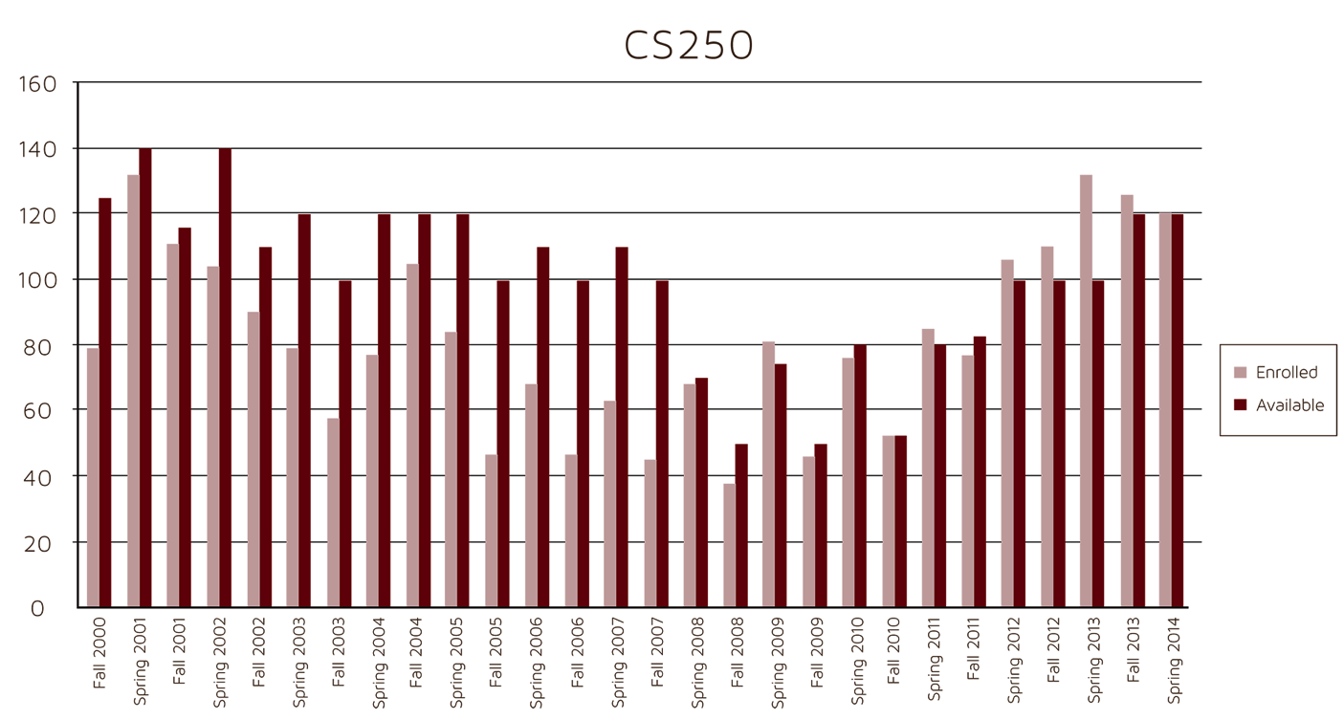
Student Enrollment for CS250
Stufor C
Data provided from LeoOnline, ODU's student information system
Notes:
Here is some data on CS 250
Now thanks to previous slides it has more meaning

Slide 9
Limited course availability during enrollment

Slide 10
CASE STUDY
Lookmai Rattana
Notes:
My name is Lookmai and I like cats.

Slide 11
Current Waitlist
Available to the entire university
The waitlist starts when a class is filled up
A vacancy appears but the list does not automatically enroll the student on the list
Scenarios provided from Waitlist History Log by Dr. Levinstein

Slide 12
Process
Student joins a waitlist for a filled class
System checks for available enrollment
Student is given 24 hours to response via email
The student enrolls his or herself into the class on LeoOnline
Notes:
Once the student enlisted him/herself on the waitlist, the system would check for an open seat. When a seat is opened, the waitlist emails the first student on the list and gives the student a 24 hours period to response. If the student agrees to enroll in the class, the system checks the course’s availability with Banner. If the class is still available, the system would register the student into the class.
Maybe throw a diagram in here to describe this process!!!!!!

Slide 13
PROBLEMS
A student not on the list can enroll before the student can respond
Lack of response from the first student causes the waitlist to clogged up
Rooms for miscommunication
Waitlist’s Visibility
Notes:
The process is simple and has a potential to become a very useful tool for the rest of the university. However, the current solution doesn’t address some of the important issues that comes with class registration process. For an example, what would happen when a student who is not on the waitlist registers for the class during the 24 hours wait period? The visibility of the waitlist is also an issue that need to be address.

Slide 14
PROBLEM CHARACTERISTICS
Bitaseme Mboe

Slide 15
Problem Characteristics
Time
Consuming
Confusing
Inefficient
Notes:
Confusing: Making a wait list more efficient in general is just downright confusing
Time Consuming: This isn’t a cakewalk. A better waitlist implementation is going to take quite a bit of time to develop
Inefficient: Self-explanatory.
This appears to be confused with a title slide…..

Slide 17
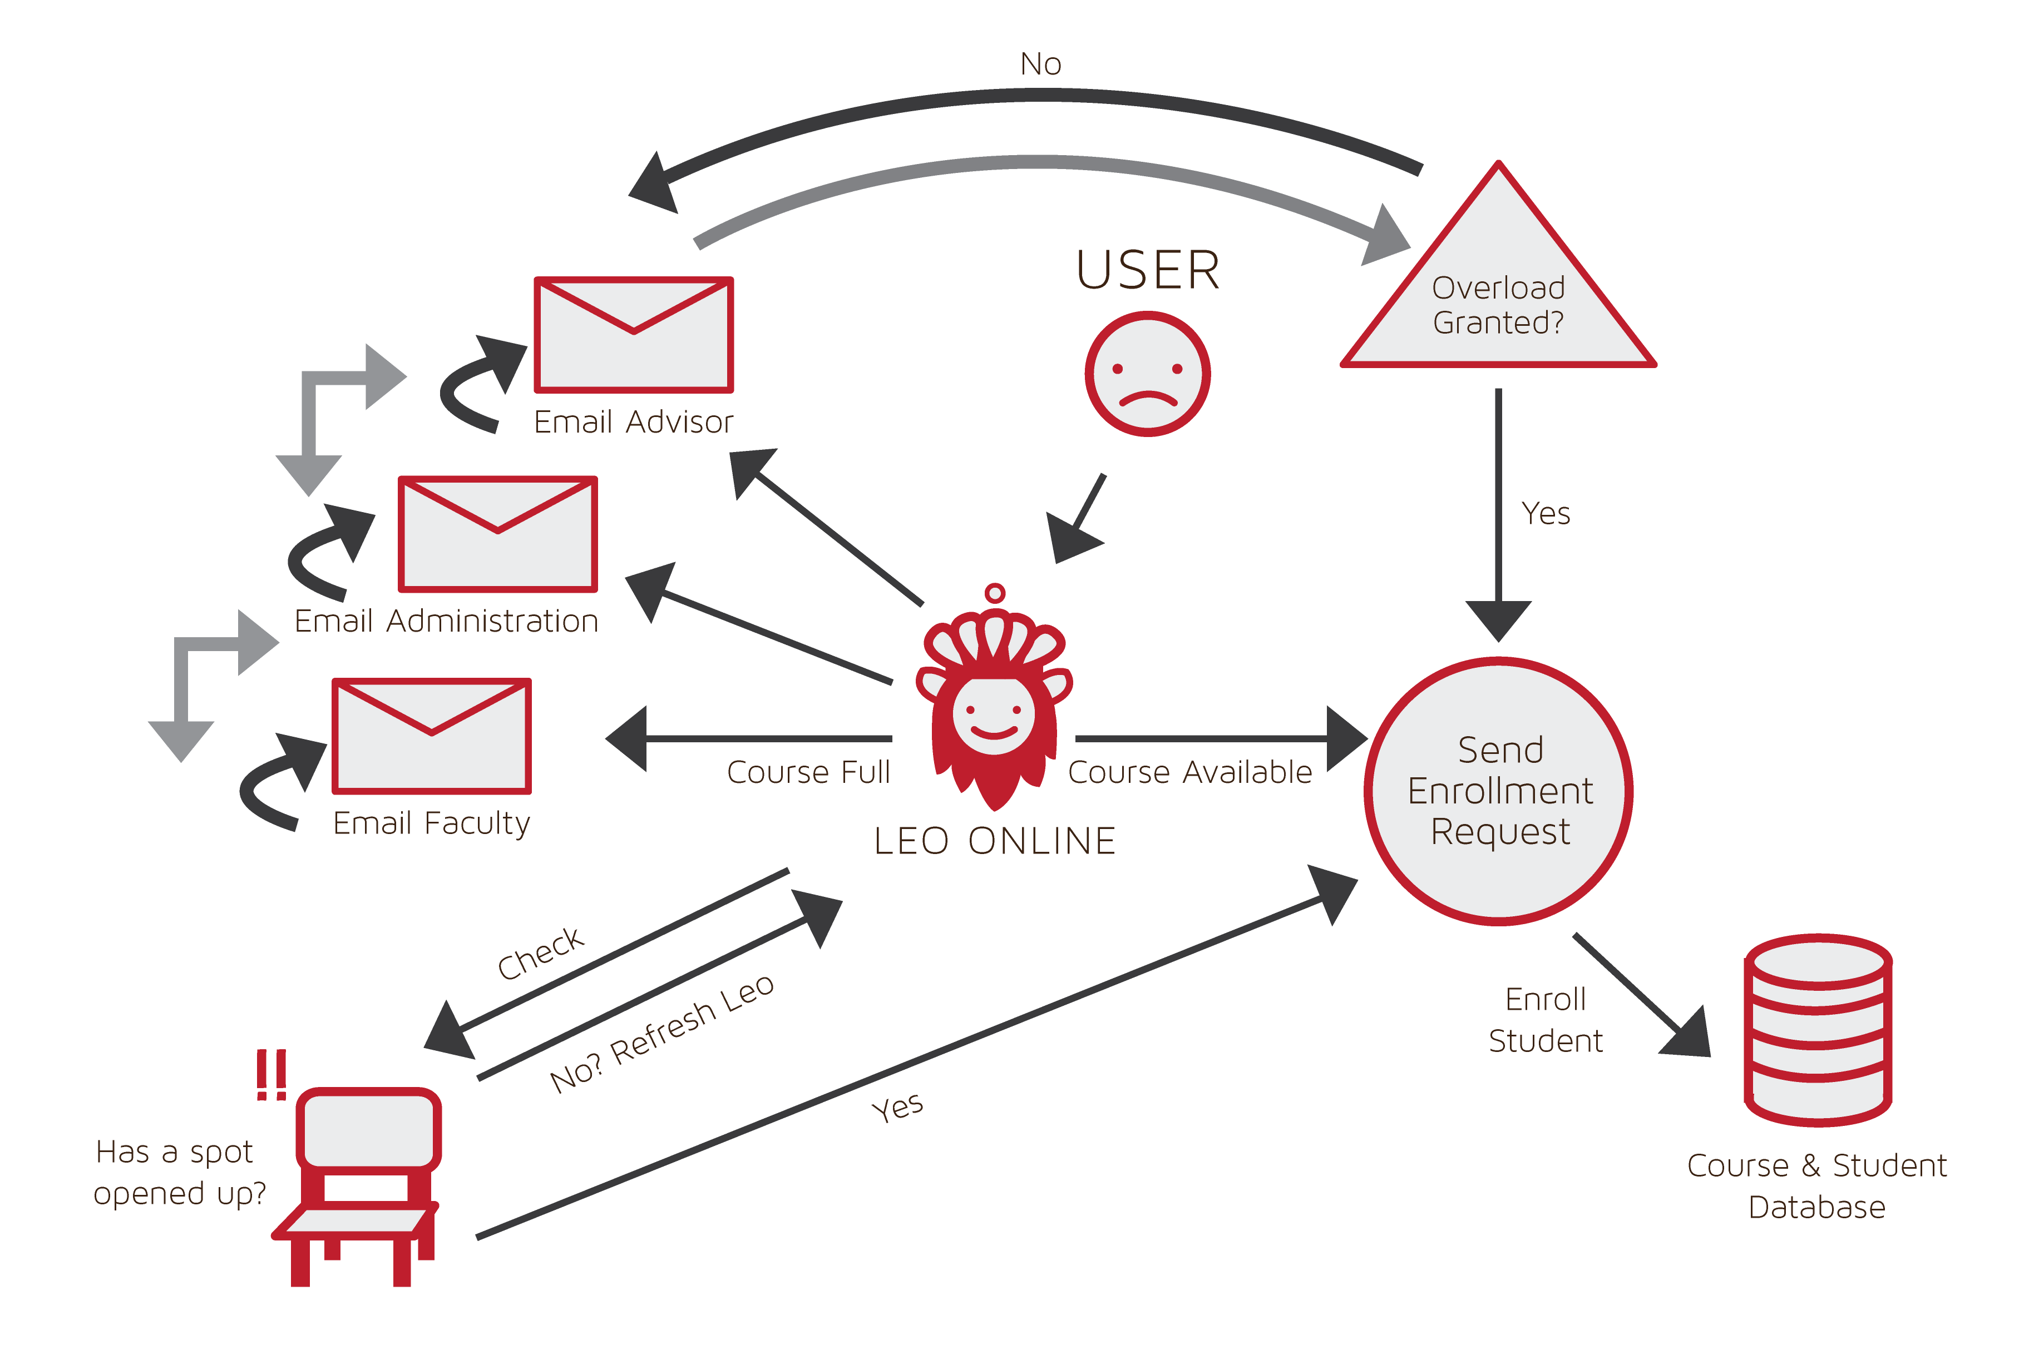
Current Process Flow
Notes:
Maybe have things pop up as they happen
Redo this process flow so that it shows that it is banner for “overload granted” triangle

Slide 18
Waitlist History Log
No one ever goes from the waitlist to the course. They just drop off the head of the waitlist, leaving vacancies in the course. In what follows, entries like this
12/02: #23441 70/ 70 cr:3 <OCNPS> 0930 TR STAFF,
show enrollment/cap (here 70/70) on the given date. Entries like this
Dec 5 10:30 3/10 ( 7)
show waiting list length/cap (available), here 3/10 ( 7) at the given date and 24 hour time. entries beginning with -- are comments.
Notes:
Credit: Dr. Levenstein

Slide 19
Waitlist History Log
-- we start with a full class and 2 on the WL.
Nov 24 16:30 2/10 ( 8)
12/02: #23441 70/ 70 cr:3 <OCNPS> 0930 TR STAFF,
-- an opening appears by 12/04 ...
12/04: #23441 69/ 70 cr:3 <OCNPS> 0930 TR STAFF,
-- ... and the WL grows ...
Dec 5 10:30 3/10 ( 7)
Dec 5 13:30 5/10 ( 5)
Notes:
Credit: Dr. Levenstein

Slide 20
Waitlist History Log
-- ... but the vacancy does not fill.
12/06: #23441 69/ 70 cr:3 <OCNPS> 0930 TR STAFF,
Dec 7 08:30 7/10 ( 3)
Dec 7 11:30 8/10 ( 2)
12/08: #23441 69/ 70 cr:3 <OCNPS> 0930 TR STAFF,
Dec 9 08:30 9/10 ( 1)
Dec 10 18:30 10/10 ( 0)
-- Meanwhile the WL grows and fills up.
12/10: #23441 69/ 70 cr:3 <OCNPS> 0930 TR STAFF,
Notes:
Credit: Dr. Levenstein

Slide 21
Waitlist History Log
-- Another vacancy appears ...
12/12: #23441 68/ 70 cr:3 <OCNPS> 0930 TR STAFF,
Dec 13 17:30 9/10 ( 1)
Dec 13 18:30 10/10 ( 0)
-- ... and it appears that someone makes use of it, but actually
-- the person at the head of the list does not respond to email
-- (my theory) and another person jumps on the WL.
Notes:
Credit: Dr. Levenstein

Slide 22
Waitlist History Log
-- Meanwhile, a third vacancy appears.
-- From other sources: no one new registered from 23441 between 12/07 and 12/14
12/14: #23441 67/ 70 cr:3 <OCNPS> 0930 TR STAFF,
12/16: #23441 67/ 70 cr:3 <OCNPS> 0930 TR STAFF,
-- another person who was notified did not respond and was dropped from WL
Dec 18 16:30 9/10 ( 1)
12/18: #23441 67/ 70 cr:3 <OCNPS> 0930 TR STAFF,
Dec 19 08:30 10/10 ( 0)
Notes:
Credit: Dr. Levenstein

Slide 23
Waitlist History Log
-- the WL fills again, but no new registrations
12/20: #23441 67/ 70 cr:3 <OCNPS> 0930 TR STAFF,
-- From other sources: no one new registered from 23441 between 12/14 and 12/21
12/22: #23441 67/ 70 cr:3 <OCNPS> 0930 TR STAFF,
12/24: #23441 67/ 70 cr:3 <OCNPS> 0930 TR STAFF,
12/26: #23441 67/ 70 cr:3 <OCNPS> 0930 TR STAFF,
Dec 27 11:30 9/10 ( 1)
Notes:
Credit: Dr. Levenstein

Slide 24
SOLUTION
Anthony Baron
Notes:
Introduce yourself
This is Anthony. He’s chill.

Slide 25
Solution Statement
CORSICA will cause the enrollment process to become more efficient and streamline by
Emplacing course waitlist
To handle course fill ups during enrollment process
Having a waitlist communication system
Let students know a course has open by email, call, or text
Notes:
In order to solve the overflow problem we will implement a waitlist system that manages student sign ups during the enrollment process, if of course that course is full. We’ve elected to include a communication system in order to reach students when a course opens up. They will be notified via: email or text; (if number given) giving them an opportunity to sign up for their desired course.
But how will the system really work?
The waitlist will contain X amount of students on the list (which will be determined at a later date.) The students on the waitlist will receive messages when a spot becomes available, with the option of receiving a phone call, as well. The message will notify the student of their position on the waitlist, let them know when there is an opening in the class, and tell them that they are not guaranteed a seat in the course (as this depends on their spot in the list and I will explain what I mean by this shortly).
If the message arrives via email or text, it will contain a link to the appropriate website; if it is a phone call, the call system will tell the student what the website is.
The waitlist program will function in accordance to strict guidelines and they are as follows:
- If a seat opens up the system will send out a message to all the students on the waitlist.
- If student 1 on the waitlist responds within 24 hours and that response is a “YES” they will be enrolled into the class.
- If student 1 on the waitlist responds within 24 hours and that response is a “NO” they will not be enrolled into the class and each student on the waitlist will go down by 1 position ( I.E. student 2’s place is now in student’s 1 place.)
If student 1 on the waitlist does not respond within 24 hours each spot on the waitlist will go down by 1 position.
If student 1, student 2 (and so on, until someone says “YES”) says “NO” the student who said “YES” will be enrolled into that class.
- If student 1 says “NO” and student 2 does not respond but student 3 says “YES” this does not mean that student 3 gets the seat. Student 2 never responded so they still have the chance to enroll into the class, provided their 24 hour window is still active.
Next slide please….

Slide 26
Solution Goals and Objectives
Provide automated system through which:
Faculty and students can be notified of available seats
Reserves the available seats for student on waitlist
Ensures fair process
Triggers alerts for enrollment aspects
Notes:
The automated portions of our waitlist enrollment system will include the: notification process (where the students are notified of the available space), the checking of course availability, alert system (where student will be updated of progress [i.e. seat is available for course X, you have enrolled in course X, you have been dropped from waitlist, etc.)]
Seat opens etc

Slide 27
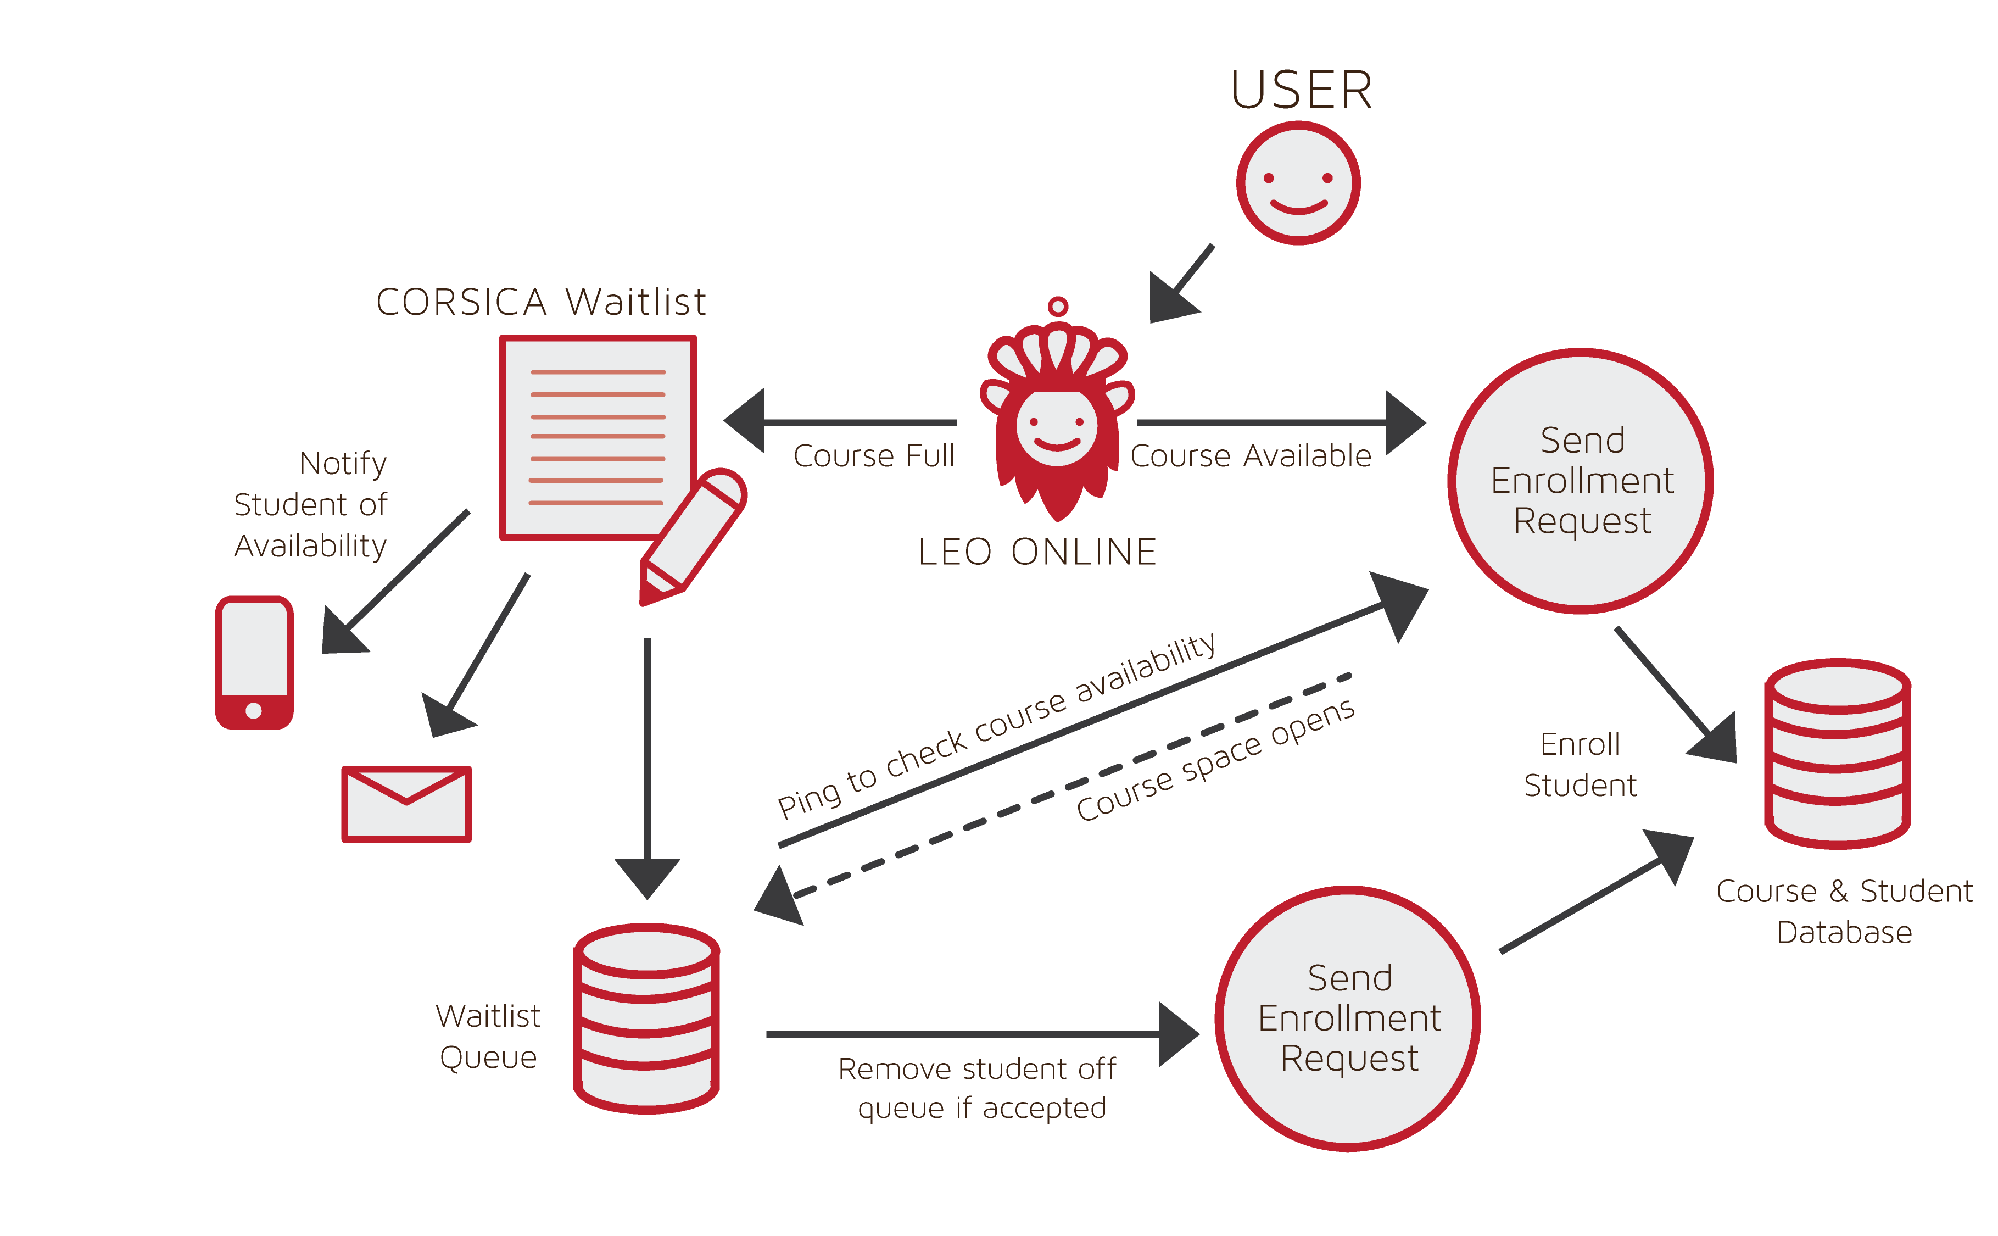
Improved Process
Notes:
Go over what happens….
Show information going back to student when student gets notified etc.

Slide 28
COMPETITION & MAJOR FUNCTIONAL COMPONENTS
Latimer Gerle

Slide 29
Competition Part I

Slide 30
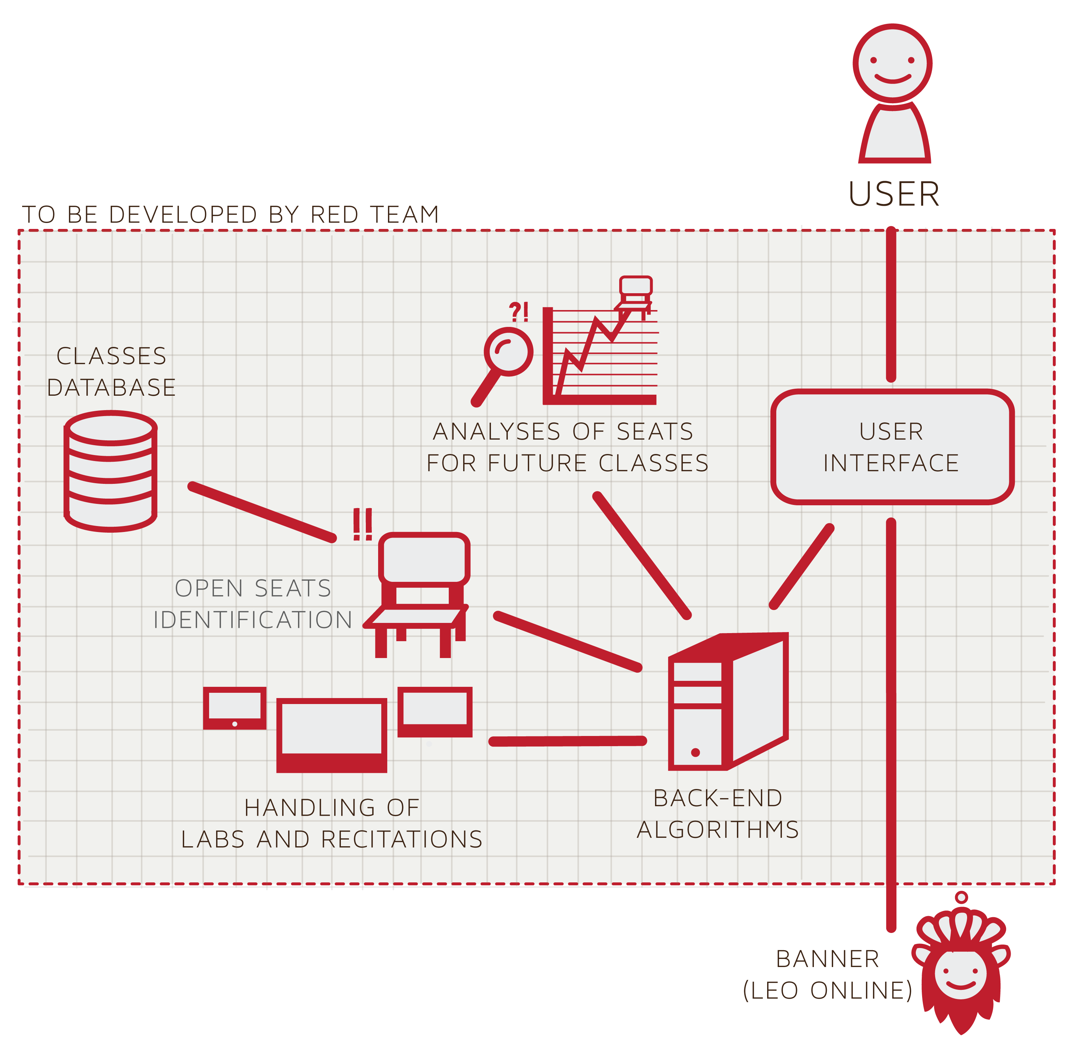
Major Functional Component Diagram
Notes:
She liked this slide

Slide 31
Required Components
Back-end algorithms
Open seat identification
Class database
Lab/recitation handling
Future class analyses
User interface
Notification system
Email
Text
Notes:
Identify the algorithms needed (Just names)
What tools do we have already available at the university
Identify a strategy for handling
Prediction reports
What do we have to build to complete this?

Slide 32
BENEFITS OF CORSICA
Nicholas LoGioco

Slide 33
Benefits of CORSICA
Track the demand for certain courses which will help better manage curriculum offerings
One location for students to sign up for every course
Decrease stress on faculty and students
Increase the amount of students enrolling into courses
Notes:
Expand on this

Slide 34
Problems with Solution
Time issues with courses
Does a course require a lab / recitation?
Do we have a max waitlist cap?
Allow overriding of the waitlist for advisors

Slide 35
References
http://colleges.usnews.rankingsandreviews.com/best-colleges/old-dominion-university-3728
http://colleges.usnews.rankingsandreviews.com/best-colleges/columbia-university-2707
http://colleges.usnews.rankingsandreviews.com/best-colleges/university-of-denver-1371
http://colleges.usnews.rankingsandreviews.com/best-colleges/university-of-michigan-ann-arbor- 9092
http://colleges.usnews.rankingsandreviews.com/best-colleges/university-of-texas-austin-3658
http://colleges.usnews.rankingsandreviews.com/best-colleges/university-of-maryland-college- park-2103
http://colleges.usnews.rankingsandreviews.com/best-colleges/university-of-minnesota-twin- cities-3969

Slide 36
Team CORSICA
Anthony Baron
Web Master
Patrick DeBerry
Reporting & Analyses
Latimer Gerle
Database &
Project Manager
Nicholas LoGioco
Algorithms
Bitaseme Mboe
Interface
Lookmai Rattana
Front End Developer & User Interface

