Slide 1
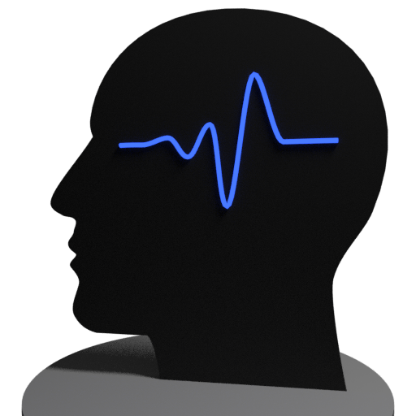
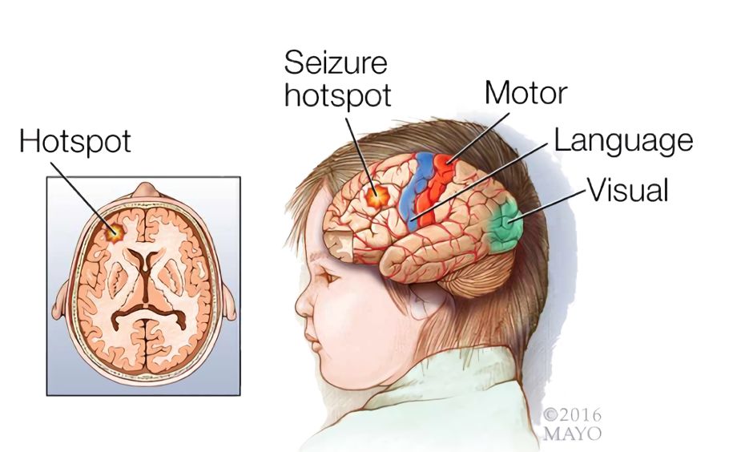
SeizSmart
A mobile application for detecting, tracking, and reporting seizures in real time.
Feasibility Presentation
CS 410 Spring 2019
Team Silver
Abel Weldergay, Kevin Sokol
Alpha Din Gabisi, Jeffrey McAteer
Danielle Luckraft, Peter Scheible
Notes:
Hi everyone, my name is Abel, and today my team and i will be presenting our feasibility assessment of a product we have proposed, that will be able to detect, track and report epileptic seizures in real time, using current technology.
Let me tell you a little bit about epilepsy, epilepsy is a neurological disorder that occurs in a particular part of the brain, as you can see in the illustration, in which the main symptom is epileptic seizures throughout the individual's lifetime

Slide 2
Table of contents
Team …………………………………………………....…….3
Background ………………………………………………..4-5
Problem ……………………………………………………..6-10
Solution ……………………………………………....…….11-15
Competition .……………………………………….…….16
Customers ………………………………………………...17
Conclusion ……………………………………………......18-20
References ……………………………………………….. 22-27
Notes:
Here is what we are going to talk to you about,
We will first discuss the problem, and the characteristics associated with the problem, then we will discuss our proposed solution, and how we realize that solution, both in hardware and software
Then we will discuss the competing systems, both direct and indirect,
Then we will close out with the customer base, which includes not only people directly affected by epilepsy, but also their loved ones, friends, and the medical community that can benefit as well

Slide 3
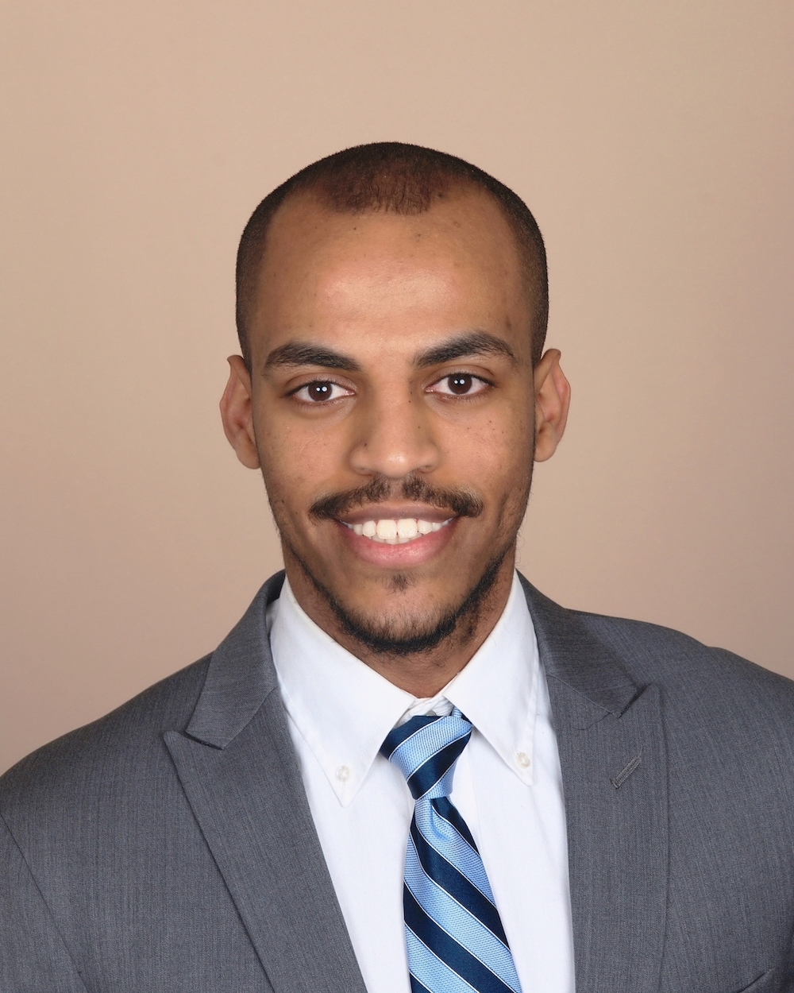
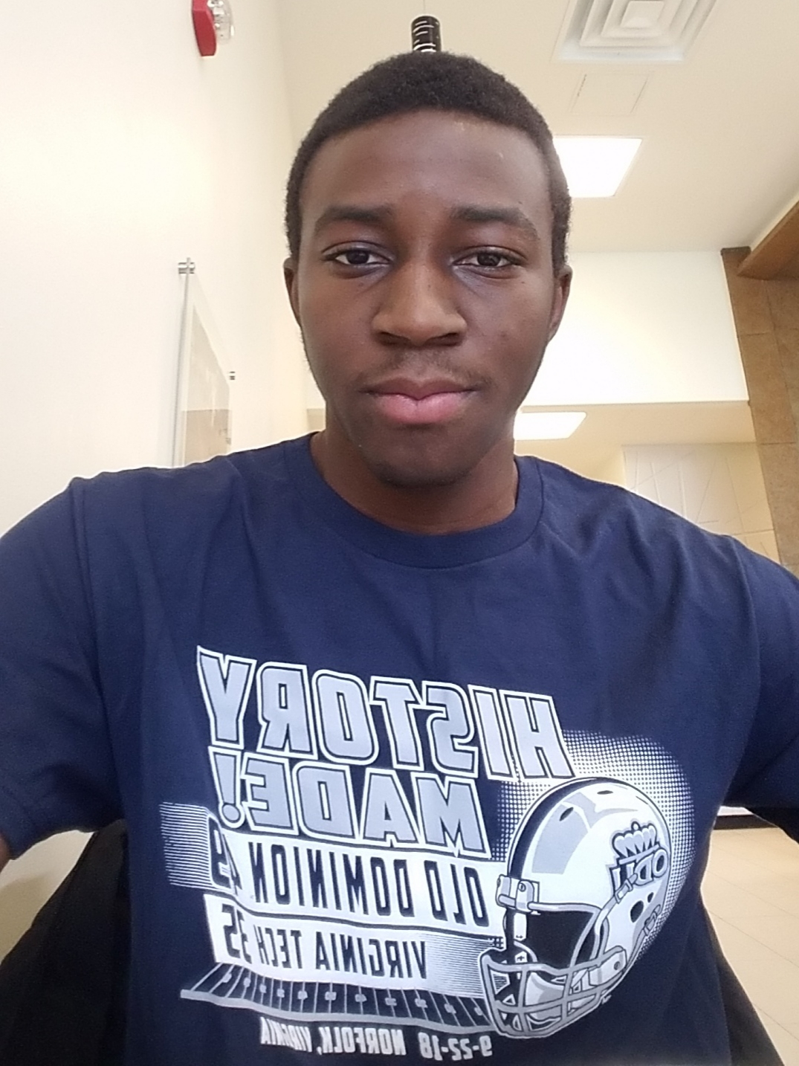
The Team
Abel Weldaregay
Team Lead / iOS Developer
Kevin Sokol
Developer
Peter Scheible
Developer
Danielle Luckraft
Webmaster / Developer
Jeffrey McAteer
Infrastructure & ML Engineer
Alpha Din Gabisi
Android Developer
Notes:
Here is our team,
I will be discussing the background and the problem, and i will be graduating in the spring of 2020
And we have jeffery, who will be graduating this december, and will be presenting the solution
And we have alpha, who will be graduating in the fall of 2020, and will be presenting our competition and customers
And we have danielle, who is a senior and is our webmaster,
And we have kevin and peter who are both seniors and have been doing research and developing for us

Slide 4
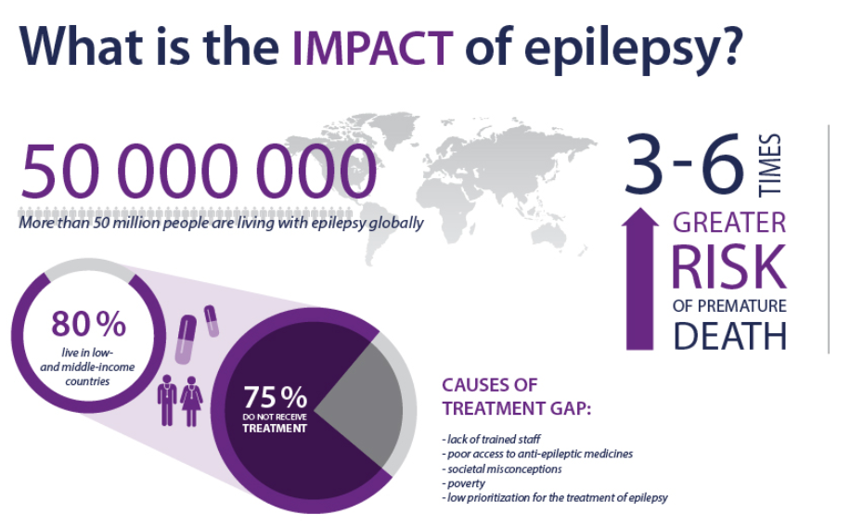
Background - Epilepsy
Epilepsy is the 4th most common neurological disease in the world.
Cases of epilepsy in the US have increased over the past five years.
Cases in the US are predicted to increase further by 2020.
Notes:
Now let me tell you some facts about epilepsy,
Epilepsy has affected more than 50 million people worldwide, making it one of the most common neurological disease in the world,
People with epilepsy are 3-6 times greater at risk of premature death
And 80 % live in low or middle income countries
And 75% do not get treatment
Cases in epilepsy have also consistently increased in the US from 2014-2019, and are predicted to increase in 2020
The ability to detect and track epileptic seizures is essential to minimizing bodily injuries or death

Slide 5
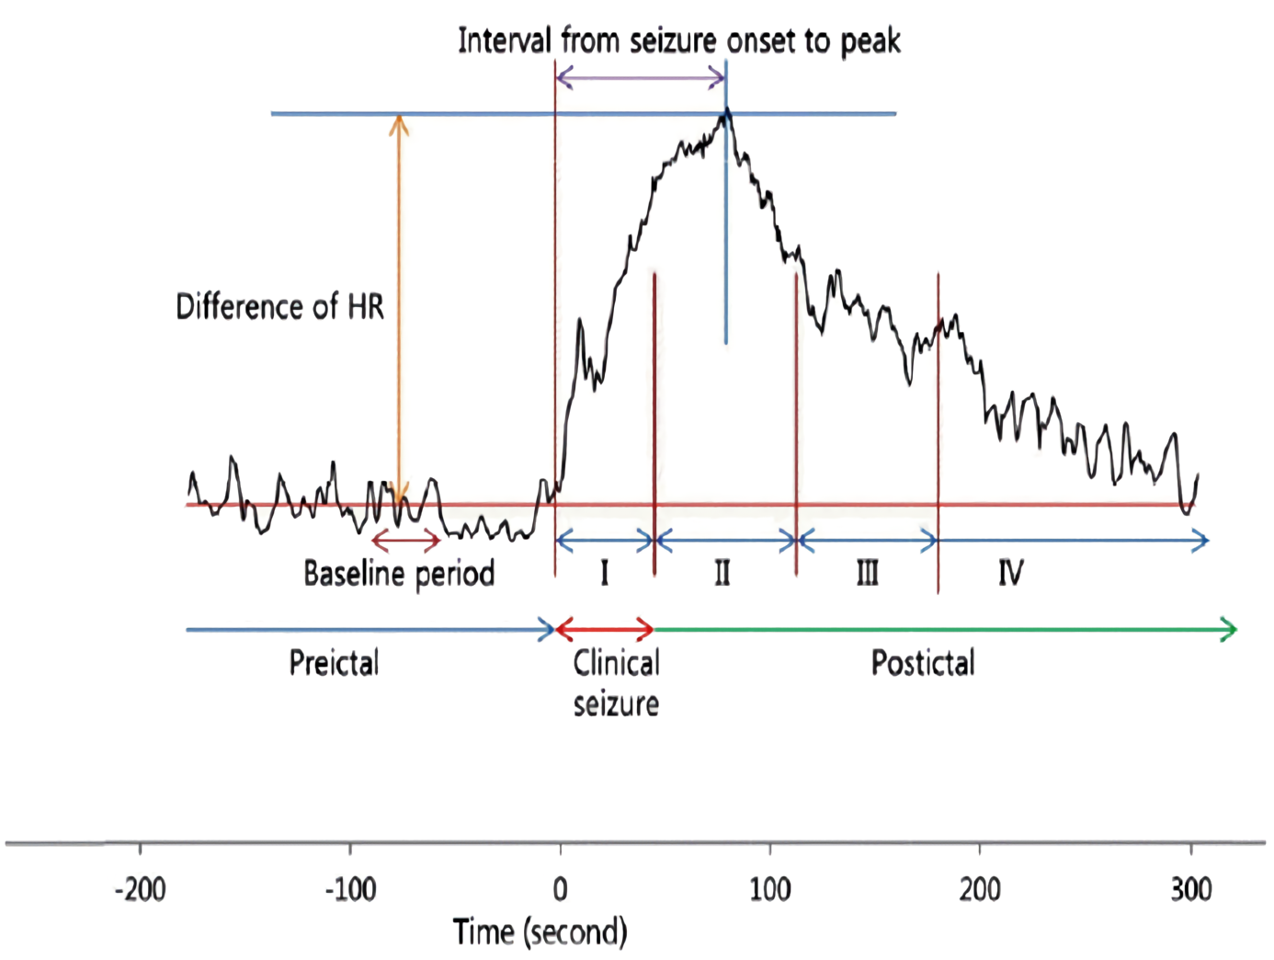
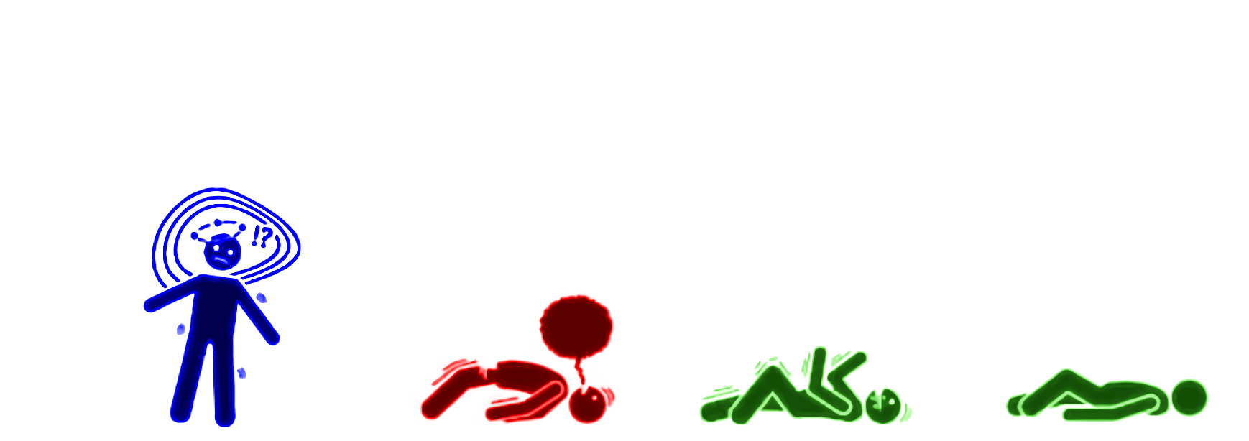
Characteristics of Generalized Seizures
Rapid change in heart rate
Rapid convulsions in limbs and face
Loss of consciousness
Notes:
Here are the characteristics of generalized seizures
There is an increase in heart rate, repetitive body movements, and loss of consciousness
Now let me tell you about the timeline of a generalized seizure

Slide 6
Problem Statement
Epileptic seizures are unpredictable and can result in injury or even death.
Current technology does not provide the ability to automatically detect the onset of a seizure based on a combination of heart rate behavior and repetitive body movements.
Available devices do not provide capabilities to tune detection variables to match individual patient seizure characteristics.
Solutions that use smartwatch technology to detect seizures must be in the proximity of a smartphone to notify emergency contacts.
Notes:
-They only measure one metric
-Don't provide the capability to make the detection process unique for each patient
-require the patient to be in close proximity of the smartphone to send a notification to emergency contacts

Slide 7
Who is Affected
Epilepsy can affect any age group from young children to seniors.
About 25% of persons with epilepsy have generalized tonic-clonic seizures.
It can also affect those who:
are Autistic,
have experienced a stroke,
or have suffered a significant infection or head trauma.
Notes:
-It can affect anyone from young children to adults
-and about 25% of patients with epilepsy suffer from generalized seizures, which is the most common and most observable
- it can also affect people who are
autistic
Experienced a stroke
Or have suffered a significant infection or head trauma

Slide 8
Problem Characteristics
Existing technology relies on an increase in heart rate OR repetitive body movements (but not both) to detect the onset of a seizure.
Concurrent recognition of a rapid change in heart rate and repetitive body movements is essential for improved accuracy and detection of seizures.
Current solutions do not provide direct notification of emergency contacts from a wearable detection device.
They instead rely on a “relay” (such as a smartphone) which must be in proximity of the wearable to notify emergency contacts.
Available solutions capable of detecting, tracking, and reporting seizures require either subscription services, prescriptions, or both.
Notes:
Current solutions rely on an increase in heart rate or repetitive body movements in order to detect the onset of a seizure, instead of a combination of both, which impacts the accuracy of the detection process
restricts the smartwatch to be in close proximity of a smartphone to send a notification to emergency personnel, which impacts the mobility of the patient
Available solutions that have the potential of tracking and recording seizures require subscription, prescription, or in some cases a combination of both.

Slide 9
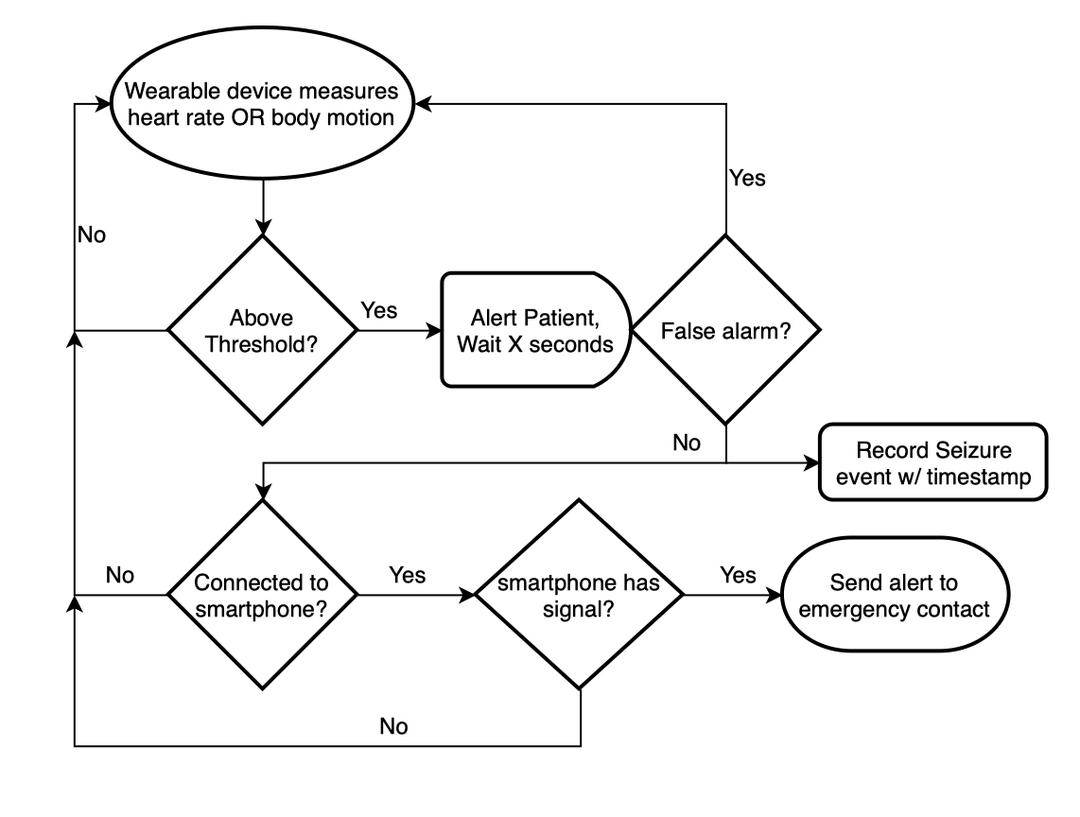
Current Process Flow
Most existing solutions detect seizures based on body motion.
Some detect seizures based on users heart rate.
The process flow for both are identical.
No existing system detects based on a combination of both metrics.

Slide 10
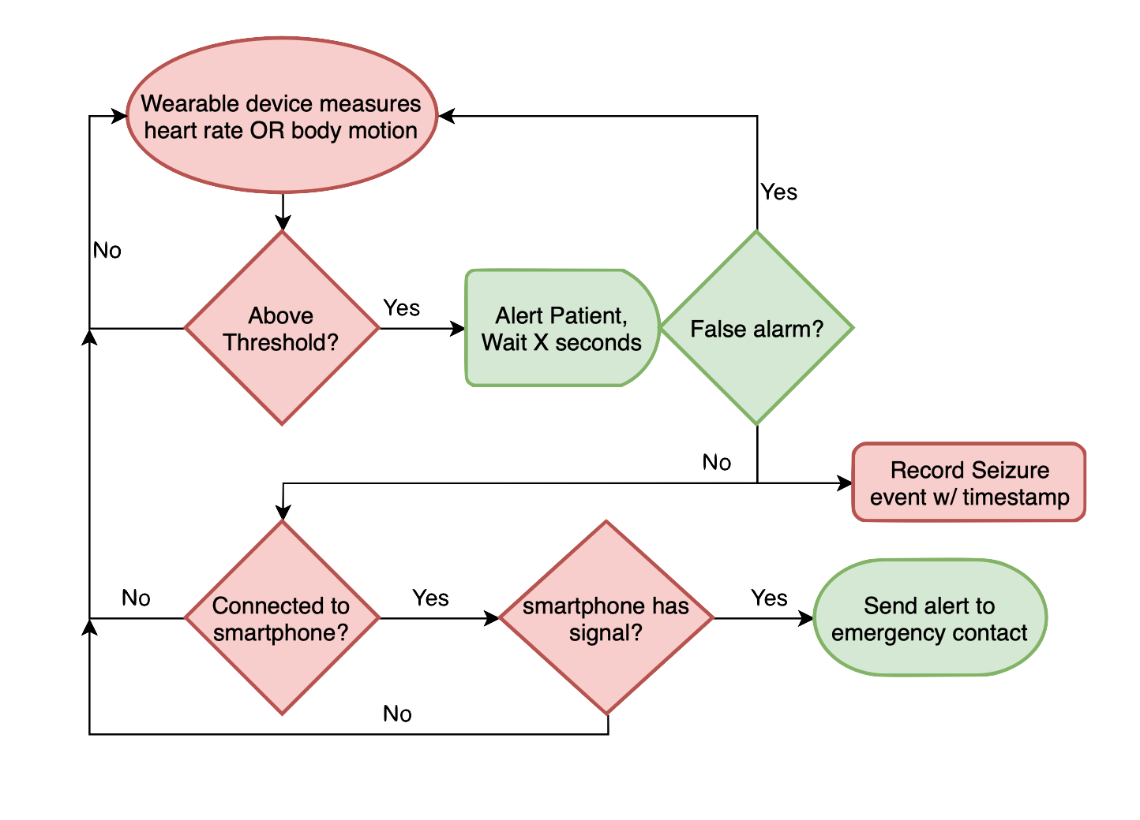
Current Process Flow
Wearables may access more data than HR/Motion.
Not all patients respond to seizures in the same way.
Current processes only begins recording seizure data after detection time.
Simpler notification capability is needed.

Slide 11
Solution Statement
Our proposed solution, SeizSmart, implements an advanced, wearable seizure detection capability using off-the-shelf smartwatch technology that is able to:
automatically detect epileptic seizures using heart rate and motion metrics,
tune a detection algorithm to match individual patient seizure characteristics,
track and record all information surrounding seizure events,
and provide automatic notification to emergency contacts without requiring a relay.
Notes:
How do we fix these problems?
We propose SeizSmart, software which runs on any off-the-shelf smartwatch.
The system detects seizures using both HR and Motion,
tunes detection to individual patients,
records valuable metadata surrounding seizure events,
and provides notifications without a relay device.

Slide 12
Solution Characteristics
Smartwatch technology is used for detection, tracking, and recording of generalized seizures.
Machine learning technology is used to evaluate heart rate and body motion characteristics to establish a seizure profile for each patient.
Heart rate performance and body motion are continuously monitored.
Both heart rate and body motion information is used to indicate a detection.
Available data about the environment during the onset of a seizure is collected.
Automatic notification to emergency contacts or first responders is available when appropriate.
Notes:
Off-the-shelf smartwatch hardware is used,
ML takes in both HR and motion and creates a unique seizure profile for each patient
This training data is recorded continuously and uploaded in batches for training to the user’s learning server.
Notifications are tiered - first the patient and their EC, finally a 911 alert if neither respond within a time window.
(Learning server may not be in cloud, see https://cloud.google.com/edge-tpu/)

Slide 13
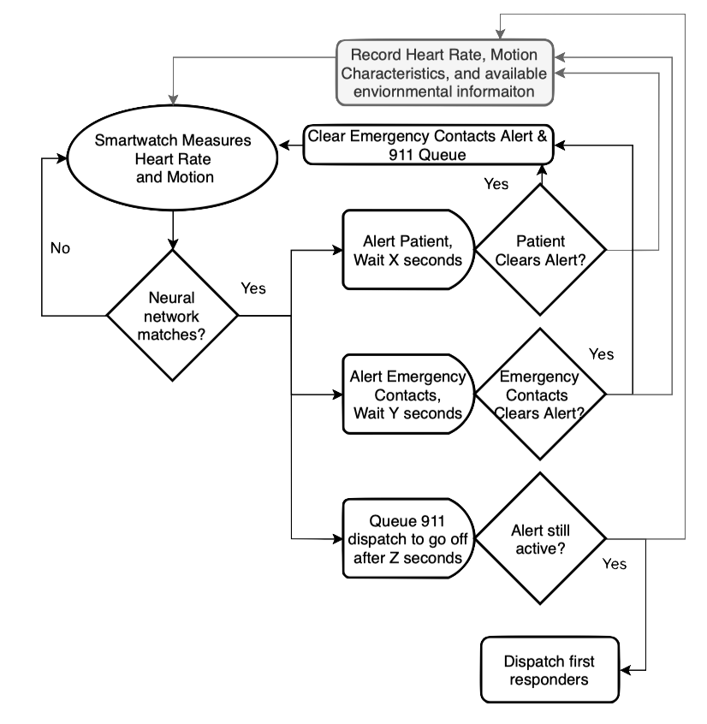
Solution Process Flow
Detection is based on a combination of heart rate and body motion characteristics.
Detection performance is enhanced using a trained machine learning approach.
Emergency notification is issued directly from the user’s smartwatch.
Notes:
Our solution process flow begins by measuring HR and motion,
which is fed into the trained NN. If the biometrics match seizure characteristics,
We alert the patient, their emergency contact, and queue a 911 call. If the patient responds, we
clear the 911 call and tell their EC they are OK. If the EC responds, we clear the 911 call.
If neither respond the 911 is dispatched directly from the smart watch.

Slide 14
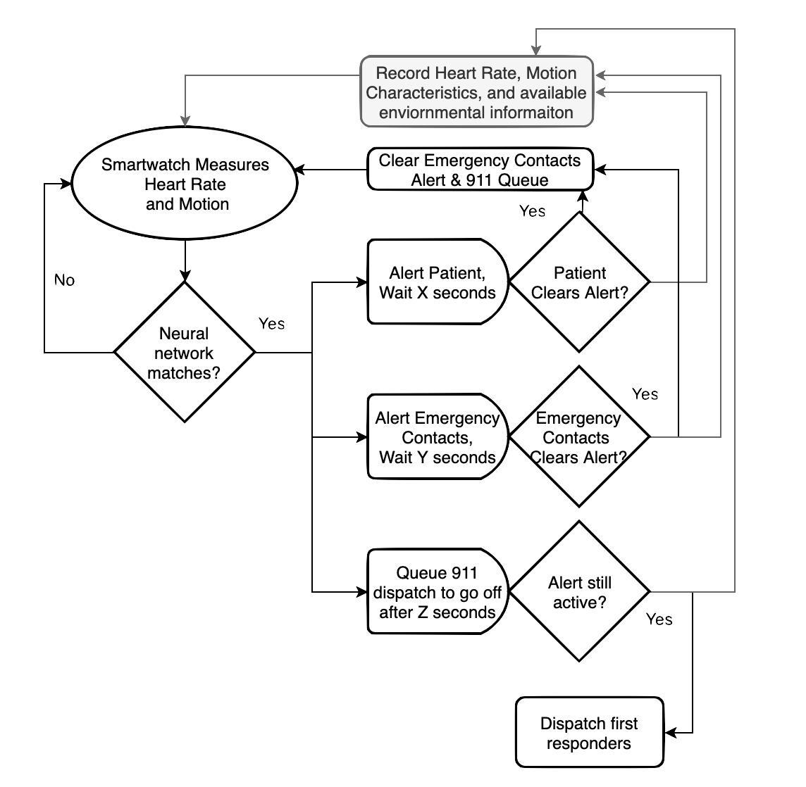
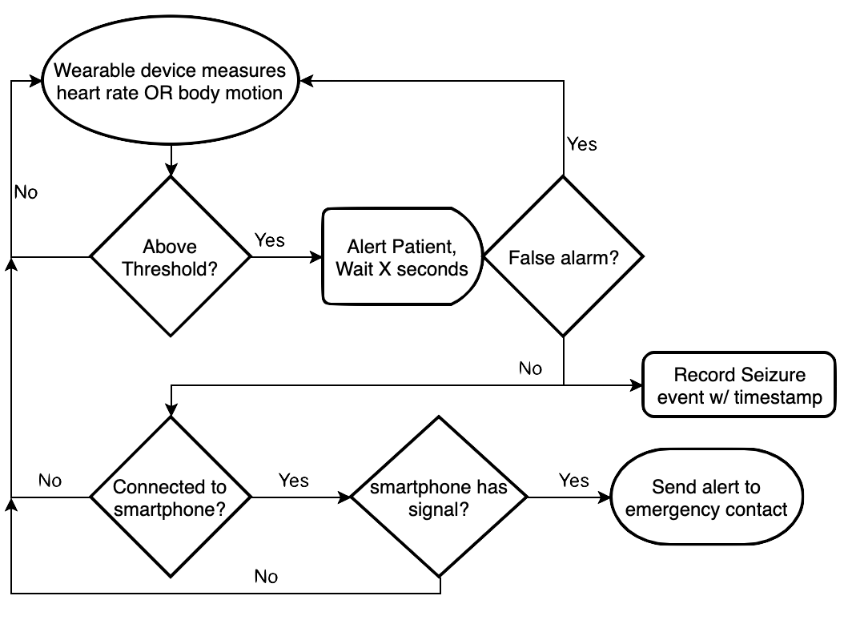
Process Flow Comparison
ML Detection Technique Tiered Notifications Fewer components
Measures >1 Data Point Records all event data
Notes:
Let’s recap the differences in process flow:
We collect more than 1 type of biometric reading,
We use modern ML instead of a simple threshold,
And our notifications alert both caregivers and first responders without requiring a relay.

Slide 15
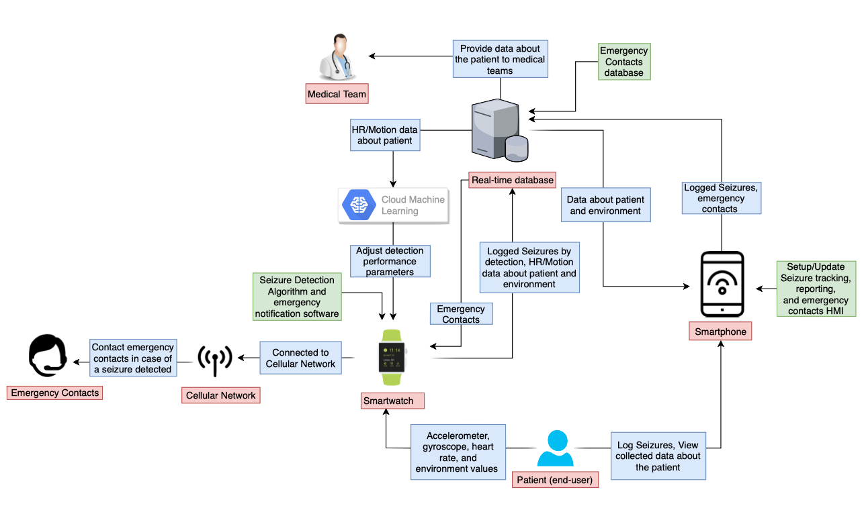
Major Functional Component Diagram
Notes:
SeizSmart has three cycles of data flow:
A passive biometric collection and batch upload to train a neural network,
An active biometric testing against a known seizure profile using a trained neural network,
And an on-demand configuration for emergency contacts and reporting preferences through a web browser (possibly your phone -> )
Notice how the smartphone is on the periphery and it not necessary,
the passive collection and training cycle needs only be intermittent,
and the critical flow happens entirely within the watch and needs only a cellular network to issue notifications.

Slide 16
Competition Matrix
Direct
Indirect
 | SeizSmart | SmartMonitor | empatica embrace 2 | SeizAlarm | Epilepsy Journal | Epilepsy Health Storylines
Detect, record and track generalized seizures in real time | ✔ | ✔ | ✔ | ❌ | ❌ | ❌
Monitor repetitive shaking motion | ✔ | ✔ | ✔ | ✔ | ❌ | ❌
Continuously monitor the user's heart rate | ✔ | ❌ | ❌ | Only checks for elevated heart rate | ❌ | ❌
Alert emergency contact when the user does not respond | ✔ | ✔ | ✔ | ✔ | ❌ | ❌
Collect data about the environment at the onset of a seizure being detected | ✔ | ❌ | ❌ | ❌ | ❌ | ❌
Function fully without dependence on a smartphone or external device | ✔ | ❌ | ❌ | ❌ | ❌ | ❌
Use machine learning to detect generalized seizures | ✔ | ❌ | ✔ | ❌ | ❌ | ❌
Require a subscription or prescription | ❌ | ✔ | ✔ | ❌ | ❌ | ❌

Slide 17
Benefits to Customer Base
Detection Performance and Hardware Flexibility
Each user’s individual seizure profile provides more accurate and customized seizure detection.
The user may configure emergency response notifications as desired.
SeizSmart is compatible with both android and iOS smartwatch technology without the need for specialized hardware.
SeizSmart will be available without a subscription and a prescription will not be required.
Peace of Mind
A smartphone does not need to be in close proximity to the smartwatch for detection and notification of emergency contacts.
SeizSmart is capable of notifying emergency personnel in extreme situations.
Notes:
We offer two main benefits to our users Detection Performance and Hardware flexibility. Users have a seizure profile tailored to their lifestyle. So they can tweak emergency response notification as desired. IOS and Android smartwatches are compatible no need for specialized hardware. No prescription or subscription is required.
Peace of mind is also offered to the user. So they do need to always be in proximity to their smartphone for notification of emergency contacts. Seizsmart can contact emergency contact as required

Slide 18
What SeizSmart Will Not Do
It will not predict seizures
It detects all types of generalized seizures except for absence seizures
It is not a medical application and is not intended to be used in the diagnosis, monitoring, prevention, or treatment of epileptic seizures.
Notes:
We do not predict seizures
We can detect every type of generalized seizures except for absence seizures. These seizures are seizures in which an individual blanks out or stares into space
We are not a medical application so there is no need for FDA approval

Slide 19
Key Points Summary
SeizSmart is a mobile application based on smartwatch technology that is designed to improve the detection, tracking, and reporting of generalized seizures.
The Problem
Current applications only check for an increase in heart rate or rapid body movements.
Current applications require a prescription or subscription plan in order to detect and track seizures.
Current applications require the smartwatch to be in close proximity to the relay device to transmit alerts and notifications.
The Solution
Continuously monitor the end-user’s heart rate and body movements.
Apply machine learning to the collected data about the end-user’s seizures to build a unique, personalized, more accurate seizure profile.
Execute within the smartwatch itself to enable independent operation without requiring proximity to a relay device.
Notes:
As we all know our competitors check for an increase in heart rate or rapid body movement. Some of their devices require a prescription or a subscription to work and a smartphone must be next to the user
We aim to provide maximum benefit to the user by monitoring both heart rates and body movement we use this data to build a unique profile for each individual user. We dont require the smartwatch to be in proximity to the user

Slide 20
Who Benefits/Why Important/Why Feasible
Who benefits?
Anyone who suffers from generalized seizures.
Medical/research teams looking for data about epilepsy.
Why important?
Provides end-users with the ability to detect, track, and record seizures using a seizure profile uniquely crafted for them.
Why feasible?
Seizmart leverages advancements in existing smartwatch and machine learning technology to detect seizures in real time.
Notes:
The people who suffer from generalized seizure and the people who support them
Our application provide users with ability to record and detect their seizure accurately using a seizure profile tailored to them
We use existing technology to track and record seizures by storing collected data about the end-user into a database and providing a web interface for users to view the collected data

Slide 22
References - Epileptic Seizure Detection
Tzallas, A. T., Tsipouras, M. G., Tsalikakis, D. G., Karvounis, E. C., Astrakas, L., Konitsiotis, S., & Tzaphlidou, M. (2012, February 29). Automated Epileptic Seizure Detection Methods: A Review Study. Retrieved from https://www.intechopen.com/books/epilepsy-histological-electroencephalographic-and-psychological-aspects/automated-epileptic-seizure-detection-methods-a-review-study
Giannakakis, G., Sakkalis, V., Pediaditis, M., & Tsiknakis, M. (1970, January 01). Methods for Seizure Detection and Prediction: An Overview. Retrieved from https://link.springer.com/protocol/10.1007/7657_2014_68
Devices & Technology. (n.d.). Retrieved from https://www.dannydid.org/epilepsy-sudep/devices-technology/
February;25(2):28-29, N. R., Publish date: December 6, 2., & Publish date: December 18, 2. (2019, January 07). Mobile Devices May Provide Accurate Seizure Detection and Help Prevent SUDEP. Retrieved from https://www.mdedge.com/neurology/epilepsyresourcecenter/article/130162/epilepsy-seizures/mobile-devices-may-provide

Slide 23
References - Epileptic Seizure Detection Continued
van Elmpt, Wouter J C, et al. “A Model of Heart Rate Changes to Detect Seizures in Severe Epilepsy.” Seizure, U.S. National Library of Medicine, Sept. 2006, www.ncbi.nlm.nih.gov/pubmed/16828317.
Borujeny, Golshan Taheri, et al. “Detection of Epileptic Seizure Using Wireless Sensor Networks.” Journal of Medical Signals and Sensors, Medknow Publications & Media Pvt Ltd, 2013, www.ncbi.nlm.nih.gov/pmc/articles/PMC3788195/.
Velez, Mariel, et al. “Tracking Generalized Tonic-Clonic Seizures with a Wrist Accelerometer Linked to an Online Database.” Seizure, U.S. National Library of Medicine, July 2016, www.ncbi.nlm.nih.gov/pubmed/27205871.

Slide 24
References - Heart rate and Epileptic Seizures
Kołodziej, M., Majkowski, A., Rak, R. J., Świderski, B., & Rysz, A. (2017, September). System for automatic heart rate calculation in epileptic seizures. Retrieved from https://www.ncbi.nlm.nih.gov/pubmed/28523469
Nei, M. (2019). Cardiac Effects of Seizures. American Epilepsy Society.
Zijlmans, Maeike, et al. “Heart Rate Changes and ECG Abnormalities during Epileptic Seizures: Prevalence and Definition of an Objective Clinical Sign.” Epilepsia, U.S. National Library of Medicine, Aug. 2002, www.ncbi.nlm.nih.gov/pubmed/12181003.

Slide 25
References - Epilepsy
“Demystifying Epilepsy and Increasing Awareness.” Mayo Clinic, Mayo Foundation for Medical Education and Research, https://newsnetwork.mayoclinic.org/discussion/epilepsy-demystify-disease-and-increase-awareness/.
“Epilepsy Foundation.” Epilepsy Foundation, 13 Mar. 2019, www.epilepsy.com/.

Slide 26
References - Direct Competitors
“About SmartWatch Inspyre™ by Smart Monitor – Smart-Monitor.” Smart, smart-monitor.com/about-smartwatch-inspyre-by-smart-monitor/.
“Embrace2 Seizure Monitoring | Smarter Epilepsy Management | Embrace Watch.” Empatica, www.empatica.com/embrace2/.
“SeizAlarm Epilepsy Seizure Detection.” SeizAlarm Epilepsy Seizure Detection, seizalarm.com/.

Slide 27
References - Indirect Competitors
“Epilepsy Journal App | OllyTree Applications.” Epilepsy Journal, www.epilepsy-journal.com/.
“Health Storylines™.” Health Storylines™, www.healthstorylines.com/.

