Slide 1
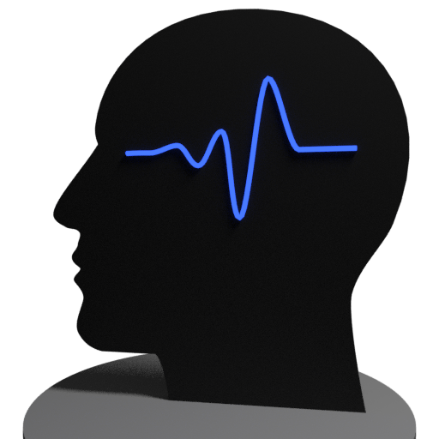
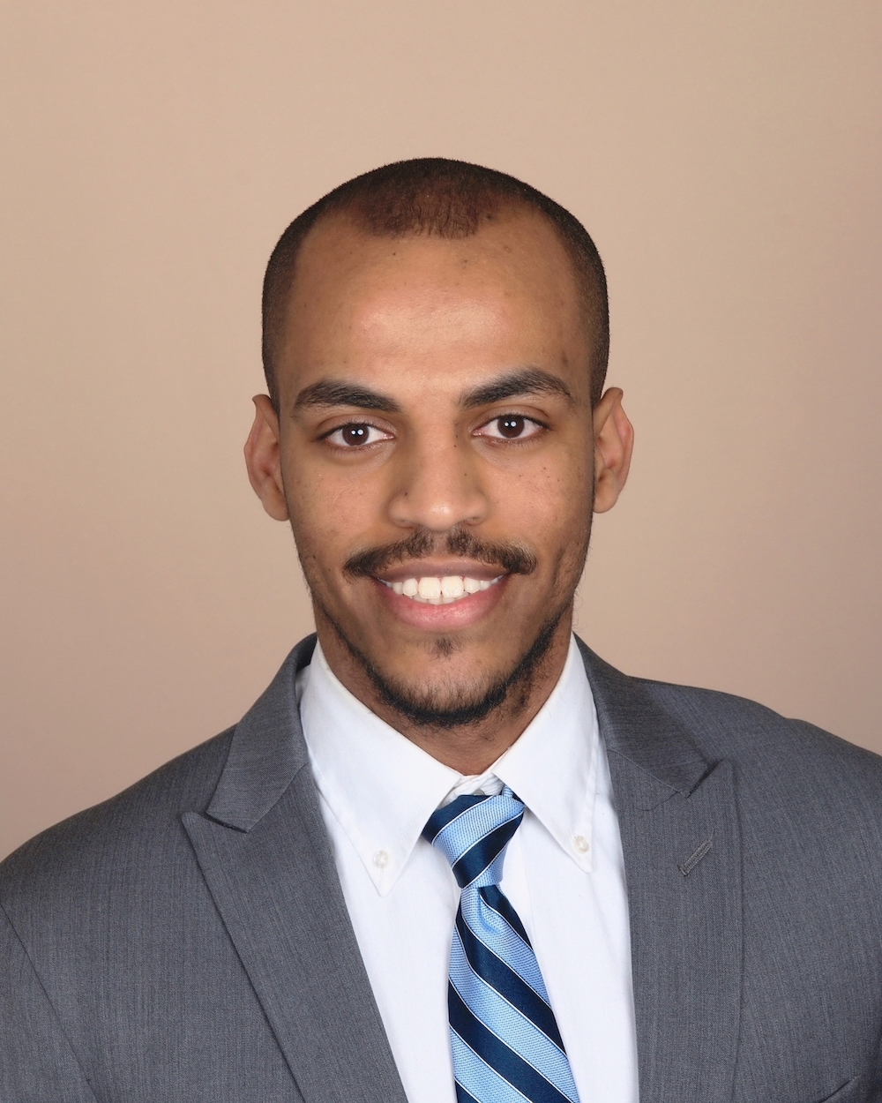
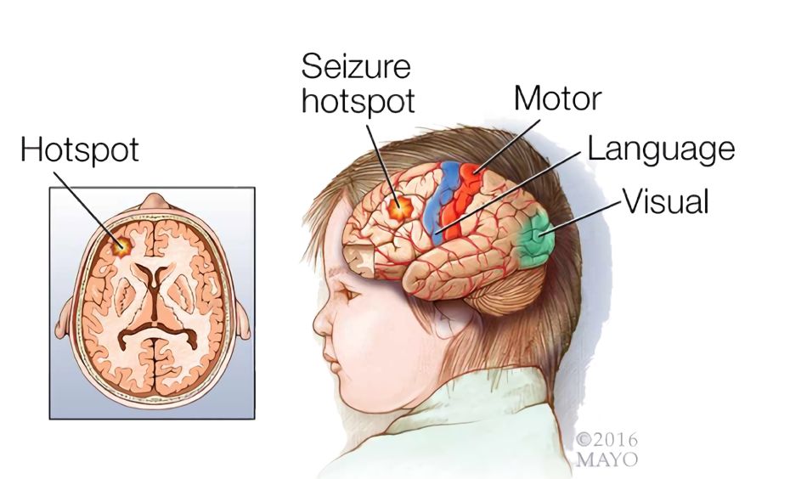
SeizSmart
A mobile application for detecting, tracking, and reporting seizures in real-time.
Formal Design Presentation
CS 410 Spring 2019
Team Silver
Abel Weldergay, Kevin Sokol
Alpha Din Gabisi, Jeffrey McAteer
Danielle Luckraft, Peter Scheible
Notes:
Good morning everyone, my name is Abel, and today my team and i will be giving our design assessment of SeizSmart, a mobile application for detecting, tracking, and reporting epileptic seizures in real time using current technology.

Slide 2
Table of Contents
Feasibility
Team & Mentors…….…………………..4-5
Background………………………………..7-8
The Problem……………………………….9
Current Process Flows……………….9-11
Our Solution……………………………….12
Solution Process Flows……………….13
Customers/Users/Roles……………..14-16
Competition……………………………….17
Design
MFCD………………………………………..19
Build Tools………………………………....20
Development Model………………..…21-23
WBS Overview...…………………………24
UI/UX - Smartphone……………………25-26
UI/UX - Smartwatch…………………….27-28
Database…………………………………..…29-34
Algorithms……………………………….....35-46
Testing………………………………………...47-48
Risks…………………………………………...49-59
Conclusion ……………………………....…60-61
Interactive Prototypes……….……....62
References
Epileptic Seizure Detection……….....64-65
Heart rate and Epileptic Seizures……….66
Epilepsy……………...………...………...………....67
Direct Competitors…...…...…...…...…...…..68
Indirect Competitors…...…...…...…...……..69
Appendix A - User Stories…………….70-72
Notes:
Here is what we are going to talk to you about, we will first give an overview of our feasibility presentation, then we will discuss our design, which includes our MFCD, build tools, development model, and our work breakdown structure, which includes the UI/UX for the smartphone and the smartwatch, our database, algorithms, and testing, then we will discuss our customer and technical risks, then we will close out with a demo of our interactive prototypes

Slide 3
Table of Contents
Green: Abel
Blue: Jeff
Orange: Kevin
Pink: Alpha
Red: Danielle
Black: Peter
Feasibility
Team & Mentors…….…………………..3-4
Background………………………………..5-7
The Problem……………………………….8
Current Process Flows……………….9-10
Our Solution……………………………….11
Solution Process Flows……………….12
Customers/Users/Roles……………..13-15
Competition……………………………….16
Design
MFCD………………………………………..17
Build Tools………………………………....18-19
Development Model………………..…20
WBS Overview...…………………………21
UI/UX - Smartphone…………………………23
UI/UX - Smartwatch………………………...24
Database……………………………………25-30
Algorithms…………………………………31-39
Risks……………………………………………45-59
Conclusion …………………………………60-61
Interactive Prototypes………………..62
References
Epileptic Seizure Detection……….....64-65
Heart rate and Epileptic Seizures……….66
Epilepsy……………...………...………...………....67
Direct Competitors…...…...…...…...…...…..68
Indirect Competitors…...…...…...…...……..69

Slide 4
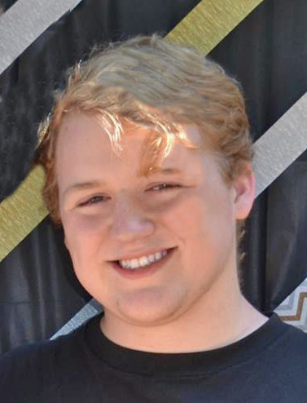
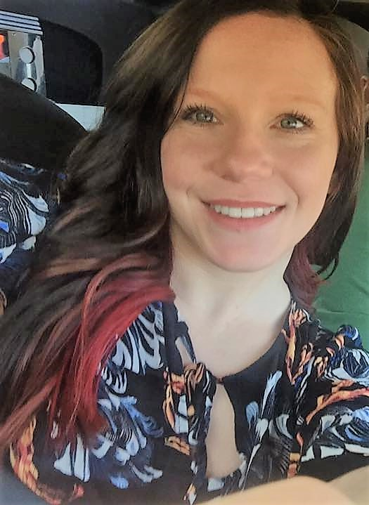
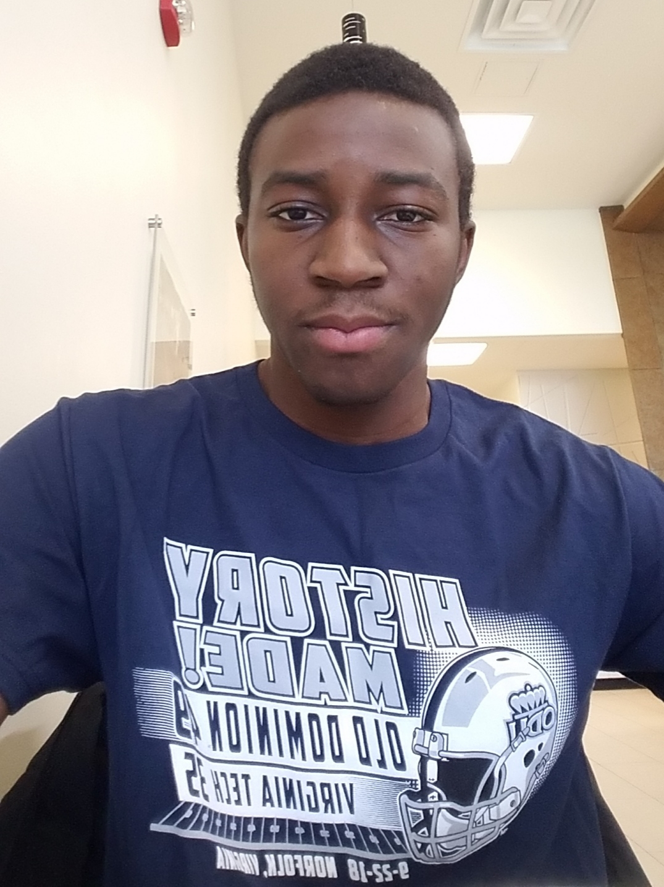
The Team
Abel Weldaregay
Team Lead / Back-End Developer
Kevin Sokol
UI/UX Developer - Smartphone
Peter Scheible
UI/UX Developer - Smartwatch
Danielle Luckraft
Webmaster / Developer
Jeffrey McAteer
Infrastructure & ML Engineer
Alpha Din Gabisi
Database Engineer
Notes:
Here is our team, I am a junior and i am the team lead and back-end developer, we have kevin who is a senior and is the UI/UX developer for the smartphone, and peter who is a senior and is the UI/UX for the smartwatch, and Danielle who is a senior is the webmaster, and jeffery who is also a senior and is the infrastructure & ML engineer, and Alpha who is a junior and is our database engineer

Slide 5
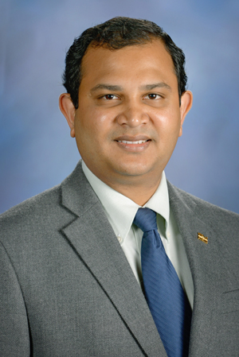
Mentors
Sampath Jayarathna. Ph.D.
Jesse Gordon
Notes:
Here are our mentors
We have dr. Sampath, who is a professor of computer science here at ODU, and Jesse Gordon who is an enterprise architect at Anthem

Slide 6
Terminology
Patient
An individual who experiences generalized seizures. May also be referred to as the end user.
Emergency Contact
Anyone who cares for a patient; Usually family members.
Seizure Profile
Personalized for each patient, describes information regarding the individual’s typical seizure, such as physical indicators, or their typical threshold for specific biometrics during a seizure. The seizure profile is used to provide more accurate seizure detection.
Notes:
Here are the key terminologies we will use throughout the presentation
One is patient, this is the individual with generalized seizures, we will also refer to it as the end-user
An emergency contact is anyone who cares for the patient, it’s usually a friend or family member
And a seizure profile is a unique set of parameters for each individual patient that’s built from collecting data about the patient’s heart rate and body motion

Slide 7
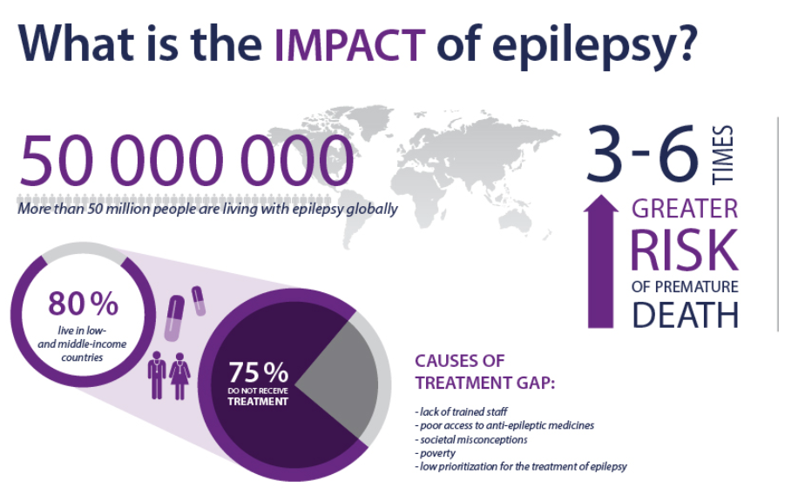
Background - Epilepsy
Epilepsy is the 4th most common neurological disease in the world.
Cases of epilepsy in the US have increased over the past five years.
Cases in the US are predicted to increase further by 2020.
Notes:
Here is some facts about epilepsy
More than 50 million people worldwide suffer from epilepsy, making it one of the most common neurological disorders in the world
Cases in the US have consistently increased from 2014-2019, and are predicted to increase further by 2020

Slide 8
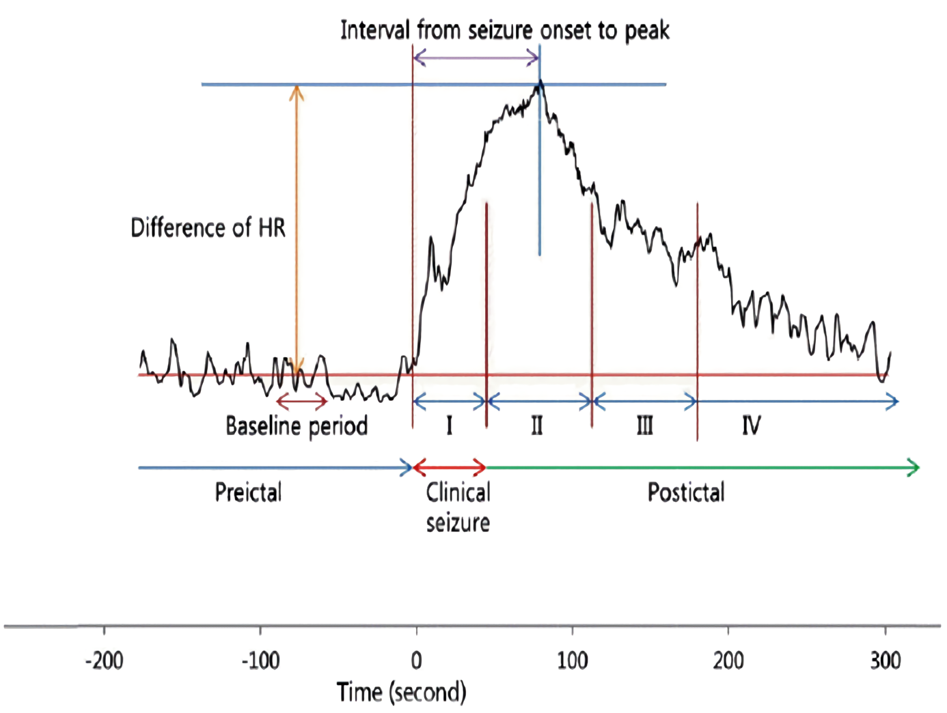
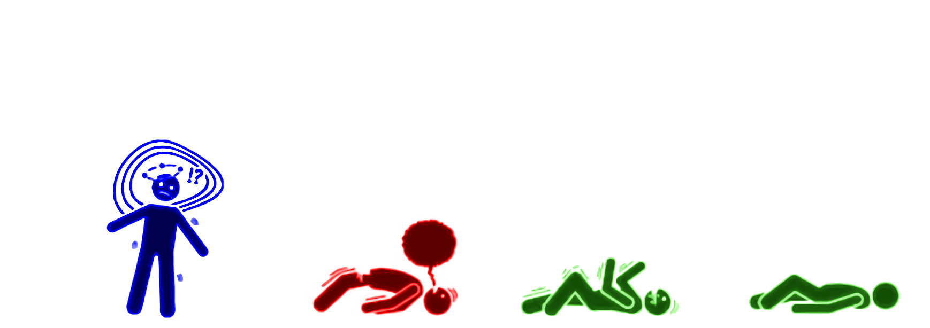
Characteristics of Generalized Seizures
Rapid change in heart rate
Rapid convulsions in limbs and face
Loss of consciousness
Notes:
Here are the key characteristics of generalized seizures
One is a rapid change in heart rate, it could either increase or decrease, as well as rapid body movements, and loss of consciousness
As you can see from the graph that illustrates the timeline of a seizure, when we transition from the preictal to the ictal phase, there is a rapid increase in heart rate
The key component we are going to focus on during this presentation will be the combination between heart rate and body movements because both are present during the onset of a seizure
This will not give us the ability to predict seizures, but it will let us detect seizures in real time, which can save someone’s life.

Slide 9
Problem Statement
Epileptic seizures are difficult to detect in a timely and accurate fashion and undetected seizures can result in injury or even death.
Current smartwatch detection technology does not provide the ability to automatically detect the onset of a seizure based on a combination of heart rate behavior and repetitive body movements.
Available devices do not provide capabilities that tune detection variables to match individual patient seizure characteristics.
Existing solutions to detect seizures use smartwatch technology which must be in the proximity of a smartphone in order to notify emergency contacts.
Notes:
The key problem with existing technology that is able to detect, track, and report epileptic seizures is that they do not detect based on a combination of heart rate and body motion which we believe give you a higher probability of accurate detection

Slide 10
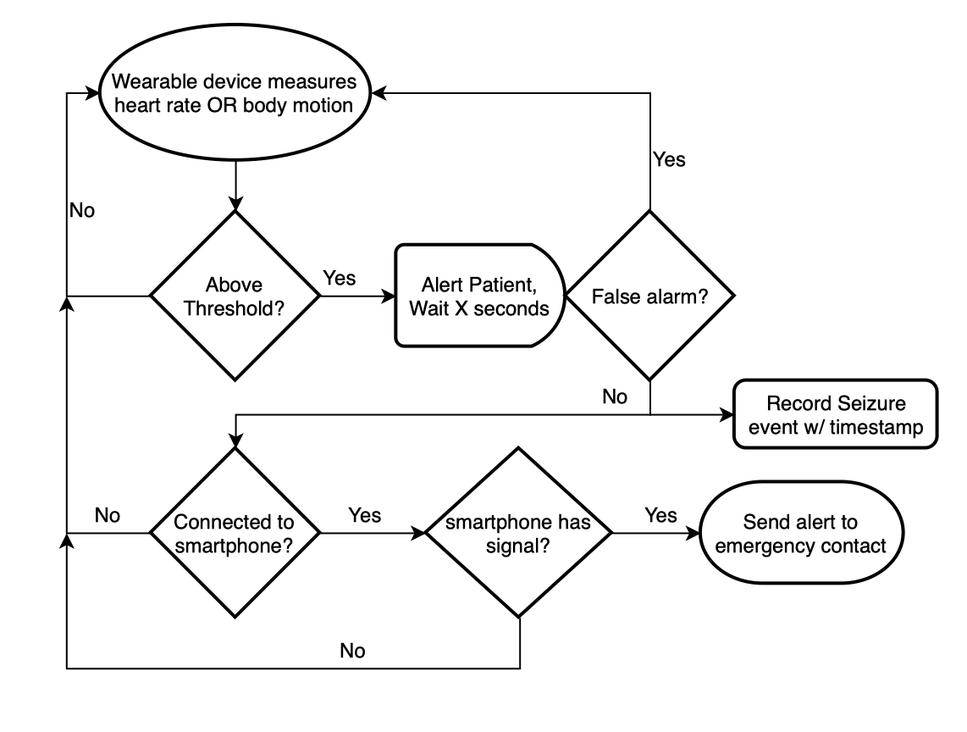
Current Process Flow
Most existing solutions detect seizures based on body motion.
Some detect seizures based on users heart rate.
The process flow for both are identical.
No existing system detects based on a combination of both metrics.
Notes:
Here is the current process flow
It starts off with the wearable device measuring heart rate or body motion, then it checks those measurements against a threshold, if it's above a threshold then it sends an alert to the patient, if the patient does not respond to the alert, then we get into the recording and reporting of the seizure, if the patient does respond then it's back to step one, and it's considered a false alarm

Slide 11
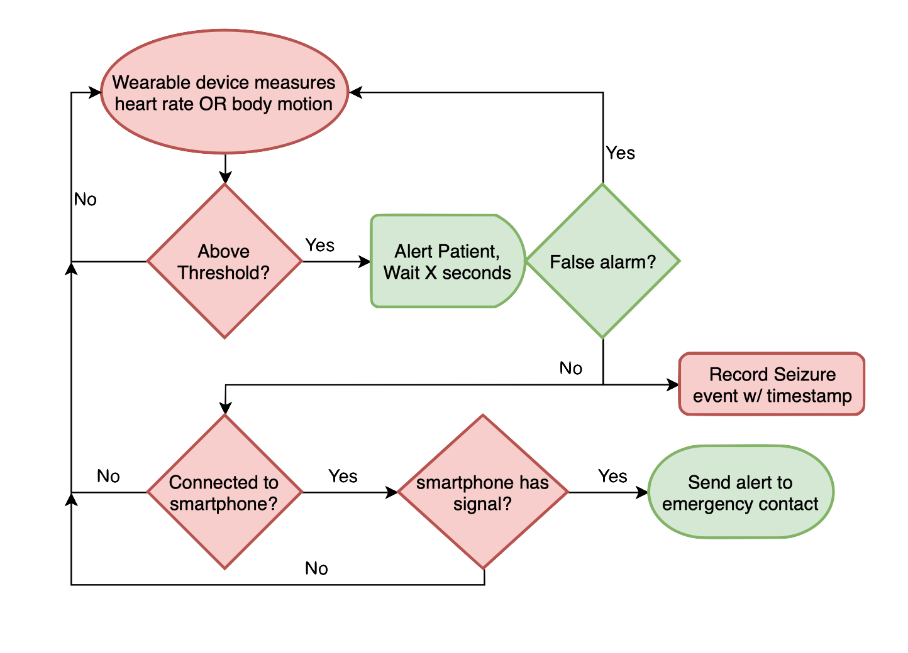
Current Process Flow
Wearables may access more data than HR/Motion.
Not all patients respond to seizures in the same way.
Current processes only begins recording seizure data after detection time.
Simpler notification capability is needed.
Notes:
Here is the problem with the current process flow
One is that it only measures heart rate or body motion to detect the onset of a seizure, this is an issue because studies have shown that patients can have an increase or decrease as well as repetitive body movements during the onset of a seizure
And it checks those measurements against a threshold, this is an issue because not all patients respond to seizures the same way
And it only starts recording data about the seizure after the detection point, and it only records data about the seizure, this is an issue because it misses out on valuable information such as the environment that can play as a potential trigger to the seizure
And in order to send a notification to emergency contacts, it must first need to be connected to a smartphone, then the smartphone will need signal, and then it will be able to send a notification to emergency contact
There needs to be a simpler way to automate the notification to emergency contacts

Slide 12
Solution Statement
Our proposed solution, SeizSmart, implements an advanced, wearable seizure detection capability using off-the-shelf smartwatch technology that is able to:
automatically detect epileptic seizures from combined heart rate and motion metrics,
detect seizures using an algorithm which matches individual patient seizure characteristics,
track and record all information surrounding seizure events,
and provide automatic notification to emergency contacts without requiring a relay.
Notes:
Our proposed solution provides the capability to make the detection process unique for each individual patient based on a combination of heart rate and body movements, while also providing the patient the capability to notify emergency contacts directly from their smartwatch

Slide 13
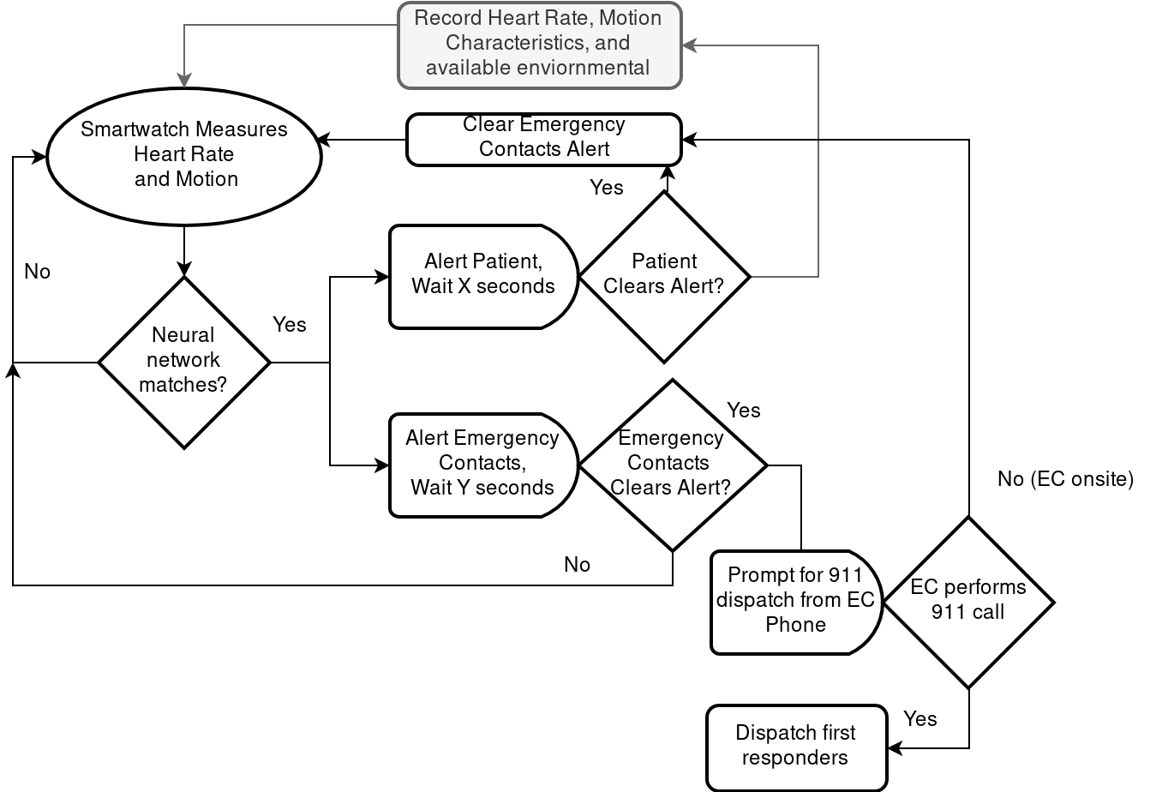
Solution Process Flow
Detection is based on a combination of heart rate and body motion metrics.
Detection performance is enhanced using a patient- unique machine learning approach.
Emergency notification is issued directly from the user’s smartwatch.
Notes:
Here is our solution process flow
It starts off with the wearable device measuring heart rate AND body motion
Then it checks those measurements against a trained neural network, and if it's a match then it sends an alert to the patient and the emergency contact
If the patient responds on time, then we clear the alert to the patient’s emergency contact, and we’re back to step one
If the patient’s emergency contact in not onsite, then we prompt the emergency contact to contact first responders directly from their phone, if they are on site, then we clear the alert to the patient’s emergency contact because they will be able to help

Slide 14
Target Consumers and End Users
Customers
Medical providers
Concerned party of individual with generalized seizures
End-Users
Individuals who have the most common types of generalized seizures:
Clonic
Tonic
Tonic-Clonic
Atonic
Myoclonic
Notes:
Our customers are the medical providers and the concerned party of the individual with generalized seizures
Our end-users are the individuals with the most common type of seizures, which are generalized seizures, and we will be able to detect all types of generalized seizures except for absence seizures because there is not enough observable information to determine the onset of the seizure

Slide 15
Benefits to Customer/User-base
Detection Performance and Hardware Flexibility
Each user’s individual seizure profile provides more accurate and customized seizure detection.
The user may configure emergency response notifications as desired.
SeizSmart is compatible with both Android and iOS smartwatch technology without the need for specialized hardware.
SeizSmart will be available without a subscription and a prescription will not be required.
Peace of Mind
A smartphone does not need to be in close proximity to the smartwatch for detection and notification of emergency contacts.
SeizSmart is capable of notifying emergency personnel in extreme situations.
Notes:
One of the key benefits of SeizSmart is that it provides the capability to make the detection process unique for each individual patient by using a trained neural network that considers a combination of heart rate and body motion to build a seizure profile
We also provide a piece of mind by not requiring the patient to be in close proximity of the smartphone to notify emergency contacts, as well as providing the capability to notify first responders in the case that the emergency contact is not available

Slide 16
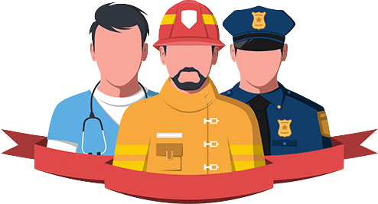
User Roles
Emergency Contact
Patient
First Responders
Concerned party
Friend/Family of Patient
Individual with generalized seizures
Last resort emergency contact
Notes:
Here are our user roles
We have an emergency contact, this is a set of people that will get notified if the patient does not respond to the alert
The patient is the individual with generalized seizures
And the first responder is the last resort emergency contact, this can be the patients doctor or anyone who has a high probability of responding

Slide 17
Competition Matrix
Direct
Indirect
 | SeizSmart | SmartMonitor | empatica embrace 2 | SeizAlarm | Epilepsy Journal | Epilepsy Health Storylines
Detect, record and track generalized seizures in real time | ✔ | ✔ | ✔ | ❌ | ❌ | ❌
Monitor repetitive shaking motion | ✔ | ✔ | ✔ | ✔ | ❌ | ❌
Continuously monitor the user's heart rate | ✔ | ❌ | ❌ | Only checks for elevated heart rate | ❌ | ❌
Alert emergency contact when the user does not respond | ✔ | ✔ | ✔ | ✔ | ❌ | ❌
Report data about the environment at the onset of a seizure being detected | ✔ | ❌ | ❌ | ❌ | ❌ | ❌
Function fully without dependence on a smartphone or external device | ✔ | ❌ | ❌ | ❌ | ❌ | ❌
Use machine learning to detect generalized seizures | ✔ | ❌ | ✔* | ❌ | ❌ | ❌
Require a subscription or prescription | ❌ | ✔ | ✔ | ❌ | ❌ | ❌

Slide 18
Solution Deliverables
Android
iOS
Deliverables:
Android watch app for detecting, Android smartphone app for reporting, recording, and adjusting detection threshold values
Server:
HTTP REST API
Distribution:
Google Play App Store
Deliverables:
iOS watch app for detecting, iPhone app for reporting, recording, and adjusting detection threshold values
Server:
HTTP REST API
Distribution:
App Store
Notes:
Solution consists of server, android watch app, API integrations?

Slide 19
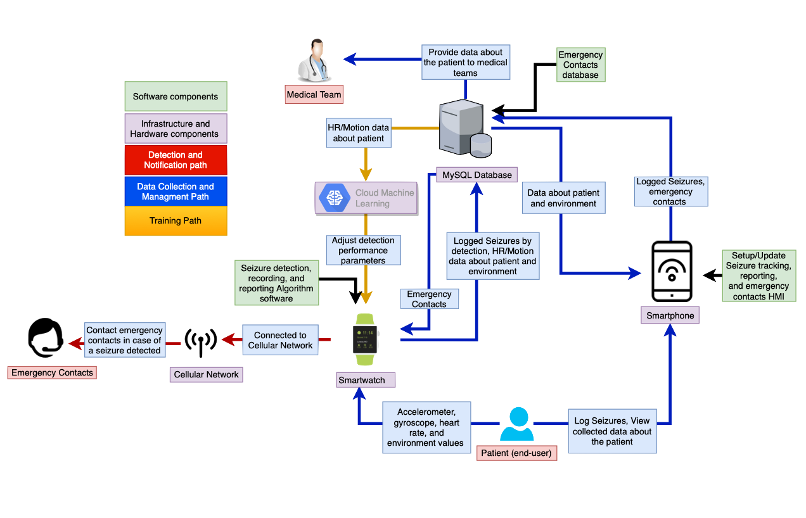
Major Functional Component Diagram
Legend
Notes:
SeizSmart has three cycles of data flow:
A passive biometric collection and batch upload to train a neural network,
An active biometric testing against a known seizure profile using a trained neural network,
And an on-demand configuration for emergency contacts and reporting preferences through a web browser (possibly your phone -> )
Notice how the smartphone is on the periphery and it not necessary,
the passive collection and training cycle needs only be intermittent,
and the critical flow happens entirely within the watch and needs only a cellular network to issue notifications.

Slide 20
Hardware and Software Components
Watch App
Cloud Server
upload biometrics
Biometric Readings
Tensorflow ML System
Local DB
Global DB
Screen GUI Alert
Daily trained NN
Daily batch job reads biometrics from DB + trains NN
iOS/Android Runtime
CentOS 7 Linux VM
 | iOS Smartwatch | Android Smartwatch | iOS Phone | Android Phone
Min Version | watchOS 5.2 | Wear OS 2.6 | iOS 8.0.1 | Android 4.3
Hardware Requirements | Wifi, Cellular, Accelerometer, Gyroscope, optical heart-rate sensor | Wifi, Cellular, Accelerometer, Gyroscope, optical heart-rate sensor | Wifi, Cellular | Wifi, Cellular

Slide 21
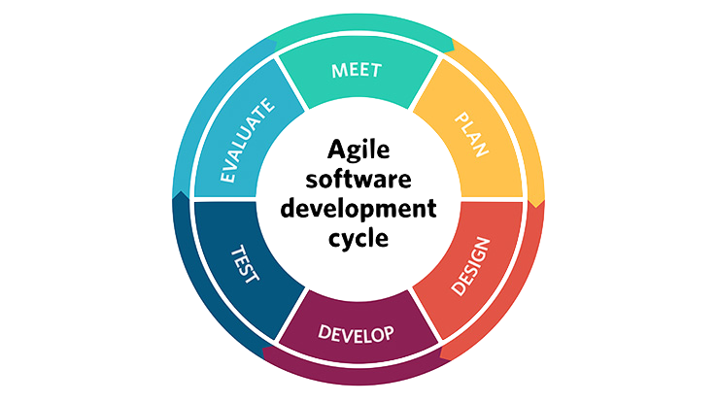
Agile Development Model
Small, diverse team
Goal is moving target
Correctness is critical
Time is limited
Agile plays to our team’s strengths and gives the project a high probability of success

Slide 22
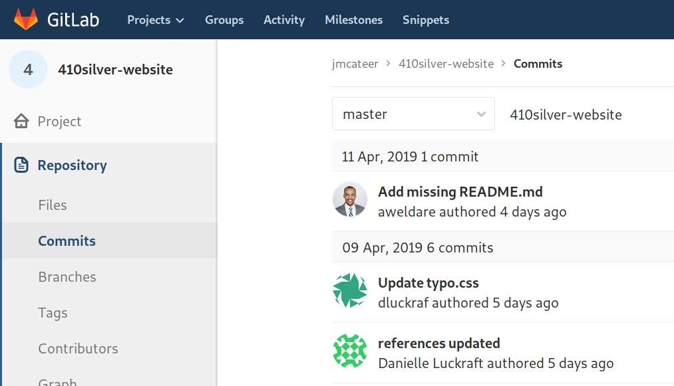
Coordination Tools
CS gitlab
Shared codebase
Issue tracking
Already in use!
Wekan kanban instance
Run off 411 VM
Use cards to track work in parallel
Weekly Sprint Meetings
Google Hangouts

Slide 23
Development Tools
 | Android | iOS | Server
Language | Java | Swift | Java
IDE | Android Studios | Xcode | Vim
UI/UX | Android Studios | Xcode | HTML5/CSS/JS
Database | SQLite | SQLite | MySQL
Build Manager | Gradle | Swift Package Manager & Cocoapods | Gradle
Version Control | Git | Git | Git
Issue Tracker | Gitlab | Gitlab | Gitlab
Testing Framework | JUnit | XCTest | JUnit

Slide 24
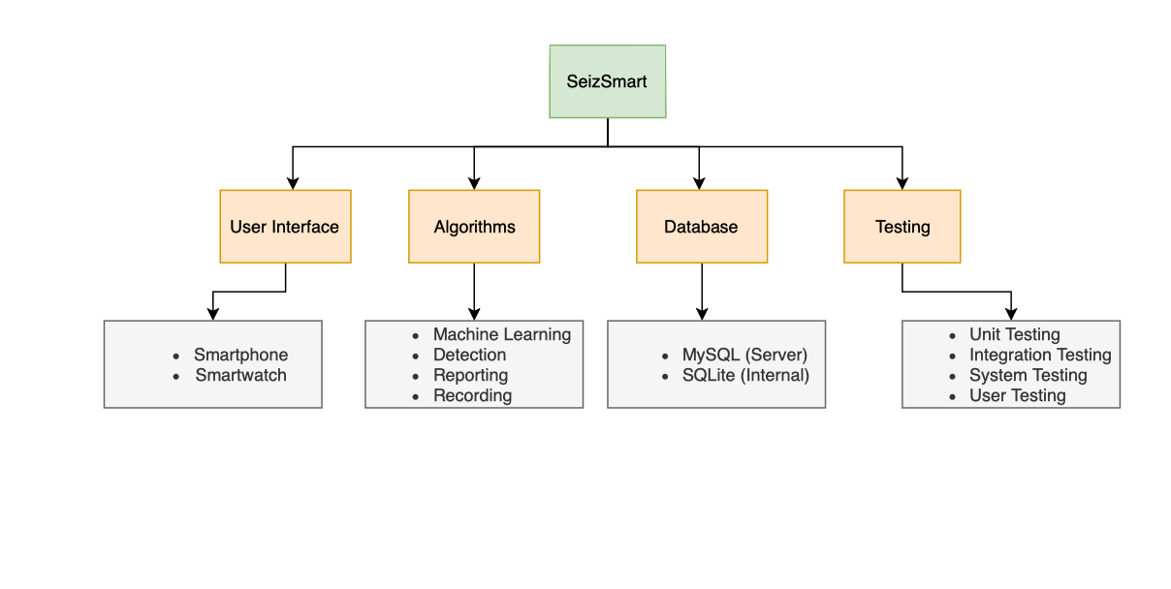
Work Breakdown Structure (WBS) Overview
New Slide
Notes:
Smartphone
Smartwatch
Realtime biometric profile matching
Offline profile learning
Local batches of biometric history
Remote ML data
Algorithmic correctness
System integration

Slide 25
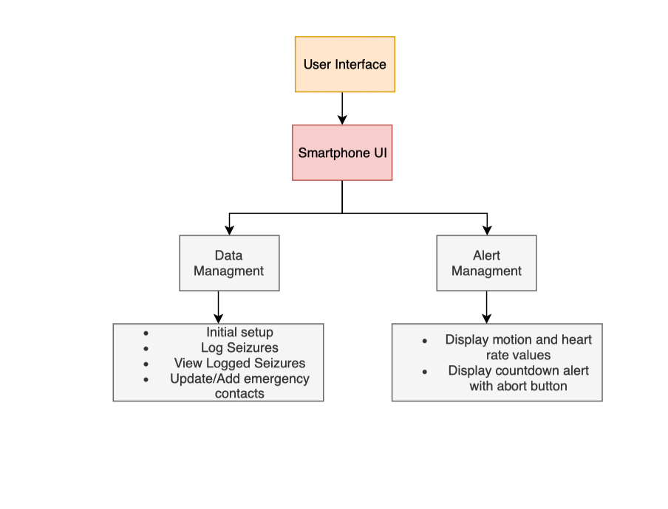
WBS - User Interface Smartphone
New Slide

Slide 26
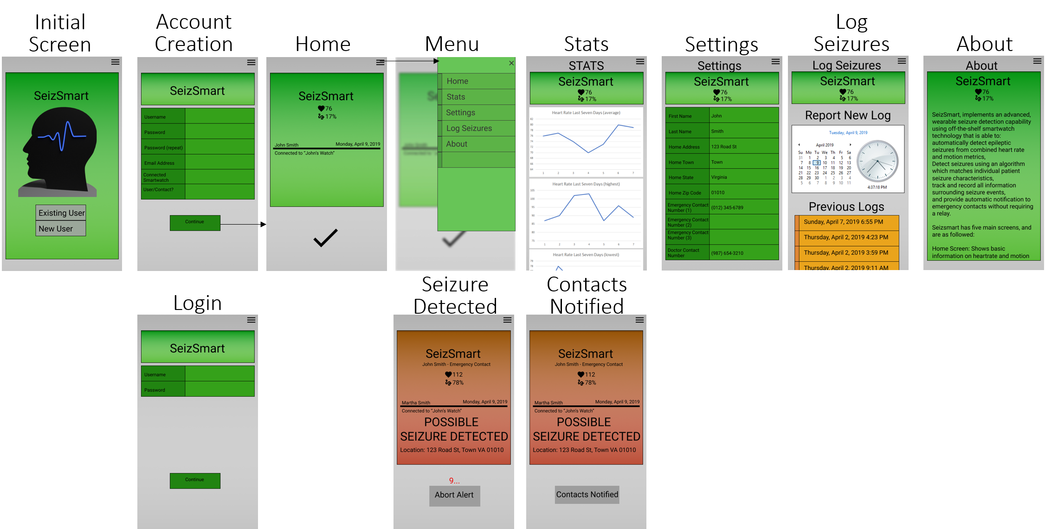
SmartPhone GUI Mockup - Patient/Emergency Contact
*Some Settings unavailable for Emergency Contact

Slide 27
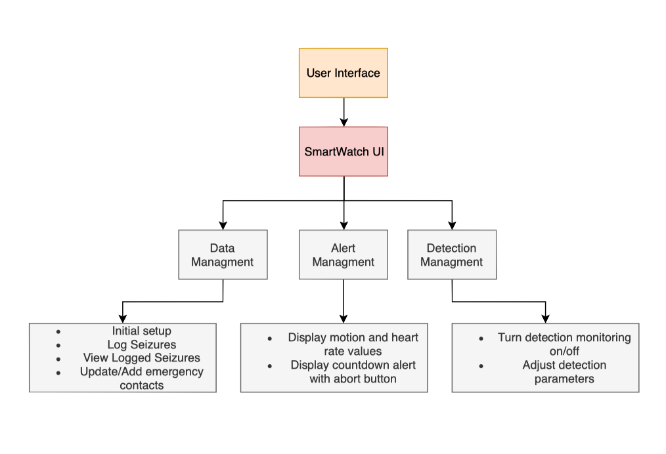
WBS - User Interface Smartwatch

Slide 28
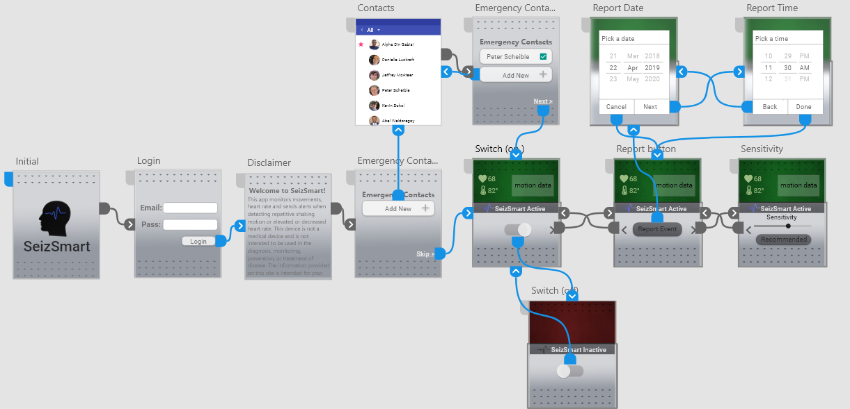
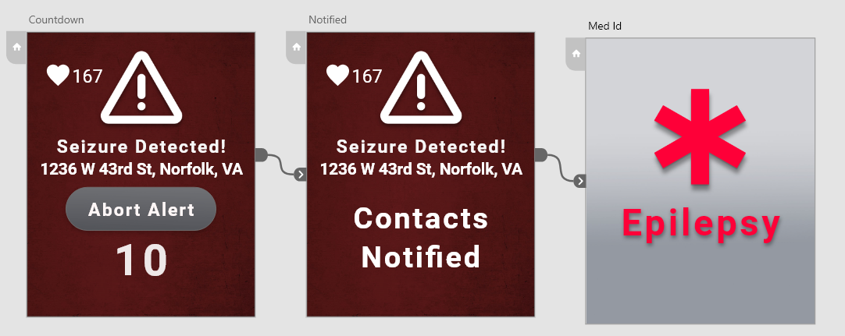
Smartwatch GUI Mockup

Slide 29
Database: External Storage MySQL
MySQL is an open-source relational database management system.
Stores all data from the watch to be used by machine learning algorithm.
Data is easily exportable to csv or other formats for research teams.

Slide 30
WBS - Server Database (External Storage)
New Slide

Slide 31
Database: Local Storage SQLite (Smart Watch)
Used for local storage on the smartwatch.
Will hold data before being sent to the main database on the server

Slide 32
WBS - Smartwatch Database
New Slide

Slide 33
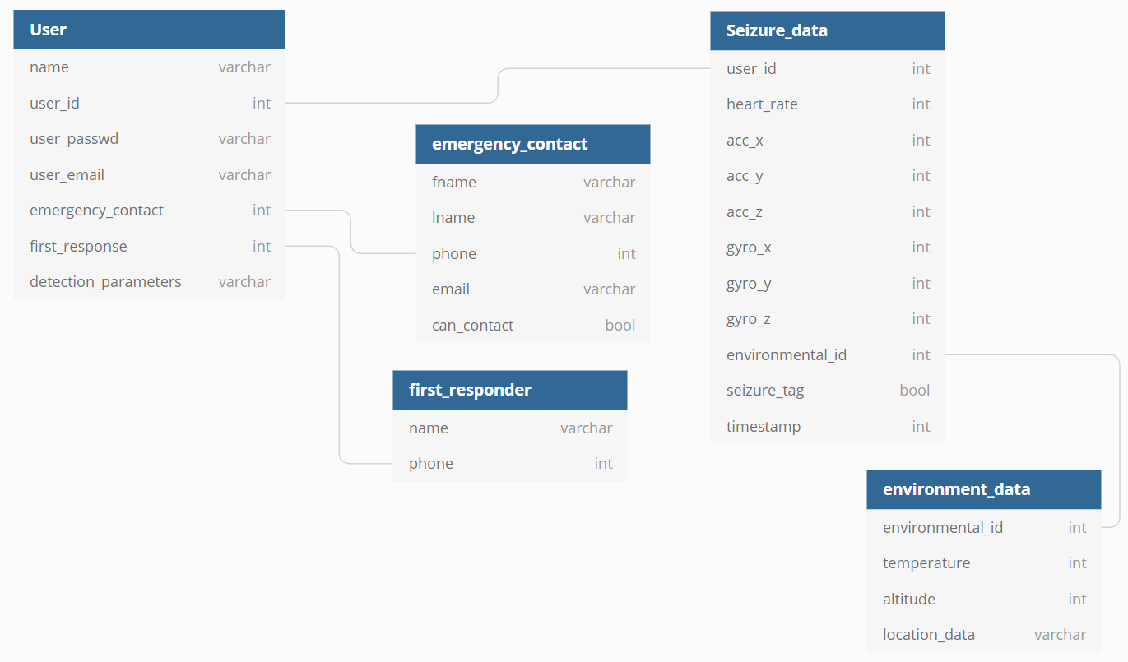
Database Schema
Notes:
All this data would be exportable in csv format so it would be easy to use this data for analysis and machine learning

Slide 34
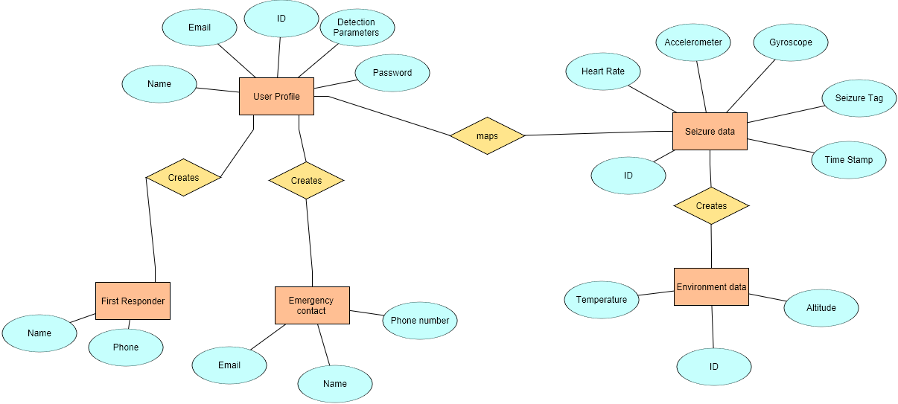
Entity Relationship Diagram (ERD)

Slide 35
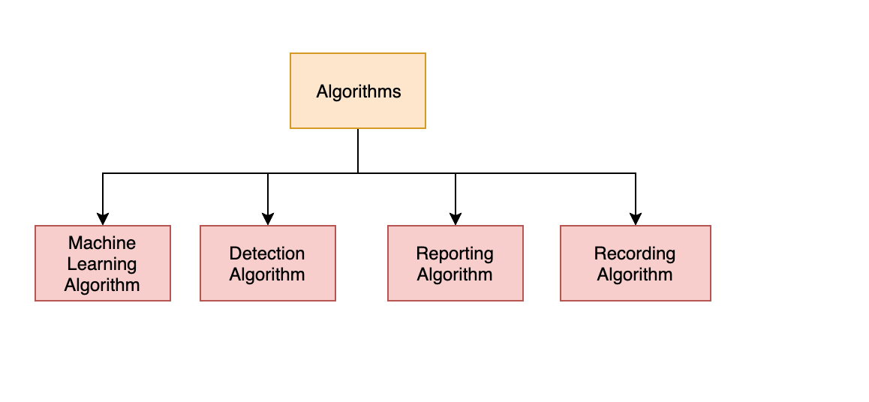
WBS - Algorithms

Slide 36
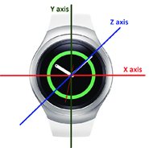
Machine Learning Algorithm
Purpose
Build a unique seizure profile for each individual patient
Tools
TensorFlow
Parameters
Motion data collected about patient
Accelerometer values
Gyroscope values
Patient’s heart rate
Seizure tag

Slide 37
Machine Learning Algorithm: Objective
Answers the question: given two sets containing N-dimensional element and a new N-dimensional element,
which set does the new element belong to?
N1
?
S2
N2
N3
S5
S1
N5
N4
S4
S3

Slide 38
Machine Learning Algorithm: Preprocessing
Each training session will use:
Min, Average, and Max X,Y,Z acceleration over last 5 mins, 1 min, and 10 sec
Must remove gravity; sdk has helper functions
Then clamp value in m/s² between -1 and 1, add 1 and divide by 2 to get value between 0 and 1
Min, Average, and Max X,Y,Z gyroscope rotations over last 5 mins, 1 min, and 10 sec
Add 360 to given degrees then divide by 720 to get value between 0 and 1
Min, Average, and Max 10-second heart rate measured over last 5 mins, 1 min, and 10 sec
Clamp between 30 and 250 beats per minute; subtract 30 and divide by 220 to get value between 0 and 1
Total of 3*(3*3*3) + 3*(3*3*3) + 3 = 165 input nodes
Single output node is 0 if no seizure during time period, 1 if seizure during time period.

Slide 39
Machine Learning Algorithm: Training
Small portion of total network: x-axis rotation data & it’s small role in detecting a seizure.
Training is computationally intensive, occurs on the server, and uses the Gradient Descent training algorithm
5m min = +0° = 0.5
5m avg = +5° = 0.50694
5m max = +270° = 0.875
1m min = +0° = 0.5
1m avg = -10° = 0.48611
1m max = +90° = 0.625
(?) = unknown weight on each connection & node
0.50
?
?
?
0.51
?
?
?
0.87
?
?
?
User reported seizure event
?
1.0
0.50
?
?
0.48
?
?
?
0.63

Slide 40
Machine Learning Algorithm: Evaluation
Evaluation is computationally trivial (adding/multiplying ~200 numbers) and occurs on watch in real-time as 10-second batches of data are read from sensors
A
0.1
To compute R using trained weight values:
R = ∑(A*0.1 + B*0.2 … F*0.1 ) * 0.3 +
∑(A*0.1 + B*0.2 … F*0.1 ) * 0.6 +
∑(A*0.1 + B*0.2 … F*0.1 ) * 0.9
Finally compare R against the user’s preferred sensitivity coefficient. If set to 0.5, this means when R > 0.5 we act on a seizure event
B
0.3
0.2
C
0.6
R
D
E
0.9
F
0.1

Slide 41
Detection Algorithm
Purpose
Determine if a patient is having a generalized seizure in real time
Tools
Smartwatch sensors
Trained Neural Network
Parameters
Acceleration 5m, 1m, 10s / avg, min, max / x, y, z
Gyroscope rotation values 5m, 1m, 10s / avg, min, max / x, y, z
Heart rate 5m, 1m, 10s / avg, min, max

Slide 42
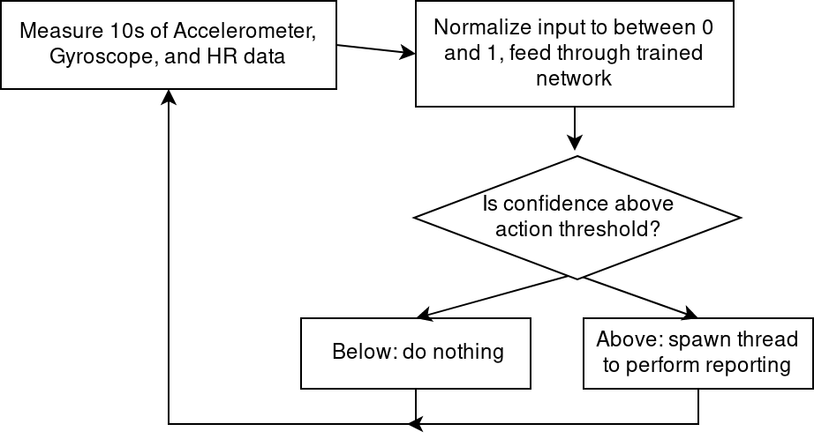
Detection Algorithm Logic Flow

Slide 43
Reporting Algorithm
Purpose
To notify the patient’s emergency contact and in some cases the patient’s last resort emergency contact
Tools
Smartwatch with cellular or wifi network
Parameters
Data about the patient
Patient’s emergency contacts list
Patient’s last resort emergency contact
Patient’s location coordinates
Patient’s heart rate and body motion data

Slide 44
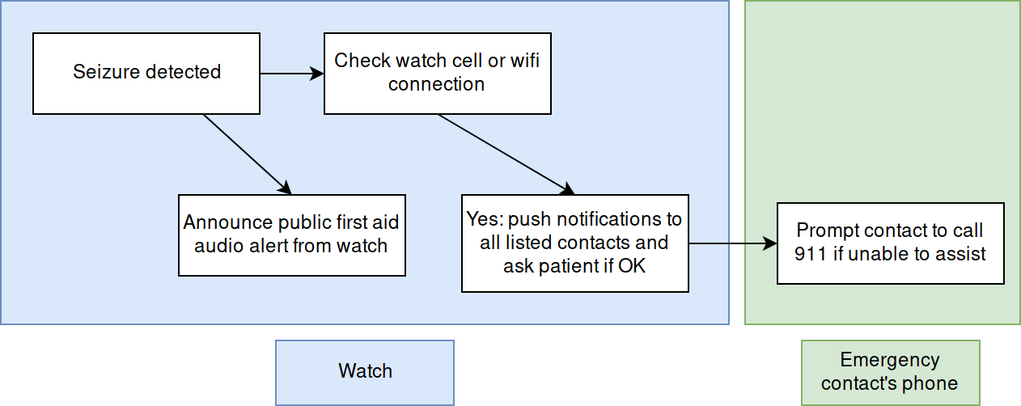
Reporting Algorithm Logic Flow

Slide 45
Recording Algorithm
Purpose
Record seizure-related data used in training.
Tools
SQLite
MySQL
Parameters
Heart rate
Accelerometer readings
Gyroscope readings
Seizure tag

Slide 46
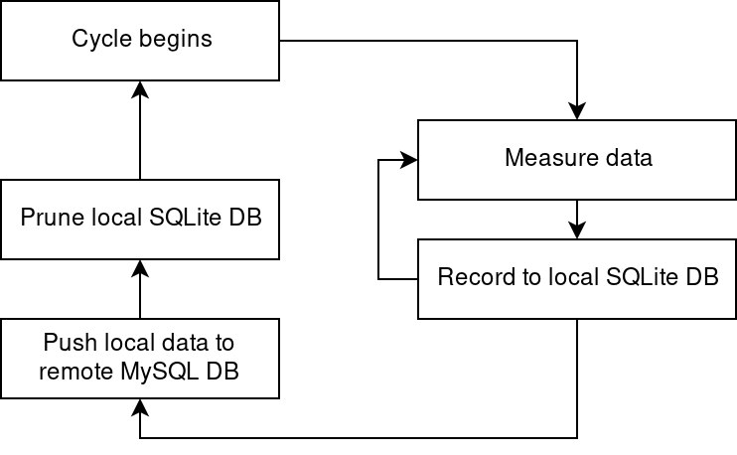
Recording Algorithm Logic Flow

Slide 47
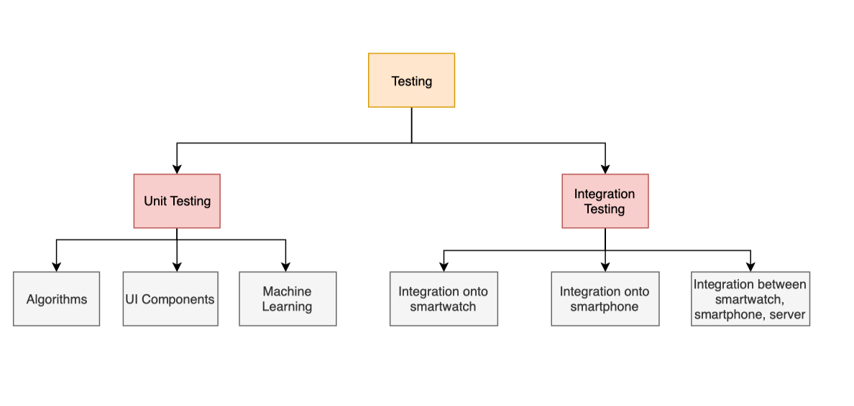
WBS - Testing
New Slide

Slide 48
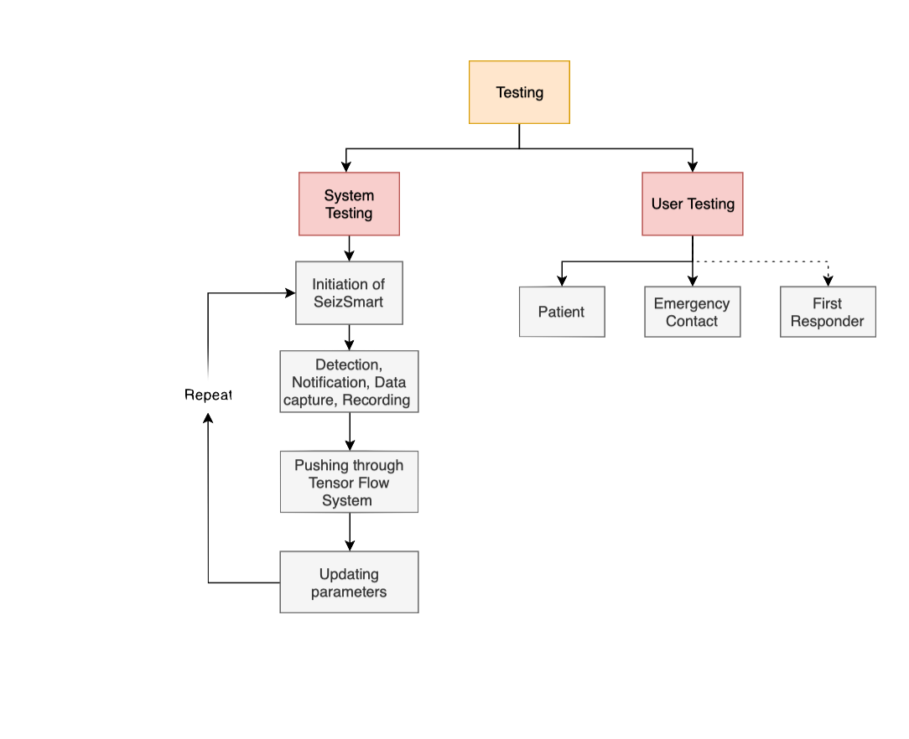
WBS - Testing Continued

Slide 49
Risk Matrix
Probability
 | Very Low | Low | Moderate | High | Very High
Very High | C3, T1 |  |  | T5
High |  |  | C4,C5 | T3
Moderate |  |  | T4 |  | C1
Low | C2
Very Low |  |  |  | T2
Impact

Slide 50
Customer Risks-C1
Mitigation
The detection process will go through a “learning” phase which may increase the number of false positives
Let the patient know ahead of time that there will be a learning phase for the application
Probability
 | Very Low | Low | Moderate | High | Very High
Very High | C3, T1 |  |  | T5
High |  |  | C4,C5 | T3
Moderate |  |  | T4 |  | C1
Low | C2
Very Low |  |  |  | T2
Impact

Slide 51
Customer Risks-C2
Mitigation
May require a certain level of end user technical competency and commitment/dedication
Provide detailed instructions of how to properly use the application
Probability
 | Very Low | Low | Moderate | High | Very High
Very High | C3, T1 |  |  | T5
High |  |  | C4,C5 | T3
Moderate |  |  | T4 |  | C1
Low | C2
Very Low |  |  |  | T2
Impact

Slide 52
Customer Risks-C3
Mitigation
Patient data could be leaked in the event of a potential data breach
Encrypt all collected data about the patient
Probability
 | Very Low | Low | Moderate | High | Very High
Very High | C3, T1 |  |  | T5
High |  |  | C4,C5 | T3
Moderate |  |  | T4 |  | C1
Low | C2
Very Low |  |  |  | T2
Impact

Slide 53
Customer Risks-C4
Mitigation
If no network is available, important data can be lost
We will preserve the most important data, which is seizure data, in the Smartwatch itself.
Probability
 | Very Low | Low | Moderate | High | Very High
Very High | C3, T1 |  |  | T5
High |  |  | C4,C5 | T3
Moderate |  |  | T4 |  | C1
Low | C2
Very Low |  |  |  | T2
Impact

Slide 54
Customer Risks-C5
Mitigation
If no network is available, emergency contacts can not be notified.
An audio alert will sound and instructions will display on watch so anyone nearby can aid effectively.
Probability
 | Very Low | Low | Moderate | High | Very High
Very High | C3, T1 |  |  | T5
High |  |  | C4,C5 | T3
Moderate |  |  | T4 |  | C1
Low | C2
Very Low |  |  |  | T2
Impact

Slide 55
Technical Risks-T1
Mitigation
Security breach
Encrypt all data in transit and at rest
Probability
 | Very Low | Low | Moderate | High | Very High
Very High | C3, T1 |  |  | T5
High |  |  | C4,C5 | T3
Moderate |  |  | T4 |  | C1
Low | C2
Very Low |  |  |  | T2
Impact

Slide 56
Technical Risks-T2
Mitigation
Battery drainage due to the high use of sensors in smartwatch
Only activate sensors that will be used and turn off all sensor listeners when not being used
Probability
 | Very Low | Low | Moderate | High | Very High
Very High | C3, T1 |  |  | T5
High |  |  | C4,C5 | T3
Moderate |  |  | T4 |  | C1
Low | C2
Very Low |  |  |  | T2
Impact

Slide 57
Technical Risks-T3
Mitigation
Ability to determine an appropriate amount of data needed to validate our initial model, and to then capture enough example data to effectively train the personalized algorithm
Speak with experienced neurologists who may be able to suggest or guide us to the frequency of certain paths of the AI decision tree. Initialize trained network using public research data biometric readings
Probability
 | Very Low | Low | Moderate | High | Very High
Very High | C3, T1 |  |  | T5
High |  |  | C4,C5 | T3
Moderate |  |  | T4 |  | C1
Low | C2
Very Low |  |  |  | T2
Impact

Slide 58
Technical Risks-T4
Mitigation
Correlating data between sensors to detect a seizure
Set the same sampling rate of all sensor updates
Probability
 | Very Low | Low | Moderate | High | Very High
Very High | C3, T1 |  |  | T5
High |  |  | C4,C5 | T3
Moderate |  |  | T4 |  | C1
Low | C2
Very Low |  |  |  | T2
Impact

Slide 59
Technical Risks-T4
Mitigation
Correlating data between sensors to detect a seizure
Set the same sampling rate of all sensor updates
Probability
 | Very Low | Low | Moderate | High | Very High
Very High | C3, T1 |  |  | T5
High |  |  | C4,C5 | T3
Moderate |  |  | T4 |  | C1
Low | C2
Very Low |  |  |  | T2
Impact

Slide 60
Technical Risks-T5
Mitigation
Machine learning might degrade performance
●There will be an option to revert threshold values back in time, or completely reset threshold values back to initial values
Probability
 | Very Low | Low | Moderate | High | Very High
Very High | C3, T1 |  |  | T5
High |  |  | C4,C5 | T3
Moderate |  |  | T4 |  | C1
Low | C2
Very Low |  |  |  | T2
Impact

Slide 61
Technical Risks-T5
Mitigation
Machine learning might degrade performance
There will be an option to revert threshold values back in time, or completely reset threshold values back to initial values
Probability
 | Very Low | Low | Moderate | High | Very High
Very High | C3, T1 |  |  | T5
High |  |  | C4,C5 | T3
Moderate |  |  | T4 |  | C1
Low | C2
Very Low |  |  |  | T2
Impact

Slide 62
What SeizSmart Will Not Do
It will not predict seizures in advance of known symptoms
It detects all types of generalized seizures except for absence seizures
It is not a medical application and is not intended to be used in the diagnosis, monitoring, prevention, or treatment of epileptic seizures.
Notes:
Here are the things it will not do,
It will not be able to predict seizures in advance
It detects all types of generalized seizures except for absence seizures because there is not enough observable information

Slide 63
Key Points Summary
SeizSmart is a mobile application based on smartwatch technology that is designed to improve the detection, tracking, and reporting of generalized seizures.
The Problem
Current applications only check for an increase in heart rate or rapid body movements.
Current applications require a prescription or subscription plan in order to detect and track seizures.
Current applications require the smartwatch to be in close proximity to the relay device to transmit alerts and notifications.
The Solution
Continuously monitor the end-user’s heart rate and body movements.
Apply machine learning to the collected data about the end-user’s seizures to build a unique, personalized, more accurate seizure profile.
Execute within the smartwatch itself to enable independent operation without requiring proximity to a relay device.
Notes:
This is a solution that addresses the challenges of providing more accurate seizure detection based on a combination of heart rate and body motion using a trained neural network and tuning the detection parameters to the patient’s behavior ,
running in off the shelf technology that does not require subscriptions or prescriptions.

Slide 64
Interactive Prototypes
App:
https://xd.adobe.com/view/17e93316-724a-4f5a-6827-3e06b38ce038-61d8/
Alert:
https://xd.adobe.com/view/1c7d93db-b2ca-40c6-71e2-d50d1892ada8-6a4c/
Phone:
https://www.figma.com/proto/NXfp6jJo21H7FiibaDyuyVVS/SeizSmart-Phone-UI-Test?node-id=0%3A1&scaling=scale-down

Slide 66
References - Epileptic Seizure Detection
Tzallas, A. T., Tsipouras, M. G., Tsalikakis, D. G., Karvounis, E. C., Astrakas, L., Konitsiotis, S., & Tzaphlidou, M. (2012, February 29). Automated Epileptic Seizure Detection Methods: A Review Study. Retrieved from https://www.intechopen.com/books/epilepsy-histological-electroencephalographic-and-psychological-aspects/automated-epileptic-seizure-detection-methods-a-review-study
Giannakakis, G., Sakkalis, V., Pediaditis, M., & Tsiknakis, M. (1970, January 01). Methods for Seizure Detection and Prediction: An Overview. Retrieved from https://link.springer.com/protocol/10.1007/7657_2014_68
Devices & Technology. (n.d.). Retrieved from https://www.dannydid.org/epilepsy-sudep/devices-technology/
February;25(2):28-29, N. R., Publish date: December 6, 2., & Publish date: December 18, 2. (2019, January 07). Mobile Devices May Provide Accurate Seizure Detection and Help Prevent SUDEP. Retrieved from https://www.mdedge.com/neurology/epilepsyresourcecenter/article/130162/epilepsy-seizures/mobile-devices-may-provide

Slide 67
References - Epileptic Seizure Detection Continued
van Elmpt, Wouter J C, et al. “A Model of Heart Rate Changes to Detect Seizures in Severe Epilepsy.” Seizure, U.S. National Library of Medicine, Sept. 2006, www.ncbi.nlm.nih.gov/pubmed/16828317.
Borujeny, Golshan Taheri, et al. “Detection of Epileptic Seizure Using Wireless Sensor Networks.” Journal of Medical Signals and Sensors, Medknow Publications & Media Pvt Ltd, 2013, www.ncbi.nlm.nih.gov/pmc/articles/PMC3788195/.
Velez, Mariel, et al. “Tracking Generalized Tonic-Clonic Seizures with a Wrist Accelerometer Linked to an Online Database.” Seizure, U.S. National Library of Medicine, July 2016, www.ncbi.nlm.nih.gov/pubmed/27205871.

Slide 68
References - Heart rate and Epileptic Seizures
Kołodziej, M., Majkowski, A., Rak, R. J., Świderski, B., & Rysz, A. (2017, September). System for automatic heart rate calculation in epileptic seizures. Retrieved from https://www.ncbi.nlm.nih.gov/pubmed/28523469
Nei, M. (2019). Cardiac Effects of Seizures. American Epilepsy Society.
Zijlmans, Maeike, et al. “Heart Rate Changes and ECG Abnormalities during Epileptic Seizures: Prevalence and Definition of an Objective Clinical Sign.” Epilepsia, U.S. National Library of Medicine, Aug. 2002, www.ncbi.nlm.nih.gov/pubmed/12181003.

Slide 69
References - Epilepsy
“Demystifying Epilepsy and Increasing Awareness.” Mayo Clinic, Mayo Foundation for Medical Education and Research, https://newsnetwork.mayoclinic.org/discussion/epilepsy-demystify-disease-and-increase-awareness/.
“Epilepsy Foundation.” Epilepsy Foundation, 13 Mar. 2019, www.epilepsy.com/.

Slide 70
References - Direct Competitors
“About SmartWatch Inspyre™ by Smart Monitor – Smart-Monitor.” Smart, smart-monitor.com/about-smartwatch-inspyre-by-smart-monitor/.
“Embrace2 Seizure Monitoring | Smarter Epilepsy Management | Embrace Watch.” Empatica, www.empatica.com/embrace2/.
“SeizAlarm Epilepsy Seizure Detection.” SeizAlarm Epilepsy Seizure Detection, seizalarm.com/.

Slide 71
References - Indirect Competitors
“Epilepsy Journal App | OllyTree Applications.” Epilepsy Journal, www.epilepsy-journal.com/.
“Health Storylines™.” Health Storylines™, www.healthstorylines.com/.

Slide 72
Appendix A1 - User Stories (Patient)
As a patient, I need to receive an alert when a seizure has been detected
As a patient, I need to be given x amount of seconds to respond to the given alert before my emergency contact is notified
As a patient, I need to be able to cancel an alert
As a patient, I need to have the ability to turn detection mode on and off
As a patient, I would like to log seizures
As a patient, I would like to view all my recorded seizures
As a patient, I would like to pick which emergency contact receives a notification during the onset of a seizure.
As a patient, I need to add emergency contacts who will receive a notification during the onset of a seizure. (Need)
As a patient, I need to be able to switch on emergency notifications (Need)
As a patient, I need to be able to store and change emergency contacts as required (Need)
As a patient I would like to be able to tweak detection parameters as needed.
As a patient I would like the smartwatch to vibrate or emit an audio alarm when a seizure is detected.
As a patient, when I don’t respond to my initial alert, I would like the smartwatch to emit an alarm or verbal notification to alert bystanders what is happening

Slide 73
Appendix A1 - User Stories (Patient) Continued
As a patient, when I don’t respond to my initial alert, I would like the smartwatch to emit verbal instructions telling bystanders how to help me
As a patient, if I fall, I would like the watch to include that in the notification to my emergency contact/first responders

Slide 74
Appendix A2 - User Stories (Emergency Contact)
As an emergency contact, I need to receive an alert when a patient is having a seizure. (Need)
As an emergency contact, I need to have the ability to cancel an alert from being sent to first responders if I am available to assist the patient. (Need)
As an emergency, I need to know patient location and patient phone number during a seizure.
As an emergency contact, I need to know patient heart rate in the alert to confirm if this is an actual seizure or just a false positive.

Slide 75
Meta
Slide Color Key
New Slide
Old Slide
Discussion of presentation design?
Rubric

