Slide 1
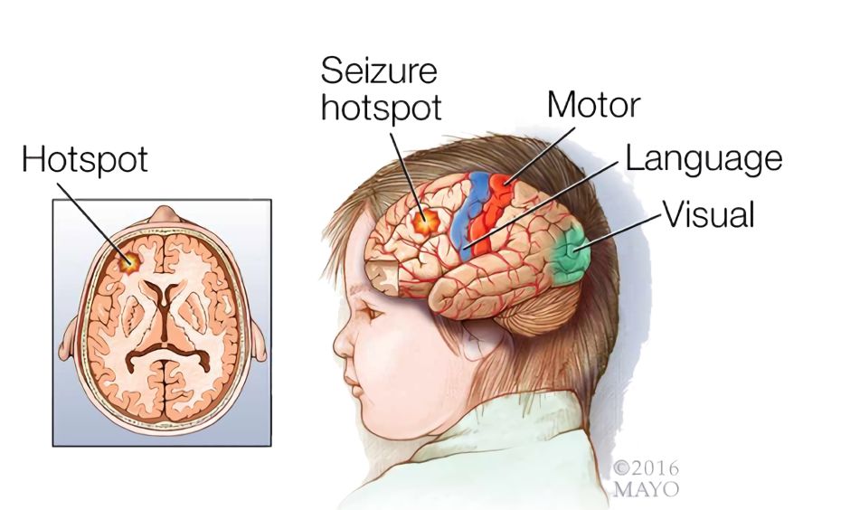
SeizSmart
A mobile application for detecting, tracking, and reporting seizures in real time.
Prototype Demo Presentation
CS 411 Fall 2019
Team Silver
Abel Weldergay, Kevin Sokol
Alpha Din Gabisi, Jeffrey McAteer
Danielle Luckraft, Peter Scheible
Dakotah Atkinson, Jody Hamberry

Slide 2
[Live Demo]

Slide 3
What have we accomplished?
Watch
Notifying emergency contacts directly from the smartwatch
Internal SQLite Database
Perform detection using biometric readings
Phone
Internal SQLite Database
Adding emergency contacts
Stats Visualization
Server
All API Endpoints Functional
NN Training Operational
SMS Gateway Operational
Public Unit Test Reports
Public Javadoc for Core library

Slide 4
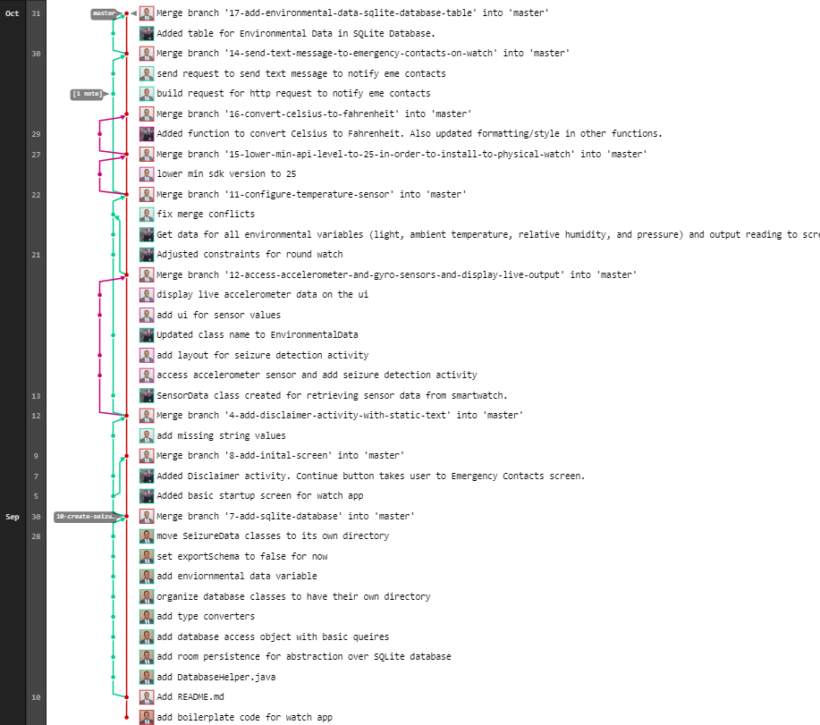
SeizSmart-Watch Git Log

Slide 5
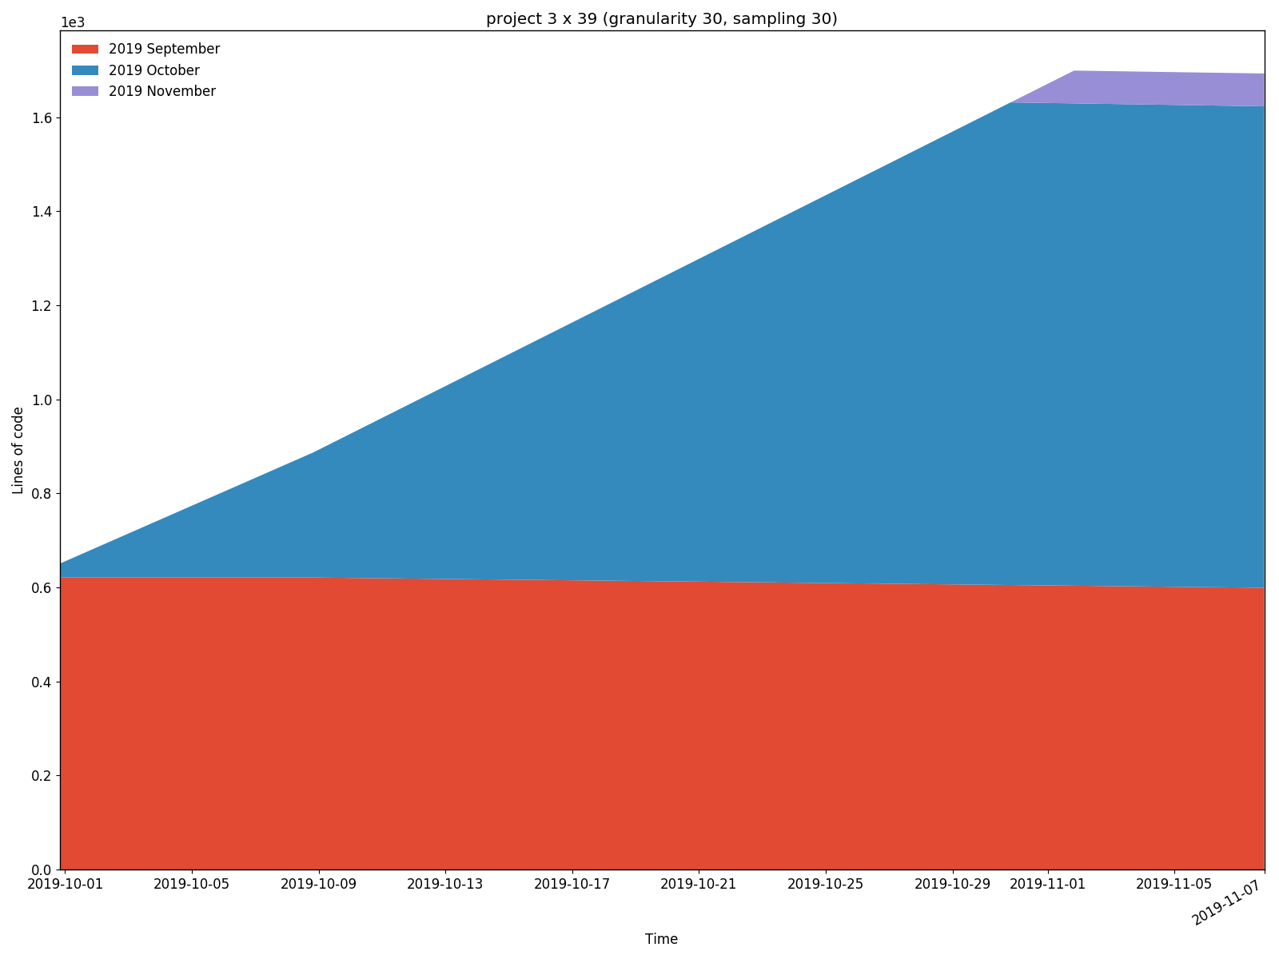
SeizSmart-Watch
Code Burndown

Slide 6
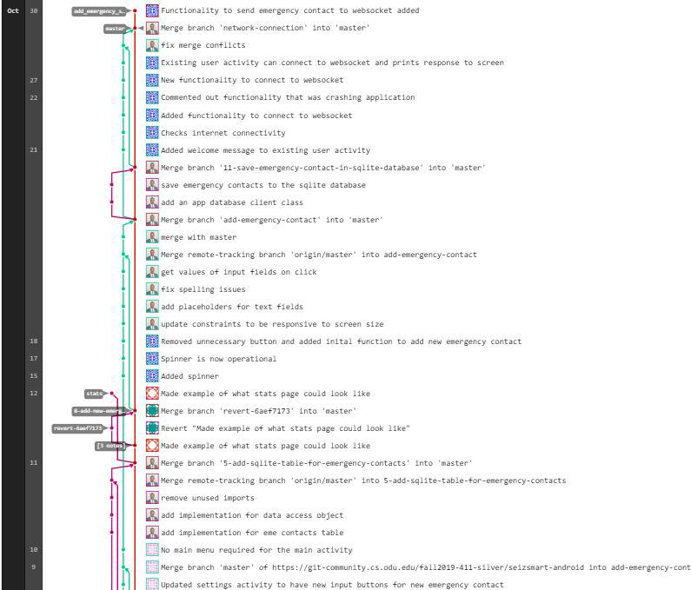
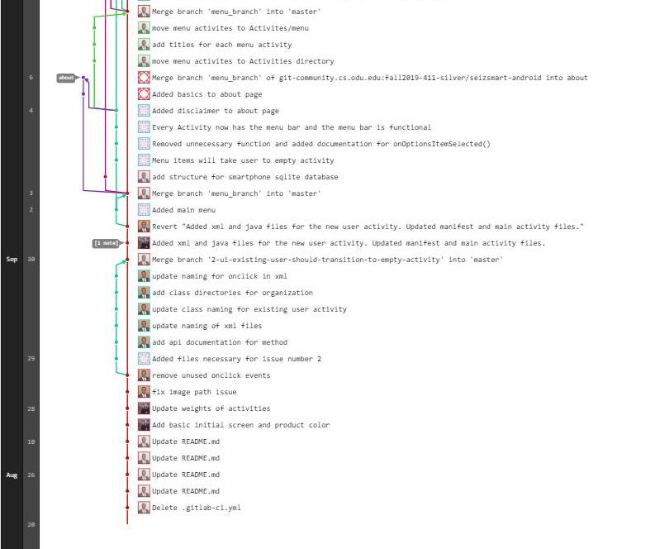
SeizSmart-Phone Git Log

Slide 7
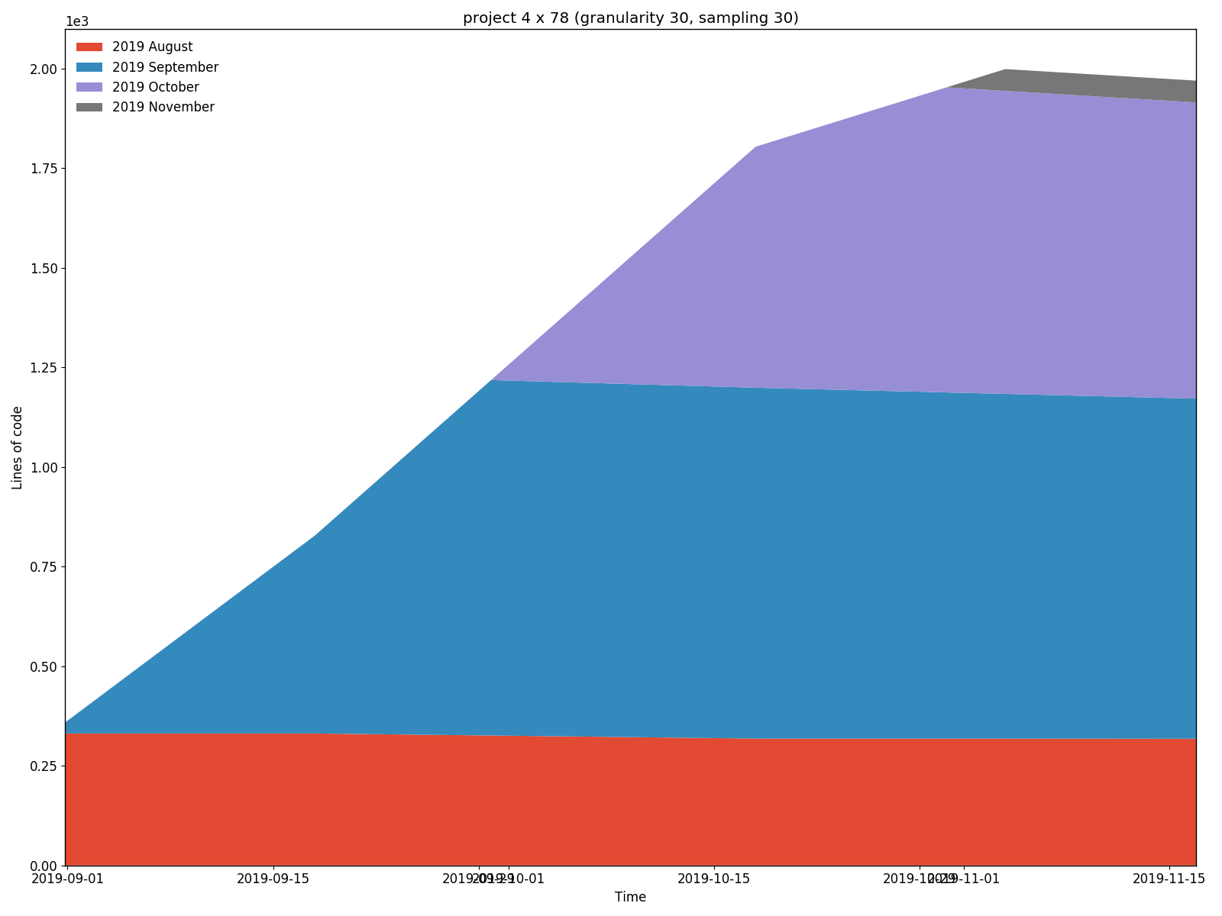
SeizSmart-Phone
Code Burndown

Slide 8
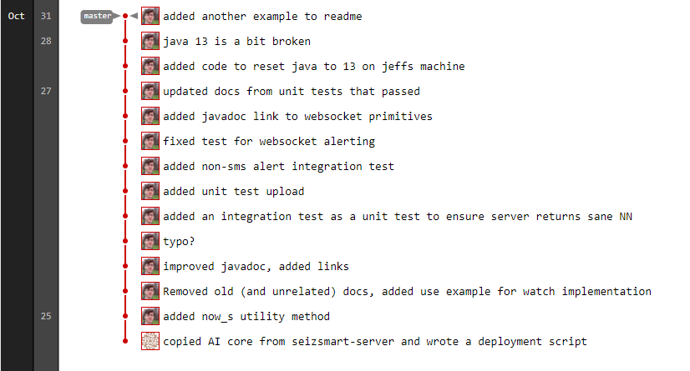
SeizSmart-Core Git Log

Slide 9
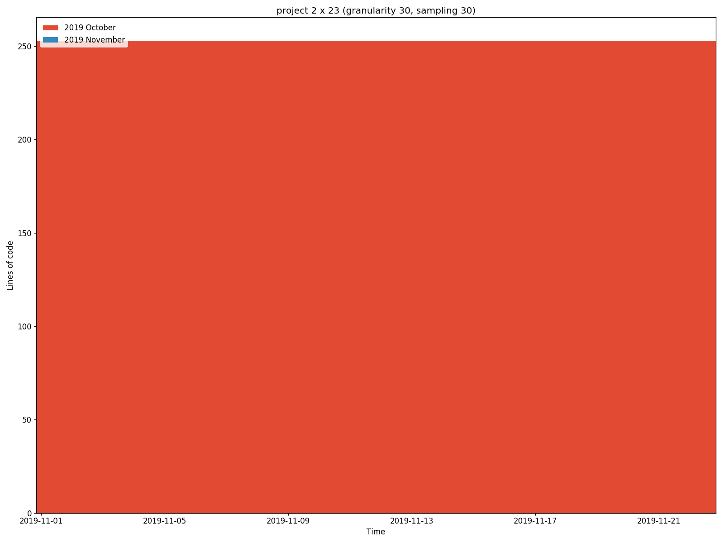
SeizSmart-Core
Code Burndown
Core originated in SeizSmart-Server and does not have much history.
Every abstraction was useful and correct because it was already tested in the server codebase.

Slide 10
SeizSmart-Server Git Log

Slide 11
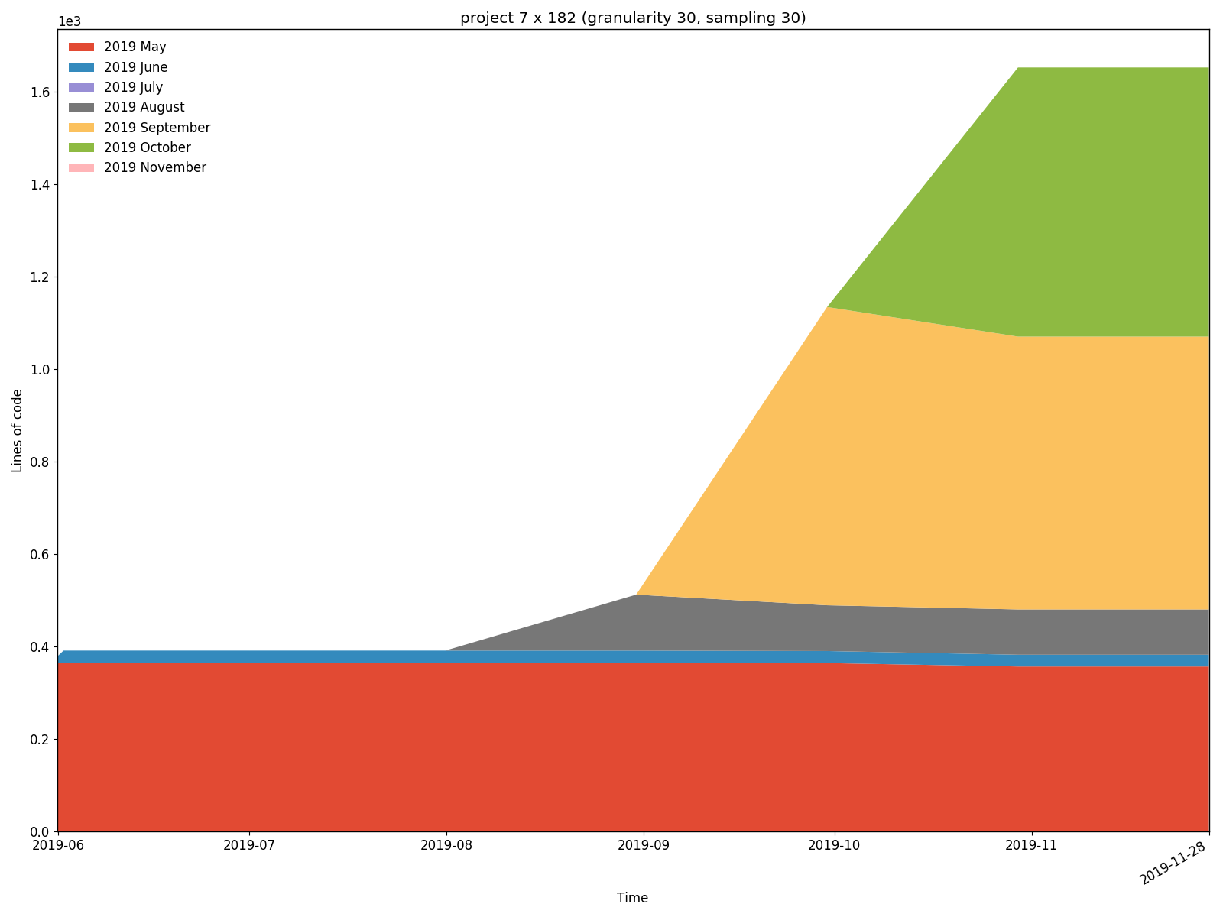
SeizSmart-Server
Code Burndown

Slide 12
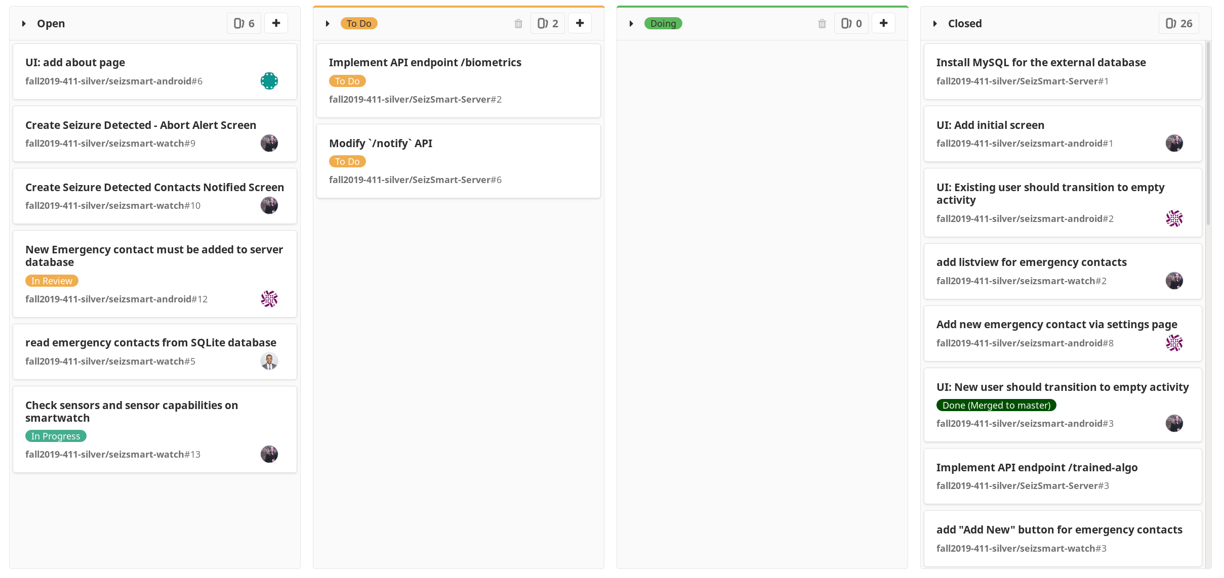
Issue board

Slide 13
Issue Board Summary
Frontend user interface
API additions to make frontend development easier
Combine “In Progress” and “Doing” issue labels

Slide 14
Challenges we’ve been facing
Tensorflow was a poor choice for our problem domain
SMS Gateway security necessitated the creation of a Gmail account
Unclear server API documentation needed more example code
Android Studio fills disks to 100% making development VMs unusable

Slide 15
What’s next?
Watch
Begin collecting heart rate and gyroscope data to determine the onset of a seizure
Phone
Add ability to log seizures from smartphone
Clear seizure alert using smartphone
Server
Persist Biometrics in MySQL
Add heart rate and gyroscope data to biometrics being considered for training
Create API endpoint to add new emergency contact to server from smartphone
Receive new seizure tag from smartphone

Slide 16
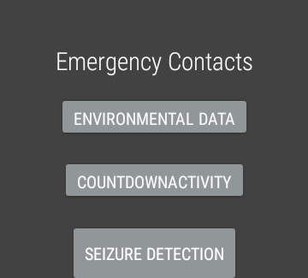
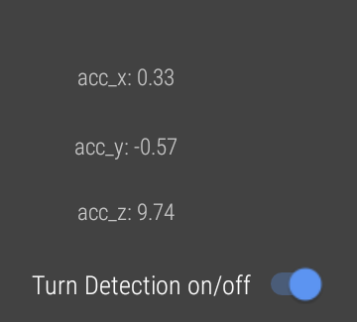
Screenshots: Watch

Slide 17
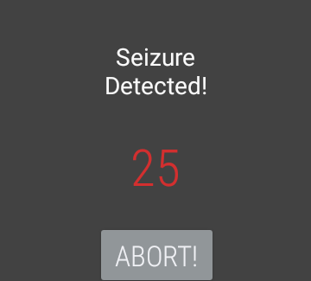
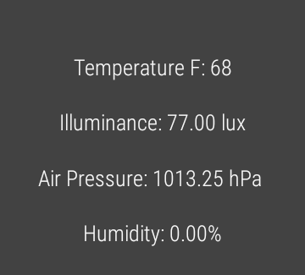
Screenshots: Watch

Slide 18
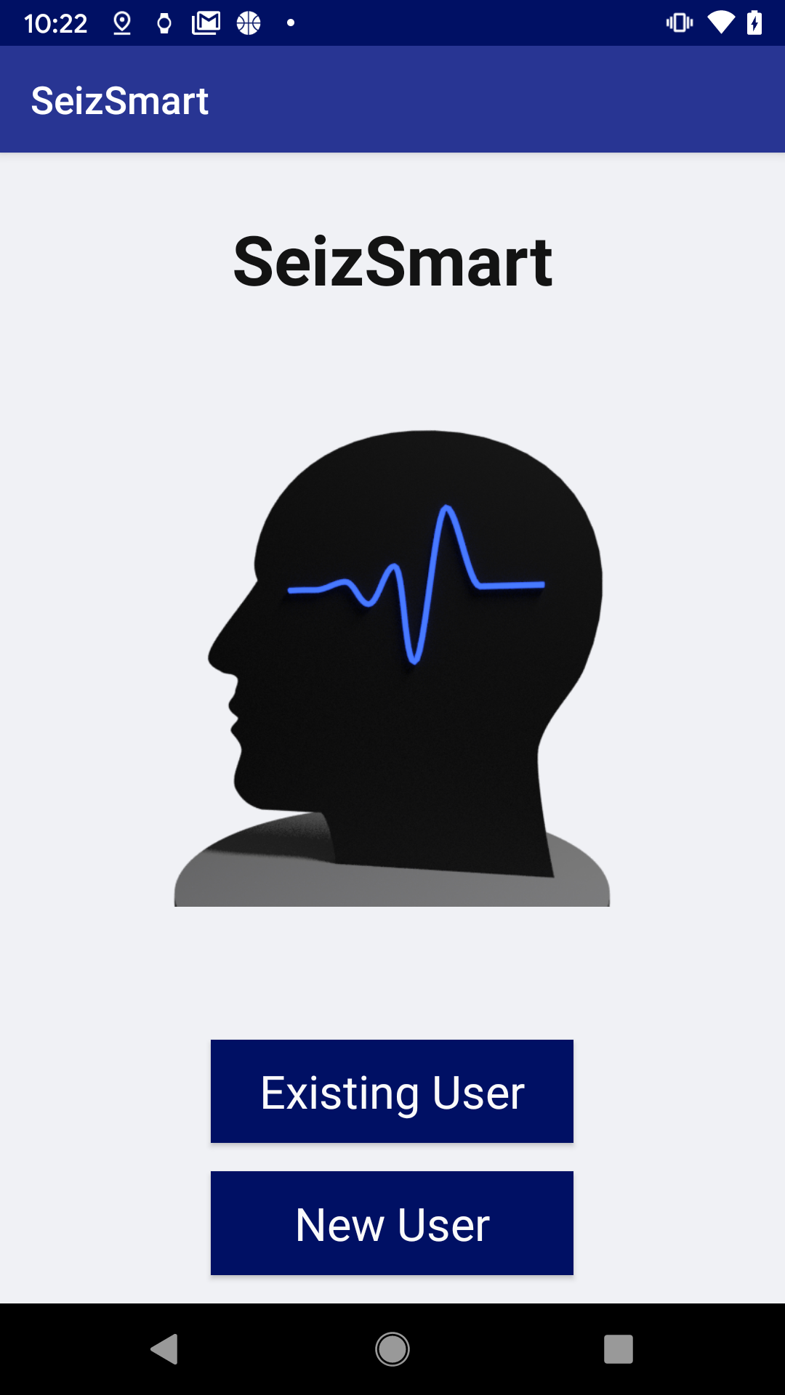
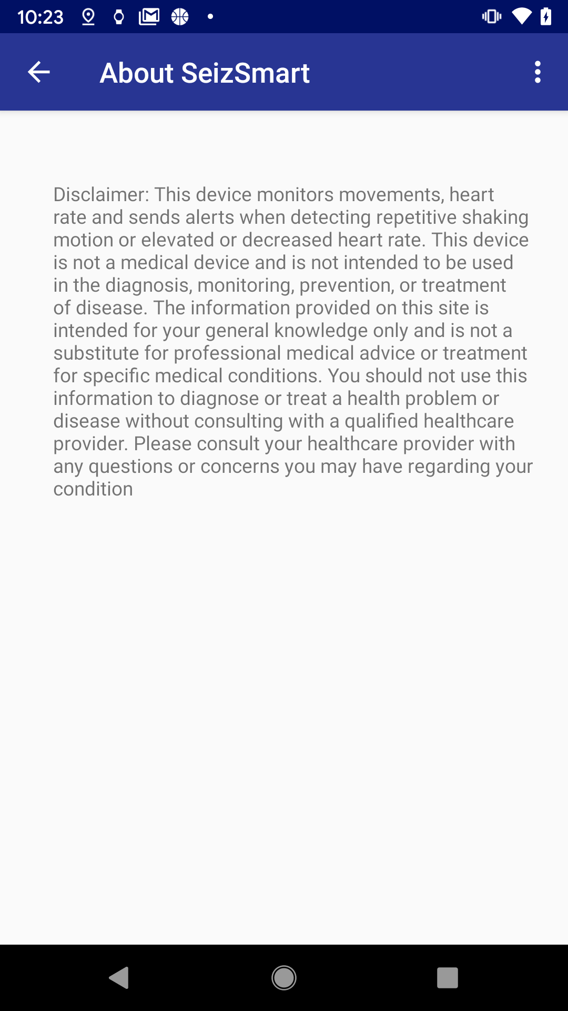
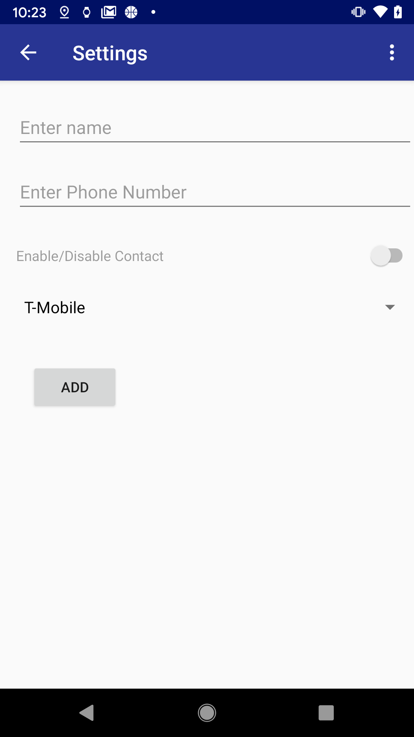
Screenshots: Phone

Slide 19
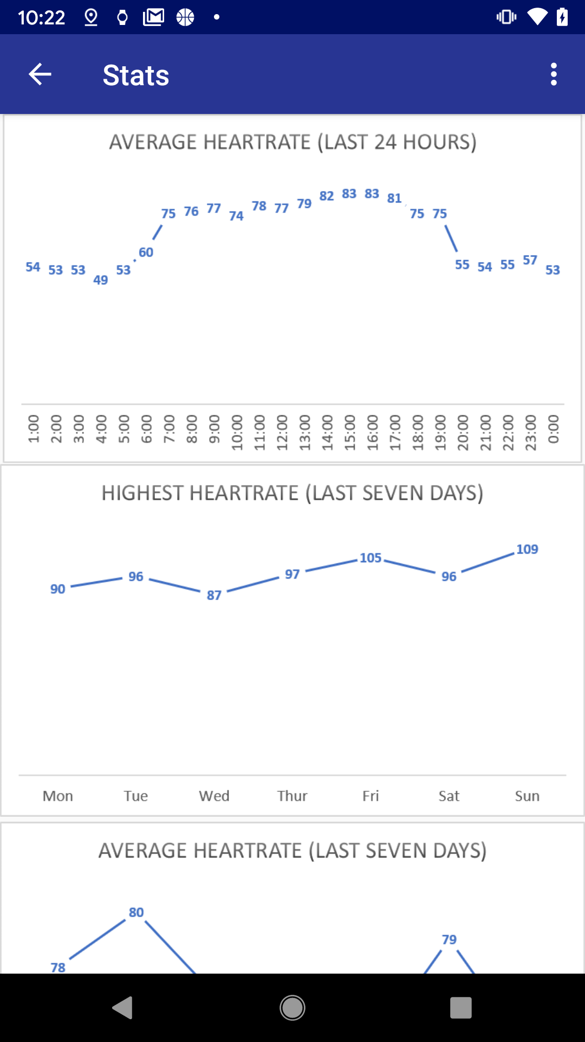
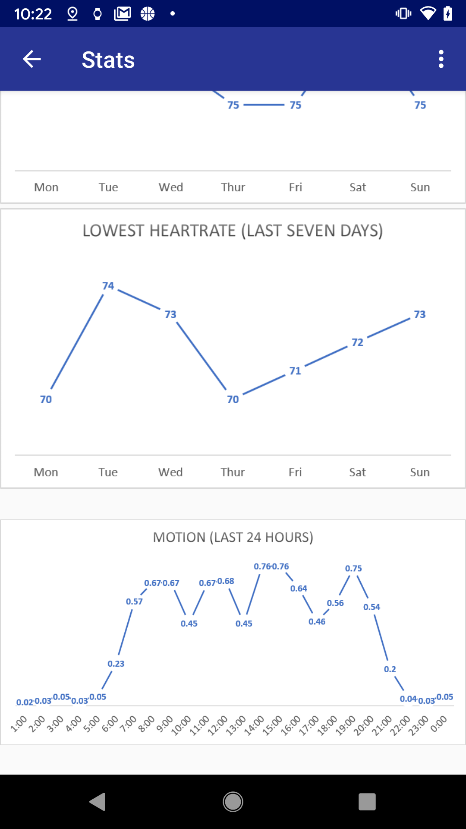
Screenshots: Phone

