Slide 1
Feasibility-
“Programming Game”
CS 410 - Team Silver
Old Dominion University
October 19, 2017

Slide 2
Team Silver Mentor
Professor Thomas Kennedy
Lecturer Professor, Old Dominion University
M.S. in Computer Science, Old Dominion University
Excels at responding promptly to emails, outlining course information, and knowing the most current Computer Science practices

Slide 3
Team Silver
Joel Stokes
Game Development Specialist
Colten Everitt
Website Administrator
Matthew Tuckson
Computer Science Expert
Peter Riley
Cyber Security Specialist
Daniel Dang
Web Development Expert
Casey Batten
Unity Game Expert
Nathaniel DeArce
Artificial Intelligence Agent
Tyler Johnson
Software Engineering Expert
Kevin Santos
Database Manager

Slide 4
Outline
Change Major/Dropout Rate for Computer Science at ODU
Problem Statement
What is Unity?
What is C#?
Unity Ease of Use and Developer Popularity
Unity Development Resources
The Advantages of C# within the Unity SDK
Why a Game?
Concepts of Gameplay and Possible Design Choices
Possible Influences on Using a Game
The Current Process Flow
Plans for Our Solution
Our Customers
Revised Process Flow
Major Components
Competition Matrix
References

Slide 5
Change Major/Dropout Rate for Computer Science at ODU
The Computer Science major at ODU is usually difficult and hard to grasp for most students. Thus, the rate of students either changing their major or dropping out of college altogether has increased in the past few years. (Additional info. . .).
In (year), approximately (# students) students changed their major from Computer Science to something else at ODU. (Cite source).
In (year), approximately (# students) Computer Science students dropped out of ODU altogether. (Cite source).
Notes:
Once added, remember to add supertext number for the reference on this slide & the final references slide!

Slide 6
“Programming Game”
Programming is intimidating for the uninitiated. As a result, first time ODU programming students drop out or switch majors. Existing tools fail to teach Object-Oriented Programming (OOP) concepts and problem solving skills.
Our Problem Statement

Slide 7
What is Unity?
Unity is a cross-platform game engine that is developed by Unity Technologies. It is primarily used for video game development as well as simulations. Unity supports 2D as well as 3D graphics and uses C# as its default scripting language.

Slide 8
What is C#?
C# is a general purpose, object-oriented programming language created by Microsoft. Some of the design goals of the language were that it was supposed to be simple, portable, suitable for applications hosted and/or embedded and had strong support for internalization.

Slide 9
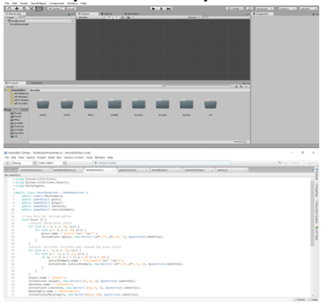
Unity Ease of Use and Developer Popularity
Unity uses an incredibly flexible UI and developer workflow system that allows users to easily begin development on a product
Options exist for both 2D and 3D development, porting to multiple platforms easily, and build settings for specific environments
Unity has tools available for both game development and generalized software development, including the excellent MonoDevelop IDE

Slide 10
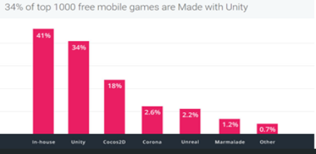
Unity Ease of Use and Developer Popularity, (Cont.)
Unity is extremely popular among both small independent developers and large corporations due to it’s flexibility and breadth of functionality
Though hard numbers have yet to be recorded, according to Unity Technologies there were over 5 billion downloads of products made with Unity in quarter one of 2016, with an extra 2.4 billion in mobile product downloads

Slide 11
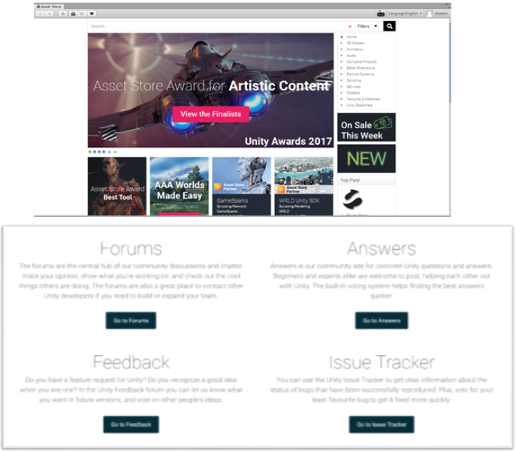
Unity Development Resources
One of the biggest advantages to the Unity SDK is it’s development resources
Included with the Engine is access to the Asset Store, which hosts a catalog of free and paid services, such as 3D models, music, graphics packs, UI elements, sub-engine features such as specialized physics, and tutorial packs
Also, there is the excellent Developer Support Community, which has various tutorial resources, live support, and a highly active developer forum where developers interact and offer advice and support to help ease the Unity development process

Slide 12
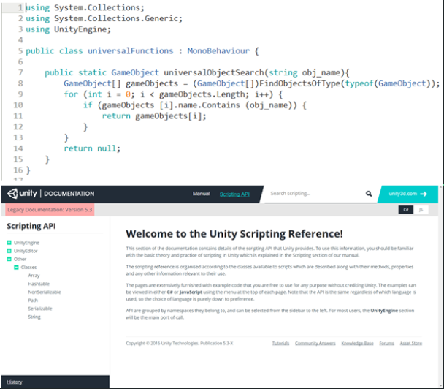
The Advantages of C# within the Unity SDK
Out of the box, the Unity SDK supports C#, JavaScript, and Boo
C# is by far the most flexible and powerful of these three, hosting both a large suite of built in functions/methods and having a series of Unity-specific tools available when used alongside the Engine
Also, there is excellent developer support available through Unity’s Scripting API website, which hosts code examples and complex breakdowns of Unity-specific functionality within C#

Slide 13
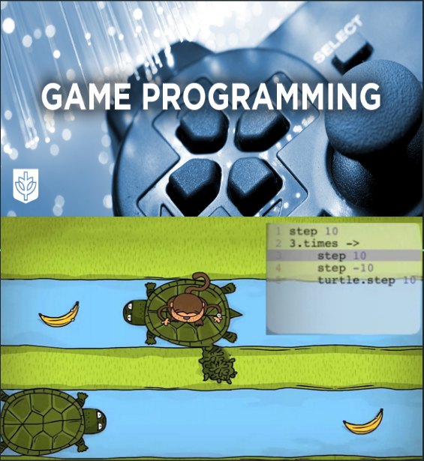
Why a Game?
There are several reasons:
Games can enhance interest among new learners
New learners are typically teenagers in middle and high school
A programming game can change the learning style from traditional to more dynamic
Programming games do not require an instructor present at all times
Concepts like Object-Oriented Programming and problem solving can possibly be better explained while playing a game
Notes:
Image 1 source: http://www.cdm.depaul.edu/academics/Pages/BS-in-Game-Programming.aspx
Image 2 source:Peter Riley’s presentation

Slide 14
Concepts of Gameplay and Possible Design Choices
A realistic approach: using relatable and applicable examples
Improvement on teaching: more complex Object-Oriented Programming concepts can be easily explained
Using a management simulator
Move away from main-character oriented games that do not contribute to how programming is taught
Notes:
Image source 1: https://medium.com/@techloop.io/funniest-programming-memes-1da50c5229d

Slide 15
Possible Influences on Using a Game
According to computerscienceonline.com, it is a pragmatic effort to teach youngsters to program before going to college
Teaching youngsters programming while they are still in elementary school can embolden their coding interest early
Notes:
Image source 1: https://elearningindustry.com/4-benefits-learning-programming-at-a-young-age-2

Slide 16
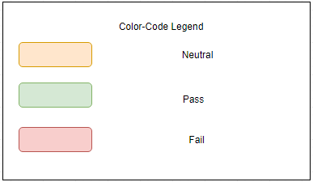
Current Process Flow (Flawed)

Slide 17
“Programming Game”
"Programming Game" will address Object-Oriented Programming (OOP) concepts and problem solving through the use of a management simulator and a Tangible User Interface (TUI).
Our Solution Statement

Slide 18
Plans for Our Solution
Our solution will be a web-based game application which allows a user to become familiar with understanding the main core of computer programming, as well as understanding how beginner software is constructed.
This application will teach Object-Oriented Programming (OOP) concepts
This application will teach problem solving skills essential to understanding the foundation of computer programming
This application will be able to teach multiple languages and be played on multiple platforms in later releases
This application will allow users to interact with each other in a multiplayer setting in order to gain real-world collaborative skills

Slide 19
Target Customers
Our initial focus will be Old Dominion University, Universities, Colleges, and other Educational Institutes that currently have a Computer Science Degree Program. However, everyone could use this product in order to gain more knowledge on computer programming, especially to gain a good foundation in Object-Oriented Programming concepts and problem solving skills

Slide 20
End Users
Students that are currently enrolled in a Computer Science Degree Program at Old Dominion University, Universities, Colleges, or other Educational Institutes

Slide 21
Current Process Flow (Revised)

Slide 22
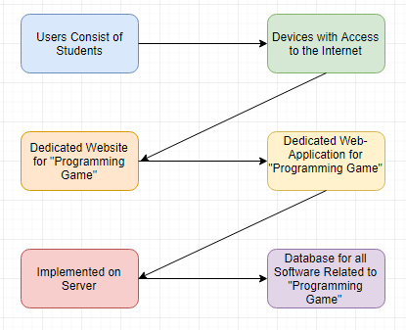
Major Functional Components
Users connect to the Internet using their prefered device
Our dedicated web-application on our dedicated website will provide gameplay for users to learn Object-Oriented Programming concepts as well as problem solving skills

Slide 23
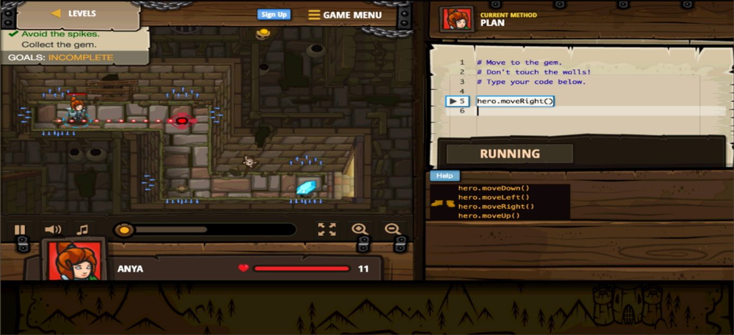
Structure of “Programming Game”

Slide 24
Competition Matrix
Game | Experience | Uses OOP | Teaches OOP | # Languages | Multiplayer
Codingame | Low-High | Yes | No | 25+ | Yes
Code Combat | Low | Yes | No | 5 | No
Screeps | Mid-High | Yes | No | 1 | Yes
CheckIO | Low-High | Yes | No | 1 | Yes
Code Monkey | Low | No | No | 1 | No
Elevator Saga | Mid-High | Yes | No | 1 | No
Codewars | Mid-High | Yes | Yes | 6 | Yes
Ruby Quiz | Mid-High | Yes | No | 1 | No

Slide 25
Competition Matrix, (Cont.)
Game | Experience | Uses OOP | Teaches OOP | # Languages | Multiplayer
Git Games | Low | No | No | 1 | No
CSS Diner | Low | No | No | 1 | No
Flexbox Defense | Low-Mid | No | No | 1 | No
Ruby Warrior | Low | No | No | 1 | No
Untrusted | Mid-High | No | No | 1 | No
Empire of Code | Low-Mid | Yes | No | 2 | Yes
Our Game | Low-Mid | Yes | Yes | 1 or 2 | Maybe

Slide 26
Conclusion
Web-application game using the Unity SDK with C# and JavaScript to create
User will learn Object-Oriented Programming (OOP) concepts and problem solving skills in depth
These skills are essential to build a solid foundation for understanding Computer Science as well as computer programming
These skills will allow students to pass introductory Computer Science classes, thus lowering the switching major/drop out rate for universities
The current process that Computer Science students go through is flawed by not teaching these fundamental skills early on in the curriculum
Our solution makes the process painless and fun

Slide 27
Questions?

Slide 28
References
“Fast Facts.” Unity, Unity Technologies, unity3d.com/public-relations.
Asset Store, Unity Technologies, www.assetstore.unity3d.com/en/.
Technologies, Unity. “Welcome to the Unity Scripting Reference!” Unity - Scripting API: Unity Technologies, docs.unity3d.com/530/Documentation/ScriptReference/index.html.
O'Neill, M. (n.d.). Computer Science Before College. Retrieved October 05, 2017, from https://www.computerscienceonline.org/cs-programs-before-college/
Porter, J. (2017, August 03). 4 Benefits Of Learning Programming At A Young Age. Retrieved October 05, 2017, from https://elearningindustry.com/4-benefits-learning-programming-at-a-young-age-2
Peter Riley’s presentation. It will be one of the main source of references for our project.

