Slide 1
Feasibility-
“Programming Game”
CS 410 - Team Silver
Old Dominion University
November 2, 2017

Slide 2
Team Silver Mentor
Professor Thomas Kennedy
Lecturer Professor, Old Dominion University
M.S. in Computer Science, Old Dominion University
Excels at:
Working directly with students
Outlining course information
Conveying an exceptional level of proficiency in the most current Computer Science practices

Slide 3
Team Silver
Joel Stokes
Game Development Specialist
Colten Everitt
Website Administrator
Matthew Tuckson
Program/Project Manager
Peter Riley
Software Engineering Expert
Daniel Dang
Web Development Expert
Casey Batten
Unity SDK Specialist
Nathaniel DeArce
Artificial Intelligence Agent
Tyler Johnson
Software Engineering Expert
Kevin Santos
Database Manager

Slide 4
Table of Contents
Problem Statement
Student Progression Dilemma in Computer Science at ODU
Computer Science Courses as Requirements
Statistics to Support the Student Progression Dilemma
Student Progression Dilemma - Table & Graph
Current Process Flow
Solution Statement
Target Customers
End Users
Why a Game?
Influences of Games on Learning
Solution Process Flow
Plans for our Solution
Potential Game Design Concepts / Rapid Prototype GUI Samples
Concepts of Gameplay and Possible Design Choices
What is Unity?
What is C#?
Unity Ease of Use and Developer Popularity
The Advantages of C# within the Unity SDK
Major Functional Components
Competition Matrix
Competition vs. our Solution
Conclusion
References

Slide 5
“Programming Game”
Programming is intimidating for the uninitiated. As a result, first time ODU programming students drop out or switch majors. Existing tools fail to teach Object-Oriented Programming (OOP) concepts and problem solving skills.
Our Problem Statement

Slide 6
Student Progression Dilemma in Computer Science at ODU
Students are not following the course series in the expected order
This data provides purpose behind the need to reassess methods of assisting students’ progress in how they learn the topics at hand
When during the learning process this assistance would be most effective
Changes in class volume, which could indicate that students are leaving the major for less intense fields
Drop-off in student numbers from CS150 to CS250
Related to differing major requirements and course overlap, but the decrease in student body is significant enough to warrant a deeper look into later classes in the major path
Decreasing class sizes show a steady decline in CS course enrollments as course level difficulty advances
Decreases may be indicative of students dropping out of the CS program or changing majors
Notes:
Data trends of students not following a course series in the expected order and changes in class volume exist, which could indicate that students are leaving the major for less intense fields.
The dropoff in student numbers from CS150 to CS250 is related to differing major requirements and course overlap, but the decrease in student body is significant enough to warrant a deeper look into later classes in the major path.

Slide 7
Statistics to Support the Student Progression Dilemma
According to the ODU Factbook:
2012 - 2016:
Number of undergraduate CS majors increased from 284 to 429
Showing the high demand in the degree path
2014 - 2015:
Roughly 672 students enrolled in CS150
2015 - 2016:
Roughly 327 students enrolled in CS250
2016 - 2017:
Roughly 199 students enrolled in CS361
Roughly 180 students enrolled in CS330
Roughly 182 students enrolled in CS350

Slide 8
Computer Science Courses as Requirements
CS150:
“Service Course”
Required to be taken by CS, Physics, Math, Engineering, & Mod-Simulation majors
CS250:
Required to be taken by CS, Mod-Simulation, & Computer and Electrical Engineering majors
CS330:
Required to be taken by CS & Mod-Simulation majors
CS361:
Required to be taken by CS & Computer and Electrical Engineering majors
CS350:
Required to be taken by CS & Computer Engineering majors

Slide 9
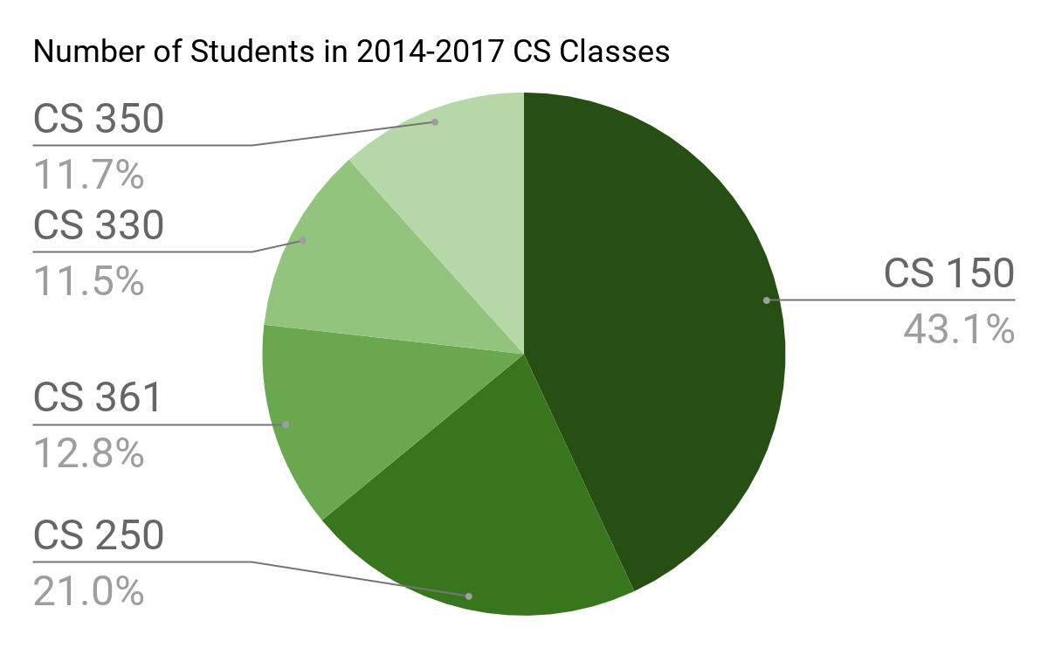
Student Progression Dilemma - Table & Graph
 | CS 150 | CS 250 | CS 361 | CS 330 | CS 350
2013-2014 | 804 | 327 | 161 | 111 | 93
2014-2015 | 672 | 367 | 208 | 203 | 148
2015-2016 | 937 | 327 | 217 | 195 | 183
2016-2017 | 920 | 337 | 199 | 180 | 182

Slide 10
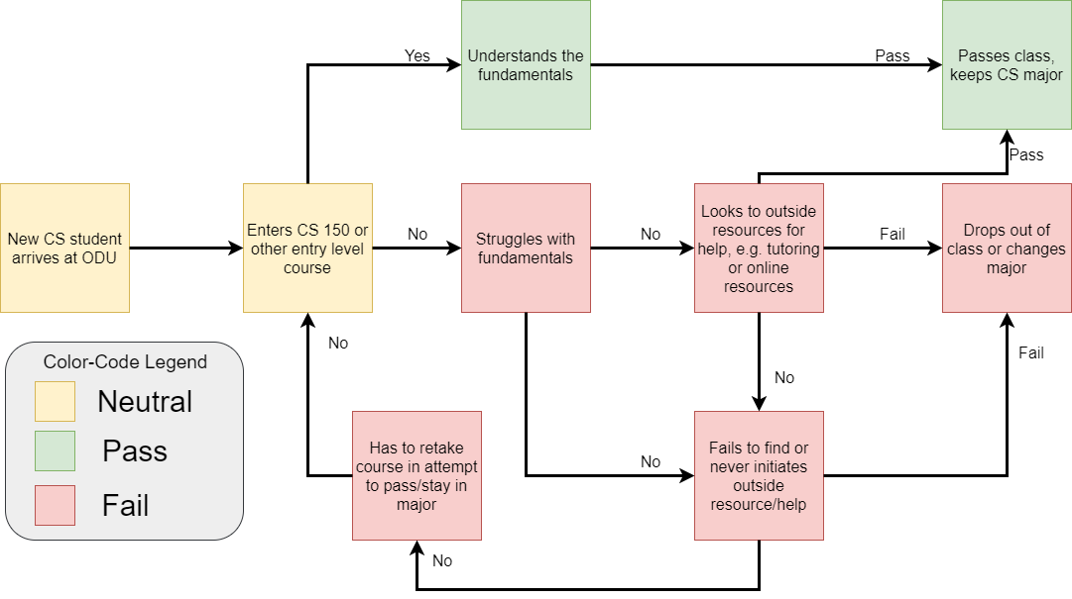
Current Process Flow

Slide 11
“Programming Game”
"Programming Game" will address Object-Oriented Programming (OOP) concepts and problem solving through the use of a management simulator and a Tangible User Interface (TUI).
Our Solution Statement

Slide 12
Target Customers
Initial focus will be Old Dominion University, as well as other universities, colleges, and educational institutions that currently offer a Computer Science degree program
Anyone could use this product in order to gain more knowledge in computer programming, Object-Oriented Programming concepts, and problem solving skills
Image Source : http://odu.edu/compsci

Slide 13
End Users
Students who are currently enrolled in a Computer Science degree program at Old Dominion University, or at other universities, colleges, or educational institutions
Left image source: https://online.odu.edu/programs/computer-science-ms
Middle image source: https://online.odu.edu/programs/computer-science
Right image: https://online.odu.edu/programs/computer-science-minor
Notes:
Image Source:
Left image https://online.odu.edu/programs/computer-science-ms
Middle image: https://online.odu.edu/programs/computer-science
Right image: Pending

Slide 14
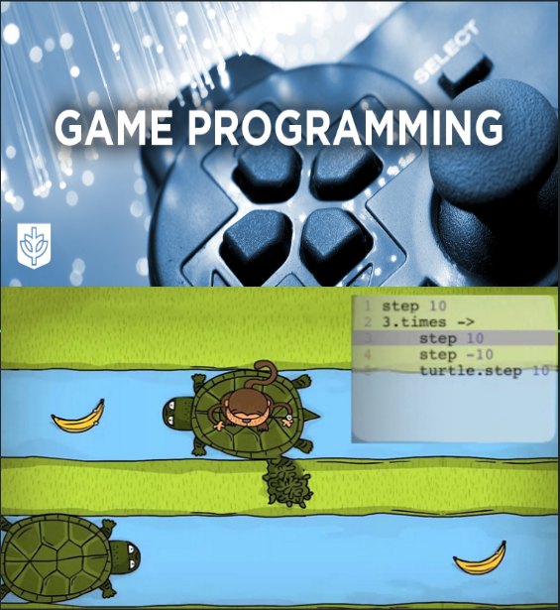
Why a Game?
Enhance interest among new learners
Nature of interaction inherently gives players a more natural way to learn content
Change the learning style from traditional to more dynamic
Do not require an instructor present at all times
Object-Oriented Programming and problem solving can potentially be better grasped and understood
Image 1 source : http://www.cdm.depaul.edu/academics/Pages/BS-in-Game-Programming.asx
Image 2 source: Peter Riley’s presentation
Notes:
Image 1source:http://www.cdm.depaul.edu/academics/Pages/BS-in-Game-Programming.asx
Image 2 source:Peter Riley’s presentation
The purpose of this slide is to illustrate our proposal as to why a game is the most solid approach to the previously mentioned societal problem. The five bulleten points describe the following:
•It is generally inferred that games in particular enhance interest in people. Thus, a game that is designed to teach a particular subject can be highly assumed that it gain the learner’s interest.
•In addition, interaction in general allows one to cope with the learning content aspect in natural way that engages interest.
•The traditional learning style has become increasingly primitive with the emerge of new technologies. Thus, a learning game can provide a more dynamic and interactive way of learning and in order to ignore the more traditional way.
•On aspect that makes a game a more asynchronous way of learning is that an instructor is not required to present for the learner to learn. This is one extremely positive aspect in the sense that such game will provide all the learning material available to the user..
•As previously mentioned with regards to the stats on the CS student dilemma progression, it is noted that students struggle with the programming aspect of object oriented and problem solving. Therefore, it is highly and potentially inferred that a game ideally allow the user to grasp, retain, and regurgitate such aspects.

Slide 15
Influences of Games on Learning
Poor academics and knowledge decrement lead to the stigma of video games being detrimental to the learning process. However, research evidence has shown that traditional learning through textbooks contributes to low engagement when compared to interactive media.
According to the Office of Naval Research (ONR) & WebMD:
Video games have positive aspects that help people become more engaged in the learning process
On average, 56 - 95% of people who play a particular game to learn a particular subject through tests, demonstrated a better understanding of such subject
Educational games with a solid foundation and interactive components keep the players engaged and promote enhanced concept learning
Stats Source:
The Benefits of Video Games. (2011, December 26). Retrieved October 19, 2017, from http://abcnews.go.com/blogs/technology/2011/12/the-benefits-of-video-games/
Notes:
ONR: Office of Naval Research.
WebMD: Medical Organizational website that conducts research on various
Stats Source:
The Benefits of Video Games. (2011, December 26). Retrieved October 19, 2017, from http://abcnews.go.com/blogs/technology/2011/12/the-benefits-of-video-games/
The purpose of this slide is to inform on the information gathered regarding some research statistics by various organizations on the postive aspects of using games as a learning tool.
•The first bulletin briefly explains that the mentioned three organizations investigated and determine that video games provided various positive aspects that help individuals become more engaged in the learning process.
•The second bullet points points out specific numeric statistics on the average percent of individual that played games showed an improvement on the understanding on the particular material the game was teaching.
•The third bulletin concludes that the investigation conducted by this study supports the idea that games can be versatile in the aspect of getting users engaged in the learning process.

Slide 16
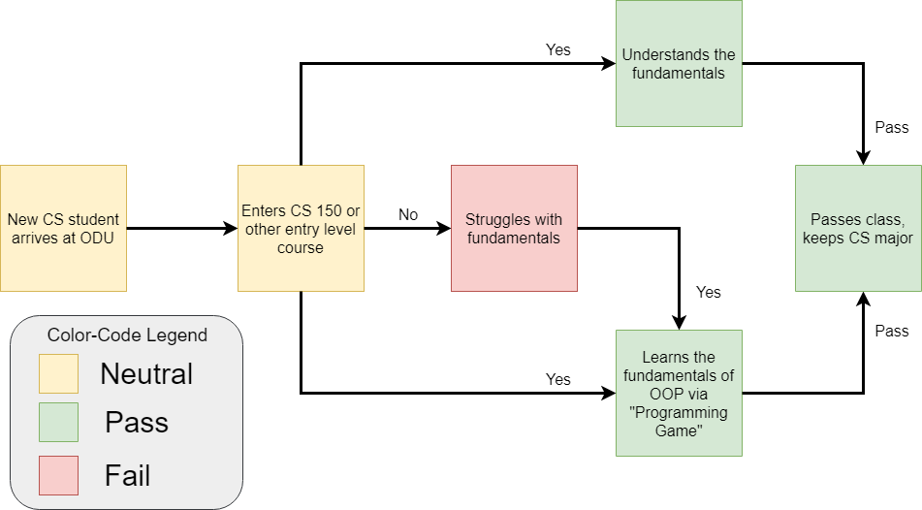
Solution Process Flow

Slide 17
Plans for our Solution
Solution: Game application that teaches users the fundamentals of computer programming and software development
This application will:
Teach Object-Oriented Programming (OOP) concepts
Teach problem solving skills
Strive to teach multiple languages
Be developed for multiple platforms
Potentially have multiplayer gameplay to connect players

Slide 18
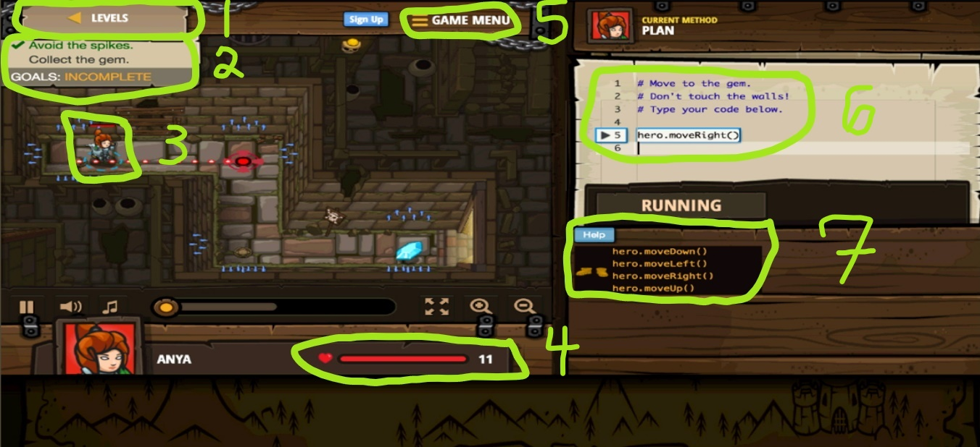
Structure of “Programming Game”
Image source: https://medium.mybridge.co/12-free-resources-learn-to-code-while-playing-games-f7333043de11

Slide 19
Rapid Prototype GUI Sample - Joel Stokes

Slide 20
Rapid Prototype GUI Sample - Casey Batten

Slide 21
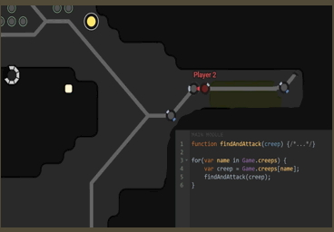
Concepts of Gameplay and Possible Design Choices
Realistic Approach:
Using relatable and applicable examples
Improvement on Teaching:
More complex Object-Oriented Programming concepts that can be easily explained
Balance Gameplay and Programming:
Implementation of the gameplay will not sacrifice the player's experience
Image source 1: https://medium.com/@techloop.io/funniest-programming-memes-1da50c5229d
Notes:
Image source 1: https://medium.com/@techloop.io/funniest-programming-memes-1da50c5229d
This slide illustrated the possible potential design choices of the game designed to teach users how to program.
•First bulletin explains that the game will enhance a relatable and applicable design to provide a more realistic approach.
•The second bulletin explains and contents that a realistic approach promotes a learning improvement mainly on teaching OOP concepts.
•Third bulletin contents that a balance of gameplay and programming at the same time will engage the player more pragmatically rather than sacrifice their experience.

Slide 22
What is Unity?
Image source: https://commons.wikimedia.org/wiki/File:Unity_Technologies_logo.svg
Cross-platform game engine developed by Unity Technologies
Primarily used for video game development as well as simulations
Supports 2D, as well as 3D, graphics and uses C# as its default scripting language
Creates games by manipulating game objects in 3D, and by attaching varying components to those objects
Game engine is truly cross-platform:
Games can be exported to several different platforms:
Desktop, mobile, web, and even game consoles such as Xbox One, PS4

Slide 23
What is C#?
General purpose, object-oriented programming language created by Microsoft in 2000
Language design goals:
Simple, portable, and suitable for applications hosted and/or embedded, with strong support for internalization
Enterprise language much like Java
Programming language for Microsoft’s web application framework ASP.NET
Used to create command-line applications and desktop GUI based applications

Slide 24
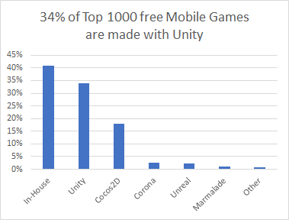
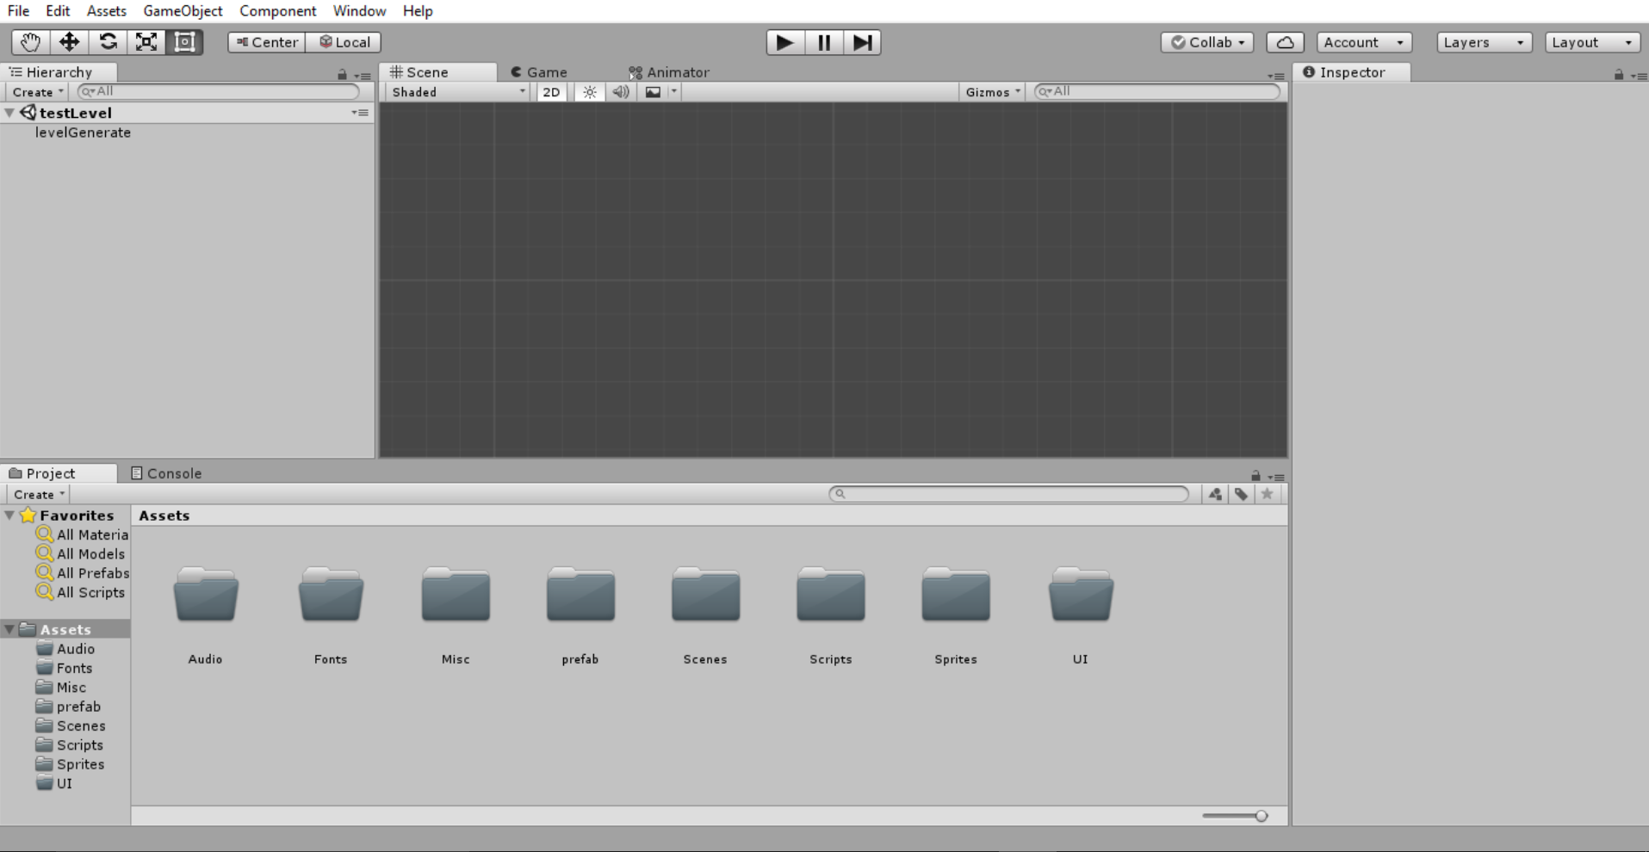
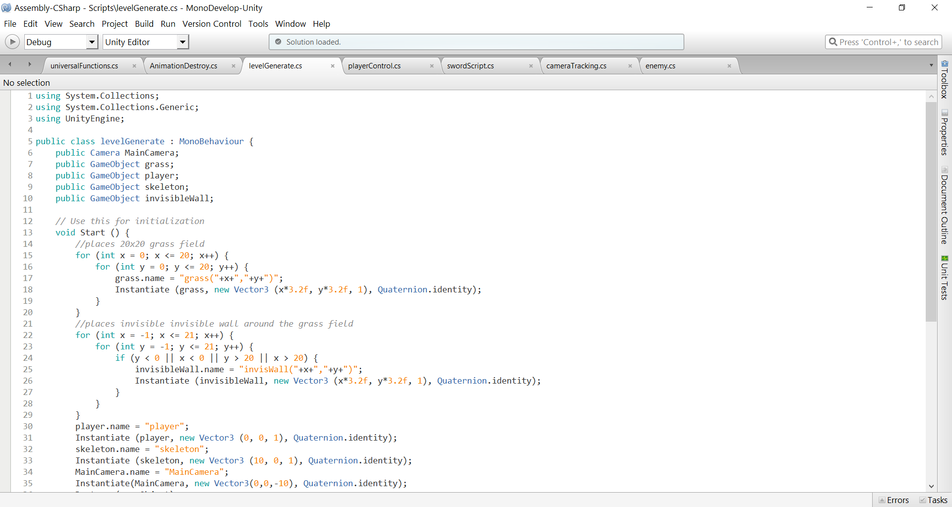
Unity Ease of Use and Developer Popularity
Flexible UI and developer workflow system
Allows users to develop a product efficiently
Tools for software development:
MonoDevelop IDE and support for multiple platforms and build environments
According to Unity Technologies, there were over 5 billion downloads of products made with Unity in quarter one of 2016, with an extra 2.4 billion in mobile product downloads
Image Source: https://unity3d.com/

Slide 25
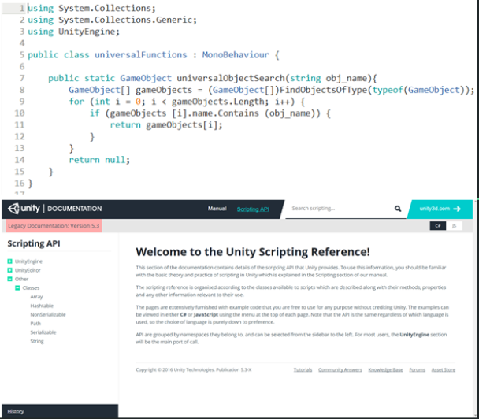
The Advantages of C# within the Unity SDK
Most flexible and powerful of the Out-of-the-Box programming languages Unity Supports
Large suite of built in functions/methods
Unity-specific tools available when used alongside the Engine
Developer support available through Unity’s Scripting API website
Code examples
Complex breakdowns of Unity-specific functionality within C#
Image source: https://docs.unity3d.com/Manual/index.html?_ga=2.37814243.1199564661.1509584726-986472080.1506709735

Slide 26
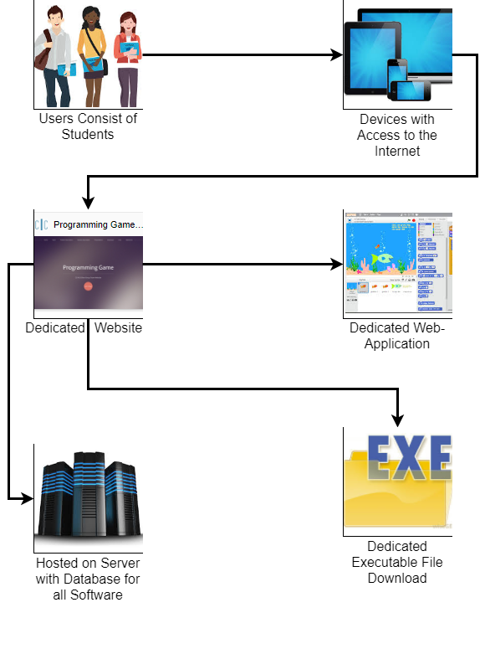
Major Functional Components
Users connect to the Internet using their preferred device
Our game will teach users Object-Oriented Programming concepts as well as problem solving skills

Slide 27
Competition Matrix Part 1
Game | Experience | Uses OOP | Teaches OOP | # Languages | Multiplayer
Our Game | Low-Mid | Yes | Yes | 1 or 2 | Maybe
Code Combat | Low | Yes | No | 5 | No
Screeps | Mid-High | Yes | No | 1 | Yes
CheckIO | Low-High | Yes | No | 1 | Yes
Code Monkey | Low | No | No | 1 | No
Elevator Saga | Mid-High | Yes | No | 1 | No
Codewars | Mid-High | Yes | Yes | 6 | Yes
Codingame | Low-High | Yes | No | 25+ | Yes

Slide 28
Competition Matrix Part 2
Game | Experience | Uses OOP | Teaches OOP | # Languages | Multiplayer
Our Game | Low-Mid | Yes | Yes | 1 or 2 | Maybe
Git Games | Low | No | No | 1 | No
CSS Diner | Low | No | No | 1 | No
Flexbox Defense | Low-Mid | No | No | 1 | No
Ruby Warrior | Low | No | No | 1 | No
Untrusted | Mid-High | No | No | 1 | No
Empire of Code | Low-Mid | Yes | No | 2 | Yes
Ruby Quiz | Mid-High | Yes | No | 1 | No

Slide 29
Competition vs. Our Solution
Competition Trends:
Low programming experience
Focus on one or two languages
Mainly teaches syntax, rather than OOP
Some include multiplayer
Our Solution:
Low programming experience
Start with one or two languages, but allow for teaching more in the future
Focus on OOP concepts, with syntax being a secondary objective
Multiplayer will depend on what gameplay features are implemented

Slide 30
Conclusion
CS students not introduced to OOP or problem solving skills early on
Skills are essential to build a solid foundation for understanding CS, including programming
Web-application or executable downloadable game using the Unity SDK with C# and JavaScript
User learns Object-Oriented Programming (OOP) concepts and problem solving skills in depth
Skills allow end user to become more proficient in Computer Science, as well as Object Oriented Design

Slide 31
Our Solution Makes the Process Painless & Fun

Slide 32
References
“Fast Facts.” Unity, Unity Technologies, unity3d.com/public-relations.
Asset Store, Unity Technologies, www.assetstore.unity3d.com/en/.
Technologies, Unity. “Welcome to the Unity Scripting Reference!” Unity - Scripting API: Unity Technologies, docs.unity3d.com/530/Documentation/ScriptReference/index.html.
O'Neill, M. (n.d.). Computer Science Before College. Retrieved October 05, 2017, from https://www.computerscienceonline.org/cs-programs-before-college/
Peter Riley’s presentation. It will be one of the main source of references for our project.
“kennedyData.” Thomas Kennedy, https://drive.google.com/drive/u/1/folders/0B_xCQd8Vk2BnSU1hNnJwSXB1NEE
“The Benefits of Video Games.” abcnews (2011, December 26). Retrieved October 19, 2017, from http://abcnews.go.com/blogs/technology/2011/12/the-benefits-of-video-games/ Good Morning America
CS410 Programming Game Pitch, By: Joel Stokes - https://youtu.be/QBvgzFgZaOQ
CS410 Project Dungeon Demo, By: Casey Batten - https://www.youtube.com/watch?v=ynhdd1IKgps
CS410 Dungeon Escape Demo (Short Ver.), By: Casey Batten - https://www.youtube.com/watch?v=VnHRaWl8Y8w

