Slide 1
Using Games to Introduce Programming to Students
Peter Riley
September 14, 2017

Slide 2
What’s the Problem?
Programming seems intimidating and confusing to new students, especially non-STEM students
Many games have already been made to introduce programming to students

Slide 3
Who’s the Customer?
Mainly aimed at middle and high school teachers and students as an introduction to programming concepts
It will also be available to beginning programmers outside of a school environment

Slide 4
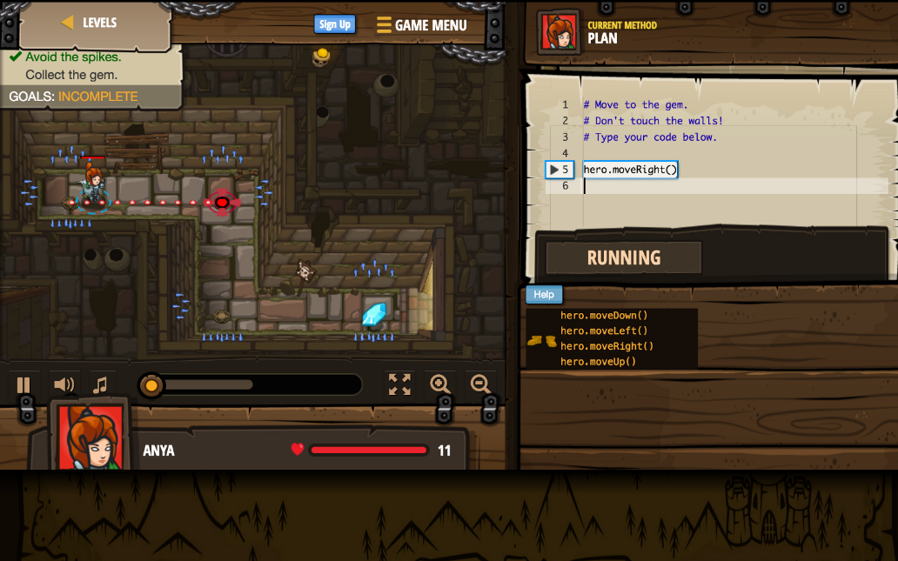
What’s the Solution?
What is already out there?
Codingame
Code Combat
Screeps
CheckIO
Vim Adventures
Cyber Dojo
Code Monkey
Elevator Saga
Codewars
Ruby Quiz
Git Games
CSS Diner
Flexbox Defense
Ruby Warrior
Untrusted
Empire of Code

Slide 5
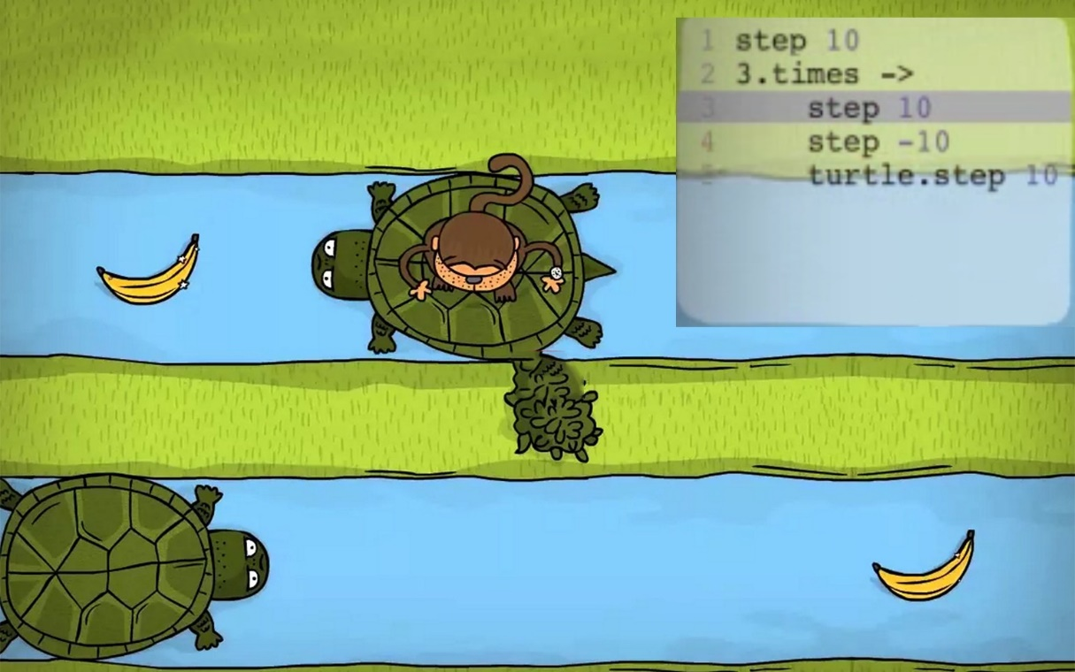
What Can I Do?
Can’t be Improved on
Puzzles (nature of programming)
Languages (many specializations already exist)
Can be Improved on
Concepts (more complex more easily explained)
Realism (more relatable and applicable examples)
A Possible Improvement: Management Simulator
Ideal for teaching object-oriented concepts
Move away from main-character oriented games that don’t contribute to how programming is taught

Slide 6
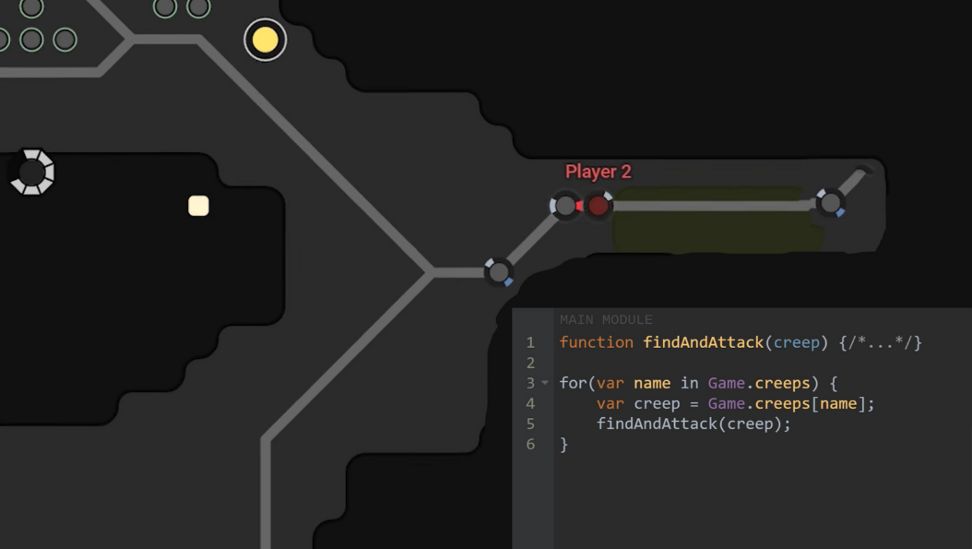
Conclusion
Creating a game to introduce programming to new students helps minimize how intimidating coding can be
It would mainly be marketed to middle and high school administrations
This idea has been done before, but using a management simulator to place the focus on object-oriented concepts could help students learn from example

Slide 7
Reference
Mybridge. 12 Free Games to Learn Programming. (2016). https://medium.mybridge.co/12-free-resources-learn-to-code-while-playing-games-f7333043de11

