Slide 1
Lecture 1- Introduction
CS 128
Introduction to C++
Sampath Jayarathna
Cal Poly Pomona
Based on slides created by Bjarne Stroustrup & Tony Gaddis

Slide 2
Today
Who I am
CS 128 educational objectives (and why)
Overview of the course, and logistics
Quick overview of C++ and why we study it
First program “Hello World!”

Slide 3
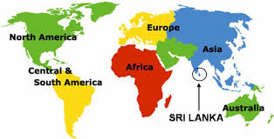
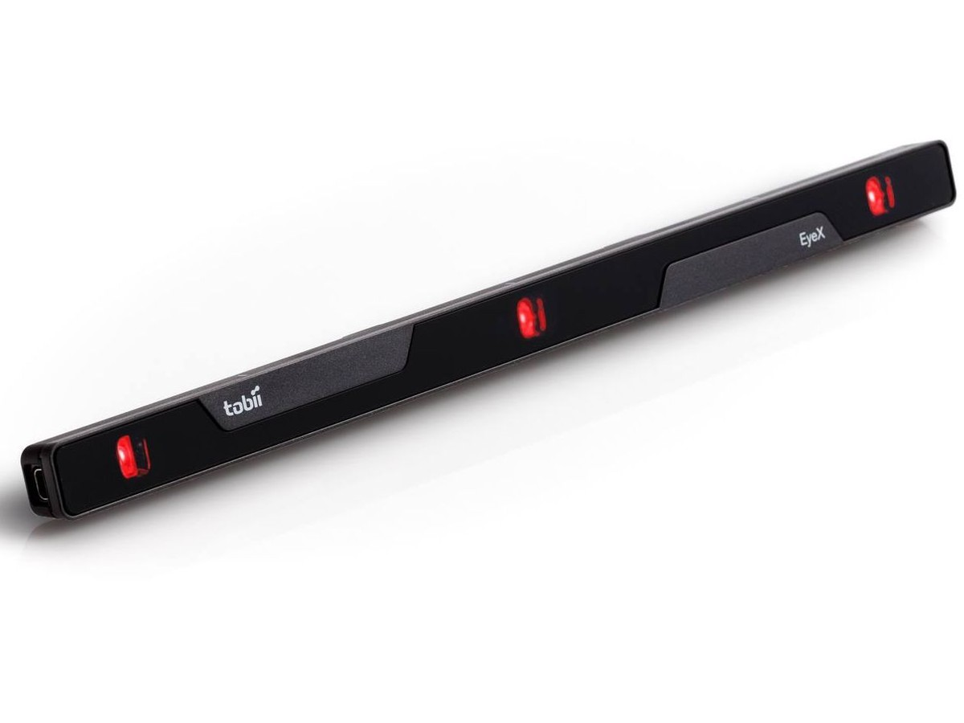


Who am I?
Instructor : Sampath Jayarathna
Joined Cal Poly Pomona Fall 2016 from Texas A&M
Originally from Sri Lanka
Research : Eye tracking, Brain EEG, User modeling, Biometrics
Web : http://www.cpp.edu/~ukjayarathna
Contact : 8-46, ukjayarathna@cpp.edu, (909) 869-3145
Office Hours : MW 1PM – 3PM, or email me for an appointment
[Open Door Policy]

Slide 4
Abstract
Today, I’ll outline the aims for this course and present a rough course plan.
I’ll introduce the basic notion of programming and give examples of areas in which software is critical to our civilization.
Finally, I’ll present the simplest possible C++ program and outline how it can be made into running code.

Slide 5
This is a course
About Programming
For beginners
  who want to become professionals
    i.e., people who can produce systems that others will use
  who are assumed to be bright
    Though not (necessarily) geniuses
  who are willing to work hard
    Though do need sleep occasionally, and take a normal course load
Using the C++ programming language

Slide 6
Course Information
Schedule : MW, 3-2636, 6.00 PM – 7.50 PM http://www.cpp.edu/~ukjayarathna/f16/cs128
www.piazza.com/csupomona/fall2016/cs128/home
Blackboard
Prereqs
  Official: MAT105 and 106 or approval of instructor
Format
  Before lecture: do reading slides
  In lecture: put reading in context
  After lecture: assignments, for hands-on practice

Slide 7
Student Learning Outcomes
After successfully completing this course, students should be able to:
Comprehend the basic concepts of programming and its use for problem solving
Learn good programming principles and practices using the C++ language
Have good knowledge of the syntax and semantics of C++ and its compilation and execution

Slide 8

Communication
Piazza:
  All questions will be fielded through Piazza.
  Many questions everyone can see the answer
  You should post at least one substantive, interesting post to the discussion forum.
  You must also respond to at least four posts made by others.
  You can also post private messages that can only be seen by the instructor
Blackboard:
  Blackboard will be used primarily for assignments/homework, extra credit submission and grade dissemination.
Email:
  Again, email should only be used in rare instances, I will probably point you back to Piazza

Slide 9
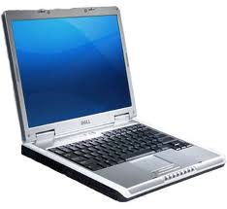
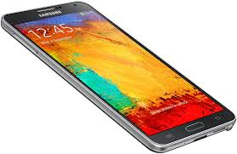
The Rules

Slide 10
Cooperate on Learning
Except for the work you hand in as individual contributions, I strongly encourage you to collaborate and help each other
If in doubt if a collaboration is legitimate: ask!
    Don’t claim to have written code that you copied from others
    Don’t give anyone else your code (to hand in for a grade)
    When you rely on the work of others, explicitly list all of your sources – i.e. give credit to those who did the work
Don’t study alone when you don’t have to
    Form study groups
    Do help each other (without plagiarizing)

Slide 11
Course Organization
Grading
Starting out with C++: From Control Structures through Objects by Gaddis, 7th Edition, 2011.

Slide 12
Course Organization
Programming Projects: We will have 2 programming projects, each worth 20% of your overall grade.
Final Exam: The final exam is comprehensive, closed books and will be held on Monday, Dec. 5th, 6.00pm - 7.30pm.
Homework: We will have five homework assignments, each worth 5% of your overall grade.
Exit Tickets
  5 to 10 low-stress ungraded quick online quizzes (less than 5 minutes each)
Extra Credit:
  Culture reports or User Study evaluation participation
  2 opportunities, 0.5 point each.

Slide 13
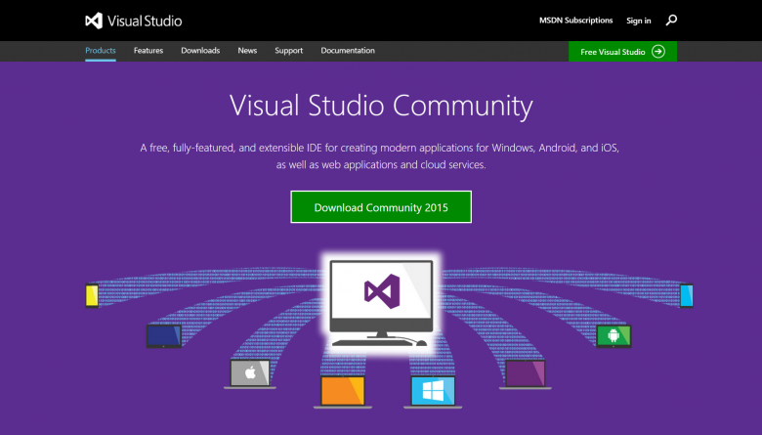
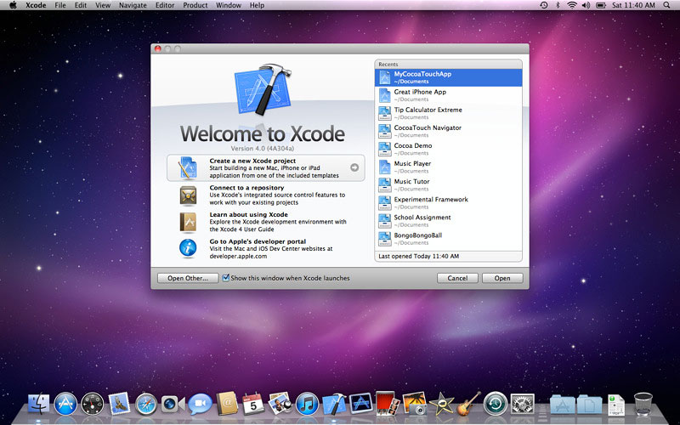
Personal devices – Software Setup
Windows – Visual Studio Community
Mac – Xcode
  From Apple App Store, search for “Xcode”
  Apple developer web site: https://developer.apple.com/downloads

Slide 14
Why C++ ?
You can’t learn to program without a programming language
The purpose of a programming language is to allow you to express your ideas in code
C++ is the language that most directly allows you to express ideas from the largest number of application areas
C++ is the most widely used language in engineering areas

Slide 15
Why C++ ?
C++ allows direct expression of ideas from many application areas
C++ is most widely used language in engineering areas
C++ is precisely and completely defined by an ISO standard
C++ is widely available
Concepts you learn with C++ are directly applicable to many other languages

Slide 16
Why programming?
Our civilization runs on software
  Most engineering activities involve software

Slide 17


Aircraft
Communication
Control
Display
Signal Processing
Monitoring

Slide 18
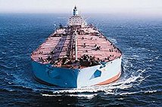
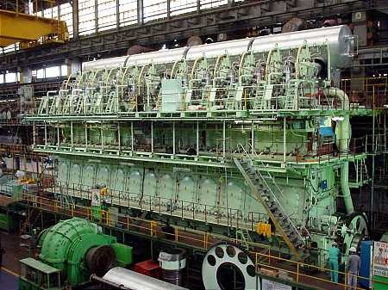
Ships
Design
Construction
Management
Monitoring
Hull Design
Pumps

Slide 19

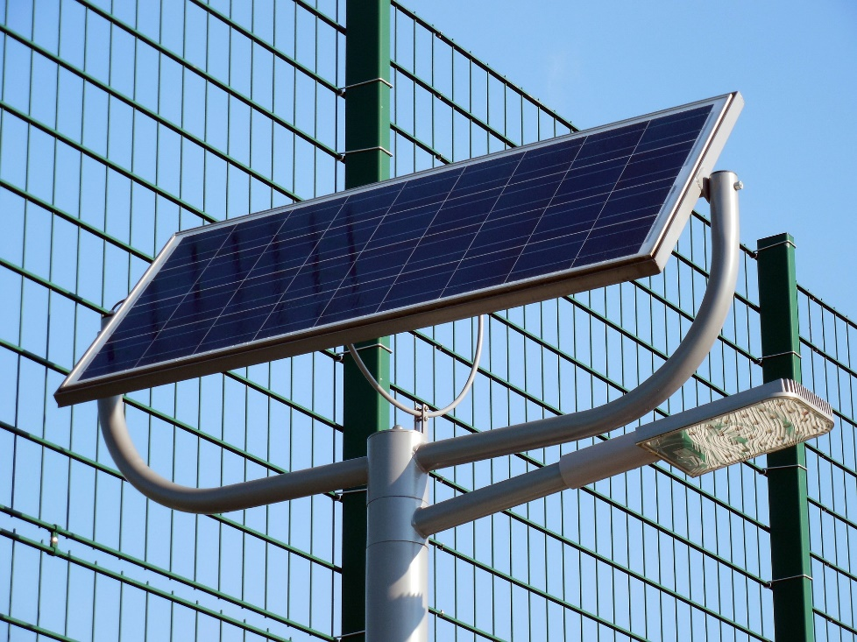

Energy
Control
Monitoring
Analysis
Design
Communications
Manufacturing
Vizualization

Slide 20
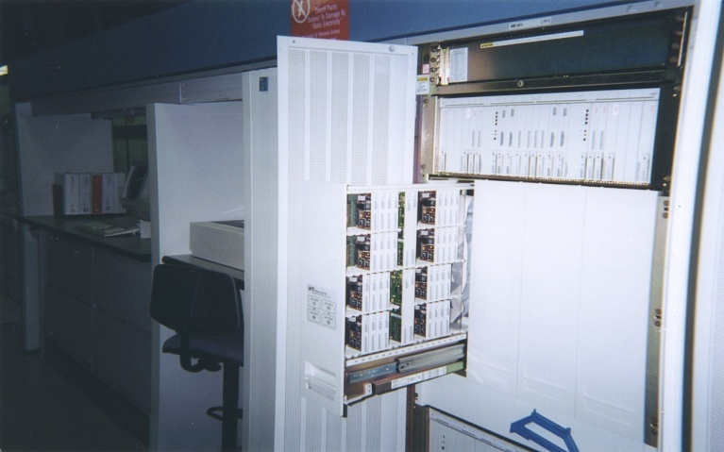
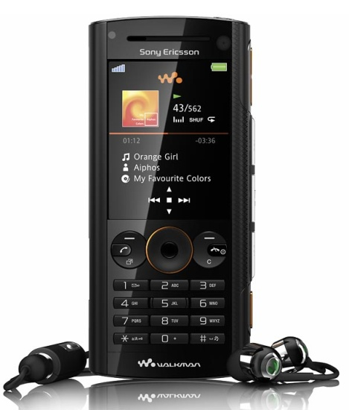
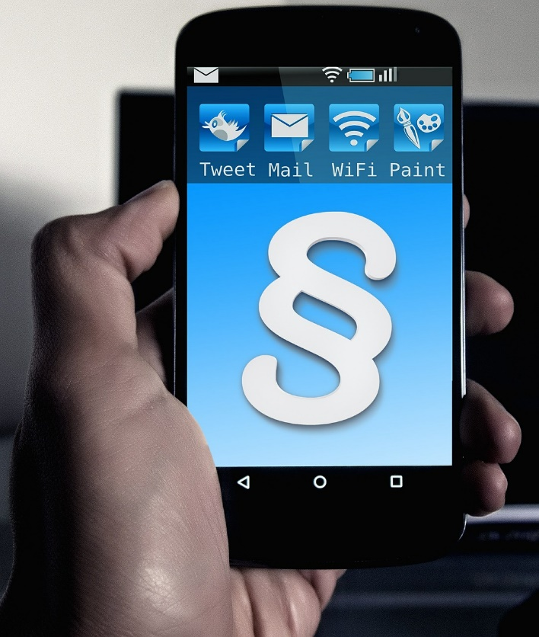
Phones
Voice Quality
User Interfaces
Billing
Mobility
Switching
Reliability
Provisioning
Images

Slide 21

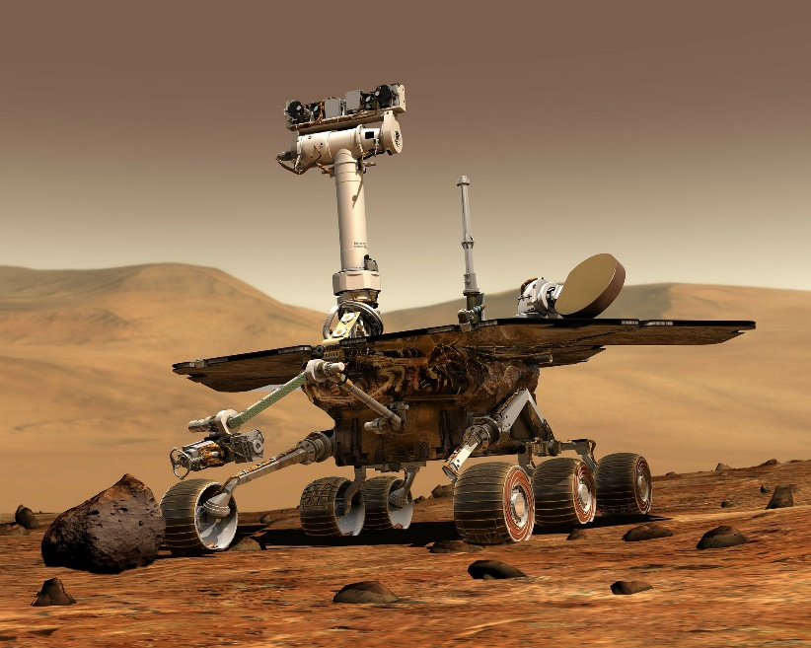
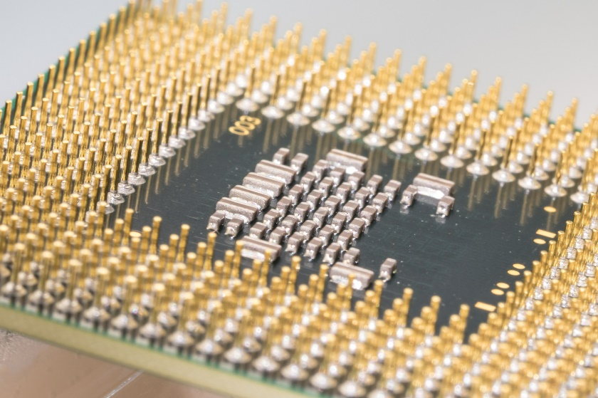
Where is C++ Used
Mars Rovers,
Animation,
Graphics,
Photoshop,
GUIs,
Embedded Systems,
OS’s, Compilers, Slides,
Chip Design,
Chip Manufacturing,
Semiconductor Tools,…

Slide 22
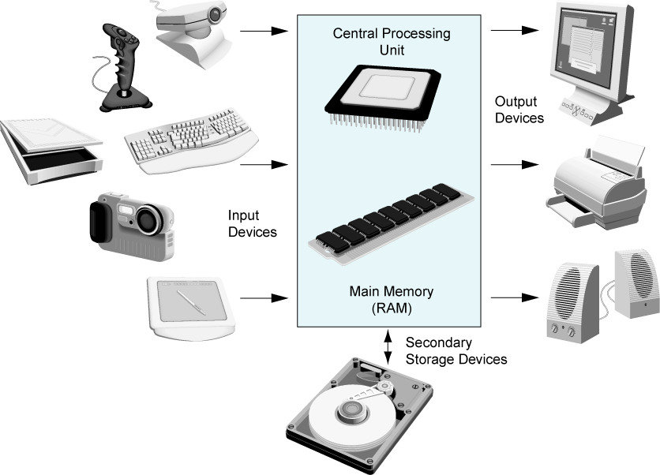
Main Hardware Component Categories

Slide 23
Central Processing Unit (CPU)
Comprised of:
  Control Unit
    Retrieves and decodes program instructions
    Coordinates activities of all other parts of computer
  Arithmetic & Logic Unit
    Hardware optimized for high-speed numeric calculation
    Hardware designed for true/false, yes/no decisions

Slide 24
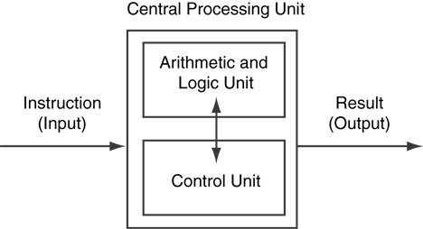
CPU Organization

Slide 25
Main Memory
It is volatile. Main memory is erased when program terminates or computer is turned off
Also called Random Access Memory (RAM)
Organized as follows:
  bit: smallest piece of memory. Has values 0 (off, false) or 1 (on, true)
  byte: 8 consecutive bits. Bytes have addresses.

Slide 26
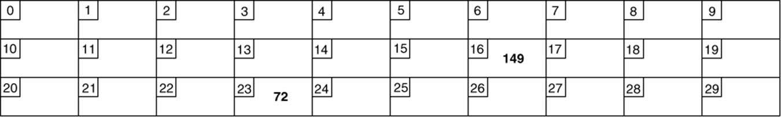
Main Memory
Addresses – Each byte in memory is identified by a unique number known as an address.
In Figure, the number 149 is stored in the byte with the address 16, and the number 72 is stored at address 23.

Slide 27
Secondary Storage & Input Devices
Non-volatile: data retained when program is not running or computer is turned off
Comes in a variety of media:
  magnetic: floppy disk, hard drive
  optical: CD-ROM, DVD
  Flash drives, connected to the USB port
Input Devices: Devices that send information to the computer from outside
Many devices can provide input:
  Keyboard, mouse, scanner, digital camera, microphone
  Disk drives, CD drives, and DVD drives

Slide 28
Software-Programs That Run on a Computer
Categories of software:
  System software: programs that manage the computer hardware and the programs that run on them. Examples: operating systems, utility programs, software development tools
  Application software: programs that provide services to the user. Examples : word processing, games, programs to solve specific problems

Slide 29
Machine Language
Machine language instructions are binary numbers, such as
1011010000000101
Rather than writing programs in machine language, programmers use programming languages.

Slide 30
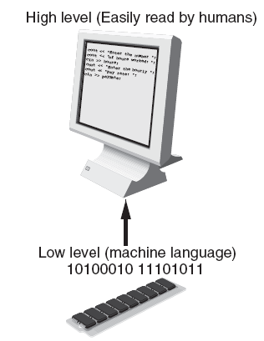

Programs and Programming Languages
Types of languages:
  Low-level: used for communication with computer hardware directly. Often written in binary machine code (0’s/1’s) directly.
  High-level: closer to human language

Slide 31
Programs and Programming Languages
Types of languages:
  Low-level: used for communication with computer hardware directly. Often written in binary machine code (0’s/1’s) directly.
  High-level: closer to human language

Slide 32
Some Well-Known Programming Languages
C++
BASIC
Ruby
Java
FORTRAN
Visual Basic
C#
COBOL
JavaScript
C
Python

Slide 33
Simplified Model
Input
Processor
Output
Memory
Abstraction

Slide 34
Memory
Usually stored in RAM
Composed of ones and zeroes
Address for each byte (group of 8 bits)
  Physical Address
  Logical Address
  Starts at zero

Slide 35
Memory Layout
Memory
Code
Static Data
Heap /
Free Store
Stack and heap
grow toward each other.
Heap /
Free Store
Stack
Stack

Slide 36
Memory
Stack : special region of your computer's memory that stores temporary variables created by each function (including the main() function)
  Every time a function declares a new variable, it is "pushed" onto the stack. Then every time a function exits, all of the variables pushed onto the stack by that function, are freed
Heap: a region of your computer's memory that is not managed automatically for you, and is not as tightly managed by the CPU.
  Memory Leaks

Slide 37
A first program – just the guts…
// …
int main() // main() is where a C++ program starts
{
cout << "Hello, world!\n"; // output the 13 characters Hello, world!
// followed by a new line
return 0; // return a value indicating success
}
// quotes delimit a string literal
// NOTE: “smart” quotes “ ” will cause compiler problems.
// so make sure your quotes are of the style " "
// \n is a notation for a new line

Slide 38
A first program – complete
#include <iostream> // get the library facilities needed for now
using namespace std; // use standard namespace std in place of std::cout
int main() // main() is where a C++ program starts
{
cout << "Hello, world!\n"; // output the 13 characters Hello, world!
// followed by a new line
return 0; // return a value indicating success
}
// note the semicolons; they terminate statements
// braces { … } group statements into a block
// main( ) is a function that takes no arguments ( )
// and returns an int (integer value) to indicate success or failure

Slide 39
Compilation Process
Starting with source code (e.g. C++) and converting it into machine code that the computer can run.
When using our IDE, the process appears like this:
Source Code
Compile
Executable File

Slide 40
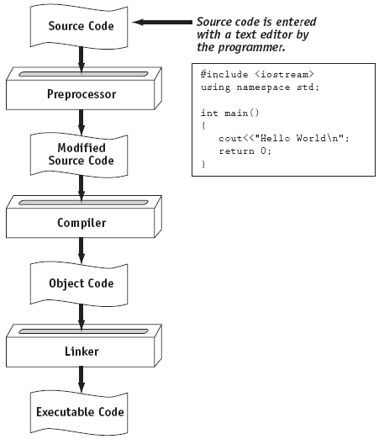
From a High-Level Program to an Executable File

Slide 41
Actual Process
Source Code
Assembler
Assembler File
Compiler
Object Code File
Linker
Executable File
Expanded Source Code
C++ Preprocessor
#included header files
Object Code for Library Functions
http://faculty.cs.niu.edu/~mcmahon/CS241/Notes/compile.html

Slide 42
Hello world
It’s almost all “boiler plate”
  Only cout << "Hello, world!\n" directly does anything
That’s normal
  Most of our code, and most of the systems we use simply exist to make some other code elegant and/or efficient
“Boiler plate,” that is, notation, libraries, and other support is what makes our code simple, comprehensible, trustworthy, and efficient.
  Would you rather write 1,000,000 lines of machine code?
This implies that we should not just “get things done”; we should take great care that things are done elegantly, correctly, and in ways that ease the creation of more/other software:
  Style Matters!

Slide 43
A second program
// modified for Windows console mode:
#include <iostream> // get the facilities for cout. This is called header
using namespace std; // use standard namespace std in place of std::cout
int main() // main() is where a C++ program starts
{
cout << "Hello, world!\n"; // output the 13 characters Hello, world!
// followed by a new line
system(" pause "); // wait for a keystroke
return 0; // return a value indicating success
}
// without system(“pause”) the output window will be closed immediately
// before you have a chance to read the output in Windows environment

Slide 44
Compilation and linking
C++ source code
C++ compiler
Object code
Executable program
linker
Library Object code
You write C++ source code
  Source code is (in principle) human readable
The compiler translates what you wrote into object code (sometimes called machine code)
  Object code is simple enough for a computer to “understand”
The linker links your code to system code needed to execute
  E.g., input/output libraries, operating system code, and windowing code
The result is an executable program
  E.g., a .exe file on windows or an a.out file on Unix

Slide 45
Hello, world!
“Hello world” is a very important program
  Its purpose is to help you get used to your tools
    Compiler
    Program development environment
    Program execution environment
  Type in the program carefully
    After you get it to work, please make a few mistakes to see how the tools respond; for example
      Forget the header
      Forget to terminate the string
      Misspell return (e.g., retrun)
      Forget a semicolon
      Forget { or }
      …

Slide 46
What is a Program Made of?
Common elements in programming languages:
  Key Words
  Programmer-Defined Identifiers
  Operators
  Punctuation
  Syntax

Slide 47
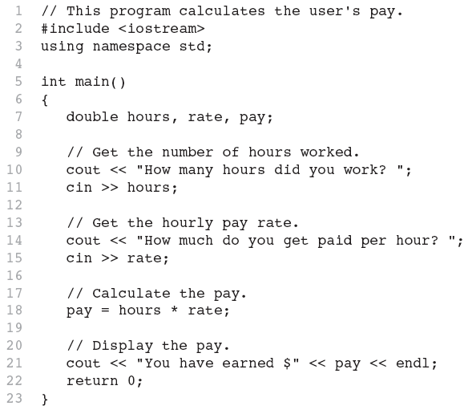
Program

Slide 48
Key Words
Also known as reserved words
Have a special meaning in C++
Can not be used for any other purpose
Key words in the previous program : using, namespace, int, double, and return

Slide 49
Key Words

Slide 50
Programmer-Defined Identifiers
Names made up by the programmer
Not part of the C++ language
Used to represent various things: variables (memory locations), functions, etc.
In pervious program : hours, rate, and pay.

Slide 51
Operators
Used to perform operations on data
Many types of operators:
  Arithmetic - ex: +,-,*,/
  Assignment – ex: =
Some operators in Program:
<< >> = *

Slide 52
Operators

Slide 53
Punctuation
Characters that mark the end of a statement, or that separate items in a list
In Program : , and ;

Slide 54
Punctuation

Slide 55
Syntax
The rules of grammar that must be followed when writing a program
Controls the use of key words, operators, programmer-defined symbols, and punctuation

Slide 56
Variables
A variable is a named storage location in the computer’s memory for holding a piece of data.
In previous program we used three variables:
  The hours variable was used to hold the hours worked
  The rate variable was used to hold the pay rate
  The pay variable was used to hold the gross pay

Slide 57
Variable Definitions
To create a variable in a program you must write a variable definition (also called a variable declaration)
Here is the statement from Program that defines the variables:
double hours, rate, pay;

Slide 58
Variable Definitions
There are many different types of data, which you will learn about in this course.
A variable holds a specific type of data.
The variable definition specifies the type of data a variable can hold, and the variable name.

Slide 59
Variable Definitions
Once again, line 7 from Program :
double hours, rate, pay;
The word double specifies that the variables can hold double-precision floating point numbers. More about these later……..

Slide 60
Input, Processing, and Output
Three steps that a program typically performs:
  Gather input data:
    from keyboard
    from files on disk drives
  Process the input data
  Display the results as output:
    send it to the screen
    write to a file

Slide 61
So what is programming?
Conventional definitions
  Telling a very fast moron exactly what to do
  A plan for solving a problem on a computer
  Specifying the order of a program execution
    But modern programs often involve millions of lines of code
    And manipulation of data is central
Definition from another domain (academia)
  A … program is an organized and directed accumulation of resources to accomplish specific … objectives …
    Good, but no mention of actually doing anything
The definition we’ll use
  Specifying the structure and behavior of a program, and testing that the program performs its task correctly and with acceptable performance
    Never forget to check that “it” works
Software == one or more programs

Slide 62
Programming
Programming is fundamentally simple
      Just state what the machine is to do
So why is programming hard?
  We want “the machine” to do complex things
        And computers are nitpicking, unforgiving, dumb beasts
  The world is more complex than we’d like to believe
        So we don’t always know the implications of what we want
  “Programming is understanding”
      When you can program a task, you understand it
      When you program, you spend significant time trying to understand the task you want to automate
  Programming is part practical, part theory
      If you are just practical, you produce non-scalable unmaintainable hacks
      If you are just theoretical, you produce toys

Slide 63
The next lecture
Will talk more about types, values, variables, declarations, simple input and output, very simple computations, and type safety.

