Slide 1
Lecture 5 Loops
CS 128
Introduction to C++
Sampath Jayarathna
Cal Poly Pomona
Based on slides created by Bjarne Stroustrup & Tony Gaddis

Slide 2
Introduction to Loops: The while Loop
Loop: a control structure that causes a statement or statements to repeat
General format of the while loop:
while (expression)
statement;
statement; can also be a block of statements enclosed in { }
expression is evaluated
if true, then statement is executed, and expression is evaluated again
if false, then the loop is finished and program statements following statement execute

Slide 3
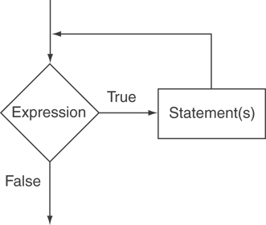
The Logic of a while Loop

Slide 4
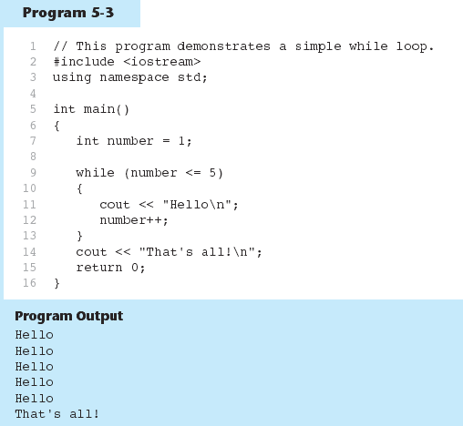
The while loop in Program 5-3

Slide 5
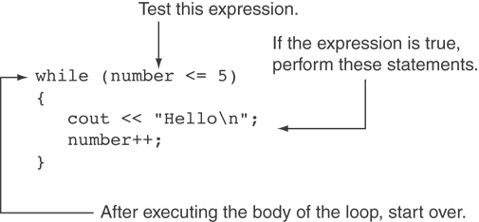
How the while Loop in Program 5-3 Lines 9 through 13 Works

Slide 6
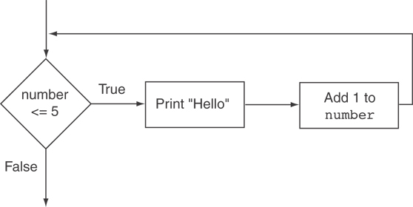
Flowchart of the while Loop

Slide 7
The while Loop is a Pretest Loop
expression is evaluated before the loop executes. The following loop will never execute: int number = 6; while (number <= 5) { cout << "Hello\n"; number++; }

Slide 8
Watch Out for Infinite Loops
The loop must contain code to make expression become false
Otherwise, the loop will have no way of stopping
Such a loop is called an infinite loop, because it will repeat an infinite number of times
int number = 1; while (number <= 5) { cout << "Hello\n"; }

Slide 9
Using the while Loop for Input Validation
Input validation is the process of inspecting data that is given to the program as input and determining whether it is valid.
The while loop can be used to create input routines that reject invalid data, and repeat until valid data is entered.

Slide 10
Using the while Loop for Input Validation
Here's the general approach, in pseudocode:
Read an item of input. While the input is invalid Display an error message. Read the input again. End While

Slide 11
Input Validation Example
cout << "Enter a number less than 10: ";
cin >> number;
while (number >= 10)
{
cout << "Invalid Entry!" << "Enter a number less than 10: ";
cin >> number;
}

Slide 12
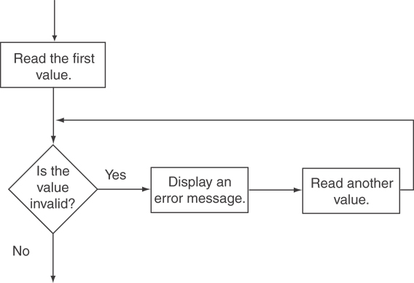
Flowchart for Input Validation

Slide 13
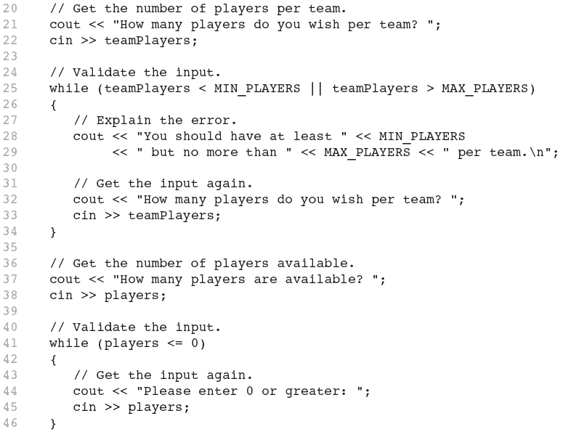
Input Validation in Program 5-5

Slide 14
Counters
Counter: a variable that is incremented or decremented each time a loop repeats
Can be used to control execution of the loop (also known as the loop control variable)
Must be initialized before entering loop

Slide 15
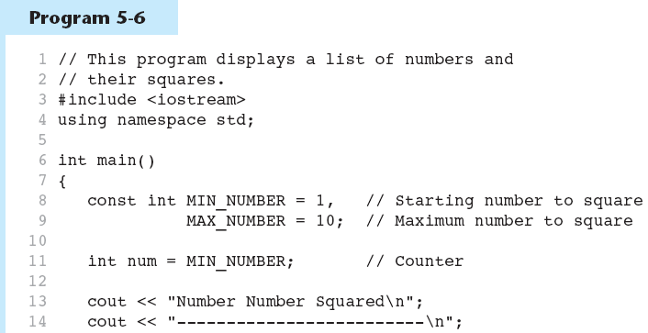
A Counter Variable Controls the Loop
Continued…

Slide 16
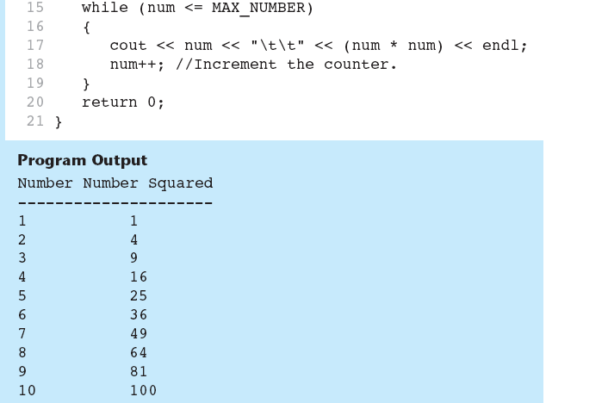
A Counter Variable Controls the Loop in Program 5-6

Slide 17
The do-while Loop
do-while: a post-test loop – execute the loop, then test the expression
General Format:
do
statement; // or block in { }
while (expression);
Note that a semicolon is required after (expression)

Slide 18
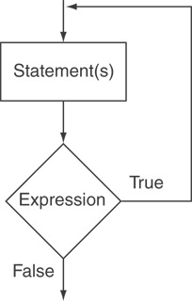
The Logic of a do-while Loop

Slide 19
An Example do-while Loop
int x = 1; do { cout << x << endl; } while(x < 0);
Although the test expression is false, this loop will execute one time because do-while is a post-test loop.

Slide 20
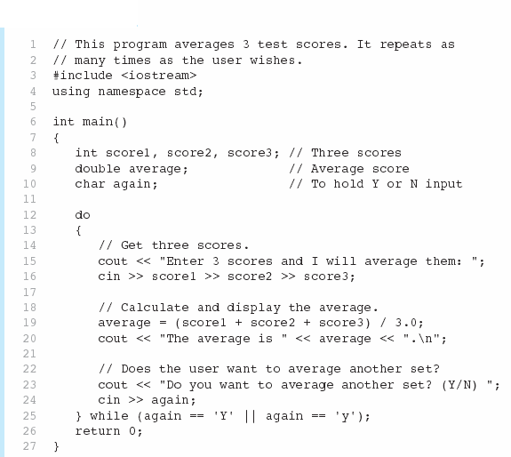
A do-while Loop in Program 5-7
Continued…

Slide 21
A do-while Loop in Program 5-7

Slide 22
do-while Loop Notes
Loop always executes at least once
Execution continues as long as expression is true, stops repetition when expression becomes false
Useful in menu-driven programs to bring user back to menu to make another choice

Slide 23
The for Loop
Useful for counter-controlled loop
General Format:
for(initialization; test; update)
statement; // or block in { }
No semicolon after the update expression or after the )

Slide 24
for Loop - Mechanics
for(initialization; test; update)
statement; // or block in { }
Perform initialization
Evaluate test expression
If true, execute statement
If false, terminate loop execution
Execute update, then re-evaluate test expression

Slide 25
for Loop - Example
int count;
for (count = 1; count <= 5; count++)
cout << "Hello" << endl;

Slide 26
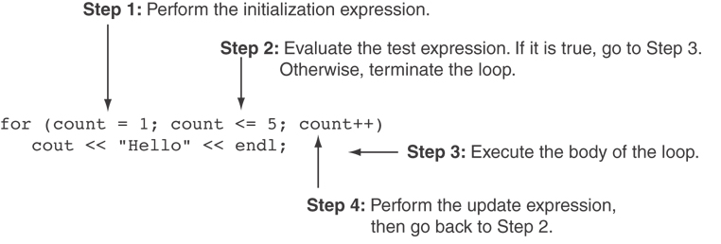
A Closer Look at the Previous Example

Slide 27
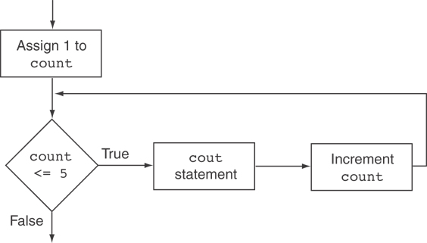
Flowchart for the Previous Example

Slide 28
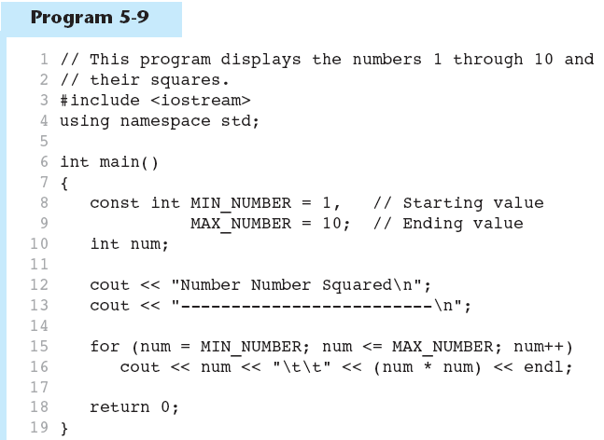
A for Loop in Program 5-9
Continued…

Slide 29
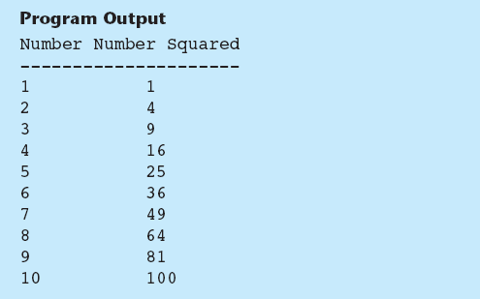
A for Loop in Program 5-9

Slide 30
A Closer Look at Lines 15 through 16 in Program 5-9

Slide 31
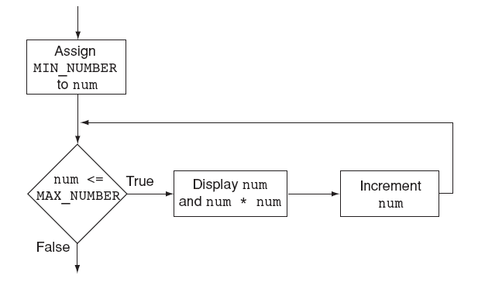
Flowchart for Lines 15 through 16 in Program 5-9

Slide 32
When to Use the for Loop
In any situation that clearly requires
an initialization
a false condition to stop the loop
an update to occur at the end of each iteration
The for loop tests its test expression before each iteration, so it is a pretest loop.
The following loop will never iterate: for (count = 11; count <= 10; count++) cout << "Hello" << endl;

Slide 33
for Loop - Modifications
You can have multiple statements in the initialization expression. Separate the statements with a comma: int x, y; for (x=1, y=1; x <= 5; x++) { cout << x << " plus " << y << " equals " << (x+y) << endl; }
Initialization Expression

Slide 34
for Loop - Modifications
You can also have multiple statements in the test expression. Separate the statements with a comma: int x, y; for (x=1, y=1; x <= 5; x++, y++) { cout << x << " plus " << y << " equals " << (x+y) << endl; }
Test Expression

Slide 35
for Loop - Modifications
You can omit the initialization expression if it has already been done:
int sum = 0, num = 1;
for (; num <= 10; num++)
sum += num;

Slide 36
for Loop - Modifications
You can declare variables in the initialization expression:
int sum = 0;
for (int num = 0; num <= 10; num++)
sum += num;
The scope of the variable num is the for loop.

Slide 37
Keeping a Running Total
running total: accumulated sum of numbers from each repetition of loop
accumulator: variable that holds running total
int sum=0, num=1; // sum is the
while (num <= 10) // accumulator
{ sum += num;
num++;
}
cout << "Sum of numbers 1 – 10 is"
<< sum << endl;

Slide 38
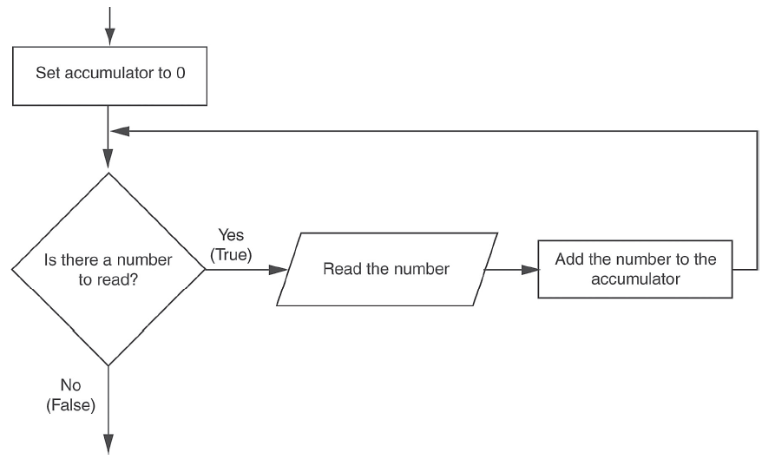
Logic for Keeping a Running Total

Slide 39
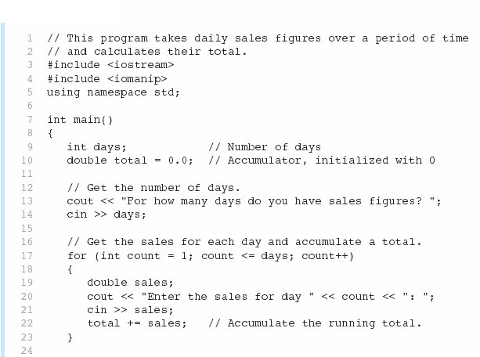
A Running Total in Program 5-12
Continued…

Slide 40
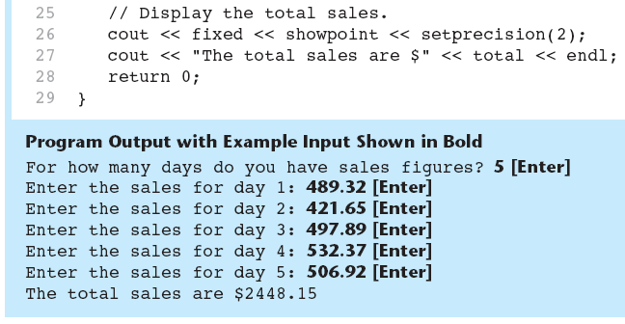
A Running Total in Program 5-12

Slide 41
Sentinels
sentinel: value in a list of values that indicates end of data
Special value that cannot be confused with a valid value, e.g., -999 for a test score
Used to terminate input when user may not know how many values will be entered

Slide 42
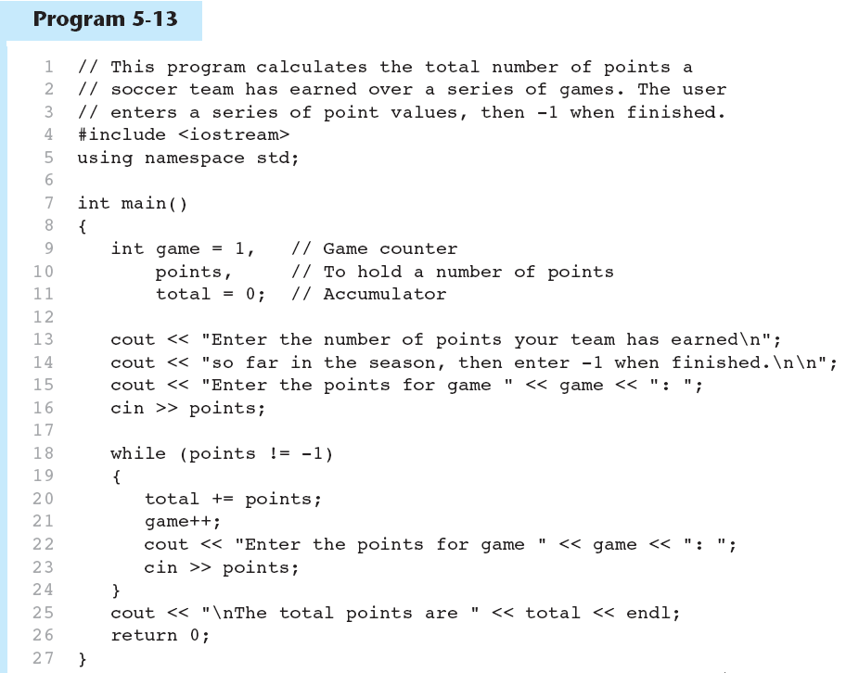
A Sentinel in Program 5-13
Continued…

Slide 43
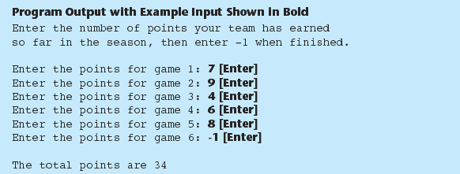
A Sentinel in Program 5-13

Slide 44
Breaking Out of a Loop
Can use break to terminate execution of a loop
Use sparingly if at all – makes code harder to understand and debug
When used in an inner loop, terminates that loop only and goes back to outer loop

Slide 45
The continue Statement
Can use continue to go to end of loop and prepare for next repetition
while, do-while loops: go to test, repeat loop if test passes
for loop: perform update step, then test, then repeat loop if test passes
Use sparingly – like break, can make program logic hard to follow

Slide 46
Deciding Which Loop to Use
The while loop is a conditional pre-test loop
Iterates as long as a certain condition exits
Validating input
Reading lists of data terminated by a sentinel
The do-while loop is a conditional pos-ttest loop
Always iterates at least once
Repeating a menu
The for loop is a pre-test loop
Built-in expressions for initializing, testing, and updating
Situations where the exact number of iterations is known

Slide 47
Nested Loops
A nested loop is a loop inside the body of another loop
Inner (inside), outer (outside) loops:
for (row=1; row<=3; row++) //outer
for (col=1; col<=3; col++)//inner
cout << row * col << endl;

Slide 48
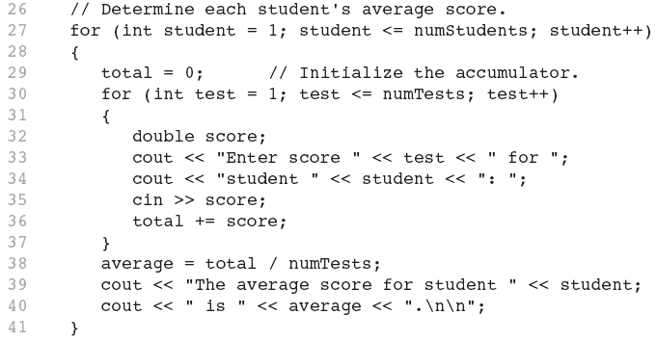
Nested for Loop in Program 5-14
Inner Loop
Outer Loop

Slide 49
Nested Loops - Notes
Inner loop goes through all repetitions for each repetition of outer loop
Inner loop repetitions complete sooner than outer loop
Total number of repetitions for inner loop is product of number of repetitions of the two loops.

