Slide 1
Lecture 9 Files, Pointers
CS 128
Introduction to C++
Sampath Jayarathna
Cal Poly Pomona
Based on slides created by Bjarne Stroustrup & Tony Gaddis

Slide 2
Using Files for Data Storage
Can use files instead of keyboard, monitor screen for program input, output
Allows data to be retained between program runs
Steps:
Open the file
Use the file (read from, write to, or both)
Close the file

Slide 3
File Operations
File: a set of data stored on a computer, often on a disk drive
Programs can read from, write to files
Used in many applications:
Word processing
Databases
Spreadsheets
Compilers

Slide 4
Files: What is Needed
Use fstream header file for file access
File stream types:
ofstream: Stream class to write on files
ifstream: Stream class to read from files
fstream: Stream class to both read and write from/to files.
Define file stream objects:
ifstream infile;
ofstream outfile;
Can use >> to read from, and << write to a file
Can use eof member function to test for end of input file

Slide 5
Writing to a new file
#include <iostream>
#include <fstream>
using namespace std;
int main () {
ofstream myfile;
myfile.open("example.dat"); // or .txt
myfile << "Writing this to a file.\n";
myfile.close();
return 0;
}

Slide 6
Testing for File Open Errors
Can test a file stream object to detect if an open operation failed:
ifstream infile;
infile.open("test.txt");
if (!infile)
{
cout << "File open failure!";
}
Can also use the fail member function

Slide 7
Using Files Writing with is_open() method
// writing on a text file
#include <iostream>
#include <fstream>
using namespace std; int main () { ofstream myfile ("example.txt");
if (myfile.is_open()) {
myfile << "This is a line.\n"; myfile << "This is another line.\n"; myfile.close();
}
else cout << "Unable to open file"; return 0;
}

Slide 8
Using Files reading with is_open() method
// Reading a text file
string line;
ifstream myfile("example.txt");
if (myfile.is_open()) {
while( getline(myfile,line) )
{
cout << line << '\n';
}
myfile.close();
}
else cout << "Unable to open file";

Slide 9
Closing Files
Use the close member function:
infile.close();
outfile.close();
Don’t wait for operating system to close files at program end:
may be limit on number of open files
may be buffered output data waiting to send to file

Slide 10
Pointer Variables
Pointer variables are yet another way using a memory address to work with a piece of data.
Pointers are more "low-level" than arrays and reference variables.
This means you are responsible for finding the address you want to store in the pointer and correctly using it.

Slide 11
Pointer Variables
Definition:
int *intptr;
Read as:
“intptr can hold the address of an int”
Spacing in definition does not matter:
int * intptr; // same as above
int* intptr; // same as above

Slide 12
Pointer Variables
Assigning an address to a pointer variable:
int *intptr;
intptr = &num;
Memory layout:
num
intptr
25
0x4a00
address of num: 0x4a00

Slide 13
Pointer Variables
Initialize pointer variables with the special value nullptr.
In C++ 11, the nullptr key word was introduced to represent the address 0.
Here is an example of how you define a pointer variable and initialize it with the value nullptr:
int *ptr = nullptr;

Slide 14
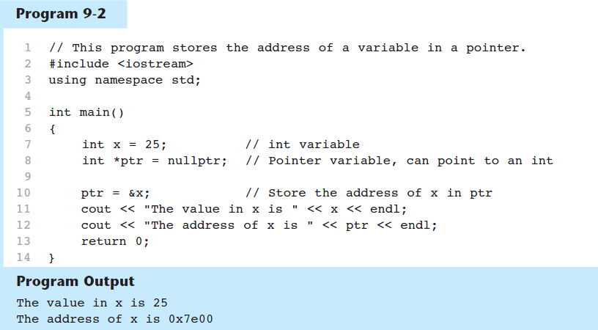
A Pointer Variable in Program 9-2

Slide 15
The Indirection Operator
The indirection operator (*) dereferences a pointer.
It allows you to access the item that the pointer points to. int x = 25; int *intptr = &x; cout << *intptr << endl;
The reference and dereference operators are thus complementary:
& is the address-of operator, and can be read simply as "address of"
* is the dereference operator, and can be read as "value pointed to by"
This prints 25.

Slide 16
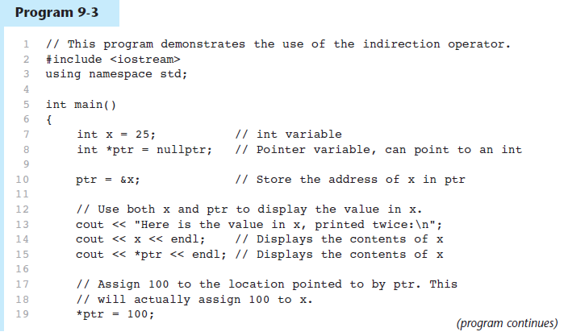
The Indirection Operator in Program 9-3

Slide 17
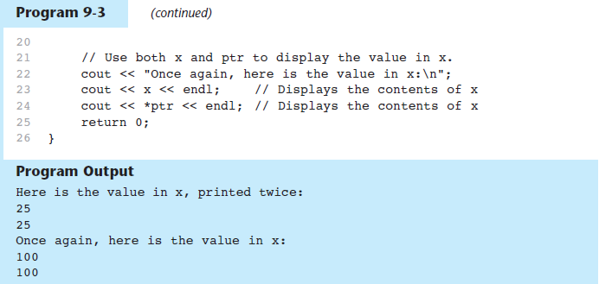
The Indirection Operator in Program 9-3

Slide 18
Pointer Arithmetic
Operations on pointer variables:
Operation | Example int vals[]={4,7,11}; int *valptr = vals;
++, -- | valptr++; // points at 7 valptr--; // now points at 4
+, - (pointer and int) | cout << *(valptr + 2); // 11
+=, -= (pointer and int) | valptr = vals; // points at 4 valptr += 2; // points at 11

Slide 19
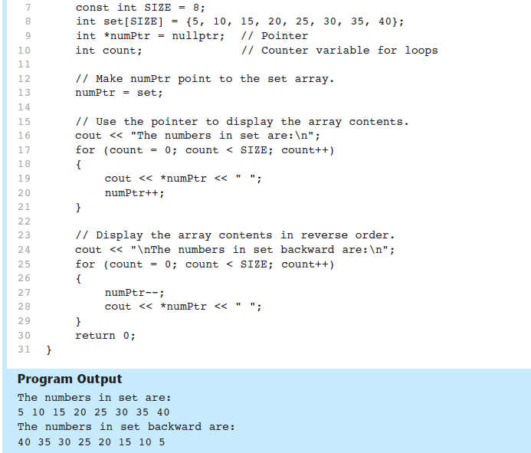
From Program 9-9

Slide 20
Initializing Pointers
Can initialize at definition time:
int num, *numptr = &num;
int val[3], *valptr = val;
Cannot mix data types:
double cost;
int *ptr = &cost; // won’t work
Can test for an invalid address for ptr with:
if (!ptr) ...

Slide 21
Pointers as Function Parameters
A pointer can be a parameter
Works like reference variable to allow change to argument from within function
Requires:
asterisk * on parameter in prototype and heading
void getNum(int *ptr); // ptr is pointer to an int
asterisk * in body to dereference the pointer
cin >> *ptr;
address as argument to the function
getNum(&num); // pass address of num to getNum

Slide 22
Example
void swap(int *x, int *y)
{ int temp;
temp = *x;
*x = *y;
*y = temp;
}
int num1 = 2, num2 = -3;
swap(&num1, &num2);

Slide 23
Dynamic Memory Allocation
Can allocate storage for a variable while program is running
Computer returns address of newly allocated variable
Uses new operator to allocate memory:
double *dptr = nullptr;
dptr = new double;
new returns address of memory location

Slide 24
Dynamic Memory Allocation
Can also use new to allocate array: const int SIZE = 25; arrayPtr = new double[SIZE];
Can then use [] or pointer arithmetic to access array:
for(i = 0; i < SIZE; i++)
*arrayptr[i] = i * i;
or
for(i = 0; i < SIZE; i++)
*(arrayptr + i) = i * i;
Program will terminate if not enough memory available to allocate

Slide 25
Releasing Dynamic Memory
Use delete to free dynamic memory:
delete fptr;
Use [] to free dynamic array:
delete [] arrayptr;
Only use delete with dynamic memory!

Slide 26
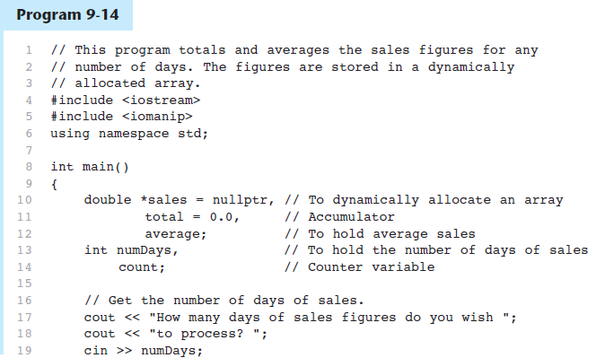
Dynamic Memory Allocation in Program 9-14

Slide 27
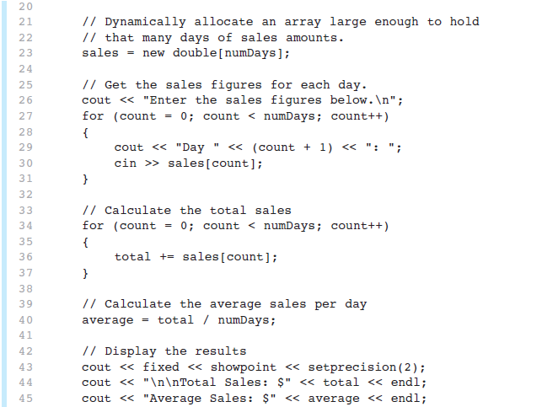
Dynamic Memory Allocation in Program 9-14
Program 9-14 (Continued)

Slide 28
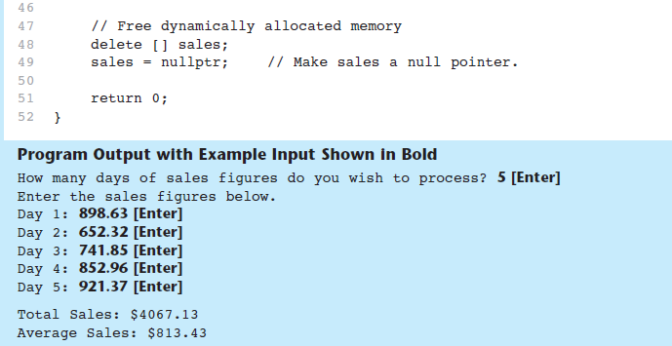
Dynamic Memory Allocation in Program 9-14
Program 9-14 (Continued)
Notice that in line 49 nullptr is assigned to the sales pointer. The delete operator is designed to have no effect when used on a null pointer.

Slide 29
Using Smart Pointers to Avoid Memory Leaks
In C++ 11, you can use smart pointers to dynamically allocate memory and not worry about deleting the memory when you are finished using it.
Three types of smart pointer:
Must #include the memory header file:
In this book, we introduce unique_ptr:
unique_ptr
shared_ptr
weak_ptr
#include <memory>
unique_ptr<int> ptr( new int );

Slide 30
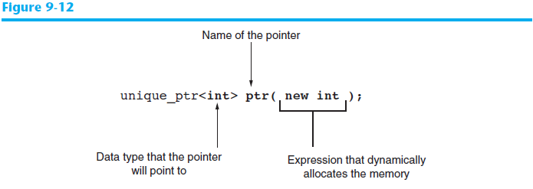
Using Smart Pointers to Avoid Memory Leaks
The notation <int> indicates that the pointer can point to an int .
The name of the pointer is ptr .
The expression new int allocates a chunk of memory to hold an int.
The address of the chunk of memory will be assigned to ptr.

Slide 31
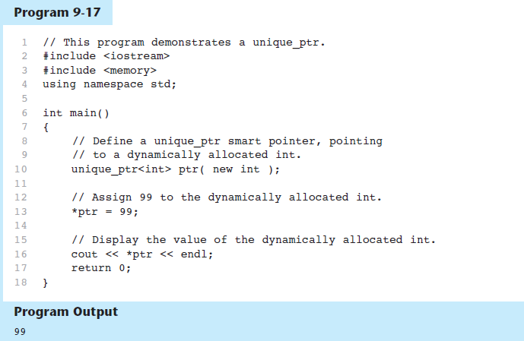
Using Smart Pointers in Program 9-17

