Slide 1
Lecture 1- Introduction
Sampath Jayarathna
Cal Poly Pomona

Slide 2
Today
Who I am
CS 480 educational objectives (and why)
Overview of the course, and logistics
Quick overview of software engineering and why we study it

Slide 3
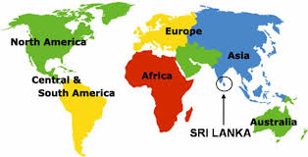
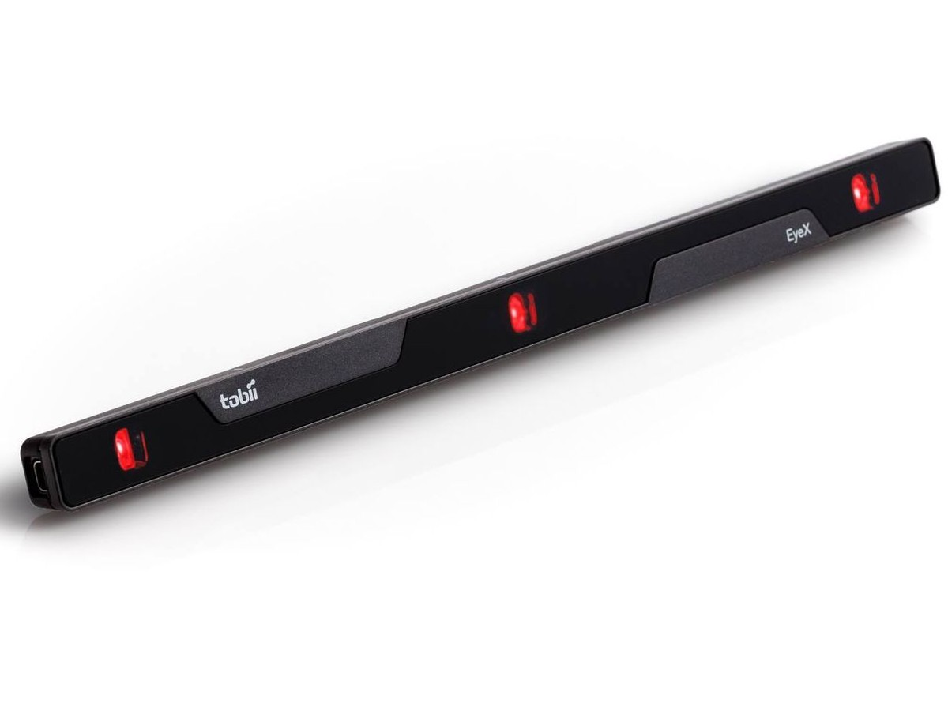
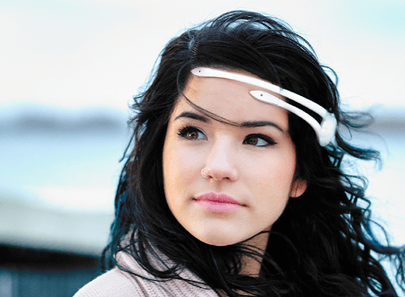
Who am I?
Instructor : Sampath Jayarathna Joined Cal Poly Pomona Fall 2016 from Texas A&M Originally from Sri Lanka
Research : Eye tracking, Brain EEG, User modeling, Biometrics
Web : http://www.cpp.edu/~ukjayarathna
Contact : 8-46, ukjayarathna@cpp.edu, (909) 869-3145
Office Hours : MW 1PM – 3PM, or email me for an appointment
[Open Door Policy]

Slide 4
Course Information
Schedule : MW, 8-348, 4.00 PM – 5.50 PM http://www.cpp.edu/~ukjayarathna/f16/cs480
www.piazza.com/csupomona/fall2016/cs480/home
Blackboard
Prereqs
Official: CS241 or approval of instructor
Practical: Know object-oriented programming language
Format
Before lecture: do reading
In lecture: put reading in context
After lecture: assignments, for hands-on practice

Slide 5
Student Learning Outcomes
After successfully completing this course, students should be able to:
For each of various software project scenarios, develop understanding of software engineering principles and methodologies such as the project’s place in the software life cycle, identify the particular tasks that should be performed next, and identify metrics appropriate to those tasks.
Apply key elements and common methods for elicitation and analysis to produce a set of software requirements for a medium-sized software system.
Demonstrate the capability to use a range of software tools in support of the development of a software product of medium size.
Demonstrate through involvement in a team project the central elements of team building and team management and written justifications and rationales for project design decisions made.

Slide 6
Communication
Piazza:
All questions will be fielded through Piazza.
Many questions everyone can see the answer
You should post at least one substantive, interesting post to the discussion forum.
You must also respond to at least four posts made by others.
You can also post private messages that can only be seen by the instructor
Blackboard:
Blackboard will be used primarily for assignments/homework, extra credit submission and grade dissemination.
Email:
Again, email should only be used in rare instances, I will probably point you back to Piazza

Slide 7
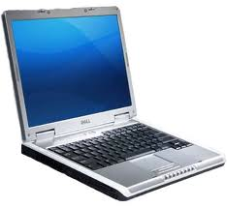
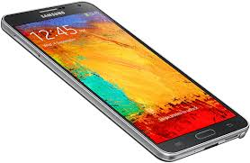
The Rules

Slide 8
Course Organization
Grading
There is no required textbook. Few optional materials,
Software Engineering by Ian Sommerville.
Software Engineering: A Practitioner's Approach, by Roger Pressman.
Interaction Design: Beyond Human-Computer Interaction by Preece et.al.

Slide 9
Course Organization
Project: More in the next couple of slides…
Final Exam: The final exam is comprehensive, closed books and will be held on Monday, Dec. 5th, 4.00pm - 5.45pm.
Homework: We will have five homework assignments, each worth 3% of your overall grade. Homework 1 – 1 Page Resume, Due: Wed. Sep. 28th , Office 8-46
Exit Tickets
5 to 10 low-stress ungraded quick online quizzes (less than 5 minutes each)
Extra Credit:
Culture reports or User Study evaluation participation
2 opportunities, 0.5 point each.

Slide 10
Team Project
It's difficult to appreciate software engineering issues without working on a large project
Issues only become real on larger projects
10 weeks is too short
There will be a natural tendency to over emphasize development
Teams will be homogenous
But that won't stop us

Slide 11
Team Project - Evaluation
Form teams of 4 (± 1?) students
Independent and non-competing
Think of other teams as working for other organizations
Code and document sharing between teams is not permitted
Project grade will have a large impact on course grade (50%)
Project grade will (attempt to) recognize individual contributions
Peer evaluation, Demo evaluation
All artifacts will be considered in the evaluation
Quality matters

Slide 12
Team Project - Milestones
Project Proposal, Wed. Oct. 5th
Requirements and Design, Wed. Oct. 26th
Bi-weekly status reports, Oct. 19, Nov. 2, Nov.16
Final Report, Wed, Nov. 30th
In-class presentation and Demo, Wed, Nov. 30th

Slide 13
Team Project - Ideas
Personal Health Monitoring Devices
Improve class room experience (students, instructors)
Drones, Arduino, Raspberry PI, Robots…….
Brain EEG: Emotiv Insight $300+
Train your brain activity to control things, RC cars, drones etc.
Eye tracking
iris recognition – Samsung Note 7
Off the shelf products for eye tracking (mobile phone cam, IR illuminators)
Fancy low-cost eye trackers: Tobii eyex $150, eyetribe $99

Slide 14
More on the class
Project (approximately 34 students, we’ll form groups on this Wednesday)
Strict milestones (only 10 weeks)
Bi-Weekly reports, due on Wed.; list top 3 risks, plus other material
Not primarily graded on whether your program "works“
Special topics (often guest lectures)
Schedule is on the web page

Slide 15
Course Goal
To gain an understanding that developing a software product is not merely a matter of programming
My goal is to have you more than just intellectually know it but really feel it and believe it
If it's not merely programming, what is it?
Models of the software development process and metrics. Software requirements and specifications. Methodologies, tools and environments. Human-computer interaction. Software design and architecture. Project management. Cost estimation. Testing and validation. Maintenance and evolution.

Slide 16
Exercise: In groups of 2 or 3 people
Take one minute and write down some possible issues besides simply writing code that might affect how you would engineer software; some examples include
Ship your computer game by November 15th or miss the Christmas market — and your company will go out of business
The US market for your product is nearing saturation, and you need to start marketing internationally
The US government restricts export of a key piece of technology needed by your company to remain competitive
Headcount on this project is ten people
You have to program in C++, because that’s the only language people currently in this shop use, but new hires only know Java.

Slide 17
What is Software Engineering?
The practical application of scientific knowledge to the design and construction of computer programs and the associated documentation required to develop, operate, and maintain them [Boehm].
The systematic approach to the development, operation, maintenance, and retirement of software [IEEE].
The establishment and use of sound engineering principles (methods) in order to obtain economically software that is reliable and works on real machines [Bauer].
Multi-person construction of multi-version software [Parnas].
“Software from womb to tomb.”

Slide 18
Why study Software Engineering?
Building software without discipline is crazy
Software is critical to society
Building a large complete software project is hard
There is a perceived crisis in our ability to build software
It’s fun!
$$$$

Slide 19
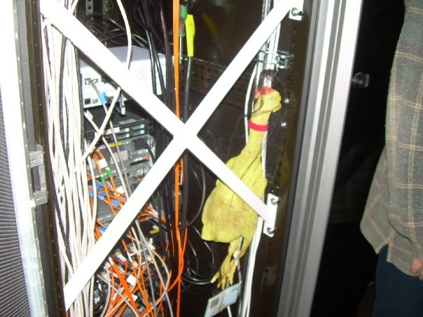
“The Software Crisis”
We’ve been in the midst of a crisis ever since the 1968 NATO meeting that christened software engineering
“We are unable to produce or maintain high-quality software at reasonable price and on schedule.”
“Software systems are like cathedrals; first we build them and then we pray. “

Slide 20
If SW Engineering So Popular, Why So Many SWE Disasters?
Therac-25 lethal radiation overdose
1985: Reused SW from machine with HW interlock on machine without it: SW bug => 3 died
Mars Climate Orbiter disintegration
1999: SW used wrong units (pound-seconds vs. newton-seconds) => wasted $325M
FBI Virtual Case File project abandonment
2005: give up after 5 years of work => wasted $170M
Ariane 5 rocket explosion
1996 => wasted $370M
Notes:
Decollage = takeoff; 350M of satellites; save memory 16 bit
June 4, 1996 -- Ariane 5 Flight 501. Working code for the Ariane 4 rocket is reused in the Ariane 5, but the Ariane 5's faster engines trigger a bug in an arithmetic routine inside the rocket's flight computer. The error is in the code that converts a 64-bit floating-point number to a 16-bit signed integer. The faster engines cause the 64-bit numbers to be larger in the Ariane 5 than in the Ariane 4, triggering an overflow condition that results in the flight computer crashing.
First Flight 501's backup computer crashes, followed 0.05 seconds later by a crash of the primary computer. As a result of these crashed computers, the rocket's primary processor overpowers the rocket's engines and causes the rocket to disintegrate 40 seconds after launch.
From wired Magazine, History's Worst Software Bugs, 2005, http://www.wired.com/software/coolapps/news/2005/11/69355?currentPage=2
French for “take off” decollage, applause
That is what a SW bug looks like
Worked in Ariane 4. Went faster, higher speed, arithmetic overflow: 64bit FP to 16bit integer

Slide 21
Some “crisis” issues
Relative cost of hardware/software
Low productivity
“Wrong” products
Poor quality
Constant maintenance
Technology transfer is slow

Slide 22
Software is critical to society
Economically important
Essential for running most enterprises
Key part of most complex systems
Essential for designing many engineering products
In many if not in most cases, the software is embedded in the system you are using — you don’t see the software

Slide 23
Software lifecycle
A software engineering lifecycle model describes how one might put structure on the software engineering activities
The classic lifecycle model is the waterfall model (roughly due to Royce in 1956), which is structured by a set of activities and is inherently document-driven

Slide 24
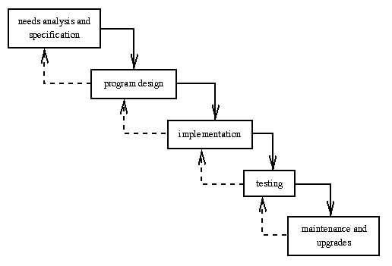
Software lifecycle

Slide 25
Exercise: In groups of 2 or 3 people
Take five minutes and design a software lifecycle.
Think about ways to improve the previous software lifecycle
Can you improve the limited feedback?
What about iterations?
What about several activities in different iterations?

Slide 26
Software lifecycle
Limited feedback increases risk
“You start at the top and it’s all downhill from there.” [uncertain origin]
The cost of fixing errors at later lifecycle phases is much higher than at earlier stages
Boehm’s 1976 data still hold — the differences are often an order of magnitude
Must increase feedback in the lifecycle to reduce these costs (and other risks)

Slide 27
Software costs
Software costs often dominate computer system costs. The costs of software on a PC are often greater than the hardware cost.
Software costs more to maintain than it does to develop. For systems with a long life, maintenance costs may be several times development costs.
Software engineering is concerned with cost-effective software development.

Slide 28
Software project failure
Increasing system complexity
As new software engineering techniques help us to build larger, more complex systems, the demands change. Systems have to be built and delivered more quickly; larger, even more complex systems are required; systems have to have new capabilities that were previously thought to be impossible.
Failure to use software engineering methods
It is fairly easy to write computer programs without using software engineering methods and techniques. Many companies have drifted into software development as their products and services have evolved. They do not use software engineering methods in their everyday work. Consequently, their software is often more expensive and less reliable than it should be.

Slide 29
FAQ of Software Engineering
What is the difference between software engineering and computer science?
Computer science focuses on theory and fundamentals; software engineering is concerned with the practicalities of developing and delivering useful software
What is the difference between software engineering and system engineering?
System engineering is concerned with all aspects of computer-based systems development including hardware, software and process engineering. Software engineering is part of this more general process.
What are the fundamental software engineering activities?

Slide 30
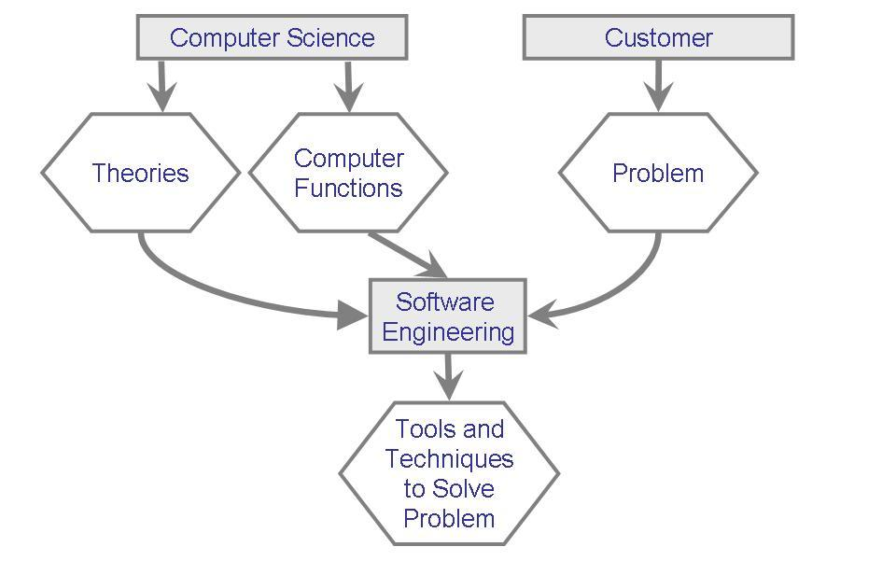
Where Does the SW Engineer Fit in? (continued)
Relationship between computer science and software engineering

Slide 31
Software process activities
Software specification, where customers and engineers define the software that is to be produced and the constraints on its operation.
Software development, where the software is designed and programmed.
Software validation, where the software is checked to ensure that it is what the customer requires.
Software evolution, where the software is modified to reflect changing customer and market requirements.

Slide 32
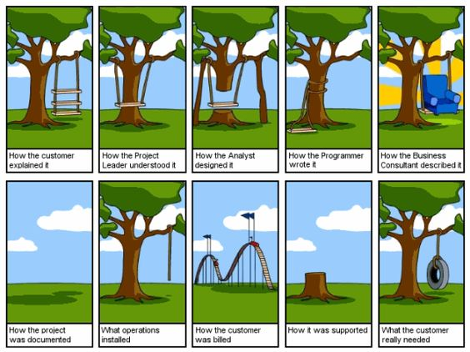
Software process activities

Slide 33
Engineering Approach Building a System
Requirement analysis and definition
System design
Program design
Writing the programs
Unit testing
Integration testing
System testing
System delivery
Maintenance

Slide 34
Members of the Development Team
Requirement analysts: work with the customers to identify and document the requirements
Designers: generate a system-level description of what the system us supposed to do
Programmers: write lines of code to implement the design
Testers: catch faults
Trainers: show users how to use the system
Maintenance team: fix faults that show up later
Librarians: prepare and store documents such as software requirements
Configuration management team: maintain correspondence among various artifacts

Slide 35
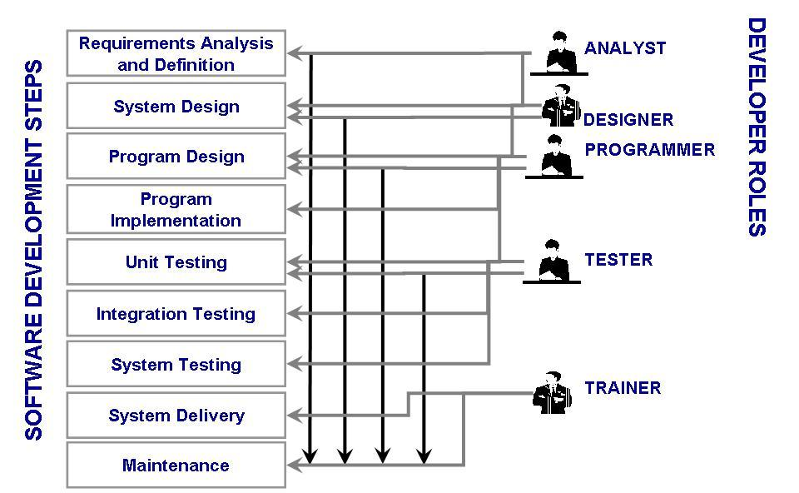
Members of the Development Team
Typical roles played by the members of a development team

Slide 36
Essential attributes of good software
Product characteristic | Description
Maintainability | Software should be written in such a way so that it can evolve to meet the changing needs of customers. This is a critical attribute because software change is an inevitable requirement of a changing business environment.
Dependability and security | Software dependability includes a range of characteristics including reliability, security and safety. Dependable software should not cause physical or economic damage in the event of system failure. Malicious users should not be able to access or damage the system.
Efficiency | Software should not make wasteful use of system resources such as memory and processor cycles. Efficiency therefore includes responsiveness, processing time, memory utilisation, etc.
Acceptability | Software must be acceptable to the type of users for which it is designed. This means that it must be understandable, usable and compatible with other systems that they use.

Slide 37
General issues that affect software
Heterogeneity
Increasingly, systems are required to operate as distributed systems across networks that include different types of computer and mobile devices.
Business and social change
Business and society are changing incredibly quickly as emerging economies develop and new technologies become available. They need to be able to change their existing software and to rapidly develop new software.
Security and trust
As software is intertwined with all aspects of our lives, it is essential that we can trust that software.
Scale
Software has to be developed across a very wide range of scales, from very small embedded systems in portable or wearable devices through to Internet-scale, cloud-based systems that serve a global community.

Slide 38
Software engineering fundamentals
Some fundamental principles apply to all types of software system, irrespective of the development techniques used:
Systems should be developed using a managed and understood development process. Of course, different processes are used for different types of software.
Dependability and performance are important for all types of system.
Understanding and managing the software specification and requirements (what the software should do) are important.
Where appropriate, you should reuse software that has already been developed rather than write new software.

Slide 39
Internet software engineering
The Web is now a platform for running application and organizations are increasingly developing web-based systems rather than local systems.
Web services allow application functionality to be accessed over the web.
Cloud computing is an approach to the provision of computer services where applications run remotely on the ‘cloud’.
Users do not buy software buy pay according to use.

Slide 40
Web-based software engineering
Web-based systems are complex distributed systems but the fundamental principles of software engineering discussed previously are as applicable to them as they are to any other types of system.
The fundamental ideas of software engineering apply to web-based software in the same way that they apply to other types of software system.

Slide 41
How Has SE Changed?
The key factors that have changed the software development

Slide 42
How Has SE Changed? Wasserman's Discipline of Software Engineering
Abstractions
Analysis and design methods and notations
User interface prototyping
Software architecture
Software process
Reuse
Measurement
Tools and integrated environments

Slide 43
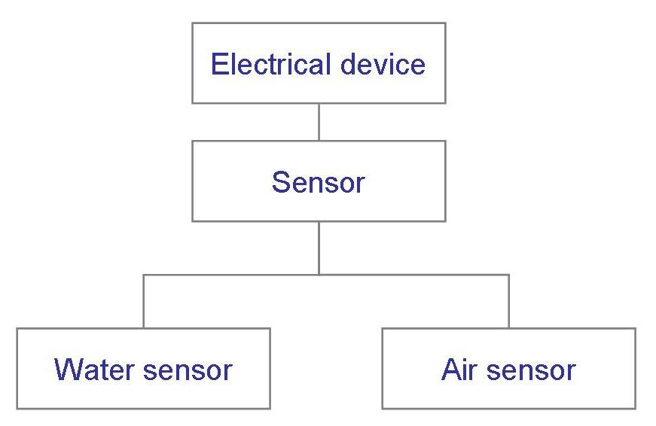
How Has SE Changed? Abstraction
A description of the problem at some level of generalization
Hide details

Slide 44
How Has SE Changed? Analysis and Design Methods and Notations
Provide documentation
Facilitate communication
Offer multiple views
Unify different views

Slide 45
How Has SE Changed? User Interface Prototyping
Prototyping: building a small version of a system
Help users identify key requirements of a system
Demonstrate feasibility
Develop good user interface

Slide 46
Software engineering ethics

Slide 47
Software engineering ethics
Software engineering involves wider responsibilities than simply the application of technical skills.
Software engineers must behave in an honest and ethically responsible way if they are to be respected as professionals.
Ethical behaviour is more than simply upholding the law but involves following a set of principles that are morally correct.

Slide 48
Issues of professional responsibility
Confidentiality
Engineers should normally respect the confidentiality of their employers or clients irrespective of whether or not a formal confidentiality agreement has been signed.
Competence
Engineers should not misrepresent their level of competence. They should not knowingly accept work which is outwith their competence.

Slide 49
Issues of professional responsibility
Intellectual property rights
Engineers should be aware of local laws governing the use of intellectual property such as patents, copyright, etc. They should be careful to ensure that the intellectual property of employers and clients is protected.
Computer misuse
Software engineers should not use their technical skills to misuse other people’s computers. Computer misuse ranges from relatively trivial (game playing on an employer’s machine, say) to extremely serious (dissemination of viruses).

Slide 50
ACM/IEEE Code of Ethics
The professional societies in the US have cooperated to produce a code of ethical practice.
Members of these organisations sign up to the code of practice when they join.
The Code contains eight Principles related to the behaviour of and decisions made by professional software engineers, including practitioners, educators, managers, supervisors and policy makers, as well as trainees and students of the profession.

Slide 51
Ethical dilemmas
Disagreement in principle with the policies of senior management.
Your employer acts in an unethical way and releases a safety-critical system without finishing the testing of the system.
Participation in the development of military weapons systems or nuclear systems.

Slide 52
Key points
Software engineering is an engineering discipline that is concerned with all aspects of software production.
Essential software product attributes are maintainability, dependability and security, efficiency and acceptability.
The high-level activities of specification, development, validation and evolution are part of all software processes.
The fundamental notions of software engineering are universally applicable to all types of system development.

Slide 53
Key points
There are many different types of system and each requires appropriate software engineering tools and techniques for their development.
Software engineers have responsibilities to the engineering profession and society. They should not simply be concerned with technical issues.
Professional societies publish codes of conduct which set out the standards of behaviour expected of their members.

Slide 54
Next time
Wednesday
Process Models, Methodologies, Requirement Analysis
Project Overview and Teams
Remember: Assignment 1 is due – Your one page resume, at 8-46 by 4pm

