Slide 1
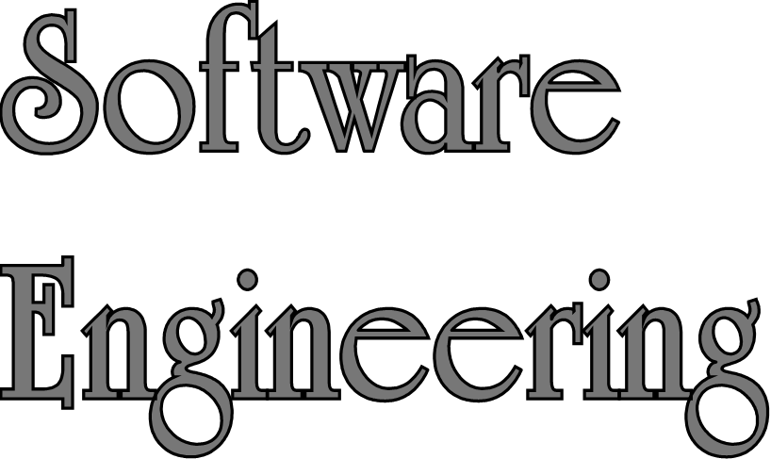
Lecture 4 – Requirement Engineering
Sampath Jayarathna
Cal Poly Pomona
Based on slides created by Ian Sommerville & Gary Kimura

Slide 2
Topics covered
Functional and non-functional requirements
Requirements engineering processes
Requirements elicitation
Requirements specification
Requirements validation
Requirements change

Slide 3
Requirements engineering
The process of establishing the services that a customer requires from a system and the constraints under which it operates and is developed.
The system requirements are the descriptions of the system services and constraints that are generated during the requirements engineering process.

Slide 4
What is a requirement?
It may range from a high-level abstract statement of a service or of a system constraint to a detailed mathematical functional specification.
This is inevitable as requirements may serve a dual function
  May be the basis for a bid for a contract - therefore must be open to interpretation;
  May be the basis for the contract itself - therefore must be defined in detail;
  Both these statements may be called requirements.

Slide 5
Types of requirement
User requirements
  Statements in natural language plus diagrams of the services the system provides and its operational constraints. Written for customers.
System requirements
  A structured document setting out detailed descriptions of the system’s functions, services and operational constraints. Defines what should be implemented so may be part of a contract between client and contractor.

Slide 6
User and system requirements

Slide 7
Agile methods and requirements
Many agile methods argue that producing detailed system requirements is a waste of time as requirements change so quickly.
The requirements document is therefore always out of date.
Agile methods usually use incremental requirements engineering and may express requirements as ‘user stories’.
This is practical for business systems but problematic for systems that require pre-delivery analysis (e.g. critical systems) or systems developed by several teams.

Slide 8
Functional and non-functional requirements
Functional requirements
  Statements of services the system should provide, how the system should react to particular inputs and how the system should behave in particular situations.
  May state what the system should not do.
Non-functional requirements
  Constraints on the services or functions offered by the system such as timing constraints, constraints on the development process, standards, etc.
  Often apply to the system as a whole rather than individual features or services.
Domain requirements
  Constraints on the system from the domain of operation

Slide 9
Functional requirements
Describe functionality or system services.
Depend on the type of software, expected users and the type of system where the software is used.
Functional user requirements may be high-level statements of what the system should do.
Functional system requirements should describe the system services in detail.

Slide 10
functional Vs non-functional requirements
An example of a functional requirement would be:
  A system must send an email whenever a certain condition is met (e.g. an order is placed, a customer signs up, etc).
A related non-functional requirement for the system may be:
  Emails should be sent with a latency of no greater than 12 hours from such an activity.
The functional requirement is describing the behavior of the system as it relates to the system's functionality. The non-functional requirement elaborates a performance characteristic of the system.

Slide 11
Requirements imprecision
Problems arise when functional requirements are not precisely stated.
Ambiguous requirements may be interpreted in different ways by developers and users.
Consider both
  User intention
  Developer interpretation

Slide 12
Requirements completeness and consistency
In principle, requirements should be both complete and consistent.
Complete
  They should include descriptions of all facilities required.
Consistent
  There should be no conflicts or contradictions in the descriptions of the system facilities.
In practice, because of system and environmental complexity, it is impossible to produce a complete and consistent requirements document.

Slide 13
Non-functional requirements
These define system properties and constraints e.g. reliability, response time and storage requirements. Constraints are I/O device capability, system representations, etc.
Process requirements may also be specified mandating a particular IDE, programming language or development method.
Non-functional requirements may be more critical than functional requirements. If these are not met, the system may be useless.

Slide 14
Types of nonfunctional requirement

Slide 15
Non-functional requirements implementation
Non-functional requirements may affect the overall architecture of a system rather than the individual components.
  For example, to ensure that performance requirements are met, you may have to organize the system to minimize communications between components.
A single non-functional requirement, such as a security requirement, may generate a number of related functional requirements that define system services that are required.
  It may also generate requirements that restrict existing requirements.

Slide 16
Non-functional classifications
Product requirements
  Requirements which specify that the delivered product must behave in a particular way e.g. execution speed, reliability, etc.
Organisational requirements
  Requirements which are a consequence of organisational policies and procedures e.g. process standards used, implementation requirements, etc.
External requirements
  Requirements which arise from factors which are external to the system and its development process e.g. interoperability requirements, legislative requirements, etc.

Slide 17
Metrics for specifying nonfunctional requirements
Property | Measure
Speed | Processed transactions/second User/event response time Screen refresh time
Size | Mbytes Number of ROM chips
Ease of use | Training time Number of help frames
Reliability | Mean time to failure Probability of unavailability Rate of failure occurrence Availability
Robustness | Time to restart after failure Percentage of events causing failure Probability of data corruption on failure
Portability | Percentage of target dependent statements Number of target systems

Slide 18
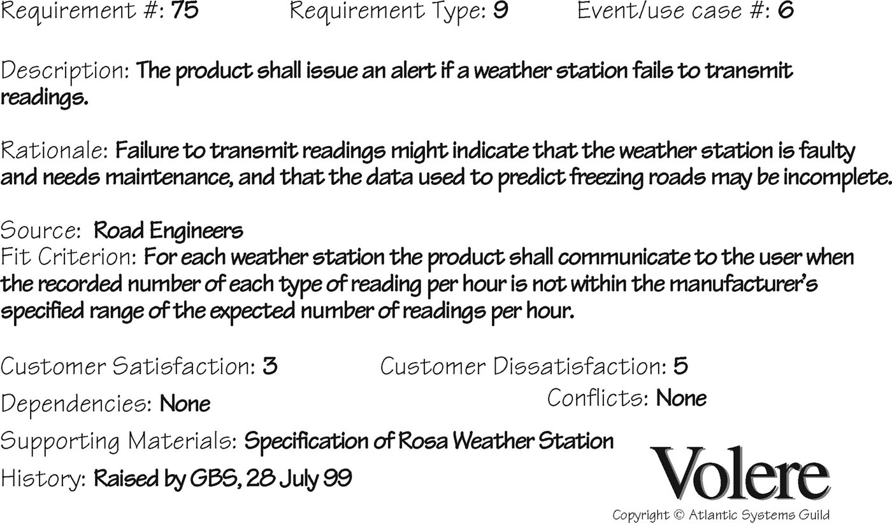
Volere shell (Snow card)

Slide 19
Volere shell
Requirement Type
  The type of the requirement as defined in the Volere requirements template. In summary the types are: Functional, Constraint and Non Functional (there are many non functional sub types)
Fit Criterion
  A measurement of the requirement such that it is possible to nonsubjectively test whether the solution fits the original requirement.
Customer Satisfaction
  On a scale from 1 to 5 how much benefit will result if a solution that fits this requirement is delivered?
Customer Dissatisfaction
  On a scale from 1 to 5 how much damage will there be if we cannot deliver a solution that fits this requirement?

Slide 20
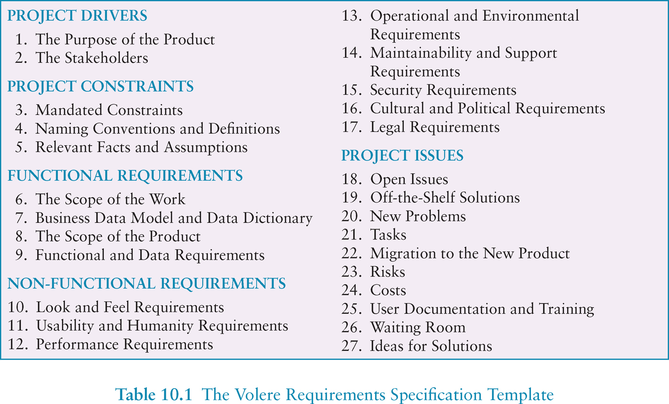
Volere requirements template

Slide 21
Case Study : Functional and Non-functional
Suppose that you have to develop software for cash dispenser. You should develop software for both cash dispenser, i.e. the part for communication with the customers (delivering money and report the account state), the software for communication and software needed in banks for communicate with the bank transaction systems. You have a team of 10 people – all of them can play a role of designers, developers, testers and document writers. You have got a contract to implement the first version in 6 months. All hardware and development tools are available. In the project 5 banks are included that use 2 different transaction systems. The customer wants that you incrementally implement the system – first the cash dispenser software, then the interface to the bank account system, finally the communication. The total system should be delivered after 6 months.

Slide 22
Requirements engineering processes
The processes used for RE vary widely depending on the application domain, the people involved and the organisation developing the requirements.
However, there are a number of generic activities common to all processes
  Requirements elicitation;
  Requirements analysis;
  Requirements validation;
  Requirements management.
In practice, RE is an iterative activity in which these processes are interleaved.

Slide 23
Requirements elicitation and analysis
Sometimes called requirements elicitation or requirements discovery.
Involves technical staff working with customers to find out about the application domain, the services that the system should provide and the system’s operational constraints.
May involve end-users, managers, engineers involved in maintenance, domain experts, trade unions, etc. These are called stakeholders.

Slide 24
System stakeholders
Any person or organization who is affected by the system in some way and so who has a legitimate interest
Stakeholder types
  End users
  System managers
  System owners
  External stakeholders

Slide 25
Case Study : Stakeholders
Suppose that you have to develop software for cash dispenser. You should develop software for both cash dispenser, i.e. the part for communication with the customers (delivering money and report the account state), the software for communication and software needed in banks for communicate with the bank transaction systems. You have a team of 10 people – all of them can play a role of designers, developers, testers and document writers. You have got a contract to implement the first version in 6 months. All hardware and development tools are available. In the project 5 banks are included that use 2 different transaction systems. The customer wants that you incrementally implement the system – first the cash dispenser software, then the interface to the bank account system, finally the communication. The total system should be delivered after 6 months.

Slide 26
Requirements elicitation
Software engineers work with a range of system stakeholders to find out about the application domain, the services that the system should provide, the required system performance, hardware constraints, other systems, etc.
Stages include:
  Requirements discovery,
  Requirements classification and organization,
  Requirements prioritization and negotiation,
  Requirements specification.

Slide 27
Problems of requirements elicitation
Stakeholders don’t know what they really want.
Stakeholders express requirements in their own terms.
Different stakeholders may have conflicting requirements.
Organisational and political factors may influence the system requirements.
The requirements change during the analysis process. New stakeholders may emerge and the business environment may change.

Slide 28
The requirements elicitation and analysis process

Slide 29
Process activities
Requirements discovery
  Interacting with stakeholders to discover their requirements. Domain requirements are also discovered at this stage.
Requirements classification and organisation
  Groups related requirements and organises them into coherent clusters.
Prioritisation and negotiation
  Prioritising requirements and resolving requirements conflicts.
Requirements specification
  Requirements are documented and input into the next round of the spiral.

Slide 30
Requirements discovery
The process of gathering information about the required and existing systems and distilling the user and system requirements from this information.
Interaction is with system stakeholders from managers to external regulators.
Systems normally have a range of stakeholders.

Slide 31
Requirement Gathering
The importance of requirements
Data gathering for requirements
Data analysis and presentation
Task description: Scenarios
Use Cases
Essential use cases
Task analysis: HTA

Slide 32
What, how and why?
What needs to be achieved?
Understand as much as possible about users, task, context
Produce a stable set of requirements
How can this be done?
Data gathering activities
Data analysis activities
Expression as ‘requirements’
All of this is iterative

Slide 33
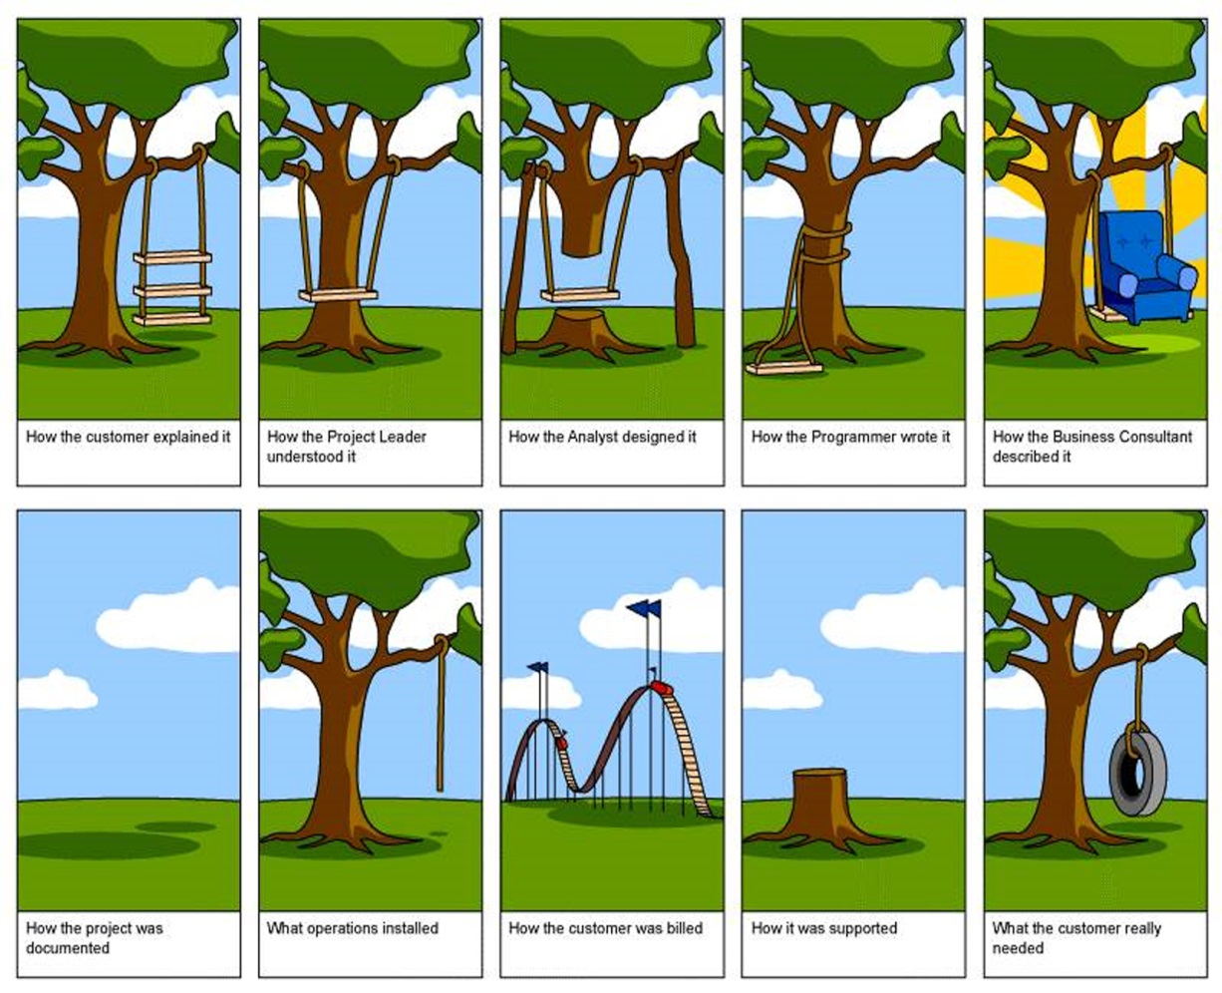
What, how and why?
Why bother?
  Requirements definition is the stage where failure occurs most commonly
Getting requirements right is crucial
33

Slide 34
Establishing requirements
What do users want? What do users ‘need’?
  Requirements need clarification, refinement, completion, re-scoping
  Input: Requirements document (maybe)
  Output: stable requirements
Why ‘establish’?
  Requirements arise from understanding users’ needs
  Requirements can be justified & related to data

Slide 35
Different kinds of requirements
Users: Who are they?
  Characteristics: nationality, educational background, attitude to computers
  System use: novice, expert, casual, frequent
    Novice: prompted, constrained, clear
    Expert: flexibility, access/power
    Frequent: short cuts
    Casual/infrequent: clear menu paths

Slide 36


What are the users’ capabilities?
Humans vary in many dimensions:
  size of hands may affect the size and positioning of input buttons
  motor abilities may affect the suitability of certain input and output devices
  height if designing a physical kiosk
  strength - a child’s toy requires little strength to operate, but greater strength to change batteries
  disabilities (e.g. sight, hearing, dexterity)

Slide 37
Personas
Capture a set of user characteristics (user profile)
Not real people, but synthesised from real users
Should not be idealised
Bring them to life with a name, characteristics, goals, personal background
Develop a small set of personas with one primary

Slide 38
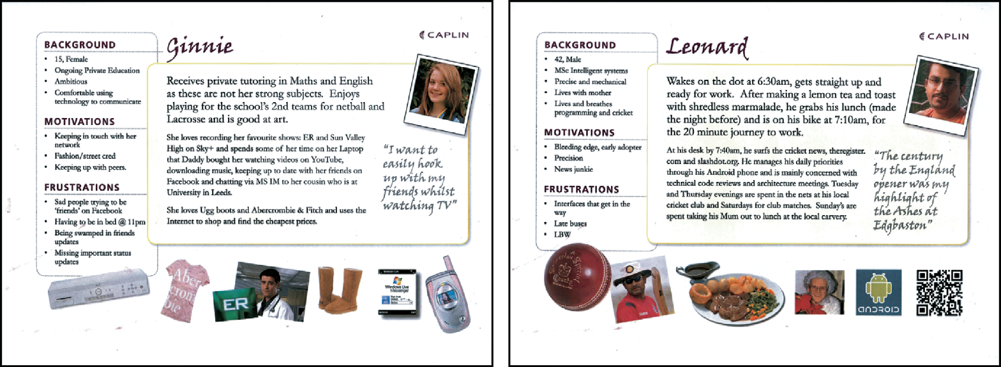
Example Persona

Slide 39
Data gathering for requirements
Interviews:
  Props, e.g. sample scenarios of use,
  prototypes, can be used in interviews
  Good for exploring issues
  Development team members can connect with stakeholders
Focus groups:
  Group interviews
  Good at gaining a consensus view and/or highlighting areas of conflict
  But can be dominated by individuals

Slide 40
Data gathering for requirements
Questionnaires:
  Often used in conjunction with other
  techniques
  Can give quantitative or qualitative data
  Good for answering specific questions from
  a large, dispersed group of people
Researching similar products:
  Good for prompting requirements

Slide 41
Data gathering for requirements
Direct observation:
  Gain insights into stakeholders’ tasks
  Good for understanding the nature and
  context of the tasks
  But, it requires time and commitment
  from a member of the design team, and
  it can result in a huge amount of data
Indirect observation:
  Not often used in requirements activity
  Good for logging current tasks

Slide 42
Data gathering for requirements
Studying documentation:
  Procedures and rules are often written
  down in manuals
  Good source of data about the steps
  involved in an activity, and any
  regulations governing a task
  Not to be used in isolation
  Good for understanding legislation, and
  getting background information
  No stakeholder time, which is a limiting
  factor on the other techniques

Slide 43
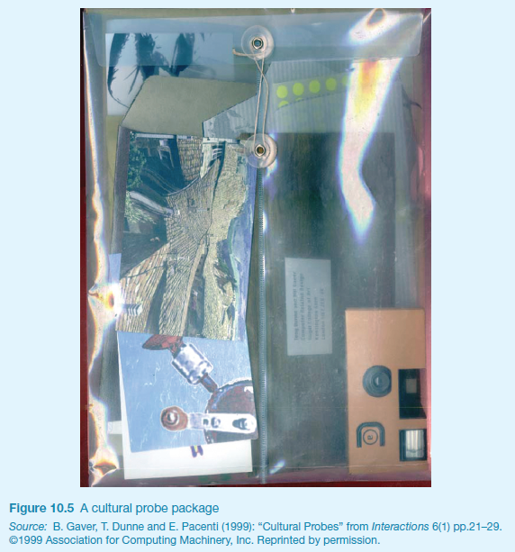
Some examples
Cultural probes

Slide 44
Contextual Inquiry
An approach to ethnographic study where user is expert, designer is apprentice
A form of interview, but
  at users’ workplace (workstation)
  2 to 3 hours long
Four main principles:
  Context: see workplace & what happens
  Partnership: user and developer collaborate
  Interpretation: observations interpreted by user and developer together
  Focus: project focus to understand what to look for

Slide 45
Data interpretation and analysis
Start soon after data gathering session
Initial interpretation before deeper analysis
Different approaches emphasize different elements e.g. class diagrams for object-oriented systems, entity-relationship diagrams for data intensive systems

Slide 46
Task descriptions
Scenarios
  an informal narrative story, simple, ‘natural’, personal, not generalizable
Use cases
  assume interaction with a system
  assume detailed understanding of the interaction
Essential use cases
  abstract away from the details
  does not have the same assumptions as use cases

Slide 47
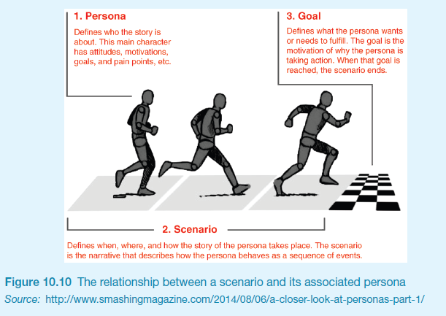
Scenarios and Personas

Slide 48
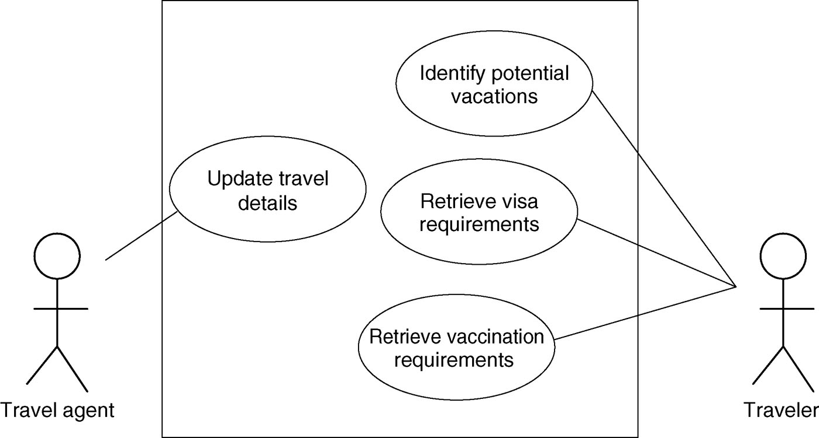
Example use case diagram for travel organizer

Slide 49
Example essential use case (business use case) for travel organizer
retrieve Visa
USER INTENTION SYSTEM RESPONSIBILITY
find visa requirements request destination and nationality
supply required information obtain appropriate visa info
obtain copy of visa info offer info in different formats
choose suitable format provide info in chosen format

Slide 50
Task analysis
Task descriptions are often used to envision new systems or devices
Task analysis is used mainly to investigate an existing situation
It is important not to focus on superficial activities
  What are people trying to achieve?
  Why are they trying to achieve it?
  How are they going about it?
Many techniques, the most popular is Hierarchical Task Analysis (HTA)

Slide 51
Hierarchical Task Analysis
Involves breaking a task down into subtasks, then sub-sub-tasks and so on. These are grouped as plans which specify how the tasks might be performed in practice
HTA focuses on physical and observable actions, and includes looking at actions not related to software or an interaction device
Start with a user goal which is examined and the main tasks for achieving it are identified
Tasks are sub-divided into sub-tasks

Slide 52
Example Hierarchical Task Analysis
0. In order to buy a DVD
1. locate DVD
2. add DVD to shopping basket
3. enter payment details
4. complete address
5. confirm order
plan 0: If regular user do 1-2-5.
If new user do 1-2-3-4-5.

Slide 53
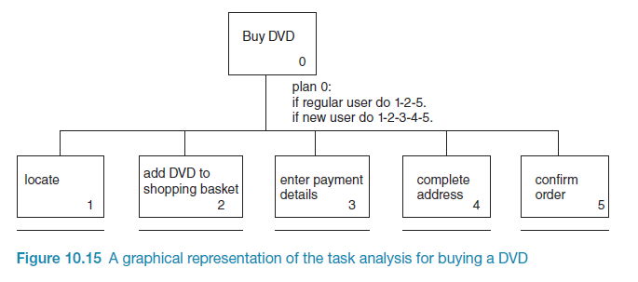
Example Hierarchical Task Analysis

Slide 54
Requirements specification
The process of writing down the user and system requirements in a requirements document.
User requirements have to be understandable by end-users and customers who do not have a technical background.
System requirements are more detailed requirements and may include more technical information.
The requirements may be part of a contract for the system development
  It is therefore important that these are as complete as possible.

Slide 55
Ways of writing a system requirements specification
Notation | Description
Natural language | The requirements are written using numbered sentences in natural language. Each sentence should express one requirement.
Structured natural language | The requirements are written in natural language on a standard form or template. Each field provides information about an aspect of the requirement.
Design description languages | This approach uses a language like a programming language, but with more abstract features to specify the requirements by defining an operational model of the system. This approach is now rarely used although it can be useful for interface specifications.
Graphical notations | Graphical models, supplemented by text annotations, are used to define the functional requirements for the system; UML use case and sequence diagrams are commonly used.
Mathematical specifications | These notations are based on mathematical concepts such as finite-state machines or sets. Although these unambiguous specifications can reduce the ambiguity in a requirements document, most customers don’t understand a formal specification. They cannot check that it represents what they want and are reluctant to accept it as a system contract

Slide 56
Requirements and design
In principle, requirements should state what the system should do and the design should describe how it does this.
In practice, requirements and design are inseparable
  A system architecture may be designed to structure the requirements;
  The system may inter-operate with other systems that generate design requirements;
  The use of a specific architecture to satisfy non-functional requirements may be a domain requirement.
  This may be the consequence of a regulatory requirement.

Slide 57
Natural language specification
Requirements are written as natural language sentences supplemented by diagrams and tables.
Used for writing requirements because it is expressive, intuitive and universal. This means that the requirements can be understood by users and customers.

Slide 58
Guidelines for writing requirements
Invent a standard format and use it for all requirements.
Use language in a consistent way. Use shall for mandatory requirements, should for desirable requirements.
Use text highlighting to identify key parts of the requirement.
Avoid the use of computer jargon.
Include an explanation (rationale) of why a requirement is necessary.

Slide 59
Problems with natural language
Lack of clarity
  Precision is difficult without making the document difficult to read.
Requirements confusion
  Functional and non-functional requirements tend to be mixed-up.
Requirements amalgamation
  Several different requirements may be expressed together.

Slide 60
Example requirements for the insulin pump software system
3.2 The system shall measure the blood sugar and deliver insulin, if required, every 10 minutes. (Changes in blood sugar are relatively slow so more frequent measurement is unnecessary; less frequent measurement could lead to unnecessarily high sugar levels.) 3.6 The system shall run a self-test routine every minute with the conditions to be tested and the associated actions defined in Table 1. (A self-test routine can discover hardware and software problems and alert the user to the fact the normal operation may be impossible.)

Slide 61
Structured specifications
An approach to writing requirements where the freedom of the requirements writer is limited and requirements are written in a standard way.
  IEEE Requirement Specification Document
  Volere requirements template
This works well for some types of requirements e.g. requirements for embedded control system but is sometimes too rigid for writing business system requirements.

Slide 62
Form-based specifications
Definition of the function or entity.
Description of inputs and where they come from.
Description of outputs and where they go to.
Information about the information needed for the computation and other entities used.
Description of the action to be taken.
Pre and post conditions (if appropriate).
The side effects (if any) of the function.

Slide 63
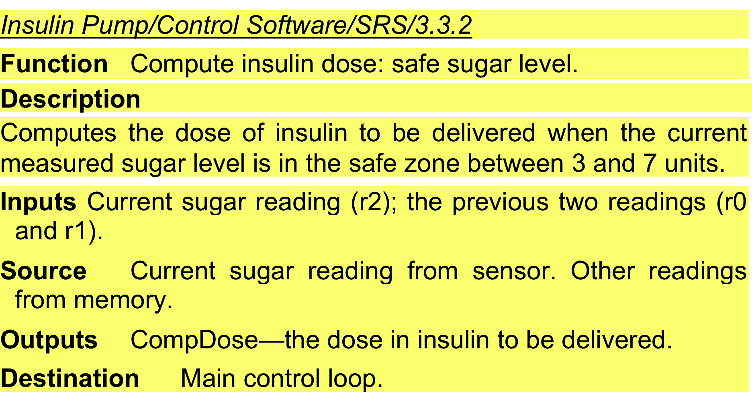
A structured specification of a requirement for an insulin pump

Slide 64
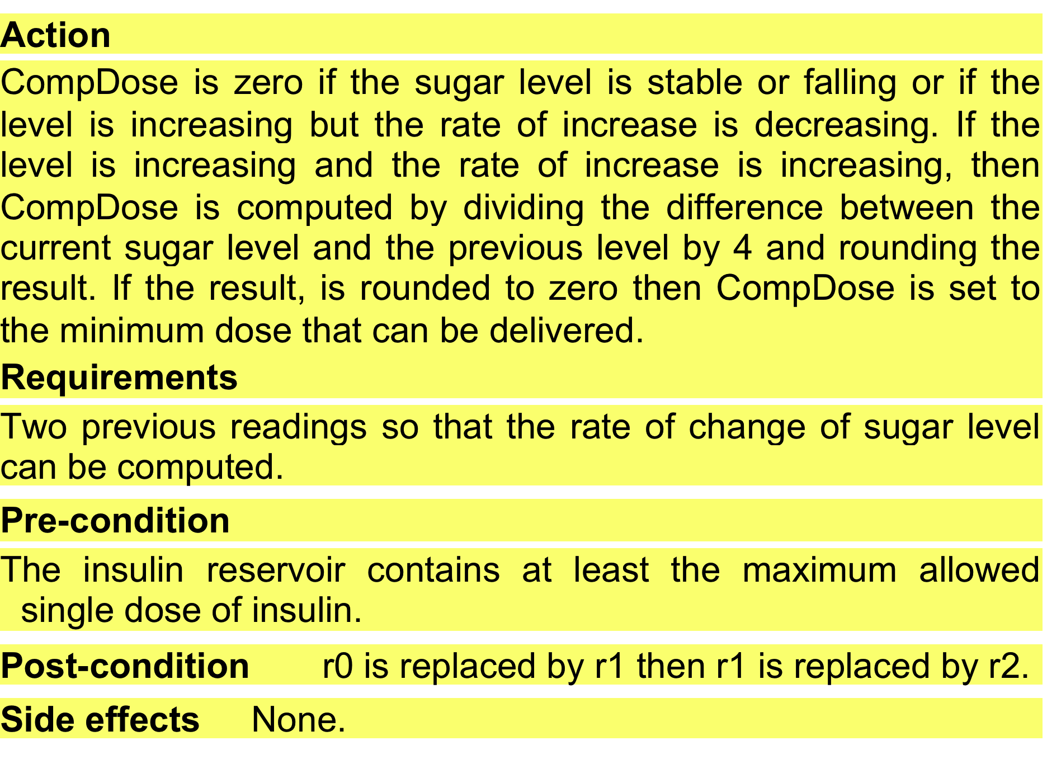
A structured specification of a requirement for an insulin pump

Slide 65
The software requirements document
The software requirements document is the official statement of what is required of the system developers.
Should include both a definition of user requirements and a specification of the system requirements.
It is NOT a design document. As far as possible, it should set of WHAT the system should do rather than HOW it should do it.

Slide 66
Users of a requirements document

Slide 67
Requirements validation
Concerned with demonstrating that the requirements define the system that the customer really wants.
Requirements error costs are high so validation is very important
  Fixing a requirements error after delivery may cost up to 100 times the cost of fixing an implementation error.

Slide 68
Requirements checking
Validity. Does the system provide the functions which best support the customer’s needs?
Consistency. Are there any requirements conflicts?
Completeness. Are all functions required by the customer included?
Realism. Can the requirements be implemented given available budget and technology
Verifiability. Can the requirements be checked?

Slide 69
Requirements validation techniques
Requirements reviews
  Systematic manual analysis of the requirements.
Prototyping
  Using an executable model of the system to check requirements. Covered in Lecture 2.
Test-case generation
  Developing tests for requirements to check testability.

Slide 70
Requirements reviews
Regular reviews should be held while the requirements definition is being formulated.
Both client and contractor staff should be involved in reviews.
Reviews may be formal (with completed documents) or informal. Good communications between developers, customers and users can resolve problems at an early stage.

Slide 71
Key points
Requirements for a software system set out what the system should do and define constraints on its operation and implementation.
Functional requirements are statements of the services that the system must provide or are descriptions of how some computations must be carried out.
Non-functional requirements often constrain the system being developed and the development process being used.
They often relate to the emergent properties of the system and therefore apply to the system as a whole.

Slide 72
Key points
The requirements engineering process is an iterative process that includes requirements elicitation, specification and validation.
Requirements elicitation is an iterative process that can be represented as a spiral of activities – requirements discovery, requirements classification and organization, requirements negotiation and requirements documentation.
You can use a range of techniques for requirements elicitation including interviews and ethnography. User stories and scenarios may be used to facilitate discussions.

Slide 73
Key points
Requirements specification is the process of formally documenting the user and system requirements and creating a software requirements document.
The software requirements document is an agreed statement of the system requirements. It should be organized so that both system customers and software developers can use it.
Requirements validation is the process of checking the requirements for validity, consistency, completeness, realism and verifiability.

