Slide 1
Lecture 8 – Project Scheduling
Sampath Jayarathna
Cal Poly Pomona
Based on slides created by Pressman

Slide 2
Eight Reasons for Late Software Delivery
An unrealistic deadline established by someone outside the software engineering group and forced on managers and practitioners within the group
Changing customer requirements that are not reflected in schedule changes
An honest underestimate of the amount of effort and /or the number of resources that will be required to do the job

Slide 3
Eight Reasons for Late Software Delivery
Predictable and/or unpredictable risks that were not considered when the project commenced
Technical difficulties that could not have been foreseen in advance
Human difficulties that could not have been foreseen in advance
Miscommunication among project staff that results in delays
A failure by project management to recognize that the project is falling behind schedule and a lack of action to correct the problem

Slide 4
Quote from Napoleon
"Any commander-in-chief who undertakes to carry out
a plan which he considers defective is at fault; he must
put forth his reasons, insist on the plan being changed,
and finally tender his resignation rather than be the
instrument of his army's downfall."

Slide 5
Handling Unrealistic Deadlines
Perform a detailed estimate using historical data from past projects; determine the estimated effort and duration for the project
Using an incremental model, develop a software engineering strategy that will deliver critical functionality by the imposed deadline, but delay other functionality until later; document the plan
Meet with the customer and (using the detailed estimate) explain why the imposed deadline is unrealistic
Be certain to note that all estimates are based on performance on past projects
Also be certain to indicate the percent improvement that would be required to achieve the deadline as it currently exists

Slide 6
Handling Unrealistic Deadlines
Offer the incremental development strategy as an alternative and offer some options
Increase the budget and bring on additional resources to try to finish sooner
Remove many of the software functions and capabilities that were requested
Dispense with reality and wish the project complete using the prescribed schedule; then point out that project history and your estimates show that this is unrealistic and will result in a disaster

Slide 7
Project Scheduling

Slide 8
General Practices
On large projects, hundreds of small tasks must occur to accomplish a larger goal
Some of these tasks lie outside the mainstream and may be completed without worry of impacting on the project completion date
Other tasks lie on the critical path; if these tasks fall behind schedule, the completion date of the entire project is put into jeopardy

Slide 9
General Practices
Project manager's objectives
Define all project tasks
Build an activity network that depicts their interdependencies
Identify the tasks that are critical within the activity network
Build a timeline depicting the planned and actual progress of each task
Track task progress to ensure that delay is recognized "one day at a time"
To do this, the schedule should allow progress to be monitored and the project to be controlled

Slide 10
General Practices (continued)‏
Software project scheduling distributes estimated effort across the planned project duration by allocating the effort to specific tasks
During early stages of project planning, a macroscopic schedule is developed identifying all major process framework activities and the product functions to which they apply
Later, each task is refined into a detailed schedule where specific software tasks are identified and scheduled

Slide 11
General Practices (continued)‏
Scheduling for projects can be viewed from two different perspectives
In the first view, an end-date for release of a computer-based system has already been established and fixed
The software organization is constrained to distribute effort within the prescribed time frame
In the second view, assume that rough chronological bounds have been discussed but that the end-date is set by the software engineering organization
Effort is distributed to make best use of resources and an end-date is defined after careful analysis of the software
The first view is encountered far more often that the second

Slide 12
Basic Principles for Project Scheduling
Compartmentalization
The project must be compartmentalized into a number of manageable activities, actions, and tasks; both the product and the process are decomposed
Interdependency
The interdependency of each compartmentalized activity, action, or task must be determined
Some tasks must occur in sequence while others can occur in parallel
Some actions or activities cannot commence until the work product produced by another is available
Time allocation
Each task to be scheduled must be allocated some number of work units
In addition, each task must be assigned a start date and a completion date that are a function of the interdependencies
Start and stop dates are also established based on whether work will be conducted on a full-time or part-time basis

Slide 13
Basic Principles for Project Scheduling (continued)‏
Effort validation
Every project has a defined number of people on the team
As time allocation occurs, the project manager must ensure that no more than the allocated number of people have been scheduled at any given time
Defined responsibilities
Every task that is scheduled should be assigned to a specific team member
Defined outcomes
Every task that is scheduled should have a defined outcome for software projects such as a work product or part of a work product
Work products are often combined in deliverables
Defined milestones
Every task or group of tasks should be associated with a project milestone
A milestone is accomplished when one or more work products has been reviewed for quality and has been approved

Slide 14
Relationship Between People and Effort
Common management myth: If we fall behind schedule, we can always add more programmers and catch up later in the project
This practice actually has a disruptive effect and causes the schedule to slip even further
The added people must learn the system
The people who teach them are the same people who were earlier doing the work
During teaching, no work is being accomplished
Lines of communication (and the inherent delays) increase for each new person added

Slide 15
Effort Applied vs. Delivery Time
There is a nonlinear relationship between effort applied and delivery time (Ref: Putnam-Norden-Rayleigh Curve)‏
Effort increases rapidly as the delivery time is reduced
Also, delaying project delivery can reduce costs significantly as shown in the equation E = L³/(P³t⁴) and in the curve below
E = development effort in person-months
L = source lines of code delivered
P = productivity parameter (ranging from 2000 to 12000)‏
t = project duration in calendar months
Effort
cost
Impossible
region
E _{theoretical}
E _{optimal}
t _{minimum}
t _{theoretical}
t _{optimal}
Development time

Slide 16
40-20-40 Distribution of Effort
A recommended distribution of effort across the software process is 40% (analysis and design), 20% (coding), and 40% (testing)‏
Work expended on project planning rarely accounts for more than 2 - 3% of the total effort
Requirements analysis may comprise 10 - 25%
Effort spent on prototyping and project complexity may increase this
Software design normally needs 20 – 25%
Coding should need only 15 - 20% based on the effort applied to software design
Testing and subsequent debugging can account for 30 - 40%
Safety or security-related software requires more time for testing

Slide 17
40-20-40 Distribution of Effort (continued)‏
Example: 100-day project
6/1
6/4
6/23
7/14
8/2
9/5
P
Analysis
Design
Coding
Testing
40
20
40

Slide 18
Task Network

Slide 19
Purpose of a Task Network
Also called an activity network
It is a graphic representation of the task flow for a project
It depicts task length, sequence, concurrency, and dependency
Points out inter-task dependencies to help the manager ensure continuous progress toward project completion
The critical path
A single path leading from start to finish in a task network
It contains the sequence of tasks that must be completed on schedule if the project as a whole is to be completed on schedule
It also determines the maximum duration of the project

Slide 20
Example Task Network
Task F
2
Task G
3
Task H
5
Task B
3
Task N
2
Task A
3
Task C
7
Task E
8
Task I
4
Task J
5
Task M
0
Task D
5
Task K
3
Task L
10
Where is the critical path and what tasks are on it?

Slide 21
Example Task Network with Critical Path Marked
Task F
2
Task G
3
Task H
5
Task B
3
Task N
2
Task A
3
Task C
7
Task E
8
Task I
4
Task J
5
Task M
0
Task D
5
Task K
3
Task L
10
Critical path: A-B-C-E-K-L-M-N

Slide 22
Defining a Task Set
A task set is the work breakdown structure for the project
No single task set is appropriate for all projects and process models
It varies depending on the project type and the degree of rigor (based on influential factors) with which the team plans to work
The task set should provide enough discipline to achieve high software quality
But it must not burden the project team with unnecessary work

Slide 23
Factors that Influence a Project’s Schedule
Size of the project
Number of potential users
Mission criticality
Application longevity
Stability of requirements
Ease of customer/developer communication
Maturity of applicable technology
Performance constraints
Embedded and non-embedded characteristics
Project staff
Reengineering factors

Slide 24
Types of Software Projects
Concept development projects
Explore some new business concept or application of some new technology
New application development
Undertaken as a consequence of a specific customer request
Application enhancement
Occur when existing software undergoes major modifications to function, performance, or interfaces that are observable by the end user
Application maintenance
Correct, adapt, or extend existing software in ways that may not be immediately obvious to the end user
Reengineering projects
Undertaken with the intent of rebuilding an existing (legacy) system in whole or in part

Slide 25
Timeline Chart

Slide 26
Mechanics of a Timeline Chart
Also called a Gantt chart; invented by Henry Gantt, industrial engineer, 1917
All project tasks are listed in the far left column
The next few columns may list the following for each task: projected start date, projected stop date, projected duration, actual start date, actual stop date, actual duration, task inter-dependencies (i.e., predecessors)‏
To the far right are columns representing dates on a calendar
The length of a horizontal bar on the calendar indicates the duration of the task
When multiple bars occur at the same time interval on the calendar, this implies task concurrency
A diamond in the calendar area of a specific task indicates that the task is a milestone; a milestone has a time duration of zero
Jan Feb Mar Apr May Jun Jul Aug Sep Oct
Task #
Task Name
Duration
Start
Finish
Pred.
1
Task A
2 months
1/1
2/28
None
2
Milestone N
0
3/1
3/1
1

Slide 27
CLASS EXERCISE
Timeline chart:
4/1 4/8 4/15 4/22 4/29 5/6 5/13 5/20 5/27 6/3
Task #
Task Name
Duration
Start
Finish
Pred.
A
Establish increments
3
4/1
None
B
Analyze Inc One
3
A
C
Design Inc One
8
B
D
Code Inc One
7
C
E
Test Inc One
10
D
F
Install Inc One
5
E
G
Analyze Inc Two
7
A, B
H
Design Inc Two
5
G
I
Code Inc Two
4
H
J
Test Inc Two
6
E, I
K
Install Inc Two
2
J
L
Close out project
2
F, K
Task network and the critical path:

Slide 28
SOLUTION
Timeline chart:
4/1 4/8 4/15 4/22 4/29 5/6 5/13 5/20 5/27 6/3
Task #
Task Name
Duration
Start
Finish
Pred.
A
Establish increments
3
4/1
4/3
None
B
Analyze Inc One
3
4/4
4/6
A
C
Design Inc One
8
4/7
4/14
B
D
Code Inc One
7
4/15
4/21
C
E
Test Inc One
10
4/22
5/1
D
F
Install Inc One
5
5/2
5/6
E
G
Analyze Inc Two
7
4/7
4/13
A, B
H
Design Inc Two
5
4/14
4/18
G
I
Code Inc Two
4
4/19
4/22
H
J
Test Inc Two
6
5/2
5/7
E, I
K
Install Inc Two
2
5/8
5/9
J
L
Close out project
2
5/10
5/11
F, K
Task network and the critical path:
A-B-C-D-E-J-K-L
B. Analyze
Inc One
3
C. Design
Inc One
8
D. Code
Inc One
7
E. Test
Inc One
10
F. Install
Inc One
5
A. Establish
Increments
3
L. Close out
Project
2
G. Analyze
Inc Two
7
H. Design
Inc Two
5
I. Code
Inc Two
4
J. Test
Inc Two
6
K. Install
Inc Two
2

Slide 29
Proposed Tasks for a Long-Distance Move of 8,000 lbs of Household Goods
Pack
household
goods
Arrange for
workers to
unload truck
Make
decision
to move
Determine
destination
location
Determine
date to move
out or move in
Make
lodging
reservations
Reserve
rental truck
and supplies
Get money
to pay for
the move
Drive truck
from origin
to destination
Find lodging
with space
to park truck
Plan travel
route and
overnight stops
Lease or buy
home at
destination
Decide on
type/size of
rental truck
Return
truck and
supplies
Load
truck
Arrange for
person to
drive truck/car
Pick up
rental truck
Unload
truck
Arrange for
workers to
load truck
Where is the critical path and what tasks are on it?

Slide 30
Task Network for a Long-Distance Move of 8,000 lbs of Household Goods
2. Get money
to pay for
the move
3. Determine
date to move
out or move in
4. Determine
destination
location
12. Plan travel
route and
overnight stops
13. Find lodging
with space
to park truck
14. Make
lodging
reservations
5. Lease or buy
home at
destination
1. Make
decision
to move
6. Decide on
type/size of
rental truck
11. Milestone
18. Drive truck
from origin
to destination
19. Unload
truck
7. Arrange for
workers to
load truck
15. Reserve
rental truck
and supplies
16. Pick up
rental truck
17. Load
truck
8. Arrange for
person to
drive truck/car
20. Return
truck and
supplies
9. Arrange for
workers to
unload truck
10. Pack
household
goods
Where is the critical path and what tasks are on it?

Slide 31
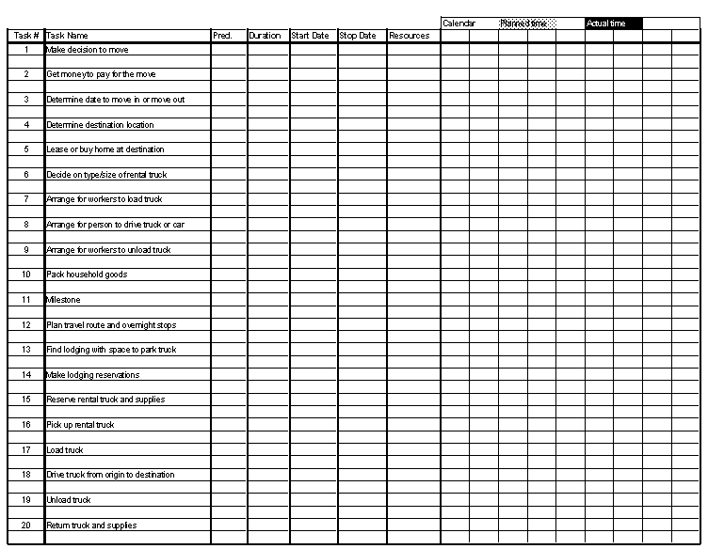
Timeline Chart for Long Distance Move

Slide 32
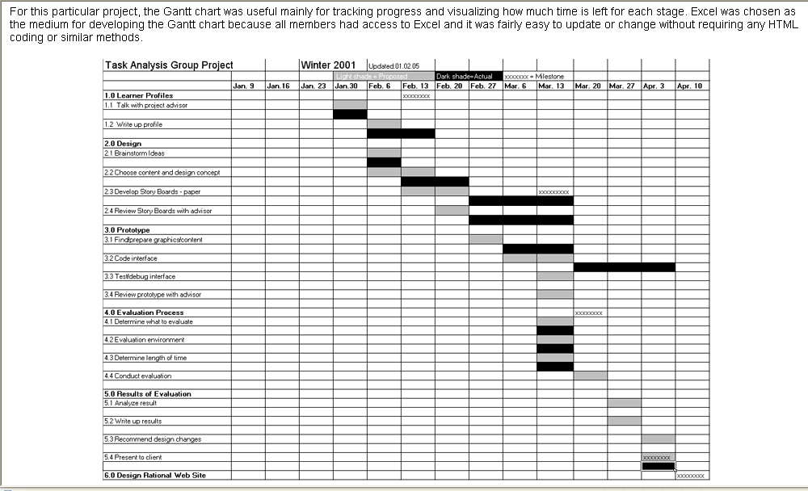
Example Timeline Chart

Slide 33
Project Control
The project manager applies control to administer project resources, cope with problems, and direct project staff
If things are going well (i.e., schedule, budget, progress, milestones) then control should be light
When problems occur, the project manager must apply tight control to reconcile the problems as quickly as possible. For example:
Staff may be redeployed
The project schedule may be redefined

Slide 34
Project Control and Time Boxing
Severe deadline pressure may require the use of time boxing
An incremental software process is applied to the project
The tasks associated with each increment are “time-boxed” (i.e., given a specific start and stop time) by working backward from the delivery date
The project is not allowed to get “stuck” on a task
When the work on a task hits the stop time of its box, then work ceases on that task and the next task begins
This approach succeeds based on the premise that when the time-box boundary is encountered, it is likely that 90% of the work is complete
The remaining 10% of the work can be
Delayed until the next increment
Completed later if required

Slide 35
Methods for Tracking the Schedule
Qualitative approaches
Conduct periodic project status meetings in which each team member reports progress and problems
Evaluate the results of all reviews conducted throughout the software engineering process
Determine whether formal project milestones (i.e., diamonds) have been accomplished by the scheduled date
Compare actual start date to planned start date for each project task listed in the timeline chart
Meet informally with the software engineering team to obtain their subjective assessment of progress to date and problems on the horizon
Quantitative approach
Use earned value analysis to assess progress quantitatively
“The basic rule of software status reporting can be summarized
in a single phrase: No surprises.” Capers Jones

Slide 36
Earned Value Analysis

Slide 37
Description of Earned Value Analysis
Earned value analysis is a measure of progress by assessing the percent of completeness for a project
It gives accurate and reliable readings of performance very early into a project
It provides a common value scale (i.e., time) for every project task, regardless of the type of work being performed
The total hours to do the whole project are estimated, and every task is given an earned value based on its estimated percentage of the total

Slide 38
Determining Earned Value
Compute the budgeted cost of work scheduled (BCWS) for each work task i in the schedule
The BCWS is the effort planned; work is estimated in person-hours or person-days for each task
To determine progress at a given point along the project schedule, the value of BCWS is the sum of the BCWS_{i} values of all the work tasks that should have been completed by that point of time in the project schedule

Slide 39
Determining Earned Value
Sum up the BCWS values for all work tasks to derive the budget at completion (BAC)‏
Compute the value for the budgeted cost of work performed (BCWP)‏
BCWP is the sum of the BCWS values for all work tasks that have actually been completed by a point of time on the project schedule

Slide 40
Progress Indicators provided through Earned Value Analysis
SPI = BCWP/BCWS
Schedule performance index (SPI) is an indication of the efficiency with which the project is utilizing scheduled resources
SPI close to 1.0 indicates efficient execution of the project schedule
SV = BCWP – BCWS
Schedule variance (SV) is an absolute indication of variance from the planned schedule
PSFC = BCWS/BAC
Percent scheduled for completion (PSFC) provides an indication of the percentage of work that should have been completed by time t
PC = BCWP/BAC
Percent complete (PC) provides a quantitative indication of the percent of work that has been completed at a given point in time t
ACWP = sum of BCWP as of time t
Actual cost of work performed (ASWP) includes all tasks that have been completed by a point in time t on the project schedule
CPI = BCWP/ACWP
A cost performance index (CPI) close to 1.0 provides a strong indication that the project is within its defined budget
CV = BCWP – ACWP
The cost variance is an absolute indication of cost savings (against planned costs) or shortfall at a particular stage of a project

