Slide 1

Lecture 9 – Cognition & Emotion
Sampath Jayarathna
Cal Poly Pomona
Based on slides from Interaction Design

Slide 2
Overview
What is cognition?
What are users good and bad at?
Explain what are Mental Models
Cover relevant theories of cognition
Notes:
2

Slide 3
Why do we need to understand users?
Interacting with technology is cognitive
Need to take into account cognitive processes involved and cognitive limitations of users
Provides knowledge about what users can and cannot be expected to do
Identifies and explains the nature and causes of problems users encounter
Supply theories, modelling tools, guidance and methods that can lead to the design of better interactive products
Notes:
3

Slide 4
Cognitive processes
Attention
Perception
Memory
Learning
Reading, speaking and listening
Problem-solving, planning, reasoning and decision-making
Notes:
4

Slide 5
Attention
Selecting things to concentrate on at a point in time from the mass of stimuli around us
Allows us to focus on information that is relevant to what we are doing
Involves audio and/or visual senses
Focussed and divided attention enables us to be selective in terms of the mass of competing stimuli but limits our ability to keep track of all events
Information at the interface should be structured to capture users’ attention, e.g. use perceptual boundaries (windows), colour, video, sound and flashing lights
Notes:
5

Slide 6
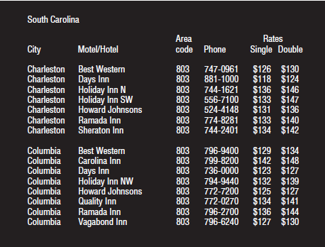
Activity: Find the price of a double room at the Holiday Inn in Columbia
Notes:
6

Slide 7
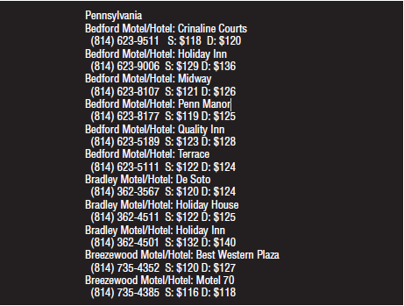
Activity: Find the price for a double room at the Quality Inn in Pennsylvania
Notes:
7

Slide 8
Activity
Tullis (1987) found that the two screens produced quite different results
  1st screen - took an average of 5.5 seconds to search
  2nd screen - took 3.2 seconds to search
Why, since both displays have the same density of information (31%)?
Spacing
  In the 1st screen the information is bunched up together, making it hard to search
  In the 2nd screen the characters are grouped into vertical categories of information making it easier
Notes:
8

Slide 9
Design implications for attention
Make information salient when it needs attending to
Use techniques that make things stand out like color, ordering, spacing, underlining, sequencing and animation
Avoid cluttering the interface with too much information
Search engines and form fill-ins that have simple and clean interfaces are easier to use
Notes:
9

Slide 10
Perception
How information is acquired from the world and transformed into experiences
The ability to see, hear, or become aware of something through the senses
Obvious implication is to design representations that are readily perceivable, e.g.
  Text should be legible
  Icons should be easy to distinguish and read
Notes:
10

Slide 11
Is color contrast good? Find Italian
Notes:
11

Slide 12
Are borders and white space better? Find french
Notes:
12

Slide 13
Activity
Weller (2004) found people took less time to locate items for information that was grouped
  using a border (2nd screen) compared with using color contrast (1st screen)
Some argue that too much white space on web pages is detrimental to search
  Makes it hard to find information
Do you agree?
Notes:
13

Slide 14

Which is easiest to read and why?
What is the time?
What is the time?
What is the time?
What is the time?
What is the time?
Notes:
14

Slide 15
Design implications
  Icons should enable users to readily distinguish their meaning
  Bordering and spacing are effective visual ways of grouping information
  Sounds should be audible and distinguishable
  Speech output should enable users to distinguish between the set of spoken words
  Text should be legible and distinguishable from the background
  Tactile feedback should allow users to recognize and distinguish different meanings
Notes:
15

Slide 16
Memory
Involves first encoding and then retrieving knowledge.
We don’t remember everything - involves filtering and processing what is attended to
Context is important in affecting our memory (i.e. where, when)
We recognize things much better than being able to recall things
we remember less about objects we have photographed than when we observe them with the naked eye (Henkel, 2014)
Notes:
16

Slide 17
Processing in memory
Encoding is first stage of memory
  determines which information is attended to in the environment and how it is interpreted
The more attention paid to something…
The more it is processed in terms of thinking about it and comparing it with other knowledge…
The more likely it is to be remembered
  e.g. when learning about HCI, it is much better to reflect upon it, carry out exercises, have discussions with others about it, and write notes than just passively read a book, listen to a lecture or watch a video about it
Notes:
17

Slide 18
Context is important
Context affects the extent to which information can be subsequently retrieved
Sometimes it can be difficult for people to recall information that was encoded in a different context:
  “You are on a train and someone comes up to you and says hello. You don’t recognize him for a few moments but then realize it is one of your neighbours. You are only used to seeing your neighbour in the hallway of your apartment block and seeing him out of context makes him difficult to recognize initially”
Notes:
18

Slide 19
Activity
Try to remember the dates of your grandparents’ birthday
Try to remember the cover of the last two DVDs you bought or rented
Which was easiest? Why?
People are very good at remembering visual cues about things
  e.g. the color of items, the location of objects and marks on an object
They find it more difficult to learn and remember arbitrary material
  e.g. birthdays and phone numbers
Notes:
19

Slide 20
Recognition versus recall
Command-based interfaces require users to recall from memory a name from a possible set of 100s
GUIs provide MP3 players visually-based options that users need only browse through until they recognize one
Web browsers, etc., provide lists of visited URLs, song titles etc., that support recognition memory
Notes:
20

Slide 21
The problem with the classic ‘7±2’
George Miller’s (1956) theory of how much information people can remember
People’s immediate memory capacity is very limited
Many designers think this is useful finding for interaction design
But…
Notes:
21

Slide 22
What some designers get up to…
Present only 7 options on a menu
Display only 7 icons on a tool bar
Have no more than 7 bullets in a list
Place only 7 items on a pull down menu
Place only 7 tabs on the top of a website page
      But this is wrong? Why?
Notes:
22

Slide 23
Why?
Inappropriate application of the theory
People can scan lists of bullets, tabs, menu items for the one they want
They don’t have to recall them from memory having only briefly heard or seen them
Sometimes a small number of items is good
But depends on task and available screen estate
Notes:
23

Slide 24
Digital content management
Is a growing problem for many users
  vast numbers of documents, images, music files, video clips, emails, attachments, bookmarks, etc.,
  where and how to save them all, then remembering what they were called and where to find them again
  naming most common means of encoding them
  but can be difficult to remember, especially when have 1000s and 1000s
  How might such a process be facilitated taking into account people’s memory abilities?
Notes:
24

Slide 25
Digital content management
Memory involves 2 processes
  recall-directed and recognition-based scanning
File management systems should be designed to optimize both kinds of memory processes
  e.g. Search box and history list
Help users encode files in richer ways
  Provide them with ways of saving files using color, flagging, image, flexible text, time stamping, etc.
Notes:
25

Slide 26
Memory aids
SenseCam developed by Microsoft Research Labs (now Autographer)
a wearable device that intermittently takes photos without any user intervention while worn
digital images taken are stored and revisited using special software
Has been found to improve people’s memory, suffering from Alzheimers

Slide 27
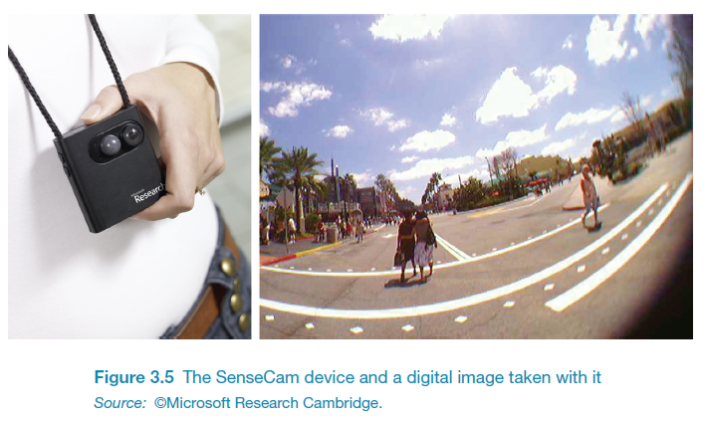
SenseCam

Slide 28
Design implications
Don’t overload users’ memories with complicated procedures for carrying out tasks
Design interfaces that promote recognition rather than recall
Provide users with various ways of encoding information to help them remember
  e.g. categories, color, flagging, time stamping
Notes:
28

Slide 29
Learning
How to learn to use a computer-based application
Using a computer-based application or YouTube video to understand a given topic
People find it hard to learn by following instructions in a manual
    prefer to learn by doing

Slide 30
Cognitive prosthetic devices
We rely more and more on the internet and smartphones to look things up
Expecting to have internet access reduces the need and extent to which we remember
Also enhances our memory for knowing where to find it online (Sparrow et al,2011)
What are implications for designing technologies to support how people will learn, and what they learn?

Slide 31
Design implications
Design interfaces that encourage exploration
Design interfaces that constrain and guide learners
Dynamically linking concepts and representations can facilitate the learning of complex material

Slide 32
Reading, speaking, and listening
The ease with which people can read, listen, or speak differs
  Many prefer listening to reading
  Reading can be quicker than speaking or listening
  Listening requires less cognitive effort than reading or speaking
  Dyslexics have difficulties understanding and recognizing written words

Slide 33
Applications
Speech-recognition systems allow users to interact with them by asking questions
  e.g. Google Voice, Siri
Speech-output systems use artificially generated speech
  e.g. written-text-to-speech systems for the blind
Natural-language systems enable users to type in questions and give text-based responses
  e.g. Ask search engine

Slide 34
Design implications
Speech-based menus and instructions should be short
Accentuate the intonation of artificially generated speech voices
  they are harder to understand than human voices
Provide opportunities for making text large on a screen

Slide 35
Problem-solving, planning, reasoning and decision-making
All involves reflective cognition
  e.g. thinking about what to do, what the options are, and the consequences
Often involves conscious processes, discussion with others (or oneself), and the use of artefacts
  e.g. maps, books, pen and paper
May involve working through different scenarios and deciding which is best option

Slide 36
Design implications
Provide additional information/functions for users who wish to understand more about how to carry out an activity more effectively
Use simple computational aids to support rapid decision-making and planning for users on the move

Slide 37
Dilemma
The app mentality developing in the psyche of the younger generation is making it worse for them to make their own decisions because they are becoming risk averse (Gardner and Davis, 2013)
Relying on a multitude of apps means that they are becoming increasingly more anxious about making decisions by themselves
Do you agree? Can you think of an example?

Slide 38
Mental models
Users develop an understanding of a system through learning about and using it
Knowledge is sometimes described as a mental model:
  How to use the system (what to do next)
  What to do with unfamiliar systems or unexpected situations (how the system works)
People make inferences using mental models of how to carry out tasks
Notes:
38

Slide 39
Mental models
Craik (1943) described mental models as:
  internal constructions of some aspect of the external world enabling predictions to be made
Involves unconscious and conscious processes
  images and analogies are activated
Deep versus shallow models
  e.g. how to drive a car and how it works
Notes:
39

Slide 40
Everyday reasoning and mental models
You arrive home on a cold winter’s night to a cold house. How do you get the house to warm up as quickly as possible? Set the thermostat to be at its highest or to the desired temperature?
(b) You arrive home starving hungry. You look in the fridge and find all that is left is an uncooked pizza. You have an electric oven. Do you warm it up to 375 degrees first and then put it in (as specified by the instructions) or turn the oven up higher to try to warm it up quicker?
Notes:
40

Slide 41
Heating up a room or oven that is thermostat-controlled
Many people have erroneous mental models (Kempton, 1996)
Why?
  General valve theory, where ‘more is more’ principle is generalised to different settings (e.g. gas pedal, gas cooker, tap, radio volume)
  12
  Thermostats based on model of on-off switch model
Notes:
41

Slide 42
Heating up a room or oven that is thermostat-controlled
Same is often true for understanding how interactive devices and computers work:
  poor, often incomplete, easily confusable, based on inappropriate analogies and superstition (Norman, 1983)
  e.g. elevators and pedestrian crossings - lot of people hit the button at least twice
  Why? Think it will make the lights change faster or ensure the elevator arrives!
Notes:
42

Slide 43
Exercise: ATMs
Write down how an ATM works
  How much money are you allowed to take out?
  What denominations?
  If you went to another machine and tried the same what would happen?
  What information is on the strip on your card? How is this used?
  What happens if you enter the wrong number?
  Why are there pauses between the steps of a transaction? What happens if you try to type during them?
  Why does the card stay inside the machine?
  Do you count the money? Why?
Notes:
43

Slide 44
How did you fare?
Your mental model
  How accurate?
  How similar?
  How shallow?
Payne (1991) did a similar study and found that people frequently resort to analogies to explain how they work
People’s accounts greatly varied and were often ad hoc
Notes:
44

Slide 45
Gulfs of execution and evaluation
The ‘gulfs’ explicate the gaps that exist between the user and the interface
The gulf of execution
  the distance from the user to the physical system
The gulf of evaluation
  the distance from the physical system to the user
Notes:
45

Slide 46
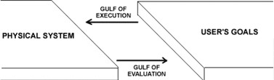
Bridging the gulfs
Bridging the gulfs can reduce cognitive effort required to perform tasks

Slide 47
Distributed cognition
Concerned with the nature of cognitive phenomena across individuals, artefacts, and internal and external representations (Hutchins, 1995)
Describes these in terms of propagation across representational state
Information is transformed through different media (computers, displays, paper, heads)
Notes:
47

Slide 48
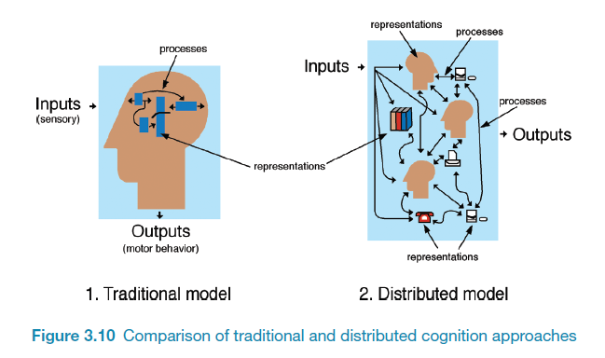
How it differs from information processing
Notes:
48

Slide 49
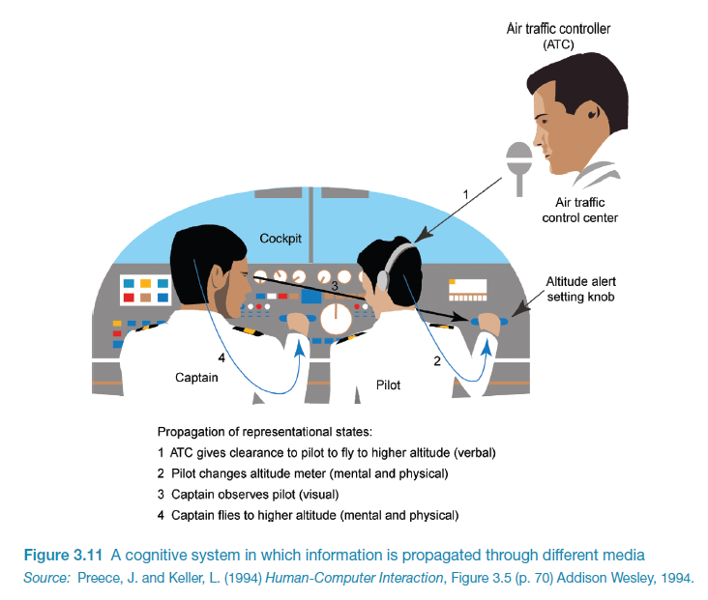

Slide 50
Externalizing to reduce memory load
Diaries, reminders, calendars, notes, shopping lists, to-do lists
  written to remind us of what to do
Post-its, piles, marked emails
  where placed indicates priority of what to do
External representations:
  Remind us that we need to do something (e.g. to buy something for mother’s day)
  Remind us of what to do (e.g. buy a card)
  Remind us when to do something (e.g. send a card by a certain date)
Notes:
50

Slide 51
Computational offloading
When a tool is used in conjunction with an external representation to carry out a computation (e.g. pen and paper)
Try doing the two sums below (a) in your head, (b) on a piece of paper and c) with a calculator.
  234 x 456 =??
  CCXXXIIII x CCCCXXXXXVI = ???
Which is easiest and why? Both are identical sums
Notes:
51

Slide 52
Design implication
Provide external representations at the interface that reduce memory load and facilitate computational offloading
  e.g. Information visualizations have been designed to allow people to make sense and rapid decisions about masses of data
Notes:
52

Slide 53
Emotional Interactions
Notes:
53

Slide 54
Emotions
Emotions and the user experience
Expressive and annoying interface
  how the ‘appearance’ of an interface can affect users
Models of emotion
  Ortony et al (2005)
Automatic emotion recognition and emotional technologies
Persuasive technologies and behavioural change
  how technologies can be designed to change people’s attitudes and behaviour
Anthropomorphism
  The pros and cons
Notes:
54

Slide 55
Emotions and the user experience
UX has traditionally been about designing efficient and effective systems
Now more about how to design interactive systems that make people respond in certain ways
  e.g. to be happy, to be trusting, to learn, to be motivated
Emotional interaction is concerned with how we feel and react when interacting with technologies
Notes:
55

Slide 56
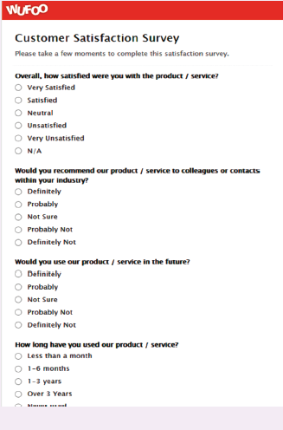
Is this form fun to fill in?
“My goal was to design
Wufoo to feel like
something Fisher-Price
would make.”
- Kevin Hale, Wufoo director
Notes:
Wufoo is a company specialising in building online forms and have transformed what are usually boring and tedious tasks into being more fun. How do the forms below compare with others you have had to fill in? One reason is the way minimalism, balance and aesthetics have been used in the design of the forms. As commented by one of Wufoo’s creators, Kevin Hale: “The inspiration for our color palette did come from our competitors. It was really depressing to see so much software designed to remind people they’re making databases in a windowless office and so we immediately knew we wanted to go in the opposite direction. My goal was to design Wufoo to feel like something Fisher-Price would make. We were determined to make sure Wufoo was fun.”
56

Slide 57
Emotional interaction
What makes us happy, sad, annoyed, anxious, frustrated, motivated, delirious and so on
  translating this into different aspects of the user experience
Why people become emotionally attached to certain products (e.g. virtual pets)
Can social robots help reduce loneliness and improve wellbeing?
How to change human behavior through the use of emotive feedback
Notes:
Emotional interaction is about considering what makes us happy, sad, annoyed, anxious, frustrated, motivated, delirious and so on and translating this knowledge into different aspects of the user experience, from when we first want something to when we no longer interact with it or need to replace it. However, it is not straightforward to achieve as people’s moods and feelings are constantly changing. There are also many reasons that might cause someone to be happy or sad, such as the sun shining or someone else winning a game.
57

Slide 58
Activity
Try to remember the emotions you went through when buying a big ticket item online (e.g. a fridge, a vacation, a computer)
How many different emotions did you go through?
Notes:
Consider the different emotions you experience for a common everyday activity – shopping online for a product, such as a new phone, a washing machine or a vacation. Firstly, there is the realisation of needing or wanting it, and then the desire and anticipation of purchasing it. This is followed by the joy or frustration of finding out more about what products are available and deciding which to choose from potentially hundreds or even thousands (by visiting numerous websites, such as comparison sites, reviews, recommendations, blogs). This entails matching what is available with what you like or need and if you can afford it. The thrill of deciding on a purchase may be quickly followed by the shock of how much it costs and the disappointment that you can’t afford it. The process of having to decide again may be accompanied by annoyance as you cant find one that is as good as your first choice. You think about other options, such as seeking advice from an expert in a shopping mall, but you have an aversion to sales assistants and don’t trust their advice, because you think they have their own interests (making money), rather than yours, at heart. So you carry on looking, getting more tired and frustrated. When you do make a decision you experience a sense of relief. You click merrily though the various options (such as color, size, warranty) and then the dreaded online payment form pops up. You type in all your details and press the final payment button. A window then appears saying that your credit card number is incorrect. So you type it in again very slowly. And you notice you need to type the 3 number security code in again. Finally, when all is done you let out a big sigh. But as you walk away from your computer doubts start to form in your mind – maybe you should have bought the other one...
This rollercoaster set of emotions is what many of us experience when shopping online, especially for expensive products, where there are a myriad of options to choose from and where we want to be sure that we make the right choice.
58

Slide 59
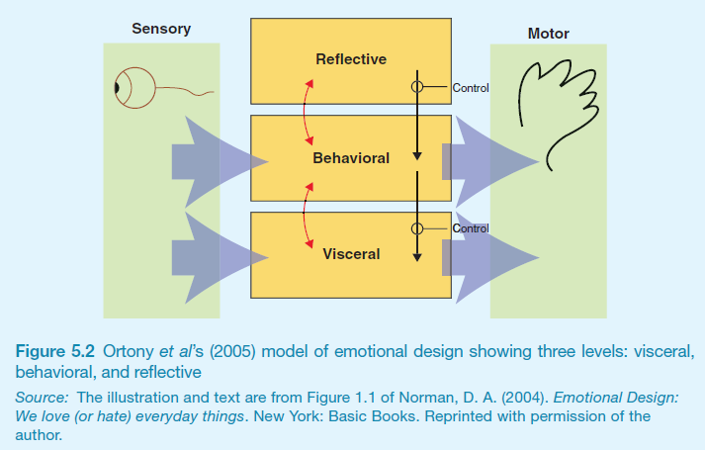
Emotional design model
Norman, Ortony and Revelle (2004) model of emotion
Notes:
59

Slide 60
Claims from model
Our emotional state changes how we think
  when frightened or angry we focus narrowly and body responds by tensing muscles and sweating
    more likely to be less tolerant
  when happy we are less focused and the body relaxes
    more likely to overlook minor problems and be more creative
Notes:
60

Slide 61
Activity
Do you feel more creative when you are in a happy mood? Do you get less work done when you are feeling stressed?

Slide 62


Expressive interfaces
Provide reassuring feedback that can be both informative and fun
But can also be intrusive, causing people to get annoyed and even angry
Color, icons, sounds, graphical elements and animations are used to make the ‘look and feel’ of an interface appealing
  conveys an emotional state
In turn this can affect the usability of an interface
  people are prepared to put up with certain aspects of an interface (e.g. slow download rate) if the end result is appealing and aesthetic
Notes:
62
A good place to start understanding how emotions affect behavior and how behavior affects emotions is to examine how people express themselves and read each other’s expressions. These include understanding the relationship between facial expressions, body language, gestures and tone of voice. For example, when people are happy they typically smile, laugh and open their bodies up. When they are angry they shout, gesticulate and screw up their face. A person’s expressions can trigger emotional responses in others. So when someone smiles it can cause others to feel good and smile back.

Slide 63
Friendly interfaces
Microsoft pioneered friendly interfaces for technophobes - ‘At home with Bob’ software
3D metaphors based on familiar places (e.g. living rooms)
Agents in the guise of pets (e.g. bunny, dog) were included to talk to the user
  Make users feel more at ease and comfortable
Notes:
63

Slide 64
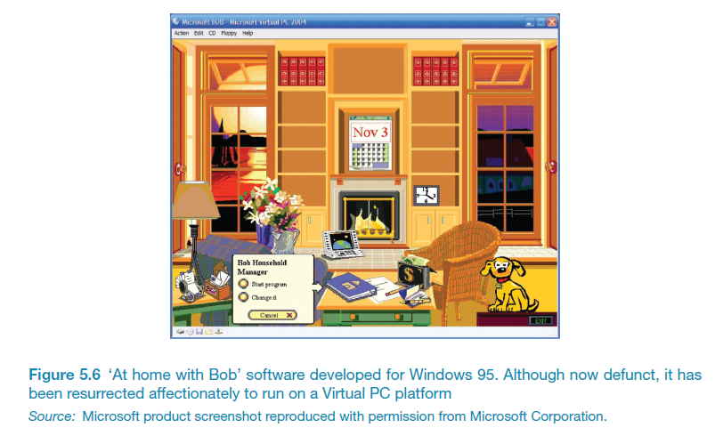
Bob
Notes:
64

Slide 65
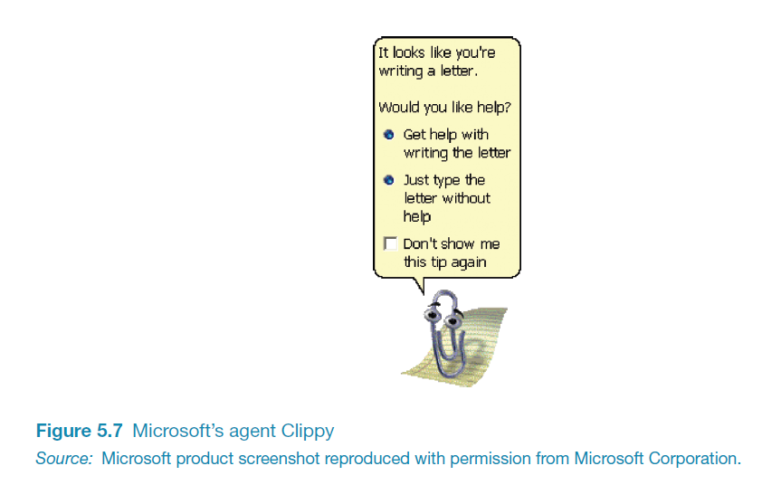
Clippy
Why was Clippy disliked
by so many?
Was it annoying,
distracting,
patronising or other?
What sort of user
liked Clippy?
Notes:
65

Slide 66
Frustrating interfaces
Many causes:
  When an application doesn’t work properly or crashes
  When a system doesn’t do what the user wants it to do
  When a user’s expectations are not met
  When a system does not provide sufficient information to enable the user to know what to do
  When error messages pop up that are vague, obtuse or condemning
  When the appearance of an interface is garish, noisy, gimmicky or patronizing
  When a system requires users to carry out too many steps to perform a task, only to discover a mistake was made earlier and they need to start all over again
Notes:
66

Slide 67
Gimmicks
Amusing to the designer but not the user, e.g.
  Clicking on a link to a website only to discover that it is still ‘under construction’
Notes:
67

Slide 68
Error messages
“The application Word Wonder has unexpectedly quit due to a type 2 error.”
Why not instead:
“the application has expectedly quit due to poor coding in the operating system”
Shneiderman’s guidelines for error messages include:
    avoid using terms like FATAL, INVALID, BAD
    Audio warnings
    Avoid UPPERCASE and long code numbers
    Messages should be precise rather than vague
    Provide context-sensitive help
Notes:
68

Slide 69
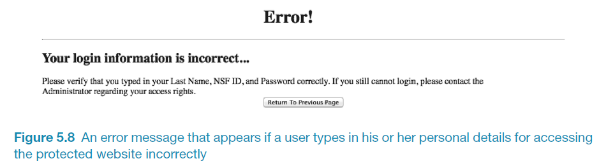
Website error messages
Notes:
69
Can you change to Figure 5.8

Slide 70
More helpful error message
“The requested page /helpme is not available on the web server.
If you followed a link or bookmark to get to this page, please let us know, so that we can fix the problem. Please include the URL of the referring page as well as the URL of the missing page.
Otherwise check that you have typed the address of the web page correctly.
The Web site you seek
Cannot be located, but
Countless more exist.”
Notes:
70

Slide 71
Should computers say they’re sorry?
Reeves and Naas (1996) argue that computers should be made to apologize
Should emulate human etiquette
Would users be as forgiving of computers saying sorry as people are of each other when saying sorry?
How sincere would they think the computer was being? For example, after a system crash:
  “I’m really sorry I crashed. I’ll try not to do it again”
How else should computers communicate with users?
Notes:
71

Slide 72
Detecting emotions and emotional technology
Sensing technologies used to measure GSR, facial expressions, gestures, body movement
Aim is to predict user’s emotions and aspects of their behavior –
E.g. what is someone most likely to buy online when feeling sad, bored or happy

Slide 73
Facial Coding
Measures a user’s emotions as they interact with a computer or tablet
Analyses images captured by a webcam of their face
Uses this to gauge how engaged the user is when looking at movies, online shopping sites and ads
6 core expressions - sadness, happiness, disgust, fear, surprise and anger

Slide 74
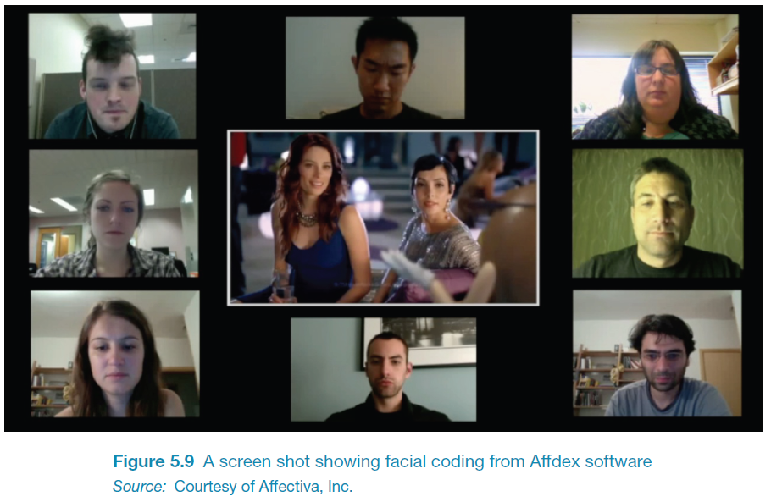

Slide 75
How to use the emotional data?
If user screws up their face when an ad pops up -> feel disgust
If start smiling -> they are feeling happy
Website can adapt its ad, movie storyline or content to match user’s emotional state
Eye-tracking, finger pulse, speech and words/phrases also analysed when tweeting or posting to Facebook

Slide 76
Indirect emotion detection
Beginning to be used more to infer or predict someone’s behaviour
For example, determining a person’s suitability for a job, or how they will vote at an election
Do you think it is creepy that technology can read your emotions from your facial expressions or from your tweets?

Slide 77
Persuasive technologies and behavioral change
Interactive computing systems deliberately designed to change people’s attitudes and behaviours (Fogg, 2003)
A diversity of techniques now used to change what they do or think
  Pop-up ads, warning messages, reminders, prompts, personalized messages, recommendations, Amazon 1-click
  Commonly referred to as nudging
Notes:
77

Slide 78
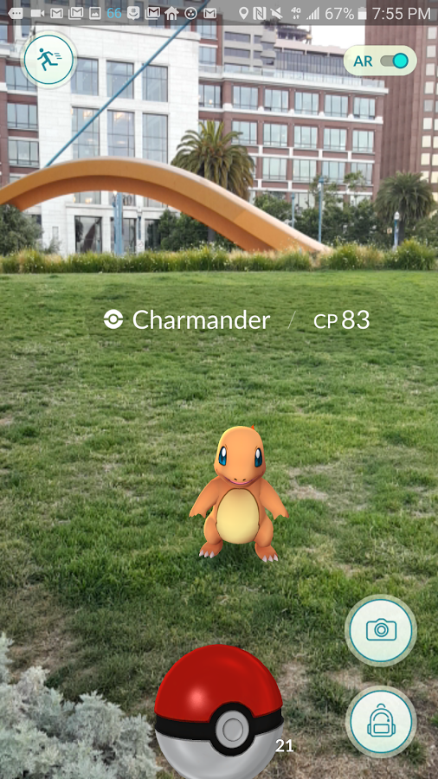
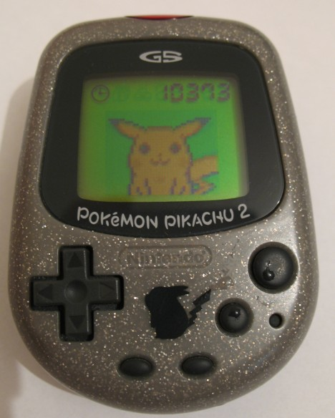
Nintendo’s Pocket Pikachu / Pokemon Go
Changing bad habits and improving well being
  Designed to motivate children to be more physically active on a regular basis
  owner of the digital pet that ‘lives’ in the device is required to walk, run, or jump
  If owner does not exercise the virtual
  pet becomes angry and refuses to play
  anymore
Notes:
78
This use of positive rewarding and sulking can be a powerful means of persuasion, given that children often become emotionally attached to their virtual pets, especially when they start to care for them.

Slide 79
How effective?
Is the use of novel forms of interactive technologies (e.g., the combination of sensors and dynamically updated information) that monitor, nag, or send personalized messages intermittently to a person more effective at changing a person’s behavior than non-interactive methods, such as the placement of warning signs, labels, or ads in prominent positions?
Notes:
79

Slide 80
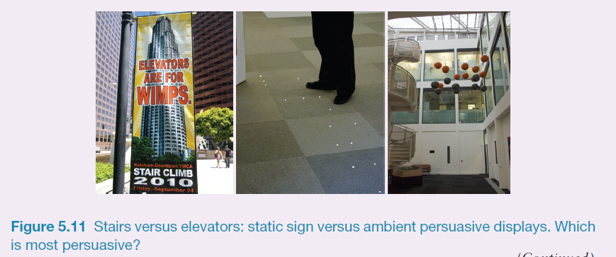
Which is most effective?
Notes:
The photo on the left in Figure 5.12 is of a banner placed in downtown LA, in an attempt to encourage the general public to take the stairs instead of the elevator, asking people to climb stairs on a certain day. The two photos on the right are of ambient displays (see also chapter 2) designed to do the same thing but using more subtle and interactive methods: (i) lights that twinkled when people approach them, intended to lure them to take the stairs and (ii) Clouds of different colored spheres that move up and down depending on how many people have taken the stairs or the elevator for a given period of time (grey represents elevator). The higher the orange cloud is relative to the grey one the more people taking the stairs than the elevator (Rogers et al, 2010). Which representation do you think is the most effective?
Comment
The banner on the left uses a striking slogan that metaphorically points a finger at you. Some people might find this amusing or a challenge. Others, however, are likely to find it offensive and even insulting and ignore it. The extent to which it will change behavior is debatable. In contrast, the ambient displays shown in the other images are meant to be much more subtle and aesthetic. They are assumed to work by raising people’s awareness of a behavior that they normally overlook or try not to think about and to nudge them at the point of decision-making (Thaler and Sunstein, 2008). An in the wild study was conducted when they were embedded in a building showed a significant increase in stair taking. Interestingly, the majority of people, when asked, were not aware of changing their behavior in response to noticing them. This suggests that ambient displays can influence at an unconscious level, and they can be used to encourage people to adhere to certain kinds of desired behaviors, where there is a choice, such as washing hands or not, eating healthy or unhealthy snacks, taking one route or another through a building, switching off the lights or leaving them on.
80

Slide 81
Tracking devices
Mobile apps designed to help people monitor and change their behaviour (e.g. fitness, sleeping, weight)
Can compare with online leader boards and charts, to show how they have done in relation to their peers and friends
Also apps that encourage reflection that in turn increase well-being and happiness

Slide 82
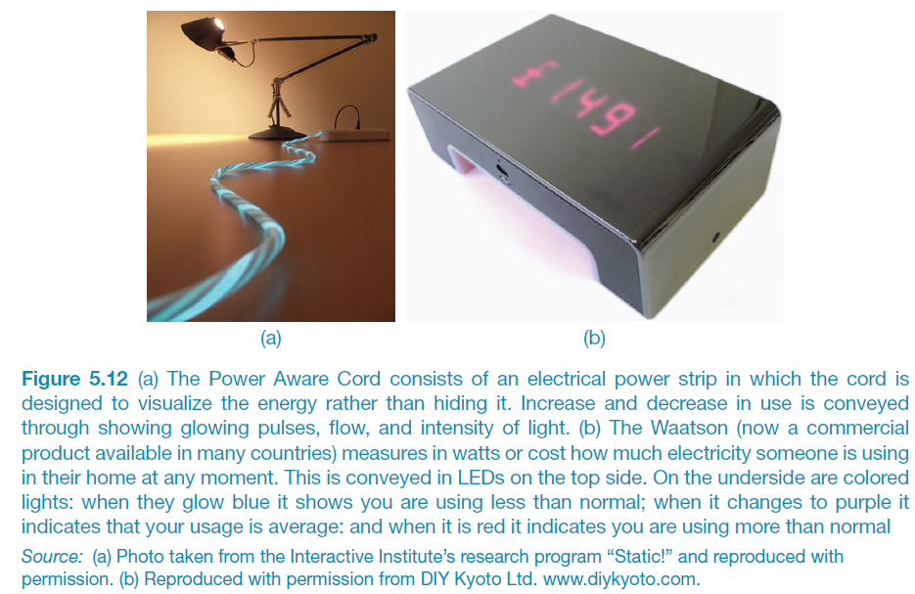
Energy reduction
Notes:
The global concern about climate change has led a number of HCI researchers to design and evaluate various energy sensing devices that display real-time feedback. A goal is to find ways of helping people reduce their energy consumption (and is part of a larger research agenda called sustainable HCI, Mankoff et al, 2008; DiSalvo et al, 2010). A focus is on persuading people to change their everyday habits with respect to environmental concerns, such as reducing their own carbon footprint, their community’s (e.g. school, workplace) or an even larger organization’s (e.g. street, town, country). Two well-known products are the Power Aware Cord and the Waatson. The Power-Aware Cord consists of an electrical power strip in which the cord is designed to visualize the energy rather than hiding it. Increase and decrease in use is conveyed through showing glowing pulses, flow, and intensity of light. The Waatson (now a commercial product available in many countries) measures in watts or cost how much electricity someone is using in their home at any moment. This is conveyed in LEDS on the top-side. On the underside are coloured lights; when they glow blue it shows you are using less than normal; when it changes to purple it indicates that your usage is average, and when it is red it indicates you are using more than usual.
82

Slide 83
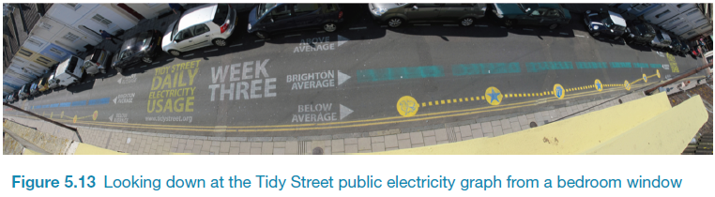
The Tidy Street project
large-scale visualization of the street’s electricity usage
  stenciled display on the road surface using chalk
  provided realtime feedback that all could see change each day
  reduced electricity consumption by 15%

Slide 84
Phishing and trust
Web used to deceive people into parting with personal details
  e.g. Paypal, eBay and won the lottery letters
Allows Internet fraudsters to access their bank accounts and draw money from them
Many vulnerable people fall for it
The art of deception is centuries old but internet allows ever more ingenious ways to trick people
Notes:
84

Slide 85
Anthropomorphism
Attributing human-like qualities to inanimate objects (e.g. cars, computers)
Well known phenomenon in advertising
  Dancing butter, drinks, breakfast cereals
Much exploited in human-computer interaction
  Make user experience more enjoyable, more motivating, make people feel at ease, reduce anxiety
Notes:
85

Slide 86
Which do you prefer?
1. As a welcome message
“Hello Chris! Nice to see you again. Welcome back. Now what were we doing last time? Oh yes, exercise 5. Let’s start again.”
“User 24, commence exercise 5.”
Notes:
86

Slide 87
Which do you prefer?
2. Feedback when get something wrong
“Now Chris, that’s not right. You can do better than that. Try again.”
“Incorrect. Try again.”
Is there a difference as to what you prefer depending on type of message? Why?
Notes:
87

Slide 88
Evidence to support anthropomorphism
Reeves and Naas (1996) found that computers that flatter and praise users in education software programs -> positive impact on them
“Your question makes an important and useful distinction. Great job!”
Students were more willing to continue with exercises with this kind of feedback
Notes:
88

Slide 89
Criticism of anthropomorphism
Deceptive, make people feel anxious, inferior or stupid
People tend not to like screen characters that wave their fingers at the user and say:
  Now Chris, that’s not right. You can do better than that.Try again.”
Many prefer the more impersonal:
  “Incorrect. Try again.”
Studies have shown that personalized feedback is considered to be less honest and makes users feel less responsible for their actions (e.g. Quintanar, 1982)
Notes:
89

Slide 90
Virtual characters
Appearing on our screens in the form of:
  Sales agents, characters in videogames, learning companions, wizards, pets, newsreaders
Provides a persona that is welcoming, has personality and makes user feel involved with them
Notes:
90

Slide 91
Disadvantages
Can lead people into false sense of belief, enticing them to confide personal secrets with chatterbots
Annoying and frustrating
  e.g. Clippy
May not be trustworthy
  virtual shop assistants?
Notes:
91

Slide 92
Virtual agents
What do the virtual agents do?
Do they elicit an emotional response in you?
Do you trust them?
What is the style of interaction?
What facial expression do they have?
Are they believable, pushy, helpful?
Would it be different if they were male? If so, how?
Notes:
92

Slide 93
What makes a virtual agent believable?
Believability refers to the extent to which users come to believe an agent’s intentions and personality
Appearance is very important
  Are simple cartoon-like characters or more realistic characters, resembling the human form more believable?
Behaviour is very important
  How an agent moves, gestures and refers to objects on the screen
  Exaggeration of facial expressions and gestures to show underlying emotions
Notes:
93

Slide 94
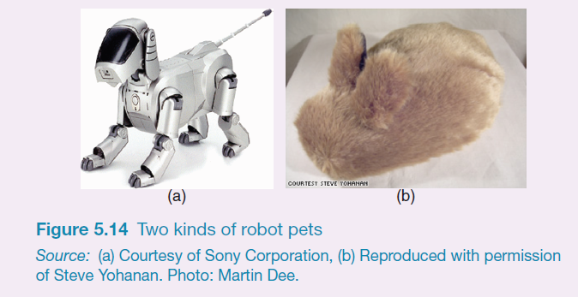
Robot-like or cuddly?
Which do you prefer and why?
Notes:
Most people like stroking pets and cuddly toys and so will as likely want to stroke pet robots. However, because they look and feel like the real thing some people may find them a bit creepy. A motivation for making robot pets cuddly is to enhance the emotional experience people have through using their sense of touch. For example, the Haptic Creature is a robotic device that mimics a pet that might sit in your lap, such as a rabbit or a cat (Yohanan et al, 2008). It is made up of a body, two ear-like appendages, a breathing mechanism, a purring mechanism, and a warming element. These enable it to detect the way it is stroked and to respond accordingly. When it is placed in a human’s lap and that person strokes its fur, it might consider this as a pleasing interaction and will update its emotional state to reflect happiness. This then triggers quick rhythmic breathing that causes its ribcage to press against the human’s hand. It also stiffens its ears and makes a gentle purring-like vibration. Note how the rabbit has no eyes, nose or mouth. These were deliberately left off to see how people respond to it primary through touch.
94

Slide 95
Implications
Should we create products that adapt according to people’s different emotional states?
  When people are feeling angry should an interface be more attentive and informative than when they are happy?
  designers “can get away with more” for products intended to be used during leisure time than those designed for serious tasks
Notes:
95

