Slide 1
Machine Learning on Data Lecture 9a- Classification
CS 795/895
Introduction to Data Science
Dr. Sampath Jayarathna
Cal Poly Pomona
Credit for some of the slides in this lecture goes to Prof. Ray Mooney at UT Austin

Slide 2
Classification Vs Clustering
In general, in classification you have a set of predefined classes (categories) and want to know which class a new object belongs to.
Clustering tries to group a set of objects (no pre-existing labels) and find whether there is some relationship between the objects.
In the context of machine learning, classification is supervised learning and clustering is unsupervised learning.

Slide 3
Shopping on the Web
Suppose you want to buy a cappuccino maker as a gift
try Google for “cappuccino maker”
What do you expect to see?
Search List….
Anything else?

Slide 4
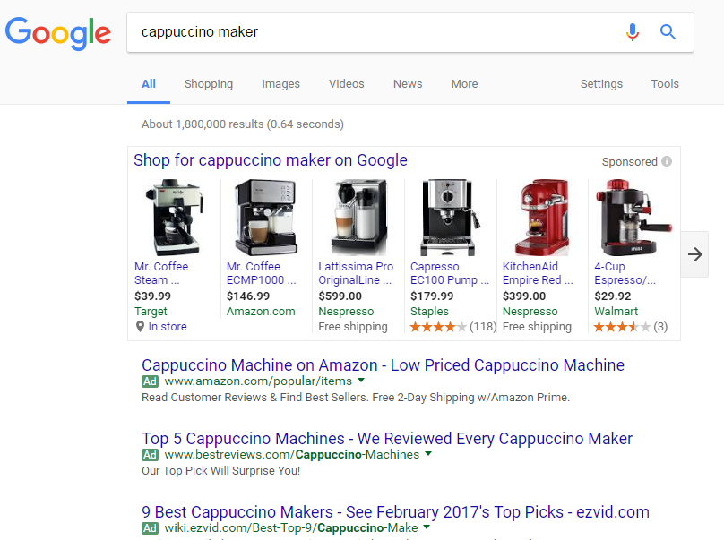

Slide 5
Observations
Broad indexing & speedy search alone are not enough.
Organizational view of data is critical need.
Categorized data are easy for user to browse.
Category taxonomies become most central in well-known web sites.

Slide 6
Text Categorization Applications
Web pages organized into category hierarchies
Journal articles indexed by subject categories (e.g., the Library of Congress, MEDLINE, etc.)
Responses to Census Bureau occupations
Patents archived using International Patent Classification
Patient records coded using international insurance categories
E-mail message filtering
News events tracked and filtered by topics

Slide 7
Cost of Manual Text Categorization
MEDLINE (National Library of Medicine)
$2 million/year for manual indexing of journal articles
using MEdical Subject Headings (18,000 categories)
Mayo Clinic
$1.4 million annually for coding patient-record events
using the International Classification of Diseases (ICD) for billing insurance companies
US Census Bureau decennial census (1990: 22 million responses)
232 industry categories and 504 occupation categories
$15 million if fully done by hand
Notes:
Why not simply categorize by hand? Too time and resource intensive.

Slide 8
What does it take to compete?
Suppose you were starting a web search company, what would it take to compete with established engines?
You need to be able to establish a competing hierarchy fast.
You will need a relatively cheap solution. (Unless you have investors that want to pay millions of dollars just to get off the ground.)

Slide 9
Why not a semi-automatic text categorization tool?
Humans can encode knowledge of what constitutes membership in a category.
This encoding can then be automatically applied by a machine to categorize new examples.
For example...
https://www.planethunters.org
Open Directory Project?
DMOZ was the largest, most comprehensive human-edited directory of the Web until 2017. It was constructed and maintained by a passionate, global community of volunteer editors. It was historically known as the Open Directory Project (ODP).

Slide 10
Rule-based Approach to TC
Text in a Web Page “Saeco revolutionized espresso brewing a decade ago by introducing Saeco Super Automatic machines, which go from bean to coffee at the touch of a button. The all-new Saeco Vienna Super-Automatic home coffee and cappuccino machine combines top quality with low price!”
Rule (espresso or coffee or cappuccino ) and machine* Coffee Maker

Slide 11
Predicting Topics of News Stories
Given: Collection of example news stories already labeled with a category (topic).
Task: Predict category for news stories not yet labeled.
For our example, we’ll only get to see the headline of the news story.
We’ll represent categories using colors. (All examples with the same color belong to the same category.)

Slide 12
Our Labeled Examples
Amatil Proposes Two-for-Five Bonus Share Issue
Citibank Norway Unit Loses Six Mln Crowns in 1986
Japan Ministry Says Open Farm Trade Would Hit U.S.
Vieille Montagne Says 1986 Conditions Unfavourable
Jardine Matheson Said It Sets Two-for-Five Bonus Issue Replacing “B” Shares
Anheuser-Busch Joins Bid for San Miguel
Italy’s La Fondiaria to Report Higher 1986 Profits
Isuzu Plans No Interim Dividend
Senator Defends U.S. Mandatory Farm Control Bill
Bowater Industries Profit Exceed Expectations

Slide 13
What to predict before seeing the document?
?
Amatil Proposes Two-for-Five Bonus Share Issue
Citibank Norway Unit Loses Six Mln Crowns in 1986
Japan Ministry Says Open Farm Trade Would Hit U.S.
Vieille Montagne Says 1986 Conditions Unfavourable
Jardine Matheson Said It Sets Two-for-Five Bonus Issue Replacing “B” Shares
Anheuser-Busch Joins Bid for San Miguel
Italy’s La Fondiaria to Report Higher 1986 Profits
Isuzu Plans No Interim Dividend
Senator Defends U.S. Mandatory Farm Control Bill
Bowater Industries Profit Exceed Expectations

Slide 14
Predict with Evidence
Senate Panel Studies Loan Rate, Set Aside Plans
Amatil Proposes Two-for-Five Bonus Share Issue
Citibank Norway Unit Loses Six Mln Crowns in 1986
Japan Ministry Says Open Farm Trade Would Hit U.S.
Vieille Montagne Says 1986 Conditions Unfavourable
Jardine Matheson Said It Sets Two-for-Five Bonus Issue Replacing “B” Shares
Anheuser-Busch Joins Bid for San Miguel
Italy’s La Fondiaria to Report Higher 1986 Profits
Isuzu Plans No Interim Dividend
Senator Defends U.S. Mandatory Farm Control Bill
Bowater Industries Profit Exceed Expectations

Slide 15
The Actual Topic
Senate Panel Studies Loan Rate, Set Aside Plans
Amatil Proposes Two-for-Five Bonus Share Issue
Citibank Norway Unit Loses Six Mln Crowns in 1986
Japan Ministry Says Open Farm Trade Would Hit U.S.
Vieille Montagne Says 1986 Conditions Unfavourable
Jardine Matheson Said It Sets Two-for-Five Bonus Issue Replacing “B” Shares
Anheuser-Busch Joins Bid for San Miguel
Italy’s La Fondiaria to Report Higher 1986 Profits
Isuzu Plans No Interim Dividend
Senator Defends U.S. Mandatory Farm Control Bill
Bowater Industries Profit Exceed Expectations

Slide 16
Representing Documents
Usually, an example is represented as a series of feature-value pairs. The features can be arbitrarily abstract (as long as they are easily computable) or very simple.
For example, the features could be the set of all words and the values, their number of occurrences in a particular document.
Japan Firm Plans to Sell U.S. Farmland to Japanese
Farmland:1
Firm:1
Japan:1
Japanese:1
Plans:1
Sell:1
To:2
U.S.:1
Representation

Slide 17
1-Nearest Neighbor
Looking back at our example
Did anyone try to find the most similar labeled item and then just guess the same color?
This is 1-Nearest Neighbor
Senate Panel Studies Loan Rate, Set Aside Plans
Amatil Proposes Two-for-Five Bonus Share Issue
Citibank Norway Unit Loses Six Mln Crowns in 1986
Japan Ministry Says Open Farm Trade Would Hit U.S.
Vieille Montagne Says 1986 Conditions Unfavourable
Jardine Matheson Said It Sets Two-for-Five Bonus Issue Replacing “B” Shares
Anheuser-Busch Joins Bid for San Miguel
Italy’s La Fondiaria to Report Higher 1986 Profits
Isuzu Plans No Interim Dividend
Senator Defends U.S. Mandatory Farm Control Bill
Bowater Industries Profit Exceed Expectations

Slide 18
Example of Classification Learning
Instance language: <size, color, shape>
size ∈ {small, medium, large}
color ∈ {red, blue, green}
shape ∈ {square, circle, triangle}
Category C = {positive, negative}
D:
Hypotheses?
Small, red, circle → positive?
Large, blue, circle → negative?
Example | Size | Color | Shape | Category
1 | small | red | circle | positive
2 | large | red | circle | positive
3 | small | red | triangle | negative
4 | large | blue | circle | negative

Slide 19
General Learning Issues
Many hypotheses are usually consistent with the training data.
Classification accuracy (% of instances classified correctly).
Measured on independent test data.
Training time (efficiency of training algorithm).
Testing time (efficiency of subsequent classification).

Slide 20
Generalization
Hypotheses must generalize to correctly classify instances not in the training data.
Simply memorizing training examples is a consistent hypothesis that does not generalize.

Slide 21
Learning for Text Categorization
Manual development of text categorization functions is difficult.
Learning Algorithms:
Neural network
Relevance Feedback (Rocchio)
Rule based (Ripper)
Nearest Neighbor (case based)
Support Vector Machines (SVM)
Bayesian (naïve)

Slide 22
Using Relevance Feedback (Rocchio)
Relevance feedback methods can be adapted for text categorization.
Use standard TF/IDF weighted vectors to represent text documents (normalized by maximum term frequency).
For each category, compute a prototype vector by summing the vectors of the training documents in the category.
Assign test documents to the category with the closest prototype vector based on cosine similarity.

Slide 23
Illustration of Rocchio Text Categorization
Unknown (test) sample category.
Category: Red or Green?

Slide 24
Rocchio Properties
Does not guarantee a consistent hypothesis.
Forms a simple generalization of the examples in each class (a prototype).
Prototype vector does not need to be averaged or otherwise normalized for length since cosine similarity is insensitive to vector length.
Classification is based on similarity to class prototypes.

Slide 25
Nearest Neighbor Classification
Also known as, Instance-Based, Lazy Learning, Memory-based, Case-based learning
well-known approach to pattern recognition
initially by Fix and Hodges (1951)
applied to text categorization in early 90’s
strong baseline in benchmark evaluations
among top-performing methods in TC evaluations
scalable to large TC applications

Slide 26
Nearest-Neighbor Learning Algorithm
Learning is just storing the representations of the training examples in D.
Testing instance x:
Compute similarity between x and all examples in D.
Assign x the category of the most similar example in D.
Does not explicitly compute a generalization or category prototypes.

Slide 27
Key Components of Nearest Neighbor
“Similar” item: We need a functional definition of “similarity” if we want to apply this automatically.
How many neighbors do we consider?
Does each neighbor get the same weight?
All categories in neighborhood? Most frequent only? How do we make the final decision?

Slide 28
K Nearest-Neighbor
Using only the closest example to determine categorization is subject to errors due to:
A single atypical example.
Noise (i.e. error) in the category label of a single training example.
More robust alternative is to find the k most-similar examples and return the majority category of these k examples.
Value of k is typically odd to avoid ties, 3 and 5 are most common.

Slide 29
Similarity Metrics
Nearest neighbor method depends on a similarity (or distance) metric.
Simplest for continuous m-dimensional instance space is Euclidian distance.
For text, cosine similarity of TF-IDF weighted vectors is typically most effective.

Slide 30
3 Nearest Neighbor Illustration (Euclidian Distance)
.
.
Unknown (test) sample category.
Category: Red or Green?
.
.
.
.
.
.
.
.
.

Slide 31
Illustration of 3 Nearest Neighbor for Text

Slide 32
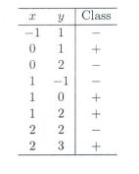
Activity 15
Suppose, you have given the following data where x and y are the 2 input variables and Class is the dependent variable.
Suppose, you want to predict the class of new data point x=1 and y=1 using Euclidian distance in 3-NN. In which class this data point belong to?
You are now want use 7-NN instead of 3-KNN which of the following x=1 and y=1 will belong to?

Slide 33
Rocchio Anomoly
Prototype models have problems with polymorphic (disjunctive) categories.
In this example, the category of the new document will be red based on cosine similarity between document and prototypes (big red arrow and big green arrow)

Slide 34
3 Nearest Neighbor Comparison
Nearest Neighbor tends to handle polymorphic categories better.
This will assign black to the document category because 2 closest neighbors among 3 Nearest Neighbors are in black category.

Slide 35
Nearest Neighbor with Inverted Index
Determining k nearest neighbors is the same as determining the k best retrievals using the test document as a query to a database of training documents.
Use standard VSR inverted index methods to find the k nearest neighbors.

Slide 36
Evaluating Categorization
Evaluation must be done on test data that are independent of the training data (usually a disjoint set of instances).
Classification accuracy: c/n where n is the total number of test instances and c is the number of test instances correctly classified by the system.
Results can vary based on sampling error due to different training and test sets.
Average results over multiple training and test sets (splits of the overall data) for the best results.

Slide 37
Cross-validation
How should the sample be split?
The most common approach is to divide the sample randomly, thus theoretically eliminating any systematic differences.
Modeling of the data uses one part only. The model selected for this part is then used to predict the values in the other part of the data. A valid model should show good predictive accuracy.

Slide 38
Cross Validation – The Ideal Procedure
1.Divide data into three sets, training, validation and test sets
2.Find the optimal model on the training set, and use the test set to check its predictive capability
3.See how well the model can predict the test set
4.The validation error gives an unbiased estimate of the predictive power of a model

Slide 39
N-fold Cross Validation
Since data are often scarce, there might not be enough to set aside for a validation sample
To work around this issue N-fold CV works as follows:
1. Split the sample into N subsets of equal size
2. For each fold estimate a model on all the subsets except one
3. Use the left out subset to test the model, by calculating a CV metric of choice
4. Average the CV metric across subsets to get the CV error
This has the advantage of using all data for estimating the model, however finding a good value for N can be tricky

Slide 40
N-fold Cross Validation Example
Split the data into 5 samples
Fit a model to the training samples and use the test sample to calculate a CV metric.
Repeat the process for the next sample, until all samples have been used to either train or test the model

Slide 41
N-Fold Cross-Validation Process
Partition data into N equal-sized disjoint segments.
Run N trials, each time using a different segment of the data for testing, and training on the remaining N−1 segments.
This way, at least test-sets are independent.
Report average classification accuracy over the N trials.
Typically, N = 10.

Slide 42
Nearest Neighbor Python Example
import numpy as np
import matplotlib.pyplot as plt
import pandas as pd
url = "https://archive.ics.uci.edu/ml/machine-learning-databases/iris/iris.data"
names = ['sepal-length', 'sepal-width', 'petal-length', 'petal-width', 'Class'] # Assign column names to the dataset
dataset = pd.read_csv(url, names=names) # Read dataset to pandas dataframe
X = dataset.iloc[:, :-1].values
y = dataset.iloc[:, 4].values
from sklearn.model_selection import train_test_split
X_train, X_test, y_train, y_test = train_test_split(X, y, test_size=0.20)
from sklearn.preprocessing import StandardScaler
scaler = StandardScaler()
scaler.fit(X_train)
X_train = scaler.transform(X_train)
X_test = scaler.transform(X_test)
from sklearn.neighbors import KNeighborsClassifier
classifier = KNeighborsClassifier(n_neighbors=5)
classifier.fit(X_train, y_train)
y_pred = classifier.predict(X_test)
from sklearn.metrics import classification_report, confusion_matrix
print(confusion_matrix(y_test, y_pred))
print(classification_report(y_test, y_pred))

