Slide 1
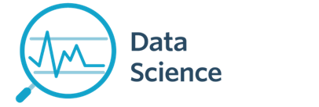
Machine Learning on Data Lecture 9b- Clustering
CS 620 / DASC 600
Introduction to Data Science & Analytics
Dr. Sampath Jayarathna
Old Dominion University
Credit for some of the slides in this lecture goes to Prof. Ray Mooney at UT Austin

Slide 2
Take-away today
What is clustering?
Applications of clustering in information retrieval
K-means algorithm
Evaluation of clustering
How many clusters?
2

Slide 3
Clustering: Definition
(Document) clustering is the process of grouping a set of documents into clusters of similar documents.
Documents within a cluster should be similar.
Documents from different clusters should be dissimilar.
Clustering is the most common form of unsupervised learning.
Unsupervised = there are no labeled or annotated data.
3

Slide 4
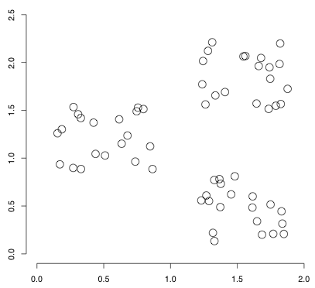
Data set with clear cluster structure
How would you design an algorithm for finding these three clusters?
4

Slide 5
Classification vs. Clustering
Classification: supervised learning
Clustering: unsupervised learning
Classification: Classes are human-defined and part of the input to the learning algorithm.
Clustering: Clusters are inferred from the data without human input.
However, there are many ways of influencing the outcome of clustering: number of clusters, similarity measure, representation of documents, . .
5

Slide 6
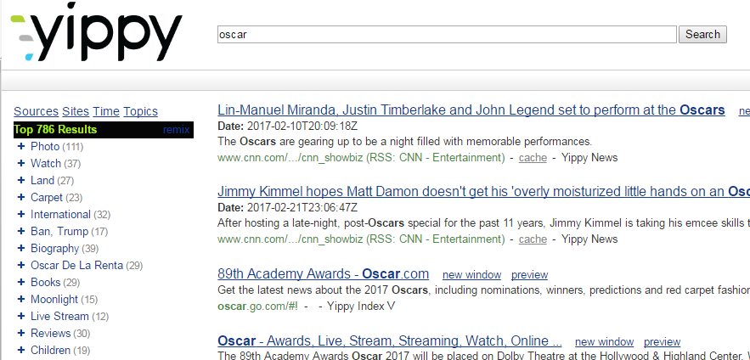
Clustering in IR
Result set clustering for better navigation
Yippy (formally Clusty): For grouping search results thematically
6

Slide 7
For improving search recall
Sec. 16.1
Cluster hypothesis - Documents in the same cluster behave similarly with respect to relevance to information needs
Therefore, to improve search recall:
When a query matches a doc D, also return other docs in the cluster containing D
Hope if we do this: The query “car” will also return docs containing automobile
Because clustering grouped together docs containing car with those containing automobile.

Slide 8
Issues for Clustering
Sec. 16.1
Representation for clustering
Document representation
Vector space? Normalization?
Need a notion of similarity/distance
How many clusters?
Completely data driven?
Avoid “trivial” clusters - too large or small
In an application, if a cluster's too large, then for navigation purposes you've wasted an extra user click without whittling down the set of documents much.

Slide 9
Flat vs. Hierarchical clustering
Flat algorithms
Usually start with a random (partial) partitioning of docs into groups
Refine iteratively
Main algorithm: K-means clustering
Hierarchical algorithms
Create a hierarchy
Bottom-up, agglomerative
Top-down, divisive
9

Slide 10
Hard vs. Soft clustering
Hard clustering: Each document belongs to exactly one cluster.
More common and easier to do
Soft clustering: A document can belong to more than one cluster.
Makes more sense for applications like creating browsable hierarchies
You may want to put sneakers in two clusters:
sports apparel
shoes
10

Slide 11
Flat algorithms
Flat algorithms compute a partition of N documents into a set of K clusters.
Given: a set of documents and the number K
Find: a partition into K clusters that optimizes the chosen partitioning criterion
Global optimization: exhaustively enumerate partitions, pick optimal one
Effective heuristic method: K-means algorithm
11

Slide 12
K-means (Hard, flat clustering)
Perhaps the best known clustering algorithm
Simple, works well in many cases
Use as default / baseline for clustering documents
Vector space model
As in vector space classification, we measure relatedness between vectors by Euclidean distance . . .
. . .which is almost equivalent to cosine similarity.
12

Slide 13
K-means
Each cluster in K-means is defined by a centroid.
Objective/partitioning criterion: minimize the average squared difference from the centroid
Definition of centroid:
where we use ω to denote a cluster.
We try to find the minimum average squared difference by iterating two steps:
reassignment: assign each vector to its closest centroid
recomputation: recompute each centroid as the average of the vectors that were assigned to it in reassignment
13

Slide 14
Example of k-means
Start with random cluster centers C1 than to C2
x2
x1
x4
x3
C1
C2
x5
x6
x7

Slide 15
Example of k-means
Identify the points that are closer to C1 than to C2
x2
x1
x4
x3
C1
C2
x5
x6
x7

Slide 16
Example of k-means
Update C1
x2
x1
x4
x3
C1
C2
x5
x6
x7

Slide 17
Example of k-means
Identify the points that are closer to C2 than to C1
x2
x1
x4
x3
C1
C2
x5
x6
x7

Slide 18
Example of k-means
Identify the points that are closer to C2 than to C1
x2
x1
x4
x3
C1
x5
x6
C2
x7

Slide 19
Example of k-means
Identify the points that are closer to C2 than C1, and points that are closer to C1 than to C2
x2
x1
x4
x3
C1
x5
x6
C2
x7

Slide 20
Example of k-means
Identify the points that are closer to C2 than C1, and points that are closer to C1 than to C2
Update C1 and C2
x2
x1
C1
x4
x3
x5
x6
C2
x7

Slide 21
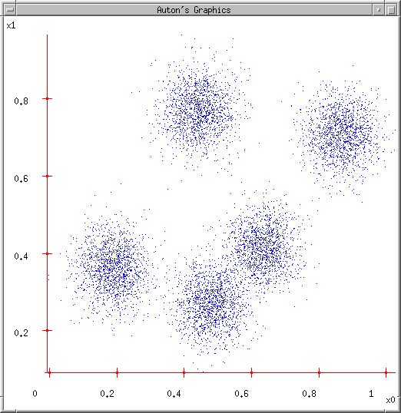
K-means for Clustering
K-means
Start with a random guess of cluster centers
Determine the membership of each data points
Adjust the cluster centers

Slide 22
Optimality of K-means
K-means is guaranteed to converge
But we don’t know how long convergence will take!
If we don’t care about a few docs switching back and forth, then convergence is usually fast (< 10-20 iterations).
However, complete convergence can take many more iterations.
Convergence does not mean that we converge to the optimal clustering!
This is the great weakness of K-means.
If we start with a bad set of seeds, the resulting clustering can be horrible.
22

Slide 23
Initialization of K-means
Random seed selection is just one of many ways K-means can be initialized.
Random seed selection is not very robust: It’s easy to get a suboptimal clustering.
Better ways of computing initial centroids:
Select seeds not randomly, but using some heuristic (e.g., document similar to any existing mean)
Try out multiple starting points
Initialize with the results of another method (Use hierarchical clustering to find good seeds)
23

Slide 24
How many clusters?
Number of clusters K is given in many applications.
What if there is no external constraint? Is there a “right” number of clusters?
One way to go: define an optimization criterion.
Elbow method (SSE vs K)
Given docs, find K for which the optimum is reached.
24

Slide 25
What Is A Good Clustering?
Sec. 16.3
Internal criterion: A good clustering will produce high quality clusters in which:
the intra-class (that is, intra-cluster) similarity is high
the inter-class similarity is low
The measured quality of a clustering depends on both the document representation and the similarity measure used

Slide 26
External criteria for clustering quality
Sec. 16.3
Quality measured by its ability to discover some or all of the hidden patterns or latent classes in gold standard data
Assesses a clustering with respect to ground truth … requires labeled data
Assume documents with C gold standard classes, while our clustering algorithms produce K clusters, ω₁, ω₂, …, ω_{K} with n_{i} members.

Slide 27
External Evaluation of Cluster Quality
Sec. 16.3
Simple measure: purity, the ratio between the dominant class in the cluster c_{j} and the size of cluster ω_{i}

Slide 28
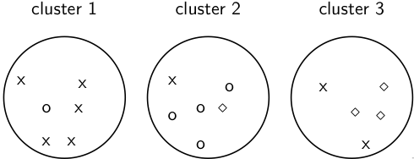
Example for computing purity
good_docs(ω₁) = max(5,1,0) = 5
good_docs(ω₂) = max(1,4,1) = 4
good_docs(ω₃) = max(2,0,3) = 3
Purity(Ω) = (1/17) × (5 + 4 + 3) = 12/17 ≈ 0.71.
28

Slide 29
Rand index
Definition:
Based on 2x2 contingency table of all pairs of documents:
TP+FN+FP+TN is the total number of pairs.
There are pairs for N documents.
Example: = 136 in o/⋄/x example
Each pair is either positive or negative (the clustering puts the two documents in the same or in different clusters) . . .
. . . and either “true” (correct) or “false” (incorrect): the clustering decision is correct or incorrect.
29

Slide 30
Rand Index: Example
As an example, we compute RI for the o/⋄/x example. We first
compute TP + FP. The three clusters contain 6, 6, and 5 points,
respectively, so the total number of “positives” or pairs of
documents that are in the same cluster is:
Of these, the x pairs in cluster 1, the o pairs in cluster 2, the ⋄
pairs in cluster 3, and the x pair in cluster 3 are true positives:
Thus, FP = 40 − 20 = 20.
How to calculate FN and TN?
30

Slide 31
Rand measure for the o/⋄/x example
TP + FP + TN + FN = 136
TN + FN = 136- 40 = 96
Same Classes = TP + FN = $\left({8 \atop 2}\right)$ + $\left({5 \atop 2}\right)$ + $\left({4 \atop 2}\right)$ = 44
FN = 44- TP = 24
TN = 96 – FN = 72
31

Slide 32
Rand measure for the o/⋄/x example
RI = (20 + 72)/(20 + 20 + 24 + 72) ≈ 0.68.
32

Slide 33
F measure
F measure
Like Rand, but “precision” and “recall” can be weighted
P = tp/(tp + fp) = 20/40 = 0.5
R = tp/(tp + fn) = 20/44 = 0.45
F_{β=1} = 2*P*R/(P+R) = 0.45/0.95 = 0.47
33

Slide 34
Evaluation Results
All 3 measures range from 0 (really bad clustering) to 1 (perfect clustering)
34

Slide 35
State-of-the-art Clustering: Topic Models in Text Processing

Slide 36
Overview
Motivation:
Model the topic/subtopics in text collections
Basic Assumptions:
There are k topics in the whole collection
Each topic is represented by a multinomial distribution over the vocabulary (language model)
Each document can cover multiple topics
Applications
Summarizing topics
Predict topic coverage for documents
Model the topic correlations
Classification, Clustering

Slide 37
Basic Topic Models
Unigram model
Mixture of unigrams
Probabilistic LSI
Latent Dirichlet Allocation (LDA)
Correlated Topic Models

Slide 38
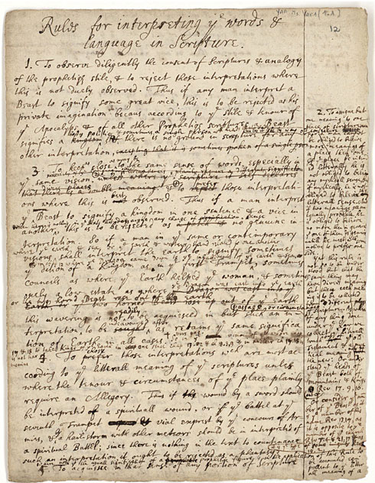
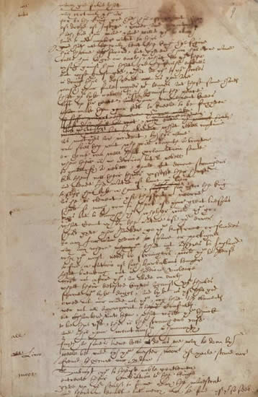
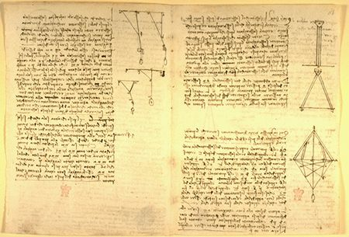
What is a “topic”?
Representation: a probabilistic distribution over words.
retrieval 0.2
information 0.15
model 0.08
query 0.07
language 0.06
feedback 0.03
……
Topic: A broad concept/theme, semantically coherent, which is hidden in documents
e.g., politics; sports; technology; entertainment; education etc.

Slide 39
Document as a mixture of topics
government 0.3 response 0.2 ...
[ Criticism of government response to the hurricane primarily consisted of criticism of its response to the approach of the storm and its aftermath, specifically in the delayed response ] to the [ flooding of New Orleans. … 80% of the 1.3 million residents of the greater New Orleans metropolitan area evacuated ] …[ Over seventy countries pledged monetary donations or other assistance]. …
Topic θ₁
city 0.2 new 0.1 orleans 0.05 ...
Topic θ₂
…
How can we discover these topic-word distributions?
Many applications would be enabled by discovering such topics
Summarize themes/aspects
Facilitate navigation/browsing
Retrieve documents
Segment documents
Many other text mining tasks
donate 0.1 relief 0.05 help 0.02 ...
Topic θ_{k}
is 0.05 the 0.04 a 0.03 ...
Background θ_{k}

Slide 40
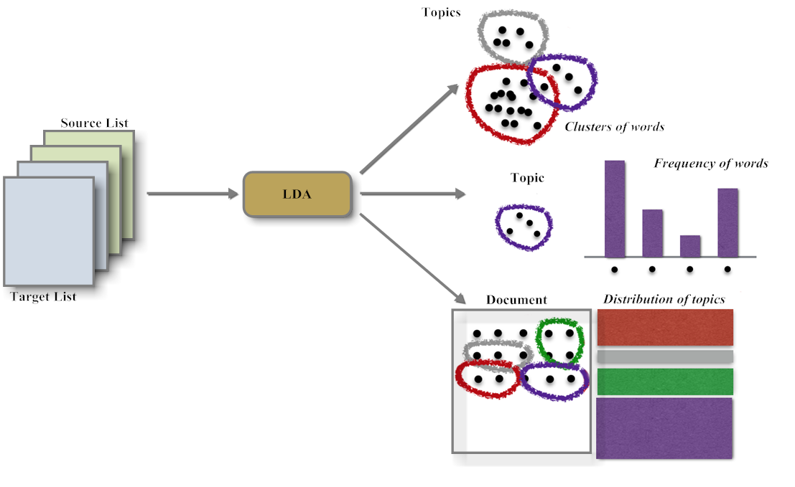
Latent Dirichlet Allocation

Slide 41
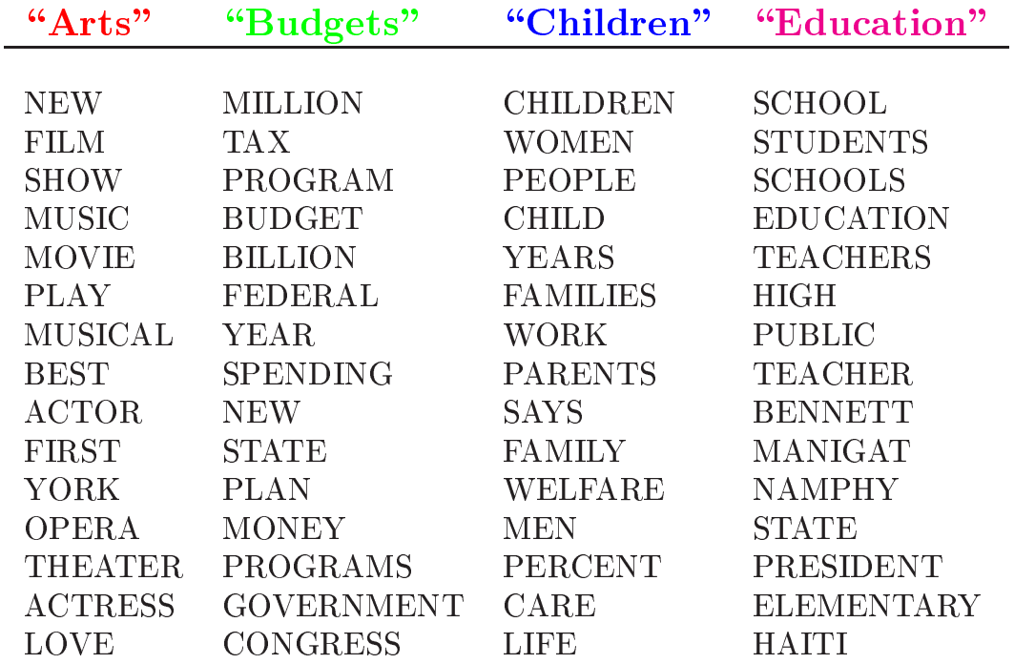
Topics learned by LDA

Slide 42
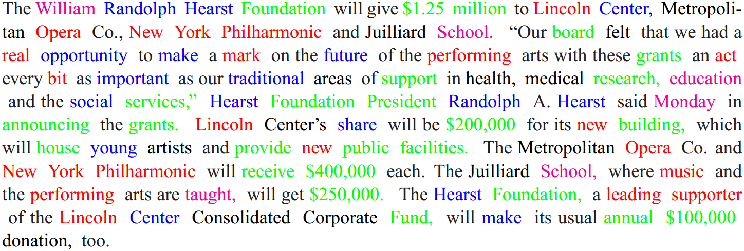
Topic assignments in document
Based on the topics shown in last slide

Slide 43
Final word
In clustering, clusters are inferred from the data without human input (unsupervised learning)
However, in practice, it’s a bit less clear: there are many ways of influencing the outcome of clustering: number of clusters, similarity measure, representation of documents.

