Slide 1
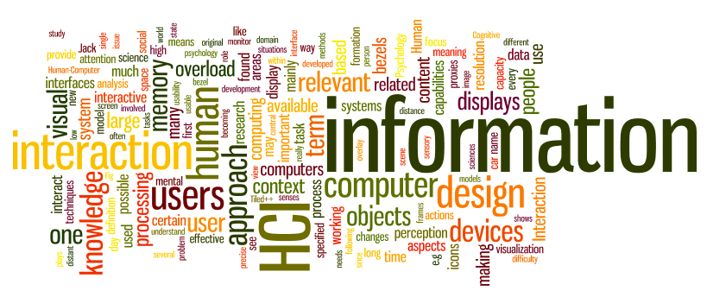
Data Gathering and Analysis
Sampath Jayarathna
Cal Poly Pomona
Credit for some of the slides in this lecture goes to www.id-book.com

Slide 2
Data recording
Notes, audio, video, photographs can be used individually or in combination:
Notes plus photographs
Audio plus photographs
Video
Different challenges and advantages with each combination

Slide 3
Interviews
Unstructured - are not directed by a script. Rich but not replicable.
Structured - are tightly scripted, often like a questionnaire. Replicable but may lack richness.
Semi-structured - guided by a script but interesting issues can be explored in more depth. Can provide a good balance between richness and replicability.
Focus groups – a group interview

Slide 4
Interview questions
Two types:
‘closed questions’ have a predetermined answer format, e.g.. ‘yes’ or ‘no’
‘open questions’ do not have a predetermined format
Closed questions are easier to analyze
Avoid:
Long questions
Compound sentences - split them into two
Jargon and language that the interviewee may not understand
Leading questions that make assumptions
e.g.. why do you like …?
Unconscious biases e.g.. gender stereotypes

Slide 5
Enriching the interview process
Props - devices for prompting interviewee, e.g. use a prototype, scenario

Slide 6
Questionnaires
Questions can be closed or open
Closed questions are easier to analyze, and may be distributed and analyzed by computer
Can be administered to large populations
Disseminated by paper, email and the web
Sampling can be a problem when the size of a population is unknown as is common online evaluation

Slide 7
Question and response format
‘Yes’ and ‘No’ checkboxes
Checkboxes that offer many options
Rating scales
Likert scales
Strongly disagree (1), disagree(2), undecided (3), agree(4), strongly agree (5)
semantic scales (fair…..biased), (weak….strong)
3, 5, 7 or more points
Open-ended responses

Slide 8
Observation
Direct observation in the field
Structuring frameworks
Degree of participation (insider or outsider)
Ethnography
Direct observation in controlled environments
Indirect observation: tracking users’ activities
Diaries
Interaction logging
Video and photographs collected remotely by drones or other equipment

Slide 9
Ethnography
Ethnography is a philosophy with a set of techniques that include participant observation and interviews
Ethnographers immerse themselves in the culture that they study
A researcher’s degree of participation can vary along a scale from ‘outside’ to ‘inside’
Analyzing video and data logs can be time-consuming
Collections of comments, incidents, and artifacts are made

Slide 10
Online Ethnography
Virtual, Online, Netnography
Online and offline activity
Interaction online differs from face-to-face
Virtual worlds have a persistence that physical worlds do not have
Ethical considerations and presentation of results are different

Slide 11
Observation in a controlled environment
Direct observation
Think aloud techniques
Indirect observation – tracking users’ activities
Diaries
Interaction logs
Web analytics
Video, audio, photos, notes are used to capture data in both types of observations

Slide 12
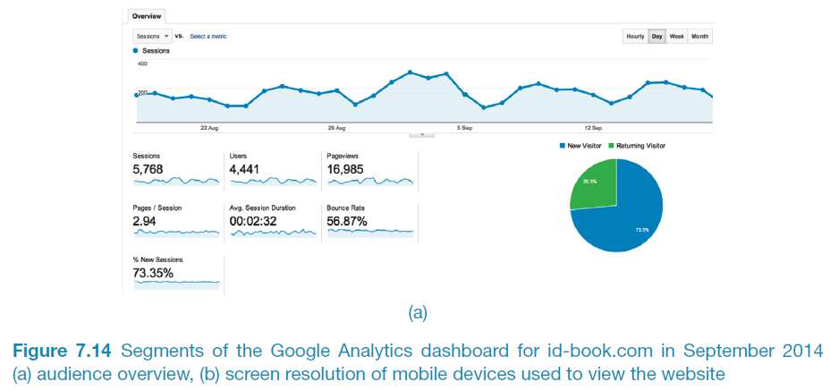
A section of Google analytics dashboard for id-book.com

Slide 13
Data Analysis
Discuss the difference between qualitative and quantitative data and analysis.
Enable you to analyze data gathered from:
Questionnaires.
Interviews.
Observation studies.

Slide 14
Quantitative and qualitative
Quantitative data
expressed as numbers
numerical methods to ascertain size, magnitude, amount
Qualitative data
difficult to measure sensibly as numbers, e.g. count number of words to measure dissatisfaction
expresses the nature of elements and is represented as themes, patterns, stories
Be careful how you manipulate data and numbers!

Slide 15
Simple quantitative analysis
Averages, Percentages
Mean: add up values and divide by number of data points
Median: middle value of data when ranked
Mode: figure that appears most often in the data
Be careful not to mislead with numbers!
Graphical representations give overview of data
Google Forms

Slide 16
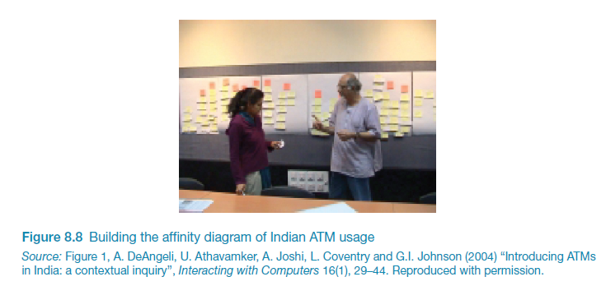
Simple qualitative analysis
Recurring patterns or themes
Emergent from data, dependent on observation framework if used
Categorizing data
Categorization scheme may be emergent or pre-specified
Looking for critical incidents
Helps to focus in on key events

Slide 17
Theoretical frameworks for qualitative analysis
Basing data analysis around theoretical frameworks provides further insight
Two such frameworks are:
Grounded Theory
Distributed Cognition

Slide 18
Grounded Theory
Aims to derive theory from systematic analysis of data
Based on categorization approach (called here ‘coding’)
Three levels of ‘coding’
Open: identify categories
Axial: flesh out and link to subcategories (process of relating categories)
Selective: form theoretical scheme (choose one category to be core category)
Researchers are encouraged to draw on own theoretical backgrounds to inform analysis

Slide 19
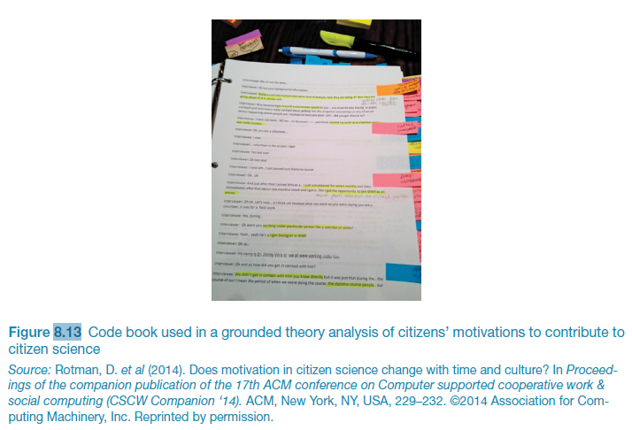
Code book used in grounded theory analysis

Slide 20
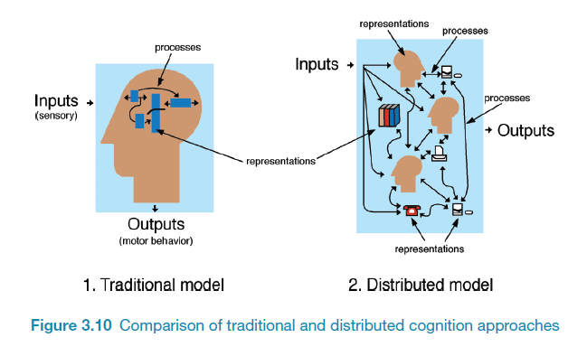
Distributed Cognition
The people, environment & artefacts are regarded as one cognitive system
Used for analyzing collaborative work
Focuses on information propagation & transformation

Slide 21
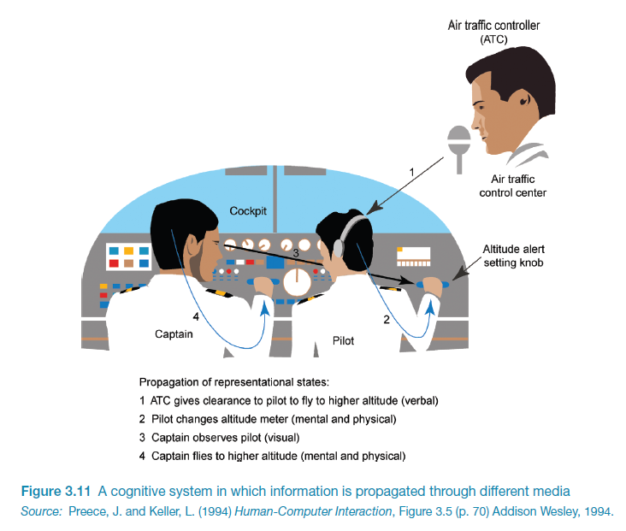

Slide 22
Tools to support data analysis
Spreadsheet – simple to use, basic graphs
Statistical packages, e.g. SPSS
Qualitative data analysis tools
Categorization and theme-based analysis
Quantitative analysis of text-based data
Nvivo http://www.qsrinternational.com/
Atlas.ti http://atlasti.com/
QDA Miner https://provalisresearch.com/

Slide 23
Presenting the findings
Only make claims that your data can support
The best way to present your findings depends on the audience, the purpose, and the data gathering and analysis undertaken
Graphical representations (as discussed above) may be appropriate for presentation
Other techniques are:
Rigorous notations, e.g. UML
Using stories, e.g. to create scenarios
Summarizing the findings

