Slide 1
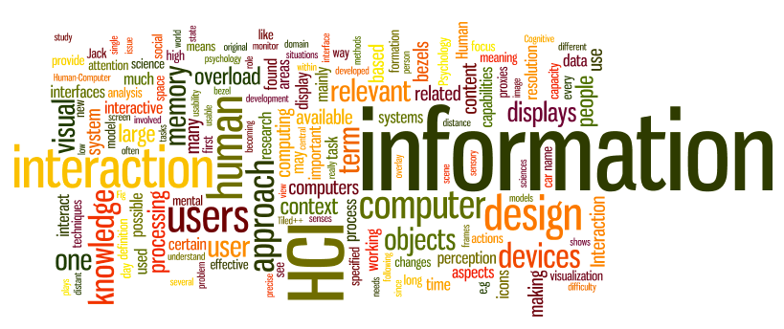
Cognitive Aspects of Design
Sampath Jayarathna
Cal Poly Pomona
Credit for some of the slides in this lecture goes to www.id-book.com

Slide 2
Why do we need to understand users?
Interacting with technology is cognitive
Need to take into account cognitive processes involved and cognitive limitations of users
Provides knowledge about what users can and cannot be expected to do
Identifies and explains the nature and causes of problems users encounter
Supply theories, modelling tools, guidance and methods that can lead to the design of better interactive products
Notes:
2

Slide 3
Cognitive processes
Attention
Perception
Memory
Learning
Reading, speaking and listening
Problem-solving, planning, reasoning and decision-making
Notes:
3

Slide 4
Attention
Selecting things to concentrate on at a point in time from the mass of stimuli around us
Allows us to focus on information that is relevant to what we are doing
Involves audio and/or visual senses
Focussed and divided attention enables us to be selective in terms of the mass of competing stimuli but limits our ability to keep track of all events
Information at the interface should be structured to capture users’ attention,
  e.g. use perceptual boundaries (windows), colour, video, sound and flashing lights
Notes:
4

Slide 5
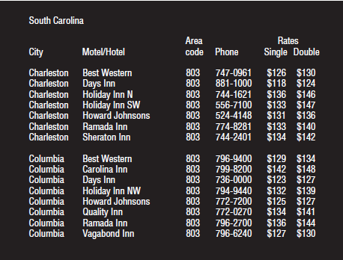
Activity: Find the price of a double room at the Holiday Inn in Columbia
Notes:
5

Slide 6

Activity: Find the price for a double room at the Quality Inn in Pennsylvania
Notes:
6

Slide 7
Activity
Tullis (1987) found that the two screens produced quite different results
  1st screen - took an average of 5.5 seconds to search
  2nd screen - took 3.2 seconds to search
Why, since both displays have the same density of information (31%)?
Spacing
  In the 1st screen the information is bunched up together, making it hard to search
  In the 2nd screen the characters are grouped into vertical categories of information making it easier
Notes:
7

Slide 8
Design implications for attention
Make information salient when it needs attending to
Use techniques that make things stand out like color, ordering, spacing, underlining, sequencing and animation
Avoid cluttering the interface with too much information
Search engines and form fill-ins that have simple and clean interfaces are easier to use
Notes:
8

Slide 9
Perception
How information is acquired from the world and transformed into experiences
Obvious implication is to design representations that are readily perceivable, e.g.
  Text should be legible
  Icons should be easy to distinguish and read
Notes:
9

Slide 10
Is color contrast good? Find Italian
Notes:
10

Slide 11
Are borders and white space better? Find french
Notes:
11

Slide 12
Activity
Weller (2004) found people took less time to locate items for information that was grouped
  using a border (2nd screen) compared with using color contrast (1st screen)
Do you agree?
Notes:
12

Slide 13

Which is easiest to read and why?
What is the time?
What is the time?
What is the time?
What is the time?
What is the time?
Notes:
13

Slide 14
Design implications
  Icons should enable users to readily distinguish their meaning
  Bordering and spacing are effective visual ways of grouping information
  Sounds should be audible and distinguishable
  Speech output should enable users to distinguish between the set of spoken words
  Text should be legible and distinguishable from the background
  Tactile feedback should allow users to recognize and distinguish different meanings
Notes:
14

Slide 15
Memory
Involves first encoding and then retrieving knowledge.
We don’t remember everything - involves filtering and processing what is attended to
We recognize things much better than being able to recall things
we remember less about objects we have photographed than when we observe them with the naked eye (Henkel, 2014)
Notes:
15

Slide 16
Context is important
Context affects the extent to which information can be subsequently retrieved
Sometimes it can be difficult for people to recall information that was encoded in a different context:
  “You are on a train and someone comes up to you and says hello. You don’t recognize him for a few moments but then realize it is one of your neighbours. You are only used to seeing your neighbour in the hallway of your apartment block and seeing him out of context makes him difficult to recognize initially”
Notes:
16

Slide 17
Recognition versus recall
Command-based interfaces require users to recall from memory a name from a possible set of 100s
GUIs provide MP3 players visually-based options that users need only browse through until they recognize one
Web browsers, etc., provide lists of visited URLs, song titles etc., that support recognition memory
Notes:
17

Slide 18
The problem with the classic ‘7±2’
George Miller’s (1956) theory of how much information people can remember
People’s immediate memory capacity is very limited
Many designers think this is useful finding for interaction design
Exercise
  Cat, house, paper, laugh, people, red, yes, number, shadow, broom, rain, plant, lamp, chocolate, radio, one, coin, jet
Notes:
18

Slide 19
What some designers get up to…
Present only 7 options on a menu
Display only 7 icons on a tool bar
Have no more than 7 bullets in a list
Place only 7 items on a pull down menu
Place only 7 tabs on the top of a website page
      But this is wrong? Why?
Notes:
19

Slide 20
Why?
Inappropriate application of the theory
People can scan lists of bullets, tabs, menu items for the one they want
They don’t have to recall them from memory having only briefly heard or seen them
Sometimes a small number of items is good
But depends on task and available screen estate
Notes:
20

Slide 21
Digital content management
Is a growing problem for many users
  vast numbers of documents, images, music files, video clips, emails, attachments, bookmarks, etc.,
  where and how to save them all, then remembering what they were called and where to find them again
Memory involves 2 processes
  recall-directed and recognition-based scanning
File management systems should be designed to optimize both kinds of memory processes
  e.g. Search box and history list
Help users encode files in richer ways
  Provide them with ways of saving files using colour, flagging, image, flexible text, time stamping, etc.
Notes:
21

Slide 22
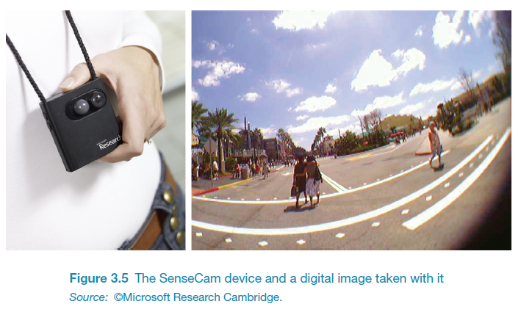
Memory aids
SenseCam developed by Microsoft Research Labs (now Autographer)
a wearable device that intermittently takes photos without any user intervention while worn
digital images taken are stored and revisited using special software
Has been found to improve people’s memory, suffering from Alzheimers

Slide 23
Design implications
Don’t overload users’ memories with complicated procedures for carrying out tasks
Design interfaces that promote recognition rather than recall
Provide users with various ways of encoding information to help them remember
  e.g. categories, color, flagging, time stamping
Notes:
23

Slide 24
Reading, speaking, and listening
The ease with which people can read, listen, or speak differs
  Many prefer listening to reading
  Reading can be quicker than speaking or listening
  Listening requires less cognitive effort than reading or speaking
  Dyslexics have difficulties understanding and recognizing written words

Slide 25
Applications
Speech-recognition systems allow users to interact with them by asking questions
  e.g. Google Voice, Siri, Alexa
Speech-output systems use artificially generated speech
  e.g. written-text-to-speech systems for the blind
Natural-language systems enable users to type in questions and give text-based responses
  e.g. Ask search engine

Slide 26
Learning
How to learn to use a computer-based application
Using a computer-based application or YouTube video to understand a given topic
People find it hard to learn by following instructions in a manual
    prefer to learn by doing

Slide 27
Design implications
Speech-based menus and instructions should be short
Accentuate the intonation of artificially generated speech voices
  they are harder to understand than human voices
Provide opportunities for making text large on a screen

Slide 28
Cognitive prosthetic devices
We rely more and more on the internet and smartphones to look things up
Expecting to have internet access reduces the need and extent to which we remember
Also enhances our memory for knowing where to find it online (Sparrow et al,2011)
What are implications for designing technologies to support how people will learn, and what they learn?

Slide 29
Dilemma
The app mentality developing in the psyche of the younger generation is making it worse for them to make their own decisions because they are becoming risk averse (Gardner and Davis, 2013)
Relying on a multitude of apps means that they are becoming increasingly more anxious about making decisions by themselves
Do you agree? Can you think of an example?

Slide 30
Mental models
Users develop an understanding of a system through learning about and using it
Knowledge is sometimes described as a mental model:
  How to use the system (what to do next)
  What to do with unfamiliar systems or unexpected situations (how the system works)
People make inferences using mental models of how to carry out tasks
Notes:
30

Slide 31
Everyday reasoning and mental models
You arrive home on a cold winter’s night to a cold house. How do you get the house to warm up as quickly as possible? Set the thermostat to be at its highest or to the desired temperature?
Notes:
31

Slide 32
Heating up a room or oven that is thermostat-controlled
Many people have erroneous mental models (Kempton, 1996)
Why?
  General valve theory, where ‘more is more’ principle is generalised to different settings (e.g. gas pedal, gas cooker, tap, radio volume)
  12
  Thermostats based on model of on-off switch model
Notes:
32

Slide 33
Heating up a room or oven that is thermostat-controlled
Same is often true for understanding how interactive devices and computers work:
  poor, often incomplete, easily confusable, based on inappropriate analogies and superstition (Norman, 1983)
  e.g. elevators and pedestrian crossings - lot of people hit the button at least twice
  Why? Think it will make the lights change faster or ensure the elevator arrives!
Notes:
33

Slide 34
Gulfs of execution and evaluation
The ‘gulfs’ explicate the gaps that exist between the user and the interface
The gulf of execution
  the distance from the user to the physical system
The gulf of evaluation
  the distance from the physical system to the user
Notes:
34

Slide 35
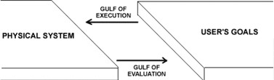
Bridging the gulfs
Bridging the gulfs can reduce cognitive effort required to perform tasks

