Slide 1
Lecture 3a – Arrays I
CS 141-02
Introduction to Programming and Problem Solving
Dr. Sampath Jayarathna
Cal Poly Pomona
Copyright © 2016 Pearson Education, Inc., Hoboken NJ

Slide 2
Introduction to Arrays
Primitive variables are designed to hold only one value at a time.
Arrays allow us to create a collection of like values that are indexed.
An array can store any type of data but only one type of data at a time.
An array is a list of data elements.

Slide 3
Creating Arrays
An array is an object so it needs an object reference.
// Declare a reference to an array that will hold integers.
int[] numbers;
The next step creates the array and assigns its address to the numbers variable.
// Create a new array that will hold 6 integers.
numbers = new int[6];
0
0
0
0
0
0
index 0
index 1
index 2
index 3
index 4
index 5
Array element values are initialized to 0. Array indexes always start at 0.

Slide 4
Creating Arrays
It is possible to declare an array reference and create it in the same statement.
int[] numbers = new int[6];
Arrays may be of any type.
float[] temperatures = new float[100];
char[] letters = new char[41];
long[] units = new long[50];
double[] sizes = new double[1200];

Slide 5
Creating Arrays
The array size must be a non-negative number.
It may be a literal value, a constant, or variable.
final int ARRAY_SIZE = 6;
int[] numbers = new int[ARRAY_SIZE];
Once created, an array size is fixed and cannot be changed.

Slide 6
Accessing the Elements of an Array
20
0
0
0
0
0
numbers[0]
numbers[1]
numbers[2]
numbers[3]
numbers[4]
numbers[5]
An array is accessed by:
the reference name
a subscript that identifies which element in the array to access.
numbers[0] = 20;

Slide 7
Activity
Create an integer array of size 3 called hours. ARRAY_SIZE is a constant of value 3.
Get hours for 3 employees and add the data to array and display the hours.
Modify the above code to have a for loop to collect hours for 6 employees.
Display the array data using a loop.

Slide 8
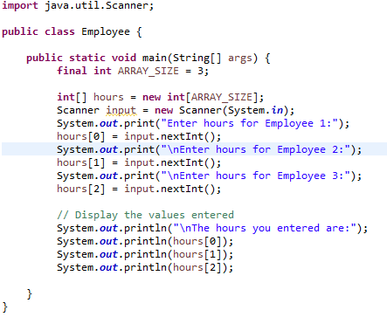
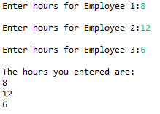
Inputting and Outputting Array Elements
Array elements can be treated as any other variable.
They are simply accessed by the same name and a subscript.

Slide 9
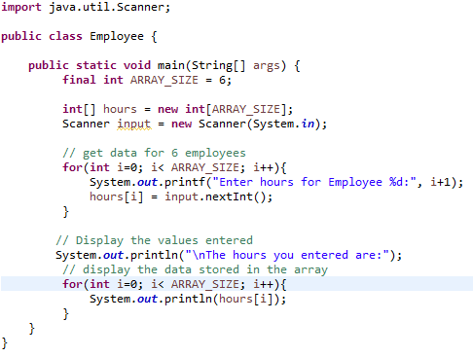
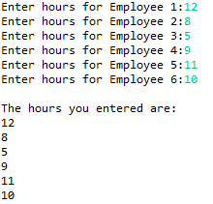
Inputting and Outputting Array Elements
Array subscripts can be accessed using variables (such as for loop counters).

Slide 10
Array Length
Arrays are objects and provide a public field named length that is a constant that can be tested.
double[] temperatures = new double[25];
The length of this array is 25.
The length of an array can be obtained via its length constant.
int size = temperatures.length;
The variable size will contain 25.

Slide 11
Array Size
The length constant can be used in a loop to provide automatic bounding.
for(int i = 0; i < temperatures.length; i++)
{
System.out.println("Temperature " + i ": "
+ temperatures[i]);
}
Index subscripts start at 0 and end at one less than the array length.

Slide 12
Bounds Checking
Array indexes always start at zero and continue to (array length - 1).
int values = new int[10];
This array would have indexes 0 through 9.
If you try to access values[10], this will give an out of bound error because the index runs from 0 to 9 with only 10 elements in this array.
In for loops, it is typical to use i, j, and k as counting variables.
It might help to think of i as representing the word index.

Slide 13
Off-by-One Errors
It is very easy to be off-by-one when accessing arrays.
// This code has an off-by-one error.
int[] numbers = new int[100];
for (int i = 1; i <= 100; i++)
numbers[i] = 99;
Here, the equal sign allows the loop to continue on to index 100, where 99 is the last index in the array.
This code would throw an ArrayIndexOutOfBoundsException.

Slide 14
Array Initialization
When relatively few items need to be initialized, an initialization list can be used to initialize the array.
int[]days = {31, 28, 31, 30, 31, 30, 31, 31, 30, 31, 30, 31};
The numbers in the list are stored in the array in order:
days[0] is assigned 31,
days[1] is assigned 28,
days[2] is assigned 31,
days[3] is assigned 30,
etc.

Slide 15
Alternate Array Declaration
Previously we showed arrays being declared:
int[] numbers;
However, the brackets can also go here:
int numbers[];
These are equivalent but the first style is typical.
Multiple arrays can be declared on the same line.
int[] numbers, codes, scores;
With the alternate notation each variable must have brackets.
int numbers[], codes[], scores;
The scores variable in this instance is simply an int variable.

Slide 16
Processing Array Contents
Processing data in an array is the same as any other variable.
grossPay = hours[3] * payRate;
Pre and post increment works the same:
int[] score = {7, 8, 9, 10, 11};
++score[2]; // Pre-increment operation
score[4]++; // Post-increment operation

Slide 17
Processing Array Contents
Array elements can be used in relational operations:
if(cost[20] < cost[0])
{
//statements
}
They can be used as loop conditions:
while(value[count] != 0)
{
//statements
}

Slide 18
The Enhanced for Loop
Simplified array processing (read only)
Always goes through all elements
General format:
for(datatype elementVariable : array)
statement;
Example:
int[] numbers = {3, 6, 9};
for(int val : numbers)
{
System.out.println("The next value is " +
val);
}

Slide 19
Array Size
You can let the user specify the size of an array:
int numTests;
int[] tests;
Scanner keyboard = new Scanner(System.in);
System.out.print("How many tests do you have? ");
numTests = keyboard.nextInt();
tests = new int[numTests];

Slide 20
Reassigning Array References
An array reference can be assigned to another array of the same type.
// Create an array referenced by the numbers variable.
int[] numbers = new int[10];
// Reassign numbers to a new array.
numbers = new int[5];
If the first (10 element) array no longer has a reference to it, it will be garbage collected.

Slide 21
Reassigning Array References
int[] numbers = new int[10];
The numbers variable
holds the address of an
int array.
Address

Slide 22
Reassigning Array References
This array gets marked for
garbage collection
The numbers variable
holds the address of an
int array.
Address
numbers = new int[5];

Slide 23
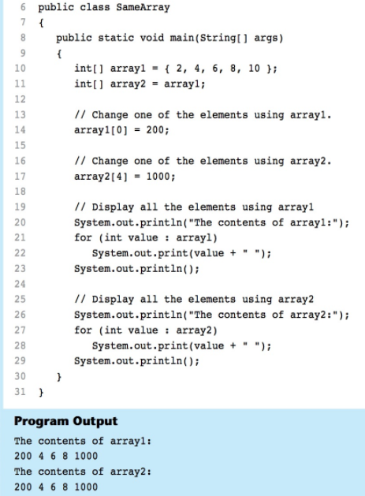
Copying Arrays
This is not the way to copy an array.
int[] array1 = { 2, 4, 6, 8, 10 };
// This does not copy array1.
int[] array2 = array1;
2
4
6
8
10
array1 holds an
address to the array
Address
Address
array2 holds an
address to the array

Slide 24
Copying Arrays
You cannot copy an array by merely assigning one reference variable to another.
You need to copy the individual elements of one array to another.
int[] firstArray = {5, 10, 15, 20, 25 };
int[] secondArray = new int[5];
for (int i = 0; i < firstArray.length; i++)
secondArray[i] = firstArray[i];
This code copies each element of firstArray to the corresponding element of secondArray.

Slide 25
Passing Array Elements to a Method
When a single element of an array is passed to a method it is handled like any other variable.
More often you will want to write methods to process array data by passing the entire array, not just one element at a time.

Slide 26
Passing Arrays as Arguments
Arrays are objects.
Their references can be passed to methods like any other object reference variable.
showArray(numbers);
5
10
15
20
25
30
35
40
Address
public static void showArray(int[] array)
{
for (int i = 0; i < array.length; i++)
System.out.print(array[i] + " ");
}

Slide 27
Comparing Arrays
The == operator determines only whether array references point to the same array object.
Above output is “The arrays are not the same”
Above output is “The arrays are the same”
int[] firstArray = { 5, 10, 15, 20, 25 };
int[] secondArray = { 5, 10, 15, 20, 25 }; //new Array object
if (firstArray == secondArray) // This is a mistake.
System.out.println("The arrays are the same.");
else
System.out.println("The arrays are not the same.");
int[] firstArray = { 5, 10, 15, 20, 25 };
int[] secondArray = firstArray; //assign address of firstArray

Slide 28
Comparing Arrays: Example
int[] firstArray = { 2, 4, 6, 8, 10 };
int[] secondArray = { 2, 4, 6, 8, 10 };
boolean arraysEqual = true;
int i = 0;
// First determine whether the arrays are the same size.
if (firstArray.length != secondArray.length)
arraysEqual = false;
// Next determine whether the elements contain the same data.
while (arraysEqual && i < firstArray.length)
{
if (firstArray[i] != secondArray[i])
arraysEqual = false;
i++;
}
if (arraysEqual)
System.out.println("The arrays are equal.");
else
System.out.println("The arrays are not equal.");

Slide 29
Useful Array Operations
Summing Array Elements:
int total = 0; // Initialize accumulator
for (int i = 0; i < units.length; i++)
total += units[i];
Averaging Array Elements:
double total = 0; // Initialize accumulator
double average; // Will hold the average
for (int i = 0; i < scores.length; i++)
total += scores[i];
average = total / scores.length;

Slide 30
Partially Filled Arrays
Typically, if the amount of data that an array must hold is unknown:
size the array to the largest expected number of elements.
use a counting variable to keep track of how much valid data is in the array.
…
int[] array = new int[100];
int count = 0;
…
System.out.print("Enter a number or -1 to quit: ");
number = keyboard.nextInt();
while (number != -1 && count <= 99)
{
array[count] = number;
count++;
System.out.print("Enter a number or -1 to quit: ");
number = keyboard.nextInt();
}
…
input, number and keyboard were previously declared and keyboard references a Scanner object

Slide 31
Activity 8
Write a RainFall class that stores the total rainfall for each of 12 months into an array of doubles. The program should have methods that return the following:
the total rainfall for the year
the average monthly rainfall
the month with the most rain
the month with the least rain
Demonstrate the class in a complete program.
Input Validation: Do not accept negative numbers for monthly rainfall figures.

