Slide 1
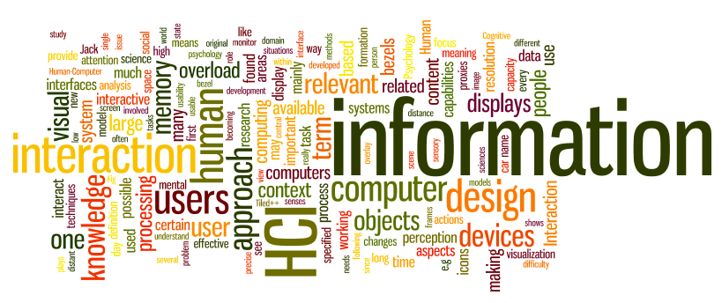
Brain Computer Interfacing
Dr. Sampath Jayarathna
Old Dominion University
Credit for some of the slides in this lecture goes to Christian A. Kothe at UCSD and Seminarlinks

Slide 2
Outline
What is a BCI?
Application Areas and Examples
Scientific Challenge
Available Tools

Slide 3
BCI: Definition
“The goal of BCI technology is to give severely paralyzed people another way to communicate, a way that does not depend on muscle control.” (Wadsworth Center)
“A system which takes a biosignal measured from a person and predicts (in real time / on a single-trial basis) some abstract aspect of the person's cognitive state.”
Biosignal
State Predictions
BCI
(inference/ estimation)

Slide 4
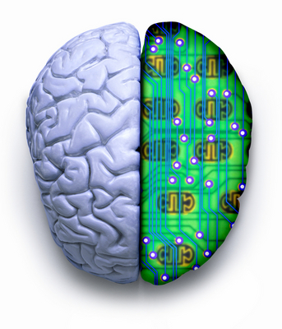
BCI Technology
A Brain-Computer Interface (BCI) is a technology which allows a human to control a computer, peripheral, or other electronic device with thought.
It does so by using electrodes to detect electric signals in the brain which are sent to a computer.
The computer then translates these electric signals into data which is used to control a computer or a device linked to a computer.

Slide 5
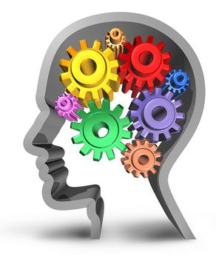
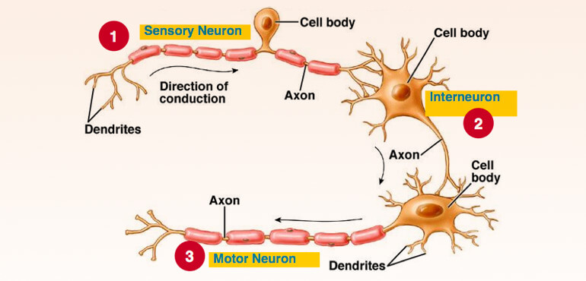
How the brain turns thoughts into action ?
The brain is full of neurons; these neurons are connected to each other by axons and dendrites.
Your neurons - as you think about anything or do anything - are at work.
Your neurons connect with each other to form a super highway for nerve impulses to travel from neuron to neuron to produce thought, hearing, speech, or movement.
If you have an itch and you reach to scratch it; you received a stimulus (an itch) and reacted in response to the stimulus by scratching.
The electrical signals that generated the thought and action travel at a rate of about 250 feet per second or faster, in some cases.

Slide 6
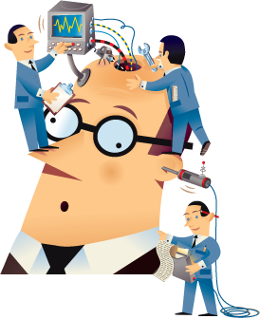
Major Historical Events
1924 ,Hans Berger, a German neurologist was the first to record human brain activity by means of EEG.
1970, Research on BCIs began at the University of California Los Angeles (UCLA).
1978, A prototype was implanted into a man blinded in adulthood.
Following years of animal experimentation, the first neuroprosthetic devices implanted in humans appeared in the mid-1990s.
2005. Matthew Nagle was one of the first persons to use a BCI to restore functionality lost due to paralysis.
2013 Duke University researchers successfully connected the brains of two rats with electronic interfaces that allowed them to directly share information, in the first-ever direct brain-to-brain interface.

Slide 7
Three BCI Subtypes
Active BCI: “An active BCI is a BCI which derives its outputs from brain activity which is directly consciously controlled by the user, independently from external events, for controlling an application.”
Reactive BCI: “A reactive BCI is a BCI which derives its outputs from brain activity arising in reaction to external stimulation, which is indirectly modulated by the user for controlling an application.”
Passive BCI: “A passive BCI is a BCI which derives its outputs from arbitrary brain activity without the purpose of voluntary control, for enriching a human- computer interaction with implicit information.”
Zander et al., 2009

Slide 8
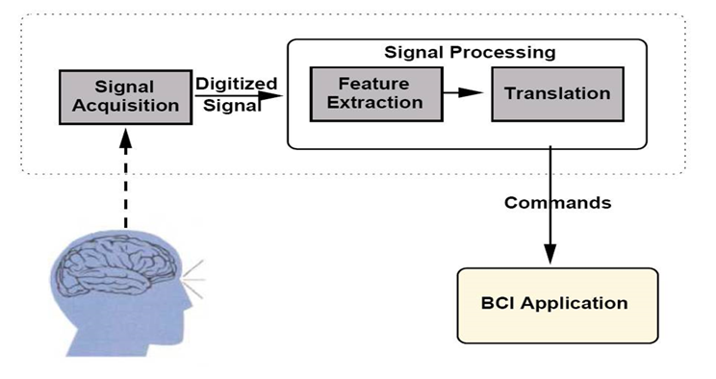
Parts of a Basic Setup

Slide 9
Notes:
Single-unit = SU electro-physiological responses of single neurons using a microelectrode system
Multiunit = MU
Local Field potential = LFP electrophysiological signal generated by the summed electric current flowing from multiple nearby neurons within a small volume of nervous tissue.

Slide 10
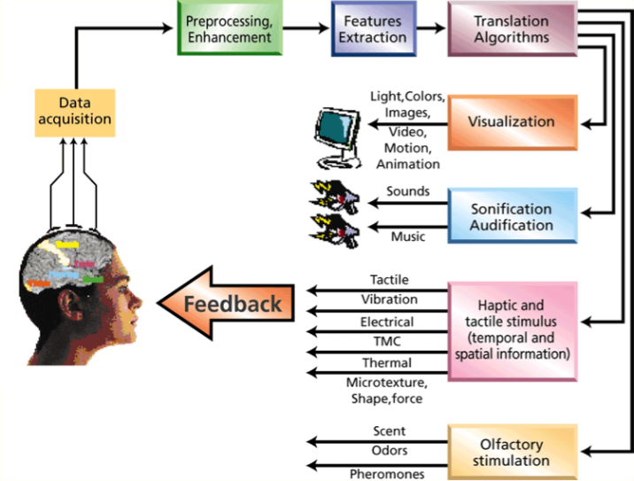
BCI Model

Slide 11
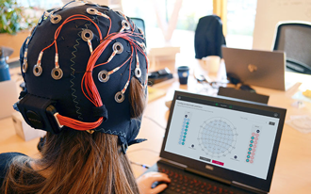
Parts of a Modern Setup
Processing and
Interface Device
Wireless Headset

Slide 12
Biosignals and other Inputs
Biosignal
BCI
(inference/ estimation)

Slide 13
Biosignal types
BCI Types
Invasive
Partial Invasive
Non Invasive
EEG
Neurosurgery
ECoG
MEG
fMRI

Slide 14
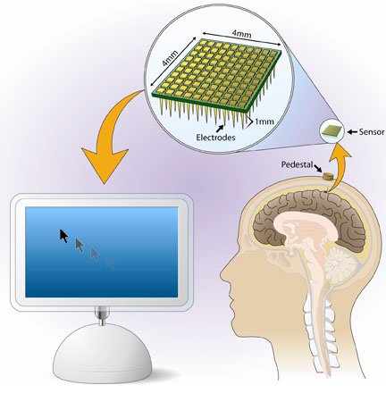
Invasive BCIs
BrainGate Neural Interface System
Invasive BCIs are implanted directly into the grey matter of the brain by neurosurgery.
As they rest in the grey matter, invasive devices produce the highest quality signals of BCI devices.
But are prone to scar tissue build-up, causing the signal to become weaker or even lost as the body reacts to a foreign object in the brain.
Utah Electrode

Slide 16
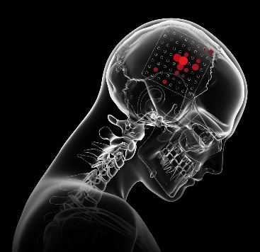
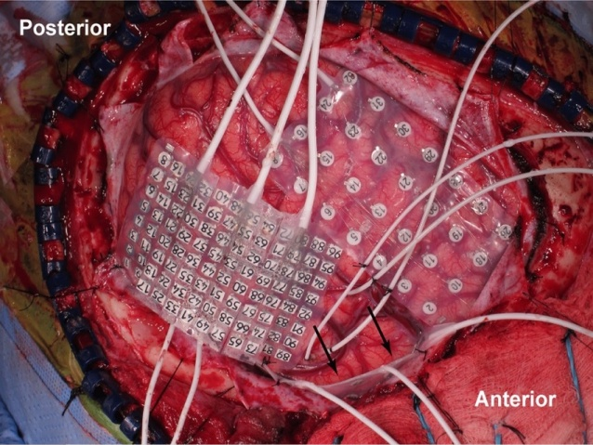
Partially Invasive
It is another brain signal reading process which is applied to the inside the skull but outside the grey matter.
Electrocorticography(ECoG) is the example of partially invasive BCI.
An electrocorticograph (ECoG) records the activity of the brain inside the skull, but from the surface of the membranes that protect it.
An electrode Grid is being implanted by surgical incision.

Slide 17
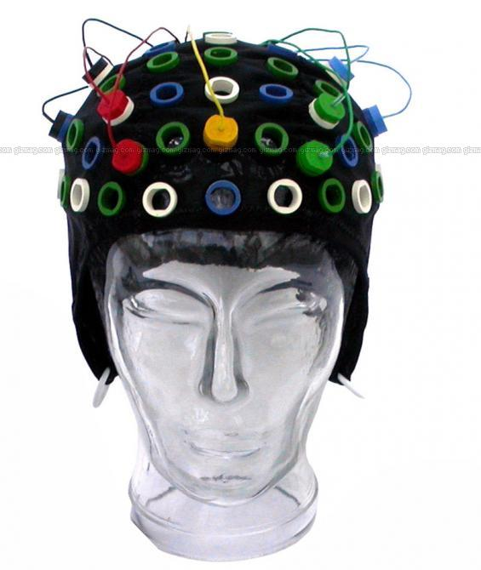
Non-Invasive
It is the most useful neuron signal imaging method which is applied to the outside of the skull, just applied on the scalp.
Techniques
Electroencephalography (EEG)
Magnetoencephalography(MEG)
functional Magnetic Resonance Imaging (fMRI)

Slide 18
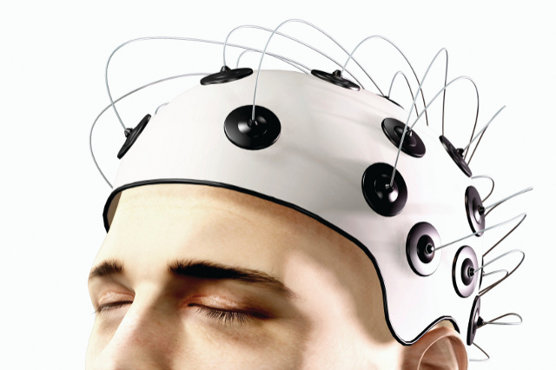
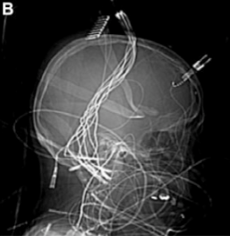
Interface
The easiest and least invasive method is a set of electrodes -- a device known as an electroencephalograph (EEG) -- attached to the scalp.
The electrodes can read brain signals.
To get a higher-resolution signal, scientists can implant electrodes directly into the gray matter of the brain itself, or on the surface of the brain, beneath the skull.

Slide 19
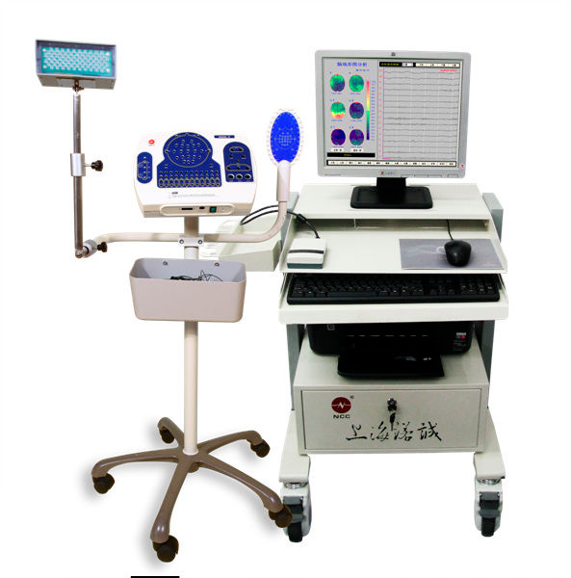
Basic Mechanism
Wires from each electrode transmit their measurements to a computer.
The electrodes measure minute differences in the voltage between neurons.
The signal is then amplified and filtered.
The computer produces a graph showing the readings from each electrode.
Digital EEG

Slide 20
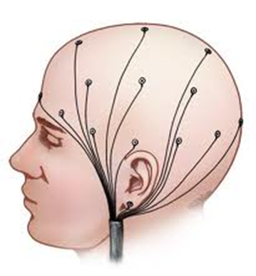
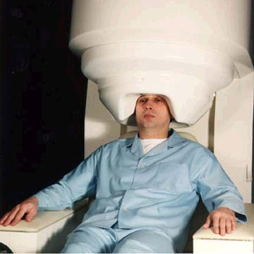
EEG and MEG
Electroencephalography EEG
In conventional scalp EEG, the recording is obtained by placing electrodes on the scalp with a conductive gel or paste, usually after preparing the scalp area by light abrasion to reduce impedance due to dead skin cells.
Many systems typically use electrodes, each of which is attached to an individual wire.
Magnetoencephalography (MEG)
MEG detects the tiny magnetic fields created as individual neurons "fire" within the brain.
It can pinpoint the active region with a millimeter, and can follow the movement of brain activity as it travels from region to region within the brain.

Slide 21
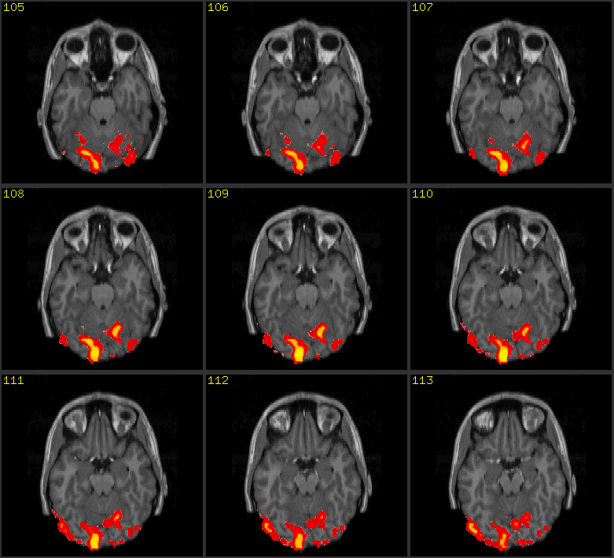
fMRI
Functional Magnetic Resonance Imaging fMRI
It exploits the changes in the magnetic properties of hemoglobin as it carries oxygen.
Activation of a part of the brain increases oxygen levels there increasing the ratio of oxyhemoglobin to deoxyhemoglobin.

Slide 22
Room-sized Sensors
Magnetoencephalograpy (MEG), functional Magnetic Resonance Imaging (fMRI)
NIMH
Sinai Hospital

Slide 23
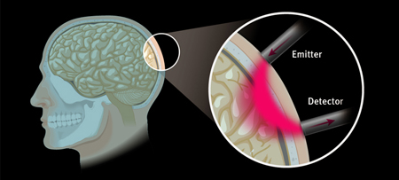
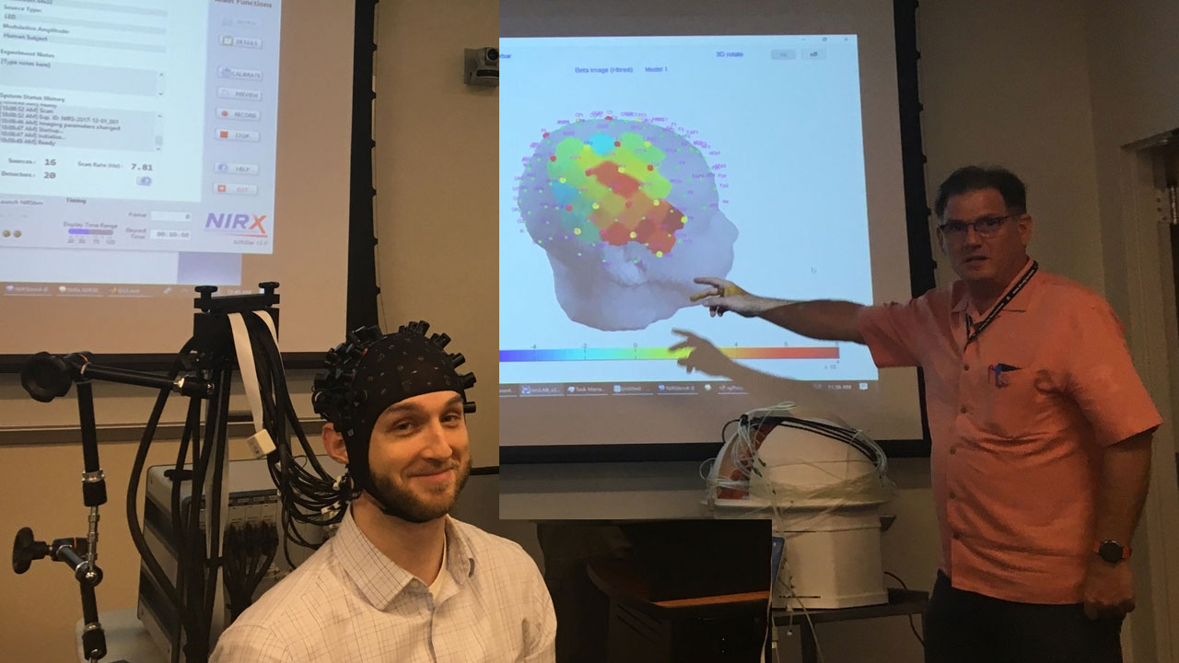
Functional Near-Infrared Spectroscopy (fNIRS)
fNIRS (Functional Near-Infrared Spectroscopy) and fMRI (functional Magnetic Resonance Imaging) are both types of “functional neuroimaging”.
Both methods measure the relative concentrations of oxygenated vs deoxygenated Hemoglobin in the blood vessels of the brain. When a group of neurons are more active, local blood flow changes in response (and in turn, changes the local oxy-/deoxy- hemoglobin concentrations) — this is known as neurovascular coupling
fNIR uses differences in the absorption of near-infrared light, while fMRI uses differences in the magnetic resonance signal.
https://www.youtube.com/watch?v=yckXdpb4anQ

Slide 24
Non-Brain Signals I
Motion Capture, Eye Tracking
SCCN MoBI Lab
SensoMotoric Instruments
(EEG: Emotiv)

Slide 25
Non-Brain Signals II
Electromyography (EMG),
is an electrodiagnostic medicine technique for evaluating and recording the electrical activity produced by skeletal muscles
Electrocardiography (ECG),
is the process of producing an electrocardiogram (ECG or EKG, a recording - a graph of voltage versus time - of the electrical activity of the heart using electrodes placed on the skin
Electrooculography (EOG)
is a technique for measuring the corneo-retinal standing potential that exists between the front and the back of the human eye

Slide 26
BCI Estimates/Predictions
State Predictions
BCI
(inference/ estimation)

Slide 27
“Aspects of Cognitive State”
Any aspect of the physical brain state that can be measured with sufficient single-trial reliability
Tonic state: degree of “relaxation”, cognitive load, ...
Phasic state: switching attention, type of imagined movement, …
Event-related state: surprised/not surprised, committed error, event noticed/not noticed, …

Slide 28
Neuroscience
Study of information content and representations for neuroscientific questions
Also: Closed-loop neuroscience experiments (experiment manipulations depending on brain state)

Slide 29
Related Areas in Science
Theory is shared with: Signal Processing, Machine Learning, Computational Intelligence, Neuroscience, Cognitive Science
Problems are similar to: Computer Vision, Speech Recognition, Pattern Recognition, Time-Series Analysis, Control Systems & Robotics

Slide 30
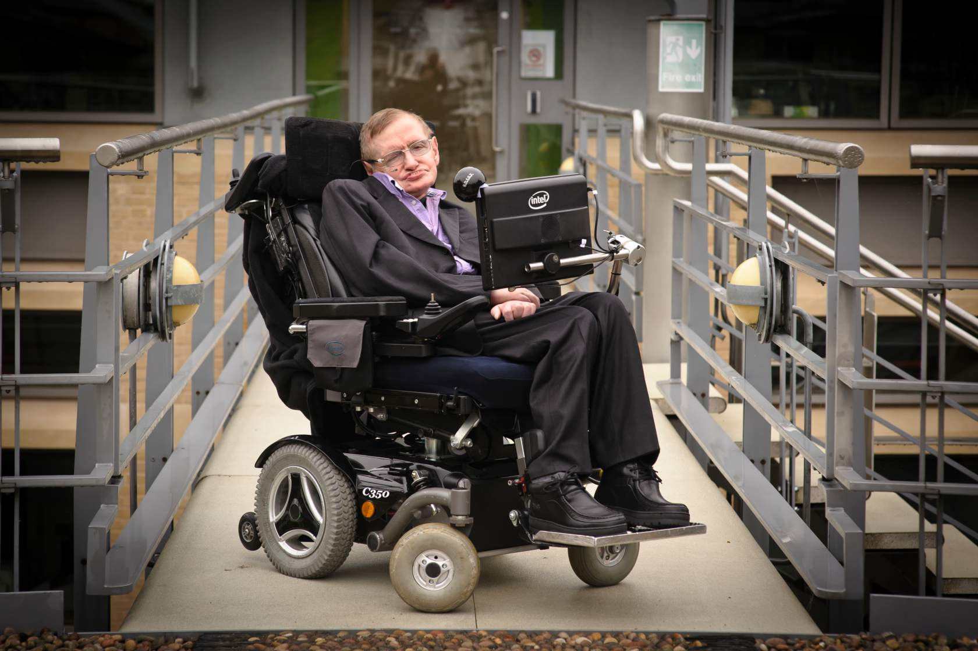
Applications
Provide disabled people with communication, environment control, and movement restoration.
Provide enhanced control of devices such as wheelchairs, vehicles, or assistance robots for people with disabilities.
Provide additional channel of control in computer games.
Monitor attention in long-distance drivers or aircraft pilots, send out alert and warning for aircraft pilots.
Develop intelligent relaxation devices.

Slide 31
Operator Monitoring
Workload / Fatigue / Alertness monitoring in Pilots, Air Traffic Controllers, Plant Operators
The MITRE Corp., 2011

Slide 32
Forensics
Lie detection, Brain Fingerprinting, Trust assessment
Farwell et al. 2000

Slide 33
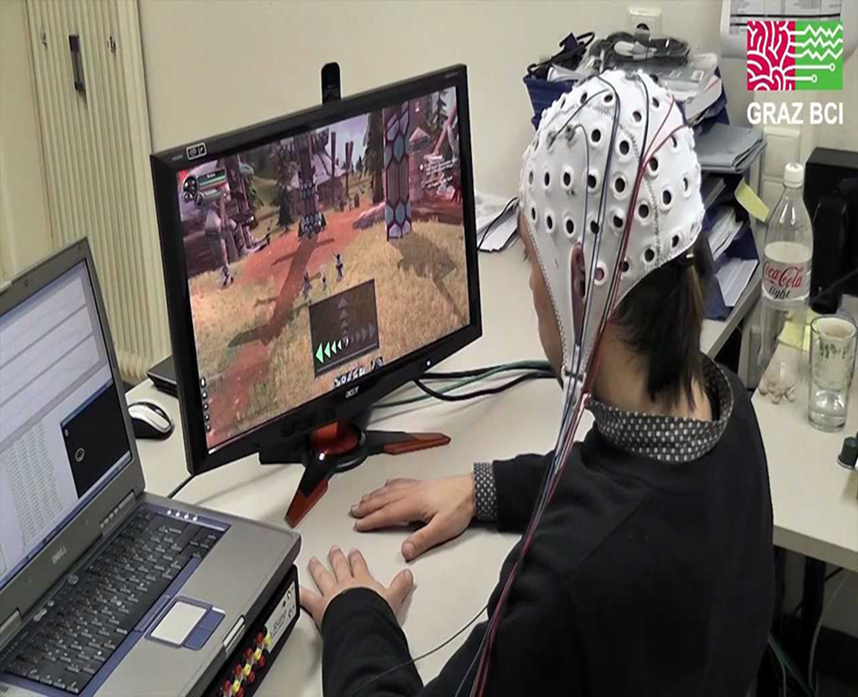
BCI Gaming

Slide 34
Entertainment
Mood Assessment, “Thought Control”, Fast Response Detection
https://www.youtube.com/watch?v=LZrat-VG4Ms
Neurosky Mindset
Force Game Test

Slide 35
Health
Sleep Stage Recognition, Neurorehabilitation
iBrain
Takata et al., 2011

Slide 36
Social
Neurowear…
https://www.youtube.com/watch?v=w06zvM2x_lw
necomimi BCI

Slide 37
Communication and Control for the Severely Disabled
Severe Disabilities: Locked-in syndrome
Speller Programs
P300 Speller
Hex-o-Spell (Blankertz et al.)

Slide 38
Communication and Control for the Severely Disabled
Prosthetic Control, Home Automation
brain project, IGUI
KU Leuven
Brain2Robot (Fraunhofer FIRST)

Slide 39
Operator Monitoring
Braking Intent, Lane-Change Intent, Workload
Haufe et al., 2011
Welke et al., 2011

Slide 40
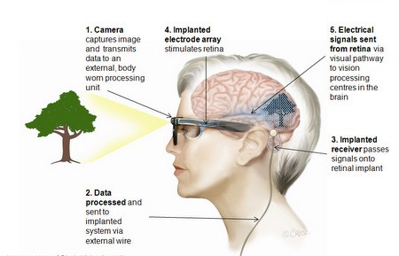
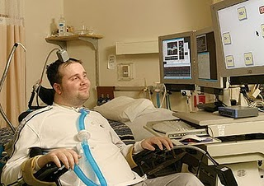
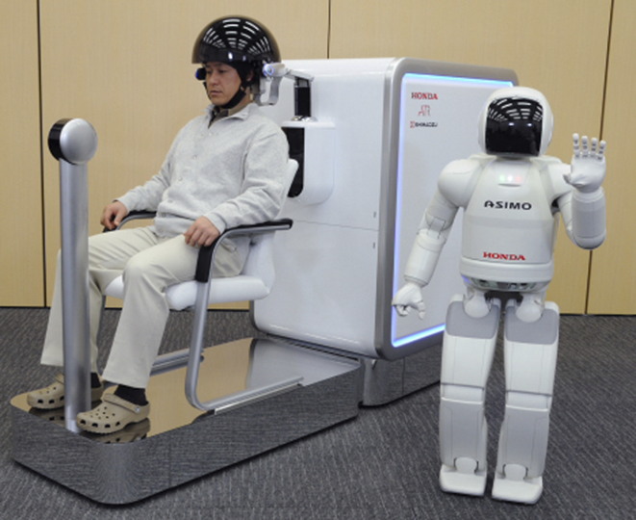
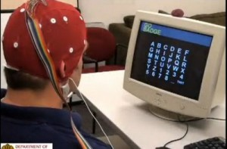
Brain Gate
Australian Bionic Eye
Honda Asimo Control
BCI2000

Slide 41
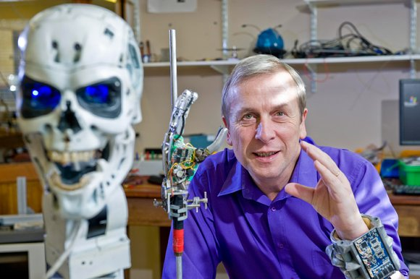
Kevin Warwick – The First Human Cyborg
https://www.youtube.com/watch?v=LW6tcuBJ6-w

Slide 42
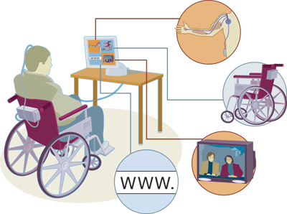
Advantages of BCI
Eventually, this technology could:
Allow paralyzed people to control prosthetic limbs with their mind.
Transmit visual images to the mind of a blind person, allowing them to see.
Transmit auditory data to the mind of a deaf person, allowing them to hear.
Allow gamers to control video games with their minds.
Allow a mute person to have their thoughts displayed and spoken by a computer.

Slide 43
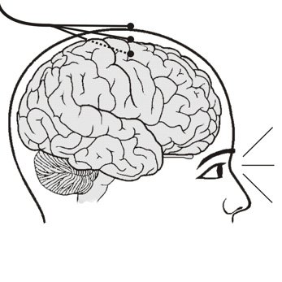
Disadvantages of BCI
Research is still in beginning stages.
The current technology is crude.
Ethical issues may prevent its development.
Electrodes outside of the skull can detect very few electric signals from the brain.
Electrodes placed inside the skull create scar tissue in the brain.

Slide 44
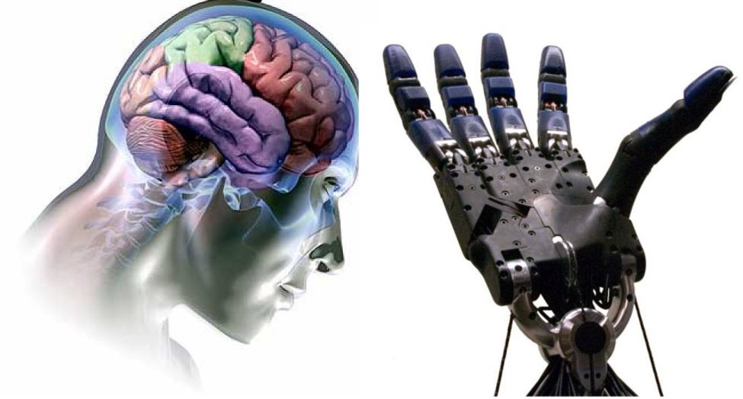
Conclusion
As BCI technology further advances, brain tissue may one day give way to implanted silicon chips thereby creating a completely computerized simulation of the human brain that can be augmented at will.
Futurists predict that from there, superhuman artificial intelligence won't be far behind.

Slide 45
Why is BCI Hard
Processing depends on unknown parameters (person-specific, task-specific, otherwise variable)
Folding of cortex differs between any two persons (even monozygotic twins)
Relevant functional map differs across individuals
Sensor locations differ across recording sessions
Brain dynamics are non- stationary at all time scales
EEG signals are mathematically complicated to handle since all sensors record almost the same signal (superposition of all brain activity)
Therefore they need to be computationally (e.g., statistically) disentangled for optimum performance

Slide 46
Why else is BCI Hard?
Signal-to-noise ratio is very challenging, so
sensitive measures are hard to obtain
Relevant brain activity is small compared to interfering artifacts and compared to brain background activity
Specific measures are even harder to obtain (with coarse-grained sensing)
Large collections of neurons are involved in many different activities, not just one
Underlying phenomena are also highly diverse and rich and derived measures are still poorly understood – not always clear what to look for

Slide 47
Consequences
Sophisticated signal processing is required
All approaches are fundamentally statistical
BCI systems must be calibrated before they can be used
Calibration should entail as much information as available, e.g., example data, prior knowledge, large databases

Slide 48
BioSig
Developed at TU Graz since at least 2002
One of the oldest open-source BCI toolboxes, for MATLAB/Octave (cross-platform)
Large amount of functionality from statistics and time- series analysis: Adaptive Autoregression (AAR), Blind Source Separation (BSS), Common Spatial Patterns (CSP), Classifiers (LDA, SVMs, …), Cross-Validation
Offline analysis only -- no real-time hardware or computation support
Not easy to use (no GUI, fairly complicated code, not very modular…)

Slide 49
BCI2000
Developed at Wadsworth Center since 1999
Large, modularized C++ system, primarily aimed at real-time acquisition, signal processing, stimulus presentation, experiment control, deployment; robust, “enterprise-grade” implementation
Supports a wide range of acquisition hardware
(currently 19 systems)
Solid documentation, workshops, book, big community
Lack of advanced signal processing and machine learning algorithms (tough extensions and in-house versions available)

Slide 50
OpenViBE
Developed at INRIA, relatively young project
Implemented in modular C++, focusing on visual programming and dataflow programming
Very user-friendly design, interface and documentation
Focus on basic signal processing building blocks, weaker support for complex information flows (machine learning, adaptive signal processing, …)
Relatively hard to extend due to complex framework
Supports a broad range of acquisition hardware (15 systems), runs on Windows and Linux

Slide 51
g.BSanalyze
Commercial System developed by g.Tec
MATLAB/Simulink-based framework
Broad collection of turnkey algorithms, evaluation methods, etc.
Extensive, high-quality graphical user interface
Primarily supporting in-house amplifiers

Slide 52
BCILAB
Developed since 2010 at Swartz Center for Computational Neuroscience, UCSD (precursors dating back to 2006)
MATLAB-based, cross-platform, offline and online analysis; stand-alone versions available
Largest collection of BCI algorithms from signal processing, machine learning, etc. (2012)
Complex Internal Framework requiring expertise to extend
Relatively little native support for acquisition systems (5), but can tie into real-time experimentation frameworks (BCI2000, LSL)

Slide 53
Other Packages
FieldTrip: Popular MEG/EEG toolbox with online features
xBCI: New C++ framework focused on online operation, GUI-centric,
cross-platform
BF++: Mature BCI framework (developed since 2000), although not very well known (offline analysis & modeling with UML and XML)
TOBI: Protocol suite for BCI interoperability and data acquisition
PyFF: Python-based BCI stimulus presentation system
BBCI: In-house MATLAB-based system developed at TU Berlin; very comprehensive, potentially available for licensing
BCI++: Relatively new C++ system, focused on human-computer interaction and virtual reality (still growing)

Slide 54
Activity 18
Student Opinion Surveys for CS 795/895 Human Computer Interaction
Click Student Opinion Survey https://www.odu.edu/academics/courses-registration/studentopinionsurvey
Complete the opinion survey and confirm it in Piazza activity thread (just write submitted the opinion survey ☺)

